Slide 1
Introduction to Java for C++ Programmers
JDBC
BY: Mahboob Ali

Slide 2
Why Java for Database Programming?
First, Java is platform independent. You can develop platform-independent database applications using SQL and Java for any relational database systems.
Second, the support for accessing database systems from Java is built into Java API, so you can create database applications using all Java code with a common interface.
Third, Java is taught in almost every university either as the first programming language or as the second programming language.

Slide 3
Java Database Connectivity (JDBC)
JDBC API is used for database from a Java application.
JDBC is not only used for database connectivity but also for spreadsheets and flat files.
Acts as a middleman between java application and a data source.
To use a particular data source from an application, we need the JDBC driver for the data source, for example, to access SQLite database form an application, sqlite JDBC driver needed.

Slide 4
Driver is simply a java library containing classes that implement the JDBC API.
All JDBC drivers have to implement the same interface, it’s not difficult to change the data source.
For example, while using an sqlite database if you want to switch to MySQL database, then just needed to install MySQL JDBC driver.

Slide 5
JDBC consists of two packages,
  java.sql (Core JDBC)
  javax.sql (Optional JDBC)
The APIs in the javax.sql package are required when working with database servers.
All popular databases provide JDBC drivers.
JDK ships with a database called derby, which can be used for desktop applications, or when prototyping.

Slide 6
JDBC Technology
Four steps required to design apps with JDBC
Connect to the database
Create a statement and execute the query
Look at the result set
Close connection

Slide 7
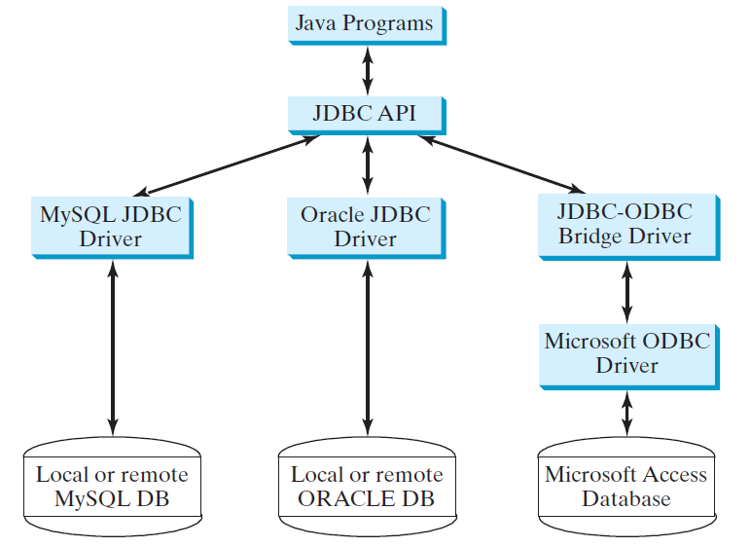
Driver Manager

Slide 8
Downloading the JDBC for SQLite
https://bitbucket.org/xerial/sqlite-jdbc/downloads/
Click on the latest version which is “sqlite-jdbc-3.21.0.jar”
Lets also download and install SQLite browser for windows (GUI for SQLite)
http://sqlitebrowser.org/

Slide 9
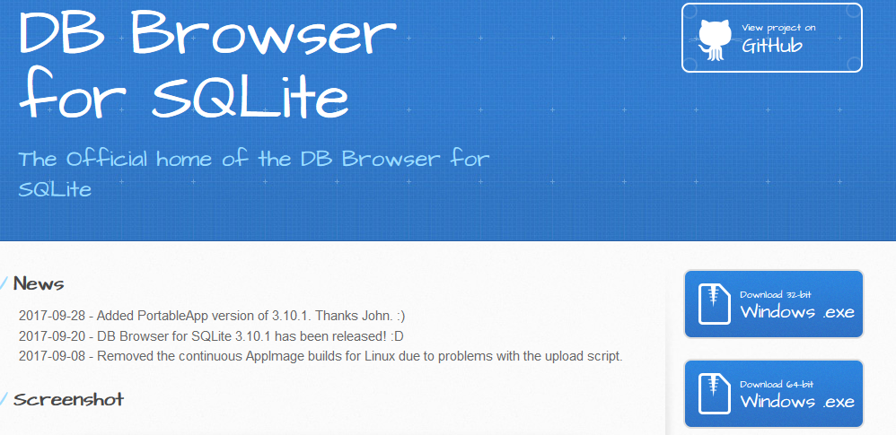
Choose appropriate windows version 32-bit or 64-bit.
Run the executable file and follow the instructions.
Once finish installation run the DB-browser.

Slide 10
Creating Databases with JDBC in Java
Create New project in Eclipse.
Add the sqlite jdbc jar file that we downloaded earlier to the library.

Slide 11
Basic CRUD operations
import java.sql.Statement;
import java.sql.Connection;
import java.sql.DriverManager;
import java.sql.SQLException;
public class TestDBExample {
  public static void main(String[] args) {
    try {
    Connection conn = DriverManager.getConnection("jdbc:sqlite:E:\\databases\\testjava.db");
    Statement statement = conn.createStatement();
    statement.execute("CREATE TABLE contacts (name TEXT, phone INTEGER, email TEXT)");
    //closing resources manually
    statement.close();
    conn.close();
    }catch(SQLException e) {
    System.out.println("Something went wrong: "+e.getMessage());
    }
  }
}

Slide 12
import java.sql.Statement;
import java.sql.Connection;
import java.sql.DriverManager;
import java.sql.SQLException;
public class TestDBExample {
  public static void main(String[] args) {
    try(Connection conn = DriverManager.getConnection("jdbc:sqlite:E:\\databases\\testjava.db");
    Statement statement = conn.createStatement()){
    statement.execute("CREATE TABLE contacts (name TEXT, phone INTEGER, email TEXT)");
    }catch(SQLException e) {
    System.out.println("Something went wrong: "+e.getMessage());
    }
  }
}

Slide 13
import java.sql.Statement;
import java.sql.Connection;
import java.sql.DriverManager;
import java.sql.SQLException;
public class InsertAndUpdateExample {
  public static void main(String[] args) {
    try {
    Connection conn = DriverManager.getConnection("jdbc:sqlite:E:\\databases\\testjava.db");
    Statement statement = conn.createStatement();
    statement.execute("CREATE TABLE IF NOT EXISTS contacts "+
    " (name TEXT, phone INTEGER, email TEXT)");
    statement.execute("INSERT INTO contacts (name, phone, email)" +
    "VALUES ('Ali', 123456, 'ali@myemail.com')");
    statement.execute("INSERT INTO contacts (name, phone, email)" +
    "VALUES ('John', 789456, 'john@myemail.com')");
    statement.execute("INSERT INTO contacts (name, phone, email)" +
    "VALUES ('Roy', 753159, 'roy@myemail.com')");
    //closing resources manually
    statement.close();
    conn.close();
    }catch(SQLException e) {
    System.out.println("Something went wrong: "+e.getMessage());
    }
  }
}

Slide 14
import java.sql.Statement;
import java.sql.Connection;
import java.sql.DriverManager;
import java.sql.SQLException;
public class InsertAndUpdateExample {
  public static void main(String[] args) {
    try {
    Connection conn = DriverManager.getConnection("jdbc:sqlite:E:\\databases\\testjava.db");
    Statement statement = conn.createStatement();
    statement.execute("CREATE TABLE IF NOT EXISTS contacts "+
    " (name TEXT, phone INTEGER, email TEXT)");
    //statement.execute("INSERT INTO contacts (name, phone, email)" +
    "VALUES ('Ali', 123456, 'ali@myemail.com')");
    //statement.execute("INSERT INTO contacts (name, phone, email)" +
    "VALUES ('John', 789456, 'john@myemail.com')");
    //statement.execute("INSERT INTO contacts (name, phone, email)" +
    "VALUES ('Roy', 753159, 'roy@myemail.com')");
statement.execute("UPDATE contacts SET phone=159357 WHERE name='Ali'");
statement.execute("DELETE FROM contacts WHERE name='Ali'");
    //closing resources manually
    statement.close();
    conn.close();
    }catch(SQLException e) {
    System.out.println("Something went wrong: "+e.getMessage());
    }
  }
}

Slide 15
import java.sql.Connection;
import java.sql.DriverManager;
import java.sql.ResultSet;
import java.sql.SQLException;
import java.sql.Statement;
public class SelectStatementExample {
  public static void main(String[] args) {
    try {
    Connection conn = DriverManager.getConnection("jdbc:sqlite:E:\\databases\\testjava.db");
    Statement statement = conn.createStatement();
    statement.execute("CREATE TABLE IF NOT EXISTS contacts "+
    " (name TEXT, phone INTEGER, email TEXT)");
    statement.execute("SELECT * FROM contacts");
    ResultSet results = statement.getResultSet();
    while(results.next()) {
    System.out.println(results.getString("name") + " " +
    results.getInt("phone") + " " +
    results.getString("email"));
    }
    results.close();
    //closing resources manually
    statement.close();
    conn.close();
    }catch(SQLException e) {
    System.out.println("Something went wrong: "+e.getMessage());
    }
  }
}

Slide 16
import java.sql.Connection;
import java.sql.DriverManager;
import java.sql.ResultSet;
import java.sql.SQLException;
import java.sql.Statement;
public class UdatedCodeExample {
public static final String DB_NAME = "testjava.db";
public static final String CONNECTION_STRING = "jdbc:sqlite:E:\\databases\\" + DB_NAME;
public static final String TABLE_CONTACTS = "contacts";
public static final String COLUMN_NAME = "name";
public static final String COLUMN_PHONE = "phone";
public static final String COLUMN_EMAIL = "email";
public static void main(String[] args) {
try {
Connection conn = DriverManager.getConnection(CONNECTION_STRING);
Statement statement = conn.createStatement();
statement.execute("DROP TABLE IF EXISTS " + TABLE_CONTACTS);
statement.execute("CREATE TABLE IF NOT EXISTS "+TABLE_CONTACTS +
" (" + COLUMN_NAME + " text, " +
COLUMN_PHONE + " integer, " +
COLUMN_EMAIL + " text" +
")" );

Slide 17
            statement.execute("INSERT INTO " + TABLE_CONTACTS +
                " (" + COLUMN_NAME + ", " +
                COLUMN_PHONE + ", " +
                COLUMN_EMAIL +
                ")" +
                "VALUES('Ali', 159753,'ali@myemail.com')");
            statement.execute("INSERT INTO " + TABLE_CONTACTS +
                "(" + COLUMN_NAME + ", " +
                COLUMN_PHONE + ", " +
                COLUMN_EMAIL +
                ")" +
                "VALUES('Jhon', 123456,'jhon@jhonemail.com')");
            statement.execute("INSERT INTO " + TABLE_CONTACTS +
                "(" + COLUMN_NAME + ", " +
                COLUMN_PHONE + ", " +
                COLUMN_EMAIL +
                ")" +
                "VALUES('Roy', 7894562,'roy@royemail.com')");
            statement.execute("INSERT INTO " + TABLE_CONTACTS +
                "(" + COLUMN_NAME + ", " +
                COLUMN_PHONE + ", " +
                COLUMN_EMAIL +
                ")" +
                "VALUES('Nick', 753654,'nick@nickemail.com')");
            statement.execute("UPDATE " + TABLE_CONTACTS + " SET "+
                COLUMN_PHONE + "=321654" + " WHERE "+
                COLUMN_NAME + "='Ali'");
            statement.execute("DELETE FROM " + TABLE_CONTACTS + " WHERE "+
            COLUMN_NAME + "='Nick'");

Slide 18
ResultSet results = statement.executeQuery("SELECT * FROM "+ TABLE_CONTACTS);
while(results.next()) {
System.out.println(results.getString(COLUMN_NAME) + " " +
results.getInt(COLUMN_PHONE) + " " +
results.getString(COLUMN_EMAIL));
}
results.close();
//closing resources manually
statement.close();
conn.close();
}catch(SQLException e) {
System.out.println("Something went wrong: "+e.getMessage());
e.printStackTrace();
}
}
}

