Slide 1
Agenda
Introductions
Encyclopedias, Wikipedia, Textbooks, and OER
Our Project
Pre-Survey
CUNY Academic Commons
Questions?
Notes:
INtro/Icebreaker: CM
Encyclopedias: CM
Wikipedia: IM
Textbooks: SO
OER: SO
Project: CM
Pre-survey: CM
Commons: IM

Slide 2


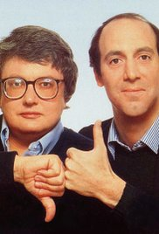



















Introductions
Introduce yourself to the group:
Name
How do you contribute or use reviews for products or media?

Slide 3


Slide 4

Where do encyclopedia articles come from?
Thousands of eminent experts, scholars, and leaders contribute to Britannica products today, much less the many thousands more whose work has appeared in Britannica products since the company’s founding in 1768. That list would include more than a hundred Nobel laureates, four U.S. presidents, countless Pulitzer Prize winners and others of international renown.
Notable contributors:
Albert Einstein
Sigmund Freud
Bill Clinton
Carl Sagan
Harry Houdini
Bertrand Russell
Jimmy Carter
Tony Hawk
Marie Curie
Leon Trotsky
George Bernard Shaw
Isaac Asimov
Milton Friedman
Joseph Ellis
Michael DeBakey
Alfred North Whitehead
Christine Sutton
Francisco Ayala

Slide 5
Where do encyclopedia articles come from?
Think, pair share:
Look at the list of contributors on the right. Do you recognize anyone? Do you notice any similarities? Are any voices missing? If so, how might this impact the content of the information?
Notable contributors:
Albert Einstein
Sigmund Freud
Bill Clinton
Carl Sagan
Harry Houdini
Bertrand Russell
Jimmy Carter
Tony Hawk
Marie Curie
Leon Trotsky
George Bernard Shaw
Isaac Asimov
Milton Friedman
Joseph Ellis
Michael DeBakey
Alfred North Whitehead
Christine Sutton
Francisco Ayala

Slide 6


Slide 7

Where do Wikipedia articles come from?
We foster an inclusive space that everyone can feel a part of.
-Wikimedia Foundation
The goal is to give people a free encyclopedia to every person in the world, in their own language. Not just in a 'free beer' kind of way, but also in the free speech kind of way.
-Jimmy Wales,
Greatest misconception about Wikipedia: We aren’t democratic. Our readers edit the entries, but we’re actually quite snobby. The core community appreciates when someone is knowledgeable, and thinks some people are idiots and shouldn’t be writing.
-Jimmy Wales,

Slide 8
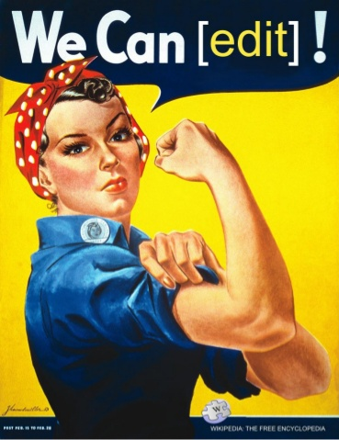
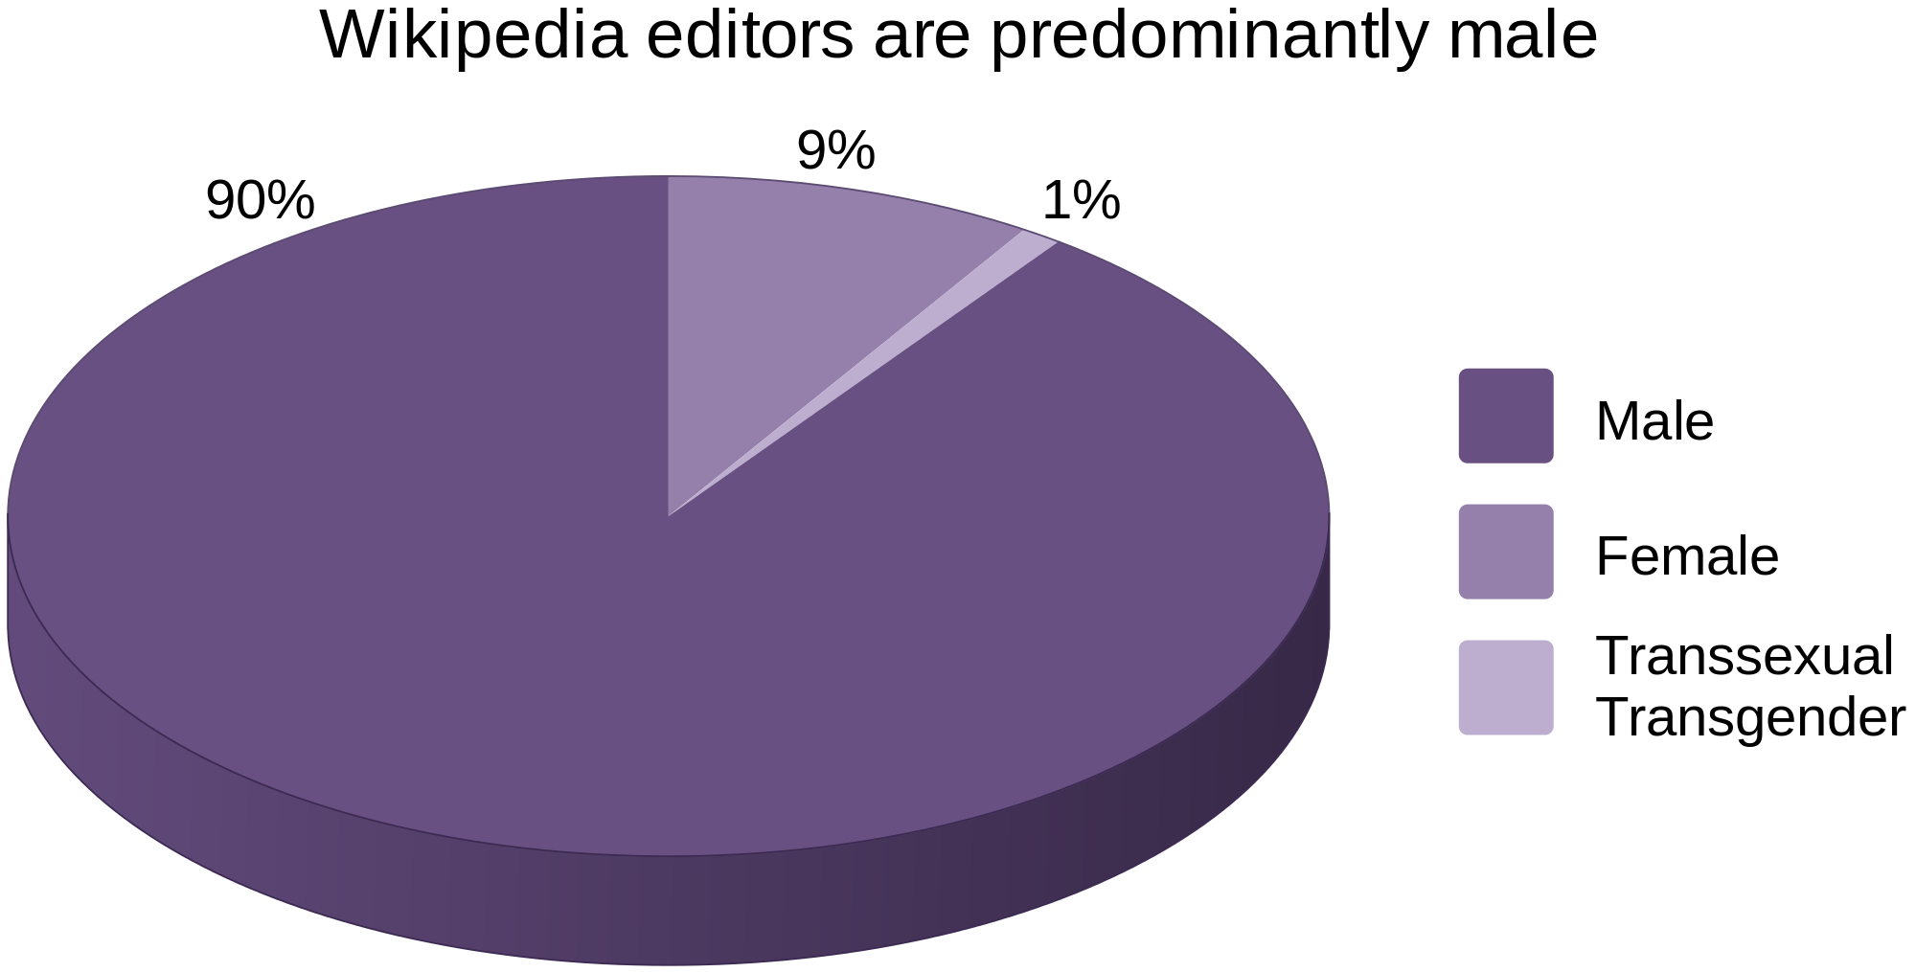
Does Wikipedia really reflect the people?
“The Decline of Wikipedia”
by Tom Simonite
MIT Technology Review
October 22, 2013
Participation bias
“The loose collective running the site today, estimated to be 90 percent male, operates a crushing bureaucracy with an often abrasive atmosphere that deters newcomers who might increase participation in Wikipedia and broaden its coverage.”

Slide 9
What does this have to do with the project?
Notes:
Foreground idea that the project is meant to add student voice to textbook/oer creation, adoption, and remix
Active process:
Not simply making a website where they post comments on a website and maybe someone pays attention
Mention inclusivity and Wikipedia

Slide 10
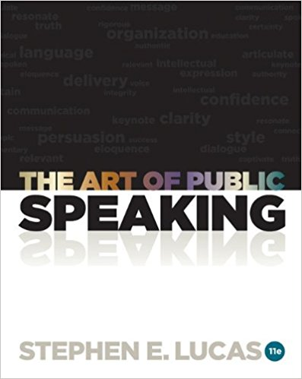
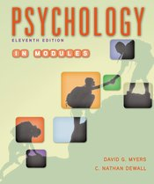
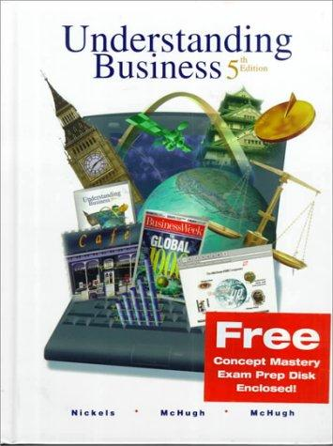
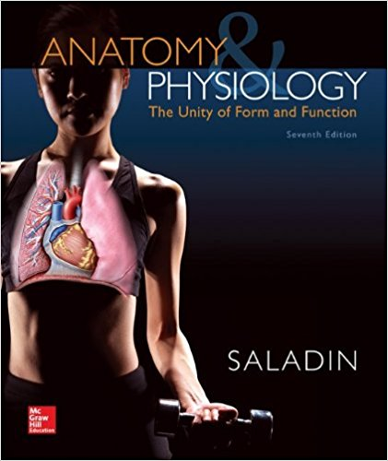

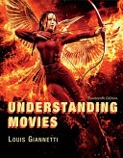
Where do textbooks come from?
The Art of Public Speaking
Stephen Lucas
University of Wisconsin–Madison
Psychology in Modules
David Myers
Hope College
Understanding Business
William Nickels
University of Maryland
James McHugh
St. Louis Community College/Forest Park
Susan McHugh
Applied Learning Systems
Anatomy & Physiology: The Unity of Form and Function
Kenneth Saladin
Georgia College & State University
Understanding Movies
Louis Giannetti
Case Western Reserve University
The Philosopher's Way: Thinking Critically About Profound Ideas
John Chaffee
LaGuardia Community College

Slide 11
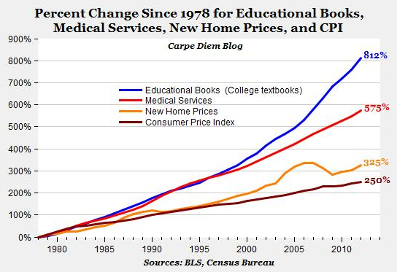
Who chooses textbooks?
Long-standing academic custom assigns faculty the right to choose the textbooks and other course materials that are required or recommended for their courses. Sometimes a collective group of faculty will make that decision… often with little regard to the cost of the textbooks, because they are not the individuals who pay for them.
A “broken” market system
The textbook market is remarkable because:
the primary individuals who choose textbooks (faculty) are not the people that pay for them (students)
the separation of textbook choice and textbook payment profoundly influences pricing, and students end up being coerced to pay for someone else’s choices
this leaves textbook producers (publishers) with a disproportionate market power to set prices high
Notes:
No ability to substitute, as in a free market
What would you pay for a glass of milk? A cup of coffee?

Slide 12
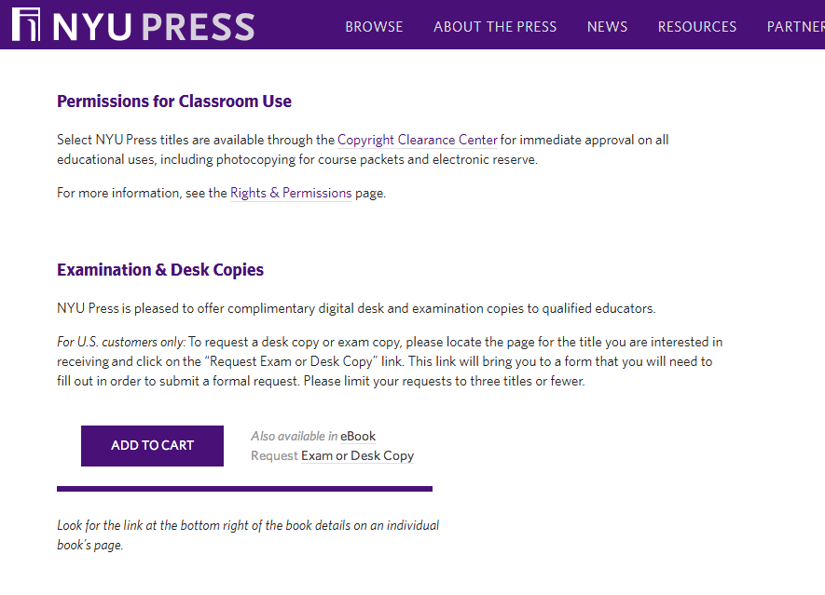

Slide 13
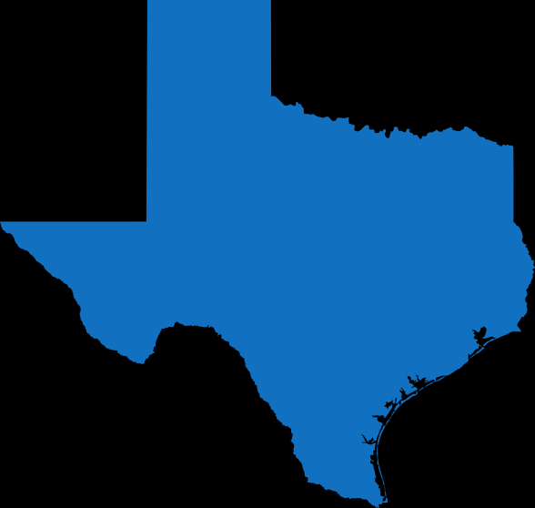
Notes:
5.3 million students
Used to pay all textbook costs as long as it came from approved vendors (Via Texas State Board of Education)
Other states would piggyback since it was cheaper in bulk...
Now more local control but the damage is done. Also, still persists

Slide 14
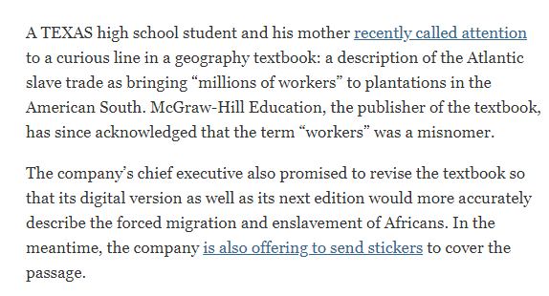

Slide 15
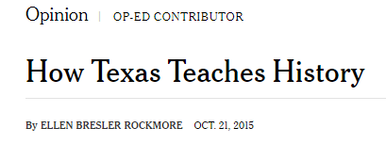

Slide 17
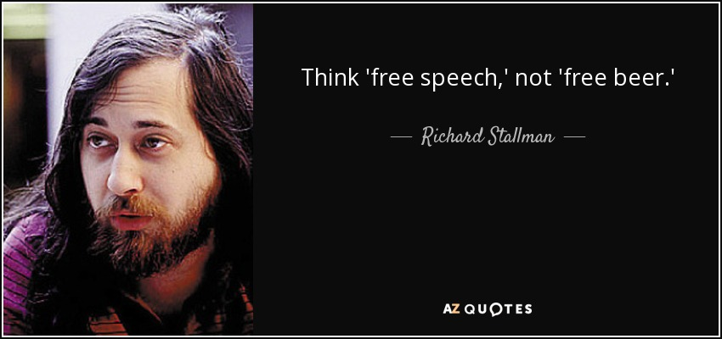

What is OER?
Open educational resources (OERs) are freely available and distributable course materials.
available at no cost* to faculty and to students
can be modified by faculty and/or students
can be redistributed by faculty who have made changes to the original OER work
Changing the market system by changing access
Notes:
Go through the asterisk!

Slide 18
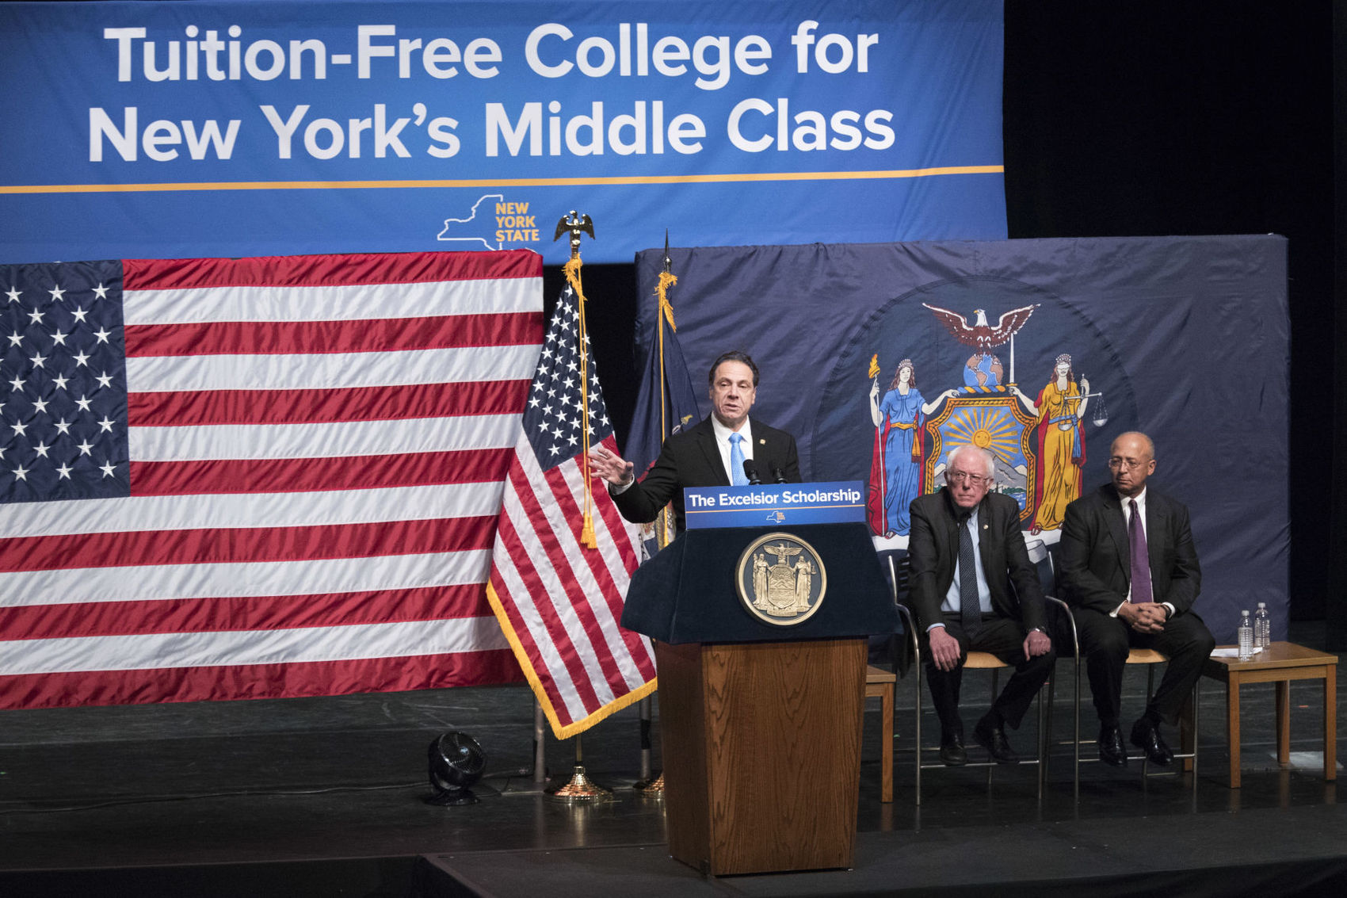
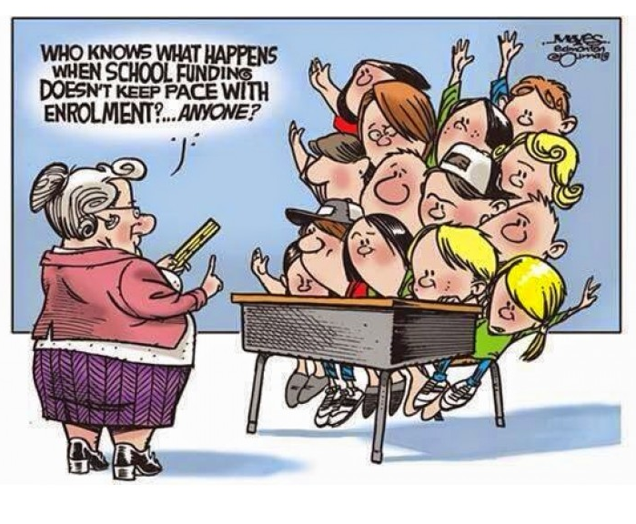
Student voice on textbooks
The purpose of this project is to train community college students to evaluate OER textbooks, with the goal of getting the voice of students into the OER textbook selection process.
FREE
vs.
QUALITY
This year, SUNY and CUNY were given $8 million by Governor Cuomo and the state of New York to implement OER in high-enrollment, general education courses.

Slide 19
Goals of the project
Produce a directory of student-rated open education resources to improve textbook quality and affordability.
The evaluation of textbook samples will involve:
Quantitative assessment surveys
Qualitative survey responses
Summative written reviews
Final Project will involve:
Creative product to promote quality OER textbook options

Slide 20
Participant expectations
Attend all sessions.
Invest up to four hours a week.
Give honest feedback on surveys.
Write reflective essays
Compose critical reviews
Based upon the terms of the grant, to qualify for the stipend:
Students must complete all assignments, including the final project
Students cannot have more than 2 unexcused absences
Students must produce work demonstrating their in-class learning

Slide 21
Timeline
Week 1 - 2 3.12-3.25 | Orientation Pre-Survey
Week 3 - 5 3.26-4.15 | Read 1st packet of textbook samples Respond to written questions Write critical review Complete quantitative survey
Week 6 - 8 4.16-5.6 | Read 2nd packet of textbook samples Respond to written questions Write critical review Complete quantitative survey
Week 9 - 11 5.7-5.27 | Read 3rd packet of textbook samples Respond to written questions Write critical review Complete quantitative survey
Week 12 - 14 5.28-6.17 | Final Project Post-Survey Final reflections
Notes:
Conference room and dates?

Slide 22
Please complete the OER Seminar Pre-Survey:
*URL*

Slide 23

Introduction to the...
Create accounts
Join Group: *URL*
Respond to the following:
Read “Textbook manifesto” by Allen B. Downey. Briefly write about a textbook challenge (or challenges) you wish to solve. Add to the Manifesto in discussion board by adding a call-to-action for professors, students, AND publishers (one Manifesto item for each group).
Homework: Respond to two of your colleagues before next meeting
Reading available here: goo.gl/Xj2hFA

Slide 24
Take away:
What did you find interesting?
What concept gave you the most trouble today?
Notes:
Foreground idea that the project is meant to add student voice to textbook/oer creation, adoption, and remix
Active process:
Not simply making a website where they post comments on a website and maybe someone pays attention
Mention inclusivity and Wikipedia

