Slide 1
Agenda
Publishing models
Evaluation Process & Rubric
Distribute Cycle One Packets
Questions?

Slide 2
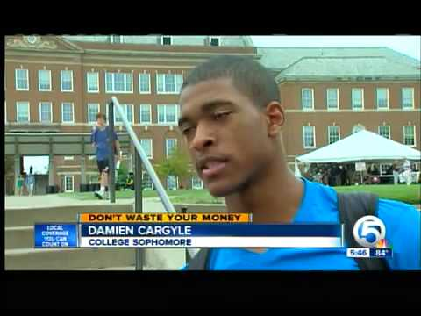
https://www.youtube.com/watch?v=TOa8CDeCPgE

Slide 3
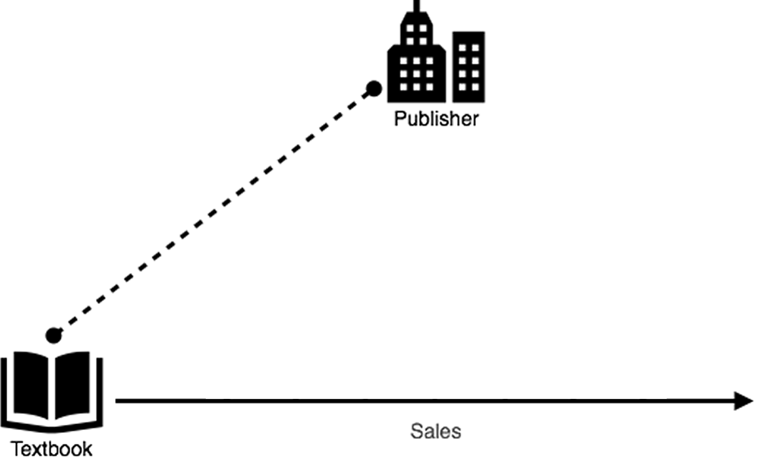
Notes:
Publishers invest in creating a textbook…

Slide 4
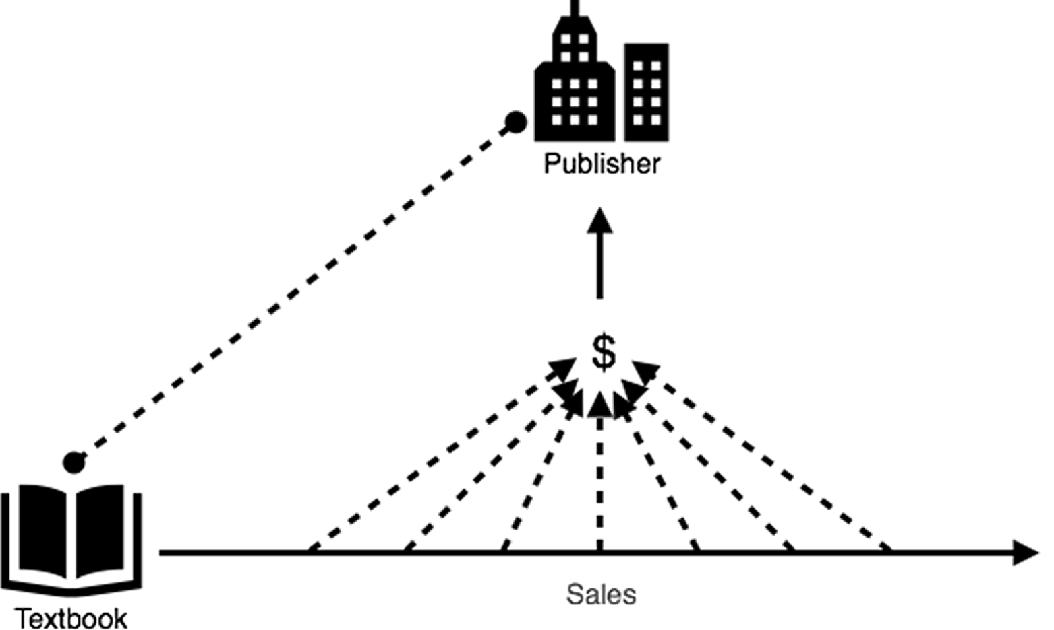
Notes:
…they recoup their investment (and make a profit) through sales of the books...

Slide 5
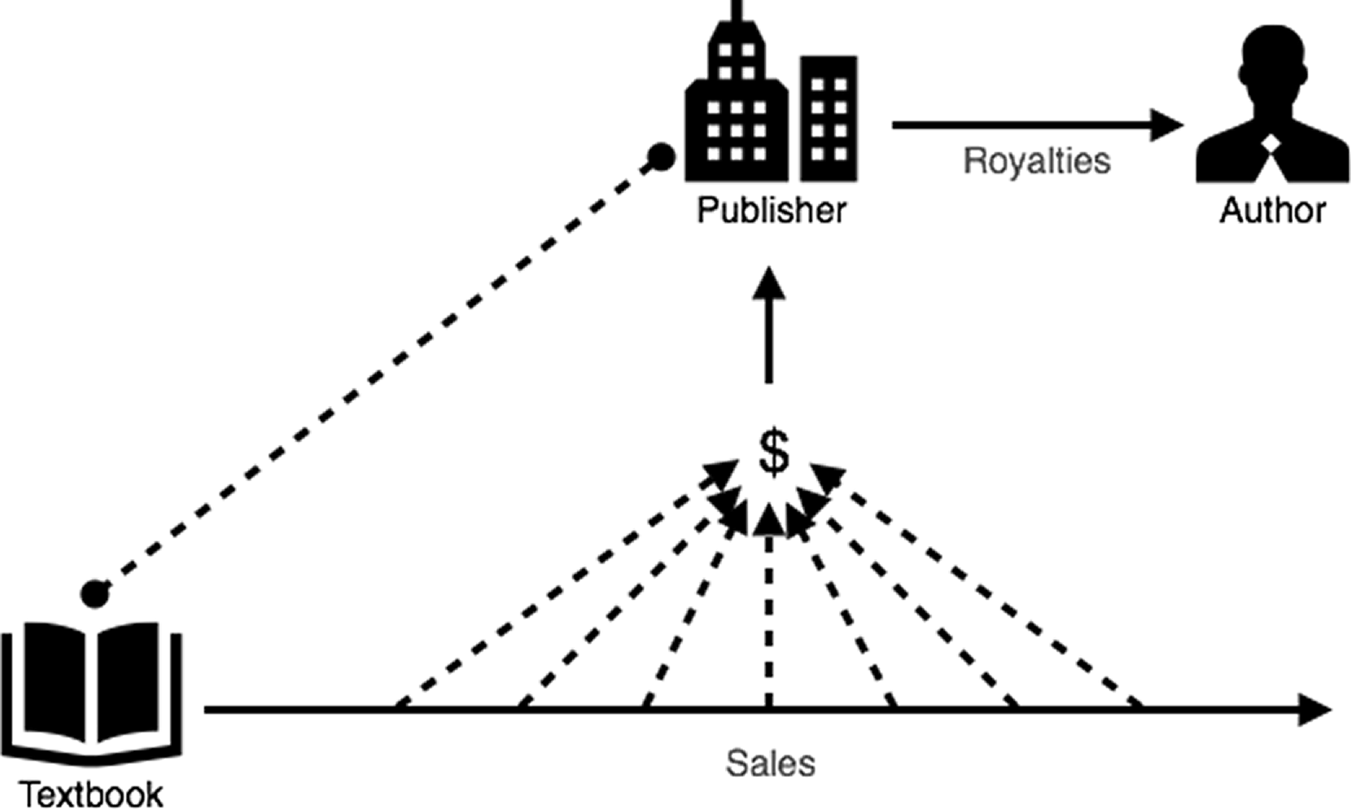
Notes:
…and have money to pay royalties to authors – typically 5% - 12%. So, if a book is free (there aren’t any sales), how could this possibly work?

Slide 6

Notes:
…and have money to pay royalties to authors – typically 5% - 12%. So, if a book is free (there aren’t any sales), how could this possibly work?

Slide 7
Other models…
Notes:
Two other models…

Slide 8

Notes:
Model 1: Someone writes a book, usually for their own course, and puts it on the internet for others to use. This is not the most prevalent, nor is it where the activity is right now…
Admit that these books might not be peer reviewed in the traditional sense.

Slide 9
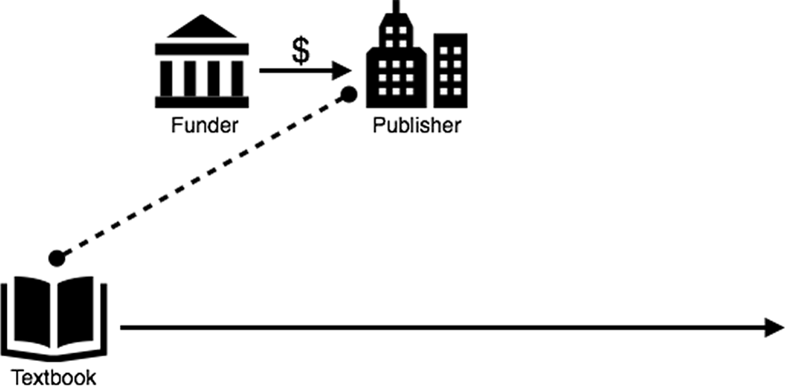
Notes:
Model 2: The addition of a “funder”. The funder agrees to pay for production of the book, but with one stipulation: The book needs to be free forever. The publishing process could be exactly the same…

Slide 10
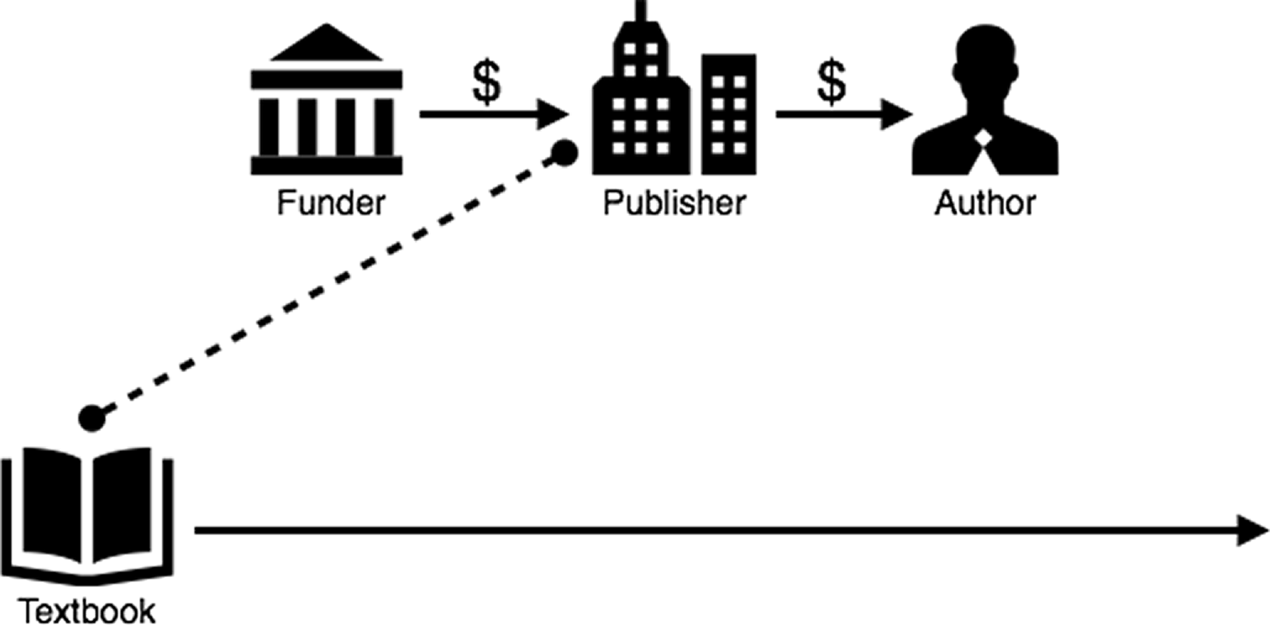
Notes:
…the author can even get paid.

Slide 11
Where does the funding come from?
Universities (SUNY, Umass Amherst, Portland State, …)
Foundations (Hewlett, Gates, …)
Governments (state, federal, New York!)
Institutional Consortia (CALI)
Notes:
Where does this funding come from?

