Slide 1
Agenda
April 17, 2018
Feedback on Cycle 2
Creative Commons & Copyright
Evaluate textbooks & Chapters
Questions?

Slide 2
Copyright and Fair Use: A Brief Overview

Slide 3
What is copyright?
Copyright is a collection of rights granted to artists, authors, musicians, and other creators of original works. Copyright laws seek to ensure that creative people benefit from their own creations. The laws protect against the unauthorized copying, distribution, and public performance of creative works.
--World Book Online

Slide 4
What is protected by U.S. copyright?
1. Literary works
2. Musical works, including any accompanying words
3. Dramatic works, including any accompanying music
4. Pantomimes and choreographic works
5. Pictorial, graphic, and sculptural works
6. Motion pictures and other audiovisual works
7. Sound recordings
8. Architectural works
--United States Copyright Office

Slide 5
What is not protected by copyright?
Works that have not been fixed in a tangible form of expression (for example, choreographic works that have not been notated or recorded, or improvisational speeches or performances that have not been written or recorded)
Titles, names, short phrases, and slogans; familiar symbols or designs; mere variations of typographic ornamentation, lettering, or coloring; mere listings of ingredients or contents
Ideas, procedures, methods, systems, processes, concepts, principles, discoveries, or devices, as distinguished from a description, explanation, or illustration
Works consisting entirely of information that is common property and containing no original authorship (for example: standard calendars, height and weight charts, tape measures and rulers, and lists or tables taken from public documents or other common sources)
--United States Copyright Office

Slide 6
What is the public domain?
A work of authorship is in the “public domain” if it is no longer under copyright protection or if it failed to meet the requirements for copyright protection. Works in the public domain may be used freely without the permission of the former copyright owner.
--United States Copyright Office

Slide 7
What is fair use?
Section 107 contains a list of the various purposes for which the reproduction of a particular work may be considered fair, such as criticism, comment, news reporting, teaching, scholarship, and research. Section 107 also sets out four factors to be considered in determining whether or not a particular use is fair:
The purpose and character of the use, including whether such use is of commercial nature or is for nonprofit educational purposes
The nature of the copyrighted work
The amount and substantiality of the portion used in relation to the copyrighted work as a whole
The effect of the use upon the potential market for, or value of, the copyrighted work

Slide 8
Fair Use
The distinction between fair use and infringement may be unclear and not easily defined. There is no specific number of words, lines, or notes that may safely be taken without permission.
Acknowledging the source of the copyrighted material does not substitute for obtaining permission.

Slide 9
Fair Use Checklist: Purpose
Favoring Fair Use
Teaching (including multiple copies for classroom use)
Research
Scholarship
Nonprofit educational institution
Criticism
Comment
News reporting
Transformative or productive use (changes the work for new utility)
Restricted access (to students or other appropriate group)
Parody
Opposing Fair Use
Commercial activity
Profiting from the use
Entertainment
Bad-faith behavior
Denying credit to original author
--Columbia University Libraries/Information Services Copyright Advisory Office

Slide 10
Fair Use Checklist: Nature
Favoring Fair Use
Published work
Factual or nonfiction based
Important to favored educational objectives
Opposing Fair Use
Unpublished work
Highly creative work (art, music, novels, films, plays)
Fiction
--Columbia University Libraries/Information Services Copyright Advisory Office

Slide 11
Fair Use Checklist: Amount
Favoring Fair Use
Small quantity
Portion used is not central or significant to entire work
Amount is appropriate for favored educational purpose
Opposing Fair Use
Large portion or whole work used
Portion used is central to or “heart of the work”
--Columbia University Libraries/Information Services Copyright Advisory Office

Slide 12
Fair Use Checklist: Effect
Favoring Fair Use
User owns lawfully purchased or acquired
copy of original work
One or few copies made
No significant effect on the market or potential market for copyrighted work
No similar product marketed by the copyright holder
Lack of licensing mechanism
Opposing Fair Use
Could replace sale of copyrighted work
Significantly impairs market or potential market for copyrighted work or derivative
Reasonably available licensing mechanism for use of the copyrighted work
Affordable permission available for using work
Numerous copies made
You made it accessible on the Web or in other public forum
Repeated or long-term use
--Columbia University Libraries/Information Services Copyright Advisory Office

Slide 13
Can I Use It?
http://www.librarycopyright.net/digitalslider/
http://librarycopyright.net/fairuse/index.php

Slide 14
Other resources
(C)opyright@CUNY: http://www.cuny.edu/libraries/services/copyright.html
University of Texas Copyright Crash Course: http://copyright.lib.utexas.edu/michigan.html
University of Texas Coursepack guidelines: http://copyright.lib.utexas.edu/copypol2.html#rules

Slide 15
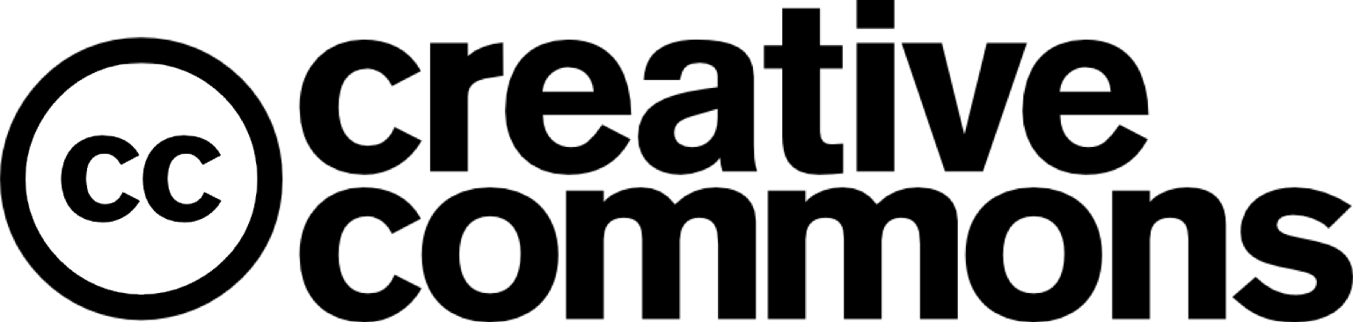
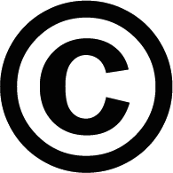
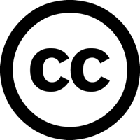
All Rights
Reserved
Some Rights
Reserved

Slide 16
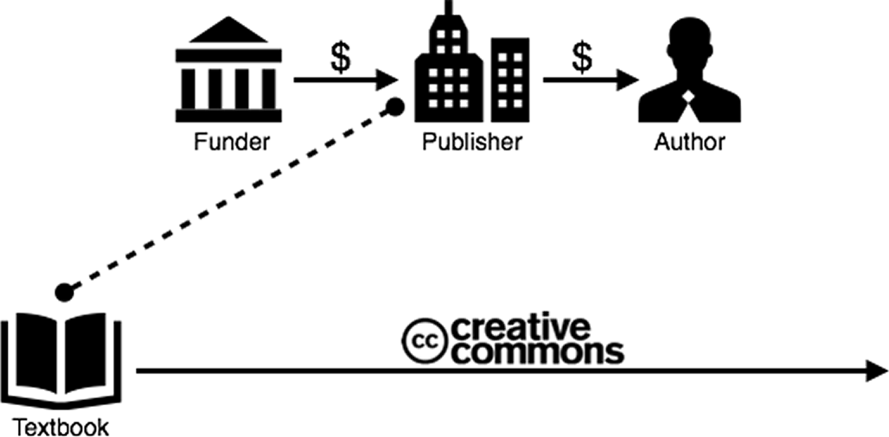
Notes:
So, the CC license is the last piece to this model. Now the end user knows what the intent of the funder/publisher is.

Slide 17
With Creative Commons licenses, you are free to…
Copy | Mix
Share | Keep
Edit | Use
Notes:
The licenses allow for these things…

Slide 18
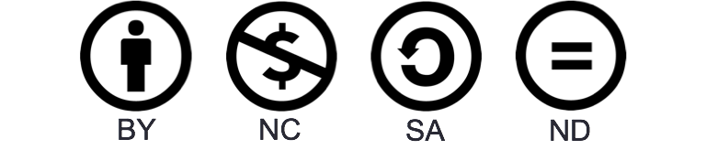
Notes:
…give a brief overview of the four license components.

Slide 19
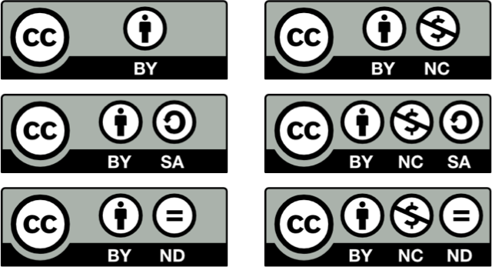
Notes:
These are the 6 CC licenses. Maybe even quiz them on one or two...
Note that these licenses are used in many places, but we often don’t notice...

Slide 20
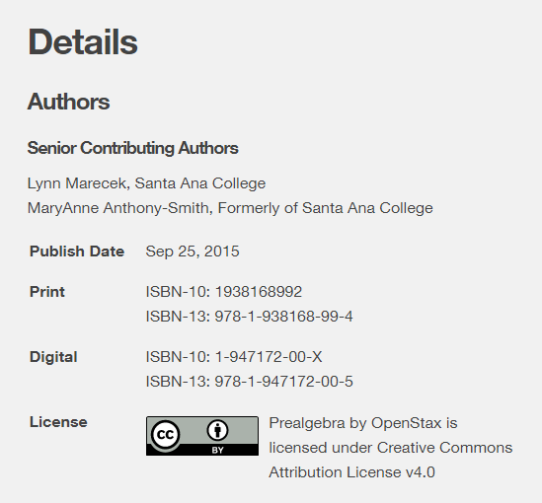
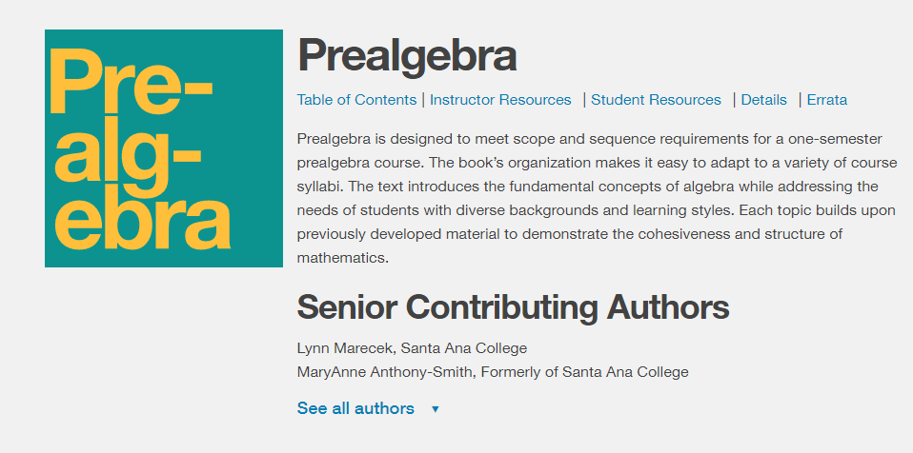

Slide 21
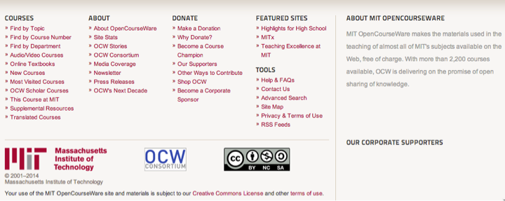
Notes:
MIT Open Courseware
This is a screenshot from an OCW page – there was a video above. Note the license.
MIT wants you to use it, and here are their terms: (BY NC SA). Ask what that means.

Slide 22
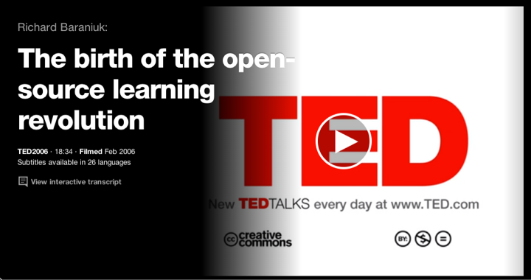
Notes:
TED Talks: BY NC ND
Ask what that means.

Slide 23
What are the advantages of using a flexible Creative Commons license for your creative work?
What might be a disadvantage?

Slide 24
ANDREW R. CHOW, “Copyright Case Over Richard Prince Instagram Show to Go Forward.” New York Times, JULY 20, 2017, https://www.nytimes.com/2017/07/20/arts/design/richard-prince-instagram-copyright-lawsuit.html.

Slide 25
Glyn Moody, “Festival uses CC-licensed pic without attribution, pays the price,” Art TEchnica, 13 July 2016,
https://arstechnica.com/tech-policy/2016/07/creative-commons-photo-misused-lawsuit/.
“Software Copyright,” Wikipedia, https://en.wikipedia.org/wiki/Software_copyright.

