Slide 1
Project Presentation

Slide 2
Summary
Credit Loss Forecasting
Background
Business Requirement
Model Methodology Selection
Variable Selection
Model Evaluation
Assumption Check
Model Performance Monitoring
Challenges
Visualization

Slide 3
Background
Credit loss forecasting:
Forecast loss rate of bank’s commercial and consumer portfolios
Main metrics to forecast:
Probability of Default (PD): the likelihood over a specified period that a borrower will not be able to make scheduled repayments
Loss Given Default (LGD): the amount of money the bank loses when a borrower defaults on a loan
Model used for:
Stress testing: test whether a bank has enough capital to withstand the impact of adverse economic developments
Strategy planning: forecast balance sheet to make short term & long term strategy plan
Portfolio category:
Commercial loan: C&I (Commercial and Industrial), CRE (Commercial Real Estate)
Consumer loan: SBB (Small Business Banking), Mortgage

Slide 4
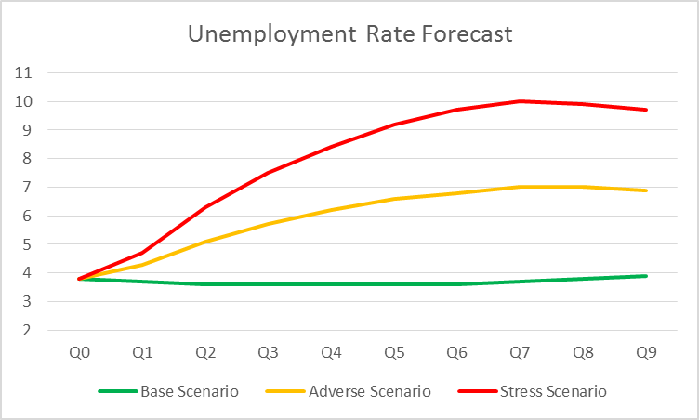
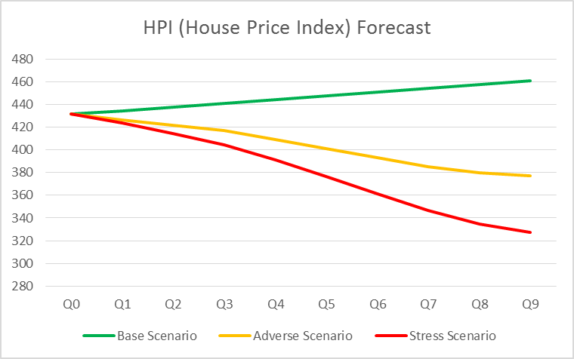
Business Requirement
Scenario analysis:
Forecast should be sensitive to macroeconomic scenarios provided by Federal Reserve:
Base Scenario: Stable economic environment with moderate economic expansion
Adverse Scenario: Weakening economic conditions
Stress Scenario: Unfavorable economic conditions with severe global recession

Slide 5
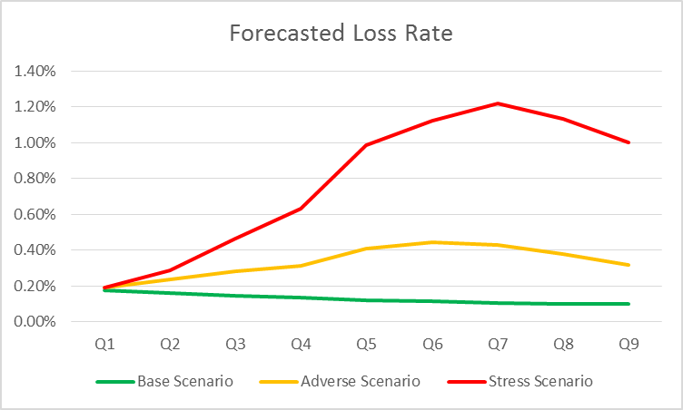
Business Requirement
Scenario analysis:
Forecast should be sensitive to macroeconomic scenarios provided by Federal Reserve:
Base: Stable economic environment with moderate economic expansion
Adverse: Weakening economic conditions
Stress: Unfavorable economic conditions with severe global recession

Slide 6
Business Requirement
Modelling approach:
Top-down approach (portfolio-level approach): most aggregated method
Use average values of customer characteristics and macroeconomic indicators
Bottom-up approach (customer-level approach): most granular method
Capture customer-level details: use customer-level characteristics and macroeconomic indicators
Aggregates the customer forecasts to estimate portfolio-level losses
Hybrid approach (panel-level approach): intermediate level of aggregation
Pools customers into homogeneous panels using customer characteristics (for example: FICO score/Location/Loan type) and subsequently tracks these panels through the observation period
Choice of approach depends on data availability and complexity of the portfolio

Slide 7
Model Methodology Selection
Methodologies like regression-based models, decision tree, and other machine learning methods are considered.
We choose logistic regression/linear regression because:
Transparency and ease of interpretability: bank’s models are reviewed and examined closely by regulators like Federal Reserve. The ease to interpret methodology to regulators is very important.
Stable result (low variance)
Industry standard: most widely used in banking industry
Benchmark model: vendor model/decision tree

Slide 8
Variable Selection
Two sets of independent variables: Macroeconomic variables and Customer-level characteristic
1. Macroeconomic variables
24 macroeconomic variables were included as potential predictors that link the PD and LGD to macroeconomic environment. Examples are Unemployment rate, HPI (house price index), GDP, etc.
Variable transformation: Quarterly, six-month, and annual differences and growth rates for each one of the variables were created, as were one quarter or one year lagged variables of these difference and growth variables. More than 200 macroeconomic variables, including both raw variables and transformed variables, were used as potential predictors for model development.

Slide 9
Variable Selection
Two steps were taken for variable reduction and selection for the full list of hundreds of economic variables:
A. Correlation Analysis:
Correlations between the entire economic variable list and dependent variable were calculated.
The most correlated variables were tested as candidate predictors, prioritizing variables with intuitive relationships.
B. Stepwise Regression:
The set of variables from the last step was selected as the initial predictors
Backward Elimination: The procedure starts with the full set of initial predictors. At each step, it removes the worst attribute (for example: largest p value) remaining in the set
The criteria for selecting final predictors is the combination of the statistical selection and business judgment.

Slide 10
Variable Selection
2. Customer-level characteristics
Commercial portfolio:
Financial ratios: from income statement and balance sheet
Examples are earning, profit margin, sales growth, debt to net worth ratio
Consumer portfolio:
Examples are Loan to Value ratio, FICO score, location, product type, loan maturity
Criteria: both statistically significant and intuitive

Slide 11
Model Evaluation
K-fold cross validation:
Validate the model performance on hold out samples
Compare metrics between training samples and hold out samples:
Coefficients stability
Linear Regression: MSE (Mean square error), Adjusted R Square.
Logistic Regression: Confusion Matrix (Accuracy rate/Precision/Recall/F1 Score), AUC-ROC curve, KS Statistic

Slide 12
Assumption Check
Statistical Significance for predictors : p value
Absence of Multi-collinearity for predictors: VIF (Variance Inflation Factor) statistic
Absence of Autocorrelation for residuals: Residuals are independent
Homoscedasticity of residuals: Variance of residual should be constant

Slide 13
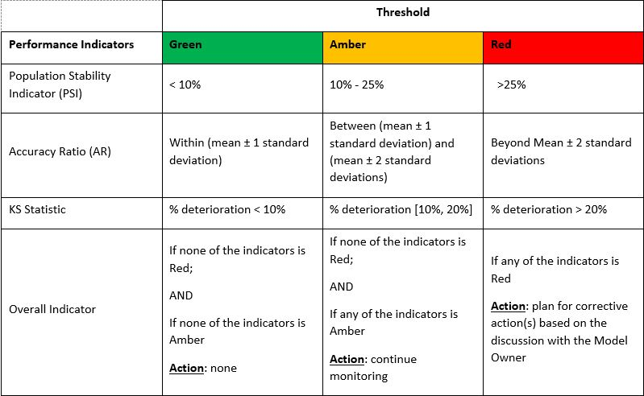
Model Performance Monitoring
The performance monitoring report will contain key statistical measures to evaluate the model output and the distribution of the input data, and tolerance thresholds against each measures.

Slide 14
Challenges
Data Availability:
Especially for commercial portfolios
Data Quality:
Data from different sources/vendors

Slide 15
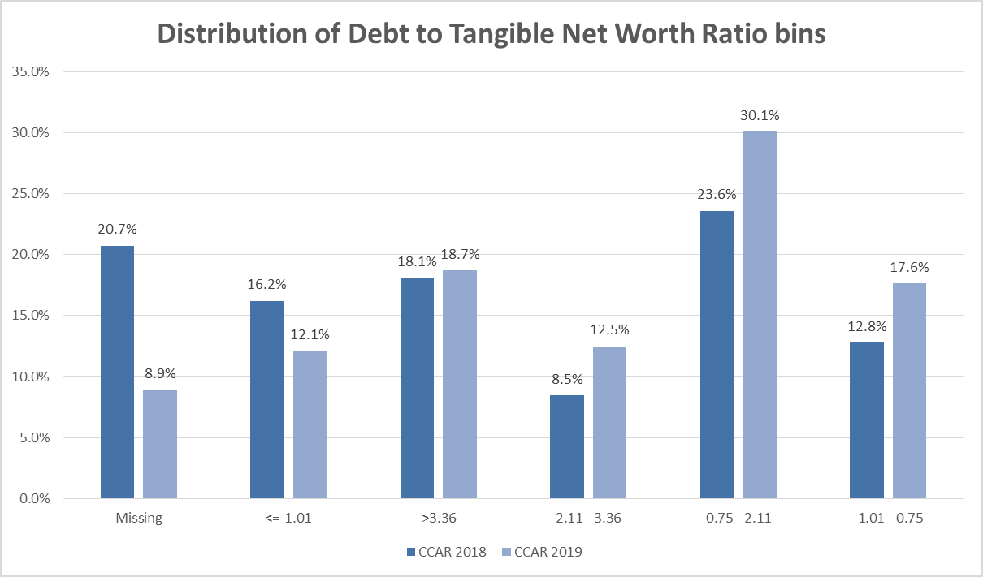
Visualization Tools
Example 1: Monitor the shift of distribution of key model drivers:
Direction of increased penalty causing higher relative losses

Slide 16
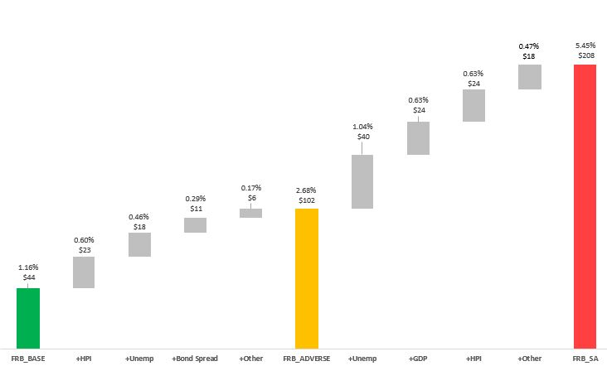
Visualization Tools
Example 2: Macroeconomic variable impact analysis:

