Slide 1
AML Segmentation Review
Mengchun Sun
AML Modeling Team
04/17/2018

Slide 2
Overview
Personal Clustering Methodology
MRMG Findings

Slide 3
Objective
Overview
AML transaction monitor models are built on 11 segments, which are based on 24 segments provided by Santander retail and finance department. However, according to retail and finance, the 24 segments are no longer updated. Consequently, more and more customers in AML transaction monitor models are now be categorized as ‘UNKNOWN’ segment. Therefore, more false positive alerts are expected.
In this document, FCC AML model team intend to explore 19 structural segments alternative to the aforementioned 24 segments.

Slide 4
Overview – Output (Active Customers)
Total of active customers: 4.7m
Inactive Customers includes 1.Non customers (~450k), 2. Customers without Branch ID(~1.9m), 3. Customers without linked accounts (~600k)
Unknown Shift
All Shift
Notes:
Improvements:
1. Lower alert volumes, provide a more accurate input for all TM models
2. Active model keep tracking customers’ changes
Six hard rules are tracked daily to monitor customers:
F-customers changed from or to selected product
Customers go expired from new customer period (after 6 months with the Bank)
Previously not defined customers
From close to active customers
From business F-customers (F-customers with only business accounts) to others
High hierarchy changed J-customers

Slide 5
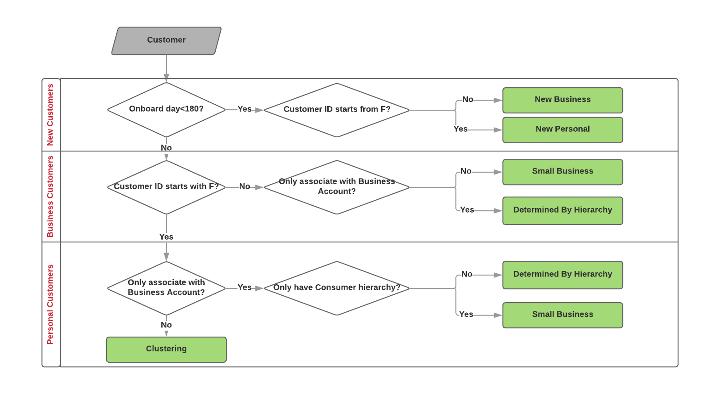
Overview – Process Flow
All customers

Slide 6
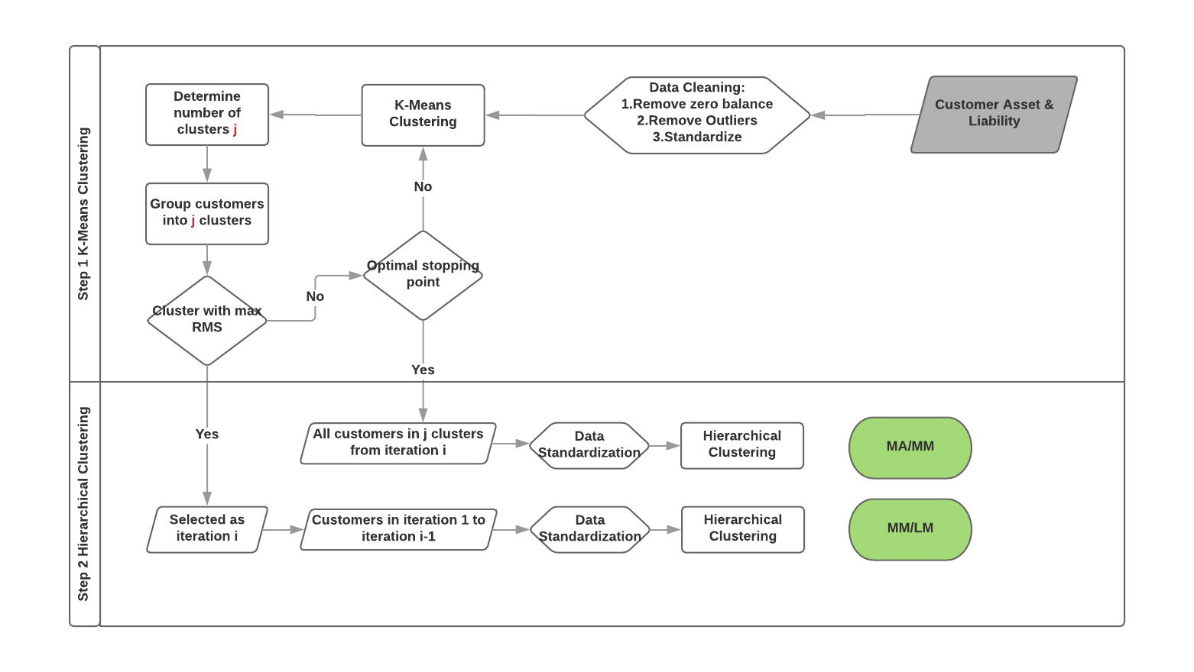
Overview – Process Flow
Two Step Clustering
Notes:
Clustering is one of the most important unsupervised learning problem, it deals with finding a structure in a collection of unlabeled data, clustering is the process of organizing objects into groups whose members are similar in some way. A cluster is therefore a collection of objects which are “similar” between them and are “dissimilar” to the objects belonging to other clusters
Because of the large customer population, traditional/simple clustering method are not able to lead to reliable 3 clusters; our team developed a two step, repeatedly clustering technique.
In the first step, model developers run K-means clustering multiple times to group customers. Each run was an iteration, for each iteration, K-means clustering output j clusters and the number j was the first choice of j when CCC>=3 to ensure convergence and cluster quality (Refer to Section 1.1 ). The most variant cluster (with the maximum RMS) from j clusters would be selected as one of the final iterations. Customers in the rest j-1 clusters would go to the next iteration and same procedure repeated until the rest population was less than 50% of the original population. Note there were i iterations from first step, j clusters in the last iteration i. Therefore, first step clustering’s output was (i-1+j) clusters.
Model developers used a lower bound of bootstrapping step, which has a minimal iteration step of average assets less than $100K and average liabilities less than $1 million among the clusters. Clusters above those thresholds would be characterized as Mass Affluent. This was determined based on expert judgement. Model developers also utilized an upper bound of bootstrapping step, which was defined as the last step in which the remaining number of customers is at least half of the total number of customers that are included in the clustering method. Model developers defined a stopping step, which was any step between the Lower Bound and Upper Bound of bootstrapping where the second round clustering method is applied to group the clusters into final segments. A valid stopping step was determined to be a stopping step that yields customers volumes of segments meeting business requirement, i.e., the Volume of Lower Mass Market is no less than Volume of Mass Market, and the Volume of Mass Market is no less than Volume of Mass Affluent. Based on this, the segmentation stopping step was determined to be the maximal stopping step.
For the second step clustering, hierarchical clustering algorithm is applied to the average asset and average liability of N-1 clusters from first step’s N-1 iterations to tell apart Mass Market from Mass Affluent, and applied another hierarchical clustering on the rest m clusters from last iteration N to tell apart Mass Market from Lower Mass Market. Specifically, for the model run on January 11, 2017, there were a total of 26 iterations, and 7 clusters in the 26th iteration. So N=26, m=7 in this case, and the total cluster from first step was N-1+m=32. The first N-1=25 iterations were used to differentiate Mass Affluent from Mass Market customers. The 26th iteration was used to cluster and differentiate Lower Mass Market from Mass Market customers.

Slide 7
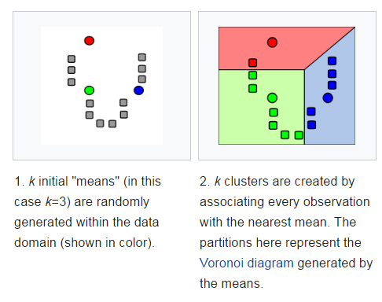
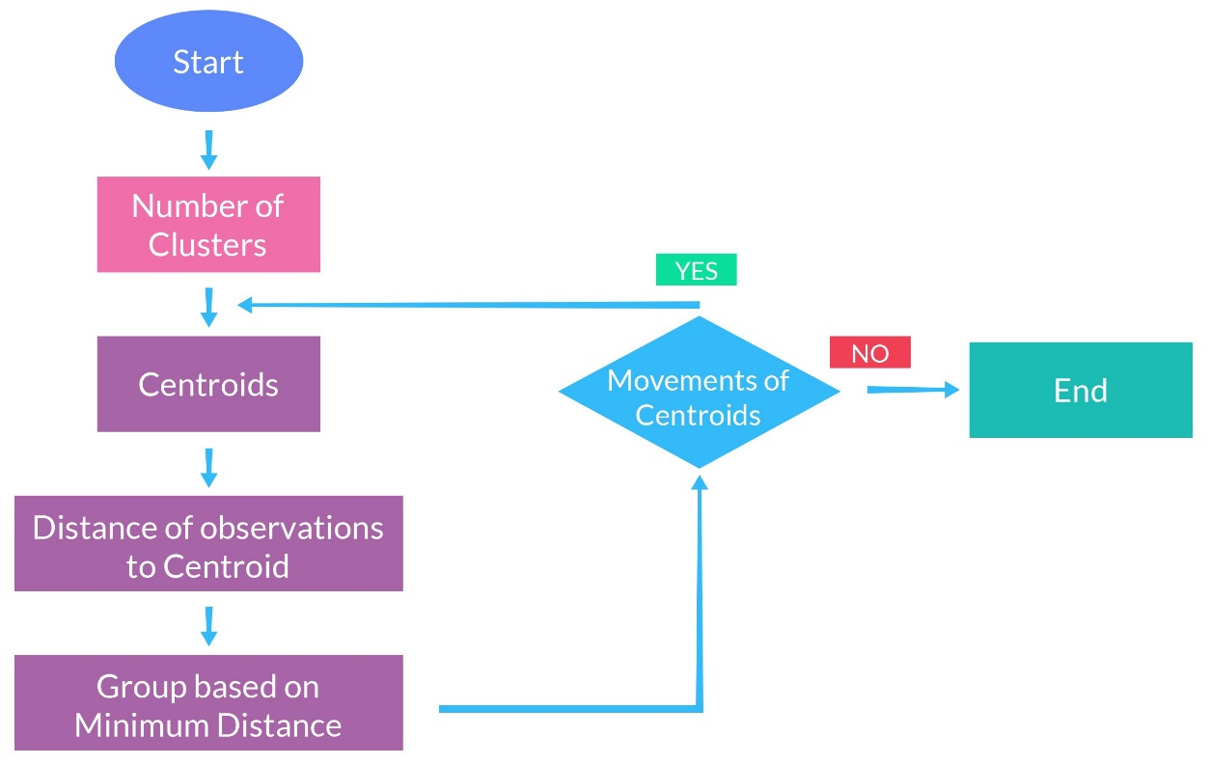
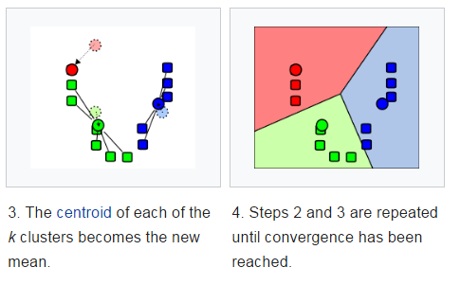
Personal Clustering Methodology - Bootstrapping Clustering
K-Means Clustering Methodology
Source:
https://clevertap.com/blog/how-to-detect-outliers-using-parametric-and-non-parametric-methods-part-ii/
https://en.wikipedia.org/wiki/K-means_clustering

Slide 8
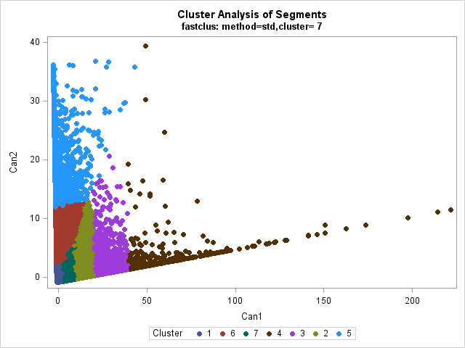
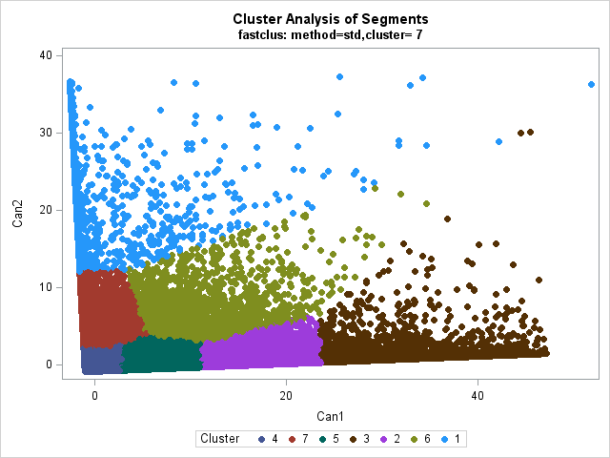
Personal Clustering Methodology - Bootstrapping Clustering
Customers | Average Asset | Average Liability | Iteration | Clusters
1,766 | $ 578,529 | $ 5,123 | 1 | 4
1,327 | $ 4,703 | $ 1,076,385 | 2 | 4
15,193 | $ 207,066 | $ 4,243 | 3 | 1
2,504 | $ 64,878 | $ 232,100 | 4 | 7
6,804 | $ 2,661 | $ 578,036 | 5 | 7
391 | $ 112,173 | $ 111,208 | 6 | 2
27,294 | $ 97,703 | $ 680 | 7 | 1
6,294 | $ 21,106 | $ 143,215 | 8 | 3
68,068 | $ 49,147 | $ 1,457 | 9 | 2
2,627 | $ 16,695 | $ 299,869 | 10 | 6
…
149,554 | $ 3,472 | $ 696 | 25 | 4
9,338 | $ 8 | $ 96,944 | 26 | 7
1,255 | $ 913 | $ 64,147 | 26 | 3
10,491 | $ 25 | $ 78,616 | 26 | 4
149,695 | $ 1,923 | $ 612 | 26 | 6
10,639 | $ 14 | $ 60,252 | 26 | 1
549,239 | $ 122 | $ 1,230 | 26 | 2
232,887 | $ 916 | $ 559 | 26 | 5

Slide 9
MRMG Findings
Findings:
Non standard K-Means clustering method
Judgmental grouping method
One run’s Hierarchical clustering
Outlier removal criteria
Standardization method
6/7. Change K-Means clustering parameters
Number of clusters determination
Lower Mass Market determination
Output stability
…
8
6
7
1
4
5
2
3
9
Results:
“Mode” Method
Original Design
7 Alternative Approaches
10

Slide 10
MRMG Finding Remediation – “Mode” Method
“Mode Method” to find the most appropriate segment for customers.
Customers’ final segmentation are not only determined by one run’s output, but by three sequential runs’ most frequent output:
If any one or more of the output is “New Customer”, then use the most recent result as final segment for the customer;
For the rest of the customers
if the customer have the same segment for two or more runs out of the three total runs, then use the most frequent result as the final segment for the customer
If the customer have three different result from three runs, use the most recent segment
Notes:
For customers whose segment were decided by EJMs, their segments is stable from each run. The mode method is designed to address the limitation for clustering method. Therefore, we use six runs’ results to show the stability of mode method output of clustering. Six runs are with date (MMDD) 0111, 0125, 0210, 0224, 0606 and 0714. We can get 4 versions of mode method final output in Table 1. Also in

Slide 11
MRMG Findings - Judgmental grouping method
Difference Rate: 7.61%

Slide 12
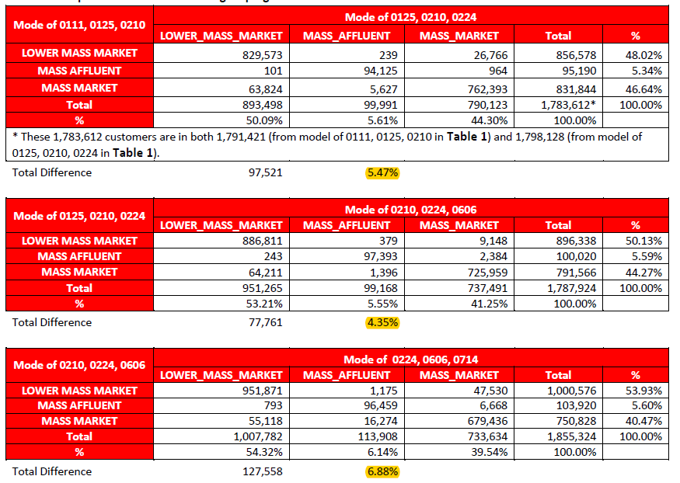
MRMG Finding Remediation – “Mode” Method

Slide 14
Appendix

Slide 15
Appendix – Unknown Distribute
New Segment | Total Number | Percent
LOWER MASS MARKET | 1,036,567 | 47.32%
MASS MARKET | 397,340 | 18.14%
SMALL BUSINESS | 297,455 | 13.58%
MASS AFFLUENT | 215,968 | 9.86%
NEW CUSTOMER - PERSONAL | 109,853 | 5.02%
MIDDLE MARKET | 97,732 | 4.46%
BUSINESS BANKING | 22,747 | 1.04%
NEW CUSTOMER - BUSINESS | 11,559 | 0.53%
LARGE CORPORATE | 592 | 0.03%
GOVERNMENT BANKING | 553 | 0.03%
Total | 2,190,366

Slide 16
Appendix - Output for All Customers
Total Customers : 6.7m
Unknown: 4m -> 2m
Current Unknown (Inactive Customers) includes 1.Non customers (~450k), 2. Customers without Branch ID(~1.9m), 3. Customers without linked accounts (~600k)
Notes:
Improvement:
Correctly segment 30% “UNKNOWN” to right segments
Lower TM models alert volume
Tracking account changes by six hard rules
Maintain segment distribution

Slide 17
Notes:
Add

Slide 18
Appendix – Active Customers Shift
 | Current Segment
New Segment | NEW BUSINESS | NEW PERSONAL | GOVERNMENT BANKING | LARGE CORPORATE | MIDDLE MARKET | BUSINESS BANKING | SMALL BUSINESS | MASS AFFLUENT | MASS MARKET | LOWER MASS MARKET | UNKNOWN | Total | Percent
NEW BUSINESS | 747 | 1,479 | - | - | - | 1 | - | - | - | - | 11,559 | 13,786 | 0.29%
NEW PERSONAL | 2 | 6,212 | - | - | - | - | - | - | 1 | 3 | 109,853 | 116,071 | 2.45%
GOVERNMENT BANKING | - | - | 727 | - | 10 | 6 | 15 | 1 | - | 21 | 553 | 1,333 | 0.03%
LARGE CORPORATE | - | - | - | 621 | 8 | 3 | 12 | - | - | 3 | 592 | 1,239 | 0.03%
MIDDLE MARKET | - | - | 8 | 178 | 5,169 | 7,256 | 793 | 129 | 31 | 6,790 | 97,732 | 118,086 | 2.49%
BUSINESS BANKING | - | - | 1 | 17 | 66 | 9,227 | 602 | 69 | 24 | 646 | 22,747 | 33,399 | 0.70%
SMALL BUSINESS | - | - | 2 | - | 83 | 2,251 | 161,994 | 12,567 | 14,008 | 57,358 | 297,455 | 545,718 | 11.50%
MASS AFFLUENT | - | - | - | - | 15 | 7,682 | 553 | 123,570 | 193,532 | 128,815 | 215,968 | 670,135 | 14.13%
MASS MARKET | - | 8 | - | 1 | 20 | 12,403 | 529 | 42,496 | 334,839 | 290,098 | 397,340 | 1,077,734 | 22.72%
LOWER MASS MARKET | - | 12 | - | - | 17 | 15,009 | 560 | 17,362 | 200,951 | 895,732 | 1,036,567 | 2,166,210 | 45.66%
Total | 749 | 7,711 | 738 | 817 | 5,388 | 53,838 | 165,058 | 196,194 | 743,386 | 1,379,466 | 2,190,366 | 4,743,711 | 100.00%

Slide 19
