Slide 1
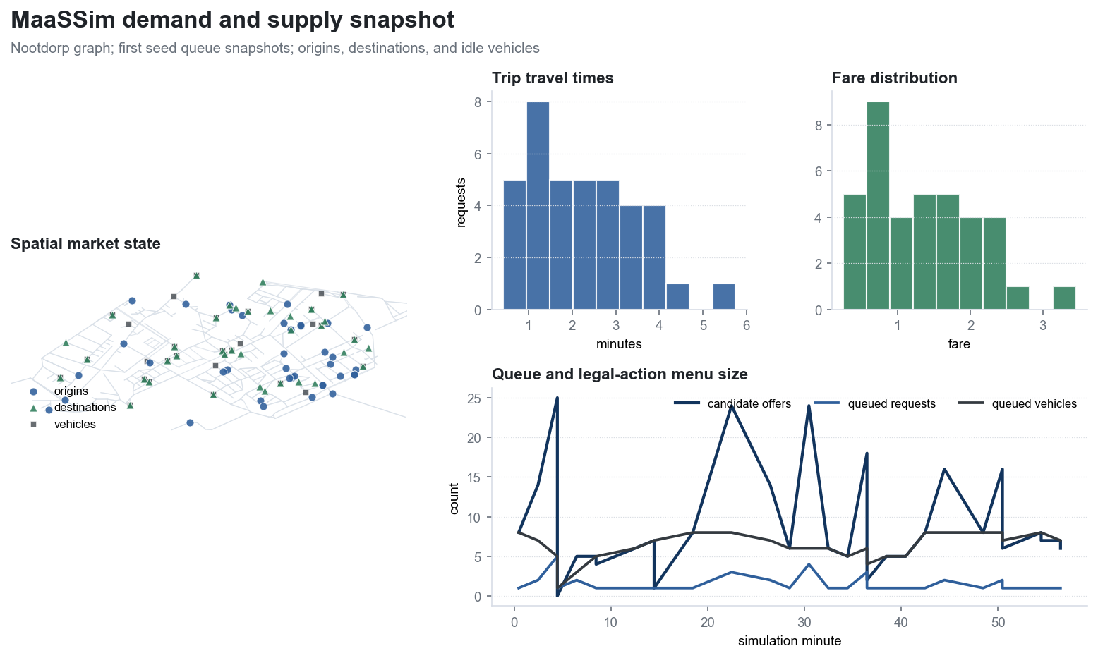
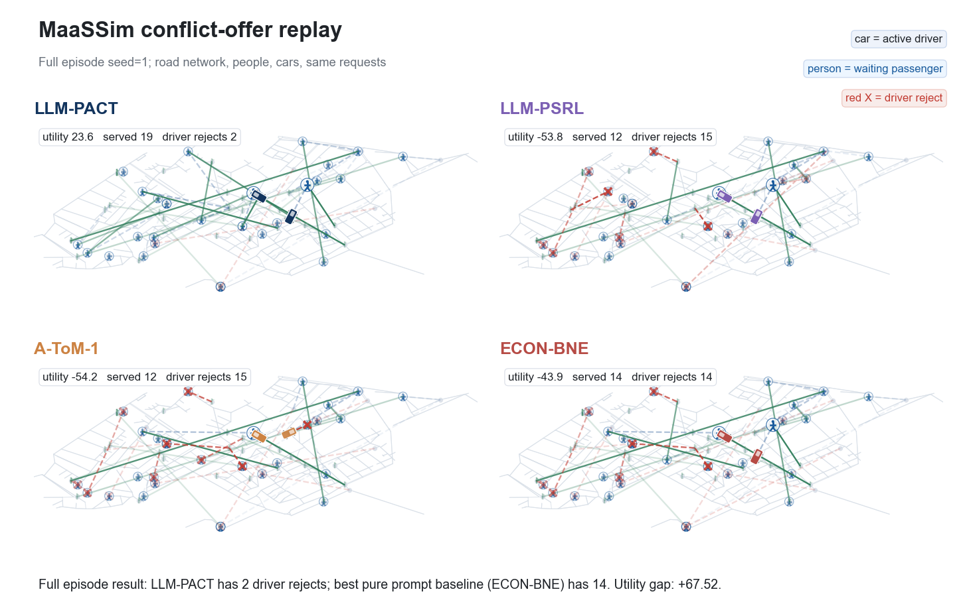
MaaSSim x PACT Dispatch Experiments
实验设计、关键图表与冲突场景动画汇总
Scenarios
Seeds
Snapshots/seed
Main policies
3
5
20
9
MaaSSim replay artifacts · normal / reject-stress / conflict-offer

Slide 2
实验设计：common-state replay + 隐性 persona
所有策略在相同队列 snapshots、相同 persona maps 上评估；差异来自 dispatch / belief / prompt policy。
1. MaaSSim snapshots
2. Persona simulator
固定车辆队列、乘客请求、候选 offer 与等待/行程/价格特征。
司机隐藏规则控制 accept / decline；乘客 persona 控制 rider rejection。
3. Policy layer
4. Metrics
Nearest、Random、LLM-PACT、LLM-belief、LLM-PSRL、A-ToM、ECON-BNE、Oracle。
utility、served rides、driver rejects、passenger wait、cache hit/live-fill 记录。
PACT / MaaSSim experiment package · generated from local artifacts

Slide 3
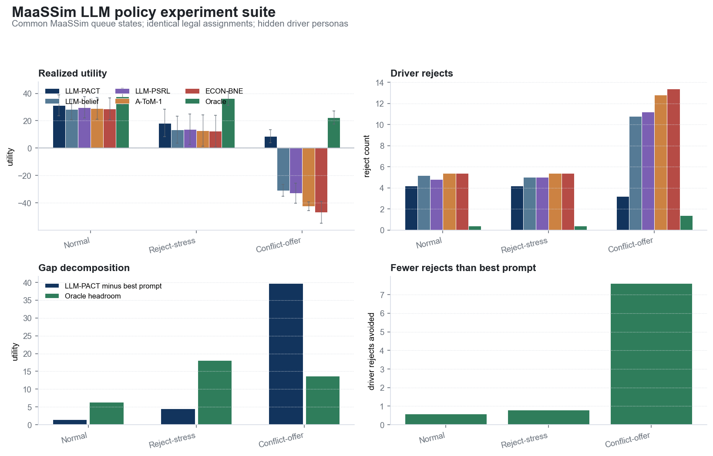
三类 MaaSSim scenario suite
5 seeds × first 20 active snapshots；utility 为 persona-aware dispatch objective。
Scenario | LLM-PACT utility | Best prompt | Prompt utility | Gap | Oracle
Normal | 31.29 ± 7.76 | LLM-PSRL | 29.81 | +1.47 | 37.64
Reject-stress | 18.37 ± 10.12 | LLM-PSRL | 13.77 | +4.60 | 36.44
Conflict-offer | 8.79 ± 4.84 | LLM-belief | -30.90 | +39.69 | 22.44
• Normal: 原始 common-state replay；reject penalty = 2.0。
• Reject-stress: 同一队列，但司机拒单代价提高到 5.0。
• Conflict-offer: 低等待 offer 被设计成 persona-risky，测试是否识别 hidden driver constraints。
PACT / MaaSSim experiment package · generated from local artifacts

Slide 4
主结果：scenario dashboard
LLM-PACT 在 persona-risky 场景下保持更低拒单与更高 utility；Oracle 给出上限。
• Normal: LLM-PACT 31.29，best prompt 29.81，gap +1.47。
• Reject-stress: LLM-PACT 18.37，best prompt 13.77，gap +4.60。
• Conflict-offer: LLM-PACT 8.79，best prompt -30.90，gap +39.69。
• 该组结果是 cache-first/live-fill reconstruction；用于 paired 分析，不替代原始 seed rows。
PACT / MaaSSim experiment package · generated from local artifacts

Slide 5
Demand / supply overview
MaaSSim road-network market snapshot: requests, vehicles, trip-time/fare, legal action menu size.
PACT / MaaSSim experiment package · generated from local artifacts

Slide 6
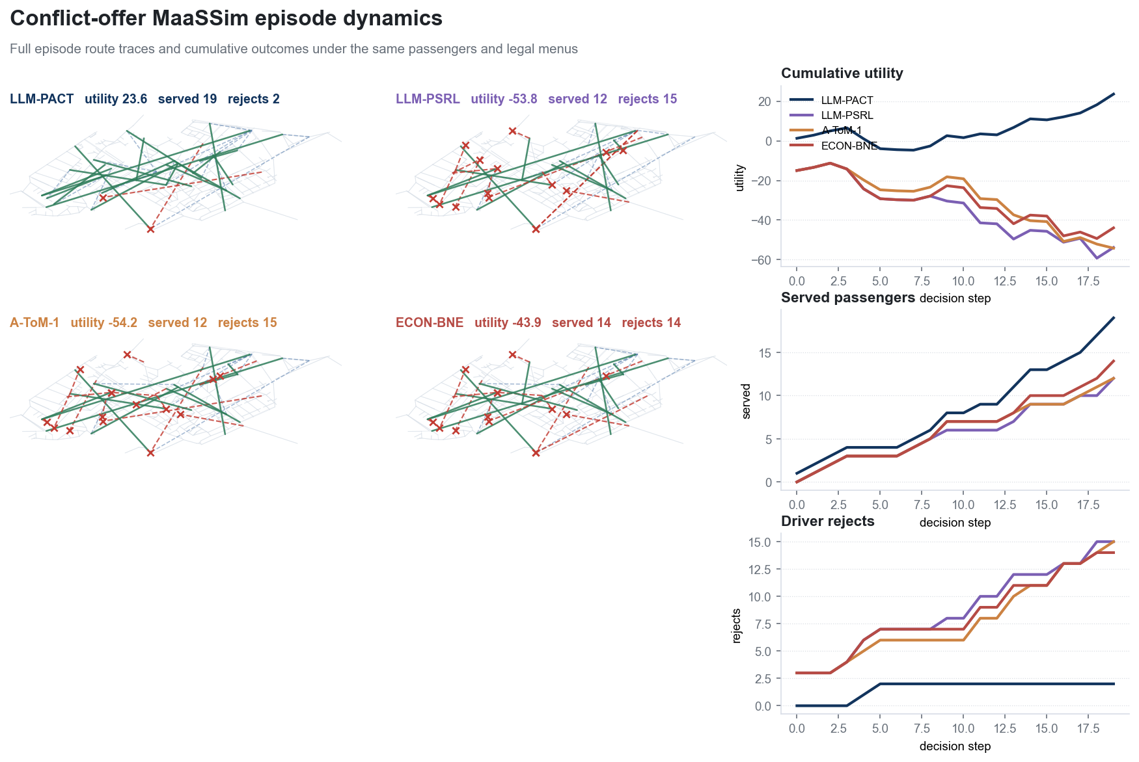
Conflict-offer episode dynamics
低等待 offer 被做成 persona-risky；LLM-PACT 避免看似便宜但高拒单风险的分配。
PACT / MaaSSim experiment package · generated from local artifacts

Slide 7
动画：Conflict people/cars replay
插入 GIF 文件；PowerPoint 播放模式下应显示动画。如果查看器只显示首帧，请直接打开同目录 GIF。
GIF asset: arr_paper/figs/fig_maassim_conflict_people_cars_llm_pact_vs_prompts.gif

Slide 8
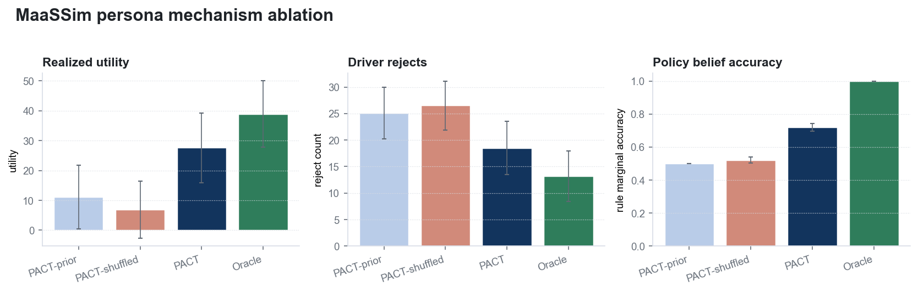
Persona mechanism
分离“学到 driver persona”与“仅 assignment solver 更强”的贡献。
• PACT posterior 连接到真实 driver IDs。
• Shuffled posterior 破坏 driver-persona 对齐。
• Oracle 使用 true hidden persona，上限验证机制。
• 结论：收益来自 persona belief 与 assignment objective 的组合。
PACT / MaaSSim experiment package · generated from local artifacts

Slide 9
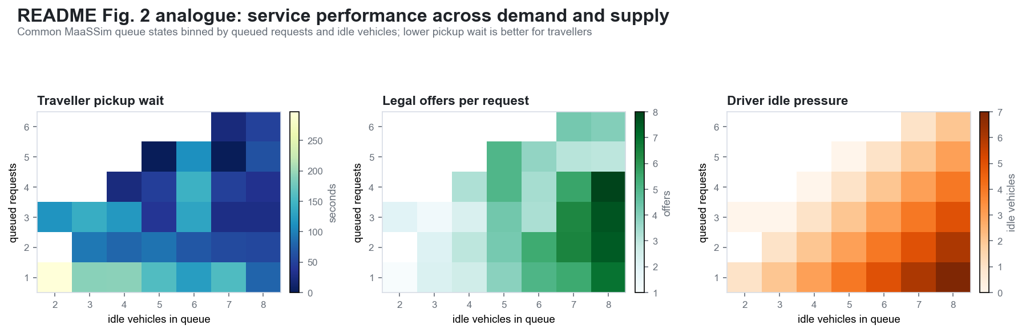
MaaSSim analogue: service surface
队列压力、等待时间、legal offers 与 idle vehicles 的服务面。
PACT / MaaSSim experiment package · generated from local artifacts

Slide 10
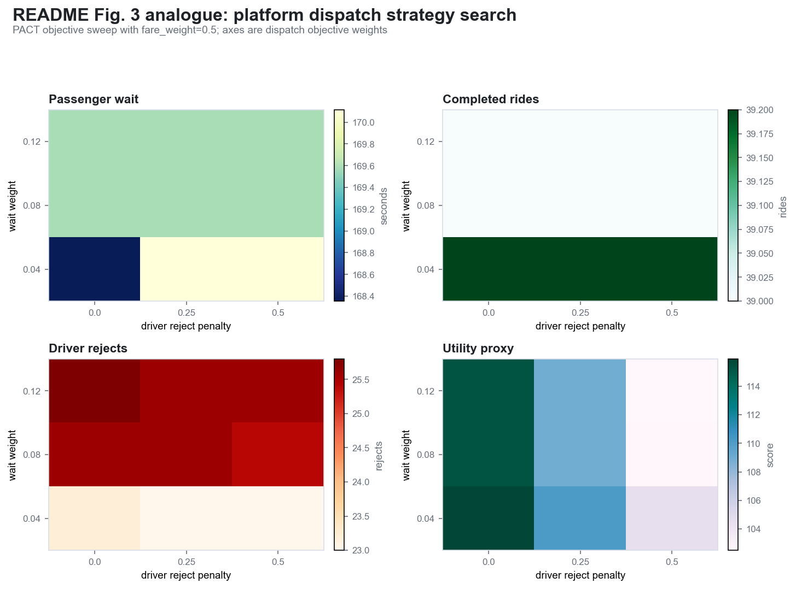
MaaSSim analogue: platform strategy
dispatch objective sweep: wait weight / reject penalty / rides / utility proxy。
PACT / MaaSSim experiment package · generated from local artifacts

Slide 11
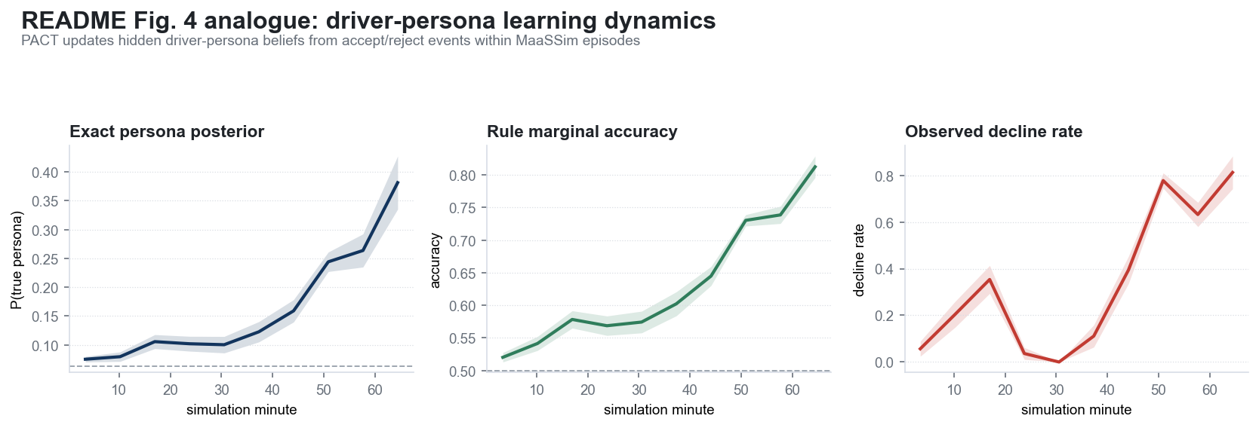
MaaSSim analogue: driver learning
hidden driver-persona posterior、rule accuracy、decline rate 随时间变化。
PACT / MaaSSim experiment package · generated from local artifacts

Slide 12
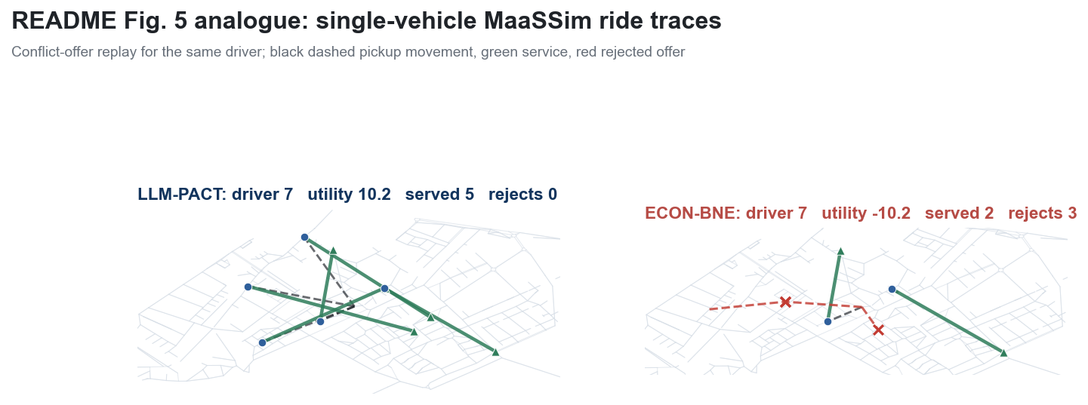
MaaSSim analogue: vehicle trace
单车路径：空驶、载客、拒单事件的 replay trace。
PACT / MaaSSim experiment package · generated from local artifacts

Slide 13
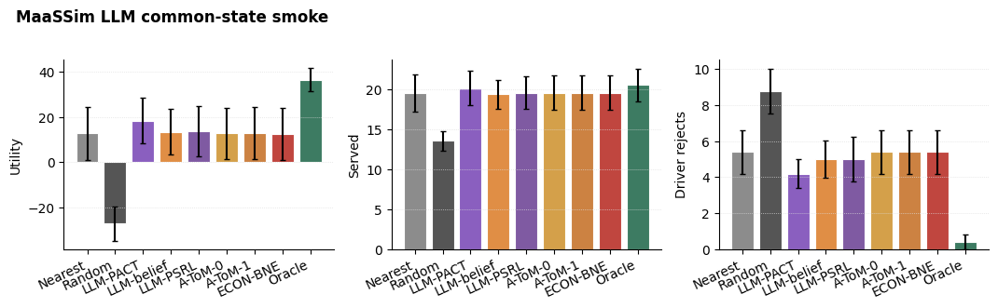
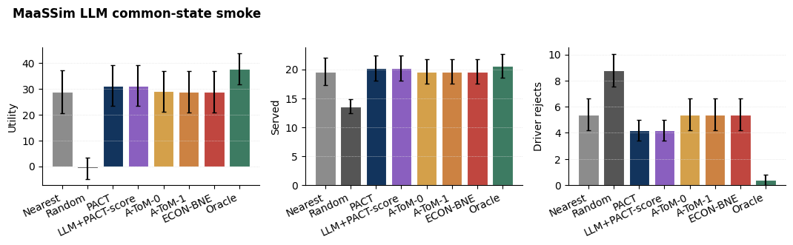
LLM prompt baselines under same legal-action interface
LLM-belief / LLM-PSRL / A-ToM / ECON-BNE 均接入相同 legal assignment menu。
• Stress setup makes hidden driver persona mistakes costly; LLM-PACT separates from pure prompt baselines.
• Core run has high SEM: useful as mechanism diagnostic, not a standalone significance claim.
PACT / MaaSSim experiment package · generated from local artifacts

Slide 14
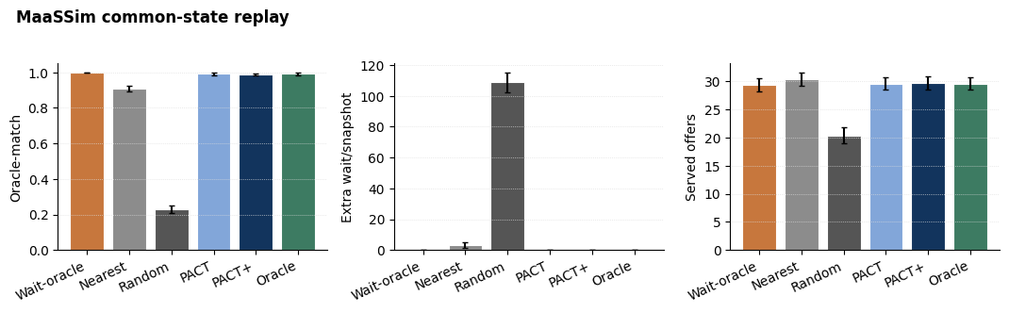
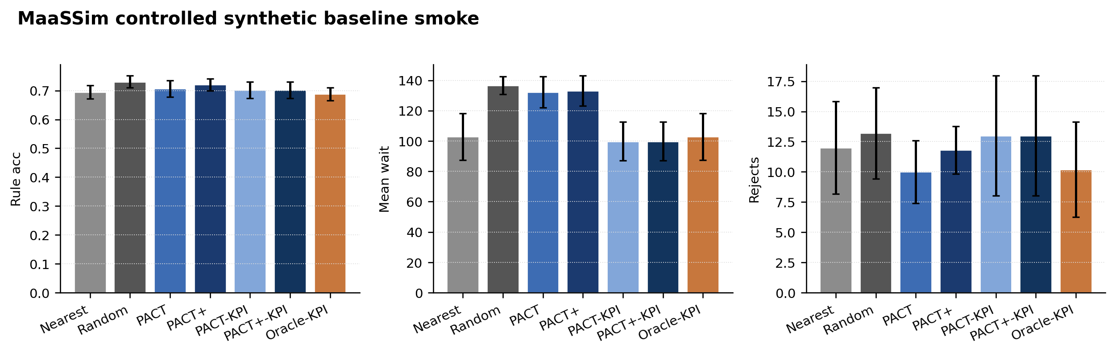
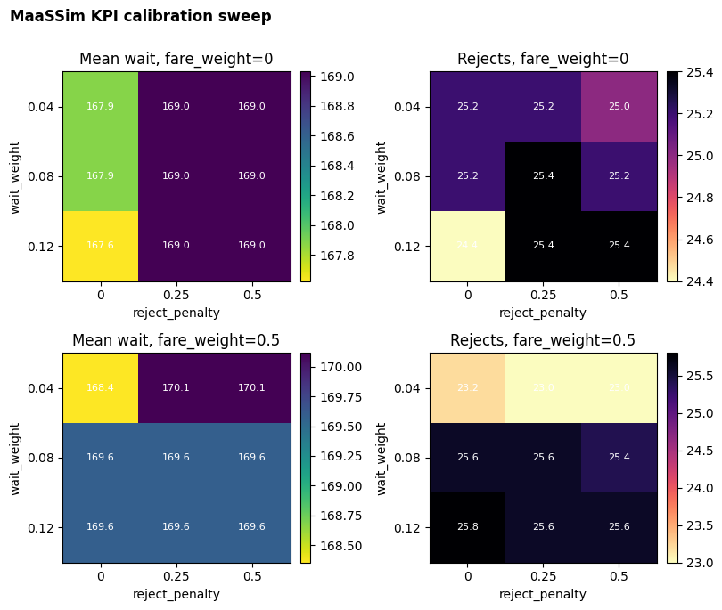
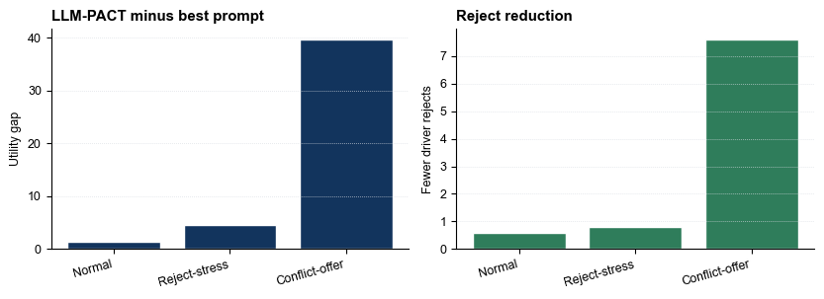
Additional figure gallery
附录图：baseline smoke、KPI calibration、scenario slices。
Common-state replay
Controlled baselines
KPI calibration
LLM scenario suite
PACT / MaaSSim experiment package · generated from local artifacts

Slide 15
Takeaways and caveats
What this MaaSSim package should support in slides/rebuttal.
1. Why MaaSSim
2. What PACT adds
3. Where it helps
Road-network dispatch gives realistic queues, vehicle movements, wait/fare/travel features, and legal assignment menus.
Driver-persona posterior turns hidden accept/reject rules into assignment utility and risk estimates.
Persona-risk stress: fewer driver rejects and larger utility gap over prompt baselines.
Caveat
Deck assets
The scenario-suite per-seed rows are current cache-first/live-fill reconstruction, not byte-for-byte recovery of deleted original rows. Treat as paired-analysis artifact.
All figures come from arr_paper/figs. The conflict animation is embedded as GIF and also kept as a standalone file.
PACT / MaaSSim experiment package · generated from local artifacts

