Slide 1
Testing in Frontend

Slide 2
Agenda
Introduction
Importance of Frontend Testing
Testing Landscape in Frontend
Testing Challenges
Best Practices
Testing Types
Navigating the Toolkit
Demo

Slide 3
Introduction
Frontend testing is crucial for delivering a user-friendly, high-performance, and secure web or mobile application that meets user expectations and industry standards.
This is making frontend testing a must-have step of the workflow for software development teams to focus on, ensuring the quality of your technology throughout its lifecycle.
Frontend testing refers to the checks performed to test the usability and functionality of your application’s GUI. Usually, test cases include the validation of menus, forms, buttons, and other application elements visible to end users.

Slide 4
Importance of Frontend Testing
When you’re developing an application, the most important thing is to ensure the developed application works correctly and is safe for production deployment.
This can be achieved by thinking about the most seamless ways a user can take through your app, optimizing the navigational experience.

Slide 5
Importance of Frontend Testing
Protection Against Regression
There might be cases where you write code that helps you deploy huge or complex features but might in return crash some other part of the application that you weren’t aware of.
Double Checking the Code
It’s rare that you’ll be able to deliver a big project alone. No one can simply know everything about every piece of code written by other programmers. And this is why frontend testing is so important - to double check that code is not inconsistent, and the frontend functionality is intact.

Slide 6
Importance of Frontend Testing
Trust in the Code
The more you can trust your code, the easier and less stressful deployments will be. Additionally, business leaders will undoubtedly be happier knowing that their application is developing at a stable pace, enabling the company to plan and prepare roadmaps easier.
Live Documentation
Another good reason to keep well-maintained tests is that they serve as live documentation. Writing tests requires a proper description of what a specific test (and the component of your application it relates to) does.
Writing tests should also improve readability and decrease coupling in the application.

Slide 7
Testing Landscape in Frontend
Frontend testing is all geared towards performance optimization and enhancing the user experience.
That’s why most of the processing was done on the server side, meaning performance optimization was achieved through the backend. Now, with applications becoming more dynamic, there is a greater need to optimize the frontend code.

Slide 8
Testing Landscape in Frontend
Cross-browser Functionality
Checking both the features and responsiveness of your app on different browsers, platforms and devices
Accessibility
You need to check that everyone can access your application, including those with visual or auditory impairments
End-to-end Checks
They are required for checking and confirming the end-to-end workflow of the application (backend to frontend) by mimicking the real-world actions users are likely to take

Slide 9
Testing Challenges
Frontend testing is essential. However, there are some common challenges you need to be aware of and prepare for when handling it.
Determining the Crucial Elements
Simulating the Real-world Environment
Choosing Testing Tools
Human Factors

Slide 10
Testing Challenges
Determining the Crucial Elements
Frontend testing normally includes testing lots of different user interface (UI) elements. These include formatting, visible text, graphics, and style/layout (CSS) as well as all the functional aspects of the app such as buttons, submit forms, and clickable links.
The process here involves testing how responsive these features are; how quickly do they load, what are the response times to user actions, and are they fast enough at executing user requests?

Slide 11
Testing Challenges
Simulating the Real-world Environment
One of the most common challenges of frontend testing is emulating how your app will work in the real world. Your test environment will always be controlled, so it’s hard to get an objective view of how the app is going to act outside of that controlled environment.
While it’s very difficult to match the user’s exact real-world conditions, your testing team can set up cases that closely reflect them by customizing the environmental factors affecting page performance.

Slide 12
Testing Challenges
Choosing Testing Tools
Frontend testing requires the use of different testing tools and kits, and you need to pick the right one for the task.
The best frontend testing tools though include:
Easy creation and maintenance of test scripts
Performance metrics insights
High-end reporting capabilities
Seamless integration
Automation tools

Slide 13
Testing Challenges
Human Factors
Leading on from the importance of automation, there are “softer” challenges to take into account in the frontend testing process. And these are human factors.
This doesn’t necessarily mean people making errors in testing, although that can happen. Sometimes, developers might be forced to skip tests for a number of different reasons. Customers may need to speed up the release or resources for it aren’t available at the moment.

Slide 14
Best Practices
Frontend testing is vital, but it’s also important that you stick to certain principles to ensure best practice when running the tests, otherwise you may not be able to fully rely on the test results. Here are the best practices in frontend testing:
F.I.R.S.T Principles
Start with the Testing Pyramid
Prioritize Frontend Elements
Use Real Browsers and Devices

Slide 15
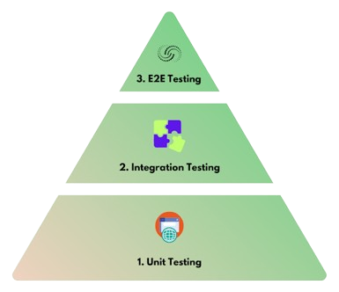
Best Practices
F.I.R.S.T Principles
To ensure that you stick to the best practices of frontend testing, you need a framework to follow. Luckily, you can use the F.I.R.S.T. principles for it and it stands for:
Fast, Isolated, Repeatable, Self-validating, Thorough
Start with the Testing Pyramid
The testing pyramid is sometimes referred to as the “test automation pyramid”. It sets out the test types that you should include in automated testing and outlines what sequences and frequency these tests should follow. The aim is to provide immediate feedback, ensuring that code changes do not disrupt existing features.

Slide 16
Best Practices
Prioritize Frontend Elements
As we mentioned earlier, frontend testing means analyzing and verifying hundreds or thousands of UI and functional elements. UI elements include things like formatting, CSS, text, graphics, while functional elements include forms, links, buttons, and so on.
You need to prioritize which of these are tested first to ensure an effective testing process. It’s sensible to test page load speed, basic text, images, and essential functions (e.g., adding items to a shopping cart, payment tools) first, and before moving on to graphics and pop-ups. Check that each of these elements are visible and responsive, and then move on to verifying graphics and layout.
Use Real Browsers and Devices
Using real browsers and devices is an essential aspect of conducting error-free, reliable frontend tests which reflect the real-world environment as much as possible. Avoid using emulators and simulators and save time and resources by using real browsers and devices - this way, you will be able to rely on your software testing results much more.

Slide 17
Testing Types
Since there are different elements to test for the frontend, there are a few different types of tests you can consider running. Each of these focuses on a different component of your frontend and together will ensure successful frontend testing for your application.

Slide 18
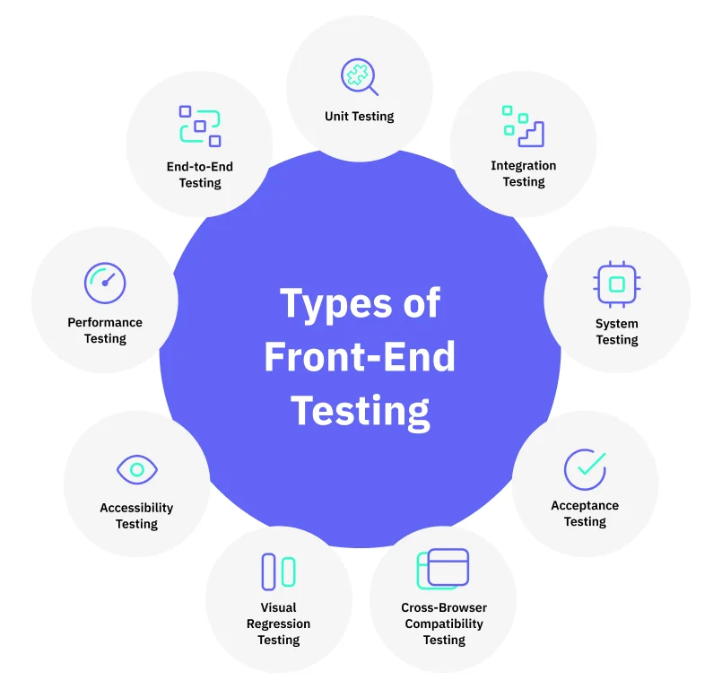
Testing Types

Slide 19
Navigating the Toolkit
There are hundreds - if not thousands - of different vendors out there supplying frontend testing tools, and it can be difficult to decide which one to choose. There is a list of some of the best and most common frontend testing tools for your needs.
Jest
Framework with a focus on simplicity. By ensuring your tests have a unique global state, Jest can reliably run tests in parallel. To make things quick, Jest runs previously failed tests first and re-organizes runs based on how long test files take. It also offers powerful code coverage and easy mocking tools.
MochaJS
It operates on Node.js and provides front-end and back-end asynchronous testing compatibility. Mocha has proven to be a well-established framework over the past few years with firm documentation support.
Hosted on Github, Mocha is recognized for its flexibility, and as a result, it has proven to be one of the most dependent libraries among JavaScript developers.

Slide 20
Navigating the Toolkit
Jasmine
Highly beneficial for front-end testing. It includes both visibility testing and the responsiveness testing of UI across various devices with different resolutions. One can also automate user behavior with custom delay and wait time for simulating the actual user behavior.
Karma
Open-source productive testing environment. It allows a QA to perform tests for an application in different environments. Karma allows the application script to be executed on real browsers and devices like phones and tablets. Karma aims to provide a testing environment for developers wherein they don’t need to set up loads of configurations. Instead, they can just run the tests and get instant feedback.
Cypress
End-to-end testing framework built on top of Mocha making asynchronous testing simple and convenient. Unit tests in Cypress are executed without even having to run a web server making it the ideal tool for testing a JS/TS library that is meant to be used in the browser.

Slide 21
Navigating the Toolkit
Selenium
Open-source automation testing suite that is widely used for the automation testing of web applications. It automates browsers and interacts with UI elements to replicate user actions to test whether a web application is functioning as expected. Selenium framework allows the tester to write test scripts in different languages such as Java, Javascript, Ruby, Perl, C#, NodeJS, Python, and PHP, offering flexibility.
Enzyme
A JavaScript testing utility for React that simplifies testing React components by providing shallow rendering and assertions.
More Testing Libraries and Frameworks for Frontend

Slide 22
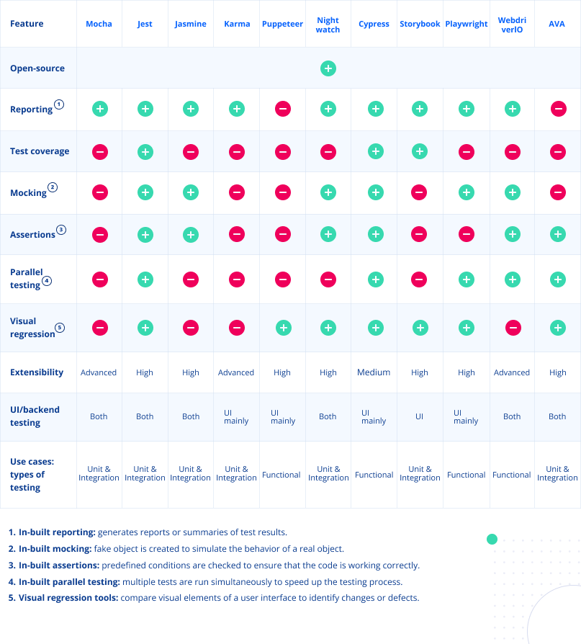
Navigating the Toolkit

Slide 23
Testing Demo
Link to repo

