Slide 1
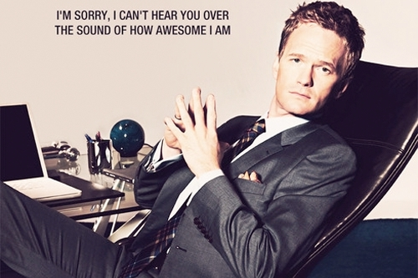
Writing awesome Java Code
Producing and maintaining readable Java that simply rocks.
Steven Schwenke + Falk Sippach

Slide 2
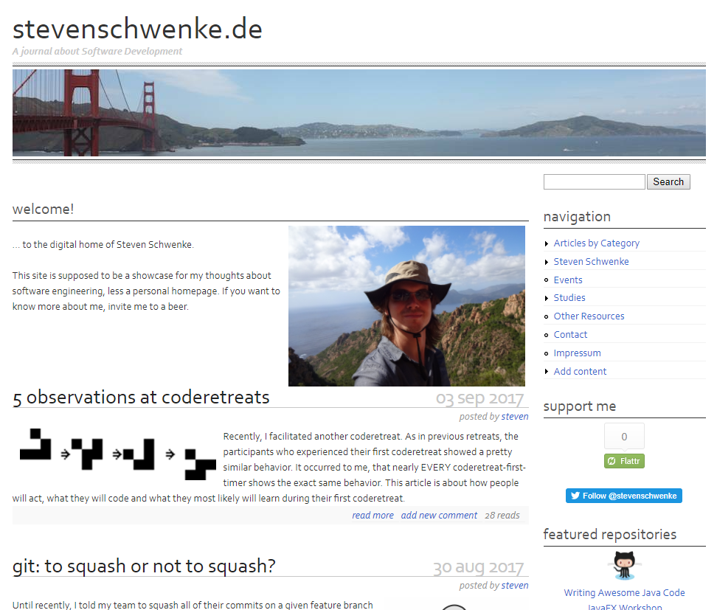
Who is this?

Slide 3

Who are you?
Name?
Erfahrung?
Java 8?
Awesome?

Slide 4
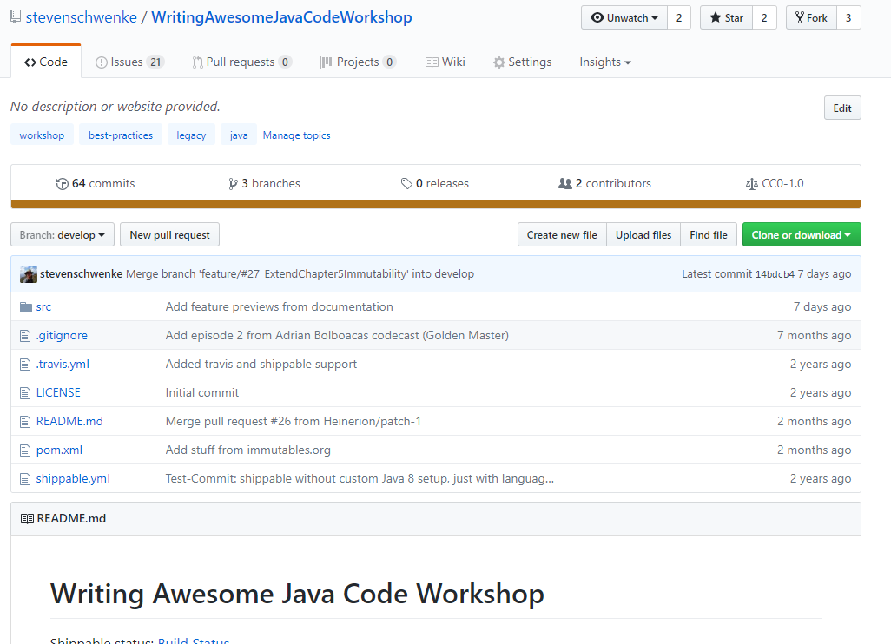
Didn‘t listen. Where can I read up on this?
Github: stevenschwenke/mikadokata

Slide 5
Mikado Method

Slide 6
Mikado Method

Slide 7
Mikado Method

Slide 8
Mikado Method

Slide 9
Mikado Method

Slide 10
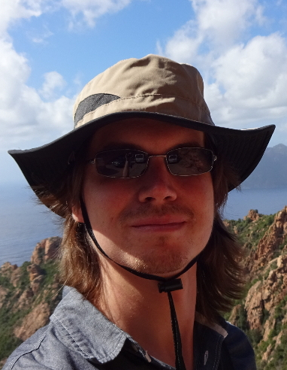
Steven Schwenke
Developer
+49 (0) 151 / 17437348
steven.schwenke@msg-david.de
msg DAVID GmbH
Wendenring 1
38114 Braunschweig
www.msg-david.de
Thanks!
Be awesome!

