Slide 1
Monitoring Java Applications with JAMon
Steve Souza
Oct 9th, 2006

Slide 2

What is JAMon?
“The Java Application Monitor (JAMon) is a free, open source, easy to use, high performance, thread safe, Java API that allows developers to easily monitor applications in development, test and production.”
Open Source - http://www.jamonapi.com
Performance Monitoring Originally Developed for GSA
Easy to Use
  Simply import, and put JAMon jar file in classpath
  SQL/JDBC Monitoring – No Code Changes Required!
  Servlet Filter – No Code Changes Required!
  Interface/Exception Monitoring – One line of Code per Interface
  Can Call Explicitly
High Performance
Thread Safe
More than Performance Monitoring - Other Uses
Notes:
Open source 600 downloads a month, sourceforge, documentation, download
Easy to use – make jar available, import, and call methods below, or use no code solutions to monitor sql calls, and jdbc
High performance – my laptop start/stop called 550,000 times a second. Is part of code so moves from dev/test/prod. Add is called 1,500,000 a second on my laptop
Thread safe – Good for use in multithreaded servers and web applications.

Slide 3
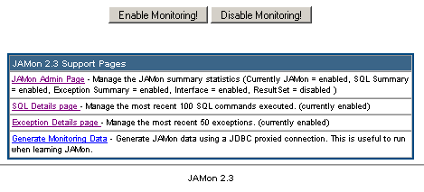
Today We Will Discuss
Ways to use JAMon – SQL/Web App/Interface monitoring
The JAMon Web Application Viewer – JAMon.war
Other Uses – MDA, Logs
Future Enhancements
Notes:
Jdbc driver, and servlet filter no code changes
MDA are sybase ASE performance tables, and jamon can be used to get performance numbers for all ASE queries. Can use jamon with log4j or parsing/aggregating logs in general
Discuss jamon war jsp’s and runtime enabling/disabling

Slide 4


JAMon Intro – The Basics
Aggregate statistics
Currently running/active
Display Statistics via JAMon Web Application
Notes:
Like an aggregate stopwatch. Simple approach with start/stop
Everytime the string is passed stats are gathered in that row
Strings allow for dynamic monitors based on runtime data
Flexibility of strings is demonstrated with one string in report representing a page hit by user, another a sql query and another a method call
Go over report from the jamonadmin.jsp file from jamon.war. Discuss each column and mention it is sortable and real time

Slide 5

SQL/JDBC Monitoring
JAMon Proxy JDBC Driver
  Works with All JDBC Drivers – ASE/Oracle/SQL Server/MySQL/…
  Monitors ALL SQL issued – select * from table where key=‘souza’
  SQL Details - N Most Recent Queries issued
  Exception Details - N Most Recent Exceptions issued
  Monitors JDBC Method Calls
  No Code Changes Required!
JDBC Syntax Without JAMon:
JDBC Syntax With JAMon:

Slide 6
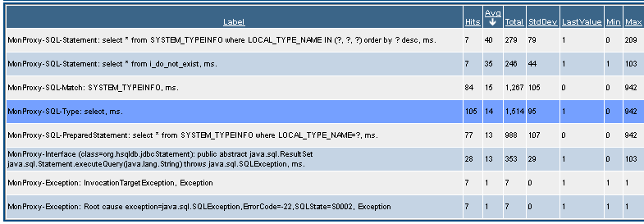
SQL/JDBC Monitoring - JAMon Web App
JAMon Summary Page
  SQL Stats – Replace Values with ‘?’
  All/Update/Select/Insert/Delete/Matches
  JDBC Method Calls – Connections, Statements, ResultSets
  Exceptions
Notes:
Query’s have values replaced with ‘?’. Much like preparedStatements. i.e. select * from table where name=‘souza’ becomes select * from table where name=?
Has totals for all sql, and first keyword such as select. Can also match say table name in query
JDBC method calls can be tracked.
All of these capabilities can be enabled/disabled at runtime separately
Exception monitoring

Slide 7
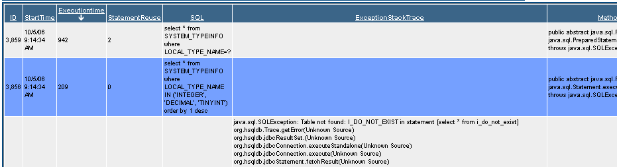
SQL/JDBC Monitoring - JAMon Web App
N Most Recent Queries Page
Notes:
A page in jamon.war that shows the most recent N (configurable) queries that have been run. Stats such as what number is the query since the app server has been running, query start time, query execution time, whether preparedstatement has been reused, the sql, exception stack trace if it occurred, and what method executed the query

Slide 8
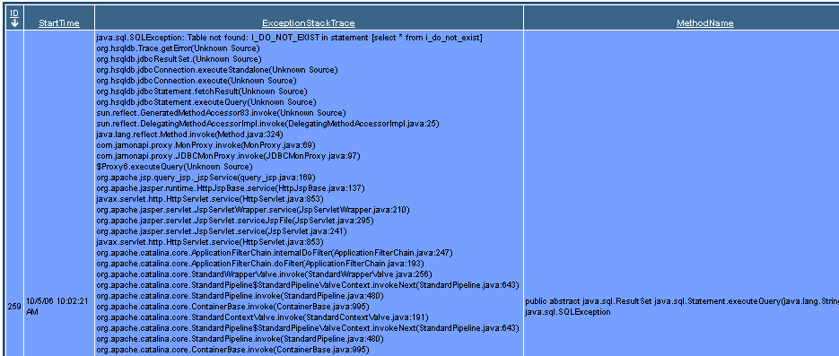
SQL/JDBC Monitoring - JAMon Web App
N Most Recent Exceptions Page
Notes:
Configurable n most recent exceptions and stack trace in exceptins.jsp page in war

Slide 9
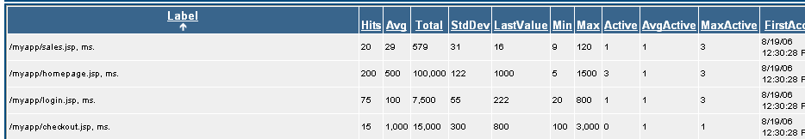
Servlet/JSP Monitoring
JAMon Servlet Filter
  No Code Changes
  Simply Change web.xml
Notes:
Jamon servlet filter tracks page hits of file resources in a war such as servlet, jsp, html, jpg etc.

Slide 10

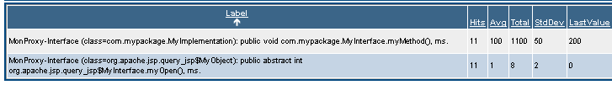
Interface/Exception Monitoring
Monitor ANY Java Interface!
  Method Calls
  Exceptions

Slide 11

The New Add Method - Examples
Example 1 – Tracking Sales
Example 2 – Exception Base Class
Notes:
Used for more than performance.

Slide 12
The New Add Method – MDA Example
Example 3 – Making Strings More Generic – MDA
Select * from employees where lname = ‘Jones’ and salary>50000
Select * from employees where lname = ‘Smith’ and salary>50000
Select * from employees where lname = ‘Souza’ and salary>50000
Select * from employees where lname = ? and salary>?
Notes:
Show usage in mda to get query performance aggregation much like jamon jdbc driver. Pass sql through jamon and aggregate it. The sybase mda tables have the sql and execution time. This data can be persisted.

Slide 13
Logging and JAMon
log4j Appenders
  File
  JDBC
  List
  JAMon
  SMTP
  Write your own
log4j PatternLayouts using JAMon Appender
  %p %c
    ERROR com.mypackage.MyClass
  %p %c - %j
    ERROR org.foo.Bar - Invalid login for user=?
Can pass any log through JAMon for summary information - ASE
log.error()
log.debug()
File
SMTP (Error)
JAMon
Notes:
Log4j jamon appenders will either be in 2.3 release or I will see if I can get them to be a part of log4j
Can parse any log through jamon parser and aggrgate a log. An example would be an ASE log.

Slide 14
Final Thoughts
Use in Sybase products – IQ (Caching), ASE (MDA), OpenSwitch,…
Next Release - Master/Details, log4j
Language Independent JAMon
Persistence
Spring Framework
Notes:
Suggest potential uses in many sybase products. Due to the fact that jamon could be implemented in many languages any vendor that has a server product could benefit by adding jamon like code

Slide 15

Questions?
http://www.jamonapi.com
Notes:
Writing local files
Space
Fail over
Alternatives
Database
Generate
Properties
Maintain in database

