Slide 1

JAMon (Java Application Monitor)
http://www.jamonapi.com
Steve Souza
Notes:
- don’t repeat!
- Relax, don’t hurry, use simple sentences.

Slide 2
Performance Tuning Overview
Performance problems occur in a small portion of code
  4% of application code accounts for more than 50% of the execution time. - Donald Knuth
  20% of application code accounts for 80% of the execution time - Barry Boehm
Developers, using guesswork, are notoriously bad at deciding what code to optimize
Measuring performance statistics helps developers find that 4% of code to optimize
  “…premature optimization is the root of all evil.” – Donald Knuth
Notes:
When creating the monitor, I “knew” a certain change would improve performance, so I took a couple hours to make the change and it slowed the system down.
Used JAMon to speed up jamon by a factor of 6.

Slide 3
Monitoring Web Applications
In Web applications it is particularly important to monitor code, due to
  An unpredictable load and number of users
  Many possible bottlenecks: Is the performance problem in servlets, JSPs, EJBs, the web server, the database, the network…?
By building monitoring into an application from the start, developers can spend time solving performance problems not diagnosing them!
“Steve, thank you for the work you did on developing this code (JAMon). We have used it and it has saved our fragile EP butts in discussions with the customer on performance. “ - Jim Graham (Sybase Practice Manager - Federal ProServe Intel)

Slide 4

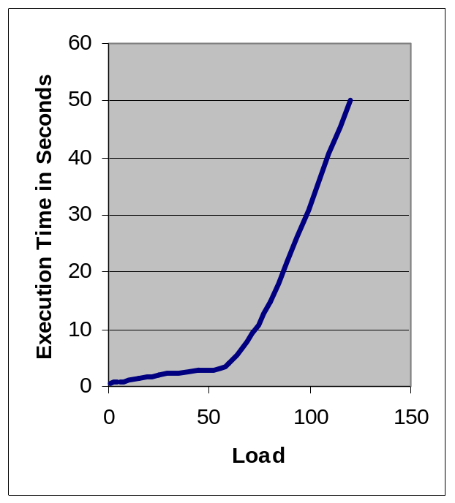
Enter JAMon
JAMon - Java Application Monitor
  Monitors performance
  Monitors scalability - performance under load
  Monitors production applications
  Monitors user/application interactions
Notes:
Just read

Slide 5

Advantages of JAMon
Simple API
Easy to Administer
Flexible
Fast
Open Source – http://www.jamonapi.com
Notes:
SIMPLE API
- works like a stopwatch.
- 3 methods – start, stop, getReport
EASY TO ADMINISTER
- no special software install (1 JAR), no special accounts, no training, html report viewable by all developers, logs have individual data points I.e. no aggregation
FLEXIBLE – String makes it very flexible. Can monitor any concept. Pages, users, methods,…
FAST
- On a 2 ghz Pentium IV notebook, JAMon's start(), and stop() methods can be executed 500,000 times per second. After disabling, the methods can be called 30,000,000 times per second.
- monitor production apps
Open Source – 20,000 page hits, 3000 downloads. GSA Advantage

Slide 6

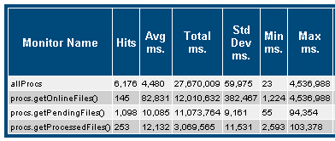
Finding Performance Bottlenecks
Three out of 25 stored procs accounted for 95% of application execution time.
Notes:
Discuss first line, then code, then Sortable html report , then stats gathered. We used this information to target our tuning efforts and tune these procs. We used this information to improve performance of these stored procs by a factor of 4. ubstantially faster than the client server version of cors. More data than this
More than page hits, stored procs, label appears in report
Hits, average time, total time, standard deviation, min and max times
Actual data from cors. Explain statistics via pageHits. We have used this information to increase the speed of the onfilefiles proc by a factor of 20.

Slide 7
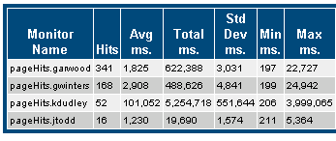
Identifying Power Users
Before using JAMon we didn’t know who our Power Users were
Notes:
Would have been nice to know during development.

Slide 8
JAMon - References
“By using JAMon, the EDS developers are now able to pinpoint where application problems are, and finger pointing no longer exists.” - Paul Morgenthau (Sybase Senior Consultant - Federal ProServe DOD)
“In our desperate search for a performance tool that would be effective in our environment, Steve Souza stepped forward with a solution.” - William Purcell (Sybase Client - EDS director for USG500/JPAS project)
“There is another way to monitor your application called JAMon API. It is easier to use, and real-time.” - Posting from a BroadVision newsgroup

Slide 9
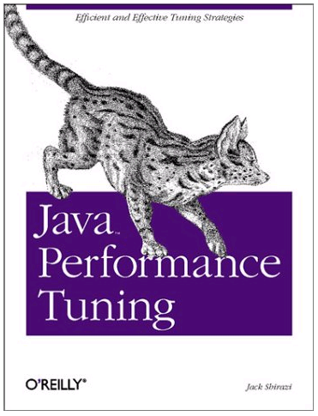
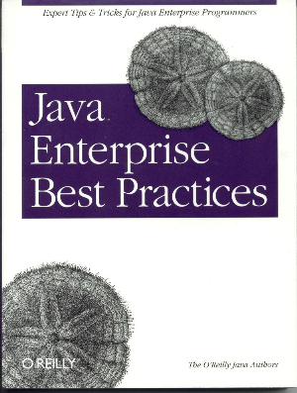
JAMon - Industry Notice
O’Reilly Java books reference JAMon
“The (JAMon) users guide was perfectly clear. The tool is after all straightforward, as all good tools should be.” - Jack Shirazi - Author of ‘Java Performance Tuning’ by O’Reilly Press

Slide 10
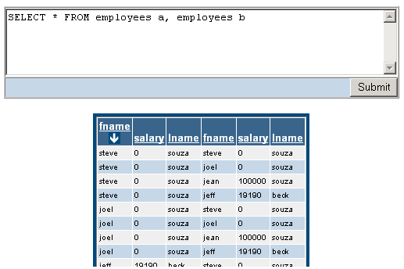
JAMon Demo
FormattedDataSet Demo – http://www.fdsapi.com
JAMonAdmin Page
Activity - Measuring Concurrency
Scalability – Combining Performance and Activity

Slide 11
Questions?
http://www.jamonapi.com
http://www.fdsapi.com
Steve Souza
Principal Consultant

