Slide 1
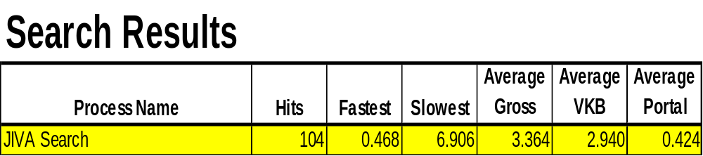
Political Infighting
Why are the searches so slow?
JIVA blames VKB, DI blames Portal
Solution: Identify the bottlenecks so that they can be addressed and eliminated.
JaMon to the rescue.
VKB was the bottleneck!

