Slide 1
PLOTLY
Data visualisation with python

Slide 2


IN THIS COURSE
Data visualisation with python
Notes:
We’ll be using the official web catalogues to

Slide 3
IN THIS COURSE
SESSION 1
Introduction to Visuals With Plotly:
1.Quick Dataframe Recap
2. How to create a chart in Plotly
3. How to export to HTML
SESSION 2
Understand and Edit Existing Plots:
1.Use web to understand functions
2. Tweak the code
3. Comment and take home
Data visualisation with python
Notes:
You are free to take these away for your own purposes

Slide 4



INCLUDED IN YOUR PACK
Data visualisation with python
Notes:
Should have 2 Notebooks and HTML examples

Slide 5

WHY PLOTLY
EXTRACT
TRANSFORM
LOAD
POWER BI
.xslx
POWER QUERY
SQL
Data visualisation with python
Notes:
Towards the end of the data journey

Slide 6
WHY PLOTLY
- NO POWER BI
- HIGHLY CONFIGURABLE
- DYNAMIC VALIDATION
- SLICK HTML FILE
Data visualisation with python
Notes:
Should have 2 Notebooks and HTML examples

Slide 7
WHY NOT PLOTLY
- NO TABS
- REQUIRES CODE
- THAT’S IT
- NO DATA EXPORT
Data visualisation with python
Notes:
Should have 2 Notebooks and HTML examples

Slide 8
PYTHON EXERCISE
Download the Plotly Zip and we will open Intro_to_Plotly_Questions in Prompt
Data visualisation with python

Slide 9


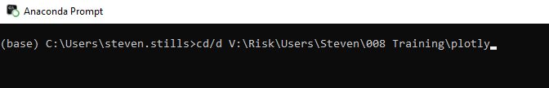
PYTHON EXERCISE
Unzip your download and save it somewhere handy
Navigate to your unzipped folder and copy the location
Open Anaconda Prompt
Type “cd/d “ the paste your location and press enter
Type “Jupyter Notebook” and press enter
Data visualisation with python

Slide 10

PYTHON EXERCISE
Open “Intro to Plotly Questions.ipynb”
Data visualisation with python

Slide 11
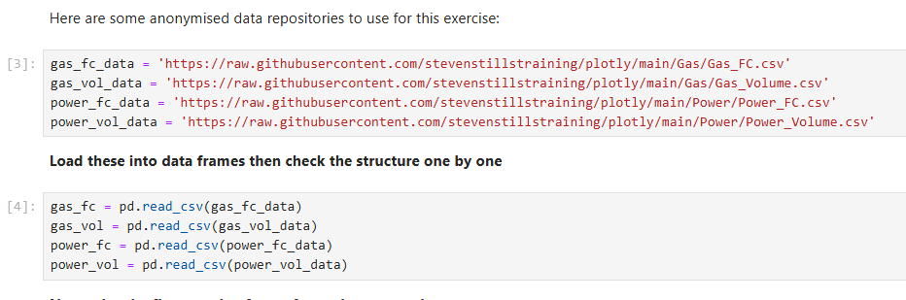
1. PREPARE YOUR DATA
Load the data Frames as show in box 4 below
Data visualisation with python

Slide 12
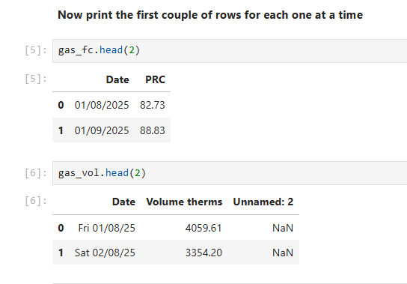
1. PREPARE YOUR DATA
Use the Syntax DATAFRAME.head(2) to control the number of rows loaded
Data visualisation with python

Slide 13
1. PREPARE YOUR DATA
Use the Syntax DATAFRAME.head(2) to control the number of rows loaded
Data visualisation with python

Slide 14
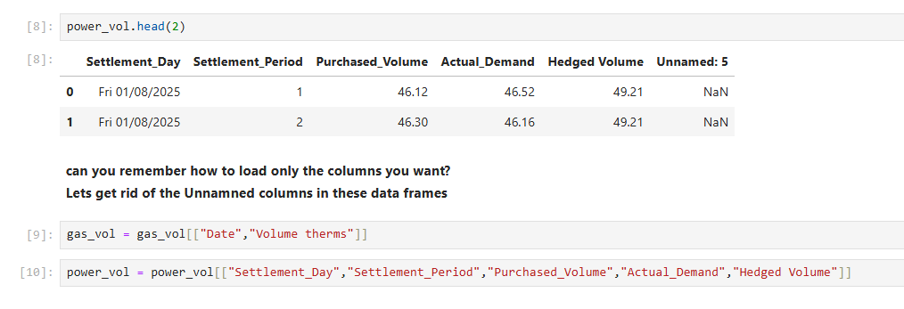
1. PREPARE YOUR DATA
Here is the correct syntax to remove unnecessary columns
Data visualisation with python

Slide 15
2: VISUALISE DATA
Here is the correct syntax to remove unnecessary columns
Data visualisation with python

Slide 16
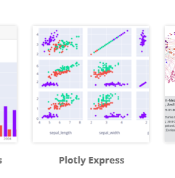
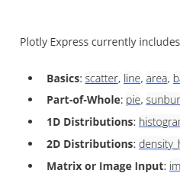
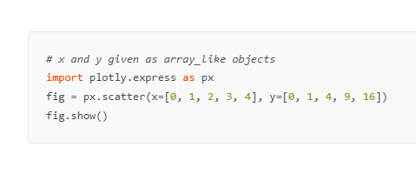
2: VISUALISE DATA
Navigate to: https://plotly.com/python/ and click these to get to the base scatter graph code
1.
2.
3.
Data visualisation with python

Slide 17
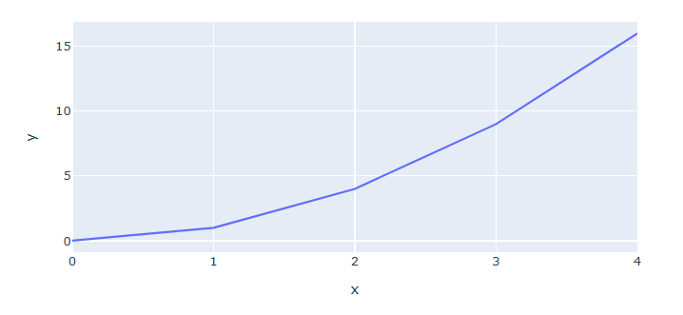
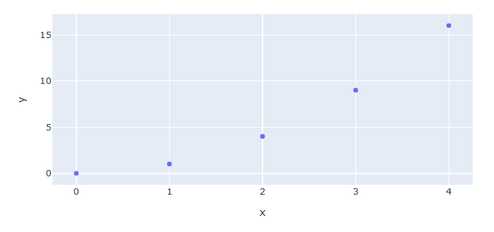
2: VISUALISE DATA
1.Replace Scatter with Line for Better Time Series Visual
Data visualisation with python

Slide 18
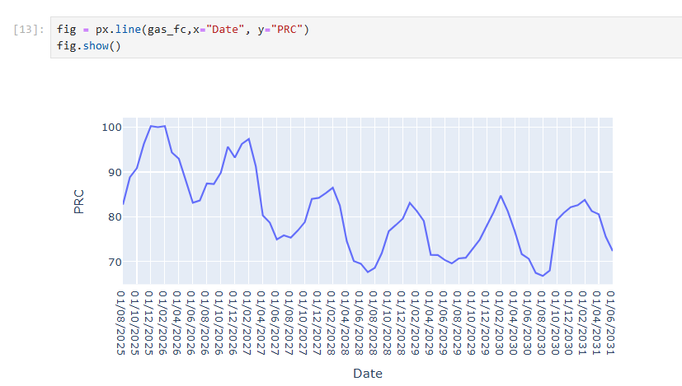
2: VISUALISE DATA
Change the Plotly Web Code to load Gas FC DataFrame
Data visualisation with python

Slide 19
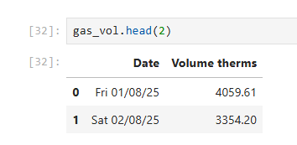
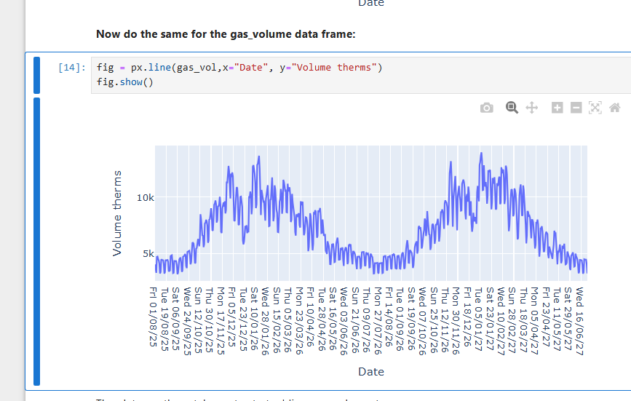
2: VISUALISE DATA
Do the Same for Gas_Vol Data. Remember we are getting these column names from the data frames in step 1.
Data visualisation with python

Slide 20
2: VISUALISE DATA
Do the Same for Gas_Vol Data. Remember we are getting these column names from the data frames in step 1.
Data visualisation with python

Slide 21
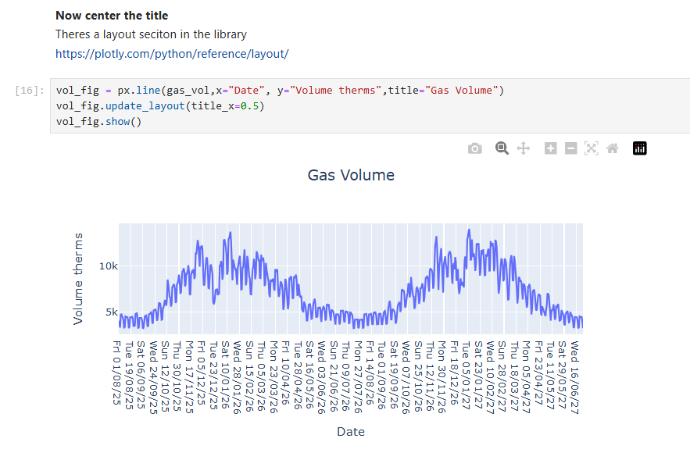
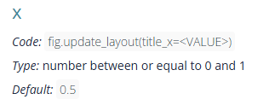
2: VISUALISE DATA
Add and Centre a title:
https://plotly.com/python/line-charts/
https://plotly.com/python/reference/layout/
Data visualisation with python

Slide 22

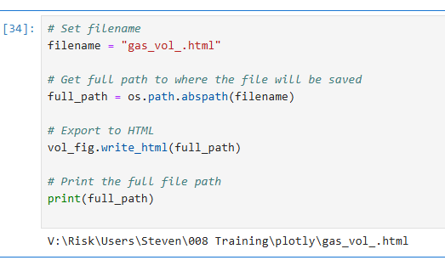

3: EXPORT DATA
Use OS data catalogue for best practices
Basic Export
https://docs.python.org/3/library/os.path.html
Data visualisation with python

