Slide 1
The Game of Set
Solving the general Case Efficiently

Slide 2
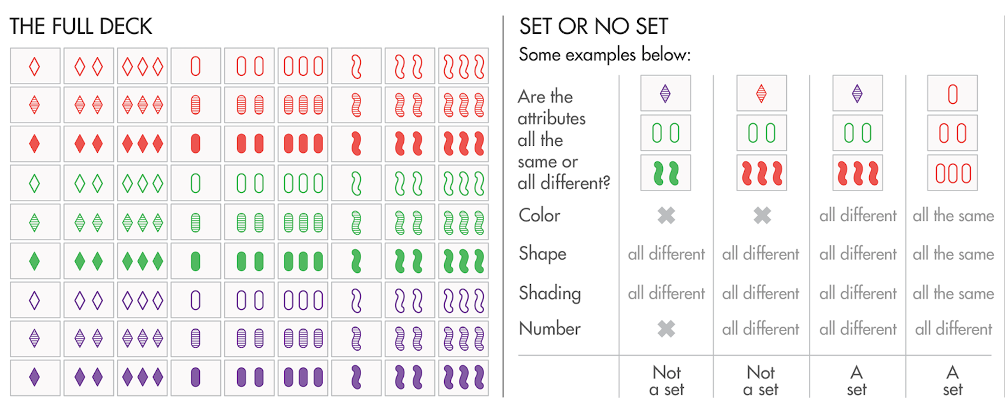
The Problem

Slide 3
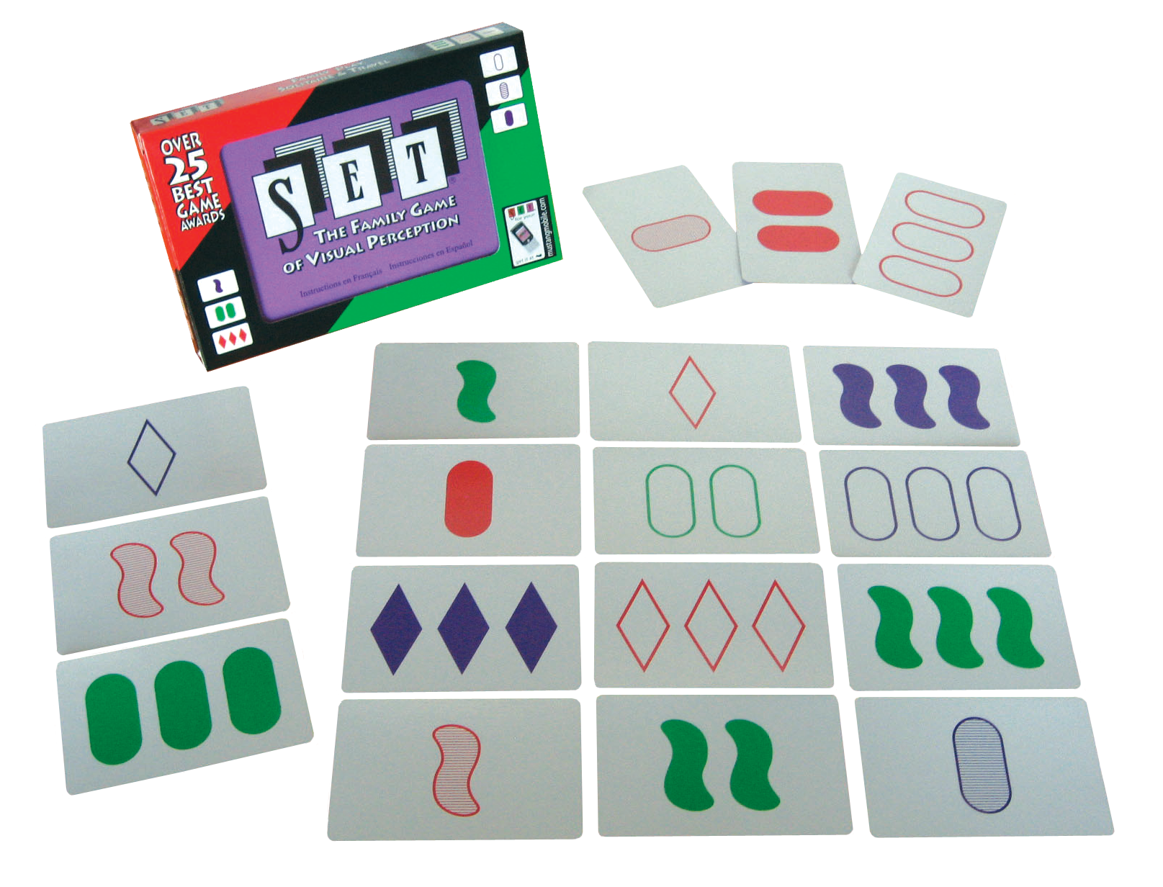
Motivating Reasons
• NP Complete (reduced from k-dimensional matching)
• Quick way calculate sets constrained size and general constraints (esp. adding members)
• Beat SAT

Slide 4
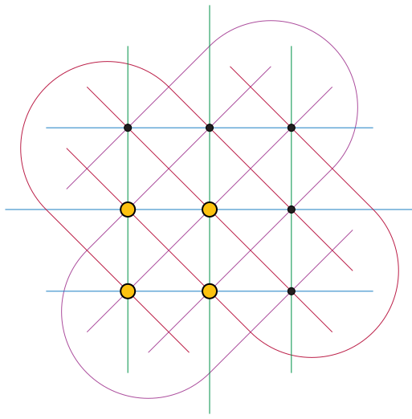
Related Work
• Mostly about cap set/education
• Ways to solve? N-dimensional check if line
• Many reduced to show np-complete but no algorithm

