Slide 1
Solving the Generalized Version of the Game of Set Efficiently
Steven Takeshita
Adviser: Zachary Kincaid

Slide 2
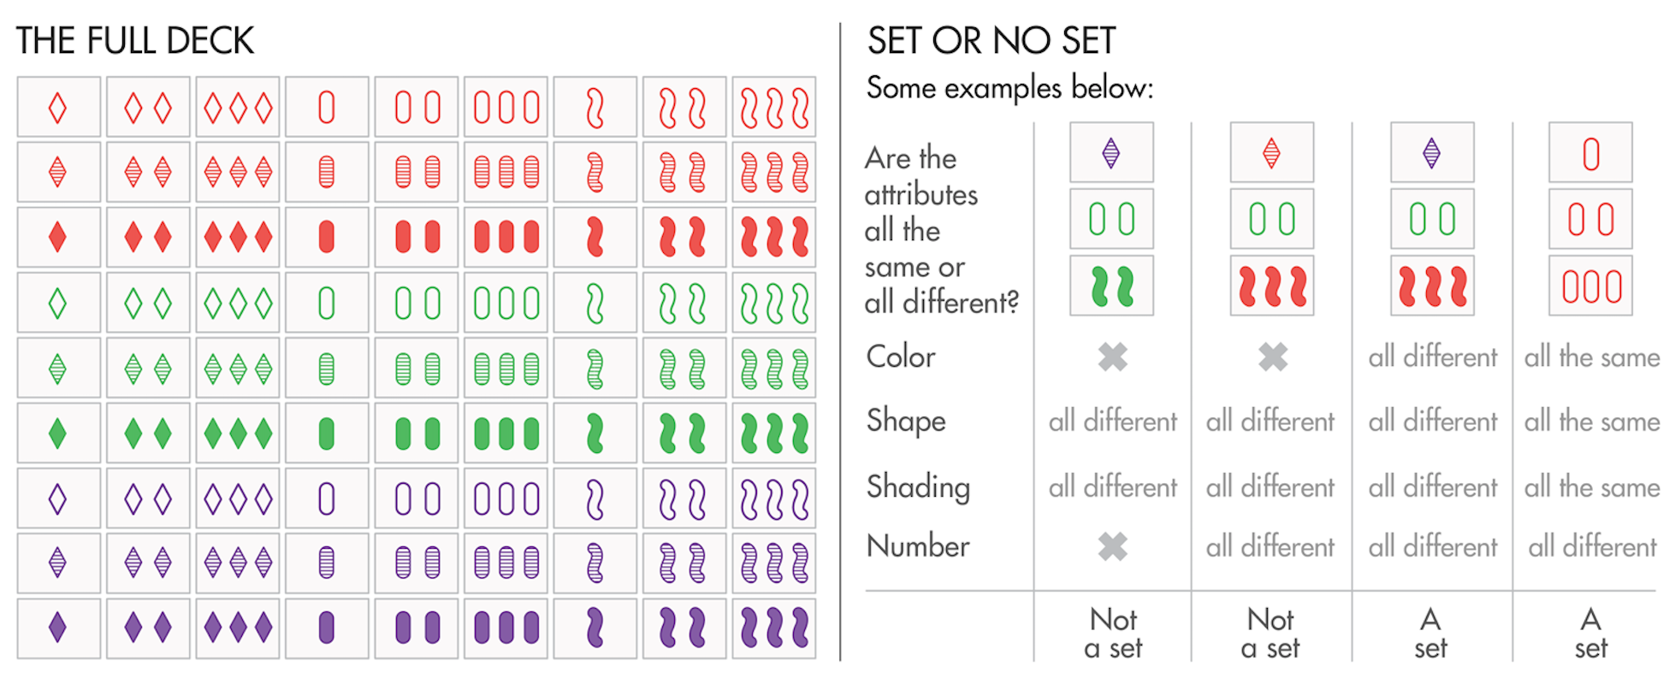
Motivation and Goal
Above on the left is the original Game of Set and all the cards of the game.
Each card has four properties and three values.
The cards visually represent all combinations of the properties and values.
The goal of the game is to find sets as fast as possible. A set constitutes three cards in which for each property all cards either have the same or different value. On the right are examples of sets.
I played this game a lot with my family but was much slower than my much faster sister.
The goal of my project is to create a the fastest solver for the generalized version of the Game of Set.

Slide 3
Problem Definition
A deck will contain v^{p} possible cards where the cards have p properties and v values.
v ∗ p cards will be outputted as the starting board.
Identify an arbitrary set of v cards, in which for all properties, the values are either the same or all different.
Remove this set of size v and count it as another set found, or if no set exists, add v more cards from the remaining v^{p} − v cards.
Find a total of n sets, where n ≤ v^{p−1} and each time a set is found, v cards will be immediately added.
There are 2 update functions that the algorithms must handle: add v cards to the board and remove v cards that formed a set.

Slide 4
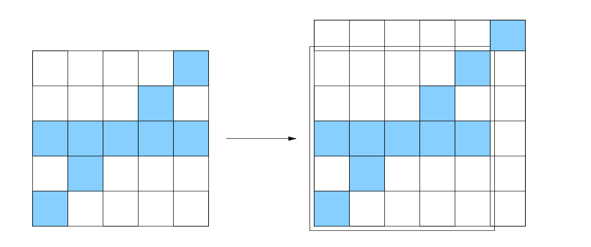
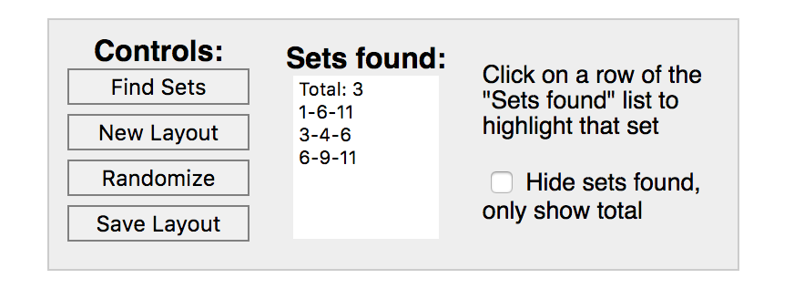
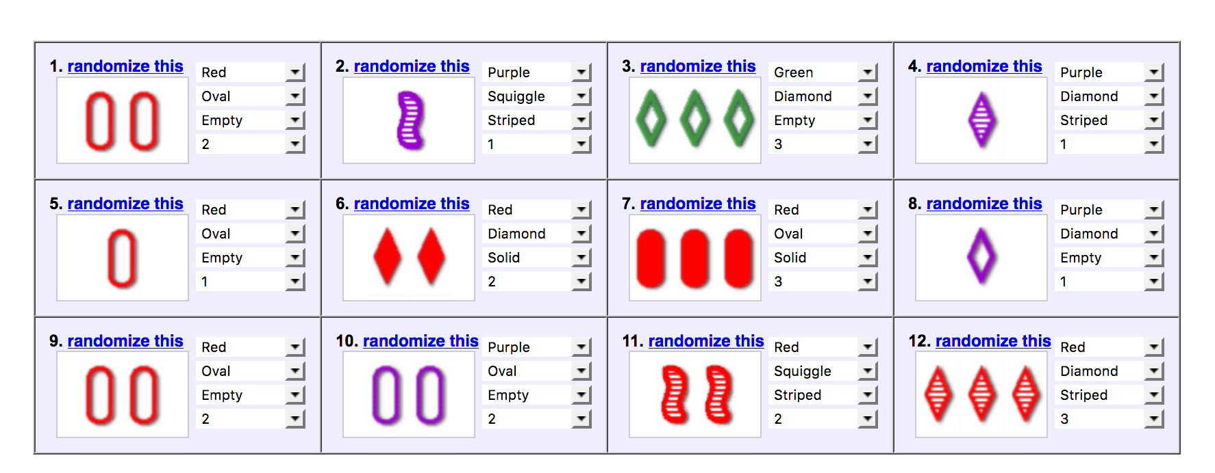
Related Work
Perfect Dimensional Matching
Source: Chadhuri et al (2003)
It has been shown that the generalized version of the Game of Set is NP complete through a reduction from Perfect Dimension Matching to the Game of Set
Online solvers exist such as the one on the left that takes as input the cards that are on the board and outputs all of the sets that exist
Some solvers even use computer vision such that the user does not even have to input the cards.
However, all of these solvers are limited to using the brute force and only apply to the original Game of Set
Source: Nolte, JavaScript Set Game Solver

Slide 5
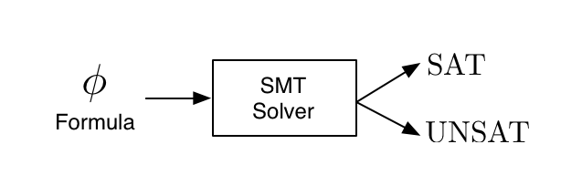
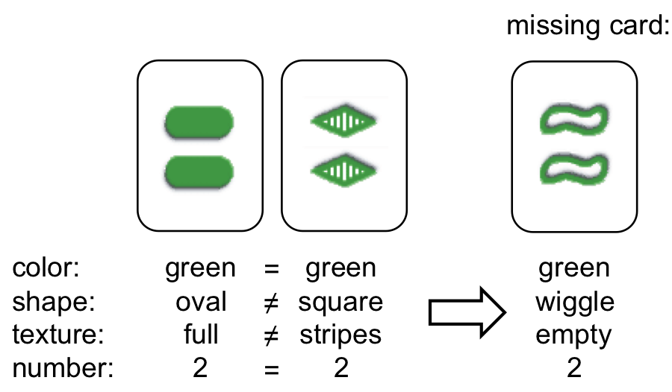
Approach
SMT Solver
Dynamic Algorithm
An SMT solver is an efficient solver for NP complete problems
It takes as input variables and sets of constraints and will output whether or not there exists a satisfying assignment of these variables with the given constraints.
A reduction from the generalized Game of Set to the SMT Solver will create an efficient solver
As the original Game of Set is played, it has been shown that the probability of a set existing on a given board greatly decreases as the game is played (on an original board of 12 cards there’s a 29:1 chance of a set existing, but this drops to 15:1 as the game is played—50% less chance of a set existing).
Remembering partial sets across draws can greatly increase speed as given v-1 cards, we can determine the last card we need to complete the set and can search for this card as we draw v new cards.
Source: http://dreal.cs.cmu.edu/presentation/20130612/#/sec-1
Source: http://www.masterbaboon.com/2010/09/solving-the-game-set/

Slide 6
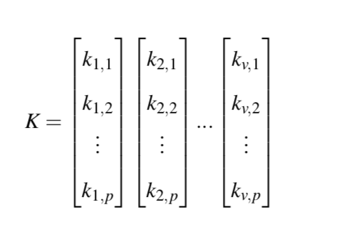
Reduction to and Implementation of SMT Solver
Variables
Constraints
For each property, the values of the cards are all different or all the same
All cards must be from the board
Cards in K must be distinct (for at least one property they must have a different value)
The cards in K must be be any of the cards we have already used to find a set
Symmetry breaking of the search space by forcing the set to be lexicographically sorted
The variables that are needed to be satisfied are represented as vectors in the variable K. Each vector represents a card within the set, where a card is made up of p variables and we have to find v cards, a total of v*p variables to satisfy.
The first 4 constraints are essential to find a correct satisfying set. Since the search space is highly symmetric, the 5th constraint is used to speed up the solver by constraining all permutations of a set to one set.
Z3
Z3, a high performance SMT solver, was used
It allows the user to easily create variables and constraints in Python
The above constraints were implemented in Z3 to find a set in a given board and was run n times to find n sets

Slide 7
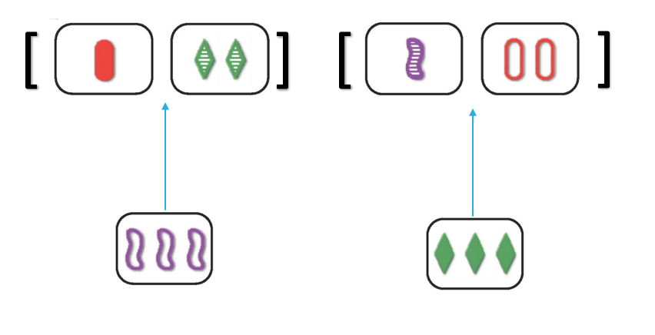
Implementation of the Dynamic Algorithm
Quick Complete Dictionary
Map the missing card to the partial set it completes
To create the initial partial sets, all combinations of 2 cards will be created as partial sets from a given board.
For each partial set, all cards will be iterated over and will be added to the partial set if they can be part of a satisfying set (for all properties the values are either all the same or all different). When we add the card, we must copy the given partial set and append the new partial set to the end of the list since partial sets can be satisfied in different ways depending on how the cards are added.
If a partial set is of size v when a satisfying card is added, it is a complete set and can be returned.
Once we add all cards to all partial sets, we iterate over the partial set list and create the quick complete dictionary. If a partial set is of size v-1, we figure out the last card that would satisfy the set, and map it to the partial set it would complete.
We draw v new cards and check if a card pulled is one of the cards we needed to satisfy an almost complete set.
Once we quick complete all partial sets, we create new size two partial sets from all combinations of the leftover new cards and repeat the above steps from step two until we have found n total sets.

Slide 8
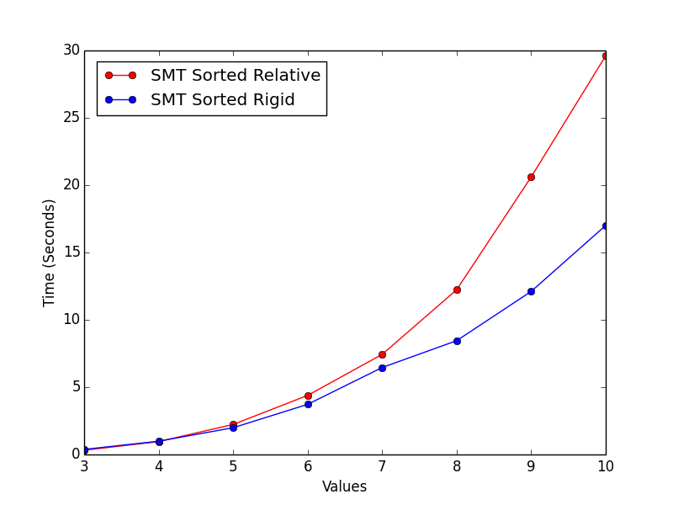
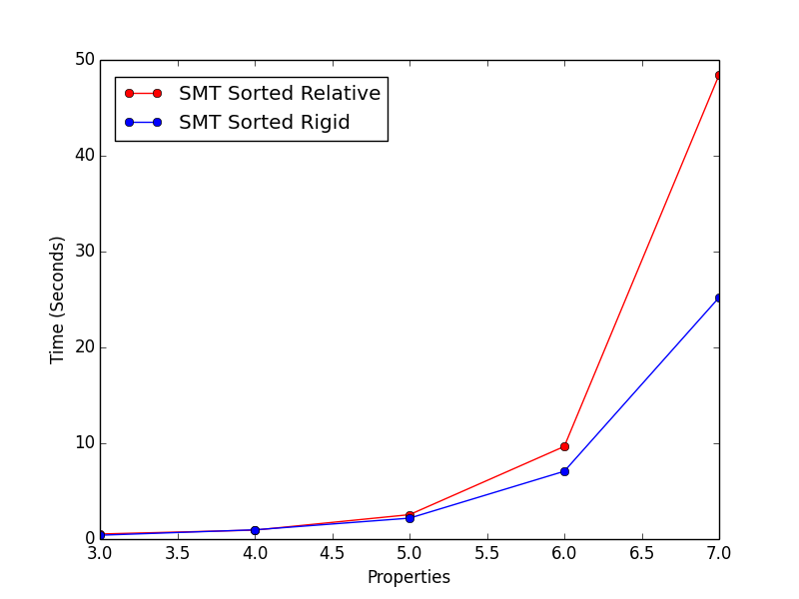
Results (SMT Symmetry Breaking Constraint Runoff)
4 Properties, 10 Sets to Find, Varying Number of Values
4 Values, 10 Sets to Find, Varying Number of Properties
Sorted Relative: For the first property the cards differ, sort by the cards’ value
Sorted Rigid: For the first property the cards differ, the 1st card’s value must be 0, the 2nd card’s value must be 1, … , vth card’s value must be v-1
The sorted rigid constraint to break the symmetry in the search space yields a faster solver than using the sorted relative constraint because the sorted rigid constraint restricts the search space more. Therefore, the optimal SMT solver uses the sorted rigid constraint and will be used to directly compare it against the dynamic algorithm.

Slide 9
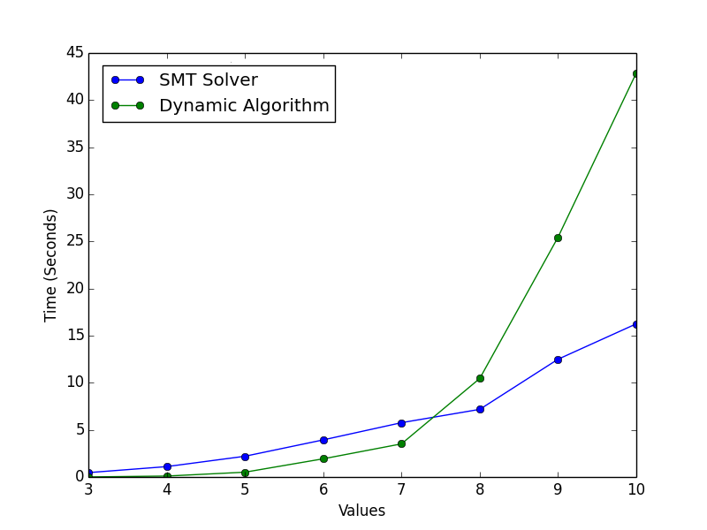
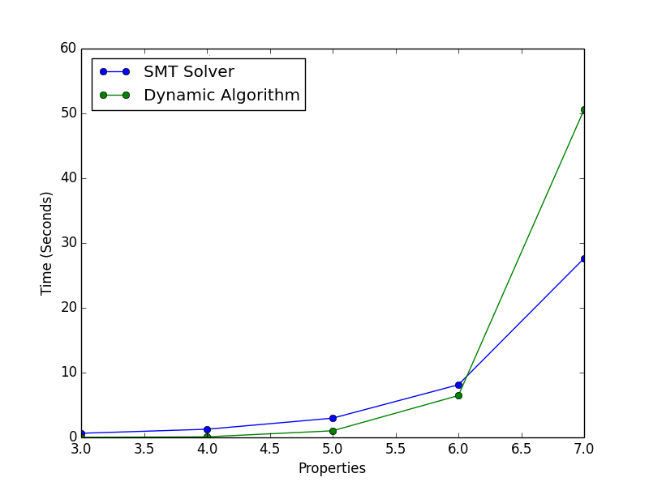
Results (SMT Solver vs Dynamic Algorithm)
4 Properties, 10 Sets to Find, Varying Number of Values
4 Values, 10 Sets to Find, Varying Number of Properties
In both cases, the dynamic algorithm is faster than the SMT solver for smaller cases. Once, we reach a threshold, the SMT solver becomes a faster solution. When we reach 7 values or 5 properties, the SMT solver beats the dynamic algorithm. This is especially in the case of the dynamic algorithm since we store all partial sets, which will be larger as we increase the number of values.

Slide 10
Conclusion and Future Work
There exists a threshold at which the SMT solver becomes significantly faster than the dynamic algorithm due to its excessive use of memory. However, until this threshold, the dynamic algorithm is marginally faster than the SMT solver.
For future research into this problem, it would be interesting to combine the SMT solver and dynamic algorithm such that the combined algorithm could benefit from the dynamic algorithm’s speed on smaller cases but also the SMT solver’s efficiency for larger cases. A solution combining the two approaches could be useful in creating efficient solvers for other problems that are also NP complete and need an efficient solver for a wide range of parameters.
References
K.Chaudhuri et al.,“On the complexity of the game of set,” 2003.
L. De Moura and N. Bjørner, “Satisfiability modulo theories: Introduction and applications,” Commun. ACM, vol. 54, no. 9, pp. 69–77, Sep. 2011.
S.Nolte,“Javascript set gamesolver.”
P. Norvig, “The odds of finding a set in the card game set ,” 2017.
F. S. M. Jorquera and A. Legge, “Set card game solver using image processing techniques on smart-phone photos,” 2013.
S. Russel and P. Norvig, Artificial Intelligence: A Modern Approach, 2nd ed. Prentice Hall, 2002.

