Slide 1

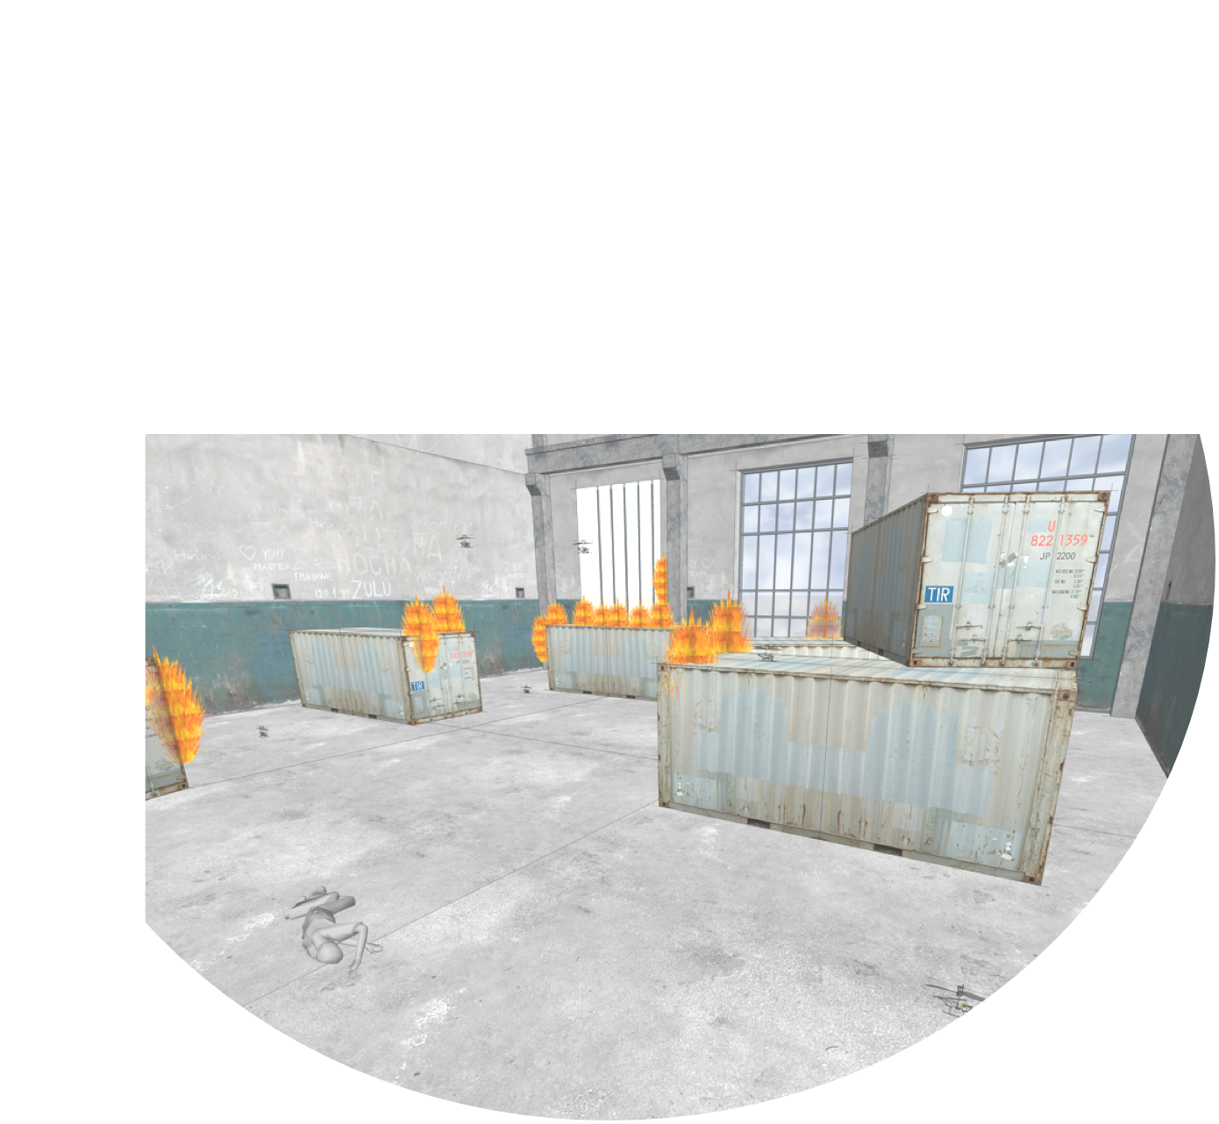

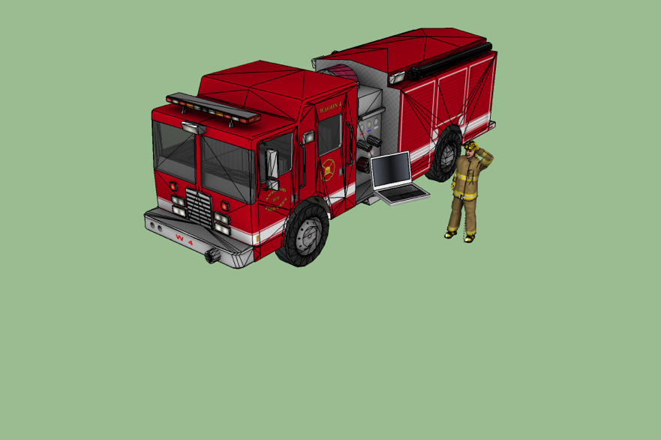

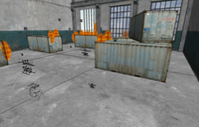
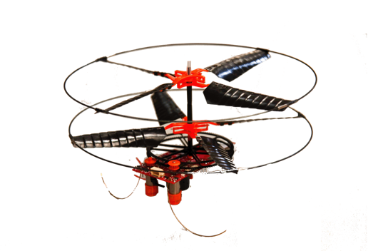
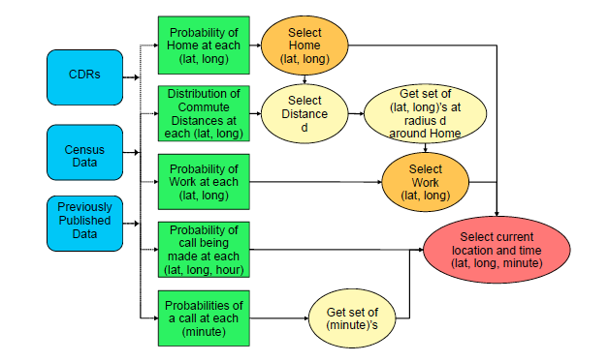
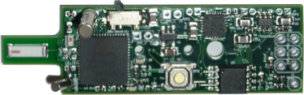
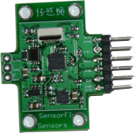
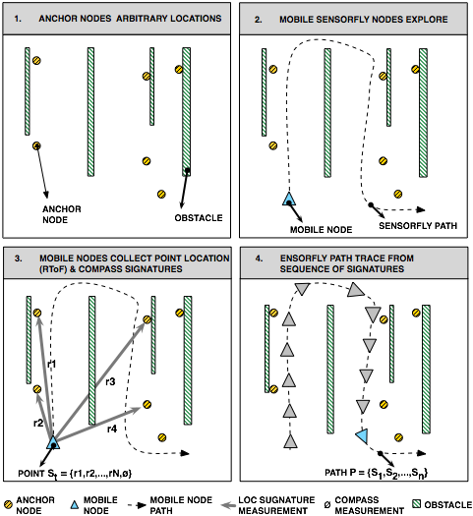
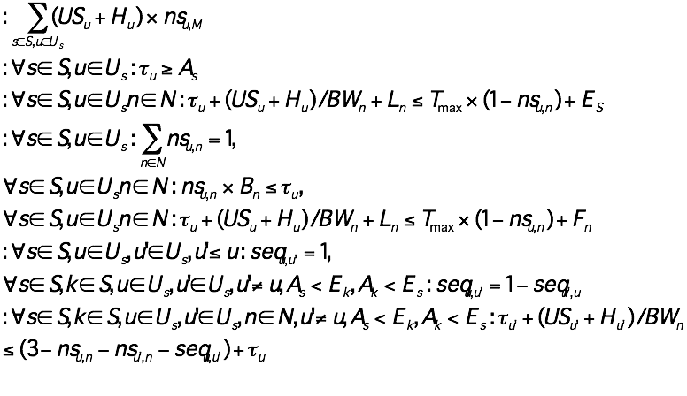
Efficient Mapping and Management of
Applications onto Cyber-Physical Systems
Prof. Margaret Martonosi, Princeton University and Prof. Pei Zhang, Carnegie Mellon University
Motivation
Testbed: Minimalistic Controlled Mobile Sensor
Region-Scale Mobility Modeling
Cyber-Physical Systems: richly heterogeneous devices (mobile devices, home electronics, taxis, robotic drones, etc.) that together gather sensor data, analyze it, and coordinate large-scale actions in response to it.
Challenge: How to program CP Systems?
Model Human Mobility based on cellphone Call Detail Records (CDRs) or similar aggregate info:
Sparse in time: Only when phone call in/out
Coarse in space: Only to granularity of cell tower spacing. (Not GPS)
Our Approach offers accuracy sufficient for detailed regional studies of human and vehicular movements.
Unreliable nodes: expected to fail, can crash or get stuck
0101010010
Low weight,
Low-cost prototype
Adapt to changing
environment, reassign
task based on node
capabilities and localized
failures
Dynamic coverage estimation:
by obtaining in-network relative
path signatures, then assign task to
multiple nodes to compute
signature paths
0101010010101010
Prior Approaches
Simplifications to reduce complexity.
Assume homogeneous systems
Program for one particular deployment
Current approach leads to “brittle” systems.
Deployments with multi-generation devices
Multiple scenarios with different mobility capabilities
How to meet performance and accuracy goals while managing power and other scarce resources?
How to select which devices to use? From a static or dynamic pool of resources.
How to support dynamic adaptivity within a single deployment? How to support portable operation across different deployments?
PLUGIN SENSOR MODULE:
3-Axis Accelerometer
3-Axis Gyroscope
3-Axis Magnetometer
MAIN BOARD:
16 MHz AVR AtMega128RFA1
16Kb SRAM
128Kb Flash Memory
2.4GHz 802.15.4 Radio
Mobile Offloading: An Initial Example
Collaborative Coverage Without Location
Select when to use 3G and when to use WiFi based on:
Availability and bandwidth of 3G and WiFi
Delay tolerance of application
Cost of data transfers on each network
Mobility prediction of device
Optimal MILP Scheduler Formulation
8-10X cost reduction due to optimization and delay tolerance
Sensing coverage for mobile nodes in many environments is hard to determine due to lack of known infrastructure or references for locations.
Sensing coverage estimation by obtaining relative motion path signatures. Dynamic task allocation allow nodes to more efficiently coordinate and predict the current sensing coverage of an area.
Our Project
Abstraction layer to allow CPS applications to express application needs
Coverage and sensing requirements
Device attribute catalog to summarize local nodes and their capabilities
Sensing capabilities, probability of success, accuracy, etc.
Model, Prediction and Control mobility of nodes
Different types of motion (people, fixed sensors, robot, etc.)
Project Future Work
Publications
Integrate WiFi offloading with mobility prediction
Broaden mapping problems from two-node offload to multi-node offload
Explore use of virtualization for mobile migration
Apply programming flow and dynamic adaptation to real-word applications:
First responder support
Regional automotive traffic management
Sibren Isaacman et al. Human Mobility Modeling via Synthetic Call Detail Records." 10th Intl. Conf. on Mobile System, Applications, and Services (MobiSys 2012)
Ozlem Bilgir Yetim and Margaret Martonosi. "Adaptive Usage of Cellular and WiFi Bandwidth: An Optimal Scheduling Formulation (Short Paper).” 7th ACM Intl. Workshop on Challenged Networks (CHANTS 2012)
Frank Mokaya, Aveek Purohit, Pei Zhang, “Invited Paper: SensorFly: Flying Sensor Network for Indoor Situational Awareness in a Disaster”, The Wireless Personal Multimedia Communications Symposium (WPMC’12) Sep. 2012
Acknowledgments
This work was supported by the National Science Foundation under collaborative grants CPS-1135874 and CPS-1135953.

