Slide 1

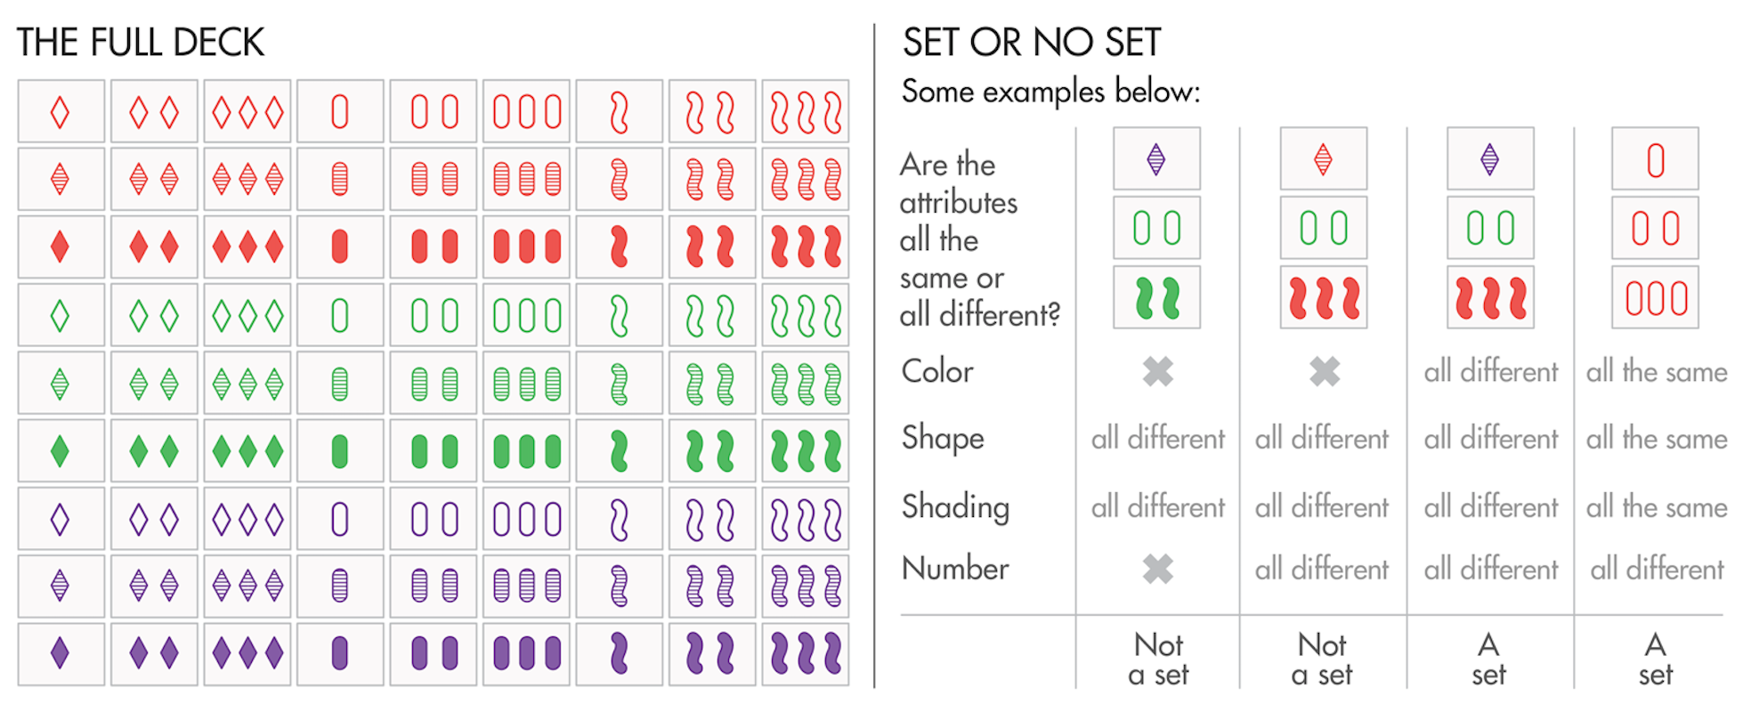
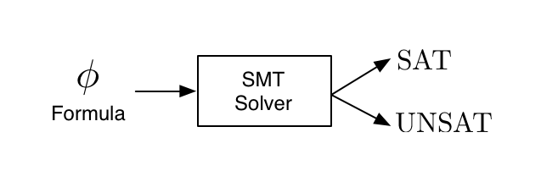
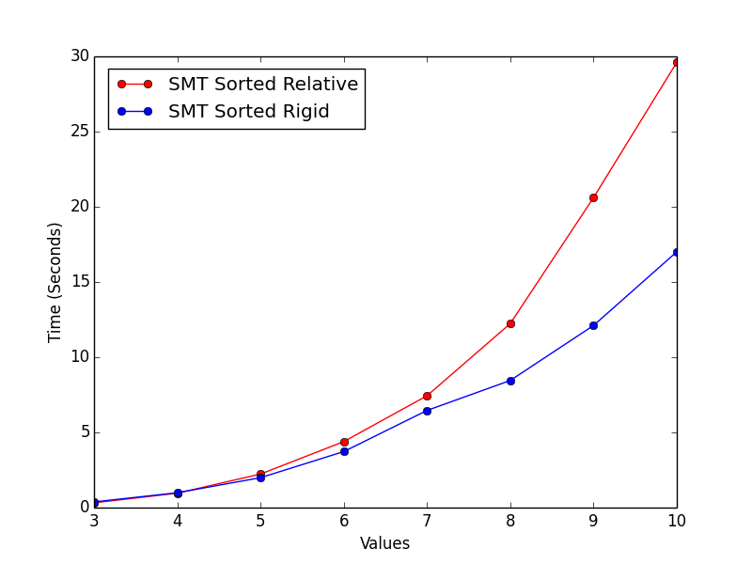
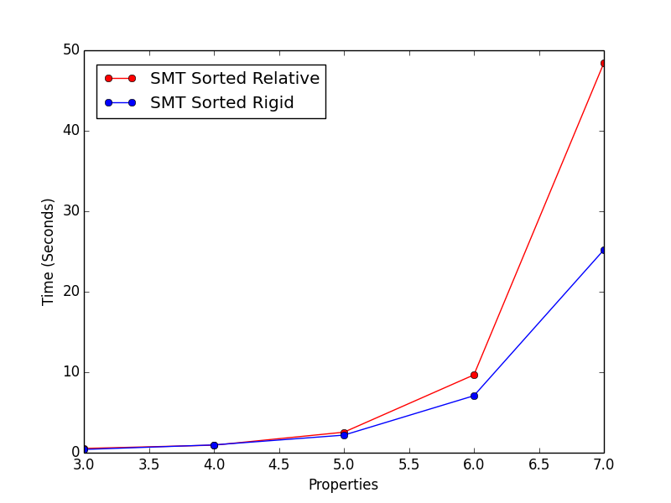
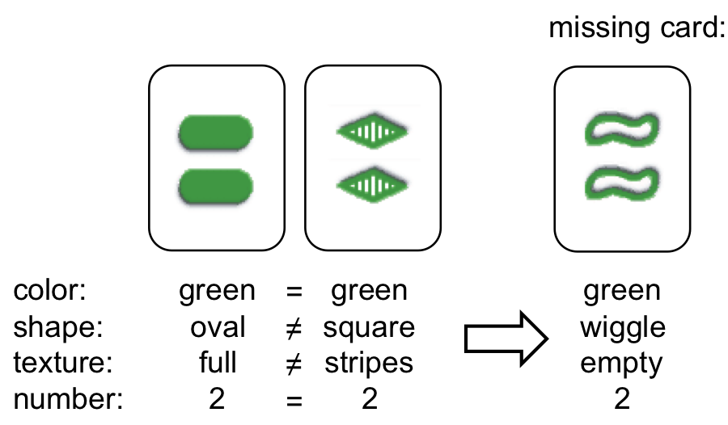
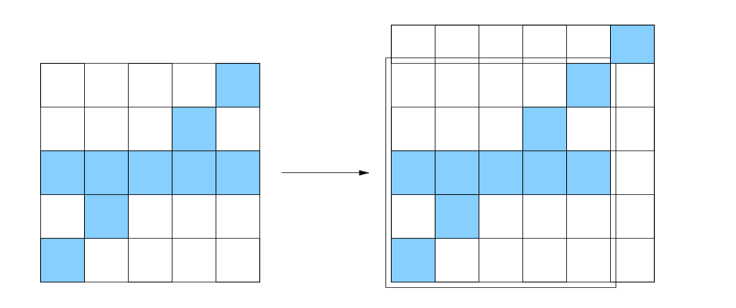
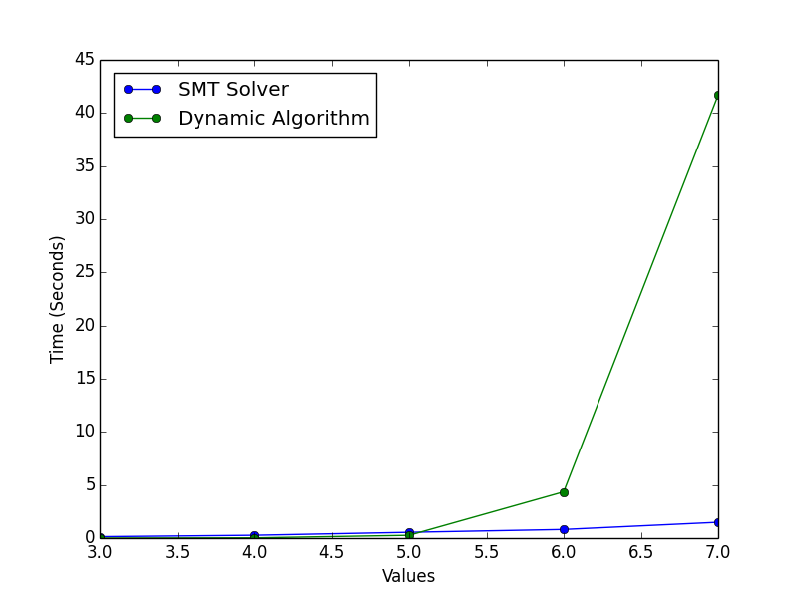
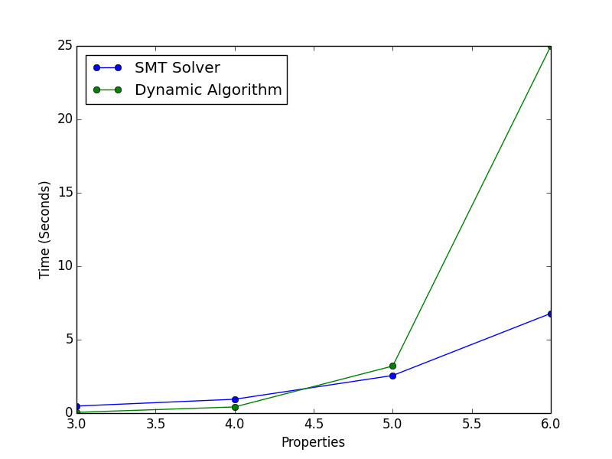
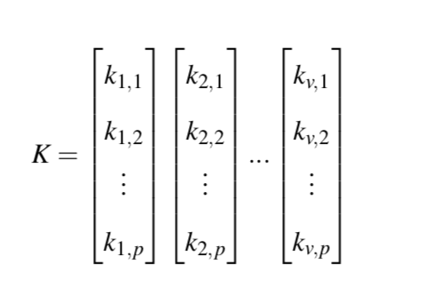
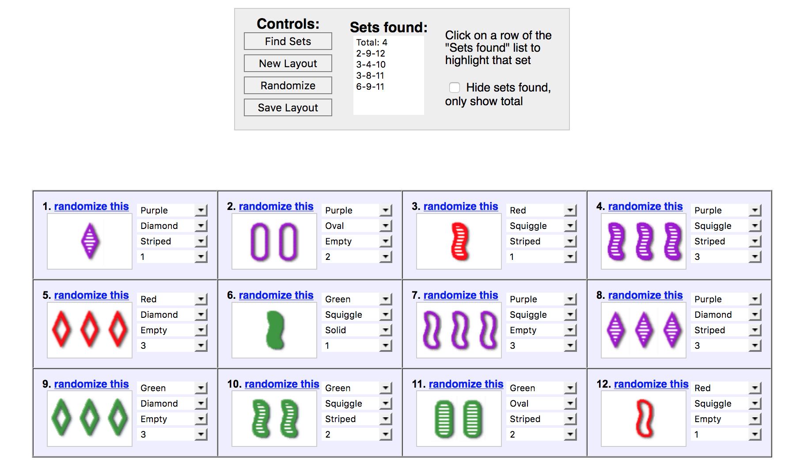
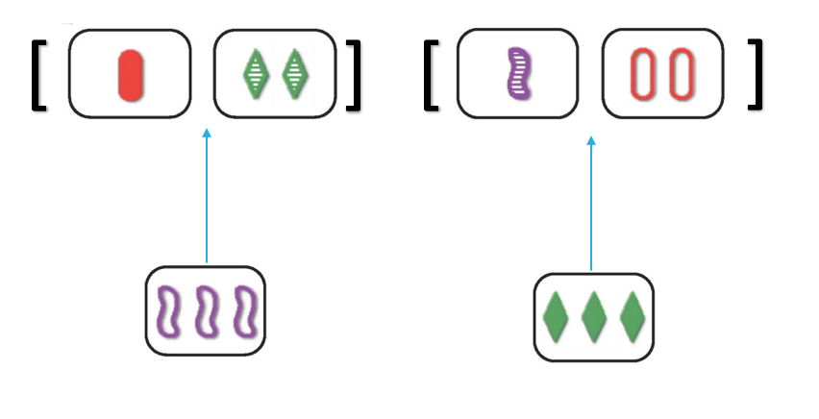
Solving the Generalized Form of the Game of Set Efficiently
Steven Takeshita
Adviser: Zachary Kincaid
Motivation
Approach
Results
SMT Solver
SMT Symmetry Breaking Constraints
SMT Solver’s are Efficient
Systematic Search
4 Properties, 10 Sets
4 Values, 10 Sets
Dynamic Algorithm
Related Work
Probability of a Set decreases as the game is played
Build off of previous knowledge of the board
Chadhuri et al (2003) NP Completeness Proof
SMT vs Dynamic Algorithm
Perfect Dimensional Matching
4 Properties, 10 Sets
4 Values, 10 Sets
Reduction to SMT
JavaScript Set Game Solver by S. Nolte
Satisfying Set of v*p variables
Constraints
All Different or All Same
Cards from the Board
Distinct Cards
Symmetry Breaking
Not Any Deleted Card
Conclusion
SMT Solver with Symmetry Breaking becomes an Efficient Solution
Threshold at which the SMT Solver becomes faster than the Dynamic Algorithm
Implementation
Project Future Work
Combine the two approaches?
Image Processing Applications
Limitation: All Use the Brute Force Solution
SMT Solver
Dynamic Algorithm
References
Z3
K.Chaudhuri et al.,“On the complexity of the game of set,” 2003.
L. De Moura and N. Bjørner, “Satisfiability modulo theories: Introduction and applications,” Commun. ACM, vol. 54, no. 9, pp. 69–77, Sep. 2011.
S.Nolte,“Javascript set gamesolver.”
P. Norvig, “The odds of finding a set in the card game set⃝R ,” 2017.
F. S. M. Jorquera and A. Legge, “Set⃝R card game solver using image processing techniques on smart-phone photos,” 2013.
S. Russel and P. Norvig, Artificial Intelligence: A Modern Approach, 2nd ed. Prentice Hall, 2002.
Problem Definition
Deck with cards that have v values and p properties
Total of v^{p} cards
Initial Board is v*p cards
Find n sets of v cards each
Remove v cards
Add v cards
Symmetry Breaking
Relative Sorted = C₁ < C₂ < … < C_{v}
Rigid Sorted = C₁ = 0, C₂ = 1, … C_{v} = v-1
Store All Partial Sets
Quick Complete Dictionary if Missing One Card

