Slide 1
Solving the Generalized Form of the Game of Set Efficiently
Steven Takeshita’19, Advised by Professor Zachary Kincaid

Slide 2
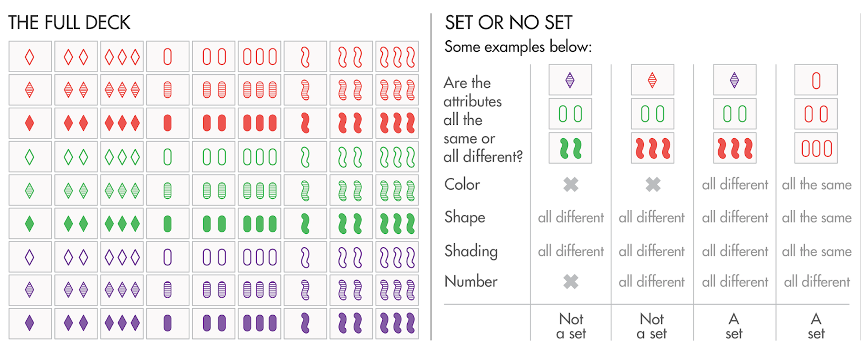
Motivation, Goal, and Problem Definition
3 Values and 4 Properties
Source: https://www.quantamagazine.org/set-proof-stuns-mathematicians-20160531/
Notes:
Picture from: https://www.quantamagazine.org/set-proof-stuns-mathematicians-20160531/
Explain the game in much more detail
V values and p properties where instead of visual they’re just a string of values
A deck contains v^p possible cards (p properties and v values)
v ∗ p cards are the starting board
For all properties the values are either the same or all different
If no set exists, add v more cards
Find a total of n sets.
Updates: Add v new or remove v cards that formed a set

Slide 3
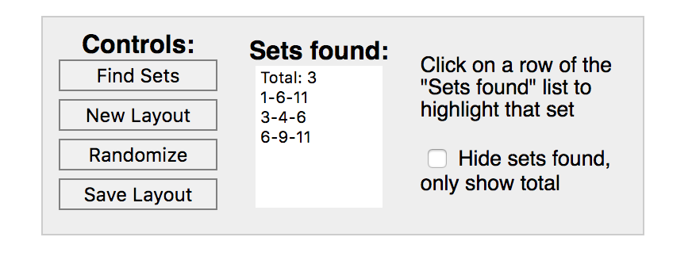
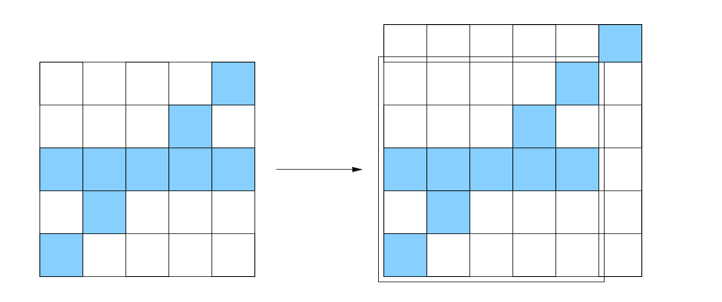
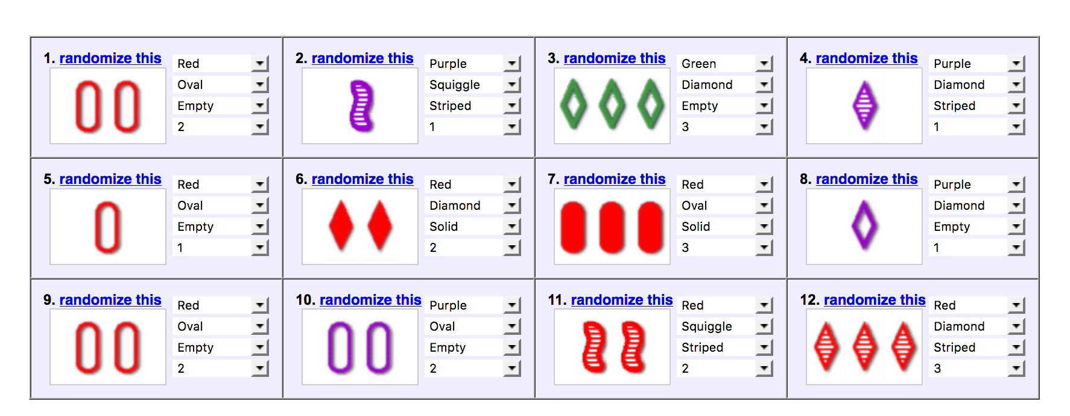
Related Work and Problem Background
Perfect Dimensional Matching
NP Complete
Source: Chadhuri et al (2003)
Source: Nolte, JavaScript Set Game Solver
Notes:
JavaScript Solver and Image Processing from Cards…
BRUTE FORCE ONLY!!!!
NP-Complete through a reduction from perfect-Dimensional Matching, a known NP-Hard problem
Left Picture: Chadhuri et al.
Right Picture: Nolte online.

Slide 4
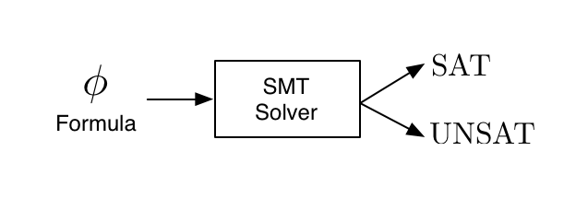
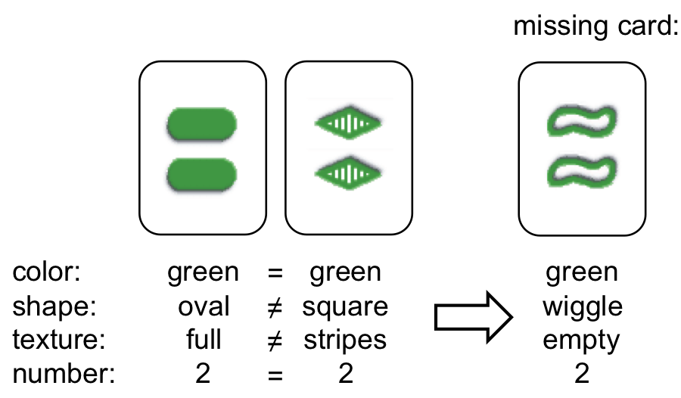
Approach
SMT Solver
Dynamic Algorithm
Ex.
Integer X. Constraint X + 1 = 2.
SAT => X = 1
Norvig (2017) Probability of Set Decreases
Source: http://dreal.cs.cmu.edu/presentation/20130612/#/sec-1
Source: http://www.masterbaboon.com/2010/09/solving-the-game-set/
Notes:
SMT:
Key Idea: SMT solvers are optimized to solve NP-complete problems and if we can leverage that speed we will be able to create a scalable solver.
Dynamic:
CSP Solver to describe what cards satisfy the given variables
Dynamic:
Hinges on this idea of partial sets and two cards wholly determining the last. Store partial sets such that when the new cards are drawn we can immediately see whether it satisfies a set or not
Left Picture: http://dreal.cs.cmu.edu/presentation/20130612/#/sec-1
Right picture: http://www.masterbaboon.com/2010/09/solving-the-game-set/

Slide 5
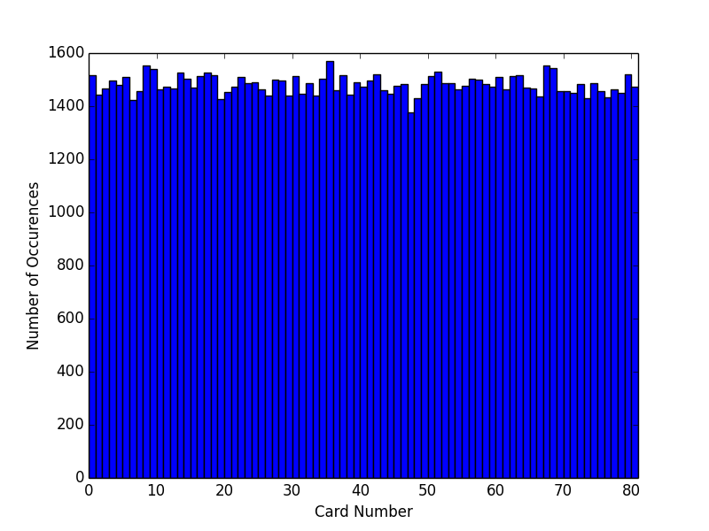
Implementation of Cards/Board
10000 Trials 3 Value, 4 Properties
Fisher Yates Shuffle with Rejection Sampling
Las Vegas Algorithm
Notes:
To ensure that the next v cards are always random from the set, I employed the use of a modified version of Fisher Yates Shuffle, creating a Las Vegas algorithm. Fisher Yates Shuffle works by iteratively randomly picking indices from a finite sequence and produces an unbiased permutation [2]. To convert the algorithm for use on a deck, I use rejection sampling to determine new cards to add to the board. I create a randomized card and if it is not in the board already and not in the removed cards set, I add it. If it is, I generate another card until I have created v ∗ p cards that are all distinct. Since the algorithm uses a randomized strategy but will always a board, whose cards are all distinct and from the deck with equal probabilities, this is known as a Las Vegas algorithm.

Slide 6
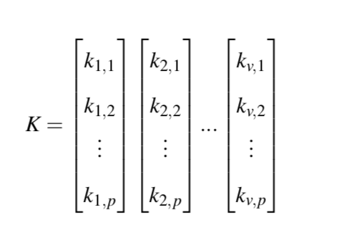
Implementation and Reduction to SMT
Constraints
All Different or All Same
Cards from the Board
Distinct Cards
Symmetry Breaking
Not Any Deleted Card
Z3

Slide 7
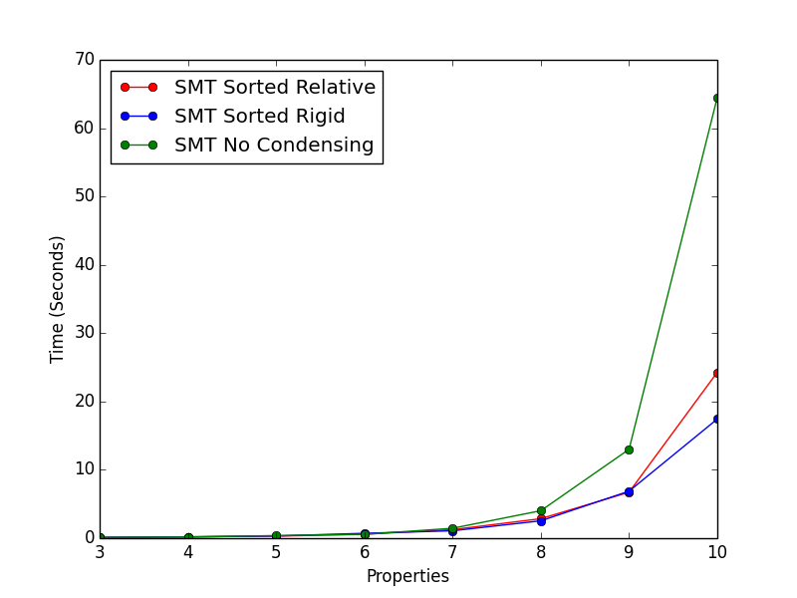
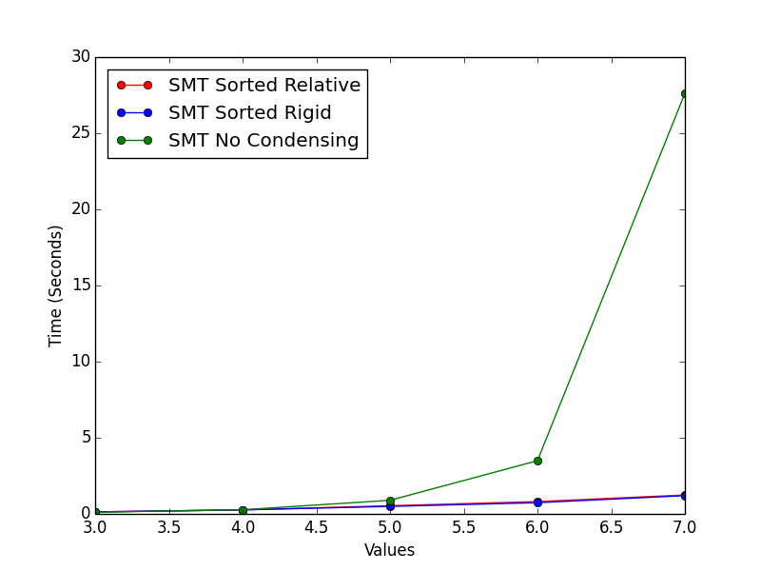
Results (SMT Symmetry Breaking)
3 Values, 5 Sets
3 Properties, 5 Sets
Sorted Relative
Sorted Rigid
No Condensing
Notes:
If cards have 3 possible values and must find 5 sets, how long does it take for varying numbers of properties/values.

Slide 8
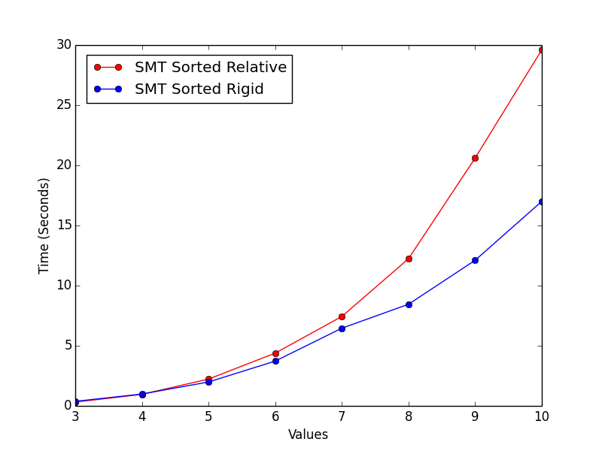
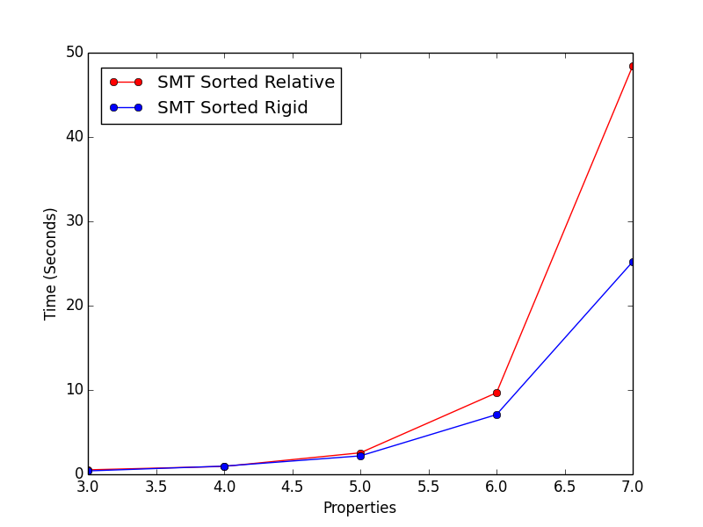
Results (SMT Runoff)
4 Properties, 10 Sets
4 Values, 10 Sets
Sorted Relative
Sorted Rigid
Sorted Relative: Sorted by value
Sorted Rigid: 1st card = 0, 2nd = 1, … , vth = v-1

Slide 9
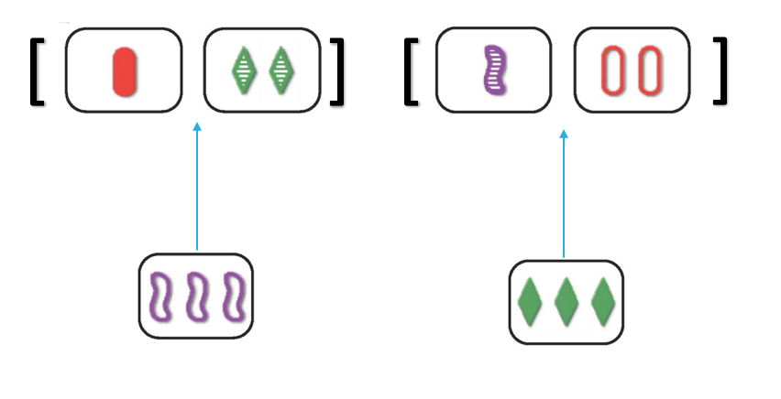
Implementation of Dynamic Algorithm
Dynamic Algorithm
Build Partial Sets
Create Cards Searching For
Draw v New Cards
Quick Complete
Repeat

Slide 10
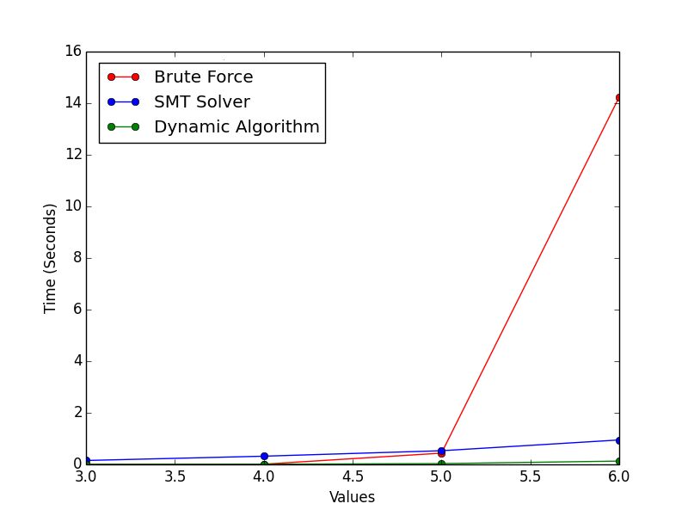
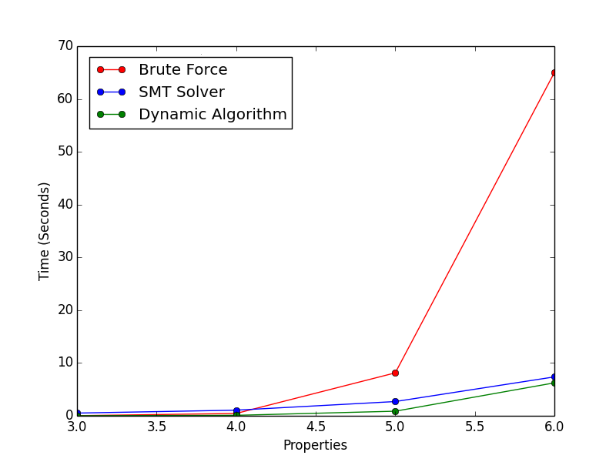
Results (with Brute Force)
3 Properties, 5 Sets
4 Values, 10 Sets
Brute Force
SMT Solver
Dynamic Algorithm

Slide 11
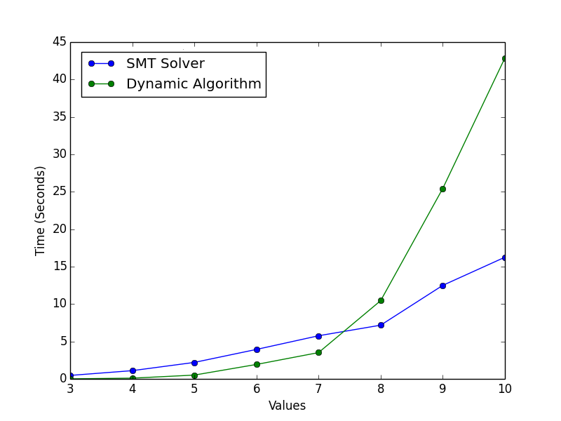
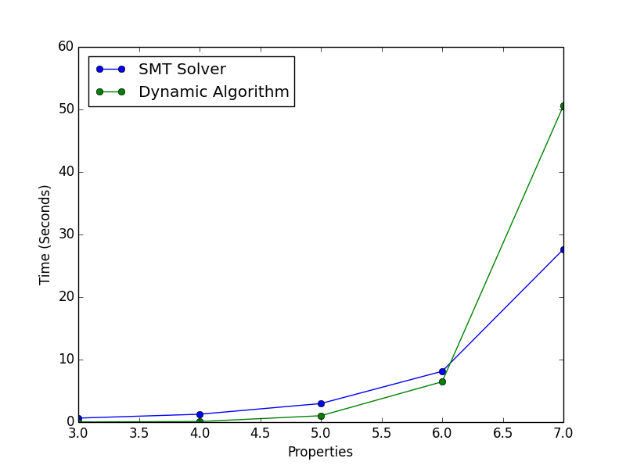
Results (SMT vs Dynamic)
4 Properties, 10 Sets
4 Values, 10 Sets
SMT Solver
Dynamic Algorithm
Notes:
Brute Force Solution coded as a bench mark was much slower and skewed the graphs.

Slide 12
Conclusion and Future Work
SMT Solver
Dynamic Algorithm
Pros: Fast on Large Cases
Future: More Symmetry Breaking of Search Tree
Pros: Fast on Medium Sized Cases
Future: Better Memory Management
Combine the two approaches?

