Slide 1
Solving the Generalized Form of the Game of Set Efficiently
Steven Takeshita’19, Advised by Professor Kincaid

Slide 2
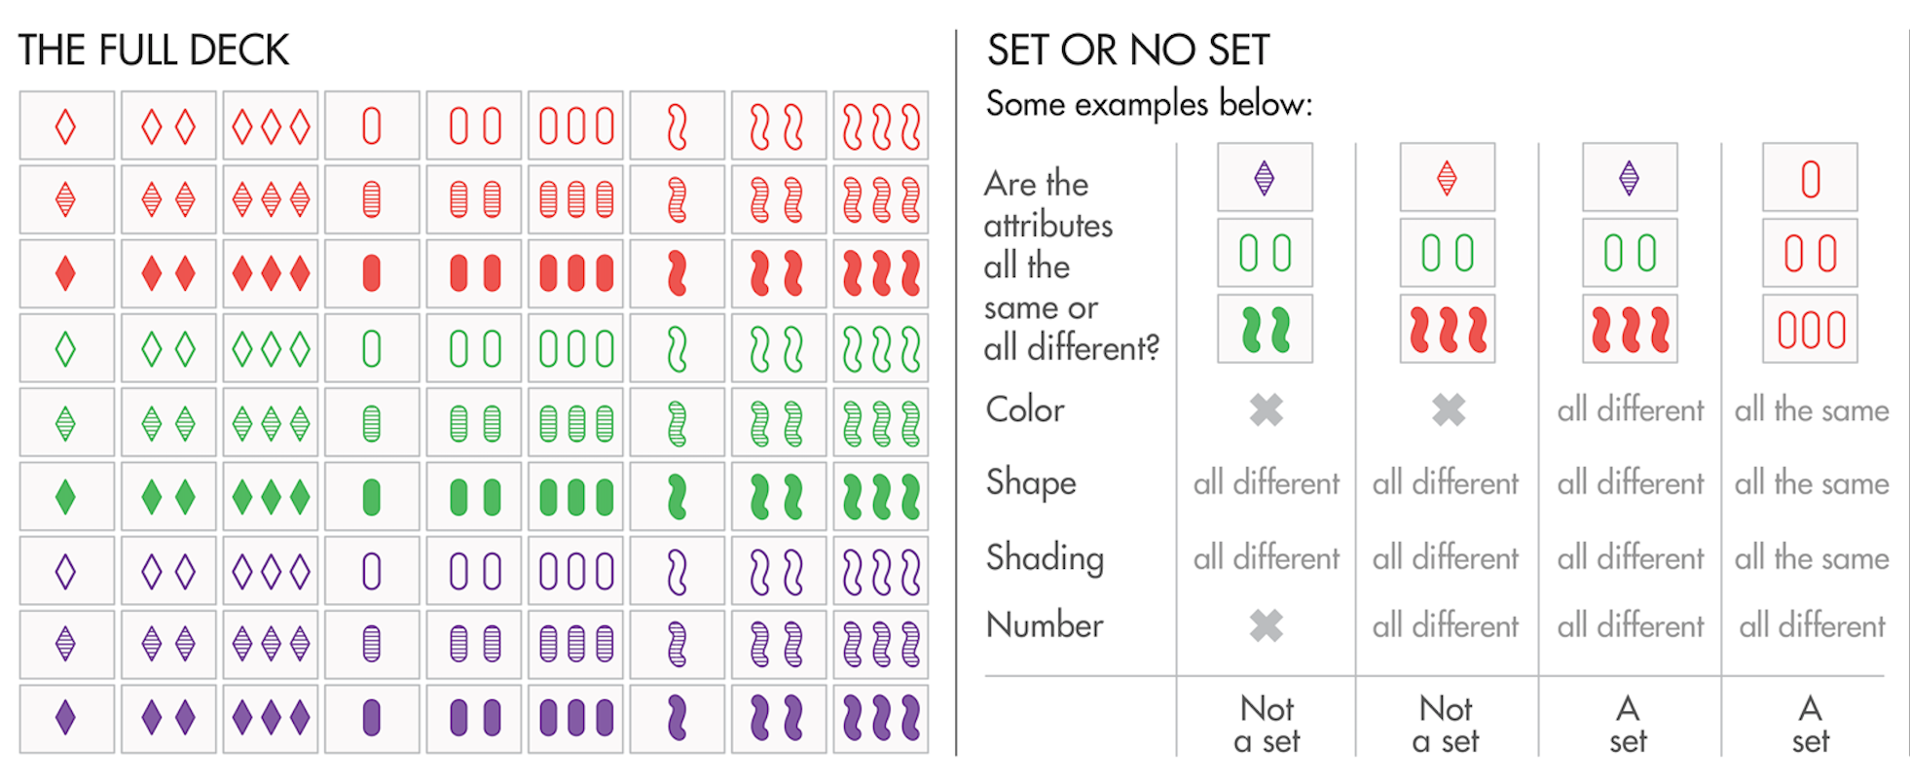
Motivation and Goal
Notes:
Picture from: https://www.quantamagazine.org/set-proof-stuns-mathematicians-20160531/

Slide 3
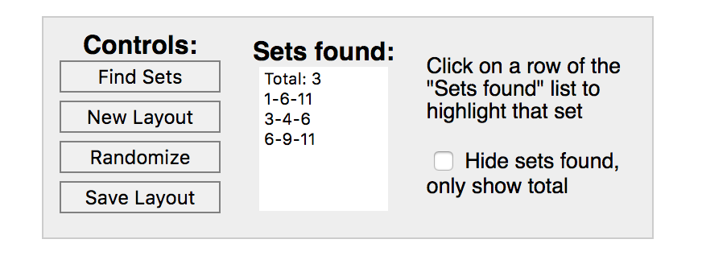
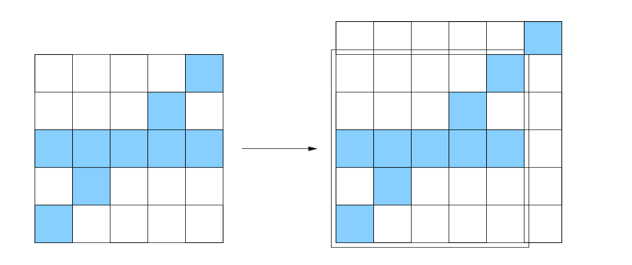
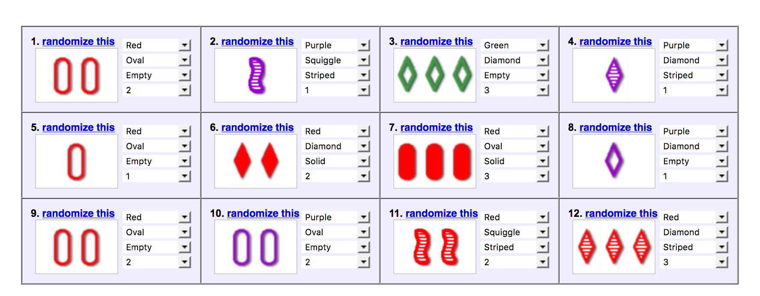
Related Work and Problem Background
NP Complete
Notes:
JavaScript Solver and Image Processing from Cards…
BRUTE FORCE ONLY!!!!
NP-Complete through a reduction from perfect-Dimensional Matching, a known NP-Hard problem
Left Picture: Chadhuri et al.
Right Picture: Nolte online.

Slide 4
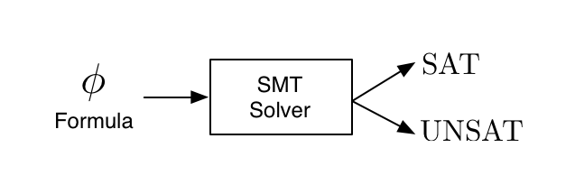
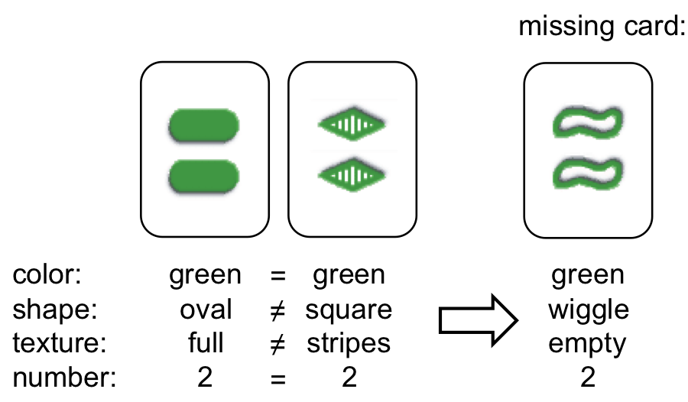
Approach
SMT Solver
Dynamic Algorithm
Notes:
SMT:
CSP Solver to describe what cards satisfy the given variables
Dynamic:
Hinges on this idea of partial sets and two cards wholly determining the last.
Left Picture: http://dreal.cs.cmu.edu/presentation/20130612/#/sec-1
Right picture: http://www.masterbaboon.com/2010/09/solving-the-game-set/

Slide 5
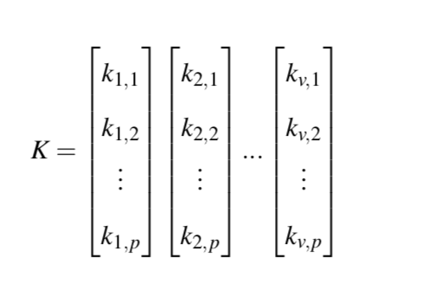
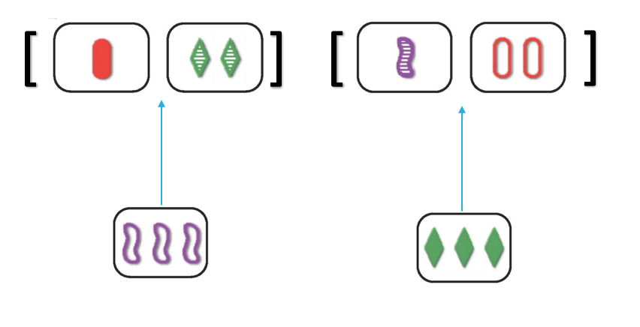
Implementation
SMT Solver
Dynamic Algorithm
Z3
All Different or All Same
Cards from the Board
Distinct Cards
Condensing Search Tree
Not Any Deleted Card

Slide 6
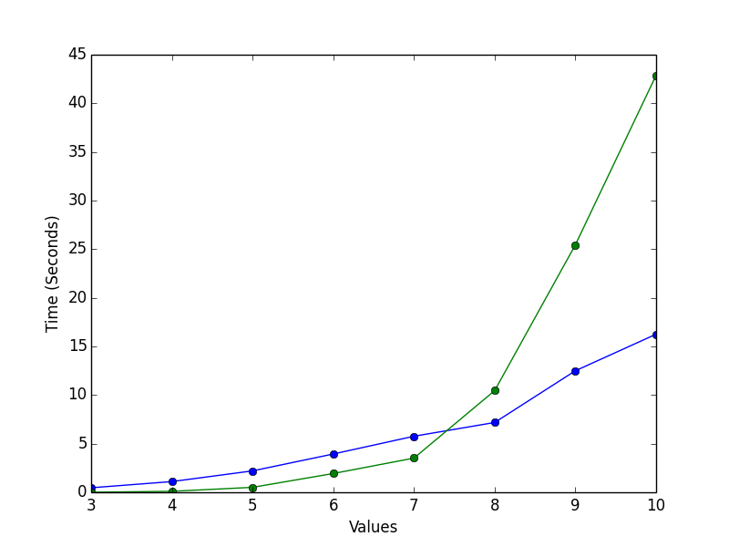
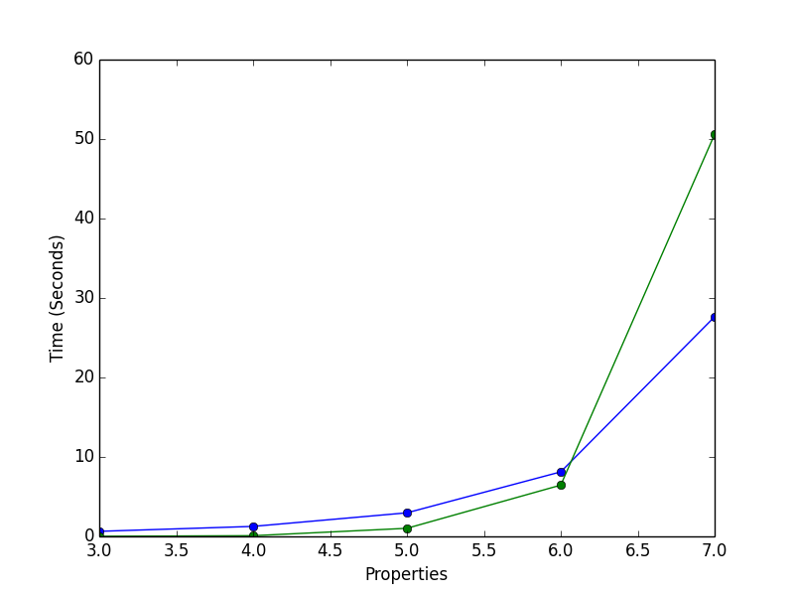
Results
4 Properties 10 Sets to Find
4 Values 10 Sets to Find
SMT Solver
Dynamic Algorithm
Notes:
Brute Force Solution coded as a bench mark was much slower and skewed the graphs.

Slide 7
Conclusion and Future Work
SMT Solver
Dynamic Algorithm
Pros: Fast on Large Cases
Future: More Condensing of Search Tree
Pros: Fast on Medium Sized Cases
Future: Better Memory Management
Combine the two approaches?

