Slide 1

MapReduce and Beyond
Engin Arslan
February 3, 2018
Engin Arslan
MapReduce
Feb 3, 2018
<number> / 44

Slide 2

What do we do when there is too much data to process?
Engin Arslan
MapReduce
Feb 3, 2018
<number> / 44

Slide 3

Scale Up vs. Scale Out (1/2)
◮ Scale up or scale vertically: adding resources to a single node in a system.
◮ Scale out or scale horizontally: adding more nodes to a system.
Engin Arslan
MapReduce
Feb 3, 2018
<number> / 44

Slide 4

Scale Up vs. Scale Out (2/2)
◮ Scale up: more expensive than scaling out.
◮ Scale out: more challenging for fault tolerance and software development.
Engin Arslan
MapReduce
Feb 3, 2018
<number> / 44

Slide 5
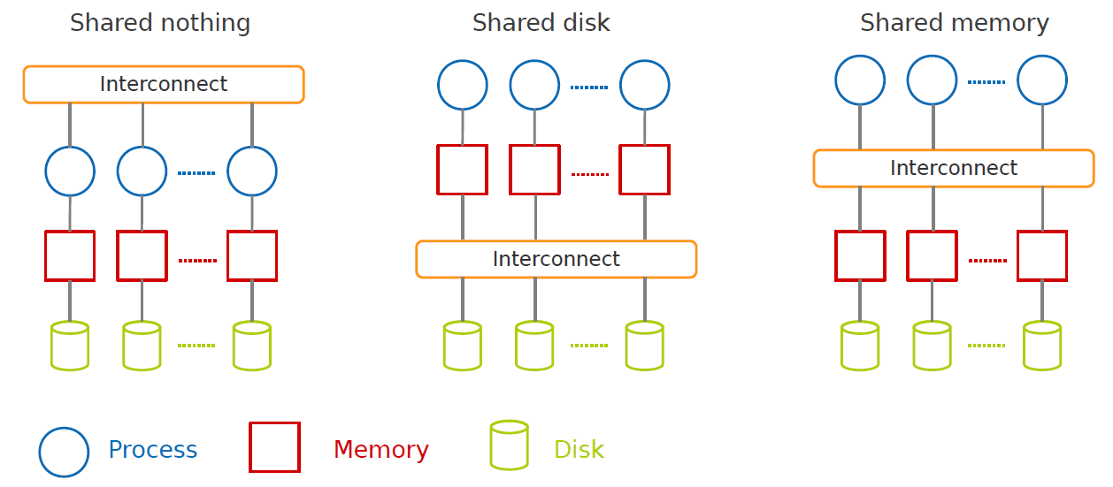
Taxonomy of Parallel Architectures
DeWitt, D. and Gray, J. “Parallel database systems: the future of high performance database systems”. ACM Communications, 35(6), 85-98, 1992.
Engin Arslan
MapReduce
Feb 3, 2018
<number> / 44

Slide 6

Taxonomy of Parallel Architectures
DeWitt, D. and Gray, J. “Parallel database systems: the future of high performance database systems”. ACM Communications, 35(6), 85-98, 1992.
Engin Arslan
MapReduce
Feb 3, 2018
5 / 44

Slide 7

MapReduce
◮ A shared nothing architecture for processing large data sets with a parallel/distributed algorithm on clusters.
Engin Arslan
MapReduce
Feb 3, 2018
6 / 44

Slide 8
MapReduce Definition
◮ A programming model: to batch process large data sets (inspired by functional programming).
Engin Arslan
MapReduce
Feb 3, 2018
7 / 44

Slide 9
MapReduce Definition
◮ A programming model: to batch process large data sets (inspired by functional programming).
◮ An execution framework: to run parallel algorithms on clusters of commodity hardware.
Engin Arslan
MapReduce
Feb 3, 2018
7 / 44

Slide 10

Simplicity
◮ Don’t worry about parallelization, fault tolerance, data distribution, and load balancing (MapReduce takes care of these).
◮ Hide system-level details from programmers.
Simplicity!
Engin Arslan
MapReduce
Feb 3, 2018
8 / 44

Slide 11
Programming Model
Engin Arslan
MapReduce
Feb 3, 2018
9 / 44

Slide 12
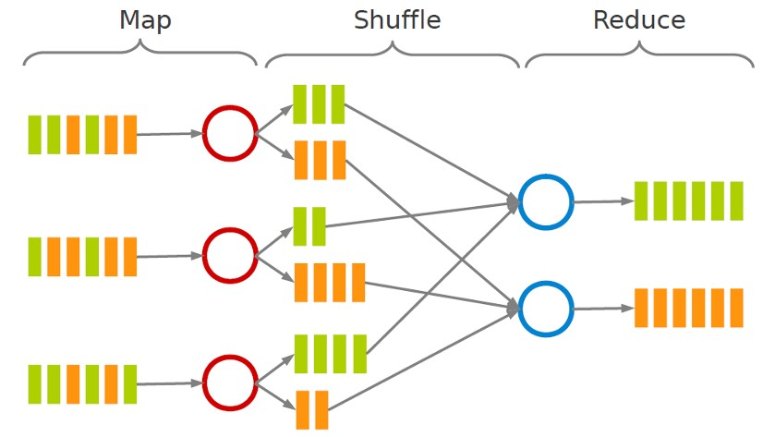
MapReduce Dataflow
◮ map function: processes data and generates a set of intermediate key/value pairs.
◮ reduce function: merges all intermediate values associated with the same intermediate key.
Engin Arslan
MapReduce
Feb 3, 2018
10 / 44

Slide 13
Example: Word Count
◮ Consider doing a word count of the following file using MapReduce:
Hello World Bye World
Hello Hadoop Goodbye Hadoop
Engin Arslan
MapReduce
Feb 3, 2018
11 / 44

Slide 14
Example: Word Count - map
◮ The map function reads in words one a time and outputs (word, 1) for each parsed input word.
◮ The map function output is:
(Hello, 1)
(World, 1)
(Bye, 1)
(World, 1)
(Hello, 1)
(Hadoop, 1)
(Goodbye, 1)
(Hadoop, 1)
Engin Arslan
MapReduce
Feb 3, 2018
12 / 44

Slide 15
Example: Word Count - shuffle
◮ The shuffle phase between map and reduce phase creates a list of values associated with each key.
◮ The reduce function input is:
(Bye, (1))
(Goodbye, (1))
(Hadoop, (1, 1)
(Hello, (1, 1))
(World, (1, 1))
Engin Arslan
MapReduce
Feb 3, 2018
13 / 44

Slide 16
Example: Word Count - reduce
◮ The reduce function sums the numbers in the list for each key and outputs (word, count) pairs.
◮ The output of the reduce function is the output of the MapReduce job:
(Bye, 1)
(Goodbye, 1)
(Hadoop, 2)
(Hello, 2)
(World, 2)
Engin Arslan
MapReduce
Feb 3, 2018
14 / 44

Slide 17
Combiner Function (1/2)
◮ In some cases, there is significant repetition in the intermediate keys produced by each map task, and the reduce function is commutative and associative.
Machine 1:
(Hello, 1)
(World, 1)
(Bye, 1)
(World, 1)
Machine 2:
(Hello, 1)
(Hadoop, 1)
(Goodbye, 1)
(Hadoop, 1)
Engin Arslan
MapReduce
Feb 3, 2018
15 / 44

Slide 18
Combiner Function (2/2)
◮ Users can specify an optional combiner function to merge partially data before it is sent over the network to the reduce function.
◮ Typically the same code is used to implement both the combiner and the reduce function.
Machine 1:
(Hello, 1)
(World, 2)
(Bye, 1)
Machine 2:
(Hello, 1)
(Hadoop, 2)
(Goodbye, 1)
Engin Arslan
MapReduce
Feb 3, 2018
16 / 44

Slide 19
Example: Word Count - map
public static class MyMap extends Mapper<...> {
  private final static IntWritable one = new IntWritable(1);
  private Text word = new Text();
  public void map(LongWritable key, Text value, Context context) throws IOException, InterruptedException {
    String line = value.toString();
    StringTokenizer tokenizer = new StringTokenizer(line);
    while (tokenizer.hasMoreTokens()) {
    word.set(tokenizer.nextToken());
    context.write(word, one);
    }
  }
}
Engin Arslan
MapReduce
Feb 3, 2018
17 / 44

Slide 20
Example: Word Count - reduce
public static class MyReduce extends Reducer<...> {
  public void reduce(Text key, Iterator<...> values, Context context) throws IOException, InterruptedException {
  int sum = 0;
  while (values.hasNext()) {
    sum += values.next().get();
  }
  context.write(key, new IntWritable(sum));
  }
}
Engin Arslan
MapReduce
Feb 3, 2018
18 / 44

Slide 21
Example: Word Count - driver
public static void main(String[] args) throws Exception {
  Configuration conf = new Configuration();
  Job job = new Job(conf, "wordcount");
  job.setOutputKeyClass(Text.class);
  job.setOutputValueClass(IntWritable.class);
  job.setMapperClass(MyMap.class);
  job.setCombinerClass(MyReduce.class);
  job.setReducerClass(MyReduce.class);
  job.setInputFormatClass(TextInputFormat.class);
  job.setOutputFormatClass(TextOutputFormat.class);
  FileInputFormat.addInputPath(job, new Path(args[0]));
  FileOutputFormat.setOutputPath(job, new Path(args[1]));
  job.waitForCompletion(true);
}
Engin Arslan
MapReduce
Feb 3, 2018
19 / 44

Slide 22
Example: Word Count - Compile and Run (1/2)
# start hdfs
> hadoop-daemon.sh start namenode
> hadoop-daemon.sh start datanode
# make the input folder in hdfs
> hdfs dfs -mkdir -p input
# copy input files from local filesystem into hdfs
> hdfs dfs -put file0 input/file0
> hdfs dfs -put file1 input/file1
hdfs dfs -ls input/
input/file0 input/file1
hdfs dfs -cat input/file0
Hello World Bye World
hdfs dfs -cat input/file1
Hello Hadoop Goodbye Hadoop
Engin Arslan
MapReduce
Feb 3, 2018
20 / 44

Slide 23
Example: Word Count - Compile and Run (2/2)
> mkdir wordcount_classes
> javac -classpath
$HADOOP_HOME/share/hadoop/common/hadoop-common-2.2.0.jar:
$HADOOP_HOME/share/hadoop/mapreduce/hadoop-mapreduce-client-core-2.2.0.jar:
$HADOOP_HOME/share/hadoop/common/lib/commons-cli-1.2.jar
-d wordcount_classes test/WordCount.java
> jar -cvf wordcount.jar -C wordcount_classes/ .
> hadoop jar wordcount.jar test.WordCount input output
> hdfs dfs -ls output output/part-00000
> hdfs dfs -cat output/part-00000 Bye 1
Goodbye 1
Hadoop 2
Hello 2
World 2
Engin Arslan
MapReduce
Feb 3, 2018
21 / 44

Slide 24
Execution Engine
Engin Arslan
MapReduce
Feb 3, 2018
22 / 44

Slide 25
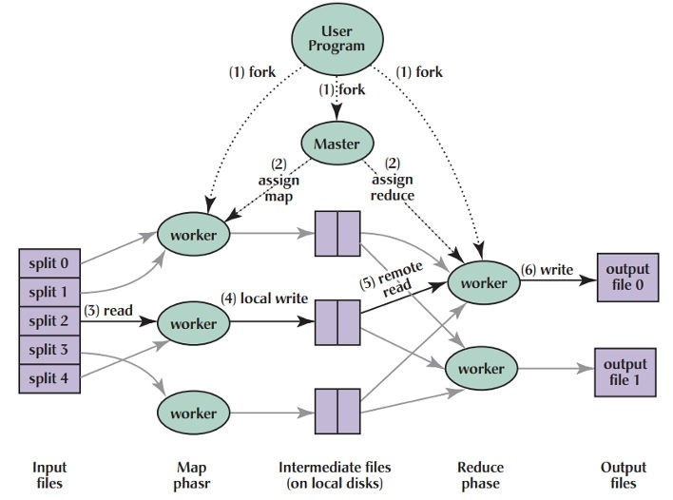
MapReduce Execution (1/7)
◮ The user program divides the input files into M splits.
A typical size of a split is the size of a HDFS block (64 MB).
Converts them to key/value pairs.
◮ It starts up many copies of the program on a cluster of machines.
J. Dean and S. Ghemawat, “MapReduce: simplified data processing on large clusters”, ACM Communications 51(1), 2008.
Engin Arslan
MapReduce
Feb 3, 2018
23 / 44

Slide 26
MapReduce Execution (2/7)
◮ One of the copies of the program is master, and the rest are workers.
◮ The master assigns works to the workers.
It picks idle workers and assigns each one a map task or a reduce task.
J. Dean and S. Ghemawat, “MapReduce: simplified data processing on large clusters”, ACM Communications 51(1), 2008.
Engin Arslan
MapReduce
Feb 3, 2018
24 / 44

Slide 27
MapReduce Execution (3/7)
◮ A map worker reads the contents of the corresponding input splits.
◮ It parses key/value pairs out of the input data and passes each pair to the user defined map function.
◮ The intermediate key/value pairs produced by the map function are buffered in memory.
J. Dean and S. Ghemawat, “MapReduce: simplified data processing on large clusters”, ACM Communications 51(1), 2008.
Engin Arslan
MapReduce
Feb 3, 2018
25 / 44

Slide 28
MapReduce Execution (4/7)
◮ The buffered pairs are periodically written to local disk.
They are partitioned into R regions (hash(key) mod R).
◮ The locations of the buffered pairs on the local disk are passed back to the master.
◮ The master forwards these locations to the reduce workers.
J. Dean and S. Ghemawat, “MapReduce: simplified data processing on large clusters”, ACM Communications 51(1), 2008.
Engin Arslan
MapReduce
Feb 3, 2018
26 / 44

Slide 29
MapReduce Execution (5/7)
◮ A reduce worker reads the buffered data from the local disks of the map workers.
◮ When a reduce worker has read all intermediate data, it sorts it by the intermediate keys.
J. Dean and S. Ghemawat, “MapReduce: simplified data processing on large clusters”, ACM Communications 51(1), 2008.
Engin Arslan
MapReduce
Feb 3, 2018
27 / 44

Slide 30
MapReduce Execution (6/7)
◮ The reduce worker iterates over the intermediate data.
◮ For each unique intermediate key, it passes the key and the corresponding set of intermediate values to the user defined reduce function.
◮ The output of the reduce function is appended to a final output file for this reduce partition.
J. Dean and S. Ghemawat, “MapRedu
Engin Arslan
MapReduce
Feb 3, 2018
28 / 44

Slide 31
MapReduce Execution (7/7)
◮ When all map tasks and reduce tasks have been completed, the master wakes up the user program.
J. Dean and S. Ghemawat, “MapReduce: simplified data processing on large clusters”, ACM Communications 51(1), 2008.
Engin Arslan
MapReduce
Feb 3, 2018
29 / 44

Slide 32
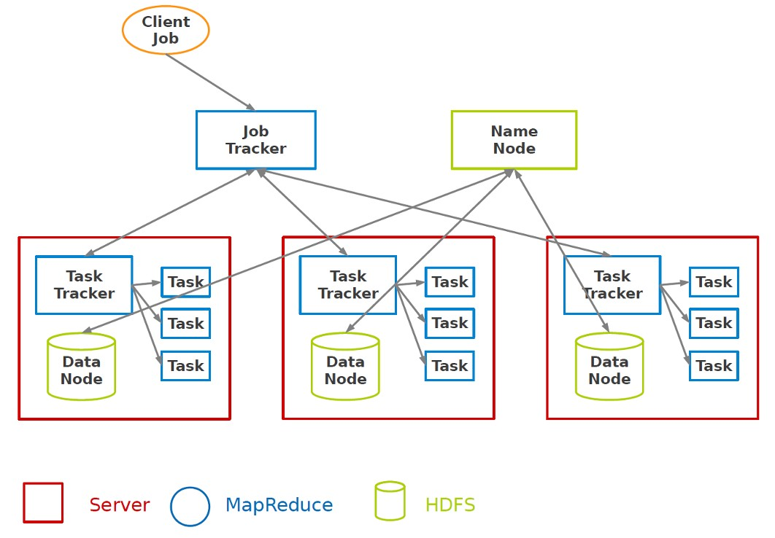
Hadoop MapReduce and HDFS
Engin Arslan
MapReduce
Feb 3, 2018
30 / 44

Slide 33
Fault Tolerance
◮ On worker failure:
Detect failure via periodic heartbeats.
Re-execute in-progress map and reduce tasks.
Re-execute completed map tasks: their output is stored on the local disk of the failed machine and is therefore inaccessible.
Completed reduce tasks do not need to be re-executed since their output is stored in a global filesystem.
◮ On master failure:
State is periodically checkpointed: a new copy of master starts from the last checkpoint state.
Engin Arslan
MapReduce
Feb 3, 2018
31 / 44

Slide 34
MapReduce Weaknesses and
Solving Techniques
Engin Arslan
MapReduce
Feb 3, 2018
32 / 44

Slide 35
W1: Access to Input Data
Weakness 1
◮ Scanning the entire input to perform the map-side processing.
◮ Initiating map tasks on all input partitions.
Accessing only a subset of input data would be enough in certain cases.
◮ Lack of selective access to data.
◮ High communication cost.
Engin Arslan
MapReduce
Feb 3, 2018
33 / 44

Slide 36
S1: Access to Input Data
Solution 1
◮ Efficient access to data.
◮ Indexing data: Hadoop++, HAIL
◮ Intentional data placement: CoHadoop
◮ Data layout: Llama, Cheetah, RCFile, CIF
Engin Arslan
MapReduce
Feb 3, 2018
34 / 44
Notes:
Hadoop++. Block indexing to achieve fast process for partial accesses
CoHadoop- put similar keys to same datanodes
Llama: Let Impala run on YARN

Slide 37
W2: Redundant Processing and Recomputation
Weakness 2
◮ Performing similar processing by different jobs over the same data.
Jobs are processed independently: redundant processing
◮ No way to reuse the results produced by previous jobs.
Future jobs may require those results: recompute everything
Engin Arslan
MapReduce
Feb 3, 2018
35 / 44

Slide 38
S2: Redundant Processing and Recomputation
Solution 2
◮ Batch processing of jobs: MRShare
◮ Result sharing and materialization: ReStore
◮ Incremental processing: Incoop
Engin Arslan
MapReduce
Feb 3, 2018
36 / 44
Notes:
MRShare: work-sharing across multiple platforms
Incoop: Reduce map-reduce jobs by running computation on only updated portion of dataset, reusing earlier job outcomes

Slide 39
W3: Lack of Early Termination
Weakness 3
◮ Map tasks must process the entire input data before any reduce task can start processing.
◮ Some jobs may need only sampling of data.
◮ Quick retrieval of approximate results.
Engin Arslan
MapReduce
Feb 3, 2018
37 / 44

Slide 40
S3: Lack of Early Termination
Solution 3
◮ Sampling: EARL
◮ Sorting: RanKloud
Engin Arslan
MapReduce
Feb 3, 2018
38 / 44
Notes:
EARL: return sample results for large complex analysis on massive datasets
RanKloud: Obtain k best results

Slide 41
W4: Lack of Iteration
Weakness 4
◮ MapReduce programmers need to write a sequence of MapReduce jobs and coordinate their execution, in order to implement an iter- ative processing.
◮ Data should be reloaded and reprocessed in each iteration.
Engin Arslan
MapReduce
Feb 3, 2018
39 / 44

Slide 42
S4: Lack of Iteration
Solution 4
◮ Looping, caching, pipelining: Twister, Haloop, MapReduce on- line, NOVA, CBP, Pregel, PrIter
◮ Incremental processing: REX, Differential dataflow
Engin Arslan
MapReduce
Feb 3, 2018
40 / 44

Slide 43
W5: Lack of Interactive and Real-Time Processing
Weakness 5
◮ Various overheads to guarantee fault-tolerance that negatively impact the performance.
◮ Many applications require fast response times, interactive analysis, and online analytics.
Engin Arslan
MapReduce
Feb 3, 2018
41 / 44

Slide 44
S5: Lack of Interactive and Real-Time Processing
Solution 5
◮ Streaming, pipelining: Dremel, Impala, Hyracks, Tenzing
◮ In-memory processing: PowerDrill, Spark/Shark, M3R
◮ Pre-computation: BlikDB
Engin Arslan
MapReduce
Feb 3, 2018
42 / 44

Slide 45
Summary
◮ Programming model: Map and Reduce
◮ Execution framework
◮ Batch processing
◮ Shared nothing architecture
Engin Arslan
MapReduce
Feb 3, 2018
43 / 44

Slide 46
Questions?
Engin Arslan
MapReduce
Feb 3, 2018
44 / 44

