Slide 1

Information Flow Processing
Engin Arslan
April 10, 2018
Engin Arslan
Information Flow Processing
April 10, 2018
<number> / 61

Slide 2
Motivation
◮ Many applications must process large streams of live data and provide results in real-time.
Engin Arslan
Information Flow Processing
April 10, 2018
2 / 61

Slide 3
Motivation
◮ Many applications must process large streams of live data and provide results in real-time.
Wireless sensor networks
Traffic management applications
Stock marketing
Environmental monitoring applications
Fraud detection tools
• ...
Engin Arslan
Information Flow Processing
April 10, 2018
2 / 61

Slide 4
Motivation
◮ Processing information as it flows, without storing them persistently.
Engin Arslan
Information Flow Processing
April 10, 2018
3 / 61

Slide 5
Motivation
◮ Processing information as it flows, without storing them persistently.
◮ Traditional DBMSs:
Store and index data before processing it.
Process data only when explicitly asked by the users.
Engin Arslan
Information Flow Processing
April 10, 2018
3 / 61

Slide 6
Motivation
◮ Processing information as it flows, without storing them persistently.
◮ Traditional DBMSs:
Store and index data before processing it.
Process data only when explicitly asked by the users.
Both aspects contrast with our requirements.
Engin Arslan
Information Flow Processing
April 10, 2018
3 / 61

Slide 7

One Name, Different Technologies
◮ Several research communities are contributing in this area:
Each brings its own expertise
Point of view
Vocabulary: event, data, stream, ...
Engin Arslan
Information Flow Processing
April 10, 2018
4 / 61

Slide 8



One Name, Different Technologies
◮ Several research communities are contributing in this area:
Each brings its own expertise
Point of view
Vocabulary: event, data, stream, ...
Tower of Babel Syndrome!
Come on! Let’s go down and confuse them by making them speak different languages, then they won’t be able to understand each other.
Genesis 11:7
Engin Arslan
Information Flow Processing
April 10, 2018
4 / 61

Slide 9
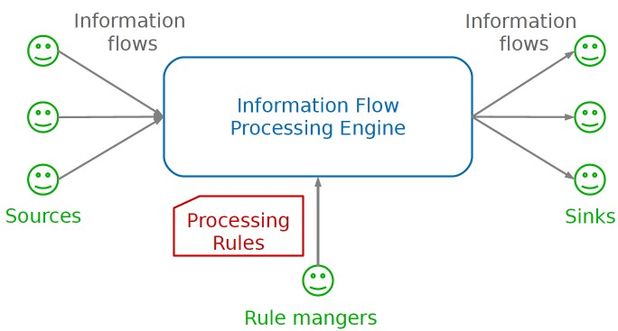
Information Flow Processing (IFP)
◮ Source: produces the incoming information flows
◮ Sink: consumes the results of processing
◮ IFP engine: processes incoming flows
◮ Processing rules: how to process the incoming flows
◮ Rule manager: adds/removes processing rules
Engin Arslan
Information Flow Processing
April 10, 2018
5 / 61

Slide 10
IFP Competing Models
◮ Data Stream Management Systems (DSMS)
◮ Complex Event Processing (CEP)
Engin Arslan
Information Flow Processing
April 10, 2018
6 / 61

Slide 11
IFP Competing Models
◮ Data Stream Management Systems (DSMS)
◮ Complex Event Processing (CEP)
Engin Arslan
Information Flow Processing
April 10, 2018
6 / 61

Slide 12
Data Stream Management Systems (DSMS)
◮ An evolution of traditional data processing, as supported by DBMSs.
Engin Arslan
Information Flow Processing
April 10, 2018
7 / 61

Slide 13
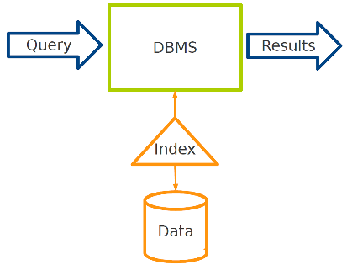
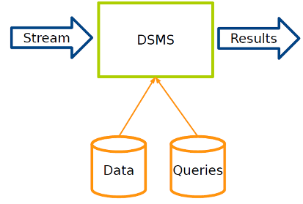
DBMS vs. DSMS (1/3)
◮ DBMS: persistent data where updates are relatively infrequent.
◮ DSMS: transient data that is continuously updated.
Engin Arslan
Information Flow Processing
April 10, 2018
8 / 61

Slide 14
DBMS vs. DSMS (2/3)
◮ DBMS: runs queries just once to return a complete answer.
◮ DSMS: executes standing queries, which run continuously and provide updated answers as new data arrives.
Engin Arslan
Information Flow Processing
April 10, 2018
9 / 61

Slide 15

DBMS vs. DSMS (3/3)
◮ Despite these differences, DSMSs resemble DBMSs: both process incoming data through a sequence of transformations based on SQL operators, e.g., selections, aggregates, joins.
Engin Arslan
Information Flow Processing
April 10, 2018
10 / 61

Slide 16
Out of Scope of DSMS
◮ DSMSs focus on producing query answers.
◮ Detection and notification of complex patterns of elements are usually out of the scope of DSMSs:
Engin Arslan
Information Flow Processing
April 10, 2018
11 / 61

Slide 17
Out of Scope of DSMS
◮ DSMSs focus on producing query answers.
◮ Detection and notification of complex patterns of elements are usually out of the scope of DSMSs: Complex Event Processing
Engin Arslan
Information Flow Processing
April 10, 2018
11 / 61

Slide 18
IFP Competing Models
◮ Data Stream Management Systems (DSMS)
◮ Complex Event Processing (CEP)
Engin Arslan
Information Flow Processing
April 10, 2018
12 / 61

Slide 19
Complex Event Processing (CEP)
◮ DSMSs limitation: detecting complex patterns of incoming items, involving sequencing and ordering relationships.
◮ CEP models flowing information items as notifications of events happening in the external world.
They have to be filtered and combined to understand what is happening in terms of higher-level events.
Engin Arslan
Information Flow Processing
April 10, 2018
13 / 61

Slide 20
CEP vs. Publish/Subscribe Systems
◮ CEP systems can be seen as an extension to traditional publish/subscribe systems.
Engin Arslan
Information Flow Processing
April 10, 2018
14 / 61

Slide 21
CEP vs. Publish/Subscribe Systems
◮ CEP systems can be seen as an extension to traditional publish/subscribe systems.
◮ Traditional publish/subscribe systems consider each event separately from the others, and filter them based on their topic or content.
Engin Arslan
Information Flow Processing
April 10, 2018
14 / 61

Slide 22
CEP vs. Publish/Subscribe Systems
◮ CEP systems can be seen as an extension to traditional publish/subscribe systems.
◮ Traditional publish/subscribe systems consider each event separately from the others, and filter them based on their topic or content.
◮ CEPs extend this functionality by increasing the expressive power of the subscription language to consider complex event patterns that involve the occurrence of multiple related events.
Engin Arslan
Information Flow Processing
April 10, 2018
14 / 61

Slide 23
Outline
◮ Stream processing engine
◮ Fault tolerance
◮ Related work
◮ Spark Stream (DStream)
Engin Arslan
Information Flow Processing
April 10, 2018
15 / 61

Slide 24
Outline
◮ Stream processing engine
◮ Fault tolerance
◮ Related work
◮ Spark Stream (DStream)
Engin Arslan
Information Flow Processing
April 10, 2018
15 / 61

Slide 25
Stream processing engine
◮ Stream: a sequence of unbounded tuples generated continuously in time · · · (a1, a2, · · · , an, t − 1)(a1, a2, · · · , an, t)(a1, a2, · · · , an, t + 1) · · ·, where a_{i} denotes an attribute.
Engin Arslan
Information Flow Processing
April 10, 2018
16/ 61

Slide 26
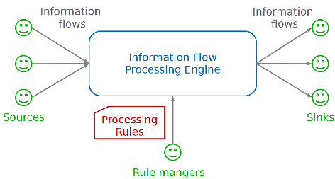
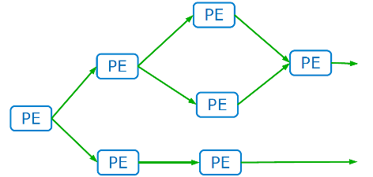
Stream processing engine
◮ Stream: a sequence of unbounded tuples generated continuously in time · · · (a1, a2, · · · , an, t − 1)(a1, a2, · · · , an, t)(a1, a2, · · · , an, t + 1) · · ·, where a_{i} denotes an attribute.
◮ Stream processing engine: creates a logical network of PEs connected in a DAG.
◮ Processing Element (PE): a processing unit in a stream processing engine.
Engin Arslan
Information Flow Processing
April 10, 2018
16 / 61

Slide 27
Processing Element (PE)
◮ Execute independently and in parallel
◮ Not synchronized
◮ Communicate through messaging: push-based vs. pull-based
◮ Upstream node vs. downstream node
◮ PE output: not emit a tuple, emit a tuple, or emit a tuple in a periodic manner
Engin Arslan
Information Flow Processing
April 10, 2018
17 / 61

Slide 28
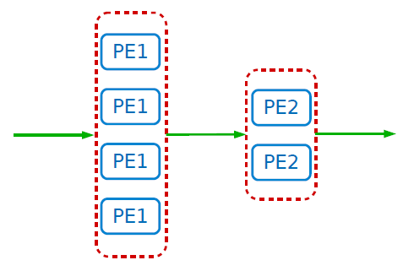

PE Physical Deployment
◮ A single PE can be running in parallel on different nodes.
Engin Arslan
Information Flow Processing
April 10, 2018
18 / 61

Slide 29
Outline
◮ Stream processing engine
◮ Fault tolerance
◮ Related work
◮ Spark Stream (DStream)
Engin Arslan
Information Flow Processing
April 10, 2018
19 / 61

Slide 30
Fault Tolerance
◮ The recovery methods of streaming frameworks must take:
Correctness, e.g., data loss and duplicates
Performance, e.g., low latency
Engin Arslan
Information Flow Processing
April 10, 2018
20 / 61

Slide 31
Basic Idea
◮ Each processing node has an associated backup node.
◮ The backup node’s stream processing engine is identical to the primary one.
◮ But the state of the backup node is not necessarily the same as that of the primary.
◮ If a primary node fails, its backup node takes over the operation of the failed node.
Engin Arslan
Information Flow Processing
April 10, 2018
21 / 61

Slide 32
Recovery Methods
◮ GAP recovery
◮ Rollback recovery
◮ Precise recovery
Engin Arslan
Information Flow Processing
April 10, 2018
22 / 61

Slide 33
GAP Recovery
◮ The weakest recovery guarantee
◮ A new task takes over the operations of the failed task.
◮ The new task starts from an empty state.
◮ Tuples can be lost during the recovery phase.
Engin Arslan
Information Flow Processing
April 10, 2018
23 / 61

Slide 34
Rollback Recovery
◮ The information loss is avoided, but the output may contain duplicate tuples.
◮ Three types of rollback recovery:
Active backup
Passive backup
Upstream backup
Engin Arslan
Information Flow Processing
April 10, 2018
24 / 61

Slide 35
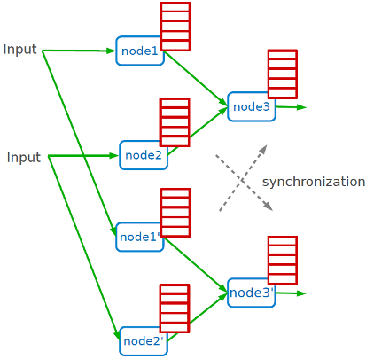
Rollback Recovery - Active Backup
◮ Both primary and backup nodes are given the same input.
◮ The output tuples of the backup node are logged at the output queues and they are not sent downstream.
◮ If the primary fails, the backup takes over by sending the logged tuples to all downstream neighbors and then continuing its processing.
Engin Arslan
Information Flow Processing
April 10, 2018
25 / 61

Slide 36
Rollback Recovery - Passive Backup
◮ Periodically check-points processing state to a shared storage.
◮ The backup node takes over from the latest checkpoint when the primary fails.
◮ The backup node is always equal or behind the primary.
Engin Arslan
Information Flow Processing
April 10, 2018
26 / 61

Slide 37
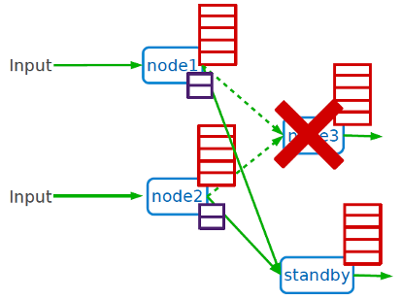
Rollback Recovery - Upstream Backup
◮ Upstream nodes store the tuples until the downstream nodes acknowledge them.
◮ If a node fails, an empty node rebuilds the latest state of the failed primary from the logs kept at the upstream server.
◮ There is no backup node in this model.
Engin Arslan
Information Flow Processing
April 10, 2018
27 / 61

Slide 38
Precise Recovery
◮ Post-failure output is exactly the same as the output without failure.
◮ Can be achieved by modifying the algorithms for rollback recovery.
For example, in passive backup, after a failure occurs the backup node can ask the downstream nodes for the latest tuples they received and trim the output queues accordingly to prevent the duplicates.
Engin Arslan
Information Flow Processing
April 10, 2018
28 / 61

Slide 39
Outline
◮ Stream processing engine
◮ Fault tolerance
◮ Related work
◮ Spark Stream (DStream)
Engin Arslan
Information Flow Processing
April 10, 2018
29 / 61

Slide 40
Related Work
◮ Samza
◮ Storm
◮ S4
Engin Arslan
Information Flow Processing
April 10, 2018
30 / 61

Slide 41
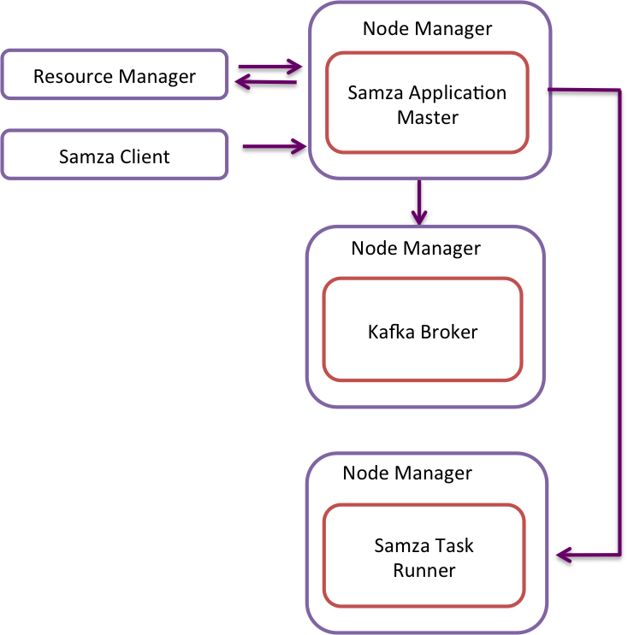
Apache Samza
Stream
Stream Task
Stream
Architecture based on Yarn
Engin Arslan
Information Flow Processing
April 10, 2018
31 / 61

Slide 42
Apache Samza
Data Mobility
  Brokers at the middle
Fault Tolerance
  For now Gap recovery, because a faulty broker node can loose messages, targeting Rollback recovery
Stream partitioning
  Based on key attributes in messages
Data storage
  Kafka stores the messages in the file system
Engin Arslan
Information Flow Processing
April 10, 2018
32 / 61

Slide 43
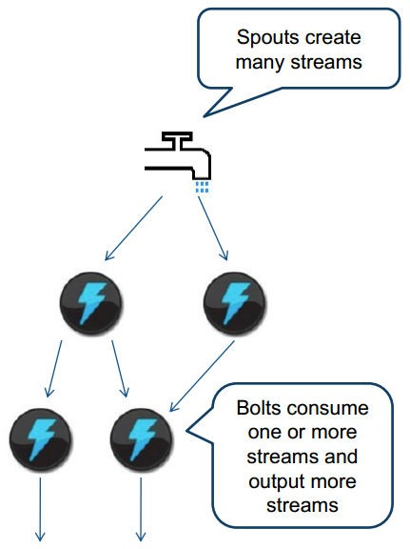
Storm (1/2)
◮ Stream processing is guaranteed: a message cannot be lost due to node failures.
◮ DAG based processing:
the DAG is called Topology
the PEs are called Bolts
the stream sources are called Spouts
◮ It does not have an explicit programming paradigm.
Engin Arslan
Information Flow Processing
April 10, 2018
33 / 61

Slide 44

Storm (2/2)
◮ Pull-based strategy.
◮ Rollback recovery with upstream backup.
◮ Three sets of nodes:
Nimbus: distributes the code among the worker nodes, and keeps track of the progress of the worker nodes
Supervisor: the set of worker nodes
Zookeeper: coordination between supervisor nodes and the Nimbus
◮ Built by twitter
Engin Arslan
Information Flow Processing
April 10, 2018
34 / 61

Slide 45
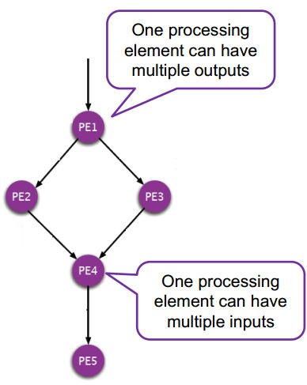
S4 (1/2)
◮ S4: Simple Scalable Streaming System.
◮ Constructing a DAG structure of PEs at runtime.
A PE is instantiated for each value of the key attribute.
◮ The processing model is inspired by MapReduce.
◮ Events are dispatched to nodes according to their key.
Engin Arslan
Information Flow Processing
April 10, 2018
35 / 61

Slide 46

S4 (2/2)
◮ Push-based strategy
◮ GAP recovery
◮ Communication layer: coordination between the processing nodes and the messaging between nodes.
Uses Zookeeper
◮ Built by yahoo
Engin Arslan
Information Flow Processing
April 10, 2018
36 / 61

Slide 47
Outline
◮ Stream processing engine
◮ Fault tolerance
◮ Related work
◮ Spark Stream (DStream)
Engin Arslan
Information Flow Processing
April 10, 2018
37 / 61

Slide 48
Motivation
◮ To run stream processing at large scale, system has to be both:
Fault-tolerant: recover quickly from failures and stragglers.
Cost-efficient: do not require significant hardware beyond that needed for basic processing.
◮ Existing streaming systems do not have both properties.
Engin Arslan
Information Flow Processing
April 10, 2018
38 / 61

Slide 49
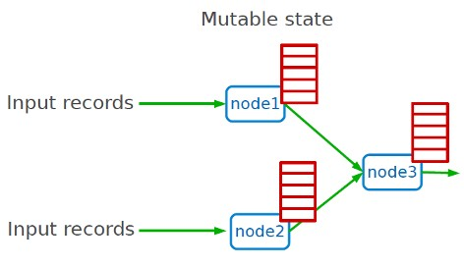
Existing Streaming Systems (1/2)
◮ Record-at-a-time processing model:
Each node has mutable state.
For each record, updates state and sends new records.
State is lost if node dies.
Engin Arslan
Information Flow Processing
April 10, 2018
39 / 61

Slide 50


Existing Streaming Systems (2/2)
◮ Fault tolerance via replication or upstream backup.
Engin Arslan
Information Flow Processing
April 10, 2018
40 / 61

Slide 51




Existing Streaming Systems (2/2)
◮ Fault tolerance via replication or upstream backup.
Fast recovery, but 2x hardware cost
Only need one standby, but slow to recover
Engin Arslan
Information Flow Processing
April 10, 2018
40 / 61

Slide 52

Existing Streaming Systems (2/2)
◮ Fault tolerance via replication or upstream backup.
Fast recovery, but 2x hardware cost
Only need one standby, but slow to recover
Neither approach tolerates stragglers.
Engin Arslan
Information Flow Processing
April 10, 2018
40 / 61

Slide 53
Observation
◮ Batch processing models for clusters provide fault tolerance efficiently.
◮ Divide job into deterministic tasks.
◮ Re-run failed/slow tasks in parallel on other nodes.
Engin Arslan
Information Flow Processing
April 10, 2018
41 / 61

Slide 54
Idea
Idea
Run a streaming computation as a series of very small and deterministic batch jobs.
Engin Arslan
Information Flow Processing
April 10, 2018
42 / 61

Slide 55
Challenges
◮ Latency (interval granularity)
Traditional batch systems replicate state on-disk storage: slow
◮ Recovering quickly from faults and stragglers
Engin Arslan
Information Flow Processing
April 10, 2018
43 / 61

Slide 56
Proposed Solution
◮ Latency (interval granularity)
Resilient Distributed Dataset (RDD)
Keep data in memory
No replication
◮ Recovering quickly from faults and stragglers
Storing the lineage graph
Using the determinism of D-Streams
Parallel recovery of a lost node’s state
Engin Arslan
Information Flow Processing
April 10, 2018
44 / 61

Slide 57
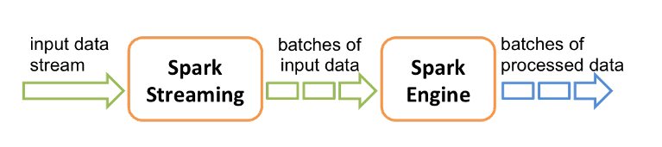
Discretized Stream Processing (D-Stream)
◮ Run a streaming computation as a series of very small, deterministic batch jobs.
Chop up the live stream into batches of X seconds.
Spark treats each batch of data as RDDs and processes them using RDD operations.
Finally, the processed results of the RDD operations are returned in batches.
Engin Arslan
Information Flow Processing
April 10, 2018
45 / 61

Slide 58
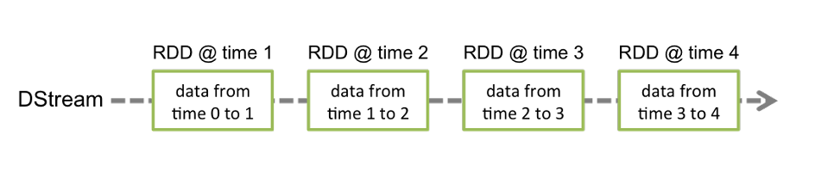
D-Stream API (1/4)
◮ DStream: sequence of RDDs representing a stream of data.
TCP sockets, Twitter, HDFS, Kafka, ...
Engin Arslan
Information Flow Processing
April 10, 2018
46 / 61

Slide 59
D-Stream API (1/4)
◮ DStream: sequence of RDDs representing a stream of data.
TCP sockets, Twitter, HDFS, Kafka, ...
◮ Initializing Spark streaming
val scc = new StreamingContext(master, appName, batchDuration, [sparkHome], [jars])
Engin Arslan
Information Flow Processing
April 10, 2018
46 / 61

Slide 60
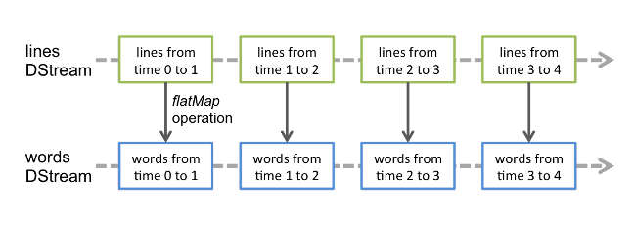
D-Stream API (2/4)
◮ Transformations: modify data from on DStream to a new DStream.
Standard RDD operations (stateless operations): map, join, ...
Engin Arslan
Information Flow Processing
April 10, 2018
<number> / 61

Slide 61
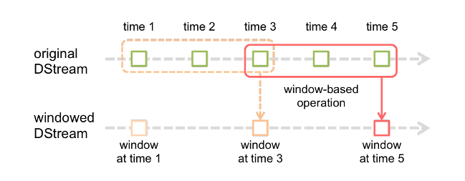
D-Stream API (2/4)
◮ Transformations: modify data from on DStream to a new DStream.
Standard RDD operations (stateless operations): map, join, ...
Stateful operations: group all the records from a sliding window of the past time intervals into one RDD: window, reduceByAndWindow, ...
Window length: the duration of the window.
Slide interval: the interval at which the operation is performed.
Engin Arslan
Information Flow Processing
April 10, 2018
47 / 61

Slide 62
D-Stream API (3/4)
◮ Output operations: send data to external entity
saveAsHadoopFiles, foreach, print, ...
Engin Arslan
Information Flow Processing
April 10, 2018
48 / 61

Slide 63
D-Stream API (3/4)
◮ Output operations: send data to external entity
saveAsHadoopFiles, foreach, print, ...
◮ Attaching input sources
ssc.textFileStream(directory)
ssc.socketStream(hostname, port)
Engin Arslan
Information Flow Processing
April 10, 2018
48 / 61

Slide 64
D-Stream API (4/4)
◮ Stream + Batch: It can be used to apply any RDD operation that is not exposed in the DStream API.
val spamInfoRDD = sparkContext.hadoopFile(...)
// join data stream with spam information to do data cleaning
val cleanedDStream = inputDStream.transform(_.join(spamInfoRDD).filter(...))
Engin Arslan
Information Flow Processing
April 10, 2018
49 / 61

Slide 65
D-Stream API (4/4)
◮ Stream + Batch: It can be used to apply any RDD operation that is not exposed in the DStream API.
val spamInfoRDD = sparkContext.hadoopFile(...)
// join data stream with spam information to do data cleaning
val cleanedDStream = inputDStream.transform(_.join(spamInfoRDD).filter(...))
◮ Stream + Interactive: Interactive queries on stream state from the Spark interpreter
freqs.slice("21:00", "21:05").topK(10)
Engin Arslan
Information Flow Processing
April 10, 2018
49 / 61

Slide 66
D-Stream API (4/4)
◮ Stream + Batch: It can be used to apply any RDD operation that is not exposed in the DStream API.
val spamInfoRDD = sparkContext.hadoopFile(...)
// join data stream with spam information to do data cleaning
val cleanedDStream = inputDStream.transform(_.join(spamInfoRDD).filter(...))
◮ Stream + Interactive: Interactive queries on stream state from the Spark interpreter
freqs.slice("21:00", "21:05").topK(10)
◮ Starting/stopping the streaming computation
ssc.start()
ssc.stop()
ssc.awaitTermination()
Engin Arslan
Information Flow Processing
April 10, 2018
49 / 61

Slide 67
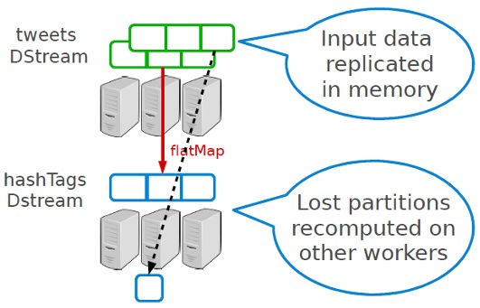
Fault Tolerance
◮ Spark remembers the sequence of operations that creates each RDD from the original fault-tolerant input data (lineage graph).
◮ Batches of input data are replicated in memory of multiple worker nodes.
◮ Data lost due to worker failure, can be recomputed from input data.
Engin Arslan
Information Flow Processing
April 10, 2018
50 / 61

Slide 68
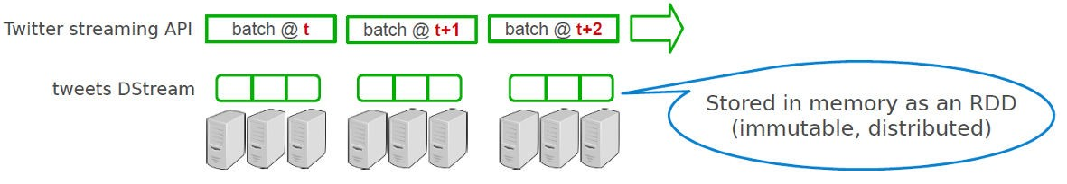
Example 1 (1/3)
◮ Get hash-tags from Twitter.
val ssc = new StreamingContext("local[2]", "test", Seconds(1))
val tweets = ssc.twitterStream(<username>, <password>)
DStream: a sequence of RDD representing a stream of data
Engin Arslan
Information Flow Processing
April 10, 2018
51 / 61

Slide 69
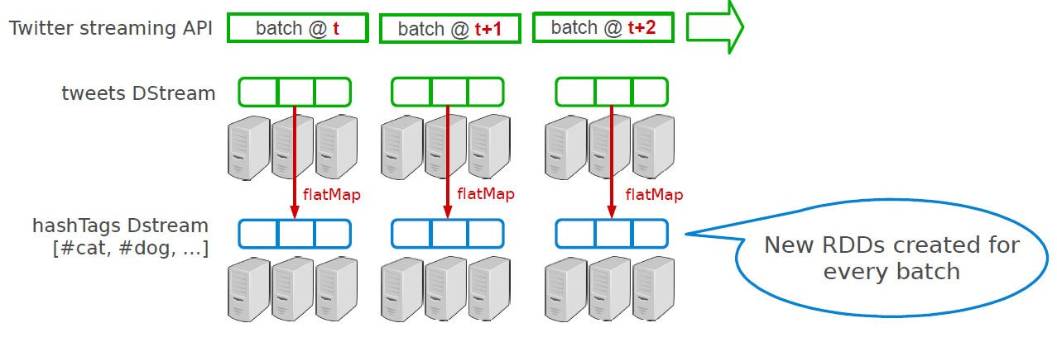
Example 1 (2/3)
◮ Get hash-tags from Twitter.
val ssc = new StreamingContext("local[2]", "test", Seconds(1))
val tweets = ssc.twitterStream(<username>, <password>)
val hashTags = tweets.flatMap(status => getTags(status))
transformation: modify data in one DStream to create another DStream
Engin Arslan
Information Flow Processing
April 10, 2018
52 / 61

Slide 70
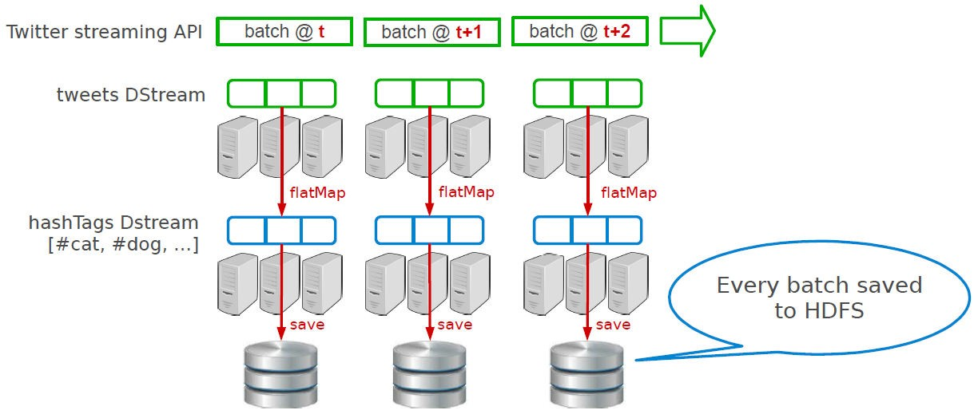
Example 1 (3/3)
◮ Get hash-tags from Twitter.
val ssc = new StreamingContext("local[2]", "test", Seconds(1)) val tweets = ssc.twitterStream(<username>, <password>)
val hashTags = tweets.flatMap(status => getTags(status)) hashTags.saveAsHadoopFiles("hdfs://...")
Engin Arslan
Information Flow Processing
April 10, 2018
53 / 61

Slide 71
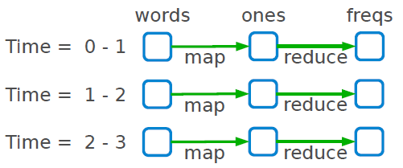
Example 2
◮ Count frequency of words received every second.
val ssc = new StreamingContext(args(0), "NetworkWordCount", Seconds(1))
val lines = ssc.socketTextStream(args(1), args(2).toInt)
val words = lines.flatMap(_.split(" "))
val ones = words.map(x => (x, 1))
val freqs = ones.reduceByKey(_ + _)
Engin Arslan
Information Flow Processing
April 10, 2018
54 / 61

Slide 72
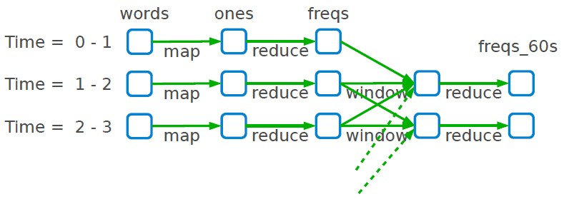
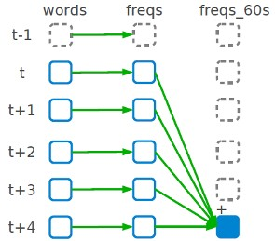
Example 3
◮ Count frequency of words received in last minute.
val ssc = new StreamingContext(args(0), "NetworkWordCount", Seconds(1)) val lines = ssc.socketTextStream(args(1), args(2).toInt)
val words = lines.flatMap(_.split(" ")) val ones = words.map(x => (x, 1))
val freqs = ones.reduceByKey(_ + _)
val freqs_60s = freqs.window(Seconds(60), Second(1)).reduceByKey(_ + _)
window length
window movement
Engin Arslan
Information Flow Processing
April 10, 2018
55 / 61

Slide 73
Example 3 - Simpler Model
◮ Count frequency of words received in last minute.
val ssc = new StreamingContext(args(0), "NetworkWordCount", Seconds(1))
val lines = ssc.socketTextStream(args(1), args(2).toInt)
val words = lines.flatMap(_.split(" ")) val ones = words.map(x => (x, 1))
val freqs_60s = ones.reduceByKeyAndWindow(_ + _, Seconds(60), Seconds(1))
Engin Arslan
Information Flow Processing
April 10, 2018
56 / 61

Slide 74

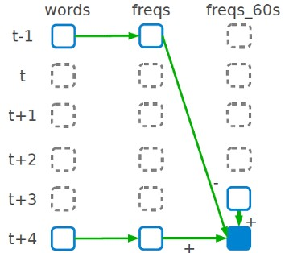
Example 3 - Incremental Window Operators
◮ Count frequency of words received in last minute.
// Associative only
freqs_60s = ones.reduceByKeyAndWindow(_ + _, Seconds(60), Seconds(1))
// Associative and invertible
freqs_60s = ones.reduceByKeyAndWindow(_ + _, _ - _, Seconds(60), Seconds(1))
Associative only
Associative and invertible
Engin Arslan
Information Flow Processing
April 10, 2018
57 / 61

Slide 75
Example 4 - Standalone Application (1/2)
import org.apache.spark.streaming.{Seconds, StreamingContext} import org.apache.spark.streaming.StreamingContext._
import org.apache.spark.storage.StorageLevel
object NetworkWordCount {
def main(args: Array[String]) {
...
  val ssc = new StreamingContext(args(0), "NetworkWordCount", Seconds(1))
  val lines = ssc.socketTextStream(args(1), args(2).toInt)
  val words = lines.flatMap(_.split(" "))
  val ones = words.map(x => (x, 1))
  freqs = ones.reduceByKey(_ + _) freqs.print()
  ssc.start() ssc.awaitTermination()
}
}
Engin Arslan
Information Flow Processing
April 10, 2018
58 / 61

Slide 76
Example 4 - Standalone Application (2/2)
◮ sics.sbt:
name := "Stream Word Count" version := "1.0"
scalaVersion := "2.10.3" libraryDependencies ++= Seq(
"org.apache.spark" %% "spark-core" % "0.9.0-incubating",
"org.apache.spark" %% "spark-streaming" % "0.9.0-incubating"
)
resolvers += "Akka Repository" at "http://repo.akka.io/releases/"
Engin Arslan
Information Flow Processing
April 10, 2018
59 / 61

Slide 77
Summary
◮ IFP: DSMS and CEP
◮ Recovering models: GAP, Rollback, and Precise
◮ Spark Stream
Run a streaming computation as a series of very small, deterministic batch jobs.
DStream: sequence of RDDs
Operators: Transformations (stateless and stateful) and output operations
Engin Arslan
Information Flow Processing
April 10, 2018
60 / 61

Slide 78
Questions?
Acknowledgements
Some slides and pictures were derived from Matei Zaharia slides and the Spark web site (http://spark.apache.org/).
Engin Arslan
Information Flow Processing
April 10, 2018
61 / 61

