Slide 1

Data Intensive Computing
Engin Arslan
earslan@unr.edu
Jan 23, 2018
Introduction
Jan 23, 2018

Slide 2
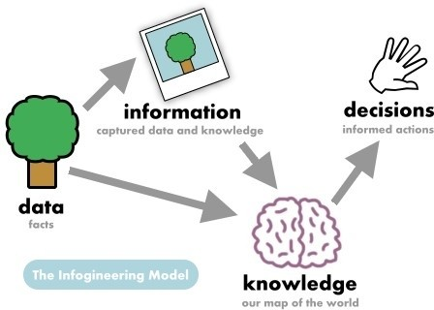
Data are not much use without human intuition ...
Data is not information, information is not knowledge, knowledge is not understanding, understanding is not wisdom.
- Clifford Stoll
Introduction
Jan 23, 2018
Notes:
American astronomer, worked in lawrance berkeley national lab

Slide 3
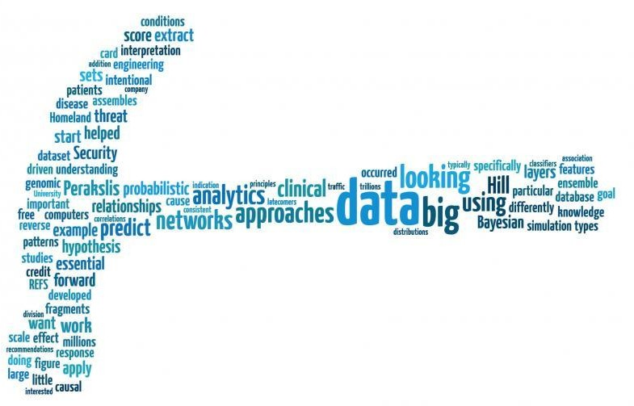
... analyzing data gives power.
Without big data analytics, companies are blind and deaf, wandering out onto the web like deer on a freeway.
- Geoffrey Moore
Introduction
Jan 23, 2018
Notes:
Organizational theoris, author

Slide 4

Analyzing data is worth the cost ...
The price of light is less than the cost of darkness.
- Arthur C. Nielsen
Introduction
Jan 23, 2018
Notes:
Founder of acnielsen company, electrical engineer

Slide 5
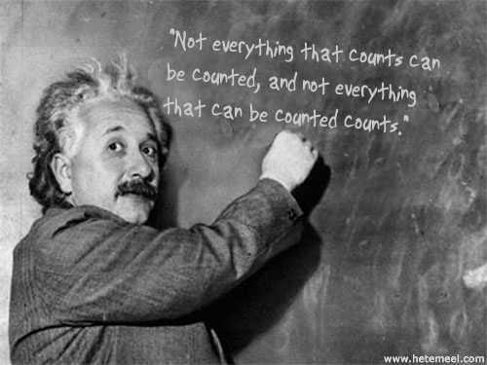
..., but there are problems with relying on data too much.
Not everything that can be counted counts, and not everything that counts can be counted.
- Albert Einstein
Introduction
Jan 23, 2018

Slide 6

Data is a treasure ..., except when it is not.
Getting information off the Internet is like taking a drink from a fire hose.
- Mitchell Kapor
Introduction
Jan 23, 2018
Notes:
Founder of lotus

Slide 7

However, any data is better than none.
An approximate answer to the right problem is worth a good deal more than an exact answer to an approximate problem.
- John Tukey
Introduction
Jan 23, 2018

Slide 8
A Brief History of Data Management!
Introduction
Jan 23, 2018

Slide 9
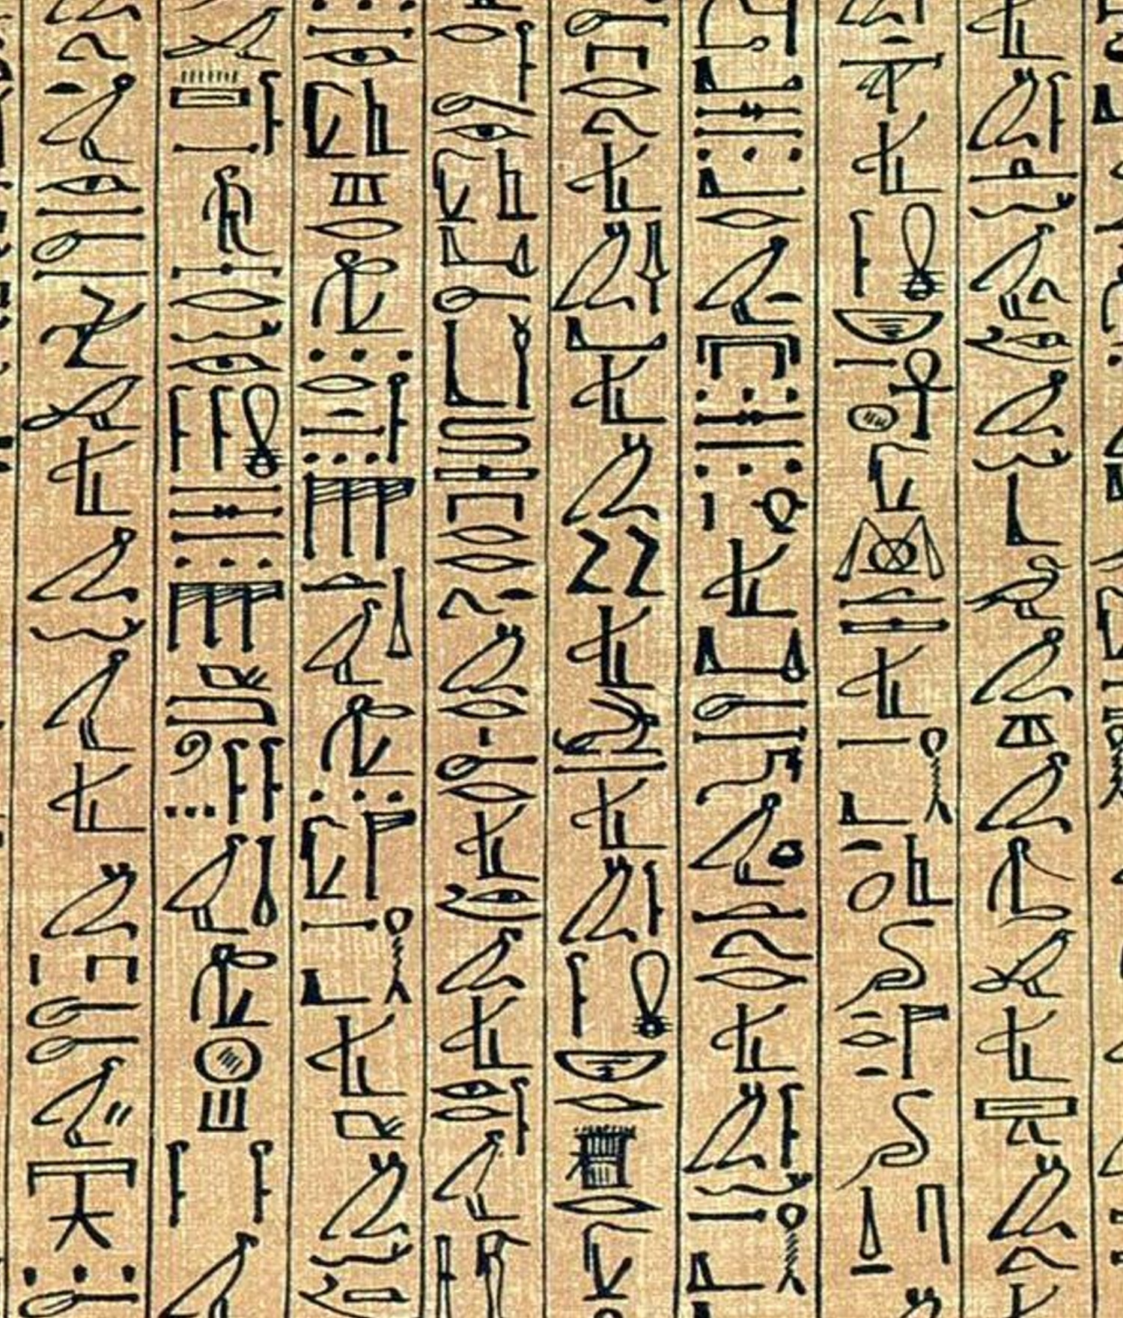
4000 B.C
Manual recording
From tablets to papyrus, to parchment, and then to paper
Introduction
Jan 23, 2018

Slide 10
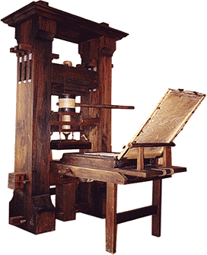
1450
Gutenberg’s printing press
Introduction
Jan 23, 2018

Slide 11
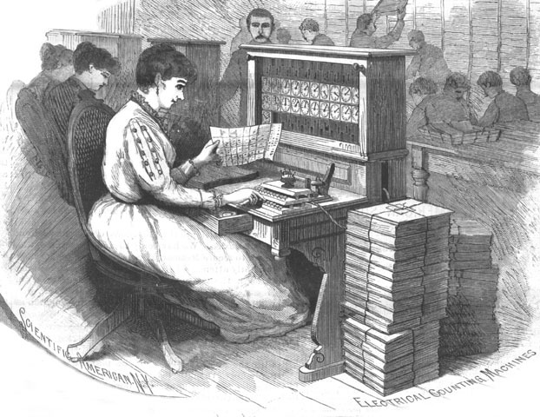

1800’s - 1940’s
Punched cards (no fault-tolerance)
Binary data
1890: US census
1911: IBM appeared
Introduction
Jan 23, 2018

Slide 12
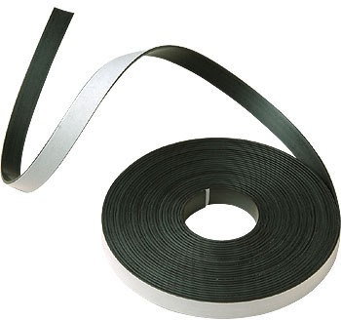

1940’s - 1970’s
Magnetic tapes
Batch transaction processing
File-oriented record processing model (e.g., COBOL)
Hierarchical DBMS (one-to-many)
Network DBMS (many-to-many)
Introduction
Jan 23, 2018
Notes:
Batch processing: running execution without interactivity

Slide 13

1980’s
Relational DBMS (tables) and SQL
ACID
Client-server computing
Parallel processing
Introduction
Jan 23, 2018

Slide 14

1990’s - 2000’s
The Internet...
Introduction
Jan 23, 2018

Slide 15
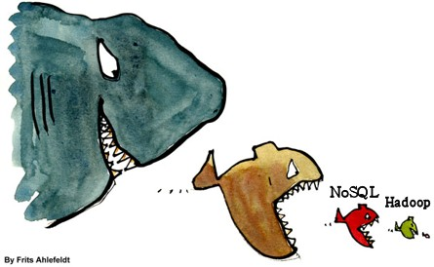
2010’s
NoSQL: BASE instead of ACID
Big Data
Introduction
Jan 23, 2018
Notes:
Basically available, soft state, eventual consistency

Slide 16

Big Data
In recent years we have witnessed a dramatic increase in available data.
For example, the number of web pages indexed by Google, which were around one million in 1998, have exceeded one trillion in 2008, and its expansion is accelerated by appearance of the social networks.
Introduction
Jan 23, 2018

Slide 17
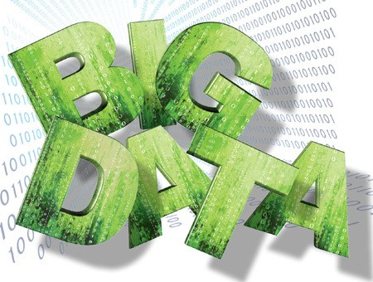
Big Data Definition
Big Data refers to datasets and flows large enough that has outpaced our capability to store, process, analyze, and understand.
Introduction
Jan 23, 2018

Slide 18
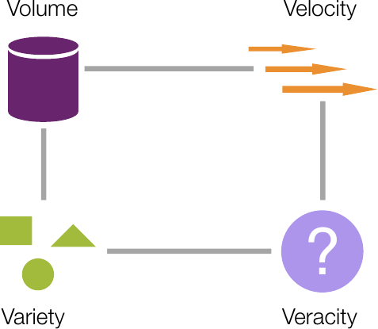
The Four Dimensions of Big Data
Volume: data size
Velocity: data generation rate
Variety: data heterogeneity
Veracity: uncertainty of accuracy and authenticity of data
Introduction
Jan 23, 2018

Slide 19

Big Data Market Driving Factors
Mobile devices
Internet of Things (IoT)
Cloud computing
Open source initiatives
Introduction
Jan 23, 2018

Slide 20
The Big Data Stack!
Introduction
Jan 23, 2018

Slide 21
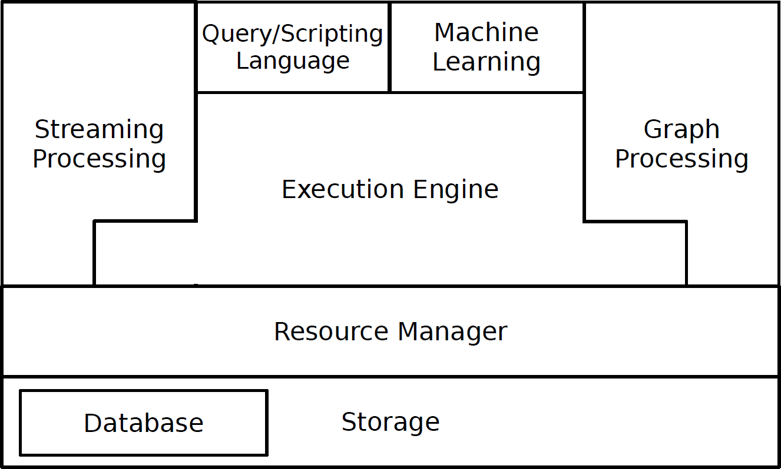
Big Data Analytics Stack
Introduction
Jan 23, 2018

Slide 22
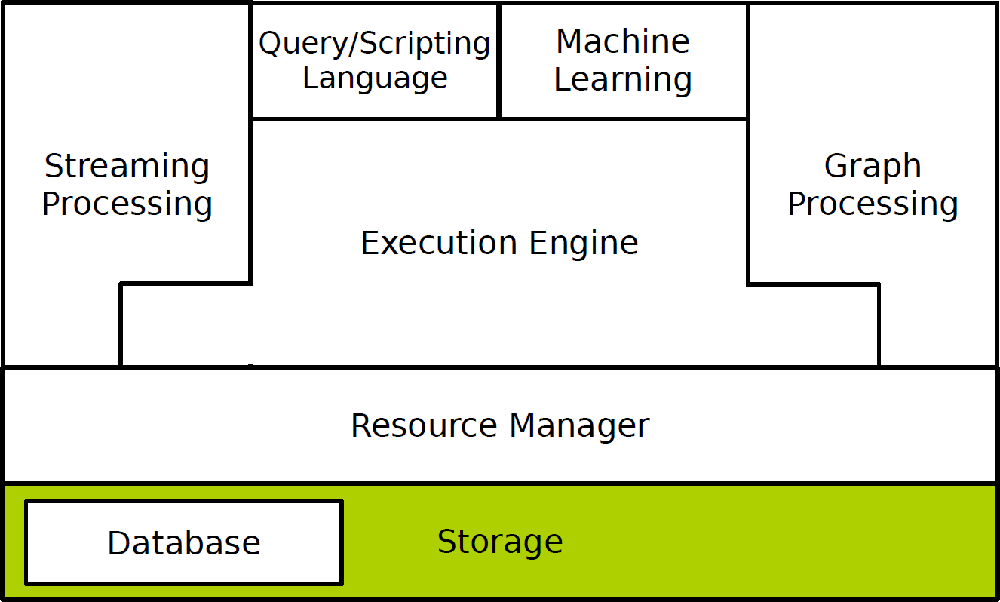
Big Data - Storage (Filesystem)
Traditional filesystems are not well-designed for large-scale data processing systems.
Efficiency has a higher priority than other features, e.g., directory service.
Massive size of data tends to store it across multiple machines in a distributed way.
HDFS, Amazon S3, ...
Introduction
Jan 23, 2018

Slide 23
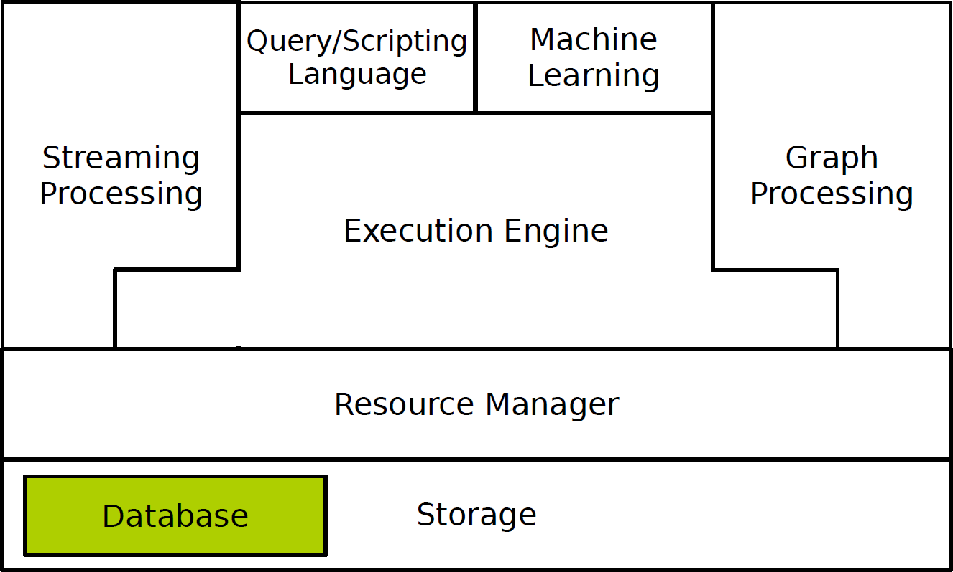
Big Data - Database
Relational Databases Management Systems (RDMS)were not de- signed to be distributed.
NoSQL databases relax one or more of theACID properties: BASE
Different data models: key/value, column-family, graph, document.
Dynamo, Scalaris, BigTable, Hbase, Cassandra, MongoDB, Volde- mort, Riak, Neo4J, ...
Introduction
Jan 23, 2018

Slide 24
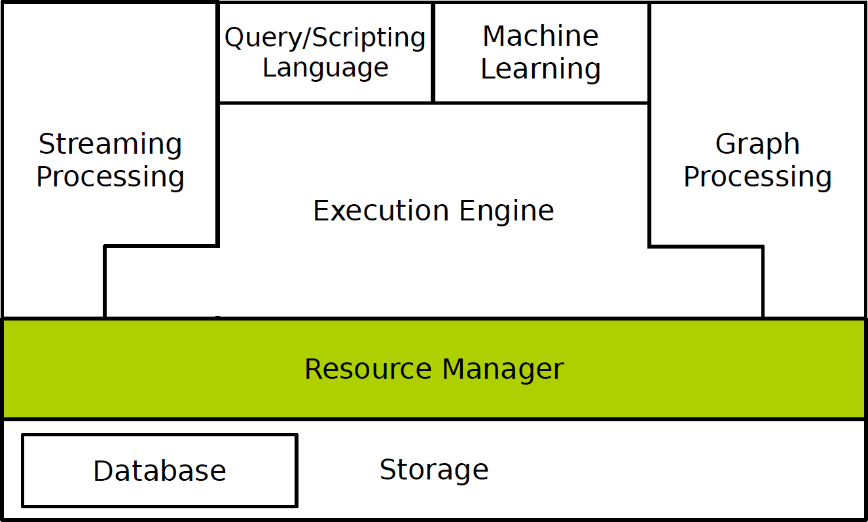
Big Data - Resource Management
Different frameworks require different computing resources.
Large organizations need the ability to share data and resources between multiple frameworks.
Resource management share resources in a cluster between multiple frameworks while providing resource isolation.
Mesos, YARN, Quincy, ...
Introduction
Jan 23, 2018

Slide 25
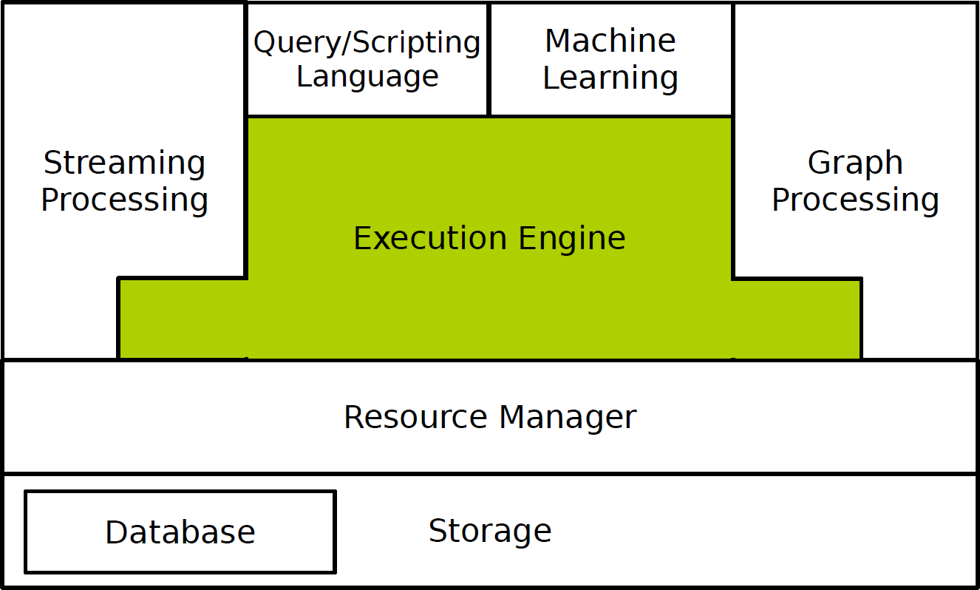
Big Data - Execution Engine
Scalable and fault tolerance parallel data processing on clusters of unreliable machines.
Data-parallel programming model for clusters of commodity ma- chines.
MapReduce, Spark, Stratosphere, Dryad, Hyracks, ...
Introduction
Jan 23, 2018

Slide 26
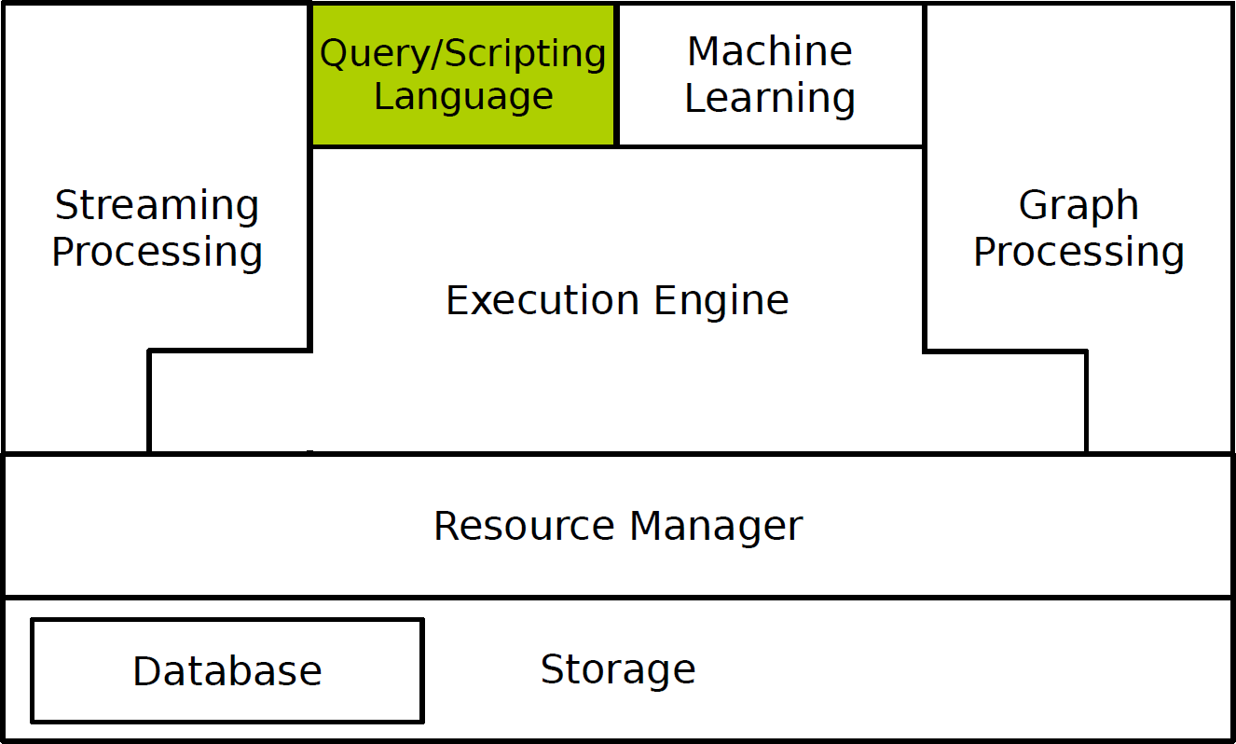
Big Data - Query/Scripting Language
Low-level programming of execution engines, e.g., MapReduce, is not easy for end users.
Need high-level language to improve the query capabilities of exe- cution engines.
It translates user-defined functions to low-level API of the execution engines.
Pig, Hive, Shark, Meteor, DryadLINQ, SCOPE, ...
Introduction
Jan 23, 2018

Slide 27
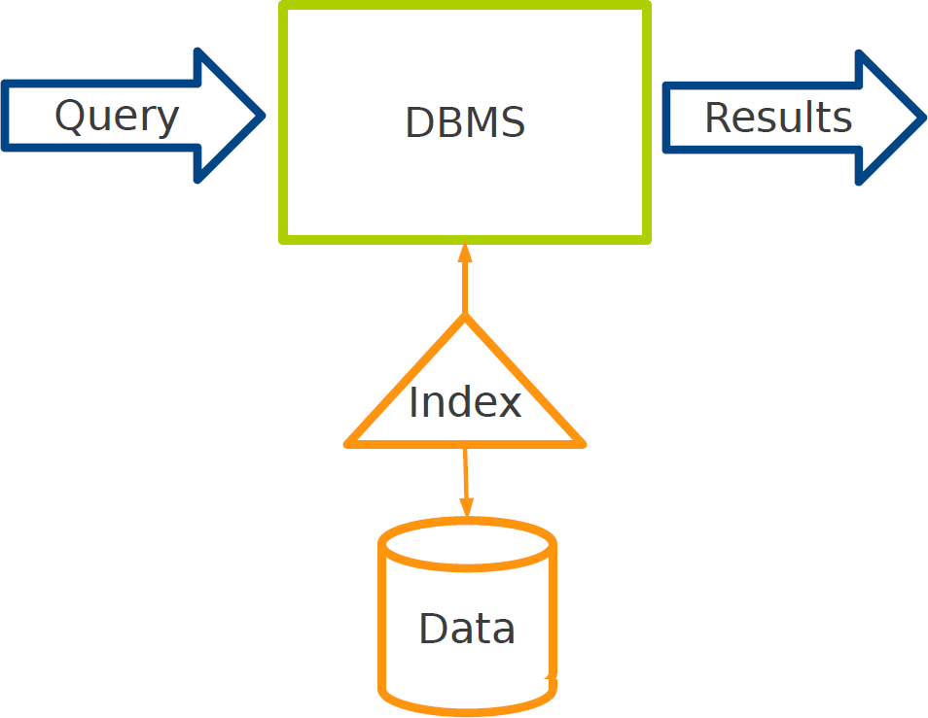
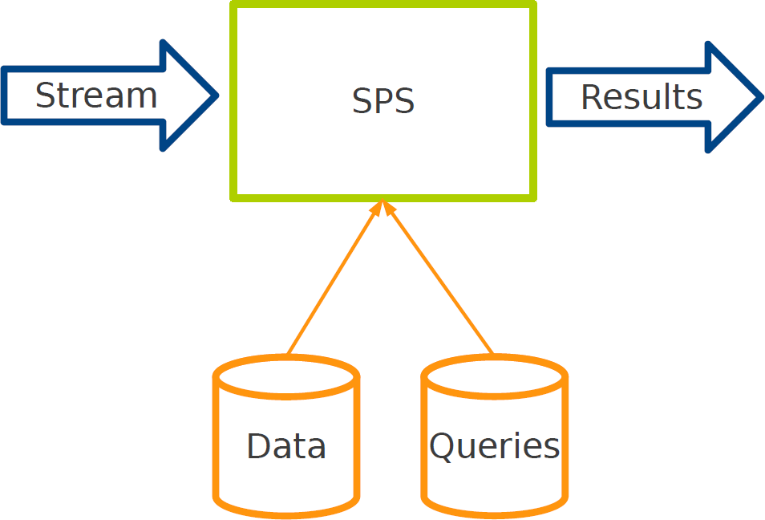
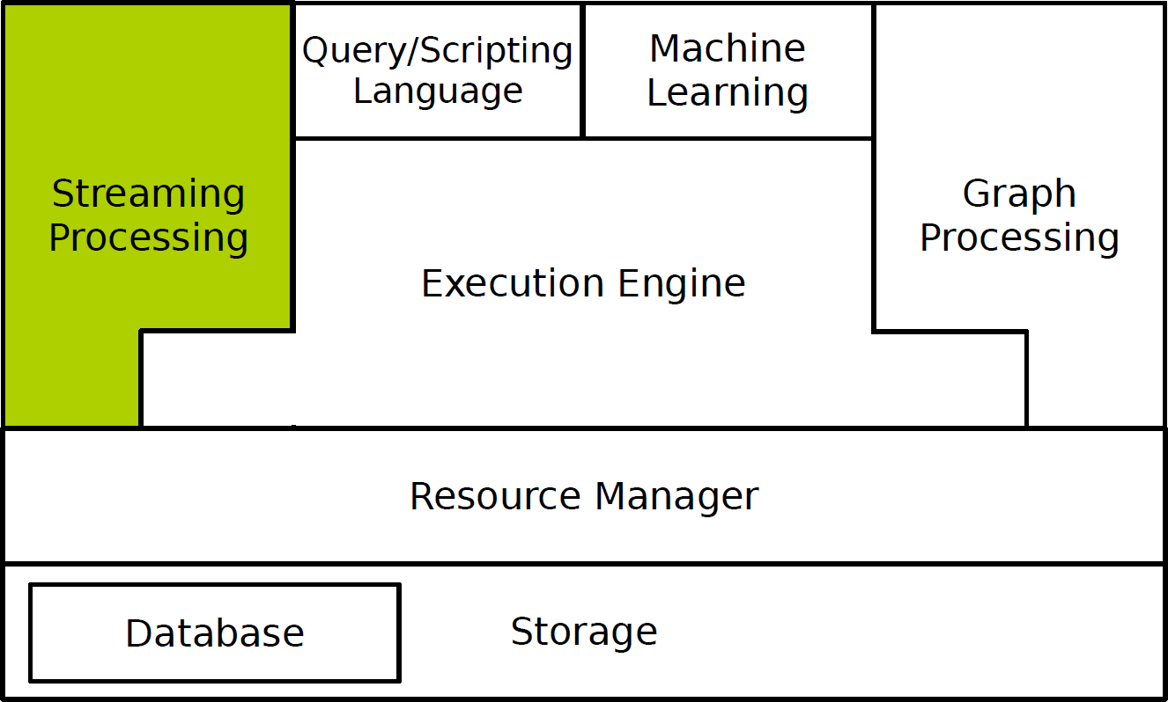
Big Data - Stream Processing
Providing users with fresh and low latency results.
Database Management Systems (DBMS) vs. Stream Processing Systems (SPS)
Storm, S4, SEEP, D-Stream, Naiad, ...
Introduction
Jan 23, 2018

Slide 28
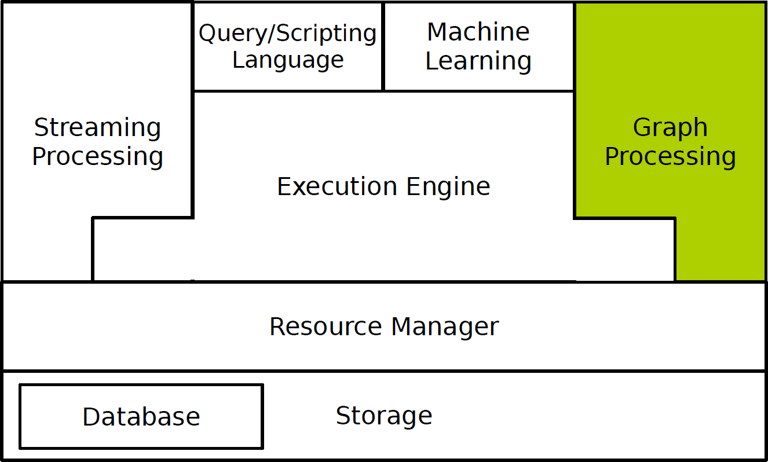
Big Data - Graph Processing
Many problems are expressed using graphs: sparse computational dependencies, and multiple iterations to converge.
Data-parallel frameworks, such as MapReduce, are not ideal for these problems: slow
Graph processing frameworks are optimized for graph-based prob- lems.
Pregel, Giraph, GraphX, GraphLab, PowerGraph, GraphChi, ...
Introduction
Jan 23, 2018

Slide 29
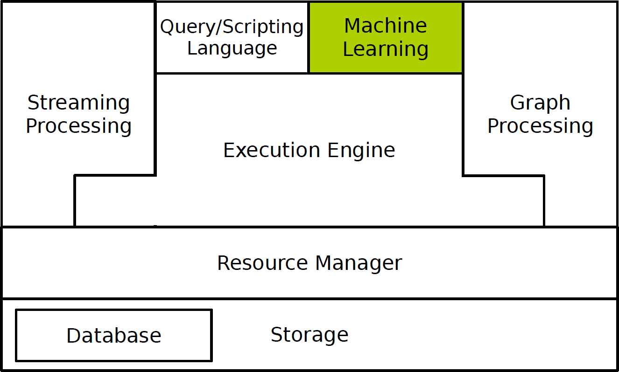
Big Data - Machine Learning
Implementing and consuming machine learning techniques at scale are difficult tasks for developers and end users.
There exist platforms that address it by providing scalable machine- learning and data mining libraries.
Mahout, MLBase, SystemML, Ricardo, Presto, ...
Introduction
Jan 23, 2018

Slide 30

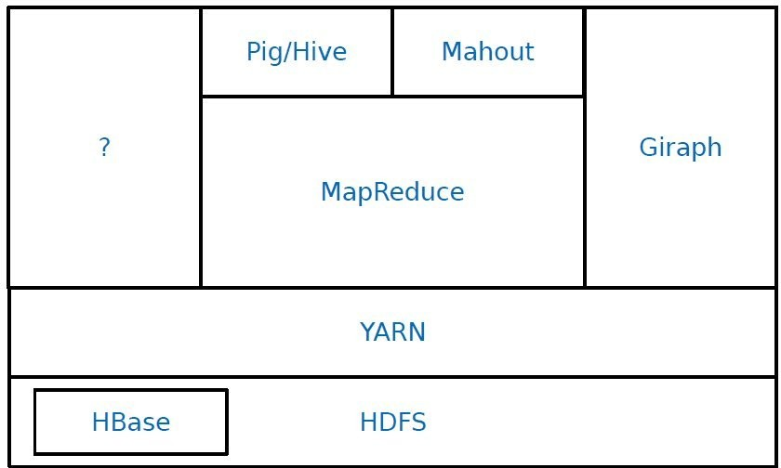
Hadoop Big Data Analytics Stack
Introduction
Jan 23, 2018

Slide 31

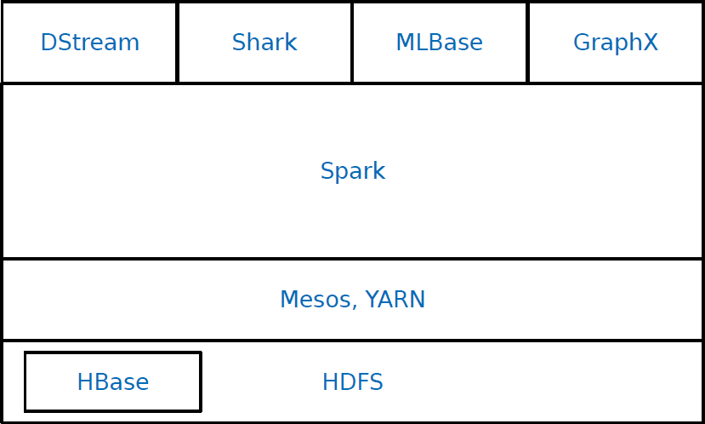
Spark Big Data Analytics Stack
Introduction
Jan 23, 2018

Slide 32
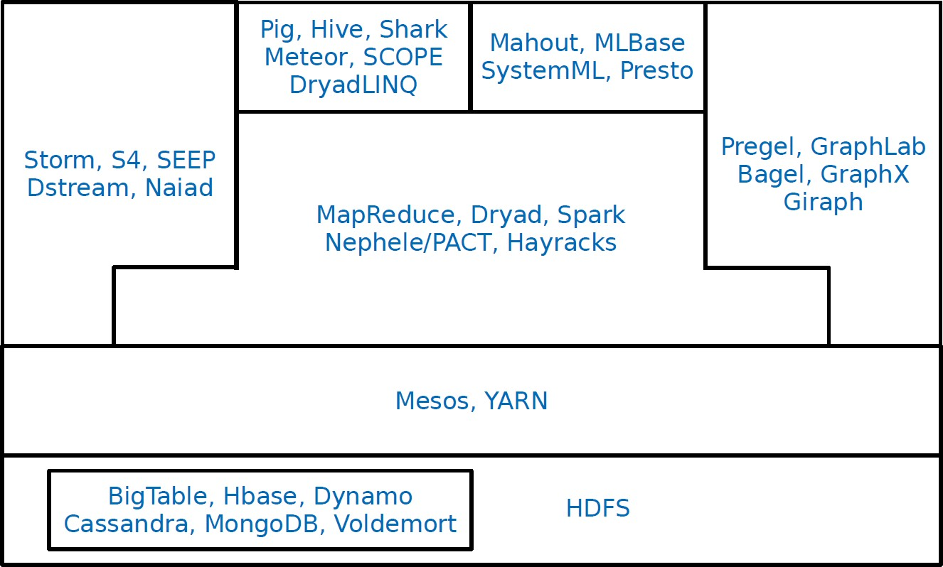
Summary
Introduction
Jan 23, 2018

Slide 33
Questions?
Introduction
Jan 23, 2018

