Slide 1
Chapter 11
Inheritance and
Polymorphism

Slide 2
Motivations
Suppose you will define classes to model
  Circle
  Rectangle
  Triangle
  Classes have many common features
  What is the best way to design these classes?
    avoid redundancy?
    answer is to use inheritance

Slide 3
Objectives
    To develop a subclass from a superclass through inheritance (§11.2).
    To invoke the superclass’s constructors and methods using the super keyword (§11.3).
    To override instance methods in the subclass (§11.4).
    To distinguish differences between overriding and overloading (§11.5).
    To explore the toString() method in the Object class (§11.6).
    To discover polymorphism and dynamic binding (§§11.7-11.8).
    To describe casting and explain why explicit downcasting is necessary (§11.9).
    To explore the equals() method in the Object class (§11.10).
    To store, retrieve, and manipulate objects in an ArrayList (§11.11).
    To implement a Stack class using ArrayList (§11.12).
    To restrict access to data and methods to subclasses using the protected visibility modifier (§11.13).
    To prevent class extending and method overriding using the final modifier (§11.14).

Slide 4

Superclasses and Subclasses
GeometricObject1
Circle4
Rectangle1
TestCircleRectangle
Run

Slide 5
Are superclass’s Constructor Inherited?
No. They are not inherited
Invoked explicitly or implicitly
Explicitly –
    using the super keyword
Constructor –
  used to construct an instance of a class
  Unlike properties and methods, a superclass's constructors are not inherited in the subclass
  Can only be invoked from the subclasses' constructors, using the keyword super
  If the keyword super is not explicitly used, the superclass's no-arg constructor is automatically invoked

Slide 6
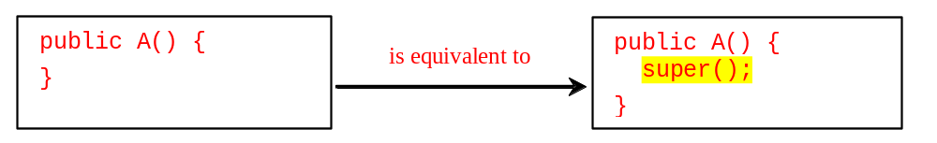

Superclass’s Constructor Is Always Invoked
A constructor may invoke –
  an overloaded constructor
  superclass’s constructor
If none of them is invoked explicitly
  Compiler puts super() as the first statement in the constructor

Slide 7
Using the Keyword super
keyword super –
  refers to the superclass of the class in which super appears
  keyword can be used in two ways:
    To call a superclass constructor
    To call a superclass method

Slide 8
CAUTION
Must use the keyword super to call the superclass constructor
Invoking a superclass constructor’s name in a subclass causes a syntax error
Java requires that the statement that uses the keyword super appear first in the constructor.

Slide 9
Constructor Chaining
Constructing an instance of a class invokes all the superclasses’ constructors along the inheritance chain (called constructor chaining).
public class Faculty extends Employee {
public static void main(String[] args) {
new Faculty();
}
public Faculty() {
System.out.println("(4) Faculty's no-arg constructor is invoked");
}
}
class Employee extends Person {
public Employee() {
this("(2) Invoke Employee’s overloaded constructor");
System.out.println("(3) Employee's no-arg constructor is invoked");
}
public Employee(String s) {
System.out.println(s);
}
}
class Person {
public Person() {
System.out.println("(1) Person's no-arg constructor is invoked");
}
}

Slide 10
Trace Execution
animation
public class Faculty extends Employee {
public static void main(String[] args) {
new Faculty();
}
public Faculty() {
System.out.println("(4) Faculty's no-arg constructor is invoked");
}
}
class Employee extends Person {
public Employee() {
this("(2) Invoke Employee’s overloaded constructor");
System.out.println("(3) Employee's no-arg constructor is invoked");
}
public Employee(String s) {
System.out.println(s);
}
}
class Person {
public Person() {
System.out.println("(1) Person's no-arg constructor is invoked");
}
}
1. Start from the main method

Slide 11
Trace Execution
animation
public class Faculty extends Employee {
public static void main(String[] args) {
new Faculty();
}
public Faculty() {
System.out.println("(4) Faculty's no-arg constructor is invoked");
}
}
class Employee extends Person {
public Employee() {
this("(2) Invoke Employee’s overloaded constructor");
System.out.println("(3) Employee's no-arg constructor is invoked");
}
public Employee(String s) {
System.out.println(s);
}
}
class Person {
public Person() {
System.out.println("(1) Person's no-arg constructor is invoked");
}
}
2. Invoke Faculty constructor

Slide 12
Trace Execution
animation
public class Faculty extends Employee {
public static void main(String[] args) {
new Faculty();
}
public Faculty() {
System.out.println("(4) Faculty's no-arg constructor is invoked");
}
}
class Employee extends Person {
public Employee() {
this("(2) Invoke Employee’s overloaded constructor");
System.out.println("(3) Employee's no-arg constructor is invoked");
}
public Employee(String s) {
System.out.println(s);
}
}
class Person {
public Person() {
System.out.println("(1) Person's no-arg constructor is invoked");
}
}
3. Invoke Employee’s no-arg constructor

Slide 13
Trace Execution
animation
public class Faculty extends Employee {
public static void main(String[] args) {
new Faculty();
}
public Faculty() {
System.out.println("(4) Faculty's no-arg constructor is invoked");
}
}
class Employee extends Person {
public Employee() {
this("(2) Invoke Employee’s overloaded constructor");
System.out.println("(3) Employee's no-arg constructor is invoked");
}
public Employee(String s) {
System.out.println(s);
}
}
class Person {
public Person() {
System.out.println("(1) Person's no-arg constructor is invoked");
}
}
4. Invoke Employee(String) constructor

Slide 14
Trace Execution
animation
public class Faculty extends Employee {
public static void main(String[] args) {
new Faculty();
}
public Faculty() {
System.out.println("(4) Faculty's no-arg constructor is invoked");
}
}
class Employee extends Person {
public Employee() {
this("(2) Invoke Employee’s overloaded constructor");
System.out.println("(3) Employee's no-arg constructor is invoked");
}
public Employee(String s) {
System.out.println(s);
}
}
class Person {
public Person() {
System.out.println("(1) Person's no-arg constructor is invoked");
}
}
5. Invoke Person() constructor

Slide 15
Trace Execution
animation
public class Faculty extends Employee {
public static void main(String[] args) {
new Faculty();
}
public Faculty() {
System.out.println("(4) Faculty's no-arg constructor is invoked");
}
}
class Employee extends Person {
public Employee() {
this("(2) Invoke Employee’s overloaded constructor");
System.out.println("(3) Employee's no-arg constructor is invoked");
}
public Employee(String s) {
System.out.println(s);
}
}
class Person {
public Person() {
System.out.println("(1) Person's no-arg constructor is invoked");
}
}
6. Execute println

Slide 16
Trace Execution
animation
public class Faculty extends Employee {
public static void main(String[] args) {
new Faculty();
}
public Faculty() {
System.out.println("(4) Faculty's no-arg constructor is invoked");
}
}
class Employee extends Person {
public Employee() {
this("(2) Invoke Employee’s overloaded constructor");
System.out.println("(3) Employee's no-arg constructor is invoked");
}
public Employee(String s) {
System.out.println(s);
}
}
class Person {
public Person() {
System.out.println("(1) Person's no-arg constructor is invoked");
}
}
7. Execute println

Slide 17
Trace Execution
animation
public class Faculty extends Employee {
public static void main(String[] args) {
new Faculty();
}
public Faculty() {
System.out.println("(4) Faculty's no-arg constructor is invoked");
}
}
class Employee extends Person {
public Employee() {
this("(2) Invoke Employee’s overloaded constructor");
System.out.println("(3) Employee's no-arg constructor is invoked");
}
public Employee(String s) {
System.out.println(s);
}
}
class Person {
public Person() {
System.out.println("(1) Person's no-arg constructor is invoked");
}
}
8. Execute println

Slide 18
Trace Execution
animation
public class Faculty extends Employee {
public static void main(String[] args) {
new Faculty();
}
public Faculty() {
System.out.println("(4) Faculty's no-arg constructor is invoked");
}
}
class Employee extends Person {
public Employee() {
this("(2) Invoke Employee’s overloaded constructor");
System.out.println("(3) Employee's no-arg constructor is invoked");
}
public Employee(String s) {
System.out.println(s);
}
}
class Person {
public Person() {
System.out.println("(1) Person's no-arg constructor is invoked");
}
}
9. Execute println

Slide 19
Impact of a Superclass without no-arg Constructor
Find out the errors in the program:
public class Apple extends Fruit {
}
class Fruit {
public Fruit(String name) {
System.out.println("Fruit's constructor is invoked");
}
}

Slide 20
Declaring a Subclass
subclass –
  extends properties and methods from the superclass
You can also:
    Add new properties
    Add new methods
    Override the methods of the superclass

Slide 21
Calling Superclass Methods
Can rewrite the printCircle() method in the Circle class as follows:
public void printCircle() {
System.out.println("The circle is created " +
super.getDateCreated() + " and the radius is " + radius);
}

Slide 22
Overriding Methods in the Superclass
A subclass inherits methods from a superclass
method overriding –
  subclass to modify the implementation of a method defined in the superclass
public class Circle extends GeometricObject {
// Other methods are omitted
/** Override the toString method defined in GeometricObject */
public String toString() {
return super.toString() + "\nradius is " + radius;
}
}

Slide 23
NOTE
An instance method can be overridden only if it is accessible
A private method cannot be overridden
  Is not accessible outside its own class
  If a method defined in a subclass is private in its superclass, the two methods are completely unrelated

Slide 24
NOTE
Like an instance method, a static method can be inherited
However, a static method cannot be overridden
If a static method defined in the superclass is redefined in a subclass, the method defined in the superclass is hidden

Slide 25

Overriding vs. Overloading

Slide 26

Object Class and Its Methods
Every class in Java is descended from the java.lang.Object class
If no inheritance is specified when a class is defined, the superclass of the class is Object

Slide 27
toString() method in Object
toString () –
  returns a string representation of the object
  default implementation –
    returns –
      a string consisting of a class name of which the object is an instance of
      at sign (@)
      a number representing this object
Loan loan = new Loan();
System.out.println(loan.toString());
Code displays something like Loan@15037e5
message is not very helpful or informative
Usually you should override the toString method so that it returns a digestible string representation of the object.

Slide 28


Polymorphism, Dynamic Binding and Generic Programming
public class PolymorphismDemo {
public static void main(String[] args) {
m(new GraduateStudent());
m(new Student());
m(new Person());
m(new Object());
}
public static void m(Object x) {
System.out.println(x.toString());
}
}
class GraduateStudent extends Student {
}
class Student extends Person {
public String toString() {
return "Student";
}
}
class Person extends Object {
public String toString() {
return "Person";
}
}
Method m takes a parameter of the Object type
Can invoke it with any object
An object of a subtype can be used wherever its supertype value is required
Feature is known as polymorphism
When the method m(Object x) is executed, the argument x’s toString method is invoked
x may be an instance of
  GraduateStudent
  Student, Person
  Object
  Classes GraduateStudent, Student, Person, and Object have their own implementation of the toString method
  Which implementation is used will be determined dynamically by the Java Virtual Machine at runtime
  apability is known as dynamic binding
PolymorphismDemo
Run

Slide 29

Dynamic Binding
Dynamic binding works as follows:
  An object o is an instance of classes C₁, C₂, ..., C_{n-1}, and C_{n}
  C₁ is a subclass of C₂, C₂ is a subclass of C₃, ..., and C_{n-1} is a subclass of C_{n}
  C_{n} is the most general class, and C₁ is the most specific class
  In Java, C_{n} is the Object class
  If o invokes a method p, the JVM searches the implementation for the method p in C₁, C₂, ..., C_{n-1} and C_{n,} in this order, until it is found
  Once an implementation is found, the search stops and the first-found implementation is invoked

Slide 30
Method Matching vs. Binding
Matching a method signature and binding a method implementation are two distinct issues
Compiler finds a matching method according to:
  parameter type
  number of parameters
  order of the parameters at compilation time
A method may be implemented in several subclasses
  Java Virtual Machine dynamically binds the implementation of the method at runtime
See Review Questions 10.7 and 10.9.

Slide 31
Generic Programming
public class PolymorphismDemo {
public static void main(String[] args) {
m(new GraduateStudent());
m(new Student());
m(new Person());
m(new Object());
}
public static void m(Object x) {
System.out.println(x.toString());
}
}
class GraduateStudent extends Student {
}
class Student extends Person {
public String toString() {
return "Student";
}
}
class Person extends Object {
public String toString() {
return "Person";
}
}
Polymorphism –
  allows methods to be used generically for a wide range of object arguments
  known as generic programming
  If a method’s parameter type is a superclass (e.g., Object), you may pass an object to this method of any of the parameter’s subclasses (e.g., Student or String)
  When an object (e.g., a Student object or a String object) is used in the method, the particular implementation of the method of the object that is invoked (e.g., toString) is determined dynamically

Slide 32
Casting Objects
Used the casting operator to convert variables of one primitive type to another
Casting can also be used to convert an object of one class type to another within an inheritance hierarchy
In the preceding section, the statement
  m(new Student());
assigns the object new Student() to a parameter of the Object type
statement is equivalent to:
  Object o = new Student(); // Implicit casting
  m(o);
The statement Object o = new Student(), known as implicit casting, is legal because an instance of Student is automatically an instance of Object.

Slide 33
Why Casting Is Necessary?
want to assign the object reference o to a variable of the Student type using the following statement:
  Student b = o;
A compilation error would occur
Why does the statement Object o = new Student() work
statement Student b = o doesn’t?
a Student object is always an instance of Object
an Object is not necessarily an instance of Student
Even though you can see that o is really a Student object, the compiler is not so clever to know it
To tell the compiler that o is a Student object, use an explicit casting
syntax is similar to the one used for casting among primitive data types
Enclose the target object type in parentheses and place it before the object to be cast, as follows:
  Student b = (Student)o; // Explicit casting

Slide 34
Casting from
Superclass to Subclass
Explicit casting must be used when casting an object from a superclass to a subclass
This type of casting may not always succeed
  Apple x = (Apple)fruit;
  Orange x = (Orange)fruit;

Slide 35
instanceof Operator
Use the instanceof operator to test whether an object is an instance of a class:
  Object myObject = new Circle();
  ... // Some lines of code
  /** Perform casting if myObject is an instance of Circle */
  if (myObject instanceof Circle) {
  System.out.println("The circle diameter is " +
  ((Circle)myObject).getDiameter());
  ...
  }

Slide 36
TIP
To help understand casting, you may also consider the analogy of fruit, apple, and orange with the Fruit class as the superclass for Apple and Orange
An apple is a fruit, so you can always safely assign an instance of Apple to a variable for Fruit
A Fruit is not necessarily an Apple, so you have to use explicit casting to assign an instance of Fruit to a variable of Apple

Slide 37
Demonstrating Polymorphism and Casting
Example creates two geometric objects:
  a circle
  a rectangle
  invokes the displayGeometricObject method to:
    display the objects
  displayGeometricObject –
      displays the area and diameter if the object is a circle
      displays area if the object is a rectangle
CastingDemo
Run

Slide 38
equals Method
equals()—
  Compares the contents of two objects
  Default implementation of the equals method in the Object class is as follows:
public boolean equals(Object obj) {
return (this == obj);
}
public boolean equals(Object o) {
if (o instanceof Circle) {
return radius == ((Circle)o).radius;
}
else
return false;
}
Equals () method is overridden in the Circle class

Slide 39
NOTE
== comparison operator used for:
  comparing two primitive data type values
  determining whether two objects have the same references
equals () method is intended to:
  test whether two objects have the same contents
    provided that the method is modified in the defining class of the objects
  == operator is stronger than the equals method, in that the == operator checks whether the two reference variables refer to the same object

Slide 40
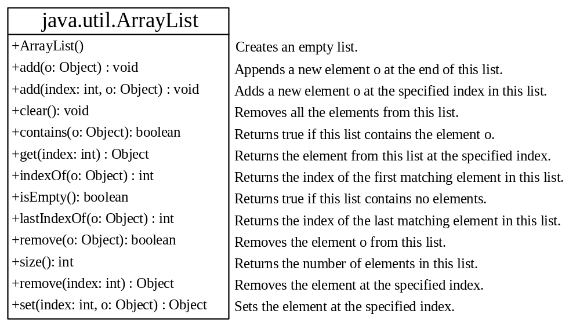
ArrayList and Vector Classes
can create an array to store objects
array’s size is fixed once the array is created
Java provides ArrayList class that can be used to store an unlimited number of objects

Slide 41
Compile Warning
You will get a compilation warning –
  “unchecked operation.”
  Ignore it
  This warning can be fixed using generic types in Chapter 20
TestArrayList
Run

Slide 42

MyStack Classes
A stack to hold objects.
MyStack

Slide 43
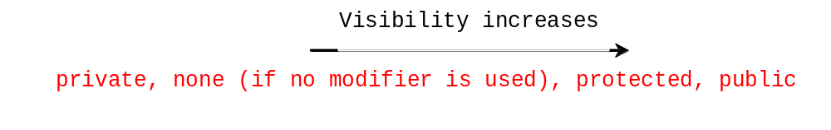
protected Modifier
protected modifier –
  can be applied to data and methods in a class
  A protected data or a protected method in a public class can be accessed by any class in the same package or its subclasses, even if the subclasses are in a different package
Private
Protected
Package (default)
public

Slide 44

Accessibility Summary

Slide 45

Visibility Modifiers

Slide 46
A Subclass Cannot Weaken the Accessibility
A subclass may override a protected method in its superclass and change its visibility to public
A subclass cannot weaken the accessibility of a method defined in the superclass
If a method is defined as public in the superclass, it must be defined as public in the subclass

Slide 47
NOTE
modifiers are used in –
  classes
  class members (data and methods)
  final modifier can also be used on local variables in a method
  A final local variable is a constant inside a method.

Slide 48
final Modifier
The final class cannot be extended:
final class Math {
...
}
The final variable is a constant:
final static double PI = 3.14159;
The final method cannot be
overridden by its subclasses.

