Slide 1
Introduction to CS520/CS596_026
Lecture One
Gordon Tian
408-668-5680
gtian@svuca.edu
gordontian@126.com
Fall 2015

Slide 2
Requirements
Cygwin
Nginx/php/mysql
Course website: www.sit.academy

Slide 3
INSTALL
Nginx/php/mysql
http://wtriple.com/wtnmp/?wtSrc=exe
Aptana
http://www.aptana.com/products/studio3/download.html
Cygwin
http://cygwin.com/install.html

Slide 4
Tools
http://bluefish.mrball.net/stable/binaries/win32/
http://www.aptana.com/products/studio3/download.html
http://www.eclipse.org/downloads/packages/eclipse-php-developers/heliossr2

Slide 5
What is HTML?
HTML is a markup language for describing web documents (web pages).
HTML stands for Hyper Text Markup Language
A markup language is a set of markup tags
HTML documents are described by HTML tags
Each HTML tag describes different document content

Slide 6
Example
<!DOCTYPE html>
<html>
<head>
<title>Page Title</title>
</head>
<body>
<h1>My First Heading</h1>
<p>My first paragraph.</p>
</body>
</html>
Save as .html or .htm file

Slide 7
HTML Versions
Tim Berners-Lee invented www 1989
Tim Berners-Lee invented HTML 1991
Dave Raggett drafted HTML+ 1993
HTML Working Group defined HTML 2.0 1995
W3C Recommended HTML 3.2 1997
W3C Recommended HTML 4.01 1999
W3C Recommended XHTML 1.0 2000
HTML5 WHATWG First Public Draft 2008
HTML5 WHATWG Living Standard 2012
HTML5 W3C Final Recommendation 2014

Slide 8
!DOCTYPE
HTML 5
<!DOCTYPE html>
HTML 4.01
<!DOCTYPE HTML PUBLIC "-//W3C//DTD HTML 4.01 Transitional//EN" "http://www.w3.org/TR/html4/loose.dtd">
HTML 1.0
<!DOCTYPE html PUBLIC "-//W3C//DTD XHTML 1.0 Transitional//EN" "http://www.w3.org/TR/xhtml1/DTD/xhtml1-transitional.dtd">

Slide 9
Comments
<!-- Write your comments here →
<!--[if IE 8]>
.... some HTML here ....
<![endif]-->

Slide 10
HTML Tags
<tag> content </tag>
Tags can be nested
HTML headings are defined with the <h1> to <h6> tags
<p>, <a>, <img>
Empty element: <br> or <br/>
<hr>
<pre> defines preformatted text.

Slide 12
Attributes
lang="en-US" for html
title for p
href for a
width and height for img or use style style="width:304px;height:228px;"
Use the style attribute. It prevents styles sheets from changing the original size of images

Slide 13
HTMl Styles - inline
style="property:value; property:value;"
<h1 style="color:blue">This is a heading</h1>
<p style="color:red">This is a paragraph.</p>
background-color, color, font-family, font-size, test-align

Slide 14
HTMl Styles – Internal CSS
<head>
<style>
Body {background-color:lightgrey}
h1 {color:blue}
p {color:green}
</style>
</head>

Slide 15
HTML Styles – External CSS
<head>
<link rel="stylesheet" href="styles.css">
</head>
To define a special style for one special element, add an id attribute to the element
p#p01 {
color:blue;
}
<p id="p01">I am different</p>
To define a style for a special type (class) of elements, add a class attribute to the element
p.error {
color:red;
}
<p class=“error“>Whoops</p>

Slide 16
Styles - <a>
<style>
a:link {color:green; background-color:transparent; text-decoration:none}
a:visited {color:pink; background-color:transparent; text-decoration:none}
a:hover {color:red; background-color:transparent; text-decoration:underline}
a:active {color:yellow; background-color:transparent; text-decoration:underline}
</style>

Slide 17
Styles - floating
<p>
<img src="smiley.gif" alt="Smiley face" style="float:right;width:42px;height:42px;">
The image will float to the right of the text.
</p>
<p>
<img src="smiley.gif" alt="Smiley face" style="float:left;width:42px;height:42px;">
The image will float to the left of the text.
</p>

Slide 18
Table
<style>
table, th, td {
border: 1px solid black;
border-spacing: 5px;
}
th, td {
padding: 15px;
text-align: left;
}
</style>

Slide 19
Table – more styles
table#t01 tr:nth-child(even) {
background-color: #eee;
}
table#t01 tr:nth-child(odd) {
background-color: #fff;
}
table#t01 th {
color: white;
background-color: black;
}

Slide 20
CSS
What is CSS?
CSS stands for Cascading Style Sheets
CSS defines how HTML elements are to be displayed
Styles were added to HTML 4.0 to solve a problem
CSS saves a lot of work
External Style Sheets are stored in CSS files

Slide 21
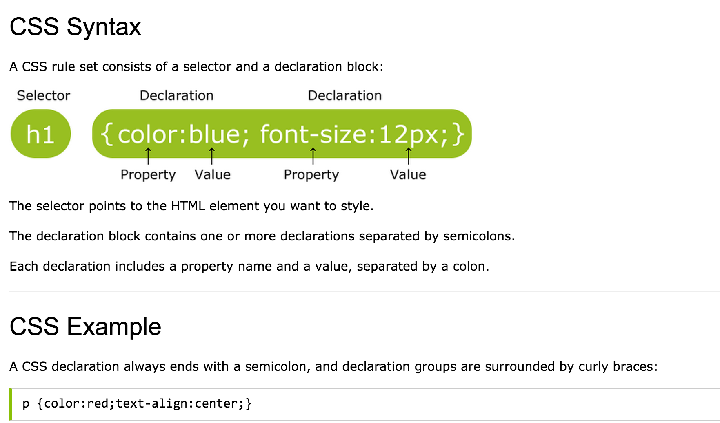
CSS

Slide 22
Selector
element
id
class

Slide 23
CSS Comment
Use c/c++/Java like comnet
/*
….
*/

