Slide 1
MySQL Essentials
Gordon Tian

Slide 2
Three Most Important Things
Backup
Redundancy – replication (master & slave)
Responsiveness

Slide 3
Backup
backup: # mysqldump -u root -p[root_password] [database_name] > dumpfilename.sql
restore:# mysql -u root -p[root_password] [database_name] < dumpfilename.sql

Slide 4
Replication
Master
log-bin = master-bin
log-bin-index = master-bin.index
server-id = 1
Mysql> CREATE USER repl_user;
Mysql> GRANT REPLICATION SLAVE ON *.*
-> TO repl_user IDENTIFIED BY ‘mypassword’;
SHOW MASTER STATUS;

Slide 5
Replication
Slave
server-id = 1
replay-log-index = slave-relay-bin.index
Relay-log = slave-relay-bin
Mysql> CHANGE MASTER TO
->MASTER_HOST =‘master-1’,
->MASTER_PORT = 3306,
->MASTER_USER =‘repl_user’,
->MASTER_PASSWORD =‘mypassword’

Slide 6
Sharding
Split data across many MySQL servers.
AUTO_INCREMENT: shard_id + AI_id

Slide 7
MySQL Cluster
MySQL cluster is a shared-nothing, auto-sharding storage solution with a distributed node architecture designed for fault tolerance and high performance.
MySQL cluster components are installed on different machines on a network, thus the cluster known as a network database (NDB). The MySQL cluster = MySQL Server + NDB components.
Data are synchronously replicated on NDB components or data nodes!!!

Slide 8
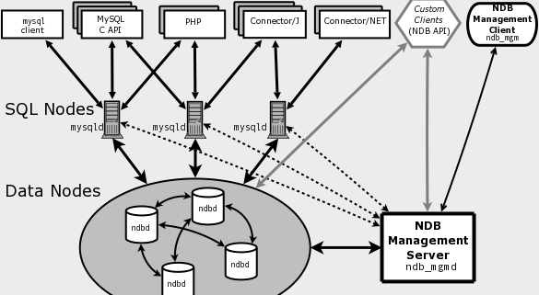
MySQL Cluster

Slide 9
SQL Joins
http://www.w3schools.com/sql/sql_join.asp
INNER JOIN: Returns all rows when there is at least one match in BOTH tables
LEFT JOIN: Return all rows from the left table, and the matched rows from the right table
RIGHT JOIN: Return all rows from the right table, and the matched rows from the left table
FULL JOIN: Return all rows when there is a match in ONE of the tables

Slide 10
Inner Join
SELECT column_name(s)
FROM table1
INNER JOIN table2
ON table1.column_name=table2.column_name;

Slide 11
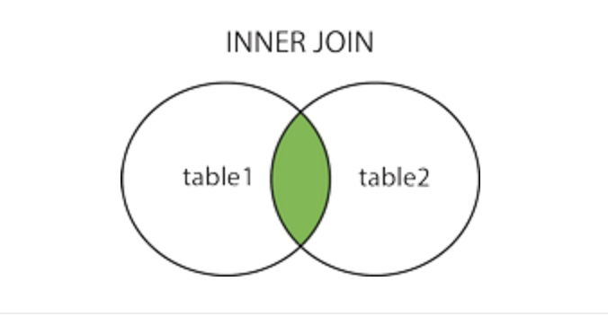
Inner Join

Slide 12
Left Join
SELECT column_name(s)
FROM table1
LEFT JOIN table2
ON table1.column_name=table2.column_name;

Slide 13
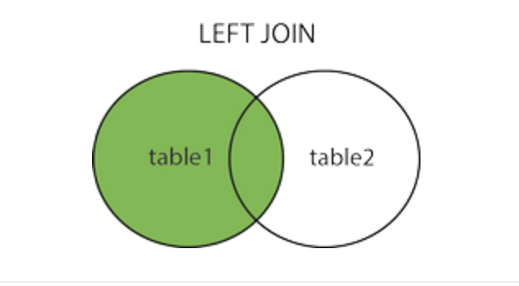
Left Join

Slide 14
Right Join
SELECT column_name(s)
FROM table1
RIGHT JOIN table2
ON table1.column_name=table2.column_name

Slide 15
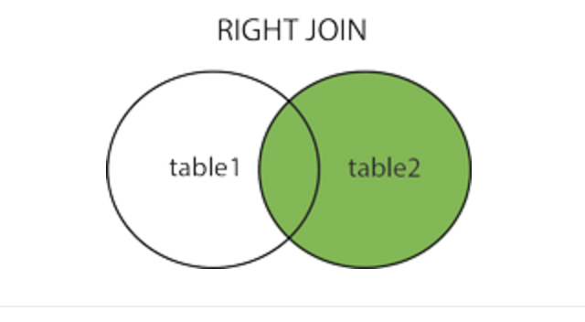
Right Join

