Slide 1
Spanning Tree protocol
CCNA Exploration Semester 3
Chapter 5
S Ward Abingdon and Witney College
Notes:
STP.ppt
S Ward Abingdon and Witney College

Slide 2
Topics
Redundancy in a converged network
How Spanning Tree Protocol (STP) eliminates layer 2 loops
The STP algorithm and its 3 steps
Rapid spanning tree protocol
S Ward Abingdon and Witney College

Slide 3
Semester 3
LAN Design
Basic Switch Concepts
Wireless
STP
VLANs
VTP
Inter-VLAN routing
S Ward Abingdon and Witney College

Slide 4
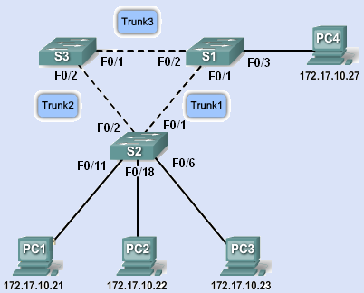
We want:
Redundancy at the distribution and core layers
Multiple switches and trunk links
One link or device fails – another takes over.
S Ward Abingdon and Witney College

Slide 5
But redundancy gives loops
Switching loops give problems if all the links are active:
Broadcast storms
Multiple frame transmission
Inconsistent switch tables
S Ward Abingdon and Witney College

Slide 6
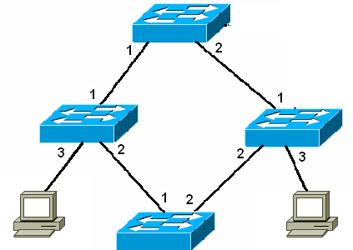
Broadcast storm
Flood broadcast through non-source ports
And so on with nothing to stop it
There’s a switching loop
Send ARP request
S Ward Abingdon and Witney College

Slide 7
Multiple Frame Transmissions
A is on port 3
Don’t know B
So flood
Send frame to B
Frame arrives
A
B
And again
S Ward Abingdon and Witney College

Slide 8
Inconsistent switch tables
?
A is on port 3
Don’t know B
So flood
A is on port 1
A is on port 2
???
A is on port 3
A is on port 1
A is on port 2
Send frame to B
A
B
S Ward Abingdon and Witney College

Slide 9
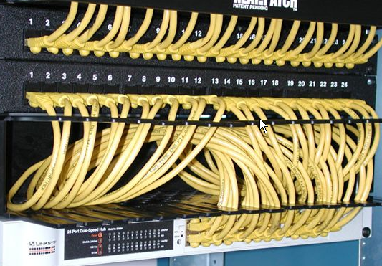
Loops by mistake
Even if there are no deliberate loops for redundancy, there can be loops set up by mistake.
S Ward Abingdon and Witney College

Slide 10

Etherchannel – the exception
Multiple connections do not make a loop where Etherchannel is used.
The links are aggregated to act as one link with the combined bandwidth.
S Ward Abingdon and Witney College

Slide 11
Redundancy without loops
There needs to be just one path at a time.
Redundant paths must be shut down, but ready to be opened when they are needed.
This must be done quickly and automatically.
Spanning Tree Protocol does this.
S Ward Abingdon and Witney College

Slide 12
What is a spanning tree?
A tree (extended star) topology
  A tree has no loops
Spanning all devices
  All devices are connected
S Ward Abingdon and Witney College

Slide 13
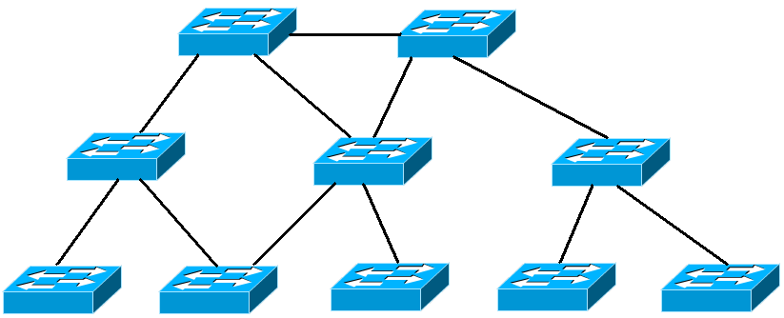
Not a spanning tree
Not a tree - it has loops.
S Ward Abingdon and Witney College

Slide 14
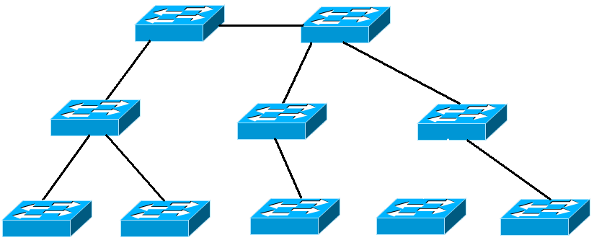
Not a spanning tree
Not spanning. Device left out.
S Ward Abingdon and Witney College

Slide 15
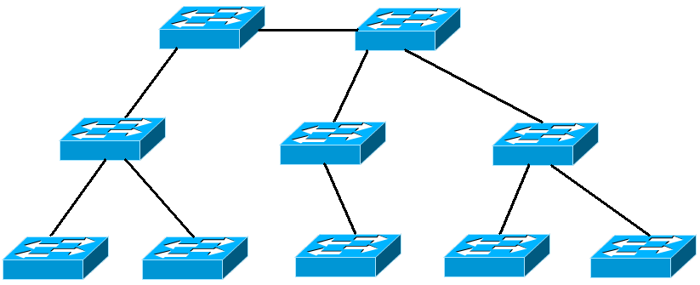
Spanning tree
No loops. Includes all devices.
S Ward Abingdon and Witney College

Slide 16
Spanning tree protocol
Used by switches to turn a redundant topology into a spanning tree
Disables unwanted links by blocking ports
STP defined by IEEE 802.1d
Rapid STP defined by IEEE 802.1w
Switches run STP by default – no configuration needed.
S Ward Abingdon and Witney College

Slide 17
Spanning tree algorithm
The switches use this algorithm to decide which ports should be shut down.
Choose one switch to be “root bridge”
Choose a “root port” on each other switch
Choose a “designated port” on each segment.
Close down all other ports.
S Ward Abingdon and Witney College

Slide 18
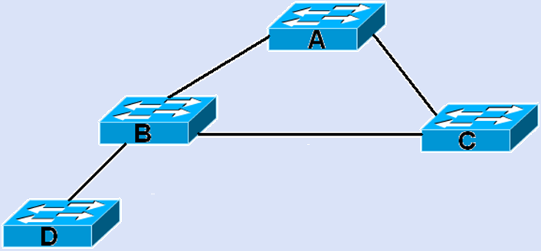
Outline of process
Root bridge
Designated port
Designated port
Root port
Root port
Root port
Designated port
Designated port
Not chosen
Close down
S Ward Abingdon and Witney College

Slide 19
1 Choose the root bridge
Each switch has a bridge ID (BID) of priority value followed by MAC address
Switches exchange Bridge Protocol Data Units (BPDUs) to compare bridge IDs
The switch with the lowest bridge ID becomes the root bridge
Administrator can set the priority to fix the selection
S Ward Abingdon and Witney College

Slide 20
Bridge ID
The bridge ID consists of bridge priority, extended system ID, and MAC address
By default the priority is 32768
Lowest priority wins
Value 1 - 65536, multiples of 4096
Extended system ID identifies VLAN.
MAC address used if priority is the same. Better not to rely on MAC address.
S Ward Abingdon and Witney College

Slide 21
Configure priority
Set priority directly
SW1#spanning-tree vlan 1 priority 24576
Or indirectly
SW1#spanning-tree vlan 1 root primary
Sets value to 24576 or 4096 less than lowest priority detected.
SW1#spanning-tree vlan 1 root secondary
Sets value to 28672. This switch should becomes the root bridge if the primary root bridge fails.
S Ward Abingdon and Witney College

Slide 22
1 Choose the root bridge
A switch starts up. It sends out BPDU frames containing the switch BID and the root ID every 2 seconds.
At first each switch identifies itself as the root bridge.
If a switch receives a BPDU with a lower BID then it identifies the switch with that BID as root bridge. It passes on this information in its own BPDUs.
Eventually all switches agree that the switch with the lowest BID is the root bridge.
S Ward Abingdon and Witney College

Slide 23
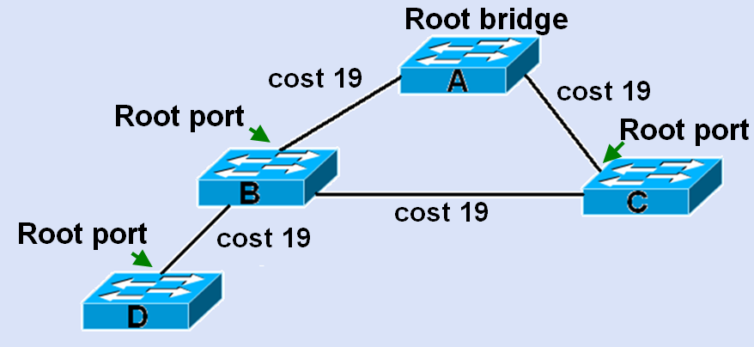
Select root ports
Every non-root bridge (Switch) selects a root port
This is the port with the lowest cost path to the root bridge
S Ward Abingdon and Witney College

Slide 24
Finding the cost of a link
Default port costs depend on the speed of the link. Set by IEEE.
Costs may change as faster Ethernet is developed.
Link speed | Revised cost | Previous cost
10 Gbps | 2 | 1
1 Gbps | 4 | 1
100 Mbps | 19 | 10
10 Mbps | 100 | 100
S Ward Abingdon and Witney College

Slide 25
Changing the cost of a link
SW1(config)#int fa0/1
SW1(config-if)#spanning-tree cost 25
SW1(config-if)#end
SW1(config)#int fa0/1
SW1(config-if)#no spanning-tree cost
SW1(config-if)#end
S Ward Abingdon and Witney College

Slide 26
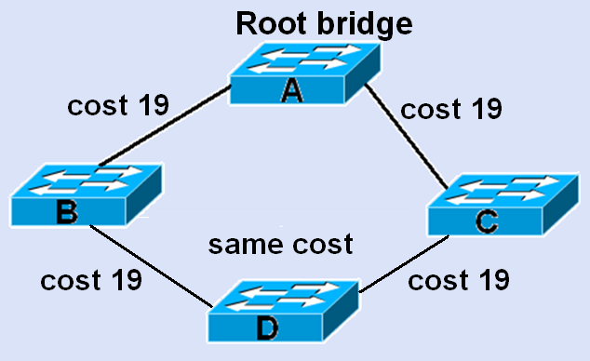
What if ports have the same cost?
Use the port priority and port number.
By default
F0/1 has
128.1
F0/2 has
128.2
S Ward Abingdon and Witney College

Slide 27
Configure port priority
SW2(config-if)#spanning-tree port-priority 112
Priority values range from 0 - 240, in increments of 16.
The default port priority value is 128.
Lower port priority value wins.
Default port priority is 128.
Losing port is shut down.
S Ward Abingdon and Witney College

Slide 28
Passing cost information
Each BPDU includes the cost of the path back to the root bridge.
The cost is the total cost of all the links.
As a switch receives a BPDU, it updates the cost by adding on the cost of the port through which the BPDU was received.
S Ward Abingdon and Witney College

Slide 29
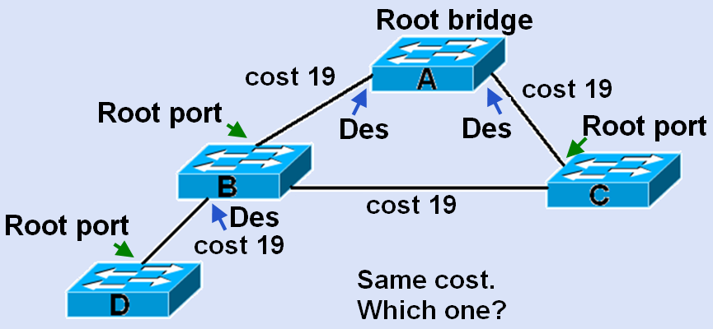
Select designated ports
On every segment, the port with the lowest cost path to the root bridge becomes the designated port
S Ward Abingdon and Witney College

Slide 30
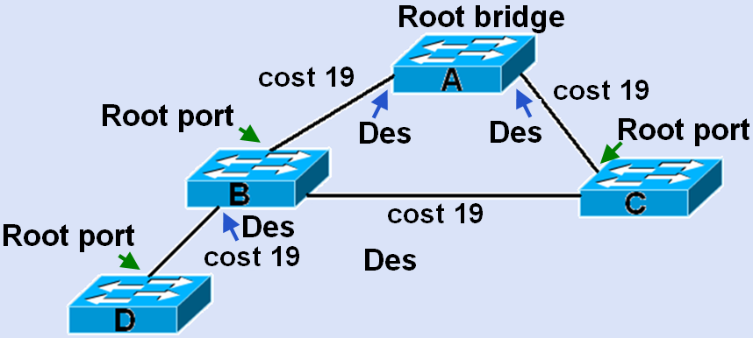
Designated port if same cost
Choose the port on the switch with the lower bridge ID. Suppose this is switch B.
S Ward Abingdon and Witney College

Slide 31
Close down redundant links
Any port that is not a root port or a designated port is put in blocking state
S Ward Abingdon and Witney College

Slide 32
BPDU
The BPDU message is encapsulated in an Ethernet frame.
The destination MAC address is 01:80:C2:00:00:00, which is a multicast address for the spanning-tree group.
S Ward Abingdon and Witney College

Slide 33
BPDU fields
2 bytes | Protocol ID | Admin
1 byte | Version
1 byte | Message type
1 byte | Flags
8 bytes | Root ID | BID and path information
4 bytes | Cost of path
8 bytes | Bridge ID
2 bytes | Port ID
2 bytes | Message age | Timers
2 bytes | Max age
2 bytes | Hello time
2 bytes | Forward delay
S Ward Abingdon and Witney College

Slide 34
Port roles
STP makes ports:
Root ports (forwarding)
Designated ports (forwarding)
Non-designated ports (shut down)
S Ward Abingdon and Witney College

Slide 35
Port states in traditional STP
Blocking – receives and transmits BPDU frames.
Listening - receives and transmits BPDU frames.
Learning - receives and transmits BPDU frames. Learns MAC addresses.
Forwarding – Fully active, forwards user data.
Disabled – Administratively shut down.
S Ward Abingdon and Witney College

Slide 36
States and timers
Blocking
Loss of BPDU detected
Max-age = 20 sec
Blocking
When link first comes up
Listening
Forward delay = 15 sec
Hello timer 2 sec for sending BPDUs.
Up to 50 sec from broken link to forwarding again.
Learning
Forward delay = 15 sec
Forwarding
S Ward Abingdon and Witney College

Slide 37
BPDU timers
Timers are optimised for a 7-switch diameter network.
The network has time to converge before switches forward user data.
Timers should not be adjusted individually.
The diameter can be adjusted and this will change all the timers. (Better not.)
spanning-tree vlan 1 root primary diameter 5
S Ward Abingdon and Witney College

Slide 38
Cisco PortFast
An access port leading to a workstation or server does not need to go through the STP modes because it will not be closed down.
PortFast allows the port to go directly from blocking to forwarding.
If a switch is connected later and the port receives a BPDU then can go to blocking and then through the modes.
S Ward Abingdon and Witney College

Slide 39
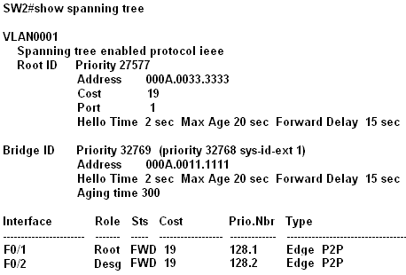
Verify spanning tree
Root bridge
This switch
S Ward Abingdon and Witney College

Slide 40
Topology change notification (TCN)
After the network converges, the root bridge sends out BPDUs, but the other switches do not normally send BPDUs back.
If there is a topology change, a switch sends a special BPDU called the topology change notification (TCN) towards the root bridge.
Each switch that receives the TCN sends an acknowledgement and sends a TCN towards the root bridge until the root bridge receives it.
The root bridge then sends out BPDUs with the topology change (TC) bit set.
S Ward Abingdon and Witney College

Slide 41
STP developments
Cisco Proprietary
Per-VLAN spanning tree protocol (PVST).
Per-VLAN spanning tree protocol plus (PVST+) - supports IEEE 802.1Q
Rapid per-VLAN spanning tree protocol (rapid PVST+)
IEEE Standards
Rapid spanning tree protocol (RSTP) -
Multiple STP (MSTP) -
S Ward Abingdon and Witney College

Slide 42
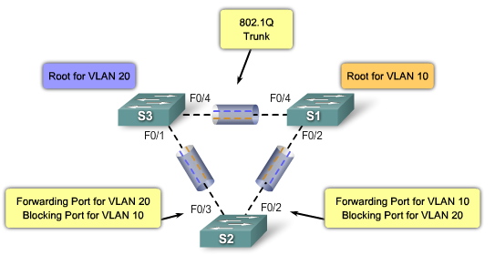
PVST+
Separate STP for each VLAN
S Ward Abingdon and Witney College

Slide 43
PVST+
PVST+ is the default spanning-tree configuration for a Catalyst 2960 switch.
The VLAN needs to be identified, so each BID has 3 fields: priority, extended system ID field, containing VID, MAC address.
Original BID just had priority, MAC address
S Ward Abingdon and Witney College

Slide 44
Rapid Spanning Tree Protocol
Supersedes STP but compatible with it.
Much faster to converge.
Same BPDU structure, puts 2 in version field.
Sends BPDUs every 2 seconds.
Different port roles and states.
Does not use timers in the same way.
3 missed BPDUs taken to mean loss of the link. (6 seconds)
S Ward Abingdon and Witney College

Slide 45
Edge port in RSTP
A port that will never connect to a switch.
Immediately goes to forwarding state.
Same idea as Cisco’s PortFast.
Configuring an edge port uses the PortFast keyword as before.
spanning-tree portfast
An edge port becomes a normal spanning-tree port if it receives a BPDU
S Ward Abingdon and Witney College

Slide 46
Link types
A link operating in full duplex between two switches is regarded as a point-to-point link.
A link operating in half duplex is regarded as a shared link.
Ports on a point-to-point link are able to move to forwarding state quickly.
S Ward Abingdon and Witney College

Slide 47
Port states
Operational | STP | RSTP
Enabled | Blocking | Discarding
Enabled | Listening | Discarding
Enabled | Learning | Learning
Enabled | Forwarding | Forwarding
Disabled | Disabled | Discarding
S Ward Abingdon and Witney College

Slide 48
RSTP port roles
Root and designated ports as before.
Alternate port
takes over if Des port fails.
S Ward Abingdon and Witney College

Slide 49
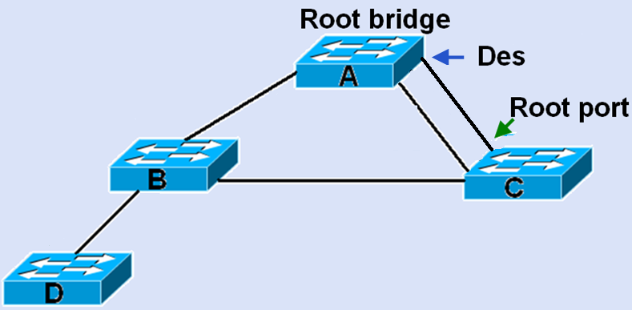
RSTP port roles
Backup port
Takes over if root port fails.
S Ward Abingdon and Witney College

Slide 50
RSTP port roles
Forwarding
Root port
Designated port
Edge port – not to switch
Discarding
Backup port
Alternate port
Both are closed down but are ready to take over at once
S Ward Abingdon and Witney College

Slide 51
Design considerations
Root bridge should be a powerful switch in the centre of the network.
Minimise the number of ports that need to be shut down by STP.
Use VTP pruning.
Use layer 3 switches in the core.
Keep STP running even if no ports need to be shut down.
S Ward Abingdon and Witney College

Slide 52
The End
S Ward Abingdon and Witney College

