Slide 1
CS 540 Computer Networks II
Sandy Wang
chwang_98@yahoo.com
Notes:
“Data and Computer Communications”, 10/e, by William Stallings, Chapter 11 “Local Area Network Overview”.

Slide 2
3. IPv4
Notes:
In this chapter, we look at the underlying technology and protocol architecture
of LANs. Chapters 12 and 13 are devoted to a discussion of specific
LAN systems.

Slide 3
Topics
Overview
LAN Switching
IPv4
IPv6
Routing Protocols -- RIP, RIPng, OSPF
Routing Protocols -- ISIS, BGP
MPLS
Midterm Exam
Transport Layer -- TCP/UDP
Congestion Control & Quality of Service (QoS)
Access Control List (ACL)
Application Layer Protocols
Application Layer Protocols continue
Others – Multicast, SDN
Final Exam

Slide 4
Reference Books
Cisco CCNA Routing and Switching ICND2 200-101 Official Cert Guide, Academic Edition by Wendel Odom -- July 10, 2013. ISBN-13: 978-1587144882
The TCP/IP Guide: A Comprehensive, Illustrated Internet Protocols Reference by Charles M. Kozierok – October 1, 2005. ISBN-13: 978-1593270476
Data and Computer Communications (10th Edition) (William Stallings Books on Computer and Data Communications) by Williams Stallings – September 23, 2013. ISBN-13: 978-0133506488

Slide 5
Topics:
IPv4 Forwarding
Life time of a IP datagram
ARP/RARP/GARP
ICMP
First Hop Redundancy
Policy Routing and VRF
Tunnels

Slide 6
Notes:
Thus, there are typically two protocols operating in each ES and router
at the network layer: an upper sublayer that provides the internetworking function
and a lower sublayer that provides network access.
Figure 14.2 depicts a typical example using IP, in which two LANs are interconnected
by a frame relay WAN. The figure depicts the operation of the Internet
Protocol for data exchange between host A on one LAN (network 1) and host B
on another LAN (network 2) through the WAN. The figure shows the protocol
architecture and format of the data unit at each stage. The end systems and routers
must all share a common
Internet Protocol. In addition, the end systems must share
the same protocols above IP. The intermediate routers need only implement up
through IP.

Slide 7
Connectionless Internetworking
Connectionless internet facility is flexible
IP provides a connectionless service between end systems
Advantages:
Is flexible
Can be made robust
Does not impose unnecessary overhead
Notes:
IP provides a connectionless, or datagram, service between end systems. There are a number of advantages to this approach:
A connectionless internet facility is flexible. It can deal with a variety of networks, some of which are themselves connectionless. In essence, IP requires very little from the constituent networks.
A connectionless internet service can be made highly robust. This is basically the same argument made for a datagram network service versus a virtual circuit service.
A connectionless internet service is best for connectionless transport protocols, because it does not impose unnecessary overhead.

Slide 8
IP Design Issues
Routing
Datagram lifetime
Fragmentation and reassembly
Error control
Flow control
Notes:
With that brief sketch of the operation of an IP-controlled internet, we now examine some design issues in greater detail:
Routing
Datagram lifetime
Fragmentation and reassembly
Error control
Flow control

Slide 9
Network Layer
Need
A frame has no routing info.
DL layer has no routing info.
For a router with 3+ NIC’s,
how to deliver a packet through multiple links.
How to find a next hop router
Responsibility
Host-to-host delivery
For routing packets through the router and switches.

Slide 10
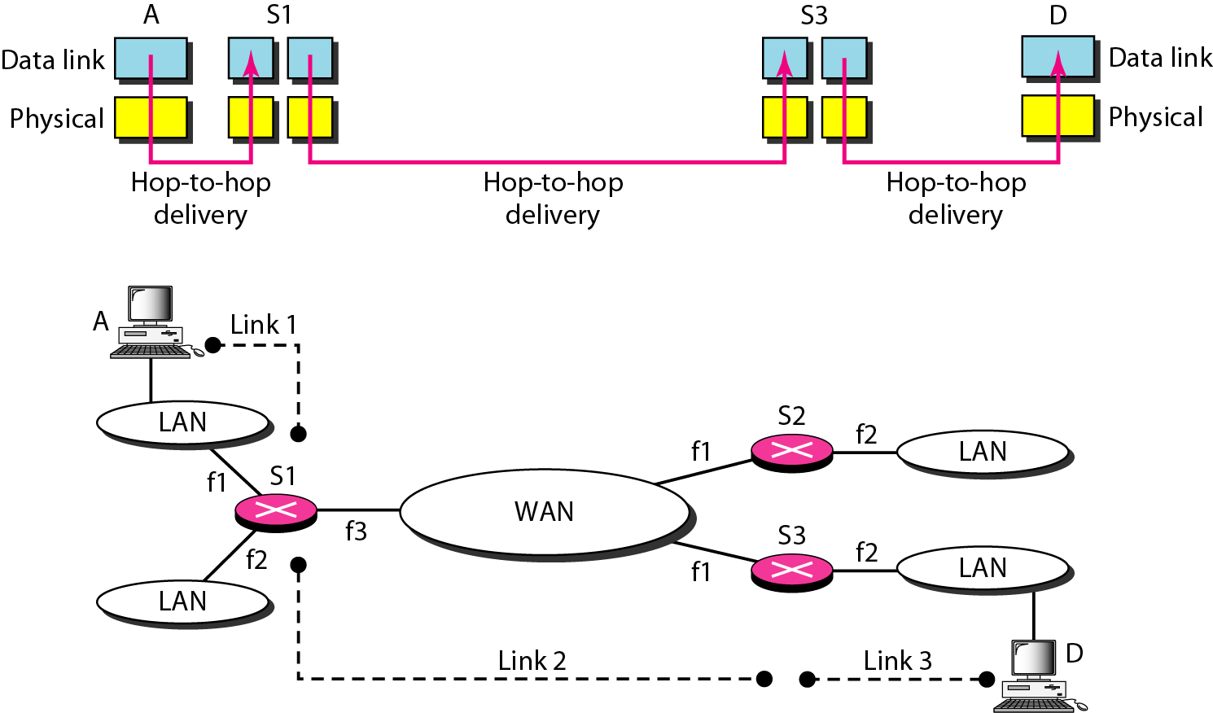
Links between two hosts

Slide 11
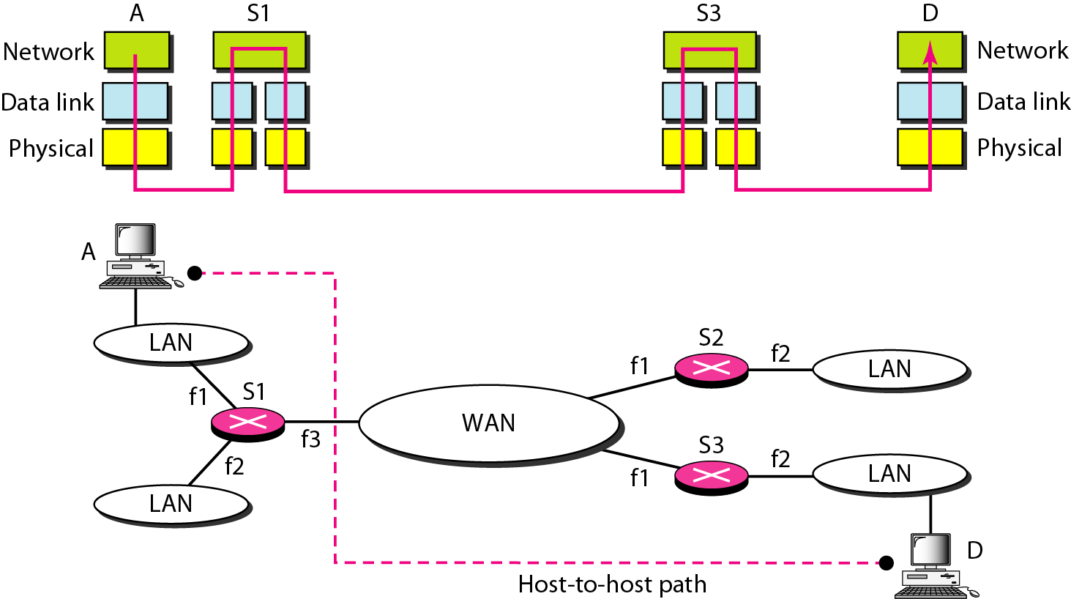
Network layer in an internetwork

Slide 12
Network Layer
Source
Creating a packet from the upper layer.
The header contains source and destination IP addresses.
Checking the routing table to find the routing info (eg. Outgoing interface, or machine address of the next hop)
If the packet is larger than MTU, fragment it.
Router
Routing the packet by consulting the routing table for each incoming packet and find the interface that the packet must be sent to.
Destination
Address verification.
For fragmented frames, wait for all fragmentations then reassemble them before delivering the packet to the upper layer.

Slide 13
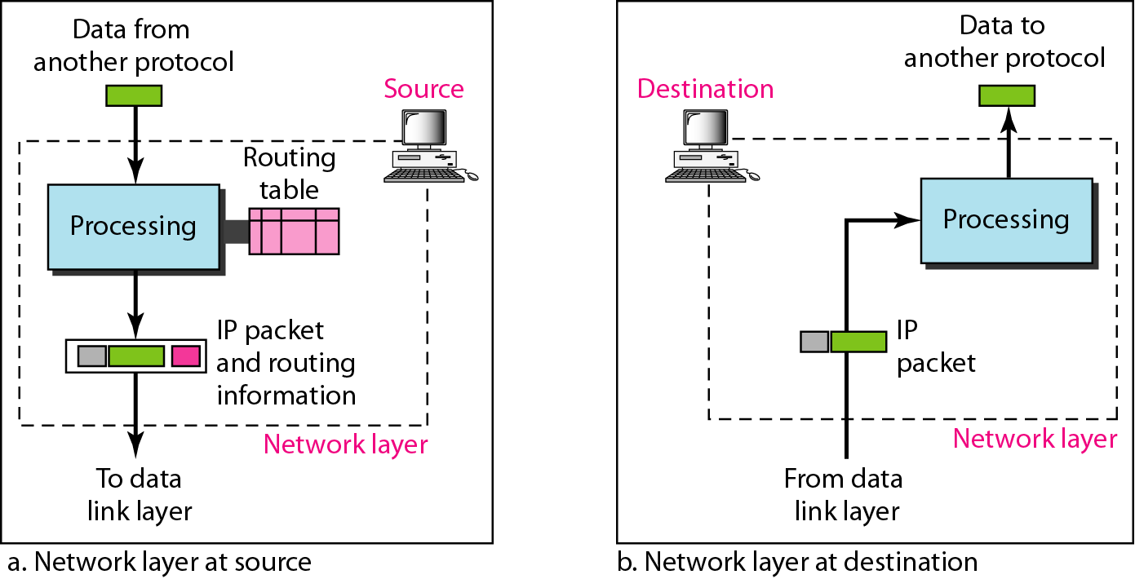
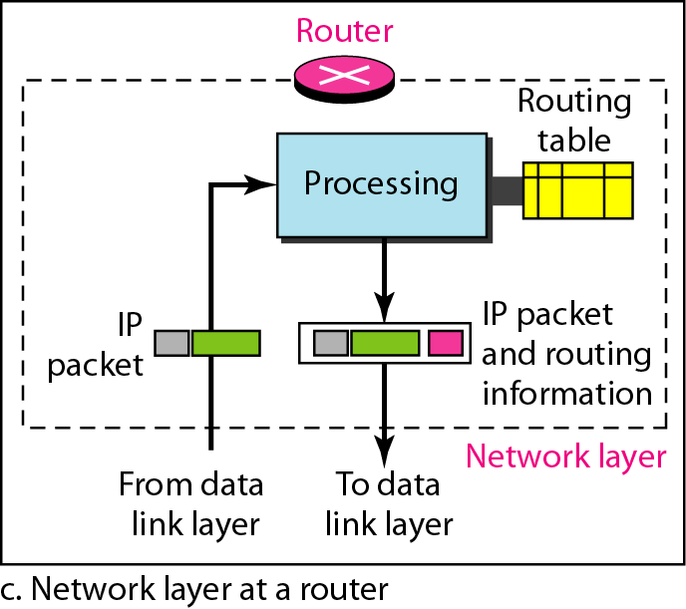
Network layer at the source, router, and destination

Slide 14
Internet as an Layer3
Switching at the network layer in the Internet uses the datagram approach to packet switching.
Use of globally unique address for each packet
Communication at the network layer in the Internet is connectionless.
Each packet is treated independently by the intermediate routers.
Packets in a message may travel through different paths.
Why?

Slide 15
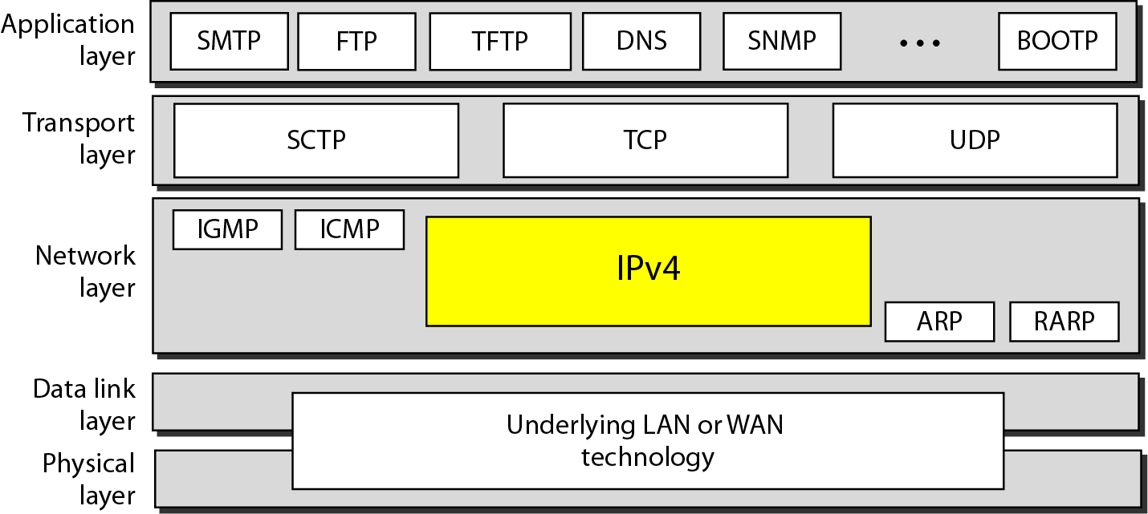
Position of IPv4 in TCP/IP protocol suite
Notes:
Stream Control Transmission Protocol –
a protocol for transmitting multiple streams of data at the same time between two end points that have established a connection in a network. Sometimes referred to as "next generation TCP" (Transmission Control Protocol) - or TCPng, SCTP is designed to make it easier to support a telephone connection over the Internet (and specifically to support the telephone system's Signaling System 7 - SS7 - on an Internet connection). A telephone connection requires that signaling information (which controls the connection) be sent along with voice and other data at the same time. SCTP also is intended to make it easier to manage connections over a wireless network and to manage the transmission of multimedia data. SCTP is a standard protocol (RFC 2960) developed by the Internet Engineering Task Force (IETF).

Slide 16
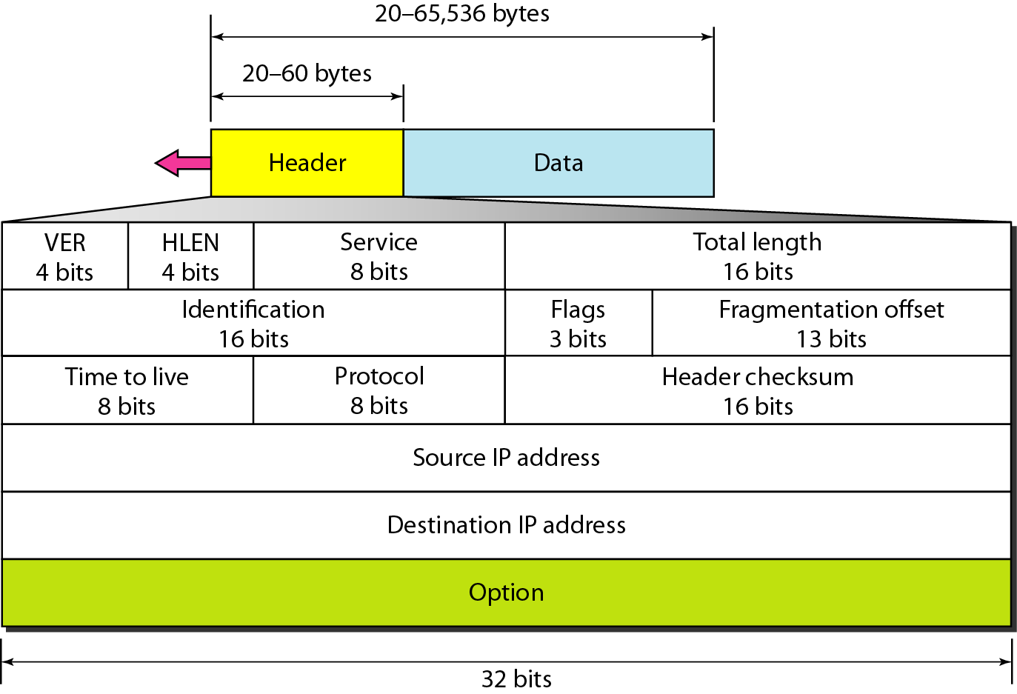
IPv4 datagram format

Slide 17
IPv4 Header
Variable length: 20-60 byte (multiple of 4)
Contains routing information

Slide 18
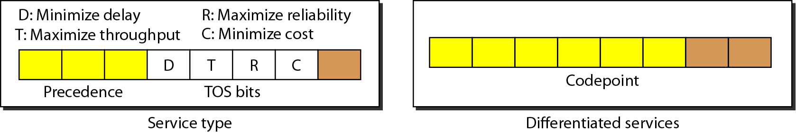
IPv4 Format
Version (4-bit): currently 4.
Header length (4-bit): the length of the IP header in 4-byte unit.
Type of Services(TOS):
This field was not used earlier because of the lack of standard
DiffServ uses this field for differentiate packet types.
Total length
to defines the total length of the datagram including the header in bytes.
16-bit number, the maximum IP size is limited to 2¹⁶ bytes, or 64 Kbytes.

Slide 19
IPv4 Format
Identification
A source node gives a unique ID to each packet.
Identification, Flags, Fragmentation offset fields are used for fragmentation (will be covered later)
Time to Live (TTL)
A packet has a limited lifetime in the network to avoid zombie packets.
Hold the maximum number of hops the packet can travel thru the network. Each router decrements it by one. A packet is discarded by a router if TTL is zero.
Protocol -- To define payload protocol type
1 for ICMP
2 for IGMP
6 for TCP
17 for UDP
89 for OSPF

Slide 20
IPv4 Format
Header checksum
Refer RFC 1071
An IP header is slightly modified by each router. At least TTL field.
The checksum must be re-calculated by routers
Source IP address and Destination IP address
Options
Variable length
For new protocols
Padding
To make the header a multiple of 32-bit words

Slide 21
Example 20.1
An IPv4 packet has arrived with the first 8 bits as shown:
01000010
The receiver discards the packet. Why?
Solution
There is an error in this packet. The 4 leftmost bits (0100) show the version, which is correct. The next 4 bits (0010) show an invalid header length (2 × 4 = 8). The minimum number of bytes in the header must be 20. The packet has been corrupted in transmission.

Slide 22
Example 20.2
In an IPv4 packet, the value of HLEN is 1000 in binary. How many bytes of options are being carried by this packet?
Solution
The HLEN value is 8, which means the total number of bytes in the header is 8 × 4, or 32 bytes. The first 20 bytes are the base header, the next 12 bytes are the options.

Slide 23
Example 20.3
In an IPv4 packet, the value of HLEN is 5, and the value of the total length field is 0x0028. How many bytes of data are being carried by this packet?
Solution
The HLEN value is 5, which means the total number of bytes in the header is 5 × 4, or 20 bytes (no options). The total length is 40 bytes, which means the packet is carrying 20 bytes of data (40 − 20).

Slide 24
Example 20.4
An IPv4 packet has arrived with the first few hexadecimal digits as shown.
0x45000028000100000102 . . .
How many hops can this packet travel before being dropped? The data belong to what upper-layer protocol?
Solution
To find the time-to-live field, we skip 8 bytes. The time-to-live field is the ninth byte, which is 01. This means the packet can travel only one hop. The protocol field is the next byte (02), which means that the upper-layer protocol is IGMP.

Slide 25

Note
An IPv4 address is 32 bits long.
The IPv4 addresses are unique and universal (all nodes connecting Internet must have IP addresses).
The address space of IPv4 is 2³² or 4,294,967,296.

Slide 26
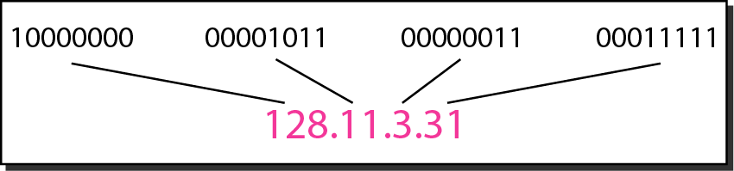
Figure 19.1 Dotted-decimal notation and binary notation for an IPv4 address

Slide 27
Note
In classful addressing, the address space is divided into five classes:
A, B, C, D, and E.

Slide 28
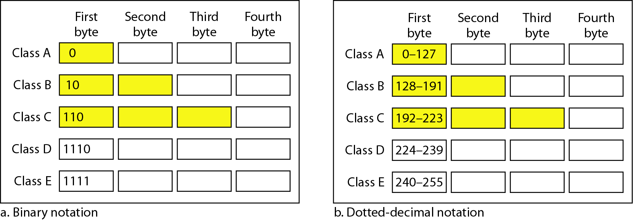
Figure 19.2 Finding the classes in binary and dotted-decimal notation
Class D: multicast
Class E: reserved

Slide 29
Table 19.1 Number of blocks and block size in classful IPv4 addressing

Slide 30
Note
In classful addressing, a large part of the available addresses were wasted.

Slide 31
Note
Classful addressing, which is almost obsolete, is replaced with classless addressing.

Slide 32
Note
In IPv4 addressing, a block of addresses can be defined as
x.y.z.t /n
in which x.y.z.t defines one of the addresses and the /n defines the mask.
Usually, x.y.z.t is the first address in the address block

Slide 33
Note
The first address in the block can be found by setting the rightmost 32 − n bits to 0s.

Slide 34
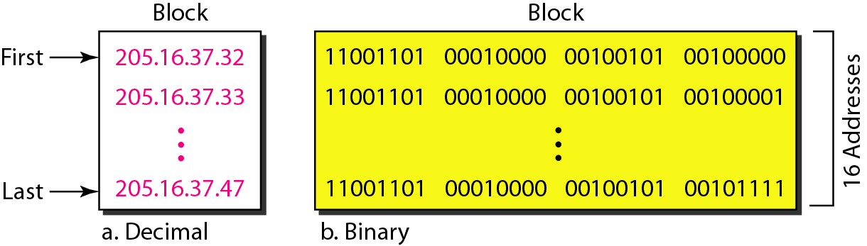
Figure 19.3 A block of 16 addresses granted to a small organization
We can see that the restrictions are applied to this block. The addresses are contiguous. The number of addresses is a power of 2 (16 = 2⁴). This block of IP addresses is represented by:
205.16.37.32/28

Slide 35
Example 19.6
A /28 block of addresses is granted to a small organization. We know that one of the addresses is 205.16.37.39. What is the first address in the block? What is its x.y.z.t/n representation?
Solution
The binary representation of the given address is
11001101 00010000 00100101 00100111
If we set 32−28 rightmost bits to 0, we get
11001101 00010000 00100101 0010000 0
or 205.16.37.32
The block representation is 205.16.37.32/28

Slide 36
Note
The last address in the block can be found by setting the rightmost 32 − n bits to 1s.

Slide 37
Example 19.7
Find the last address for the block in Example 19.6.
Solution
The binary representation of the given address is
11001101 00010000 00100101 00100111
If we set 32 − 28 rightmost bits to 1, we get
11001101 00010000 00100101 00101111
or
205.16.37.47
This is actually the block shown in Figure 19.3.

Slide 38
Note
The number of addresses in the block can be found by using the formula 2^{32−n}.

Slide 39
Example 19.9
Another way to find the first address, the last address, and the number of addresses is to represent the mask as a 32-bit binary (or 8-digit hexadecimal) number. This is particularly useful when we are writing a program to find these pieces of information. In Example 19.5 the /28 can be represented as
11111111 11111111 11111111 11110000
(twenty-eight 1s and four 0s).
Find
a. The first address
b. The last address

Slide 40
Example 19.9 (continued)
Solution
a. The first address can be found by ANDing the given addresses with the mask. ANDing here is done bit by bit. The result of ANDing 2 bits is 1 if both bits are 1s; the result is 0 otherwise.

Slide 41
Example 19.9 (continued)
b. The last address can be found by ORing the given addresses with the complement of the mask. ORing here is done bit by bit. The result of ORing 2 bits is 0 if both bits are 0s; the result is 1 otherwise. The complement of a number is found by changing each 1 to 0 and each 0 to 1.

Slide 42
Figure 19.4 A network configuration for the block 205.16.37.32/28

Slide 43
Note
The first address in a block is normally not assigned to any device; it is used as the network address that represents the organization to the rest of the world.

Slide 44
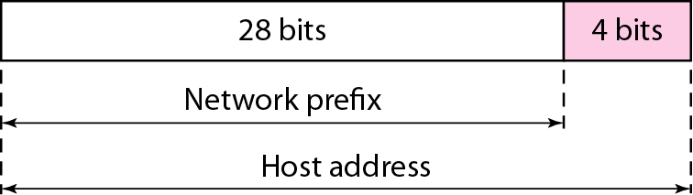
Figure 19.6 hierarchy in IP addressing

Slide 45
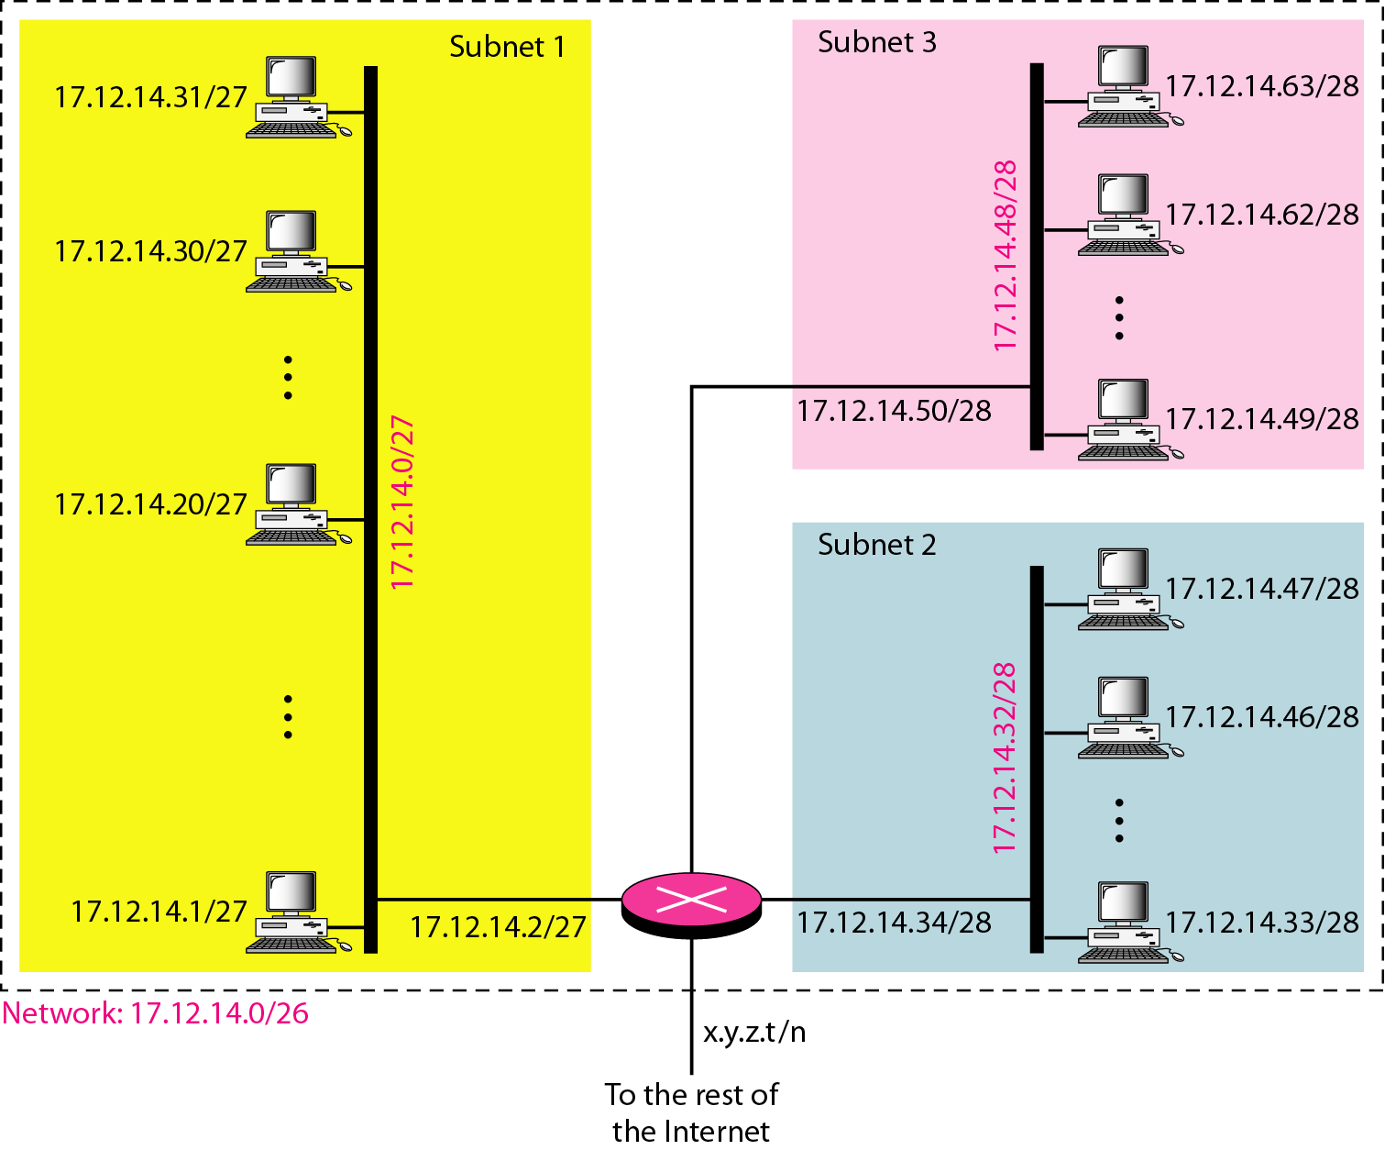
Figure 19.7 Configuration and addresses in a subnetted network

Slide 46
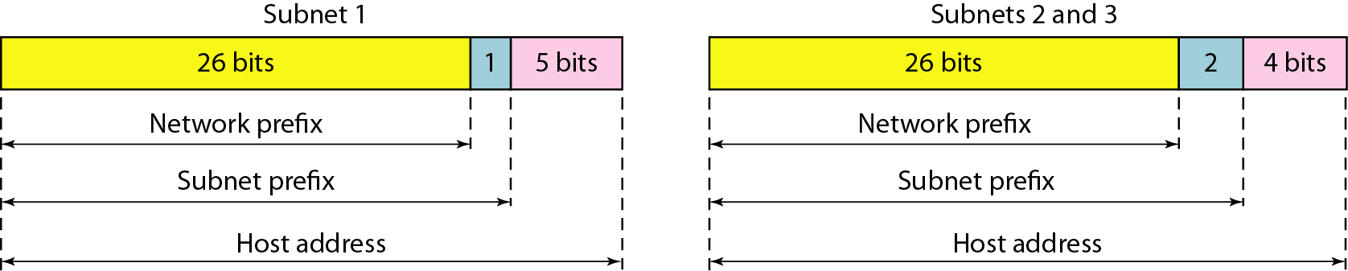
Figure 19.8 Three-level hierarchy in an IPv4 address

Slide 47
Example 19.10
An ISP is granted a block of addresses starting with 190.100.0.0/16 (65,536 addresses). The ISP needs to distribute these addresses to three groups of customers as follows:
a. The first group has 64 customers; each needs 256 addresses.
b. The second group has 128 customers; each needs 128 addresses.
c. The third group has 128 customers; each needs 64 addresses.
Assume the blocks of IPs are sequentially assigned. Design the subblocks and find out how many addresses are still available after these allocations.

Slide 48
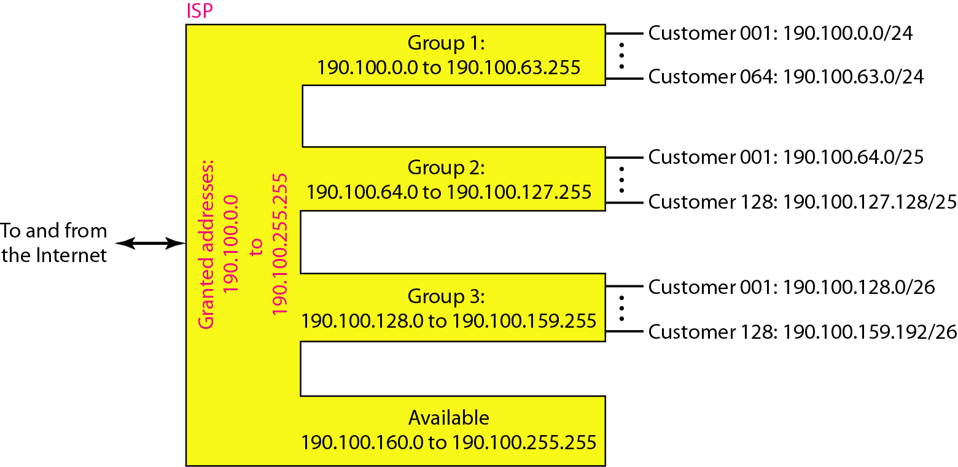
Figure 19.9 An example of address allocation and distribution by an ISP

Slide 49
……
128
190.100.0.0/24
256
190.100.127.0/25
128
190.100.127.128/25
128
190.100.1.0/24
256
190.100.128.0/26
64
190.100.128.64/26
64
…….
190.100.128.128/26
64
190.100.128.192/26
64
190.100.63.0/24
256
…….
190.100.159.0/26
64
190.100.64.0/25
128
190.100.159.64/26
64
190.100.159.128/26
64
190.100.64.128/25
128
190.100.159.192/26
64
190.100.65.0/25
128
190.100.160.0 to 190.100.255.255
Are available
190.100.65.128/25
128

Slide 50
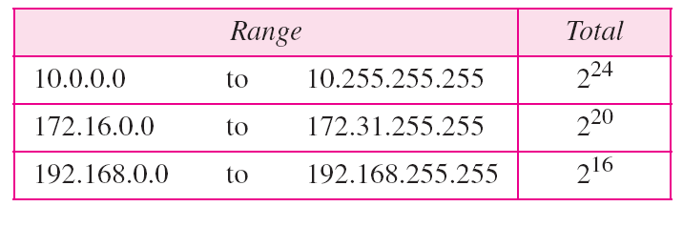
Table 19.3 Addresses for private networks
Home used wireless router usually uses 192.168.1.0/24
or 192.168.0.0/24 IP block

Slide 51
Figure 20.1 Links between two hosts

Slide 52
Figure 20.2 Network layer in an internetwork

Slide 53
Figure 20.3 Network layer at the source, router, and destination

Slide 54
Figure 20.3 Network layer at the source, router, and destination (continued)

Slide 55
Packet Switching
Data transmitted in small packets
Typically less than 1500 bytes (why?)
Longer messages split into series of packets
Each packet contains a portion of user data plus some control info
Control info
Routing (addressing) info
Packets are received, stored briefly (buffered) and past on to the next node
Store and forward

Slide 56
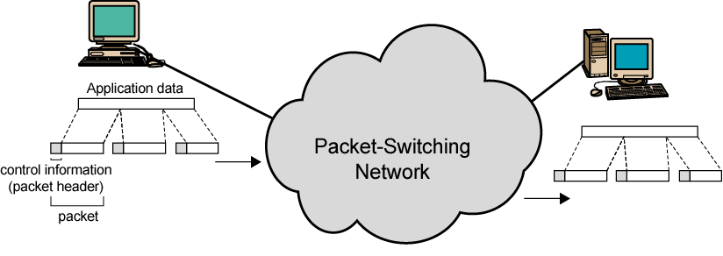
Use of Packets

Slide 57
Switching Technique
Station breaks long message into packets
Packets sent one at a time to the network
Packets handled in two ways
Datagram
Virtual circuit

Slide 58
Datagram
Each packet treated independently
Packets can take any practical route
Packets may arrive out of order
Packets may go missing
Up to receiver to re-order packets and recover from missing packets

Slide 59
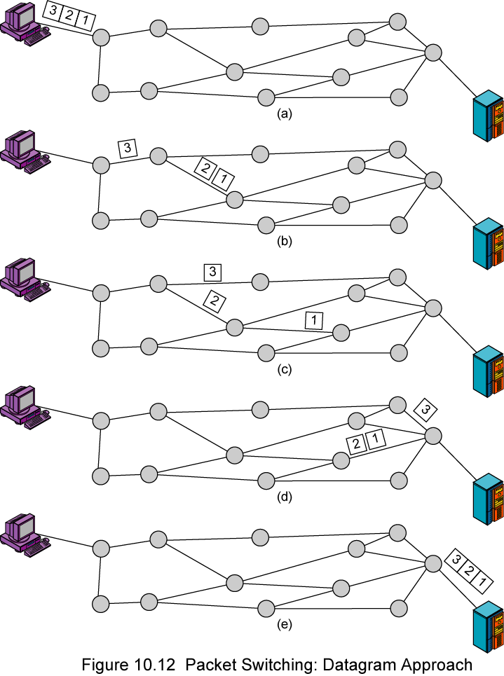
Datagram Diagram

Slide 60
Virtual Circuit
Preplanned route established before any packets sent
Call request and call accept packets establish connection (handshake)
Each packet contains a virtual circuit identifier instead of destination address
No routing decisions required for each packet
Clear request to drop circuit
Not a dedicated path

Slide 61
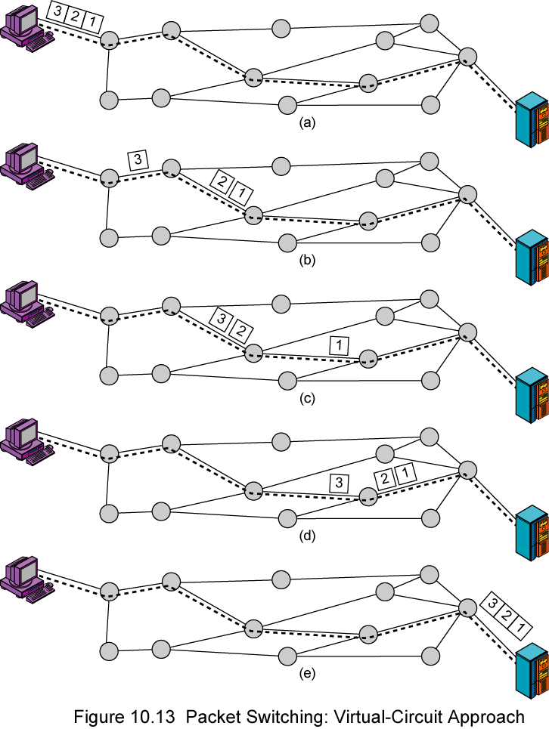
Virtual Circuit Diagram

Slide 62
Virtual Circuits v Datagram
Virtual circuits
Network can provide sequencing and error control
Packets are forwarded more quickly
No routing decisions to make
Less reliable
Loss of a node looses all circuits through that node
Datagram
No call setup phase
Better if few packets
More flexible
Routing can be used to avoid congested parts of the network

Slide 63
Note
Switching at the network layer in the Internet uses the datagram approach to packet switching.

Slide 64
Note
Communication at the network layer in the Internet is connectionless.

Slide 65
Note
IPv4 is an unreliable and connectionless datagram protocol – a best effort delivery
Best effort means that IPv4 provides no error control (except for error detection on the header) or flow control
IPv4 does its best to get a transmission through to its destination, but with no guarantees

Slide 66
Figure 20.5 IPv4 datagram format

Slide 67
Note
The total length field defines the total length of the datagram including the header.

Slide 68
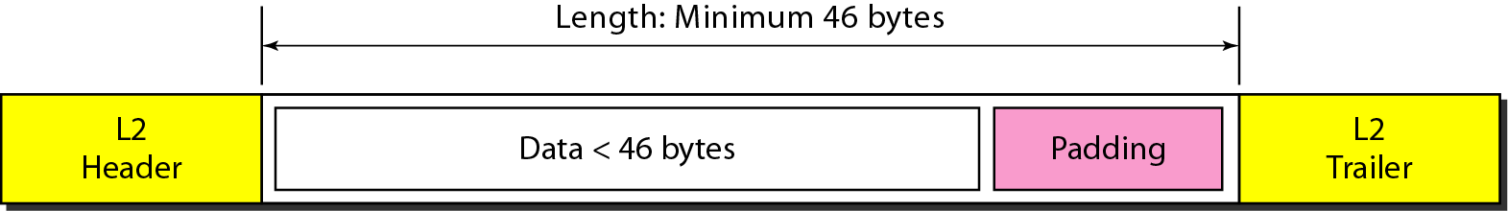
Figure 20.7 Encapsulation of a small datagram in an Ethernet frame
One of the reason why “total length”
field is required.

Slide 69
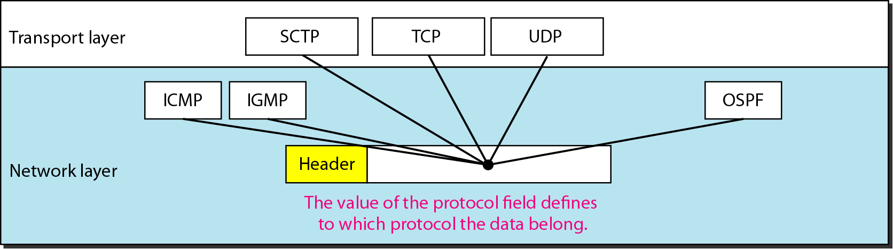
Figure 20.8 Protocol field and encapsulated data

Slide 70
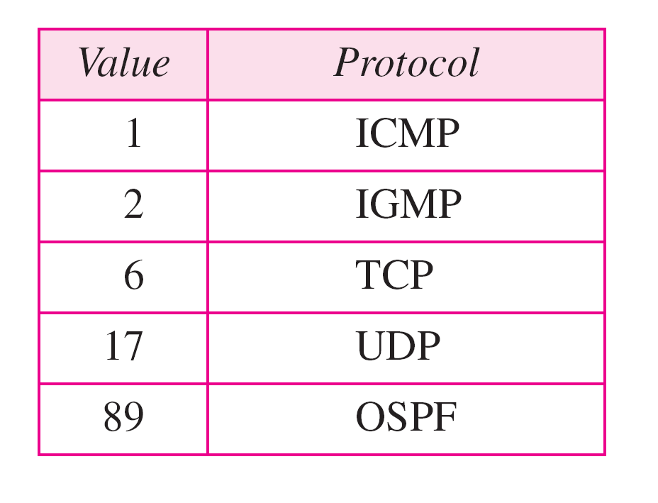
Table 20.4 Protocol values

Slide 71
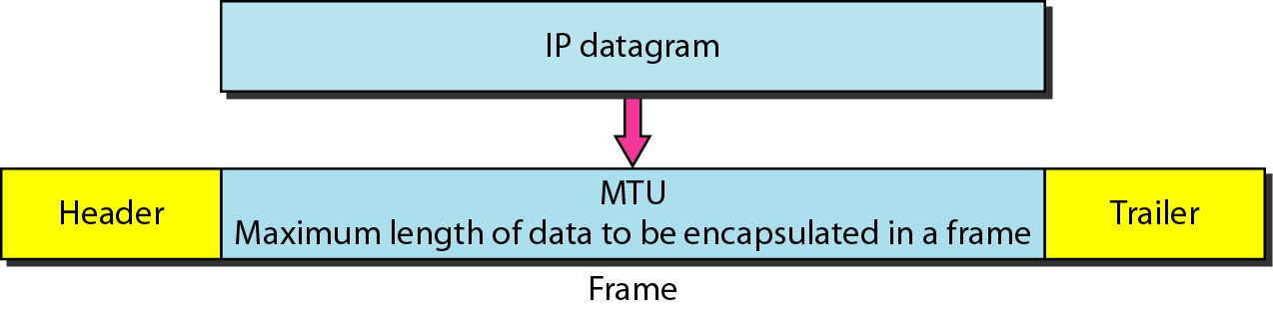
Fragmentation
A IP packet can travel through many different networks using different L2 (Data Link layers).
The source node has no idea of the path and data link layer its packets will travel.
MTU
Each DL has its own frame format and limitation.
One of such limitation is the maximum size of the frame, which is imposed by software, hardware, performance, and standards.

Slide 72
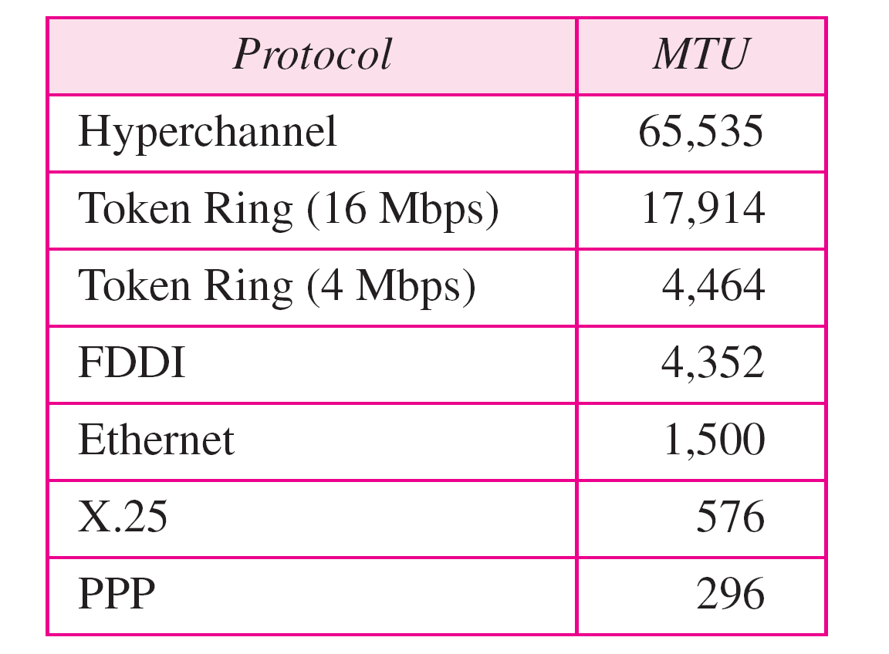
MTUs for some networks

Slide 73
Fields Related to Fragmentation
Identification: identifies a datagram originating from the source host. A combination of the identification and source address must uniquely define a datagram as it leaves the source node.
Flags: see next slide.
Fragmentation offset: is the offset of the data in the original datagram measured in units of 8 bytes.

Slide 74

Figure 20.10 Flags (3 bits) used in fragmentation
first bit: reserved (not used)
second bit: = 1 requires the packet not to be fragmented
drops the packet if it is > MTU
third bit: =1 more fragmented packets later
=0 the last fragmented packet

Slide 75
Fragmentation of IP
The source node usually does not fragment the packet. Instead, L4 will segment the data into a size that can fit into L3 and L2 of the source.
But, there is a possibility that a packet travel thru a link whose MTU is smaller than one of the source node.
Then, the packet must be fragmented to go forward the next hop.
Each fragment has its own header mostly repeated from the original packet.
A fragmented packet can be further fragmented into even smaller packet.
Fragmented packets will be re-assembled only by the final destination.

Slide 76
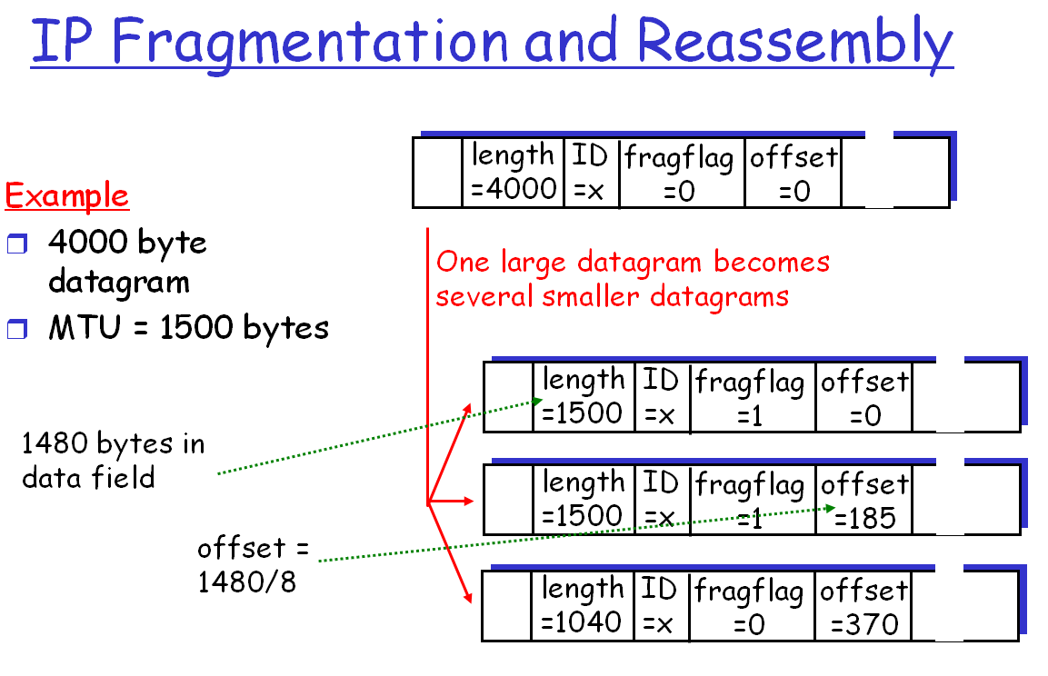

Slide 77
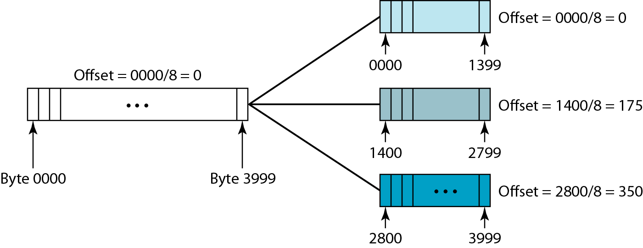
Fragmentation example

Slide 78
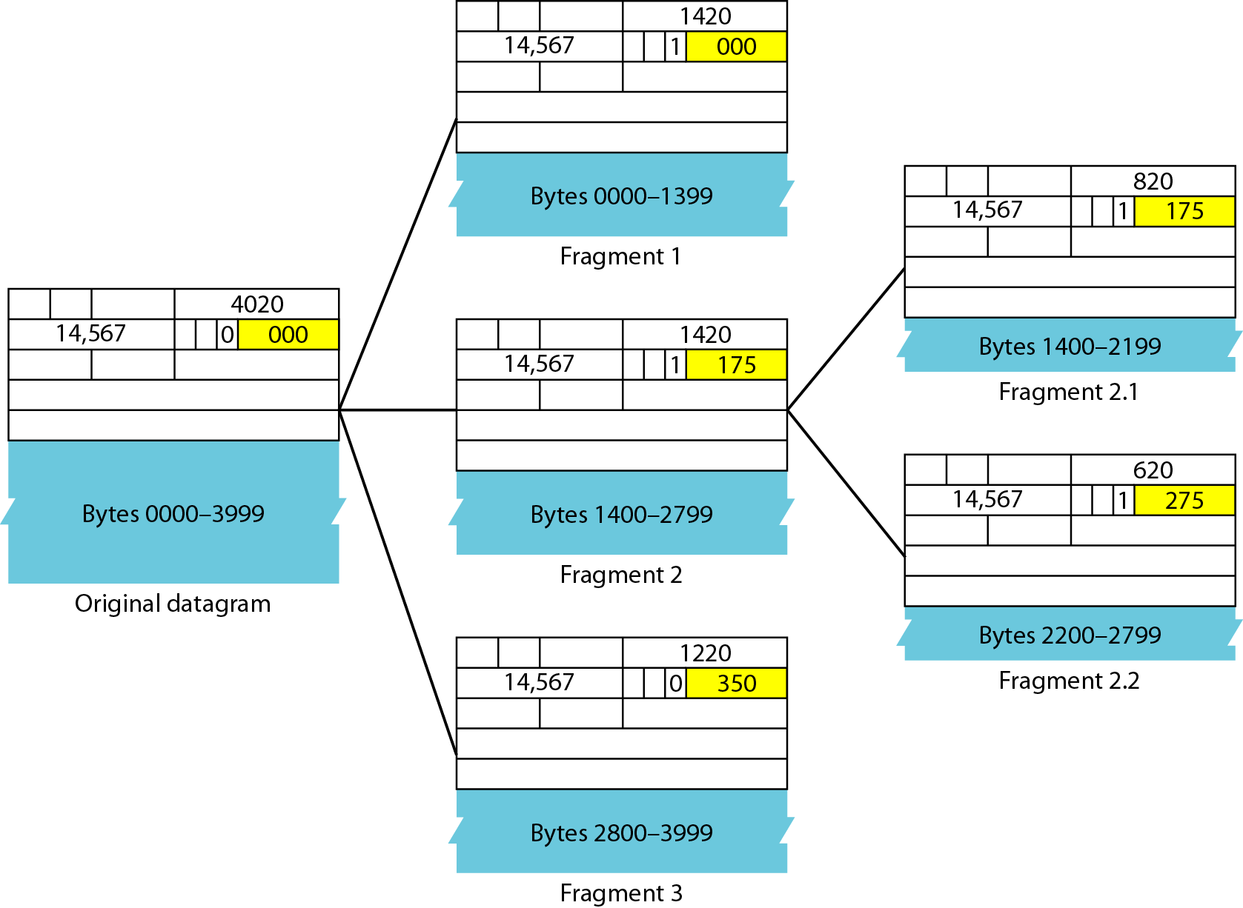
Detailed fragmentation example

Slide 79
Example 20.5
A packet has arrived with an M bit value of 0. Is this the first fragment, the last fragment, or a middle fragment? Do we know if the packet was fragmented?
Solution
If the M bit is 0, it means that there are no more fragments; the fragment is the last one. However, we cannot say if the original packet was fragmented or not. A non-fragmented packet is considered the last fragment.

Slide 80
Example 20.6
A packet has arrived with an M bit value of 1. Is this the first fragment, the last fragment, or a middle fragment? Do we know if the packet was fragmented?
Solution
If the M bit is 1, it means that there is at least one more fragment. This fragment can be the first one or a middle one, but not the last one. We don’t know if it is the first one or a middle one; we need more information (the value of the fragmentation offset).

Slide 81
Example 20.7
A packet has arrived with an M bit value of 1 and a fragmentation offset value of 0. Is this the first fragment, the last fragment, or a middle fragment?
Solution
Because the M bit is 1, it is either the first fragment or a middle one. Because the offset value is 0, it is the first fragment.

Slide 82
Example 20.8
A packet has arrived in which the offset value is 100. What is the number of the first byte? Do we know the number of the last byte?
Solution
To find the number of the first byte, we multiply the offset value by 8. This means that the first byte number is 800. We cannot determine the number of the last byte unless we know the length.

Slide 83
Example 20.9
A packet has arrived in which the offset value is 100, the value of HLEN is 5, and the value of the total length field is 100. What are the numbers of the first byte and the last byte?
Solution
The first byte number is 100 × 8 = 800. The total length is 100 bytes, and the header length is 20 bytes (5 × 4), which means that there are 80 bytes in this datagram. If the first byte number is 800, the last byte number must be 879.

Slide 84
Internet Checksum
Only for the header, but not for the payload
Each router modifies the IP header, but not the payload.
No special hardware can be used.
Computationally efficient.
The upper layers will check the integrity of the payload by their own schemes.

Slide 85
Routing
ES / routers maintain routing tables
Routing table indicates next router to which datagram is sent
Source routing
Source specifies route to be followed
Route recording
Can be static or dynamic
Can be useful for security and priority
Each router appends its internet address to a list of addresses in the datagram
Useful for testing and debugging purposes
Notes:
For the purpose of routing, each end system and router maintains a routing table that lists, for each possible destination network, the next router to which the internet datagram should be sent.
The routing table may be static or dynamic. A static table, however, could contain alternate routes if a particular router is unavailable. A dynamic table is more flexible in responding to both error and congestion conditions. In the Internet, for example, when a router goes down, all of its neighbors will send out a status report, allowing other routers and stations to update their routing tables. A similar scheme can be used to control congestion. Congestion control is particularly important because of the mismatch in capacity between local and wide area networks. Chapter 19 discusses routing protocols.
Routing tables may also be used to support other internetworking services, such as security and priority. For example, individual networks might be classified to handle data up to a given security classification. The routing mechanism must assure that data of a given security level are not allowed to pass through networks not cleared to handle such data.
Another routing technique is source routing. The source station specifies the route by including a sequential list of routers in the datagram. This, again, could be useful for security or priority requirements.
Finally, we mention a service related to routing: route recording. To record a route, each router appends its internet address to a list of addresses in the datagram. This feature is useful for testing and debugging purposes.

Slide 86
Datagram Lifetime
If dynamic or alternate routing is used the potential exists for a datagram to loop indefinitely
Consumes resources
Transport protocol may need upper bound on lifetime of a datagram
Can mark datagram with lifetime
When lifetime expires, datagram is discarded
Notes:
If dynamic or alternate routing is used, the potential exists for a datagram to loop indefinitely through the internet. This is undesirable for two reasons. First, an endlessly circulating datagram consumes resources. Second, we will see Chapter 15 that a transport protocol may depend on the existence of an upper bound on datagram lifetime. To avoid these problems, each datagram can be marked with a lifetime. Once the lifetime expires, the datagram is discarded.
A simple way to implement lifetime is to use a hop count. Each time that a datagram passes through a router, the count is decremented. Alternatively, the lifetime could be a true measure of time. This requires that the routers must somehow know how long it has been since the datagram or fragment last crossed a router, to know by how much to decrement the lifetime field. This would seem to require some global clocking mechanism. The advantage of using a true time measure is that it can be used in the reassembly algorithm, described next.

Slide 87
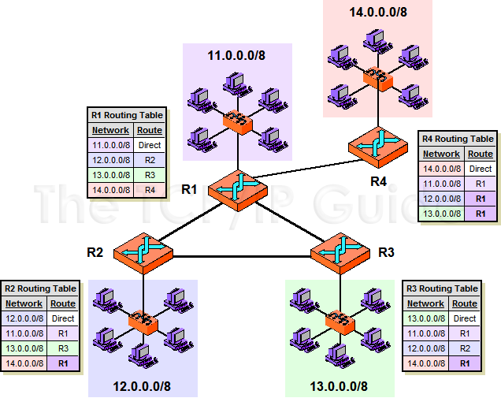
should go to R3.

Slide 88
should go to R3.
104.0.0.4/8
104.0.0.1/8
102.0.0.1/8
103.0.0.1/8
102.0.0.2/8
e1
103.0.0.3/8
e2
123.0.0.2/8
123.0.0.3/8
e0
103.0.0.1
123.0.02
103.0.0.1

Slide 89
Example of IP Routing Table
Destination Gateway Genmask Flags Interface
217.136.39.1 0.0.0.0 255.255.255.255 UH ppp0
192.168.0.0 0.0.0.0 255.255.0.0 U eth0
169.254.0.0 0.0.0.0 255.255.0.0 U eth0
172.16.0.0 0.0.0.0 255.240.0.0 U eth0
10.0.0.0 0.0.0.0 255.0.0.0 U eth0
0.0.0.0 217.136.39.1 0.0.0.0 UG ppp0
Destination Gateway Flags Interface
217.136.39.1/32 0.0.0.0 UH ppp0
192.168.0.0 /16 0.0.0.0 U eth0
169.254.0.0/16 0.0.0.0 U eth0
172.16.0.0 /12 0.0.0.0 U eth0
10.0.0.0/8 0.0.0.0 U eth0
0.0.0.0/0 217.136.39.1 UG ppp0

Slide 90
Longest Prefix Match
Destination Interface
192.168.1.0/24 eth1
192.168.32.0 /20 eth2
192.168.0.0/16 eth3
172.20.0.0/16 eth4
172.16.0.0 /12 eth5
10.0.0.0/8 eth6
0.0.0.0/0 ppp0
Binary Number
1 → 0000 0001
32 → 0010 0000
20 → 0001 0100
16 → 0001 0000
192.168.1.10
192.168.36.10
192.168.48.10
172.32.0.10
172.18.0.10
172.20.1.10
10.1.0.10
20.1.0.10
36 → 0010 0100
48 → 0011 0000
32 → 0010 0000
18 → 0001 0010
20 → 0001 0100

Slide 91
Address Resolution Protocol (ARP)
Need MAC address to send to LAN host
Manual
ARP (RFC 826) provides dynamic IP to Ethernet address mapping
Source broadcasts ARP request
Included in network address
Use central directory
Use address resolution protocol
Destination replies with ARP response
Notes:
Earlier in this chapter, we referred to the concepts of a global address (IP address) and an address that conforms to the addressing scheme of the network to which a host is attached (subnetwork address). For a local area network, the latter address is a MAC address, which provides a physical address for a host port attached to the LAN. Clearly, to deliver an IP datagram to a destination host, a mapping must be made from the IP address to the subnetwork address for that last hop. If a datagram traverses one or more routers between source and destination hosts, then the mapping must be done in the final router, which is attached to the same subnetwork as the destination host. If a datagram is sent from one host to another on the same subnetwork, then the source host must do the mapping. In the following discussion, we use the term system to refer to the entity that does the mapping.
For mapping from an IP address to a subnetwork address, a number of approaches are possible:
Each system can maintain a local table of IP addresses and matching subnetwork addresses for possible correspondents. This approach does not accommodate easy and automatic additions of new hosts to the subnetwork.
The subnetwork address can be a subset of the network portion of the IP address. However, the entire internet address is 32 bits long and for most subnetwork types (e.g., Ethernet) the host address field is longer than 32 bits.
A centralized directory can be maintained on each subnetwork that contains the IP-subnet address mappings. This is a reasonable solution for many networks.
An address resolution protocol can be used. This is a simpler approach than the use of a centralized directory and is well suited to LANs.
RFC 826 defines an Address Resolution Protocol (ARP), which allows dynamic distribution of the information needed to build tables to translate an IP address A into a 48-bit Ethernet address; the protocol can be used for any broadcast network. ARP exploits the broadcast property of a LAN; namely, that a transmission from any device on the network is received by all other devices on the network. ARP works as follows:
Each system on the LAN maintains a table of known IP-subnetwork address mappings.
When a subnetwork address is needed for an IP address, and the mapping is not found in the system's table, the system uses ARP directly on top of the LAN protocol (e.g., IEEE 802) to broadcast a request. The broadcast message contains the IP address for which a subnetwork address is needed.
Other hosts on the subnetwork listen for ARP messages and reply when a match occurs. The reply includes both the IP and subnetwork addresses of the
replying host.
The original request includes the requesting host's IP address and subnetwork address. Any interested host can copy this information into its local table,
avoiding the need for later ARP messages.
5. The ARP message can also be used simply to broadcast a host's IP address and subnetwork address, for the benefit of others on the subnetwork.

Slide 92
21-1 ADDRESS MAPPING
The delivery of a packet to a host or a router requires two levels of addressing: logical and physical. We need to be able to map a logical address to its corresponding
physical address and vice versa. This can be done by using either static or dynamic mapping.
Topics discussed in this section:
Mapping Logical to Physical Address
Mapping Physical to Logical Address

Slide 93
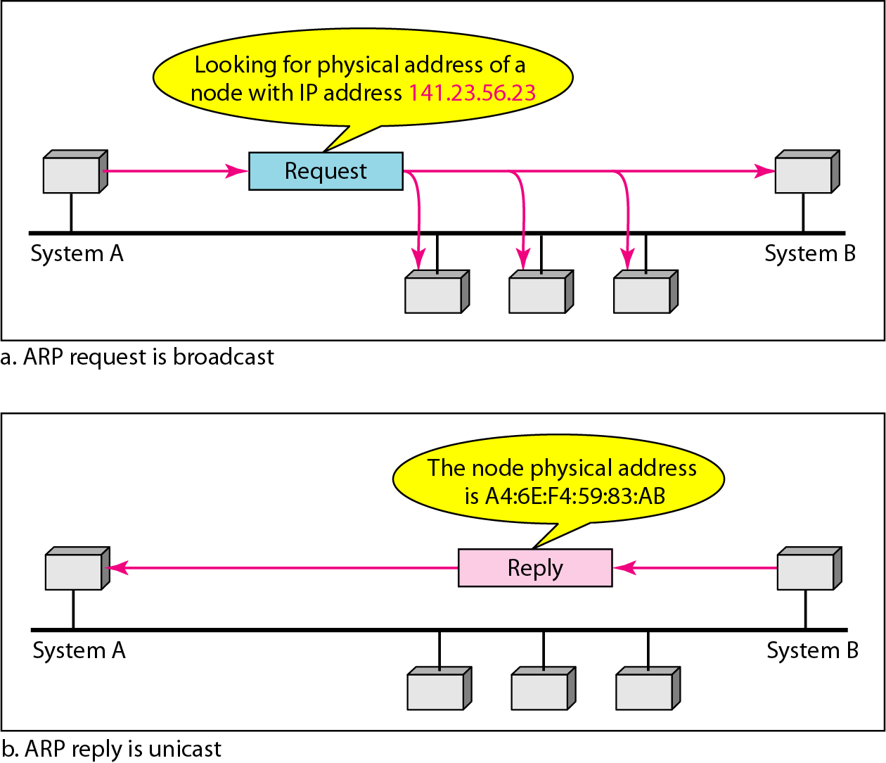
Figure 21.1 Mapping Logical to Physical Address
ARP (address resolution protocol)

Slide 94
Note
ARP can be useful if the ARP reply is cached (kept in cache memory for a while).

Slide 95
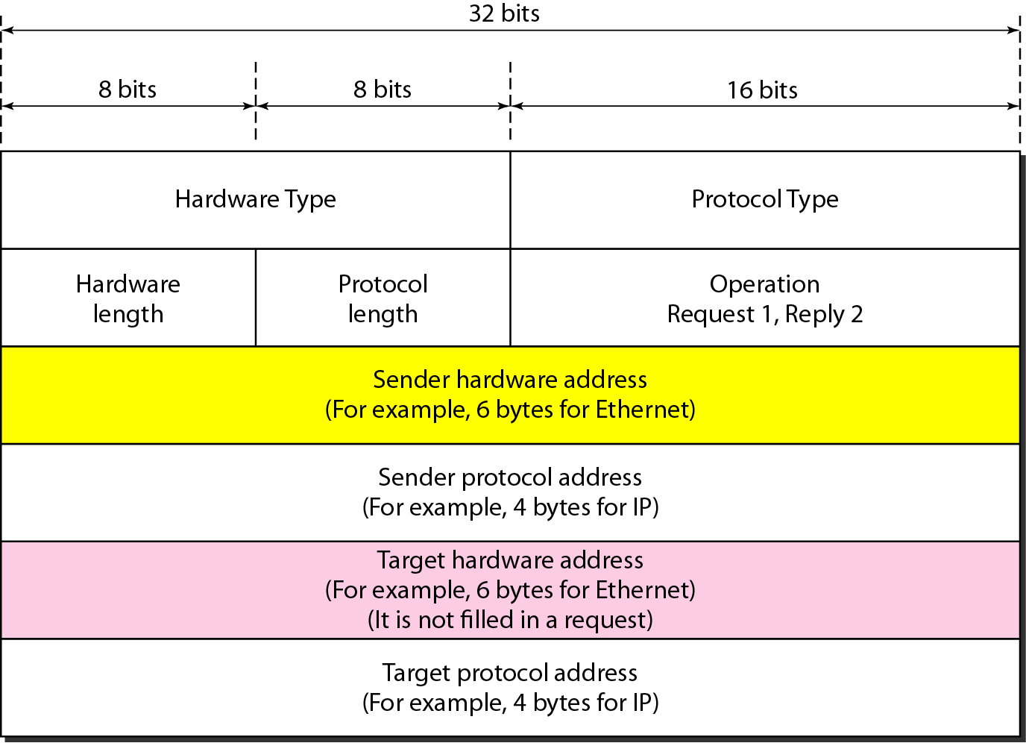
Figure 21.2 ARP packet

Slide 96
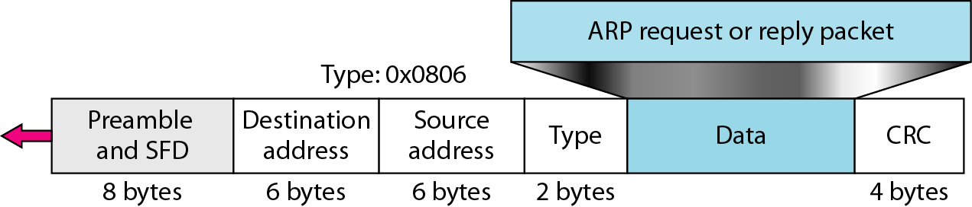
Figure 21.3 Encapsulation of ARP packet

Slide 97
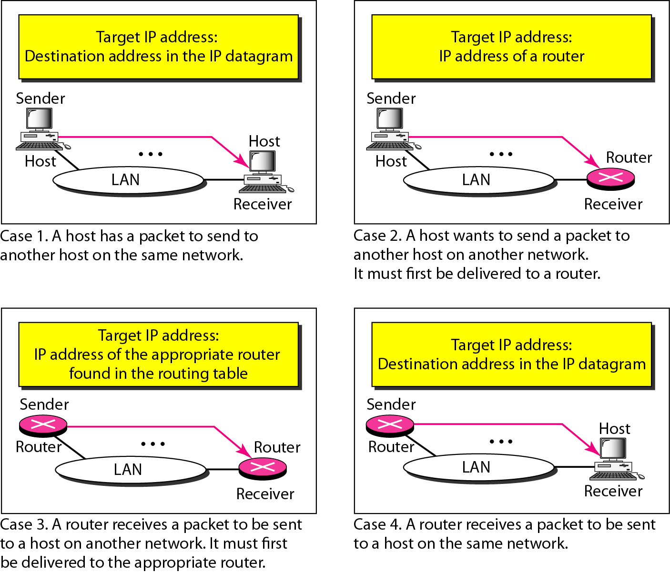
Figure 21.4 Four cases using ARP

Slide 98
Note
An ARP request is broadcast; an ARP reply is unicast.

Slide 99
Example 21.1
A host with IP address 130.23.43.20 and physical address B2:34:55:10:22:10 has a packet to send to another host with IP address 130.23.43.25 and physical address A4:6E:F4:59:83:AB. The two hosts are on the same Ethernet network. Show the ARP request and reply packets encapsulated in Ethernet frames.
Solution
Figure 21.5 shows the ARP request and reply packets. Note that the ARP data field in this case is 28 bytes, and that the individual addresses do not fit in the 4-byte boundary. That is why we do not show the regular 4-byte boundaries for these addresses.

Slide 100
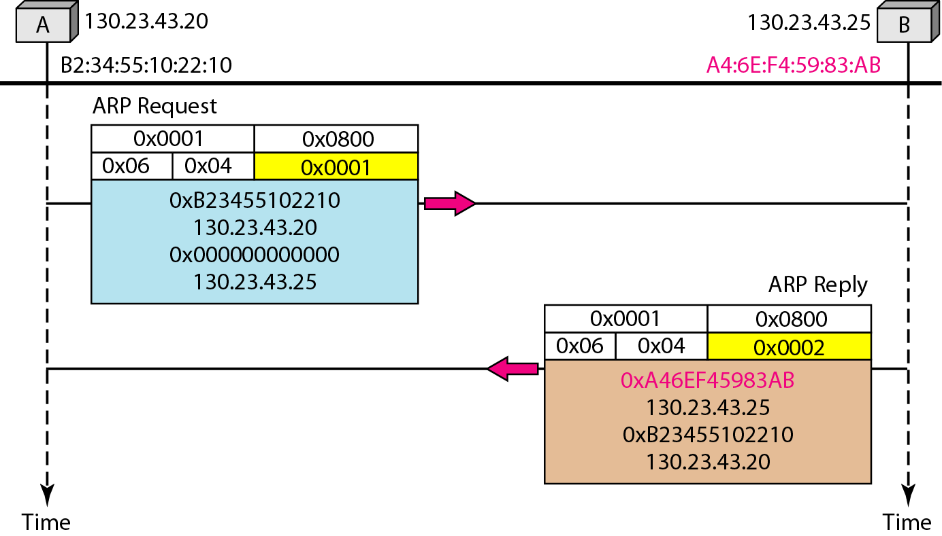
Figure 21.5 Example 21.1, an ARP request and reply

Slide 101
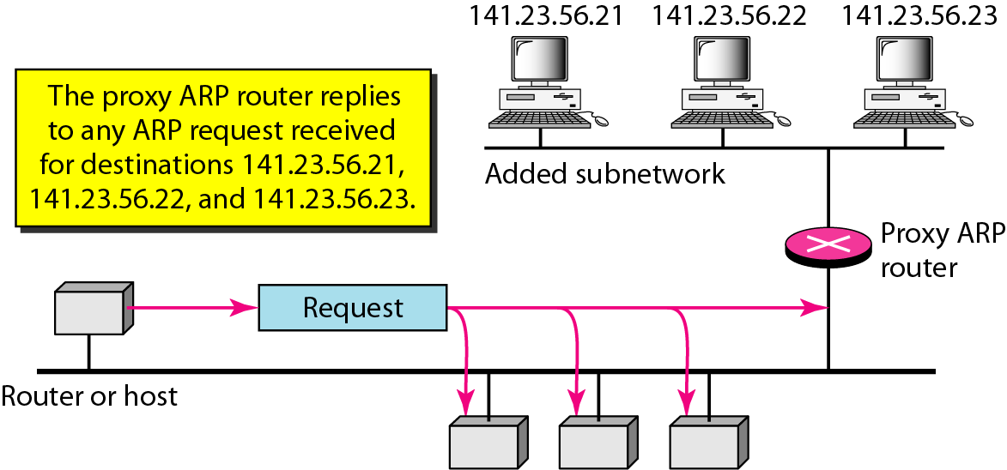
Figure 21.6 Proxy ARP

Slide 102
Reverse Address Resolution Protocol (RARP)
A machine can use the phy address to get the logical address using RARP.
A RARP messages is created and brodcast on the local network.
The machine on the local network that knows the logical address will respond with a RARP reply.
Broadcasting is done at data link layer.
Broadcast requests does not pass the boundaries of a network.

Slide 103
21-2 ICMP
The IP protocol has no error-reporting or error-correcting mechanism. The IP protocol also lacks a mechanism for host and management queries. The Internet Control Message Protocol (ICMP) has been designed to compensate for the above two deficiencies. It is a companion to the IP protocol.
Topics discussed in this section:
Types of Messages Message Format Error Reporting and Query
Debugging Tools

Slide 104
Internet Control Message Protocol (ICMP)
RFC 792
Provides a means for transferring messages from routers and other hosts to a host
Provides feedback about problems
Datagram cannot reach its destination
Router does not have buffer capacity to forward
Router can send traffic on a shorter route
Encapsulated in IP datagram
Hence not reliable
Notes:
The IP standard specifies that a compliant implementation must also implement ICMP (RFC 792). ICMP provides a means for transferring messages from routers and other hosts to a host. In essence, ICMP provides feedback about problems in the communication environment. Examples of its use are when a datagram cannot reach its destination, when the router does not have the buffering capacity to forward a datagram, and when the router can direct the station to send traffic on a shorter route. In most cases, an ICMP message is sent in response to a datagram, either by a router along the datagram's path or by the intended destination host.
Although ICMP is, in effect, at the same level as IP in the TCP/IP architecture, it is a user of IP. An ICMP message is constructed and then passed down to IP, which encapsulates the message with an IP header and then transmits the resulting datagram in the usual fashion. Because ICMP messages are transmitted in IP datagrams, their delivery is not guaranteed and their use cannot be considered reliable.

Slide 105
Common ICMP Messages
Destination unreachable
Time exceeded
Parameter problem
Source quench
Redirect
Echo and echo reply
Timestamp and timestamp reply
Address mask request and reply
Notes:
In those cases in which the ICMP message refers to a prior datagram, the information field includes the entire IP header plus the first 64 bits of the data field of the original datagram. This enables the source host to match the incoming ICMP message with the prior datagram. The reason for including the first 64 bits of the data field is that this will enable the IP module in the host to determine which upper-level protocol or protocols were involved. In particular, the first 64 bits would include a portion of the TCP header or other transport-level header.
The destination unreachable message covers a number of contingencies. A router may return this message if it does not know how to reach the destination network. In some networks, an attached router may be able to determine if a particular host is unreachable and returns the message. The destination host itself may return this message if the user protocol or some higher-level service access point is unreachable. This could happen if the corresponding field in the IP header was set incorrectly. If the datagram specifies a source route that is unusable, a message is returned. Finally, if a router must fragment a datagram but the Don't Fragment flag is set, the datagram is discarded and a message is returned.
A router will return a time exceeded message if the lifetime of the datagram expires. A host will send this message if it cannot complete reassembly within a time limit.
A syntactic or semantic error in an IP header will cause a parameter problem message to be returned by a router or host. For example, an incorrect argument may be provided with an option. The Parameter field contains a pointer to the octet in the original header where the error was detected.
The source quench message provides a rudimentary form of flow control. Either a router or a destination host may send this message to a source host, requesting that it reduce the rate at which it is sending traffic to the internet destination. On receipt of a source quench message, the source host should cut back the rate at which it is sending traffic to the specified destination until it no longer receives source quench messages. The source quench message can be used by a router or host that must discard datagrams because of a full buffer. In that case, the router or host will issue a source quench message for every datagram that it discards. In addition, a system may anticipate congestion and issue source quench messages when its buffers approach capacity. In that case, the datagram referred to in the source quench message may well be delivered. Thus, receipt of a source quench message does not imply delivery or nondelivery of the corresponding datagram.
A router sends a redirect message to a host on a directly connected router to advise the host of a better route to a particular destination. The following is an example, using Figure 14.7. Router R1 receives a datagram from host C on network Y, to which R1 is attached. R1 checks its routing table and obtains the address for the next router, R2, on the route to the datagram's internet destination network, Z. Because R2 and the host identified by the internet source address of the datagram are on the same network, R1 sends a redirect message to C. The redirect message advises the host to send its traffic for network Z directly to router R2, because this is a shorter path to the destination. The router forwards the original datagram to its internet destination (via R2). The address of R2 is contained in the parameter field of the redirect message.
The echo and echo reply messages provide a mechanism for testing that communication is possible between entities. The recipient of an echo message is obligated to return the message in an echo reply message. An identifier and sequence number are associated with the echo message to be matched in the echo reply message. The identifier might be used like a service access point to identify a particular session, and the sequence number might be incremented on each echo request sent.
The timestamp and timestamp reply messages provide a mechanism for sampling the delay characteristics of the internet. The sender of a timestamp message may include an identifier and sequence number in the parameters field and include the time that the message is sent (originate timestamp). The receiver records the time it received the message and the time that it transmits the reply message in the timestamp reply message. If the timestamp message is sent using strict source routing, then the delay characteristics of a particular route can be measured.
The address mask request and address mask reply messages are useful in an environment that includes subnets. The address mask request and reply messages allow a host to learn the address mask for the LAN to which it connects. The host broadcasts an address mask request message on the LAN. The router on the LAN responds with an address mask reply message that contains the address mask.

Slide 106
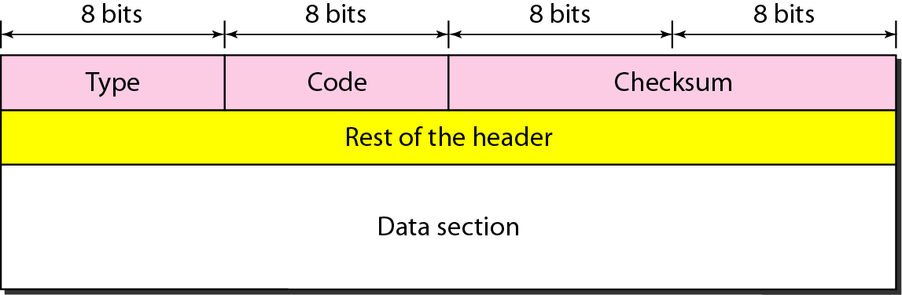
Figure 21.8 General format of ICMP messages

Slide 107
Note
ICMP always reports error messages to the original source.

Slide 108
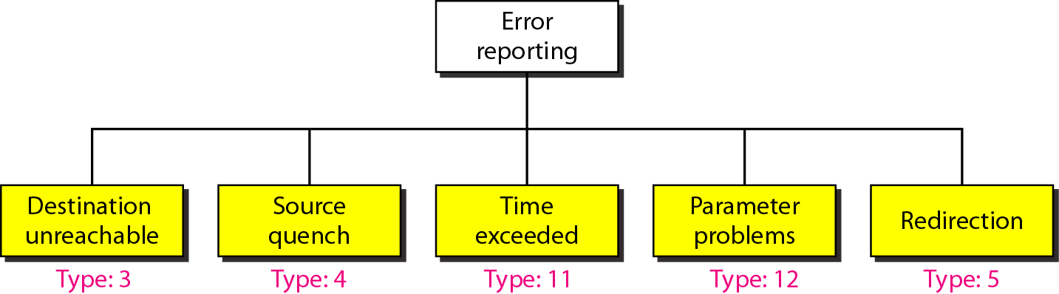
Figure 21.9 Error-reporting messages

Slide 109
Note
Important points about ICMP error messages:
❏ No ICMP error message will be generated in response to a datagram carrying an ICMP error message.
❏ No ICMP error message will be generated for a fragmented datagram that is not the first fragment.
❏ No ICMP error message will be generated for a datagram having a multicast address.
❏ No ICMP error message will be generated for a datagram having a special address such as 127.0.0.0 or 0.0.0.0.

Slide 110
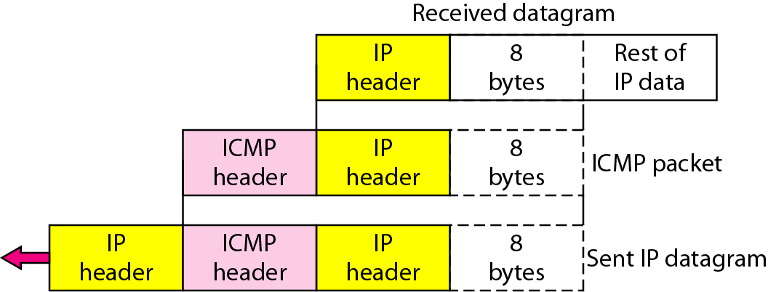
Figure 21.10 Contents of data field for the error messages

Slide 111
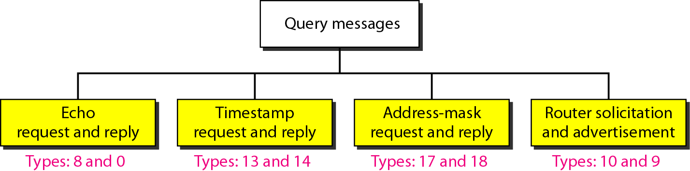
Figure 21.12 Query messages

Slide 112
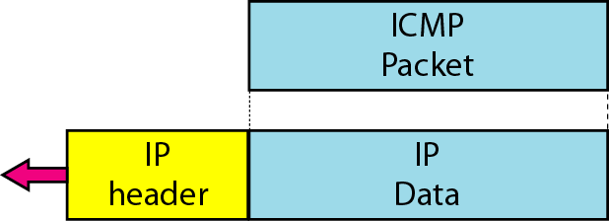
Figure 21.13 Encapsulation of ICMP query messages

Slide 113
Example 21.3
We use the ping program to test the server fhda.edu. The result is shown on the next slide. The ping program sends messages with sequence numbers starting from 0. For each probe it gives us the RTT time. The TTL (time to live) field in the IP datagram that encapsulates an ICMP
message has been set to 62. At the beginning, ping defines the number of data bytes as 56 and the total number of bytes as 84. It is obvious that if we add 8 bytes of ICMP header and 20 bytes of IP header to 56, the result is 84. However, note that in each probe ping defines the number of bytes as 64. This is the total number of bytes in the ICMP packet (56 + 8).

Slide 114
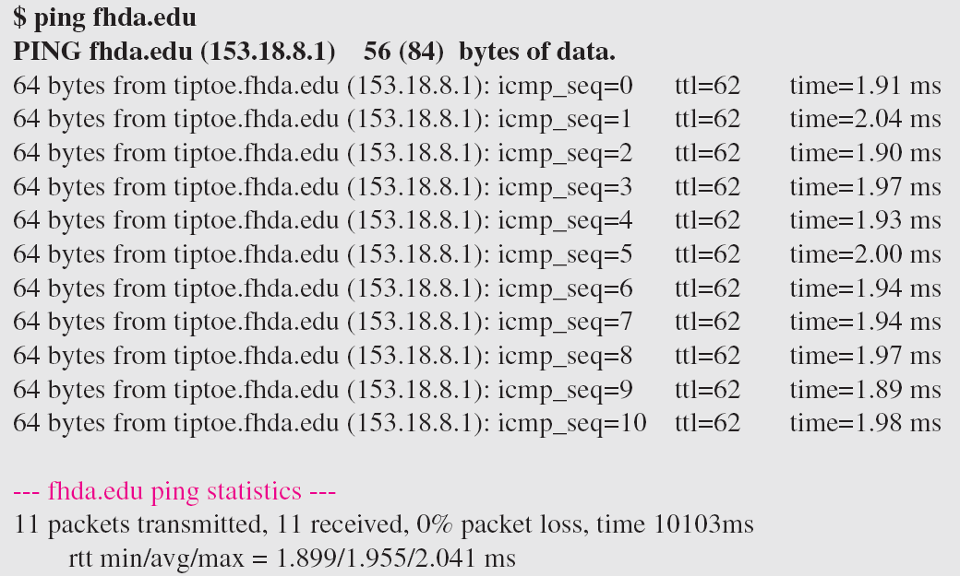
Example 21.3 (continued)

Slide 115
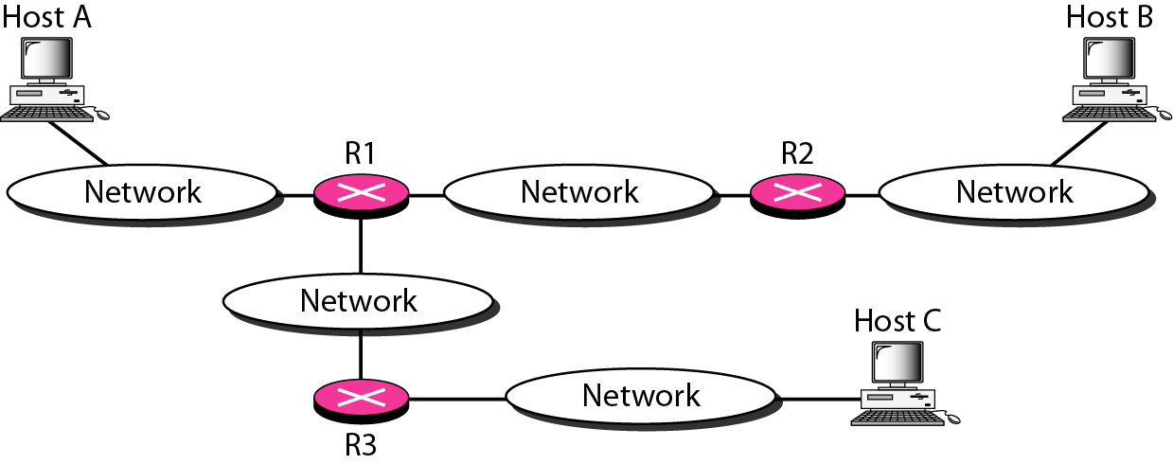
Figure 21.15 The traceroute program operation

Slide 116
“Real” Internet delays and routes
What do “real” Internet delay & loss look like?
Traceroute program: provides delay measurement from source to router along end-end Internet path towards destination. For all i:
sends three packets that will reach router i on path towards destination
router i will return packets to sender
sender times interval between transmission and reply.
3 probes
3 probes
3 probes

Slide 117
First Hop Redundancy
Protect the default gateway used on a subnetwork by allowing two or more routers to provide backup for that address; in the event of failure of the/an active router, the backup router will take over the address

Slide 118
Introduction
Virtual Router Redundancy Protocol (VRRP) [ RFC 5798]
is designed to eliminate the single point of failure inherent in the static default routed environment.
specifies an election protocol that dynamically assigns responsibility for a virtual router to one of the VRRP routers on a LAN.
Cisco Proprietary Protocols
Hot Standby Router Protocol (HSRP).
Gateway Load Balancing Protocol (GLBP).

Slide 119
VRRP
A group of routers function as one virtual router by sharing ONE virtual IP address and ONE virtual MAC address
One (master) router
performs packet forwarding for local hosts
answers ARP requests for these IP address(es) associated with a virtual router
only one master router doing the actual routing
The rest of the routers act as “back up” in case the master router fails
Backup routers stay idle as far as packet forwarding from the client side is concerned
consists of a Virtual Router Identifier (VRID) and a set of associated IP address(es) across a common LAN.
Notes:
In HSRP, both the active and standby routers send periodic messages (known as hello messages). In VRRP, only the master sends periodic messages (known as advertisements).
Same problem with load balancing requirements.
Cisco developed HSRP in response to emerging customer requirements. The company continues to enhance its capability based on customer feedback and market direction. Widely deployed by many Cisco customers, HSRP is a time-proven feature of Cisco IOS software. It has some great benefits like HSRP tracking and preempt feature which is not available in standardized VRRP.
However we strive to be standards compliant and therefore we are in the process of supporting VRRP. VRRP is also something which will be useful interoperating with 3rd party switches for gateway redundancy.

Slide 120
VRRP Redundancy Features
VRRP provides redundancy for the real IP address of a router, or for a virtual IP address shared among the VRRP group members.
If a real IP address is used, the owning router becomes the master.
If a virtual IP address is used, the master is the router with the highest priority.
A VRRP group has one master router and one or more backup routers.
The master router uses VRRP messages to inform group members of the IP addresses of the backup routers.

Slide 121
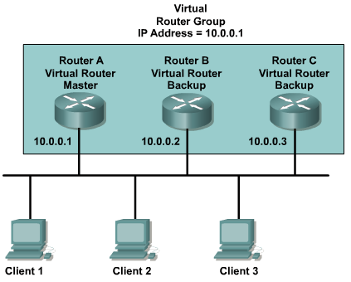
VRRP Example

Slide 122
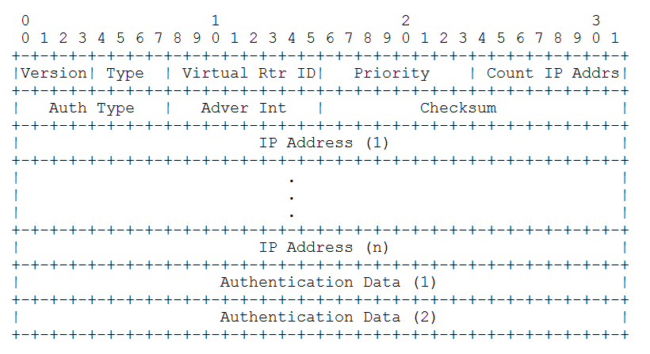
Relevant fields in the VRRP header

Slide 123
Relevant fields in the VRRP header
Priority
A value between 0-255.
0: indicate the current Master has stopped participating in VRRP
255: for the VRRP router that owns the IP address(es) associated with the virtual router
Note that if the IP address owner is available, then it will always become the Master.
1-254: for the VRRP routers backing up a virtual router
VRID (Virtual Router IDentifier)
different for each virtual router in the network
used by only one physical router at a time
in the range 1-255

Slide 124
First Hop Redundancy with VRRP
R1- Master, forwarding traffic; R2, R3 - backup
VRRP ACTIVE
VRRP BACKUP
VRRP BACKUP
IP: 10.0.0.254
MAC: 0000.0c12.3456
vIP: 10.0.0.10
vMAC: 0000.5e00.0100
IP: 10.0.0.253
MAC: 0000.0C78.9abc
vIP:
vMAC:
IP: 10.0.0.252
MAC: 0000.0cde.f123
vIP:
vMAC:
Gateway routers
R1
R2
R3
Clients
CL1
CL2
CL3
IP: 10.0.0.1
MAC: aaaa.aaaa.aa01
GW: 10.0.0.10
ARP: 0000.5e00.0100
IP: 10.0.0.2
MAC: aaaa.aaaa.aa02
GW: 10.0.0.10
ARP: 0000.5e00.0100
IP: 10.0.0.3
MAC: aaaa.aaaa.aa03
GW: 10.0.0.10
ARP: 0000.5e00.0100
Notes:
Same problem with load balancing requirements…only 1 router is active forwarding traffic from the client subnet to outside.

Slide 125
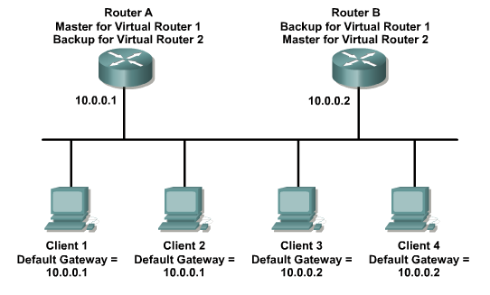
The VRRP Operation Process
-if)# vrrp 1 ip 10.0.0.1
-if)# vrrp 2 ip 10.0.0.2
-if)# vrrp 1 ip 10.0.0.1
-if)# vrrp 2 ip 10.0.0.2
Two virtual routers groups are configured: Virtual Router 1 and 2.
Virtual Router 1 is 10.0.0.1 and Virtual Router 2 is 10.0.0.2.
Since each router owns one of these IPs it will be the Master Router for that group and the other router set with the same IP will be the backup.

Slide 126
The VRRP Operation Process
The priority of the Master Router is set to 255.
Backup router priority values can range from 1 to 254; the default
value is 100. The VRRP MAC address is 0000.5e00.01xx.
The master sends the advertisement on multicast 224.0.0.18
on a default interval of 1 second (advertisement interval).
The master-down interval is the time interval for backup to declare
the master down (seconds).

Slide 127
VRRP Configuration
Master Router:
interface FastEthernet0/1
ip address 10.1.2.3 255.255.255.0
duplex auto
speed auto
vrrp 10 ip 10.1.2.3
Backup Router:
interface FastEthernet0/1
ip address 10.1.2.2 255.255.255.0
duplex auto
speed auto
vrrp 10 ip 10.1.2.3
vrrp 10 priority 150
Even with the higher priority, the router
below is still the backup because the router
above is using its own IP address.

Slide 128
MAC address: 00-00-5E-00-01-[VRID]
This address is used by only one physical router at a time, and it will reply with this MAC address when an ARP request is sent for the virtual router's IP address.
Physical routers within the virtual router must communicate within themselves using packets with
multicast IP address 224.0.0.18
and IP protocol number 112.

Slide 129
vIP: 10.0.0.10
vMAC: 0000.5e00.0100
virtual router
backup
master
VRRP
physical router
physical router
IP: 10.0.0.253
MAC: 0000.0C78.9abc
IP: 10.0.0.254
MAC: 0000.0c12.3456

Slide 130
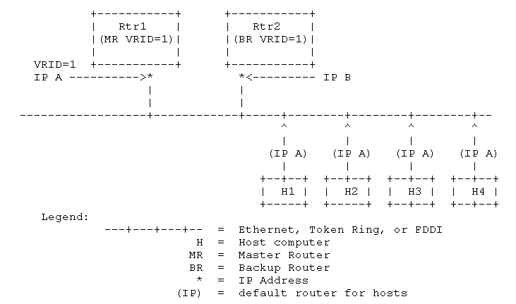
Sample Configuration 1

Slide 131
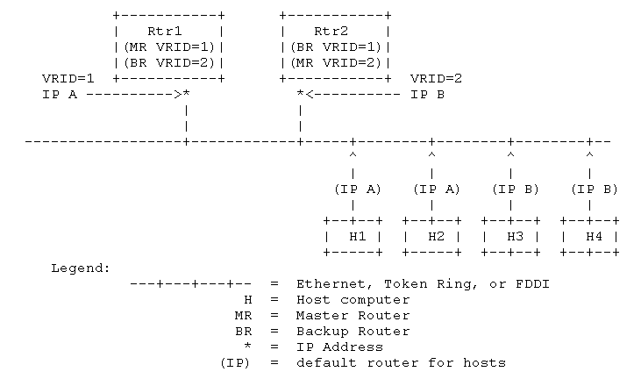
Sample Configuration 2

Slide 132
Elections of master routers
Master router sends an advertisement to the backups.
Advertisement intervals can be set by the user; the VRRP default is 1 second.
If the advertisements suddenly stop, the backups set interval timers, typically for three times the advertisement frequency.
If no further advertisements appear, the backups assume the master is down and the failover routine is activated.
From that point, the election of the next-in-line master typically takes less than a second.

Slide 133
Policy-Based Routing
Make routing decisions based on policies set by the network administrator
Forwarding decision not based on destination address
Select next-hop based on attributes of user packet
Source/destination address
Application ports
Packet length
Or other information available in a packet header or payload

Slide 134
Policy-Based Routing – Action Example
set ip next-hop ip-address1 […]
set ip default next-hop ip-address1 […]
set interface interface1 […]
set ip precedence value
set ip tos value
set vrf value

Slide 135
Policy-Based Routing Example – Cisco
interface Ethernet0
ip address 192.168.93.10 255.255.255.0
ip policy route-map foo
interface Serial1
ip address 11.0.0.2 255.0.0.0
interface BRI0
ip address 10.0.0.2 255.0.0.0
route-map foopermit 10
match ip address 101
set ip next-hop 11.0.0.1
route-map foopermit 11
match ip address 103
set ip next-hop 10.0.0.1
route-map foopermit 12
set default interface Null0
access-list 101 permit tcp 192.168.93.0 0.0.0.255 any eq telnet
access-list 101 permit icmp any any
access-list 103 permit tcp 192.168.93.0 0.0.0.255 any eq ftp

Slide 136
Policy-Based Routing Example -- Linux
$ ip route list table main
195.96.98.253 dev ppp2 proto kernel scope link src 212.64.78.148
212.64.94.1 dev ppp0 proto kernel scope link src 212.64.94.251
10.0.0.0/8 dev eth0 proto kernel scope link src 10.0.0.1
127.0.0.0/8 dev lo scope link
default via 212.64.94.1 dev ppp0
echo 200 John >> /etc/iproute2/rt_tables
ip rule add from 10.0.0.10 table John
ip rule ls
0: from all lookup local
32765: from 10.0.0.10 lookup John
32766: from all lookup main
32767: from all lookup default
ip route add default via 195.96.98.253 dev ppp2 table John

Slide 137
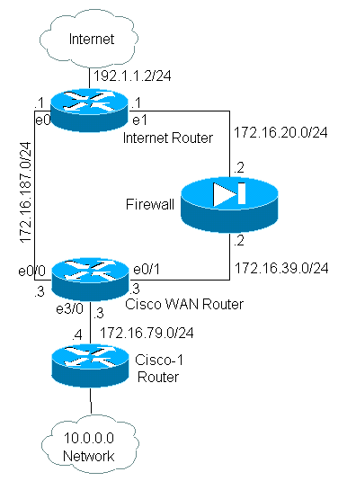
work.
Network Diagram

Slide 138
Virtual Routing and Forwarding (VRF)
VRFs provide a valuable routing tool to provide isolation between different networks that are sharing the same network infrastructure.
Virtual routing and forwarding (VRF) is a technology included in IP (Internet Protocol) network routers that allows multiple instances of a routing table to exist in a router and work simultaneously.

