Slide 1
CS 540 Computer Networks II
Sandy Wang
chwang_98@yahoo.com
Notes:
“Data and Computer Communications”, 10/e, by William Stallings, Chapter 11 “Local Area Network Overview”.

Slide 2
4. IPv6
Notes:
In this chapter, we look at the underlying technology and protocol architecture
of LANs. Chapters 12 and 13 are devoted to a discussion of specific
LAN systems.

Slide 3
Topics
Overview
LAN Switching
IPv4
IPv6
Routing Protocols -- RIP, RIPng, OSPF
Routing Protocols -- ISIS, BGP
MPLS
Midterm Exam
Transport Layer -- TCP/UDP
Congestion Control & Quality of Service (QoS)
Access Control List (ACL)
Application Layer Protocols
Application Layer Protocols continue
Others – Multicast, SDN
Final Exam

Slide 4
Reference Books
Cisco CCNA Routing and Switching ICND2 200-101 Official Cert Guide, Academic Edition by Wendel Odom -- July 10, 2013. ISBN-13: 978-1587144882
The TCP/IP Guide: A Comprehensive, Illustrated Internet Protocols Reference by Charles M. Kozierok – October 1, 2005. ISBN-13: 978-1593270476
Data and Computer Communications (10th Edition) (William Stallings Books on Computer and Data Communications) by Williams Stallings – September 23, 2013. ISBN-13: 978-0133506488
http://class.svuca.edu/~sandy/class/CS540/

Slide 5
Topics:
IPv6 Protocol
ICMPv6
Neighbor Discovery Protocol
Tunnels

Slide 6
Understand the shortcomings of IPv4
Know the IPv6 address format, address types, and abbreviations
Be familiar with the IPv6 header format
Know the extension header types
Know the differences between ICMPv4 and ICMPv6
Know the strategies for transitioning from IPv4 to IPv6

Slide 7
IPv6 Advantages Over IPv4
Larger address space
Better header format
New options
Allowance for extension
Support for resource allocation
Support for more security

Slide 8
Auto-configuration
Obtain an Interface ID that is unique on the link to which the host is attached -- link layer addresses used.
Obtain correct prefix -- router periodically advertises.
Put them together.

Slide 9
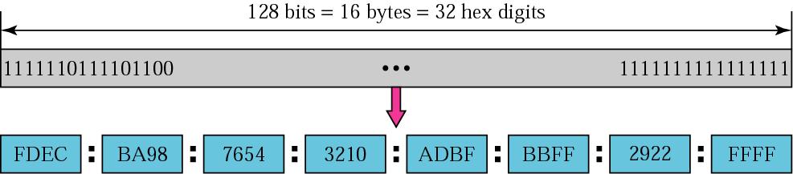
IPv6 address

Slide 10
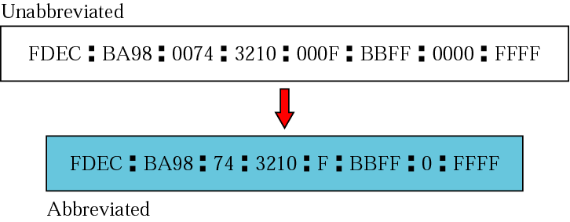
Abbreviated address

Slide 11
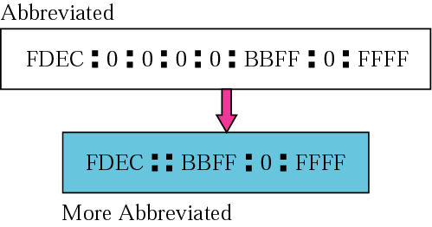
Abbreviated address with consecutive zeros

Slide 12

CIDR address

Slide 13
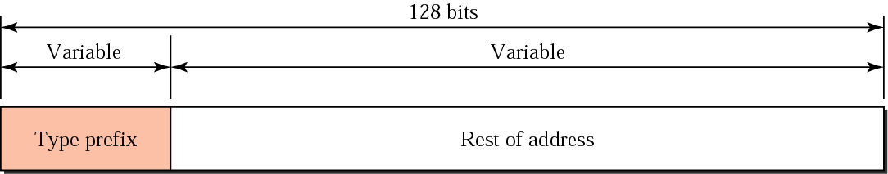
Address structure

Slide 14
Type of IPv6 Addresses
Unicast
An identifier for a single interface. A packet sent to a unicast address is delivered to the interface identified by that address.
Anycast
An identifier for a set of interfaces (typically belonging to different nodes). A packet sent to an anycast address is delivered to one of the interfaces identified by that address (the "nearest" one, according to the routing protocols' measure of distance).
Multicast
An identifier for a set of interfaces (typically belonging to different nodes). A packet sent to a multicast address is delivered to all interfaces identified by that address.

Slide 15
Address Type Identification – RFC 4291
Address type | Binary Prefix | IPv6 Notation
Unspecified | 00...0 (128 bits) | ::/128
Loopback | 00...1 (128 bits) | ::1/128
Multicast | 11111111 | FF00::/8
Link Local Unicast | 1111111010 | FE80::/10
Global Unicast

Slide 16
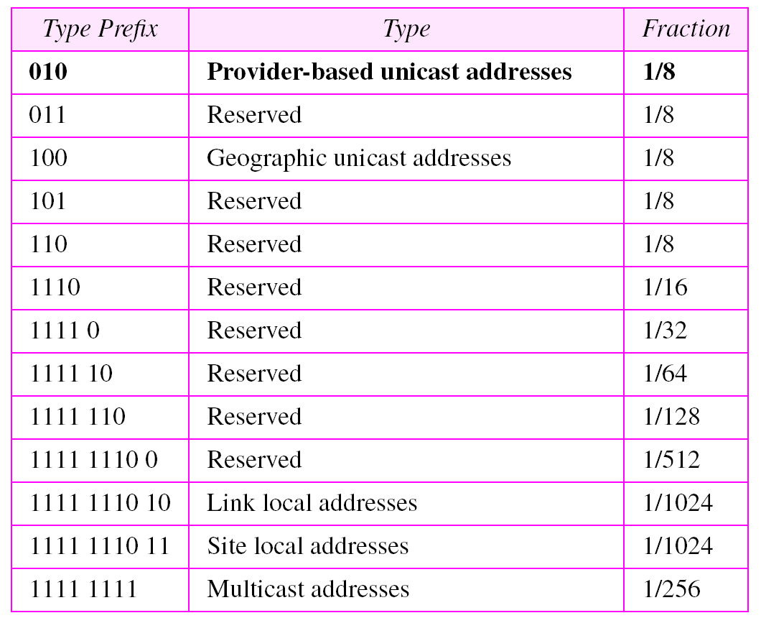
Table 27.1 Type prefixes for IPv6 addresses

Slide 17

Unspecified address

Slide 18

Loopback address

Slide 19
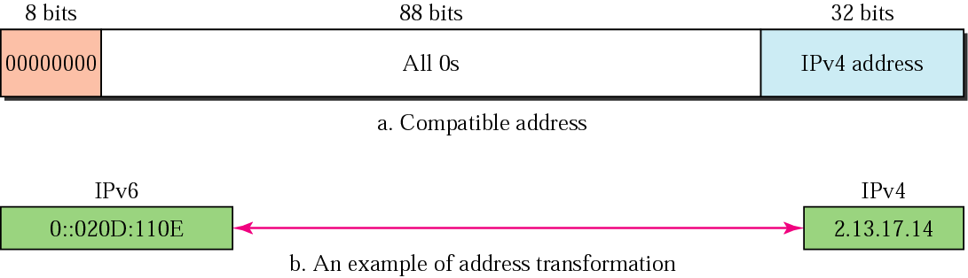
Compatible address

Slide 20
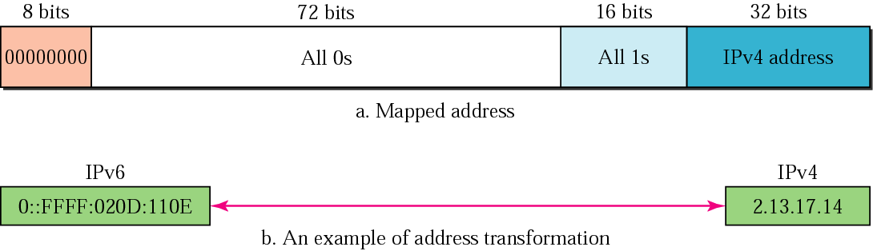
Mapped address

Slide 21
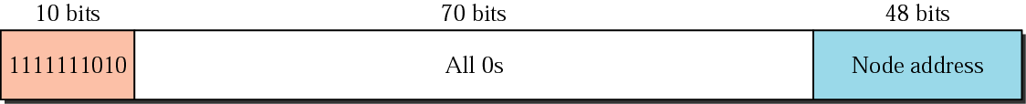
Link local address

Slide 22
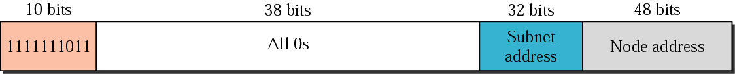
Site local address

Slide 23
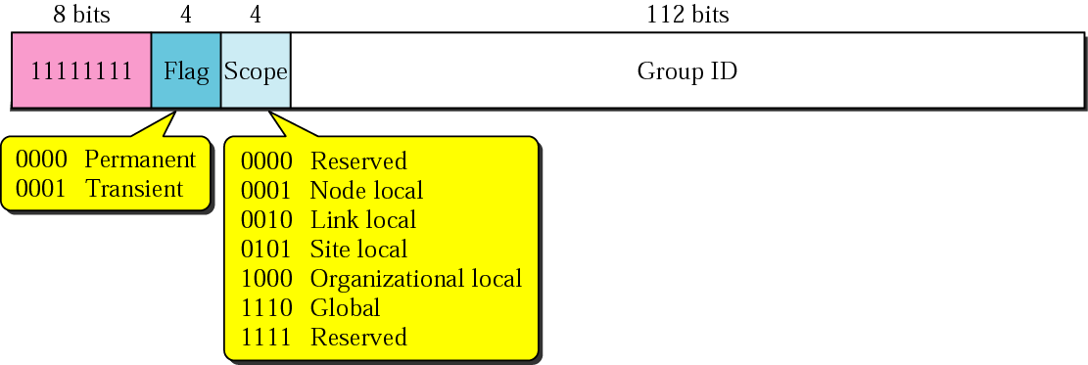
Multicast address
0 reserved
1 Interface-Local scope
2 Link-Local scope
3 reserved
4 Admin-Local scope
5 Site-Local scope
6 (unassigned)
7 (unassigned)
8 Organization-Local scope
9 (unassigned)
A (unassigned)
B (unassigned)
C (unassigned)
D (unassigned)
E Global scope
F reserved

Slide 24
Well-known IPv6 multicast addresses
Address | Description
FF02::1 | All nodes on the local network segment
FF02::2 | All routers on the local network segment
FF02::5 | OSPFv3 All SPF routers
FF02::6 | OSPFv3 All DR routers
FF02::8 | IS-IS for IPv6 routers
FF02::9 | RIP routers
FF02::A | EIGRP routers
FF02::D | PIM routers
FF02::16 | MLDv2 reports (defined in RFC 3810)
FF02::1:2 | All DHCP servers and relay agents on the local network segment (defined in RFC 3315)
FF05::1:3 | All DHCP servers on the local network site (defined in RFC 3315)

Slide 25
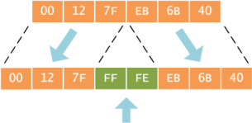
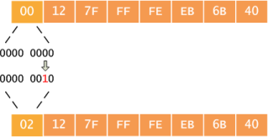
EUI-64 in IPv6
IEEE's 64-bit Extended Unique Identifier (EUI-64) format
1. Break MAC Organizationally Unique Identifier (OUI) and
the NIC specific part.
2. Invert the universal/local (U/L) flag (bit 7) in the OUI

Slide 26
Solicited-Node Multicast Address
Taking the last 24 bits of IPv6 Unicast or Anycast address and append to FF02::1:FF00:0/104
2601:9:7181:15F1
0212:7FFF:FE EB:6B40
FF02::1
FF00:00
EB:6B40
A host is required to join a Solicited-Node multicast group for each of its configured unicast or anycast addresses

Slide 27
Solicited-Node Multicast Group
FE80::
0212:7F FF:FE EB:6B40
2601:9:7181:15F1
0212:7F FF:FE EB:6B40
FF02::1
FF00:00
EB:6B40

Slide 28
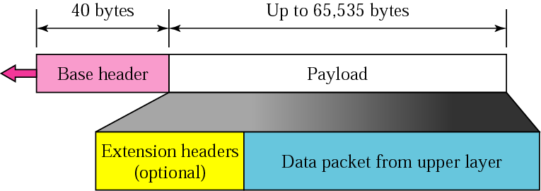
IPv6 datagram

Slide 29
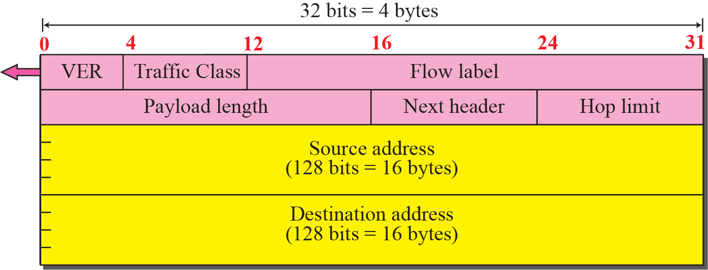
IPv6 Header

Slide 30
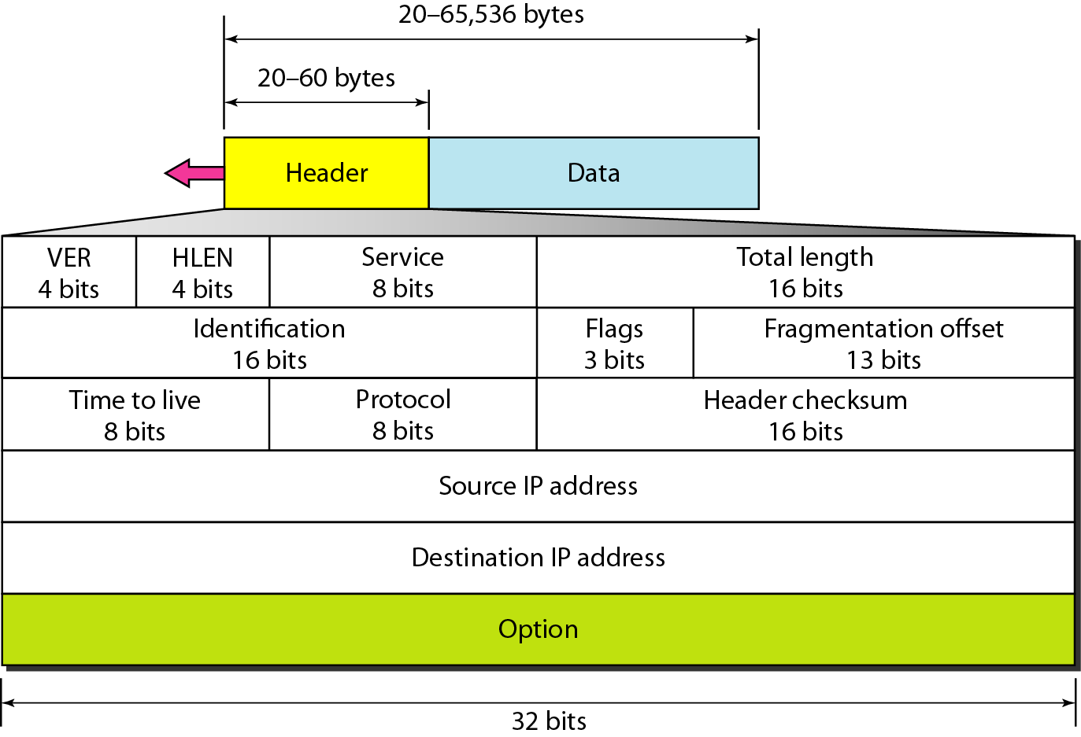
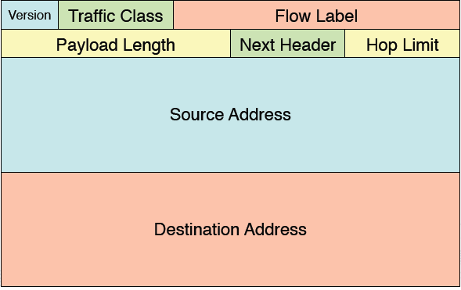
IPv4 and IPv6 Header

Slide 31
Header comparison
0
15
16
31
Removed (6)
vers hlen TOS total length
identification flags flag-offset
ID, flags, flag offset
TOS, hlen
header checksum
20
bytes
TTL protocol header checksum
source address
destination address
Changed (3)
options and padding
total length => payload
protocol => next header
TTL => hop limit
IPv4
vers traffic class flow-label
Added (2)
payload length next header hop limit
traffic class
flow label
40
bytes
source address
Expanded
destination address
address 32 to 128 bits
IPv6

Slide 32
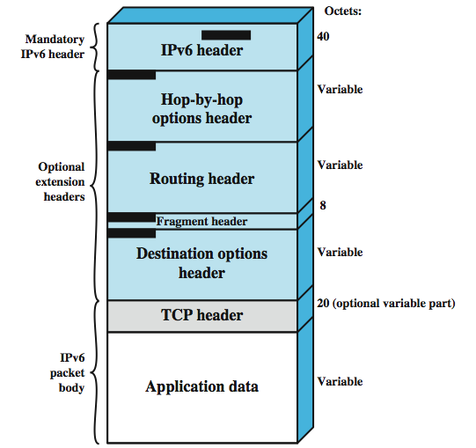

IPv6 Packet (PDU) Structure

Slide 33
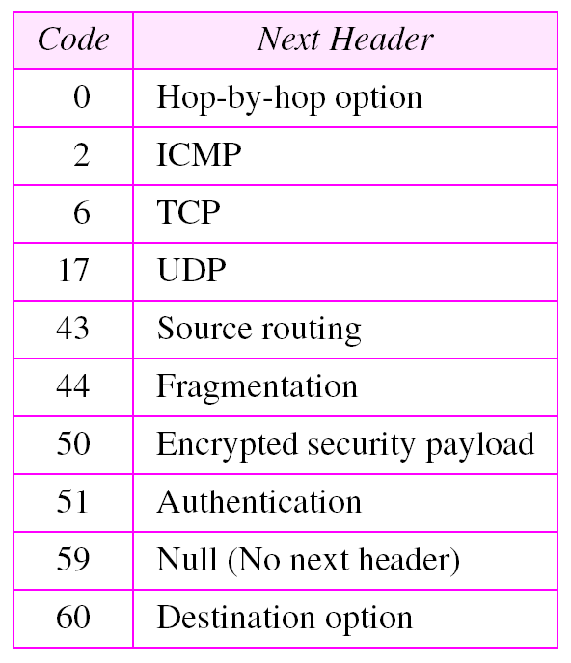
Next header codes

Slide 34
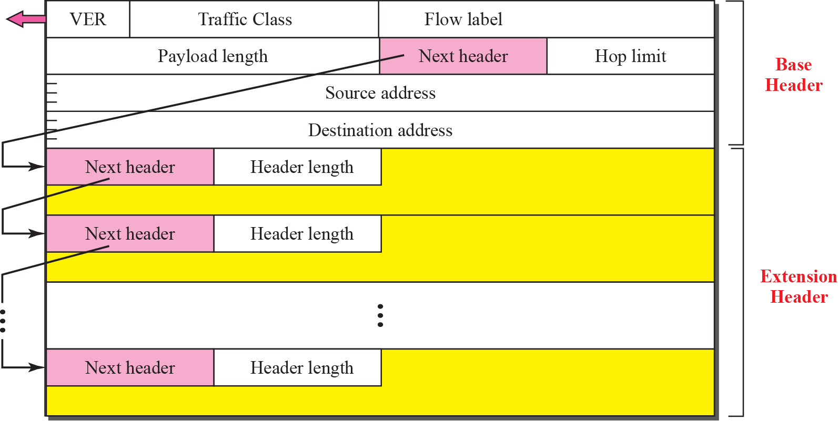
Extension header format

Slide 35
Extension Header
Extension Header | Type | Description
Hop-by-Hop Options | 0 | Options that need to be examined by all devices on the path.
Destination Options (before routing header) | 60 | Options that need to be examined only by the destination of the packet.
Routing | 43 | Methods to specify the route for a datagram (used with Mobile IPv6).
Fragment | 44 | Contains parameters for fragmentation of datagrams.
Authentication Header (AH) | 51 | Contains information used to verify the authenticity of most parts of the packet.
Encapsulating Security Payload (ESP) | 50 | Carries encrypted data for secure communication.
Destination Options (before upper-layer header) | 60 | Options that need to be examined only by the destination of the packet.
Mobility (currently without upper-layer header) | 135 | Parameters used with Mobile IPv6.

Slide 36
Extension Header
Extension Header | Type | Description
Experimental Use | 139 | Host Identity Protocol RFC5201
Shim6 Protocol | 140 | RFC5533
Use for experimentation and testing | 253 | Used for testing protocol extensions or new features
Use for experimentation and testing | 254 | Used for testing protocol extensions or new features

Slide 37

Hop-by-hop option header format

Slide 38
The format of options in a hop-by-hop option header

Slide 39
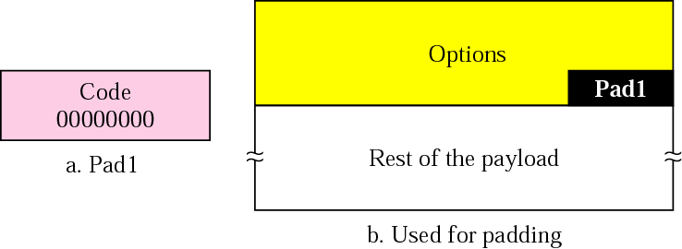
Pad1

Slide 40
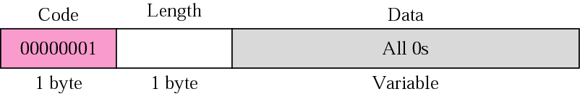
PadN

Slide 41

Jumbo payload

Slide 42
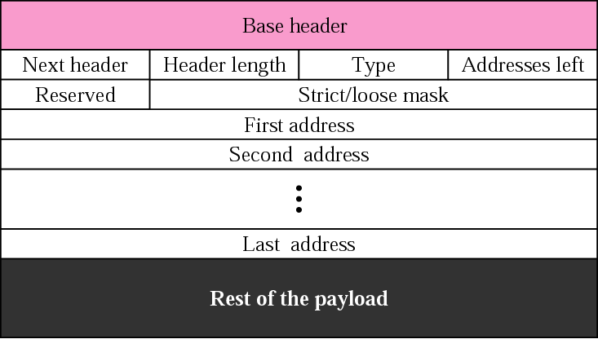
Source routing

Slide 43
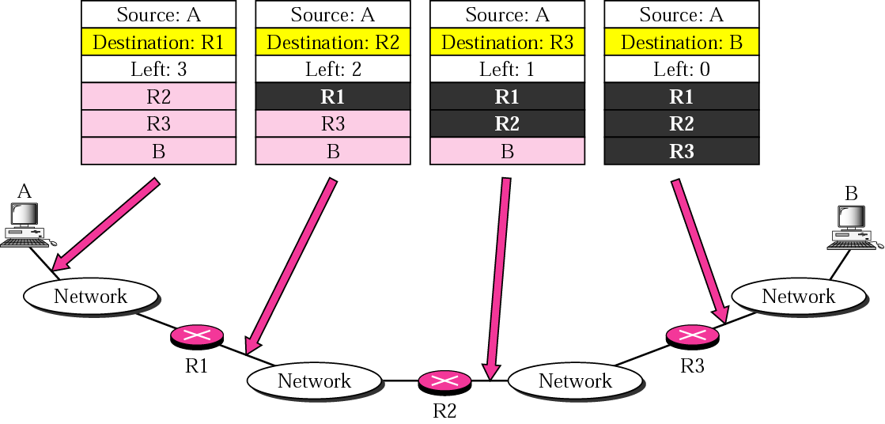
Source routing example

Slide 44
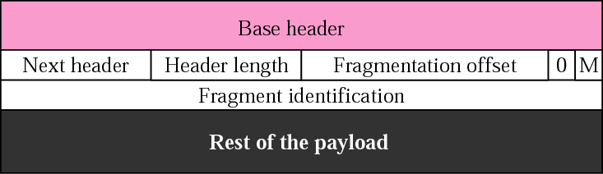
Fragmentation

Slide 45
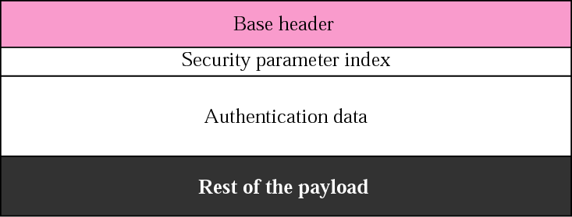
Authentication

Slide 46
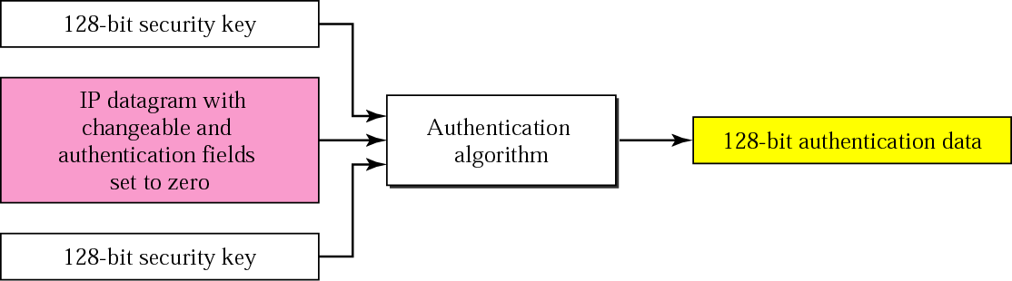
Calculation of authentication data

Slide 47

Encrypted security payload

Slide 48
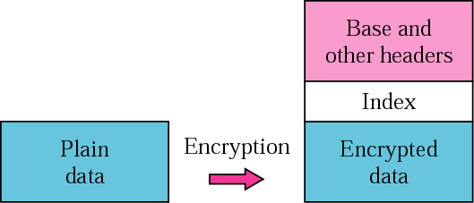
Transport mode encryption

Slide 49
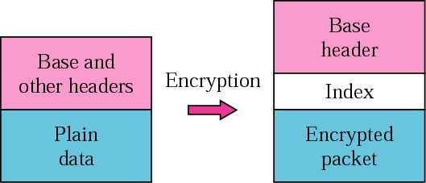
Tunnel-mode encryption

Slide 50
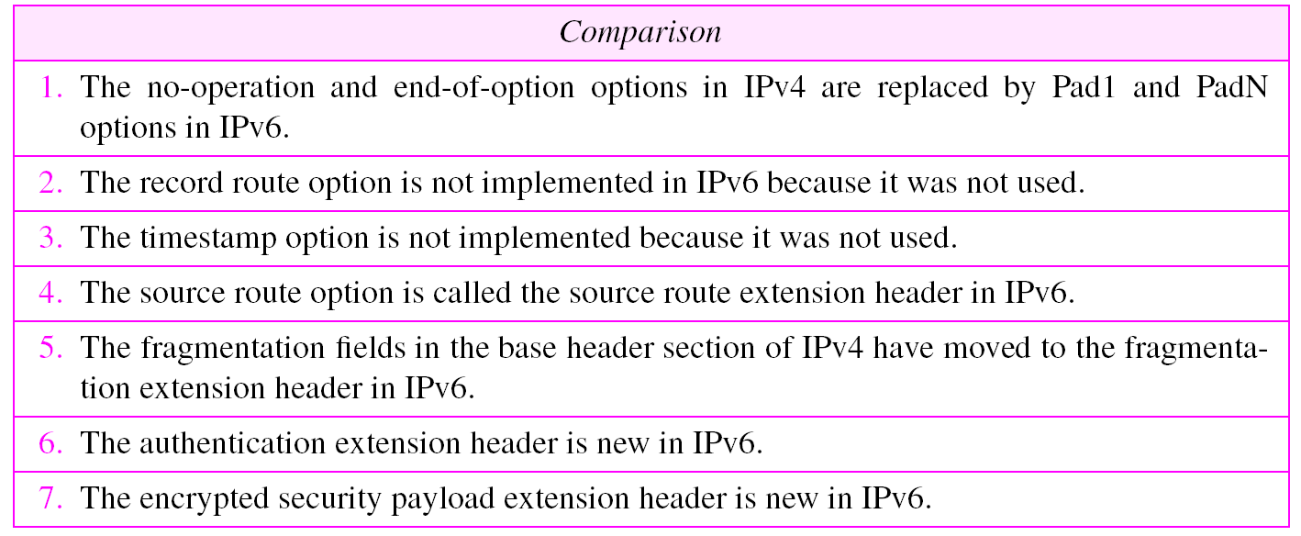
Comparison between IPv4 options and IPv6 extension headers

Slide 51
ICMPv6
27.2 ICMPv6
ICMPv6, while similar in strategy to ICMPv4, has changes that makes it more suitable for IPv6. ICMPv6 has absorbed some protocols that were independent in version 4.
The topics discussed in this section include:
Error Reporting
Query

Slide 52
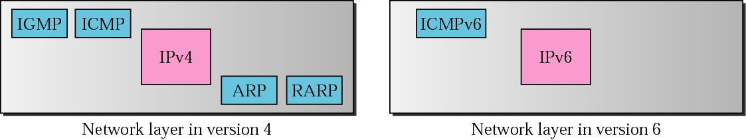
Comparison of network layers in version 4 and version 6

Slide 53
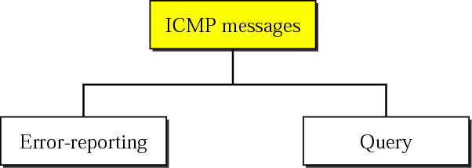
Categories of ICMPv6 messages

Slide 54
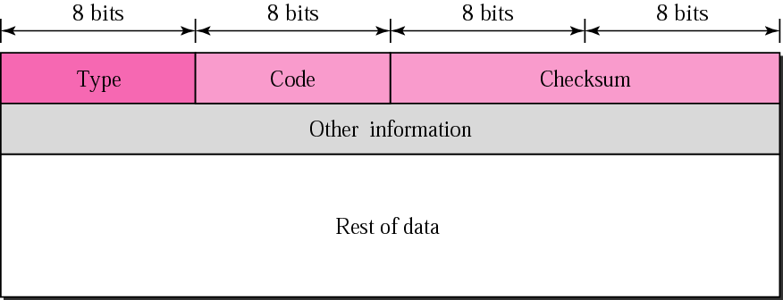
General Format of ICMP messages

Slide 55
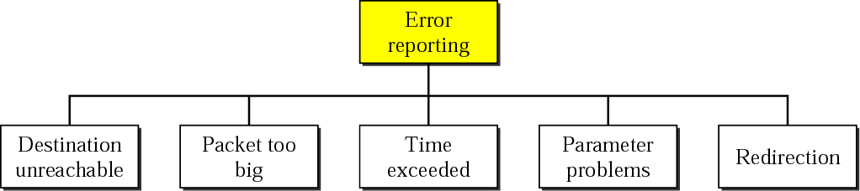
Error-reporting messages

Slide 56
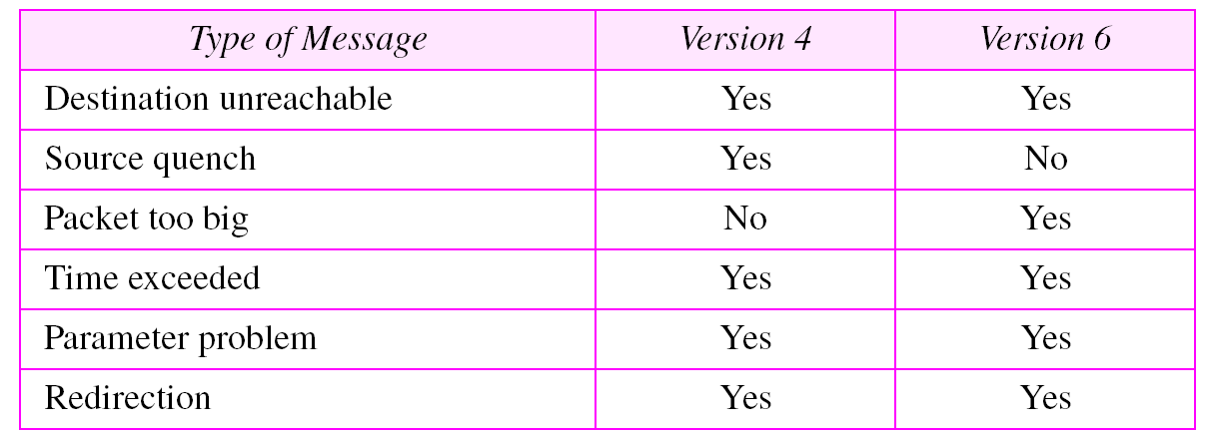
Comparison of error-reporting messages in ICMPv4 and ICMPv6

Slide 57
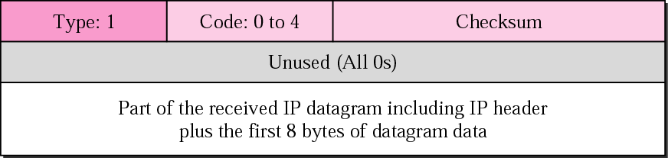
Destination-unreachable message format

Slide 58
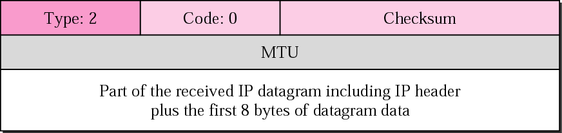
Packet-too-big message format

Slide 59

Time-exceeded message format

Slide 60

Parameter-problem Message Format

Slide 61
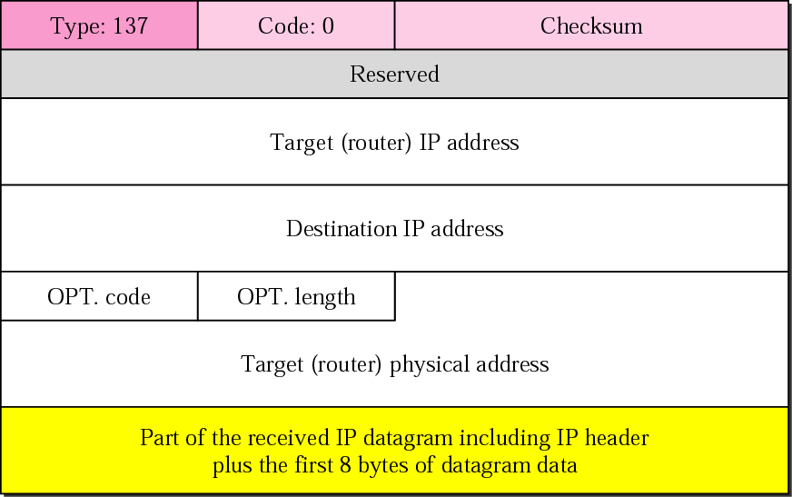
Redirection Message Format

Slide 62
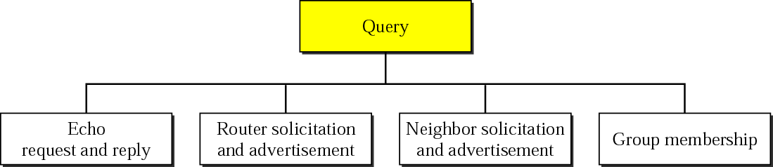
Query Messages

Slide 63
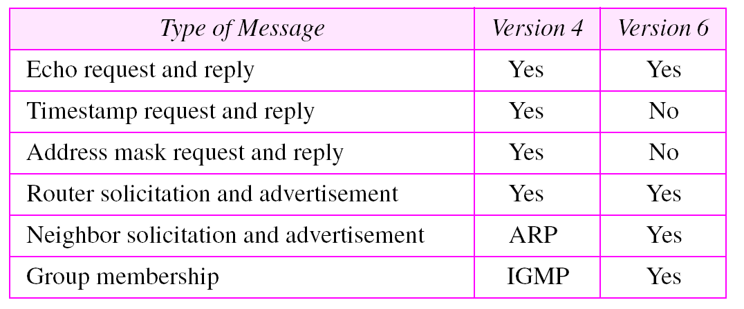
Comparison Of Query Messages In ICMPv4 and ICMPv6

Slide 64
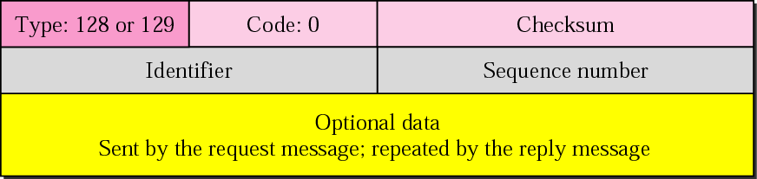
Echo Request And Reply Messages

Slide 65
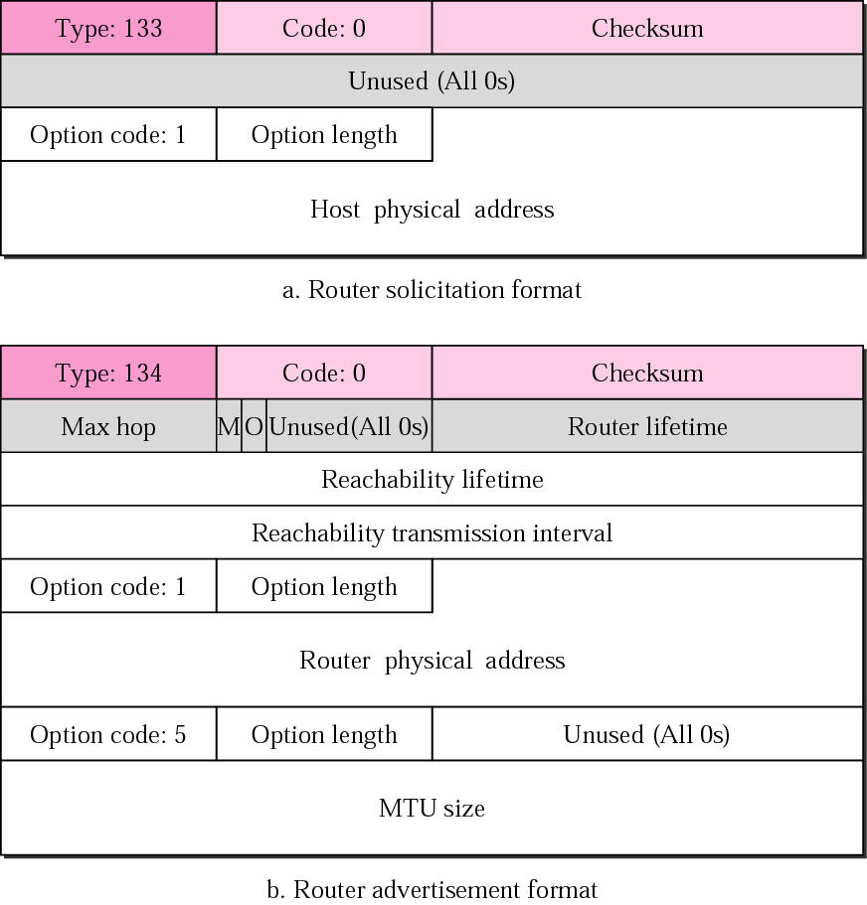
Router-solicitation And Advertisement Message Formats

Slide 66
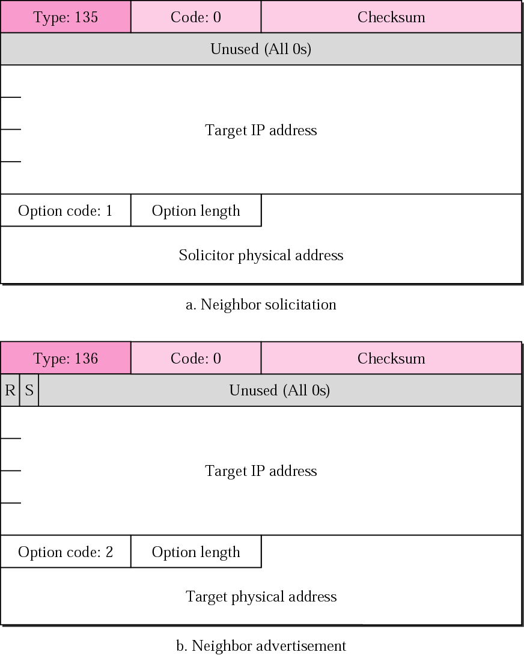
Neighbor-solicitation And Advertisement Message Formats

Slide 67
Internet Control Message Protocol version 6 (ICMPv6)
Notes:
ICMP was developed to be a companion to the original Internet Protocol, version 4. With the creation of IP version 6 (IPv6), a new version of ICMP called (ta-da) ICMP version 6 (ICMPv6) was created as well, and the original ICMP is now sometimes called ICMPv4 to differentiate it, just as the “old” IP is now often called “IPv4”. These two versions have some differences in their specifics, but really are very similar in overall operation.
In TCP/IP, diagnostic, test and error-reporting functions at the internet/network layer are performed by the Internet Control Message Protocol (ICMP), which is like the Internet Protocol’s “administrative assistant”.

Slide 68
Protocol Overview
ICMPv6 is a multipurpose protocol used for
Reporting errors encountered in processing packets
Performing diagnostics
Performing Neighbor Discovery
Reporting multicast memberships.
ICMP messages are transported within an IPv6 packet in which extension headers can also be present.
An ICMP message is identified by a value of 58 in the Next Header field of the IPv6 header or of the preceding Header.

Slide 69
ICMPv6: Introduction
IPv6 uses the ICMP as defined for IPv4 with a number of changes.
The resulting protocol is called ICMPv6.
ICMP messages, delivered in IP packets, are used for out-of-band messages related to network operation or mis-operation.
ICMP uses IP, ICMP packet delivery is unreliable, so hosts can't count on receiving ICMP packets for any network problem.

Slide 70
ICMPv6: Introduction
The ICMPv6 is an integral part of the IPv6 architecture and must be completely supported by all IPv6 implementations.
ICMPv6 combines functions previously subdivided among different protocols, such as
ICMP (Internet Control Message Protocol version 4)
IGMP (Internet Group Membership Protocol)
ARP (Address Resolution Protocol)
It introduces some simplifications by eliminating obsolete types of messages no longer in use.

Slide 71
ICMP: Functions
Announce network errors
A host or entire portion of the network being unreachable, due to some type of failure.
A TCP or UDP packet directed at a port number with no receiver attached is also reported via ICMP.
Announce network congestion
When a router begins buffering too many packets, due to an inability to transmit them as fast as they are being received, it will generate ICMP Source Quench messages.
Directed at the sender, these messages should cause the rate of packet transmission to be slowed.
Generating too many Source Quench messages would cause even more network congestion, so they are used sparingly.

Slide 72
ICMP: Functions
Assist Troubleshooting
ICMP supports an Echo function, which just sends a packet on a round--trip between two hosts.
Ping will transmit a series of packets, measuring average round--trip times and computing loss percentages.
Announce Timeouts
If an IP packet's TTL field drops to zero, the router discarding the packet will often generate an ICMP packet announcing this fact.
TraceRoute is a tool which maps network routes by sending packets with small TTL values and watching the ICMP timeout announcements.

Slide 73

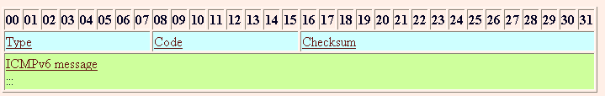
ICMPv6 Header
Three Fields
Type (8 bits)
Indicates the type of the message.
If the high order bit = 0 (0- 127)→ error message
if the high-order bit = 1 (128 – 255) → information message.
Code ( 8 bits)
content depends on the message type, and it is used to create an additional level of message granularity.
Checksum (16 bits)
Used to detect errors in the ICMP message and in part of the IPv6 message.

Slide 74
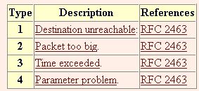

Types of ICMPv6 Messages
Error messages
ICMPv6 messages are grouped into two classes:
Error messages
To provide feedback to a source device about an error that has occurred.
Generated specifically in response to some sort of action, usually the transmission of a datagram
Identified as such by having a zero in the high-order bit of their message
Type field values 0 to 127.
Informational messages
Used to let devices exchange information, implement certain IP-related features, and perform testing.
Message Types from 128 to 255.
Many of these ICMP types have a "code" field.
Informational messages

Slide 75
ICMPv6 Error Messages
Type Value | Message Name | Summary Description of Message Type
1 | Destination Unreachable | Indicates that a datagram could not be delivered to its destination. Code value provides more information on the nature of the error.
2 | Packet Too Big | Sent when a datagram cannot be forwarded because it is too big for the MTU of the next hop in the route. This message is needed in IPv6 and not IPv4 because in IPv4, routers can fragment oversized messages, while in IPv6 they cannot.
3 | Time Exceeded | Sent when a datagram has been discarded prior to delivery due to the Hop Limit field being reduced to zero.
4 | Parameter Problem | Indicates a miscellaneous problem (specified by the Code value) in delivering a datagram.

Slide 76
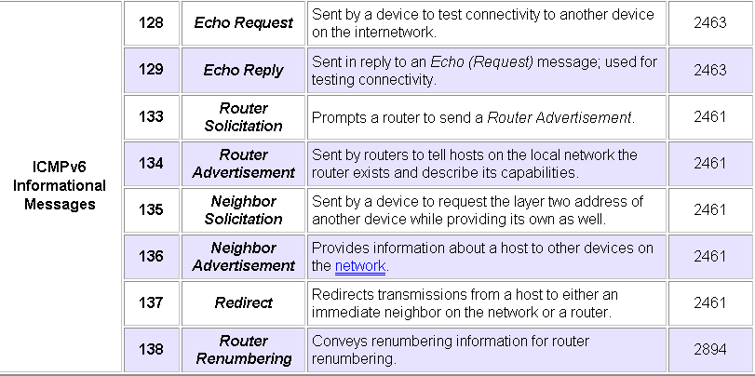
ICMP Information Messages

Slide 77
Path MTU Discovery (PMTUD) for IPv6

Slide 78
PMTUDv6 - Overview
To enable hosts to discover the min. MTU on a path to a particular destination.
Fragmentation in IPv6 is not performed by intermediary routers.
The source node may fragment packets by itself only when the path MTU is smaller than the packets to deliver
PMTUD for IPv6 uses ICMPv6 error message
Type 2 Packet Too Big
For detail info - http://www.ietf.org/rfc/rfc1981.txt
Notes:
In order for a datagram to be successfully carried along a route, its size must be small enough to fit within the lower-layer frame at each step on the way. The term maximum transmission unit (MTU) describes the size limit for any given physical network. If a datagram is too large for the MTU of a network, it must be broken into pieces, a process called fragmentation, and then the pieces reassembled at the destination device. T
Every network link has a maximum packet size called the link's MTU (Maximum Transmission Unit). The full path from one computer to another may travel across many links with different MTUs.
The smallest MTU for all the links in a path is the path MTU.
Fragmentation may occur in intermediary routers when the packet is larger than the link layer’s MTU. Fragmentation is a harmful and costly operation in terms of CPU cycles for routers. Moreover, in some circumstances, fragmentation over fragmentation might occur in several intermediate routers along a delivery path, causing a decrease in performance.
RFC 2460, Internet Protocol, Version 6 (IPv6) Specification, it is strongly recommended that IPv6 nodes implement PMTUD for IPv6 to avoid fragmentation.

Slide 79
Differences between IPv4 & IPv6 MTU
Increased Default MTU
In IPv4, the minimum MTU that routers and physical links were required to handle = 576 bytes.
In IPv6, all links must handle a datagram size of at least 1280 bytes.
improves efficiency by increasing the ratio of maximum payload to header length, and reduces the frequency with which fragmentation is required.
Elimination of En Route Fragmentation
In IPv4, datagrams may be fragmented by either the source device, or by routers during delivery.
In IPv6, only the source node can fragment; routers do not.
The source must therefore fragment to the size of the smallest MTU on the route before transmission.

Slide 80
Differences between IPv4 & IPv6 MTU
MTU Size Error Feedback
Since routers cannot fragment datagrams, they must drop them if they are forced to try to send a too-large datagram over a physical link.
A feedback process has been defined using ICMPv6 that lets routers tell source devices that they are using datagrams that are too large for the route.
Movement of Fragmentation Header Fields
To reflect the decreased importance of fragmentation in IPv4, the permanent fields related to the process that were in the IPv4 header have been farmed out to a Fragment extension header, included only when needed.

Slide 81
Determining the Appropriate Datagram Size
How does the source know what size to use?
It has two choices:
Use Default MTU
Use the default MTU of 1280, which all physical networks must be able to handle.
Good choice especially for short communications or for sending small amounts of data.
Use Path MTU Discovery feature
A node sends messages over a route to determine what the overall minimum MTU for the path is, in a technique very similar to how it is done in IPv4.

Slide 82
Path MTU Discovery Process
The sending node assumes that the path MTU is the link MTU of the interface on which the traffic is being forwarded.
The sending node sends IPv6 packets at the path MTU size.
If a router on the path is unable to forward the packet over a link with a link MTU that is smaller than the size of the packet, it discards the IPv6 packet and sends an ICMPV6 Packet Too Big message back to the sending node. The ICMPV6 Packet Too Big message contains the link MTU of the link on which the forwarding failed.
The sending node sets the path MTU for packets being sent to the destination to the value of the MTU field in the ICMPv6 Packet Too Big message.
The sending node starts again at step 2 and repeats steps 2 through 4 for as many times as are necessary to discover the path MTU.

Slide 83
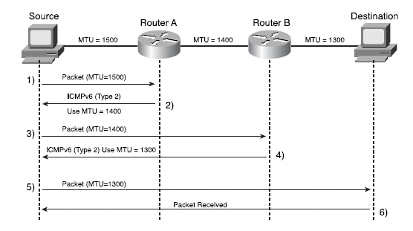
PMTUD uses ICMPv6 Type 2 Message
Notes:
First, the source node that sends the first IPv6 packet to a destination node uses 1500 bytes as the MTU value (1).
the intermediary Router A replies to the source node using an ICMPv6 message Type 2, Packet Too Big, and specifies 1400 bytes as the lower MTU value in the ICMPv6 packet (2).
The source node then sends the packet but instead uses 1400 bytes as the MTU value; the packet passes through Router A (3).
However, along the path, intermediary Router B replies to the source node using an ICMPv6 message
Type 2 and specifies 1300 bytes as the MTU value (4).
Finally, the source node resends the packet using 1300 MTU bytes as the MTU value.

Slide 84
IPv6 Fragmentation

Slide 85
IPv6 Fragmentation
For purposes of fragmentation, IPv6 datagrams are broken into two pieces:
Unfragmentable Part
Includes the main header of the original datagram + any extension headers that need to be present in each fragment - Hop-By-Hop Options, Destination Options (for those options to be processed by devices along a route) and Routing.
Fragmentable Part
Data portion of the datagram + other extension headers if present - authentication Header, Encapsulating Security Payload and/or Destination Options (for options to be processed only by the final destination).
Unfragmentable Part must be present in each fragment, while the fragmentable part is split up amongst the fragments.

Slide 86
IPv6 Fragment Sets
So to fragment a datagram, a device creates a set of fragment datagrams, each of which contains the following, in order:
Unfragmentable Part
The full Unfragmentable Part of the original datagram, with its Payload Length changed to the length of the fragment datagram.
Fragment Header
A Fragment header with the Fragment Offset, Identification and M flags set in the same way they are used in IPv4.
Fragment
A fragment of the Fragmentable Part of the original datagram. Note that each fragment must have a length that is a multiple of 8 bytes, because the value in the Fragment Offset field is specified in multiples of 8 bytes.

Slide 87
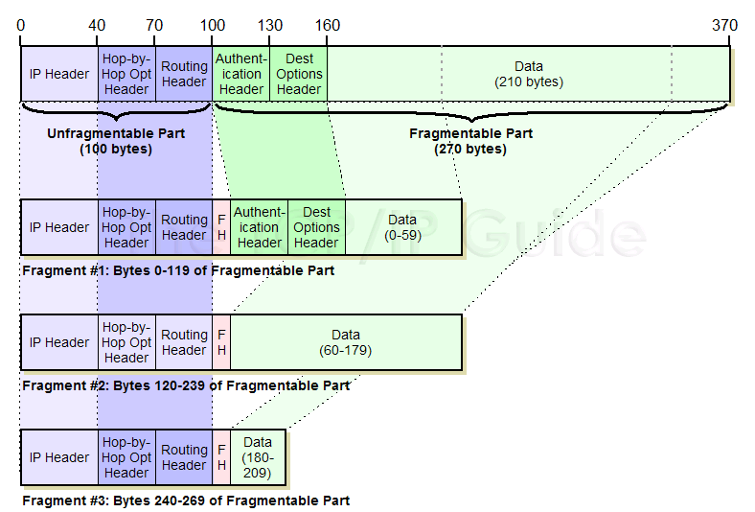
IPv6 Fragmentation
Suppose we need to send this over a link with an MTU of only 230 bytes.
We would actually require three fragments, not the two, because of the need to put the two 30-byte unfragmentable extension headers in each fragment, and the requirement that each fragment be a length that is a multiple of 8.
Fragment #1: The first fragment would consist of the 100-byte Unfragmentable Part, followed by an 8-byte Fragment header and the first 120 bytes of the Fragmentable Part of the original datagram. This would contain the two fragmentable extension headers and the first 60 bytes of data.
Fragment # 2: This would also contain the 100-byte Unfragmentable Part, followed by a Fragment header and 120 bytes of data (bytes 60 to 179).
Second Fragment: This would also contain the 100-byte Unfragmentable Part, followed by a Fragment header and 120 bytes of data (bytes 60 to 179).
Notes:
Let's take an example to illustrate how IPv6 fragmentation works. Suppose we have an IPv6 datagram exactly 370 bytes wide, consisting of a 40-byte IP header, four 30-byte extension headers, and 210 bytes of data.
Two of the extension headers are unfragmentable, while two are fragmentable. (In practice we would never need to fragment such a small datagram but I am trying to keep the numbers simple.)
Suppose we need to send this over a link with an MTU of only 230 bytes.
We would actually require three fragments, not the two you might expect, because of the need to put the two 30-byte unfragmentable extension headers in each fragment, and the requirement that each fragment be a length that is a multiple of 8. Here is how the fragments would be structured:
First Fragment: The first fragment would consist of the 100-byte Unfragmentable Part, followed by an 8-byte Fragment header and the first 120 bytes of the Fragmentable Part of the original datagram. This would contain the two fragmentable extension headers and the first 60 bytes of data. This leaves 150 bytes of data to send. Second Fragment: This would also contain the 100-byte Unfragmentable Part, followed by a Fragment header and 120 bytes of data (bytes 60 to 179). This would leave 30 bytes of data remaining. Third Fragment: The last fragment would contain the 100-byte Unfragmentable Part, a Fragment header and the final 30 bytes of data.

Slide 88
IPv6 Neighbour Discovery Protocol (NDP)
Notes:
The new Internet Protocol version 6 (IPv6) represents an evolution of the venerable Internet Protocol. It maintains the same basic operational principles of IPv4, but makes some important modifications, particularly in the area of addressing. In fact, some of the more significant changes in IPv6 are actually not in the IP protocol itself, but in the protocols that support IP. One of the most interesting of these was the creation of an entirely new support protocol for IPv6. It combines several tasks previously performed by other protocols in IPv4, adds some new functions, and makes numerous improvements to the whole package. This new standard is called the IPv6 Neighbor Discovery (ND) protocol.

Slide 89
IPv6 ND - Overview
IPv6 ND is a set of messages and processes that determine relationships between neighboring nodes.
ND replaces ARP, ICMP Router Discovery, and ICMP Redirect used in IPv4 and provides additional functionality.

Slide 90
IPv6 ND - Overview
ND is used by hosts to:
Discover neighbouring routers.
Discover addresses, address prefixes, and other configuration parameters.
ND is used by routers to:
Advertise their presence, host configuration parameters, and on-link prefixes.
Inform hosts of a better next-hop address to forward packets for a specific destination.
ND is used by nodes to:
Resolve the link-layer address of a neighbouring node to which an IPv6 packet is being forwarded and determine when the link-layer address of a neighbouring node has changed.
Determine whether a neighbour is still reachable.

Slide 91
IPv6 ND – What is Neighbour?
Neighbour is one that has been used for years in various networking standards and technologies to refer to devices that are local to each other.
Two devices are neighbours if they are on the same local network, meaning that they can send information to each other directly.
Most of the functions of the ND protocol are implemented using a set of five special ICMPv6 control messages.
ND is a messaging protocol.
It doesn't implement a single specific function but rather a group of activities that are performed through the exchange of messages.
ND standard describes nine specific functions performed by the protocol.
Notes:
Since a neighbor is a local device, the name of the Neighbor Discovery protocol would seem to indicate that ND is all about how neighbors discover each other's existence. In the context of this protocol, however, the term discovery has a much more generic meaning: it refers to discovering not just who our neighbors are but also important information about them. In addition to letting devices identify their neighbors, ND facilitates all the tasks in the bullet list above, including such functions as address resolution, parameter communication, autoconfiguration and much more as we will see in the next few topics.

Slide 92
ICMPv6 Control Messages Used By NDP
RS- Router Solicitation Messages (ICMPv6 Type 133)
Sent by hosts to request that any local routers send a Router Advertisement message so they don't have to wait for the next regular advertisement message.
RA - Router Advertisement Messages (ICMPv6 Type 134)
Sent regularly by routers to tell hosts that they exist and provide important prefix and parameter information to them.
NS - Neighbor Solicitation Messages (ICMPv6 Type 135)
Sent to verify the existence of another host and to ask it to transmit a Neighbor Advertisement.
NA - Neighbor Advertisement Messages (ICMPv6 Type 136)
Sent by hosts to indicate the existence of the host and provide information about it.
Redirect Messages (ICMPv6 Type 137)
Sent by a router to tell a host of a better method to route data to a particular destination.

Slide 93
ICMPv6 Messages Used by NDP
Mechanism | Type 133 (RS) | Type 134 (RA) | Type 135 (NS) | Type 136 (NA) | Type 137 (Redirect)
Replacement of ARP |  |  | X | X
Prefix advertisement | X | X
Prefix renumbering | X | X
DAD |  |  | X
Router redirection |  |  |  |  | X

Slide 94
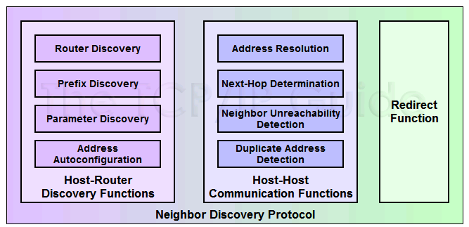
NDP Functional Groups and Functions
Mainly three functions
Host-Router Functions
Host-Host Communication Functions
Redirect Function

Slide 95
1. Host-Router Discovery Functions
One of the two main groups of functions in ND are those that facilitate the discovery of local routers and the exchange of information between them and hosts.
Router Discovery
Core function of this group: the method by which hosts locate routers on their local network.
Prefix Discovery
Closely related to the process of router discovery is prefix discovery.
To determine what network they are on, which in turn tells them how to differentiate between local and distant destinations and whether to attempt direct or indirect delivery of datagrams.
Parameter Discovery
A host learns important parameters about the local network and/or routers, such as the MTU of the local link.
Address Auto-configuration
Hosts in IPv6 are designed to be able to automatically configure themselves, but this requires information that is normally provided by a router.

Slide 96
2. Host-Host Communication Functions
Address Resolution
The process by which a device determines the layer two address of another device on the local network from that device's layer three (IP) address.
Performed by ARP in IP version 4.
Next-Hop Determination
Looking at an IP datagram's destination address and determining where it should next be sent.
Neighbor Unreachability Detection
Determining whether or not a neighbor device can be directly contacted.
Duplicate Address Detection (DAD)
Determining if an address that a device wishes to use already exists on the network.

Slide 97
3. Redirect Function
The last functional group contains just one function: Redirect.
The technique whereby a router informs a host of a better next-hop node to use for a particular destination.

Slide 98
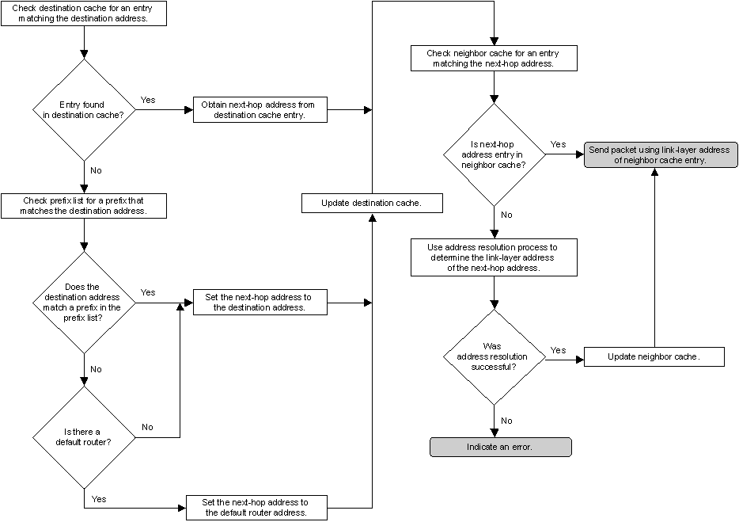
The Host Sending Algorithm

Slide 99
How Neighbour Solicitation and Neighbour Advertisement Works
A node can use following special addresses:
All-node multicast address (FF02::1, destination)
All-routers multicast address (FF02::2, destination)
Solicited-mode multicast address (destination)
Link-local address (sources or destination)
Unspecified address (::, source)

Slide 100
Address Resolution
The address resolution process for IPv6 nodes consists of an exchange of Neighbor Solicitation and Neighbor Advertisement messages to resolve the link-layer address of the on-link next-hop address for a given destination.
The sending host sends a multicast Neighbor Solicitation message on the appropriate interface.
The multicast address of the Neighbor Solicitation message is the solicited-node multicast address derived from the target IP address.
The Neighbor Solicitation message includes the link-layer address of the sending host in the Source Link-Layer Address option.
When the target host receives the Neighbor Solicitation message, it updates its own neighbor cache based on the source address of the Neighbor Solicitation message and the link-layer address in the Source Link-Layer Address option.

Slide 101
Address Resolution
Next, the target node sends a unicast Neighbor Advertisement to the Neighbor Solicitation sender.
The Neighbor Advertisement includes the Target Link-Layer Address option.
After receiving the Neighbor Advertisement from the target, the sending host updates its neighbor cache with an entry for the target based upon the information in the Target Link-Layer Address option.
At this point, unicast IPv6 traffic between the sending host and the target of the Neighbor Solicitation can be sent.

Slide 102
Mapping IPv4/IPv6 Multicast Address into Multicast MAC Addresses
IPv4 01:00:5E:00:00:00 - 01:00:5E:7F:FF:FF
Insert the lower 23 bits of a IPv4 multicast address into the MAC address
IPv6 33:33:XX:XX:XX:XX
Insert the lower 32 bits of a IPv6 multicast address into the MAC address

Slide 103
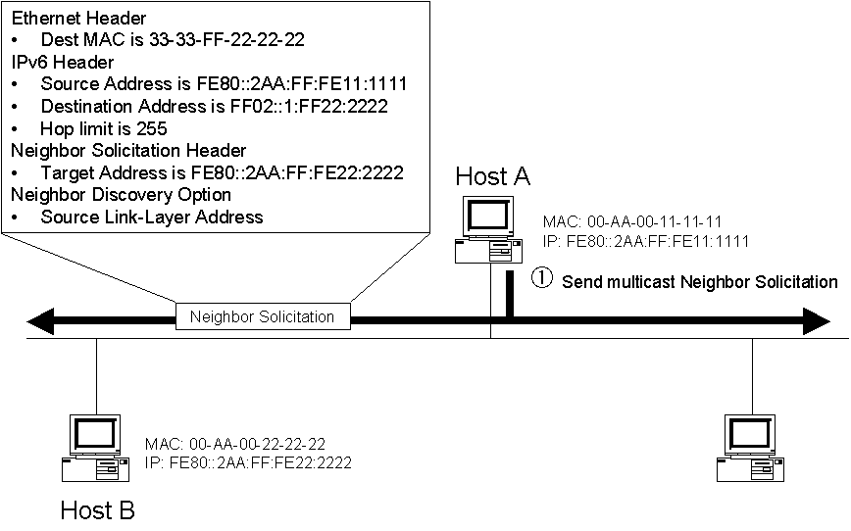
Address Resolution: Example
The multicast Neighbor Solicitation for address resolution
FE08::2AA:FF:FE22:2222
FF02::1:FF22:2222
33:33:FF:22:22:22
Notes:
Host A has an Ethernet MAC address of 00-AA-00-11-11-11 and a corresponding link-local address of FE80::2AA:FF:FE11:1111. Host B has an Ethernet MAC address of 00-AA-00-22-22-22 and a corresponding link-local address of FE80::2AA:FF:FE22:2222. To send a packet to Host B, Host A must use address resolution to resolve Host B’s link-layer address.
Based on Host B’s IP address, Host A sends a solicited-node multicast Neighbor Solicitation to the address of FF02::1:FF22:2222

Slide 104

Address Resolution: Example contd.
The unicast Neighbor Advertisement for address resolution
Notes:
Host B, having registered the solicited-node multicast address of 33-33-FF-22-22-22 with its Ethernet adapter, receives and processes the Neighbor Solicitation. Host B responds with a unicast Neighbor Advertisement message,

Slide 105
Prefix advertisement
It uses
Router Advertisement (RA) message &
All node mulicast address (FF02::1)
RA sent periodically on the local link to all node-multicast address

Slide 106
Router Advertisement Message Parameters
IPv6 prefix
Multiple ipv6 prefixes can be advertised per local link
By default – prefix length = 64 bits
Nodes gets IPv6 address, they append their link-layer in EUI-format to the prefix received = 128 bit IPv6 node address.
Life-time
Lifetime may vary from 0 to infinite.
Two types of lifetime value per prefix:
Valid Lifetime: how long the node’s address remains in valid state
Preferred Lifetime: how long the address configured by a node remains preferred. It must be <= valid lifetime

Slide 107
Router Advertisement Message Parameters
Default router information
Information about the existence and lifetime of the default router’s ipv6 address
Default router’s address = router’s link local address
Flags/options
Use flags to instruct nodes to use stateful configuration than stateless

Slide 108
Router Discovery
Router discovery is the process through which nodes attempt to discover the set of routers on the local link.
Router discovery in IPv6 is similar to ICMP Router Discovery for IPv4 described in RFC 1256.
An important difference between ICMPv4 Router Discovery and IPv6 Router Discovery is the mechanism through which a new default router is selected when the current one becomes unavailable.
In ICMPv4 Router Discovery, the Router Advertisement message includes an Advertisement Lifetime field.
It is the time after which the router, upon receiving its last Router Advertisement message, can be considered unavailable.
In the worst case, a router can become unavailable and hosts will not attempt to discover a new default router until the Router Advertisement time has elapsed.

Slide 109
IPv6 Router Discovery
IPv6 has a Router Lifetime field in the Router Advertisement message.
It indicates the length of time that the router can be considered a default router.
If the current default router becomes unavailable, the condition is detected through neighbor unreachability detection instead of the Router Lifetime field in the Router Advertisement message.
Because neighbor unreachability detection determines that the router is no longer reachable, a new router is chosen immediately from the default router list.

Slide 110
Router Discovery - parameters
In addition to configuring a default router, IPv6 router discovery also configures the following:
The default setting for the Hop Limit field in the IPv6 header.
A determination of whether the node should use a stateful address protocol, such as DHCPv6, for addresses and other configuration parameters.
The timers used in reachability detection and the retransmission of Neighbor Solicitations.
The list of network prefixes defined for the link. Each network prefix contains both the IPv6 network prefix and its valid and preferred lifetimes.
If indicated, a network prefix combined with the interface identifier creates a stateless IP address configuration for the receiving interface. A network prefix also defines the range of addresses for nodes on the local link.
The MTU of the local link.

Slide 111
IPv6 Router Discovery Processes
IPv6 routers periodically send a Router Advertisement message on the local link advertising their existence as routers.
They also provide configuration parameters such as default hop limit, MTU, and prefixes.
Active IPv6 hosts on the local link receive the Router Advertisement messages and use the contents to maintain the default router list, the prefix list, and other configuration parameters.
A host that is starting up sends a Router Solicitation message to the link-local scope all-routers multicast address (FF02::2).
Upon receipt of a Router Solicitation message, all routers on the local link send a unicast Router Advertisement message to the node that sent the Router Solicitation.
The node receives the Router Advertisement messages and uses their contents to build the default router and prefix lists and set other configuration parameters.

Slide 112
IPv6 Router Discovery Processes
Any node can send RS to all-routers multicast address FF02::2 on the local link
When RS is received, a router responds with RA using all-node multicast FF02::1
To avoid flooding of RS on the link, each node can send only three RS at boot time.

Slide 113

IPv6 Router Discovery Processes - The multicast Router Solicitation for router and prefix discovery
To forward packets to off-link destinations, Host A must discover the presence of Router 1.
Host A sends a multicast Router Solicitation to the address FF02::2

Slide 114

IPv6 Router Discovery Processes – The unicast Router Advertisement for router and prefix discovery
Router 1, having registered the multicast address of 33-33-00-00-00-02 with its Ethernet adapter, receives and processes the Router Solicitation.
Router 1 responds with a unicast Router Advertisement message containing configuration parameters and local link prefixes

Slide 115
Duplicate Address Detection (DAD)
IPv4 nodes use ARP Request messages and a method called gratuitous ARP to detect a duplicate IP address on the local link.
Similarly, IPv6 nodes use the Neighbor Solicitation message to detect duplicate address use on the local link.
Before a node can configure its IPv6 address using stateless autoconfiguration, it must verify on the local link that the tentative address it wants to use is unique and not already in use by another mode.
Node sending a Neighbour Solicitation (NS) on the local link using unspecified address (::) as its source address and solicited-node multicast of the tentative unicast address as the destination address.
If a duplicate address – no assignment of this unicast address

Slide 116

DAD – Example The multicast Neighbor Solicitation for duplicate address detection
Host B has a link-local address of FE80::2AA:FF:FE22:2222.
Host A is attempting to use the link-local address of FE80::2AA:FF:FE22:2222.
Before Host A can use this link-local address, it must verify its uniqueness through duplicate address detection.
Host A sends a solicited-node multicast Neighbor Solicitation to the address FF02::1:FF22:2222

Slide 117

DAD – Example The multicast Neighbor Advertisement for duplicate address detection
Host B, having registered the solicited-node multicast address of 33-33-FF-22-22-22 with its Ethernet adapter, receives and processes the Neighbor Solicitation.
Host B notes that the source address is the unspecified address.
Host B then responds with a multicast Neighbor Advertisement message

Slide 118


Duplicate Address Detection
By default, DAD is enabled on Cisco routers

Slide 119

Router Redirect
Routers use the redirect function to inform originating hosts of a better first-hop neighbor to which traffic should be forwarded for a specific destination.
Nodes receiving it may modify its routing table according to the new router address.

Slide 120
Router Redirect
There are two instances where redirect is used:
A router informs an originating host of the IP address of a router available on the local link that is “closer” to the destination.
“Closer” is routing metric function used to reach the destination network segment.
This condition can occur when there are multiple routers on a network segment and the originating host chooses a default router and it is not the best one to use to reach the destination.
A router informs an originating host that the destination is a neighbor (it is on the same link as the originating host).
This condition can occur when the prefix list of a host does not include the prefix of the destination.
Because the destination does not match a prefix in the list, the originating host forwards the packet to its default router.

Slide 121
Router Redirect Process
The originating host forwards a unicast packet to its default router.
The router processes the packet and notes that the address of the originating host is a neighbor.
Additionally, it notes that the addresses of both the originating host and the next-hop are on the same link.
The router forwards the packet to the appropriate next-hop address.
The router sends the originating host a Redirect message.
In the Target Address field of the Redirect message is the next-hop address of the node to which the originating host should send packets addressed to the destination.

Slide 122
Router Redirect Process
For packets redirected to a router, the Target Address field is set to the link-local address of the router.
For packets redirected to a host, the Target Address field is set to the destination address of the packet originally sent.
The Redirect message includes the Redirected Header option. It might also include the Target Link-Layer Address option.
Upon receipt of the Redirect message, the originating host updates the destination address entry in the destination cache with the address in the Target Address field.
If the Target Link-Layer Address option is included in the Redirect message, its contents are used to create or update the corresponding neighbor cache entry.

Slide 123

Router Redirect Process - Example The unicast packet forwarded by the originating node
Link-local & site-local addresses
Host A is sending a packet to an off-link host at FEC0::2:2AA:FF:FE99:9999 (not shown) and is using Router 1 as its current default router.
However, Router 2 is the better router to use to reach this destination.
Host A sends the packet destined to FEC0::2:2AA:FF:FE99:9999 to Router 1
Notes:
Host A has the Ethernet MAC address of 00-AA-00-11-11-11 and a corresponding link-local address of FE80::2AA:FF:FE11:1111.
Host A also has the site-local address of FEC0::1:2AA:FF:FE11:1111.
Router 1 has the Ethernet MAC address of 00-AA-00-22-22-22 and a corresponding link-local address of FE80::2AA:FF:FE22:2222. Router 1 also has the site-local address of FEC0::1:2AA:FF:FE22:2222.
Router 2 has the Ethernet MAC address of 00-AA-00-33-33-33 and a corresponding link-local address of FE80::2AA:FF:FE33:3333. Router 2 also has the site-local address of FEC0::1:2AA:FF:FE33:3333.

Slide 124

Router Redirect Process - Example The unicast packet forwarded by the router
Router 1 receives the packet from Host A and notes that Host A is a neighbor.
It also notes that Host A and the next-hop address for the destination are on the same link. Based on the contents of its local routing table, Router 1 forwards the unicast packet received from Host A to Router 2

Slide 125

Router Redirect Process - Example The Redirect message sent by the router
To inform Host A that subsequent packets to the destination of FEC0::2:2AA:EE:FE99:9999 should be sent to Router 2, Router 1 sends a Redirect message to Host A

Slide 126
Transformation From IPv4 to IPv6
27.3 TRANSITION FROM IPv4 TO IPv6
Three strategies have been devised by the IETF to provide for a smooth transition from IPv4 to IPv6.
The topics discussed in this section include:
Dual Stack
Tunneling
Header Translation

Slide 127

Figure 27.48 Three transition strategies

Slide 128

Figure 27.49 Dual stack

Slide 129


Figure 27.18 Tunneling strategy

Slide 130

Figure 27.19 Header translation strategy

Slide 131
Naming Services
DNS must be included in transition strategy
Resolving Names:
IPv4 specifies “A” records
IPv6 specifies “AAAA” records
Applications should be aware of both records
Will require development update and thorough testing
Tools like “Scrubber” by Sun make it easy

Slide 132
Naming Services
Querying DNS server

Slide 133

Manually Configured Tunnels
Manually configured tunnels are logical tunnels formed when one protocol version packet is encapsulated in the payload of another version packet
e.g. IPv4 encapsulated in IPv6 or IPv6 encapsulated in IPv4

Slide 134
Configured Tunnel-building
Configured tunnels require static IPv4 addresses
Configured tunnels are generally setup and maintained by a network administrator
Configured tunnels are a proven IPv6 deployment technique and provide stable links

Slide 135
Potential Tunnel Issues
MTU fragmentation
ICMPv4 error handling
Filtering protocol 41
NAT (Network Address Translation)

Slide 136
ISATAP
ISATAP (Intra-Site Automatic Tunneling Addressing Protocol) an automatic tunneling mechanism used inside an organization that has an IPv4-dominant backbone, but has selected users that need IPv6 capability

Slide 137
ISATAP Functions
ISATAP connects dual-stack nodes, isolated within an IPv4-only network
To exchange IPv6 traffic with each other (host ISATAP)
To exchange traffic with the global IPv6 Internet
ISATAP is a mechanism with minimal configuration required
ISATAP is ideal when there are relatively few, relatively scattered individual nodes that need service

Slide 138
Link-Local ISATAP

Slide 139
Link-local ISATAP example
Two ISATAP hosts exchanging packets using link-local addresses
Only route on ISATAP hosts is “send all IPv6 traffic via ISATAP pseudo-IF”
Hosts are many IPv4 hops away which appear link-local to IPv6

Slide 140
Globally-routable ISATAP
ISATAP more flexible when using an ISATAP router
ISATAP hosts are configured with ISATAP router IPv4 address
Hosts sends router solicitation, inside tunnel, and ISATAP router responds
Notes:
IPv4 routing is aware of ISATAP router (address block allocation)
Tunnel uses local-link and application can use global-scope address

Slide 141
ISATAP Summary
ISATAP scales better than manually configured tunnels inside the enterprise
Decapsulate-from-anywhere issues (like 6to4) mitigated by internal deployment
No authentication provided – any dual stack node that knows ISATAP router address can obtain services
May need to look at other alternatives if security is required

Slide 142
IPv6 6to4 Transition Mechanism
6to4 is an automatic tunneling mechanism that provides v6 capability to a dual-stack node or v6-capable site that has only IPv4 connectivity to the site

Slide 143
6to4 Basics
6to4 is an automatic tunnel mechanism
Provides v6 upstream for v6-capable site over v4-only Internet connection
Uses embedded addressing (v4addr embedded in v6addr) as do other automatic mechanisms

Slide 144
6to4 Address Construction
6to4 setups a valid, unique /48 IPv6 prefix from the outside IPv4 address of the site router

Slide 145
6to4 Site-to-Site Example
6to4 edge devices are called “6to4 site routers”
IPv4-only between sites, full IPv6 within sites
Host A packet tunneled through IPv4 network to destination 6to4 site

Slide 146
6RD Tunnel
IPv6 Rapid Deployment on IPv4 Infrastructures (6rd) – RFC 5969
Utilize an SP's own IPv6 address prefix rather than a well-known prefix (2002::/16)

Slide 147
6RD Address Format
6rd delegated prefix
IPv4 addr bits
Subnet ID
Intf ID
N bits
M bits
Z bits
64 bits
N + M + Z = 64 bits
Common prefix
IPv4 addr bits
Common Suffix
Parameter | Value
6rd Prefix/length | 2001:DB8::/32
IPv4 Common prefix/length | 10.1.0.0/16
IPv4 Common suffix/length | 0.0.0.1/8

Slide 148
6rd Prefix 2001:DB8::/32
Ipv4 common prefix: 10.1.0.0/16
Ipv4 common suffix: 0.0.0.1/8
2001:DB8:0100:/40
2001:DB8:0300:/40
10.1.1.1/16
10.1.3.1/16
IPv6
CE1
BR
IPv4 Network
CE2
IPv6
IPv4
10.1.2.1/16
2001:DB8:0200:/40
IPv6: 2001:DB8:0100::C15C:0 → 2001:DB8:0200::C26B:0
IPv4: 10.1.1.1 → 10.2.1.1

Slide 149
6rd Prefix 2001:DB8::/32
Ipv4 common prefix: 10.1.0.0/16
Ipv4 common suffix: 0.0.0.1/8
2001:DB8:0100:/40
2001:DB8:0300:/40
10.1.1.1/16
10.1.3.1/16
IPv6
CE1
BR
IPv4 Network
CE2
10.1.2.1/16
2001:DB8:0200:/40
2001:DB8::/32 Tunnel0
::/0 2001:BABE::1
2001:DB8::/32 Tunnel0
::/0 Tunnel0 or
::/0 2001:DB8:0300::D55C:3

