Slide 1
CS 540 Computer Networks II
Sandy Wang
chwang_98@yahoo.com
Notes:
“Data and Computer Communications”, 10/e, by William Stallings, Chapter 11 “Local Area Network Overview”.

Slide 2
11. QoS
Notes:
In this chapter, we look at the underlying technology and protocol architecture
of LANs. Chapters 12 and 13 are devoted to a discussion of specific
LAN systems.

Slide 3
Topics
Overview
LAN Switching
IPv4
IPv6
Routing Protocols -- RIP, RIPng, OSPF
Routing Protocols -- ISIS, BGP
MPLS
Midterm Exam
Transport Layer -- TCP/UDP
Access Control List (ACL)
Congestion Control & Quality of Service (QoS)
Application Layer Protocols
Application Layer Protocols continue
Others – Multicast, SDN
Final Exam

Slide 4
Reference Books
Cisco CCNA Routing and Switching ICND2 200-101 Official Cert Guide, Academic Edition by Wendel Odom -- July 10, 2013. ISBN-13: 978-1587144882
The TCP/IP Guide: A Comprehensive, Illustrated Internet Protocols Reference by Charles M. Kozierok – October 1, 2005. ISBN-13: 978-1593270476
Data and Computer Communications (10th Edition) (William Stallings Books on Computer and Data Communications) by Williams Stallings – September 23, 2013. ISBN-13: 978-0133506488
http://class.svuca.edu/~sandy/class/CS540/

Slide 5
Motivation
Internet is designed to give best-effort service
i.e. all packets are treated the same
However, not all packets are the same
HTTP – delay sensitive
Voice/Video streaming – delay and jitter sensitive
Online Games – delay and jitter sensitive
BitTorrent – totally insensitive
Delay, jitter, bandwidth do not matter
File transfer will finish eventually
Should the network give better quality to some packets?

Slide 6
Three Relevant Factors
Application performance
How much bandwidth do you need?
What about delay and jitter?
Bandwidth required to provide performance
How to meet performance goals…
While still offering general service to all applications
Complexity/cost of required mechanisms
How to modify the network to meet perf. goals?
Political concerns, e.g. network neutrality
Security

Slide 7
QoS: Quality of Service
Idea: build some unfairness into the network
Some traffic is high priority, gets better service
Some traffic is low priority, gets reduced service
Thus, “important” traffic receives “better” service
What traffic is important?
What do we mean by “better” service?
Is the gain guaranteed and strictly defined?
Is the gain relative and fungible?

Slide 8
Benefits of QoS
QoS features provide improved and more predictable network service by offering the following:
Dedicated bandwidth
Improved loss characteristics
Congestion management and Avoidance
Traffic Shaping
Prioritization of traffic

Slide 9
What makes up QoS?
Quality of Service is managing:
Loss -- packets that never get there
Delay -- packets that take too long to get there
Jitter -- variations in the arrival times of packets

Slide 10
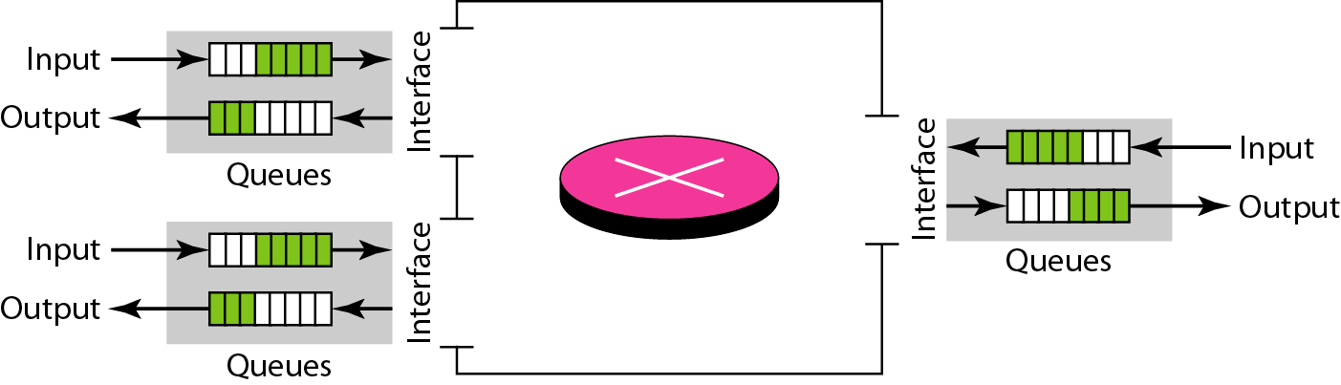
Queues in a router

Slide 11
Components of QoS - Loss
Loss refers to the percentage of packets that fail to reach their destination.
Loss can result from errors in the network, corrupted frames and congested networks. With modern switched and optically based networks corrupted frames and packet losses due to network noise, interference and collisions are becoming rare.
Many of the packets lost in a healthy network are actually deliberately dropped by networking devices as a means of avoiding congestion.
For many TCP/IP based traffic flows, such as those associated with file and print services, small numbers of lost packets are of little concern.
For UDP traffic associated with real-time applications such as streaming media and voice, retransmission is not feasible and losses are less tolerable. As a guide, a highly available network should suffer less than 1% loss and for voice traffic the loss should approach 0%.

Slide 12
Components of QoS - Delay
Delay or Latency refers to the time it takes for a packet to travel from the source to the destination.
Delay is comprised of fixed and variable delays.
Fixed delays comprise such events as serialization and encoding/decoding. (Eg a bit takes a fixed 100ns to exit a 10Mb Ethernet interface)
Variable delays are often the result of congestion and include the time packets spend in network buffers waiting their turn to access the media.
Delay is a more significant problem for network traffic that is bi-directional in nature as the delays tend to be additive.

Slide 13
Components of QoS - Jitter
Delay variation or Jitter is the difference in the delay times of consecutive packets.
Jitter results in degraded audio performance. Jerky motion, loss of video quality or total loss of video depending on the encoding scheme used.
Hardware such as IP Phones use a jitter buffer to smooth out arrival times. However there are limits on a buffers ability to do this. In general, traffic that requires low latency will also require that variation in latency is also kept to a minimum. This is because any buffering used to reduce jitter will directly add to the total delay in the network.
Design rule - voice networks cannot cope with more than 30 ms of jitter.

Slide 14
Quality of Service Requirements for Data
Use the proven relative priority model to divide traffic into no more than four classes, such as:
Gold (Mission-Critical) Transactional, software
Silver (Guaranteed-Bandwidth) Streaming video, messaging, intranet
Bronze (Best-Effort and Default class) Internet browsing, E-Mail
Less-than-Best-Effort (Optional; higher-drop preferences) FTP, backups, applications (Napster, KaZaa)

Slide 15
Quality of Service Requirements for Voice
Voice traffic should be given:
Loss should be no more than 1%.
One-way latency should be no more than 150-200 ms.
Average jitter should be no more than 30 ms.
21-106 kbps of guaranteed priority bandwidth is required per call (depending on the sampling rate, codec and Layer 2 overhead).
150 bps (+ Layer 2 overhead) per phone of guaranteed bandwidth is required for Voice Control traffic.

Slide 16
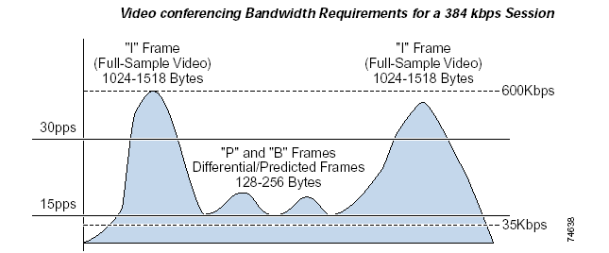
Quality of Service Requirements for Video
Requirements vary:
Video conferencing requirements are similar to voice.
Streaming media is often buffered for several seconds so latency requirements can be relaxed.
Allow for video’s bursty nature…

Slide 17
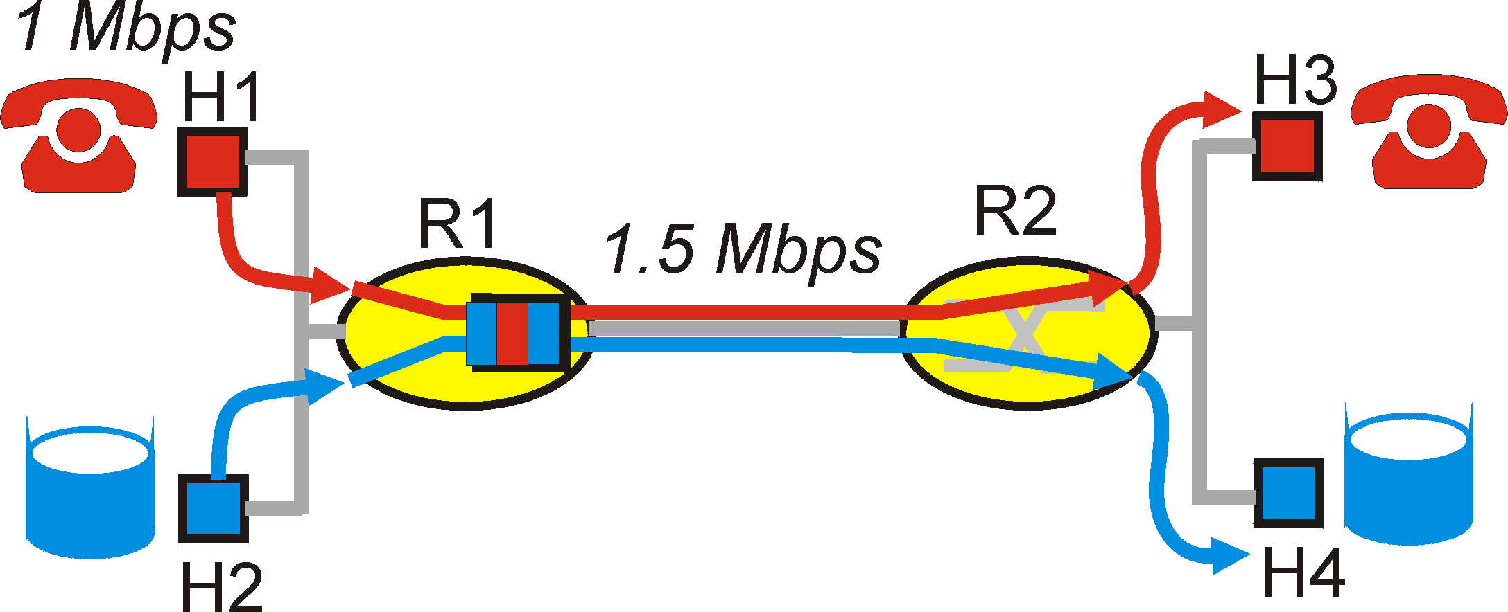
Principles for QOS Guarantees
Consider a phone application at 1Mbps and an FTP application sharing a 1.5 Mbps link.
bursts of FTP can congest the router and cause audio packets to be dropped.
want to give priority to audio over FTP
PRINCIPLE 1: Marking of packets is needed for router to distinguish between different classes; and new router policy to treat packets accordingly

Slide 18
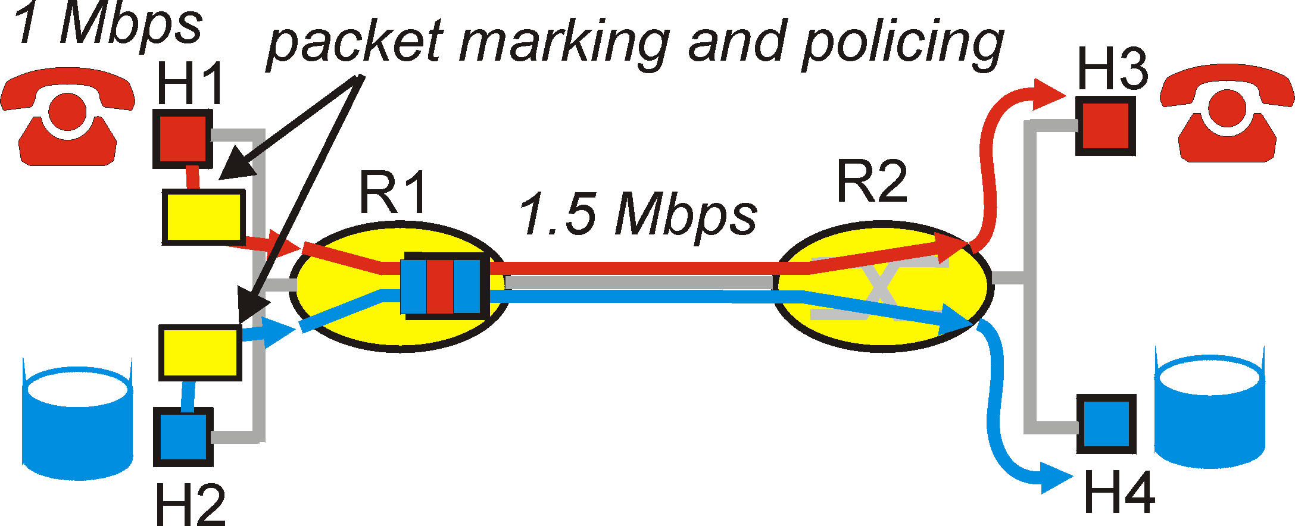
Principles for QOS Guarantees
Applications misbehave (audio sends packets at a rate higher than 1Mbps assumed above);
PRINCIPLE 2: provide protection (isolation) for one class from other classes
Require Policing Mechanisms to ensure sources adhere to bandwidth requirements; Marking and Policing need to be done at the edges:

Slide 19
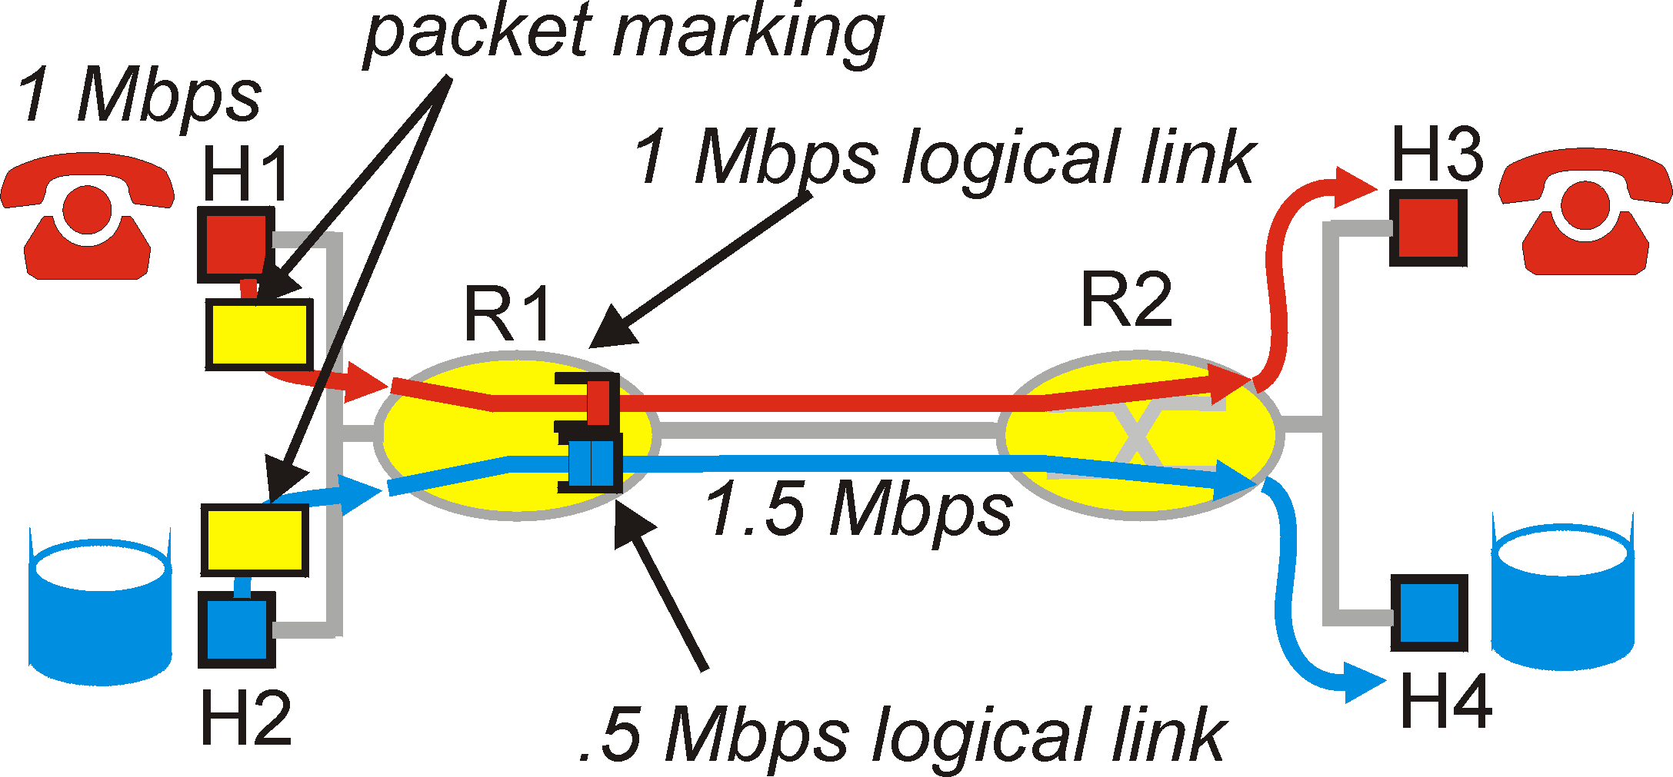
Principles for QOS Guarantees
Alternative to Marking and Policing: allocate a set portion of bandwidth to each application flow; can lead to inefficient use of bandwidth if one of the flows does not use its allocation
PRINCIPLE 3: While providing isolation, it is desirable to use resources as efficiently as possible

Slide 20
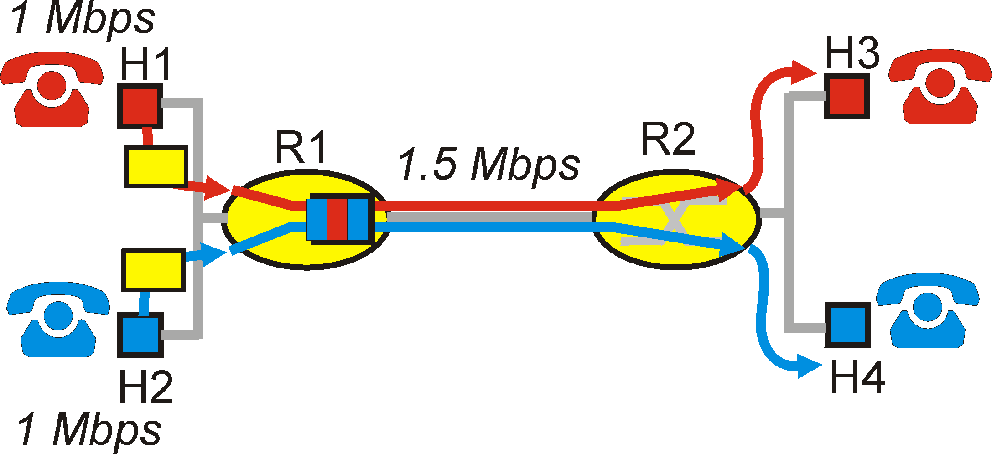
Principles for QOS Guarantees
Cannot support traffic beyond link capacity
Two phone calls each requests 1 Mbps
PRINCIPLE 4: Need a Call Admission Process; application flow declares its needs, network may block call if it cannot satisfy the needs

Slide 21
Building blocks
Classification
Scheduling
Active Buffer Management
Traffic Shaping & Policing
Leaky Bucket
Token Bucket
Resource Utiliztion
Admission Control
QoS Routing

Slide 22
Quality of Service Mechanisms
QoS Service Models:
Best Effort The default if no explicit QoS is configured
Integrated Services Model – IntServ RSVP – A pre-negotiated QoS path is established end-to-end. Not well established as the application software must do the negotiating.
Differentiated Services Model – DiffServ Each hop (router) prioritises traffic according to configuration. Sometimes referred to as a per-hop-behaviour.
DiffServ is the focus of this course

Slide 23
QoS at Internet Scale
Priority queues at the edge of the network help
… but what about QoS across the entire Internet?
Differentiated Service (DiffServ)
Class-based traffic management mechanism
Coarse grain control
Relative performance improvements / lower overhead
Integrated Service (IntServ)
Flow-based traffic management mechanism
Fine grained control
Guaranteed performance / high overhead

Slide 24
Differentiated Services (DiffServ)
Goal: offer different levels of service to packets
Organized around domains (ASs)
Involves edge and core routers (sometimes hosts too)
Edge routers
Sort packets into classes (based on many factors)
Set bits (DiffServ Code Point) in packet headers
Police/shape traffic
Core Routers
Handle per-hop packet behavior based on DSCP

Slide 25



DiffServ at a High-Level
AS-1
AS-2
Ingress/
Egress Routers
Core
Routers
Ingress/Egress routers assign class to each packet
Must analyze each packet, high overhead
Core routers use classes to do priority queuing
Classes may switch between AS boundaries

Slide 26
Establishing Differentiated Services
There is a need to “tag” traffic with a QoS level so that a specific per-hop treatment can be applied:
Layer 2 – CoS – Class of Service field.
3 bits 0-7 value
Field is present in ISL and 802.1Q/P encapsulations
Layer 3 – ToS – Type of Service field.
3 bits 0-7 value Only relevant to IP
Often referred to as “IP Precedence”
Layer 3 – DSCP – Differentiated Services Code Point
Supersedes ToS
6 bits (first 3 bits are ToS) 0-63 value
0 is the lowest priority

Slide 27
Establishing Differentiated Services
It may seem confusing to have three options for marking traffic:
The way to proceed is often determined by the QoS capabilities of hosts, switches and routers within the network.
In many instances it may be necessary to use different marking techniques at different points within a network.
For example, it is common to use the DSCP to mark the QoS requirements of packets through the routed layers of the network and mark the frames using the CoS to allow layer 2 devices such as switches to provide for the QoS requirements of packet at the data link layer.

Slide 28
How do we Classify Packets?
It depends.
Based on ports
i.e. 80 (HTTP) takes precedence over 21 (FTP)
Based on application
i.e. HTTP takes precedence over BitTorrent
Based on location
i.e. home users get normal service…
While hospitals/policy/fire department get priority service
Based on who pays more $$$
$100 for “premium” Internet vs. $25 “value” Internet

Slide 29
IP Header, Revisited
DiffServ Code Point
Used to label the class of the packet
0
4
8
12
16
19
24
31
Version
HLen
DSCP/ECN
Datagram Length
Identifier
Flags
Offset
TTL
Protocol
Checksum
Source IP Address
Destination IP Address
Options (if any, usually not)
Data

Slide 30


Classification and Conditioning
Packet is marked in the Type of Service (TOS) in IPv4, and Traffic Class in IPv6
6 bits used for Differentiated Service Code Point (DSCP) and determine PHB that the packet will receive
2 bits are currently unused
D: Delay
T: Throughput
R: Reliability
C: Cheapest
(low cost)

Slide 31
DSCP values
Last 3 bits
 | 7 | 6 | 5 | 4 | 3 | 2 | 1 | 0
7 | 63 | 62 | 61 | 60 | 59 | 58 | 57 | 56 CS7
6 | 55 | 54 | 53 | 52 | 51 | 50 | 49 | 48 CS6
5 | 47 | 46 EF | 45 | 44 | 43 | 42 | 41 | 40 CS5
4 | 39 | 38 AF43 | 37 | 36 AF42 | 35 | 34 AF41 | 33 | 32 CS4
3 | 31 | 30 AF33 | 29 | 28 AF32 | 27 | 26 AF31 | 25 | 24 CS3
2 | 23 | 22 AF23 | 21 | 20 AF22 | 19 | 18 AF21 | 17 | 16 CS2
1 | 15 | 14 AF13 | 13 | 12 AF12 | 11 | 10 AF11 | 9 | 8 CS1
0 | 7 | 6 | 5 | 4 | 3 | 2 | 1 | 0 Default
First 3 bits

Slide 32
Forwarding (PHB)
PHBs being developed:
Expedited Forwarding: packet departure rate of a class equals or exceeds specified rate
logical link with a minimum guaranteed rate
Premium service
DSCP = 101110 (46)
Assured Forwarding: 4 classes of traffic
Each guaranteed minimum amount of bandwidth
Each with three drop preference partitions
Gold, silver, bronze

Slide 33
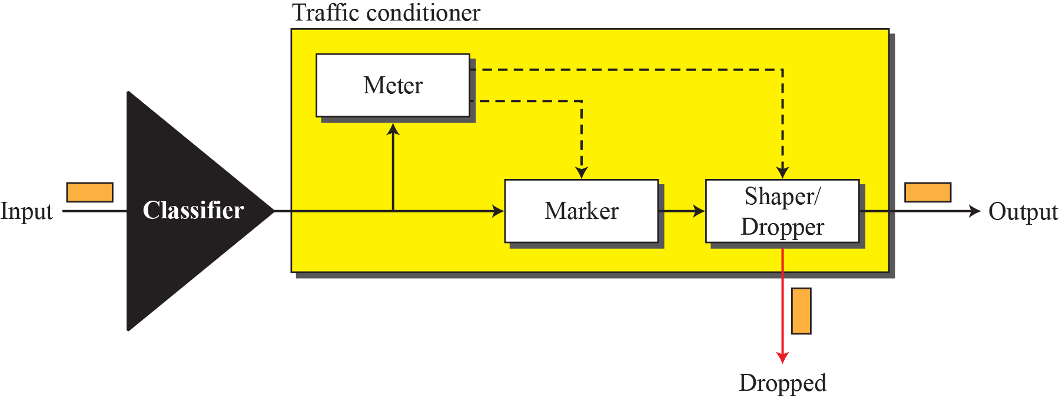

Slide 34
Forwarding (PHB)
Per Hop Behavior (PHB) result in a different observable (measurable) forwarding performance behavior
PHB does not specify what mechanisms to use to ensure required PHB performance behavior
Examples:
Class A gets x% of outgoing link bandwidth over time intervals of a specified length
Class A packets leave first before packets from class B

Slide 35
DiffServ Routers
DiffServ Edge Router
Classifier
Marker
Meter
Policer
DiffServ Core Router
PHB
Select PHB
PHB
Local
conditions
PHB
PHB
Extract
DSCP
Packet
treatment
Notes:
DiffServ edge router utilises these functions in order to perform its task: - Classification (based on for example application, user or load) - Marking (of the DiffServ packets) - Metering (for policing or marking purposes) - Policing (handling of non-conformant traffic)
DiffServ core router will treat an IP packet based on 1) DS codepoint 2) Local conditions
DS codepoint is actually an index to a table that contains so called Per Hop Behaviors (PHB).
Per Hop Behavior is the set of rules how the packet (or actually the aggregate flow that the packet belongs to) is treated.
The local conditions can be, for example, the occupancy level(s) of the buffer(s) of the router.
Based on these two pieces of information, the edge router treats the packet.
For example, the packet may be discarded or accepted for buffering.

Slide 36
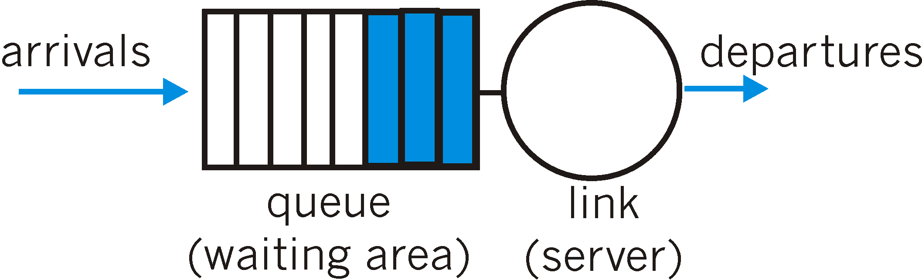
Scheduling and Buffer management
Scheduling: choosing the next packet for transmission
Packet dropping:
not drop-tail
not only when buffer is full
Active Queue Management

Slide 37
Scheduling
Scheduling is used to give different queueing priorities according to the packet or frames DSCP or CoS value.
First In First Out – FIFO (No QoS treatment)
Priority Queuing
Weighted Fair Queuing - WFQ

Slide 38
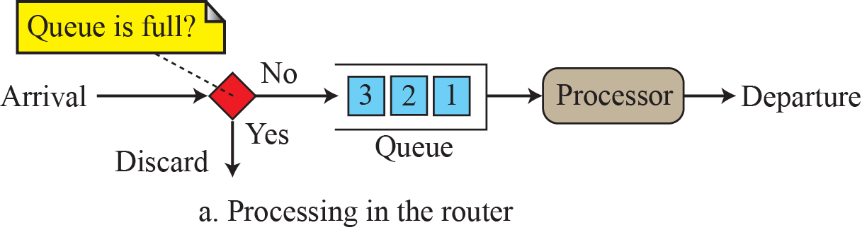
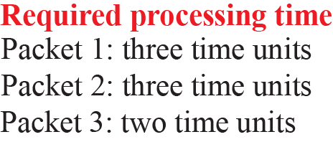
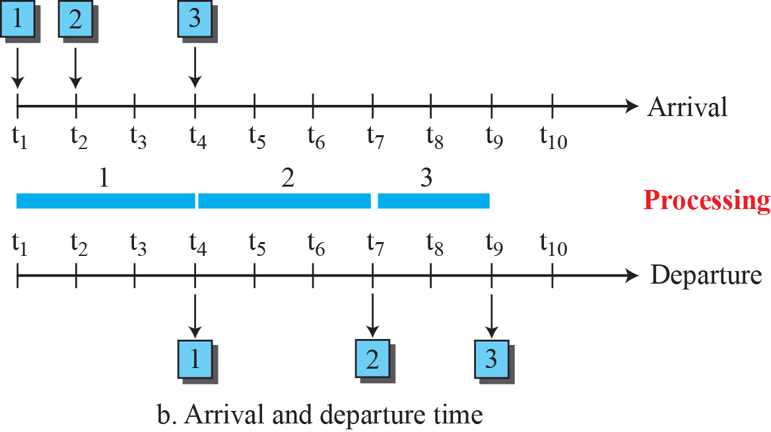
FIFO queue

Slide 39
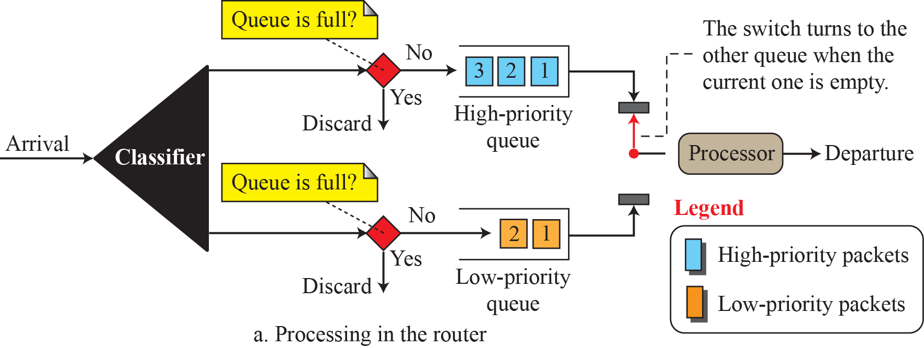
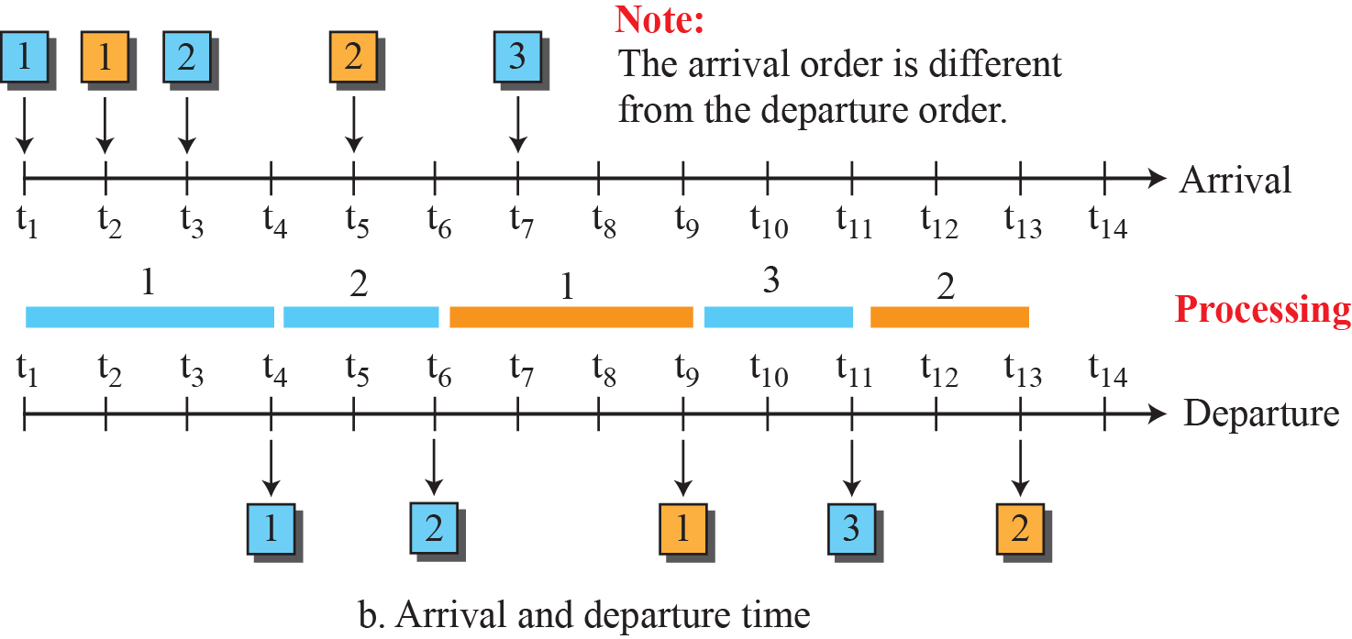
Priority queuing
Q₁
*
*
*
Q_{n}

Slide 40
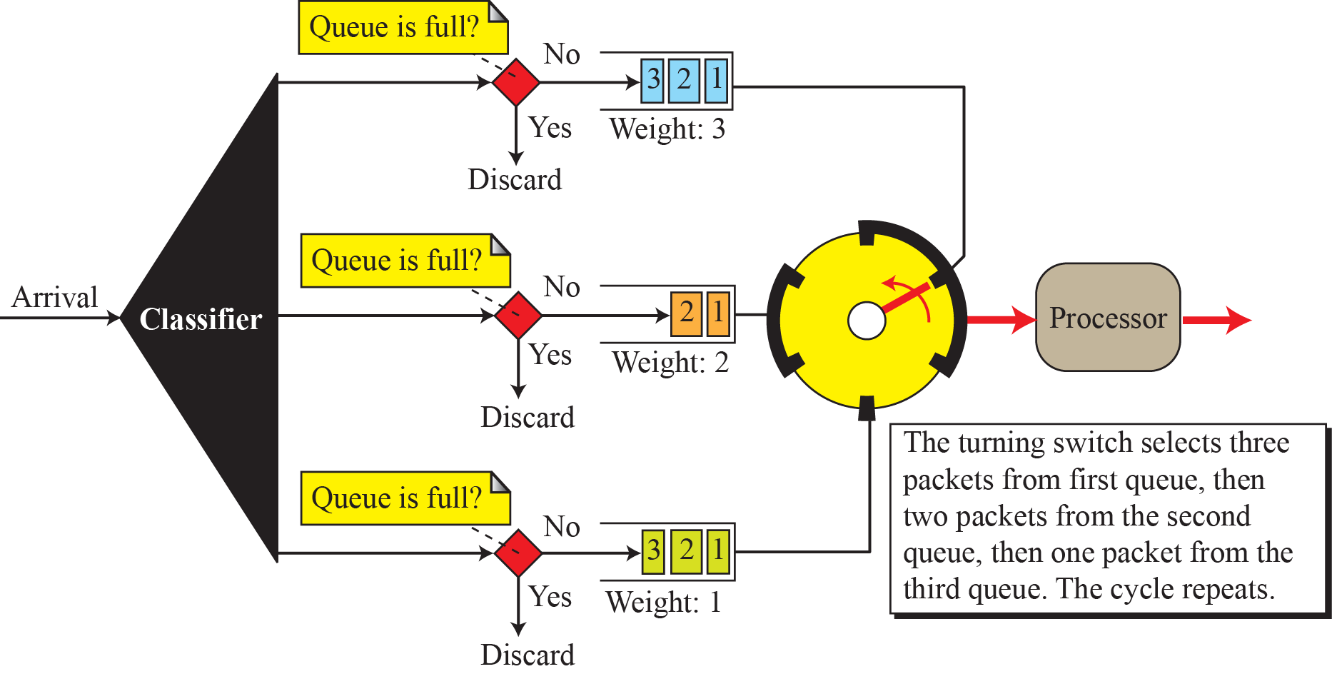
Weighted fair queuing

Slide 41
Weighted Random Early Deletion - W-RED
Stated requirement
“Avoid congestion in the first place”
“Statistically give some traffic better service than others”
Congestion avoidance, rather than congestion management
55
Notes:
55

Slide 42
Behavior of a TCP Sender
Sends as much as credit (TCP window) allows
Starts credit small (initial cwnd = 1)
Avoid overloading network queues
Increases credit exponentially (slow start) per RTT
To gauge network capability via packet loss signal
56
Notes:
56

Slide 43
Data packets
S
R
ACK packets
Data packets
S
R
ACK packets
Data packets
S
R
ACK packets

Slide 44
Behavior of a TCP Receiver
When in receipt of “next message,” schedules an ACK for this data
When in receipt of something else, acknowledges all received in-sequence data immediately
i.e. send duplicate ACK in response to out of sequence data received
57
Notes:
57

Slide 45
Dropped Packet
Data packets
S
R
ACK packets
Data packets
S
R
ACK packets
Duplicate ACKs

Slide 46
Sender Response to ACK
If ACK advances sender’s window
Update window and send new data
If not then it’s a duplicate ACK
Presume it indicates a lost packet
Send first unacknowledged data immediately
Halve current sending window
shift to congestion avoidance mode
Increase linearly to gauge network throughput
58
Notes:
58

Slide 47
Implications for Routers
Dropping a data packet within a data sequence is an efficient way of indicating to the sender to slow down
Dropping a data packet prior to queue exhaustion increases the probability of successive packets in the same flow sequence being delivered, allowing the receiver to generate duplicate ACKs, in turn allowing the sender to adjust cwnd and reducing sending rate using fast retransmit response
Allowing the queue to fill causes the queue to tail drop, which in turn causes sender timeout, which in turn causes window collapse, followed by a flow restart with a single transmitted segment
59
Notes:
59

Slide 48
Congestion Avoidance
Prioritising traffic in a congested network is fine but it would be better to avoid the congestion altogether.
Congestion leads to dropped packets. By default packets are dropped indiscriminately once a router’s buffers are full. This is known as “tail drop”.
Dropping packets causes TCP to reduce its window-size thus reducing the data rate and lessening congestion – good!
Tail drop causes many TCP sessions to do this simultaneously – bad!
This means that bandwidth may not be fully utilised and it results in a traffic flow that resembles a “saw tooth”.
Tail drop can result in bursty traffic flows that cause other problems such as jitter.

Slide 49
RED Algorithm
Attempt to maintain mean queue depth
Drop traffic at a rate proportional to mean queue depth and time since last discard
1
Queue
exhaustion
tail
drop
Probability
of packet
drop
Onset of
RED
RED
discard
0
Average queue depth
60
Notes:
60

Slide 50
Random Early Detection (RED)
Basic premise:
router should signal congestion when the queue first starts building up (by dropping a packet)
but router should give flows time to reduce their sending rates before dropping more packets
Note: when RED is coupled with ECN, the router can simply mark a packet instead of dropping it
Therefore, packet drops should be:
early: don’t wait for queue to overflow
random: don’t drop all packets in burst, but space them

Slide 51
RED
FIFO scheduling
Buffer management:
Probabilistically discard packets
Probability is computed as a function of average queue length (why average?)
Discard Probability
1
0
min_th
max_th
queue_len
Average
Queue Length

Slide 52
RED (cont’d)
Discard
Discard Probability
1
0
min_th
max_th
queue_len
Enqueue
Discard/Enqueue
probabilistically

Slide 53
Weighted RED
Alter RED-drop profile according to QoS indicator
precedence and/or drop preference
1
Low priority traffic
Discard Probability
High priority traffic
0
Weighted Queue Length
Notes:
61

Slide 54
Outcomes of RED
Increase overall efficiency of the network
ensure that packet loss occurs prior to tail drop
allowing senders to back off without need to resort to retransmit time-outs and window collapse
ensure that network load signaling continues under load stress conditions
62
Notes:
62

Slide 55
Outcomes of W-RED
High precedence and short duration TCP flows will operate without major impact
RED’s statistical selection is biased towards large packet trains for selection of deletion
Low precedence long held TCP flows will back off transfer rate
by how much depends on RED profile
W-RED provides differentiation of TCP-based traffic profiles
but without deterministic level of differentiation
63
Notes:
63

Slide 56
Pitfalls of RED
No effect on UDP
Packet drop uses random selection
Depends on host behavior for effectiveness
Not deterministic outcome
Specifically dependent on
bulk of traffic being TCP
TCP using RTT-epoch packet train clustering
ACK spacing will reduce RED effectiveness
TCP responding to RED drop - but not all TCPs are created equal
64
Notes:
64

Slide 57
Weighted RED
Appropriate when
Any given flow has low probability of having data in queue
Stochastic model
Reduces turbulent inputs
Traffic classification based on IP precedence
Different min_threshold values per IP precedence value
65
Notes:
65

Slide 58
RED Summary
Basic idea is sound, but does not always work well
Basically, dropping packets, early or late is a bad thing
High network utilization with low delays when flows are long lived
Average queue length small, but capable of absorbing large bursts
Many refinements to basic algorithm make it more adaptive
requires less tuning
Does not work well for short lived flows (like Web traffic)
Dropping packets in an already short lived flow is devastating
Better to mark ECN instead of dropping packets
ECN not widely supported

Slide 59
Traffic Shaping and Policing
To control the amount and the rate of traffic.
Traffic Shaping is to control the traffic when it leaves the network.
Traffic Policing is to control the traffic when it enters the network.
Two techniques can shape or police the traffic: leaky bucket and token bucket.

Slide 60
Bursty Traffic Policing VS. Shaping:
Traffic Policing propagates bursts. When the traffic rate reaches the configured maximum rate, excess traffic is dropped (or remarked). The result is an output rate that appears as a saw-tooth with crests and troughs.
Traffic Shaping In contrast to policing, retains excess packets in a QUEUE and then schedules the excess for later transmission over increments of time. The result of traffic shaping is a smoothed packet output rate.
Shaping implies the existence of a queue and of sufficient memory to buffer delayed packets, while policing does not buffer excess packets.

Slide 61
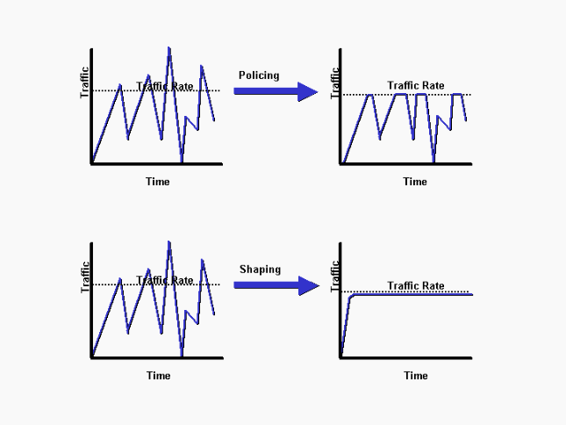
Bursty Traffic Policing VS. Shaping:

Slide 62
The Leaky Bucket Algorithm
The Leaky Bucket Algorithm
used to control rate in a network.
It is implemented as a single-server queue
with constant service time.
If the bucket (buffer) overflows then packets are discarded.
Leaky Bucket (parameters r and B):
Every r time units: send a packet.
For an arriving packet
If queue not full (less than B) then enqueue
Note that the output is a “perfect” constant rate.

Slide 63
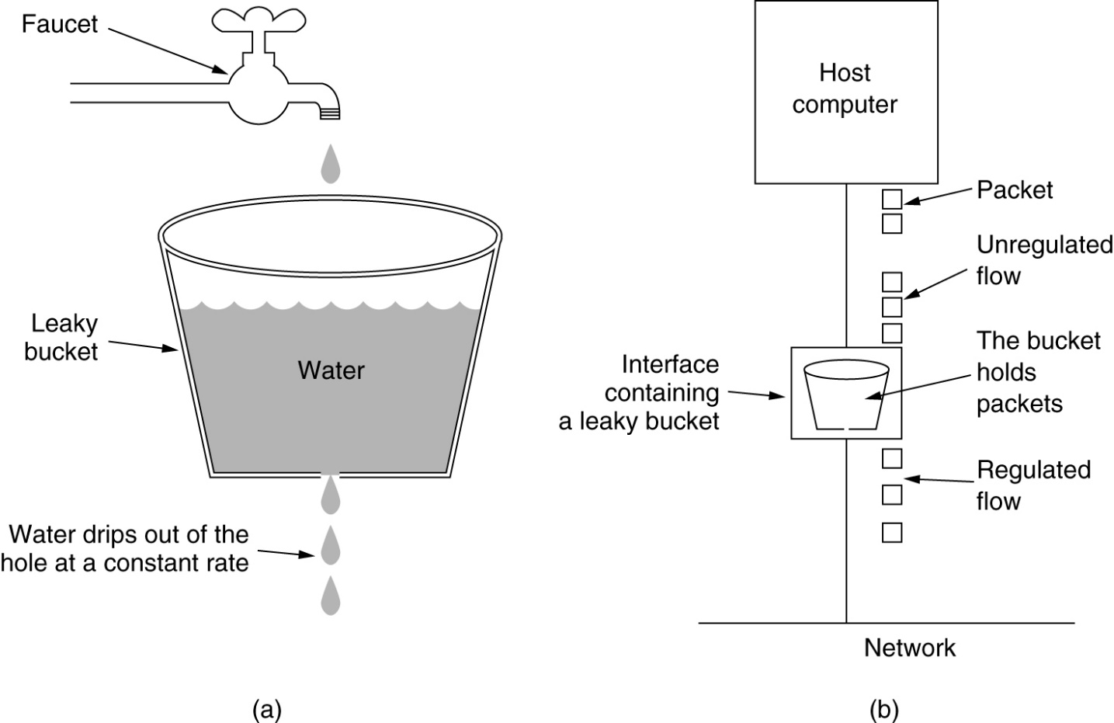
The Leaky Bucket Algorithm

Slide 64
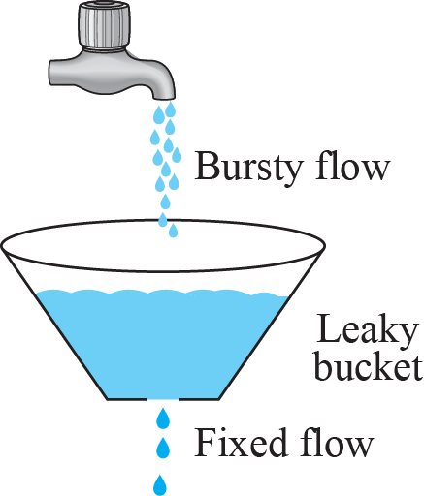
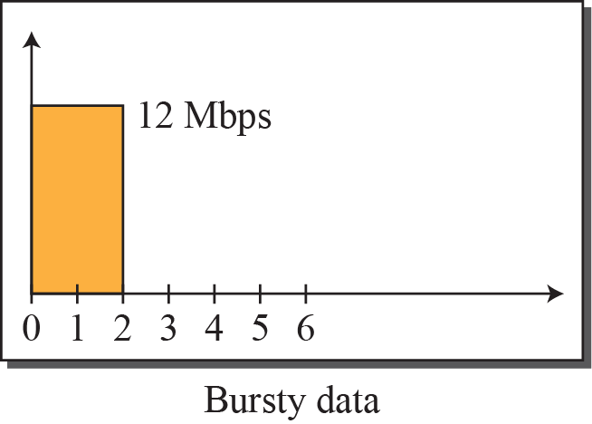
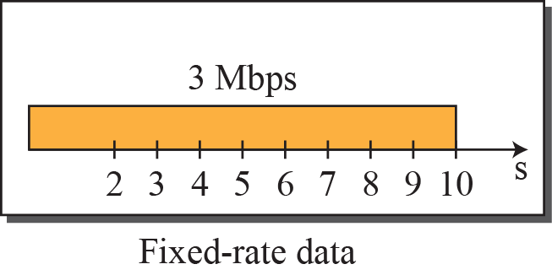
Leaky bucket
2 Mbps
7
8
9
10

Slide 65
Token Bucket Algorithm
Token Bucket (r, MaxTokens):
Generate a token every r time units
If number of tokens more than MaxToken, reset to MaxTokens.
For an arriving packet: enqueue
While buffer not empty and there are tokens:
send a packet and discard a token
Highlights:
The bucket holds tokens.
To transmit a packet, we “use” one token.
Allows the output rate to vary,
depending on the size of the burst.
In contrast to the Leaky Bucket
Granularity
Packets (or bits)

Slide 66
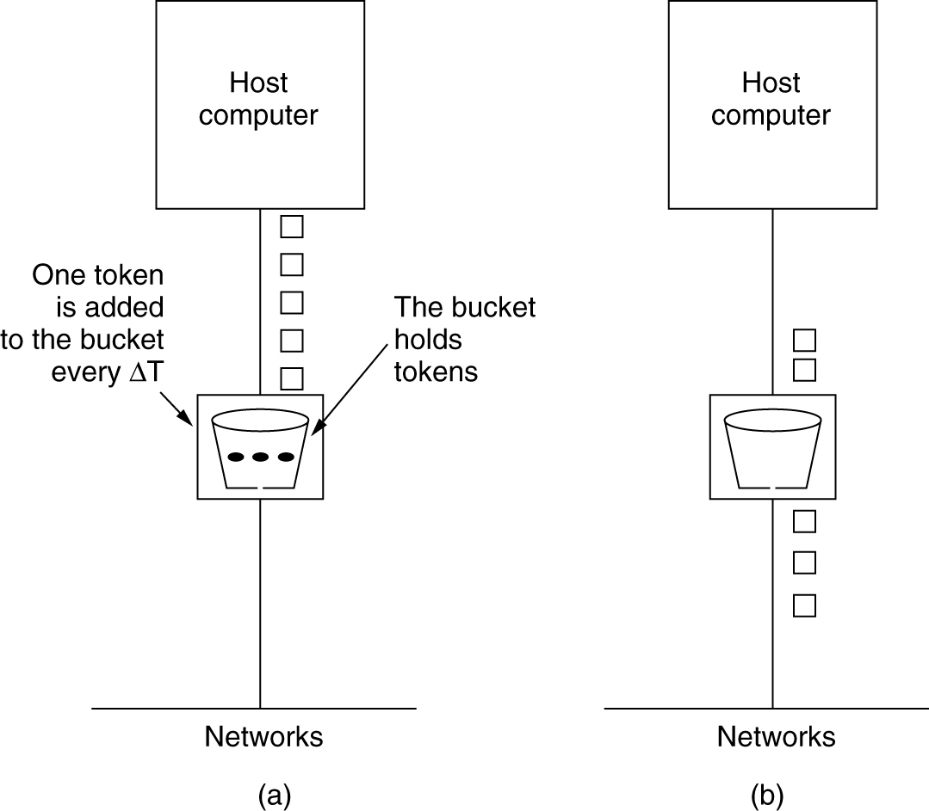
The Token Bucket Algorithm
5-34

Slide 67
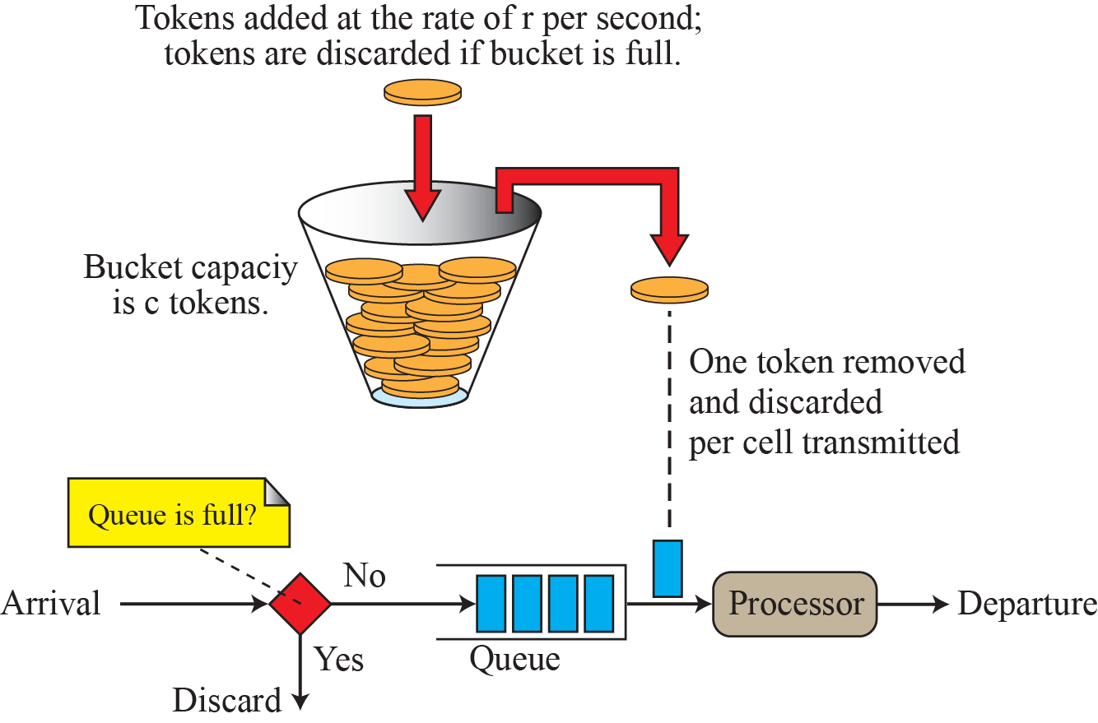
Token Bucket
Since the Leaky Bucket is not fair for idle host for long times then gets bursty data, it still transmits the average rate (ignoring its long idle time)! Hence, we have Token Bucket (TB).

Slide 68
The bucket gets tokens at a certain rate (data unit per sec, du/s).
A token is permission for the source to send a certain number of du’s into the network.
To send a packet, remove from the bucket a number of tokens equal in representation to the packet size in du’s.
If not enough tokens are in the bucket to send a packet, the packet either:
queued waiting until the bucket has enough tokens (in the case of a shaper), OR
discard/marked-down (in the case of a policer).
If the bucket fills to its specified capacity (max burst size) , newly arriving tokens are discarded.
A token bucket permits burstiness, but bounds (shape/police) it.

Slide 69
The token bucket algorithm provides users with three actions/categories for each in-bound (incoming) packet, in case of Traffic Policing configured :
a conform action– Config. to transmit packet,
an exceed action– Config. to transmit packet but with lower priority, and
an optional violate – Drop the packet.

Slide 70
Leaky Bucket vs Token Bucket
Leaky Bucket
Discard:
Packets
Rate:
fixed rate (perfect)
Arriving Burst:
Waits in bucket
Token Bucket
Discard:
Tokens
Packet management separate
Rate:
Average rate
Bursts allowed
Arriving Burst:
Can be sent immediately

Slide 71



Intserv: QoS guarantee scenario
Resource reservation
call setup, signaling (RSVP)
traffic, QoS declaration
per-element admission control
request/
reply
QoS-sensitive scheduling (e.g., WFQ)

Slide 72
From Relative to Absolute Service
Priority mechanisms can only deliver absolute assurances if total load is regulated
Service Level Agreements (SLAs) specify:
Amount user (organization, etc.) can send
Level of service delivered to that traffic
DiffServ offers low (but unspecified) delay and no drops
Acceptance of proposed SLAs managed by “Bandwidth Broker”
Only over long time scales

Slide 73
Inter-Domain Premium DiffServ
Goal of IntServ: end-to-end bandwidth guarantees
Mechanism: end-to-end bandwidth reservations
Like the telephone network, circuit reservations
End hosts ask for reserved capacity from the network
Please reserve 1 Mbps
?
?
?
?
?
AS-1
?
?
AS-2

Slide 74
High-Level IntServ Design
Reservations are made by endpoints
Applications know their own requirements
Applications run on end-hosts
Network does not need to guess about requirements
Guarantees are end-to-end on a per-flow basis
Soft-state
State in routers constantly refreshed by endpoints

Slide 75
Requirements for IntServ
Fixed, stable paths
Only routers on the path know about the reservation
Current Internet cannot guarantee this
Routers maintain per-flow state
Very high overhead (even with soft-state)
State is used to reserve bandwidth
Guarantees QoS for reserved flows
… but some flows may not be admitted

Slide 76
RSVP Reservation Protocol
Performs signaling to set up reservation state
Initiated by the receiver
Each reservation is a simplex data flow sent to a unicast or multicast address
<Destination IP, protocol # (TCP, UDP), port #>
Multiple senders/receivers can be in the same session

Slide 77
RSVP Example
Soft-state: PATH and RESV need to be periodically refreshed
RESV
PATH
PATH

Slide 78
IntServ Summary
The good:
Reservations are guaranteed and precise
Reserved bandwidth is not shared with a class
Tight allocations for each flow
Soft-state slightly reduces overhead on routers
The bad:
IntServ is a whole Internet upgrade
Heavyweight mechanisms, per flow state
Security: end-hosts can DoS by reserving lots of bandwidth

Slide 79
Call Admission
Arriving session must :
Declare its QOS requirement
R-spec: defines the QOS being requested
Characterize traffic it will send into network
T-spec: defines traffic characteristics
Signaling protocol: needed to carry R-spec and T-spec to routers (where reservation is required)
RSVP

Slide 80
RSVP request (T-Spec)
A token bucket specification
bucket size, b
token rate, r
the packet is transmitted onward only if the number of tokens in the bucket is at least as large as the packet
peak rate, p
p > r
maximum packet size, M
minimum policed unit, m
All packets less than m bytes are considered to be m bytes
Reduces the overhead to process each packet
Bound the bandwidth overhead of link-level headers

Slide 81
RSVP request (R-spec)
An indication of the QoS control service requested
Controlled-load service and Guaranteed service
For Controlled-load service
Simply a Tspec
For Guaranteed service
A Rate (R) term, the bandwidth required
R ≥ r, extra bandwidth will reduce queuing delays
A Slack (S) term
The difference between the desired delay and the delay that would be achieved if rate R were used
With a zero slack term, each router along the path must reserve R bandwidth
A nonzero slack term offers the individual routers greater flexibility in making their local reservation
Number decreased by routers on the path.

Slide 82
Comparison of Intserv & Diffserv Architectures
 | Intserv | Diffserv
Granularity of service differentiation | Individual Flow | Aggregate of flows
State in routers (e.g. scheduling, buffer management) | Per Flow | Per Aggregate
Traffic Classification Basis | Several Header Fields | DS
Type of Service Differentiation | Deterministic of statistical quarantees | Absolute or relative assurance
Admission Control | Required | Required for absolute differentiation
Signaling Protocol | RSVP | Not required for relative schemes

Slide 83
Comparison of Intserv & Diffserv Architectures
 | Intserve | Diffserv
Coordination for service differentiation | End-to-End | Local (Per-Hop)
Scope of Service Differentiation | A Unicast or Multicast path | Anywhere in a network or in specific paths
Scalability | Limited by the number of flows | Limited by the number of classes of services
Network Accounting | Based on flow characteristics and QoS requirement | Based on class usage
Network Management | Similar to Circuit Switching Networks | Similar to existing IP networks
Inter-domain deployment | Multilateral agreements | Bilateral Agreement

Slide 84
Advantages of DiffServ
Giving priority does improve performance
… at the expense of reduced perf. for lower classes
Relatively lightweight solution
Some overhead on ingress/egress routers
No per flow state, low overhead on core routers
Easy to deploy
No hard reservations
No advanced setup of flows
No end-to-end negotiation

Slide 85
Disadvantages of DiffServ
No performance guarantees
All gains are relative, not absolute
Classes are very coarse
i.e. all packets of a specific class get better performance
No per flow or per destination QoS
What if some ASs do not support DiffServ?
Impossible to predict end-to-end behavior
Security
Any host can tag traffic as high priority
E.g. Win 2K tagged all traffic as high priority by default

