Slide 1
CS 540 Computer Networks II
Sandy Wang
chwang_98@yahoo.com
Notes:
“Data and Computer Communications”, 10/e, by William Stallings, Chapter 11 “Local Area Network Overview”.

Slide 2
10. Access Control List
Notes:
In this chapter, we look at the underlying technology and protocol architecture
of LANs. Chapters 12 and 13 are devoted to a discussion of specific
LAN systems.

Slide 3
Topics
Overview
LAN Switching
IPv4
IPv6
Routing Protocols -- RIP, RIPng, OSPF
Routing Protocols -- ISIS, BGP
MPLS
Midterm Exam
Transport Layer -- TCP/UDP
Access Control List (ACL)
Congestion Control & Quality of Service (QoS)
Application Layer Protocols
Application Layer Protocols continue
Others – Multicast, SDN
Final Exam

Slide 4
Reference Books
Cisco CCNA Routing and Switching ICND2 200-101 Official Cert Guide, Academic Edition by Wendel Odom -- July 10, 2013. ISBN-13: 978-1587144882
The TCP/IP Guide: A Comprehensive, Illustrated Internet Protocols Reference by Charles M. Kozierok – October 1, 2005. ISBN-13: 978-1593270476
Data and Computer Communications (10th Edition) (William Stallings Books on Computer and Data Communications) by Williams Stallings – September 23, 2013. ISBN-13: 978-0133506488
http://class.svuca.edu/~sandy/class/CS540/

Slide 5
What are ACLs
ACLs are lists of conditions that are applied to traffic traveling across a router's interface.
These lists tell the router what types of packets to accept or deny.
Acceptance and denial can be based on specified conditions.
ACLs enable management of traffic and secure access to and from a network.

Slide 6
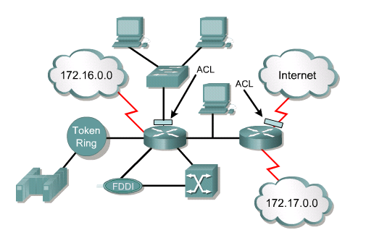

Slide 7
ACLs can be created for all routed network protocols, such as Internet Protocol (IP) and Internetwork Packet Exchange (IPX).
ACLs must be defined on a per-protocol, per direction, or per port basis.
ACLs control traffic in one direction at a time on an interface.
A separate ACL would need to be created for each direction, one for inbound and one for outbound traffic.
Finally every interface can have multiple protocols and directions defined.

Slide 8
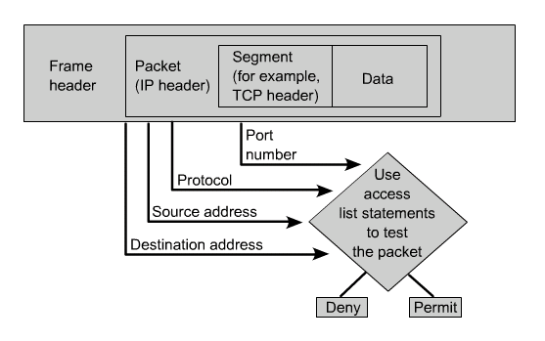

Slide 9
The following are some of the primary reasons to create ACLs:
Limit network traffic and increase network performance.
Provide traffic flow control. ACLs can restrict the delivery of routing updates.
Provide a basic level of security for network access.
Decide which types of traffic are forwarded or blocked at the router interfaces.
Allow an administrator to control what areas a client can access on a network.
Screen certain hosts to either allow or deny access to part of a network.

Slide 10
How ACLs Work
An ACL is a group of statements that define whether packets are accepted or rejected at inbound and outbound interfaces.
These decisions are made by matching a condition statement in an access list and then performing the accept or reject action defined in the statement.
The order in which ACL statements are placed is important.

Slide 11
The Cisco IOS software tests the packet against each condition statement in order from the top of the list to the bottom.
Once a match is found in the list, the accept or reject action is performed and no other ACL statements are checked.
If a condition statement that permits all traffic is located at the top of the list, no statements added below that will ever be checked.

Slide 12
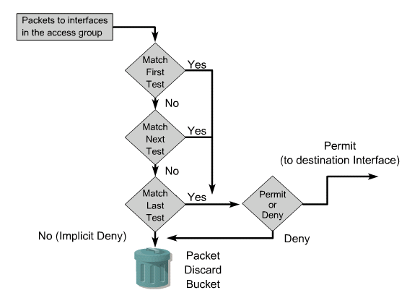

Slide 13
If additional condition statements are needed in an access list, the entire ACL must be deleted and recreated with the new condition statements.
The beginning of the router’s process is the same, whether ACLs are used or not.
As a frame enters an interface, the router checks to see whether the layer 2 address matches or if it is a broadcast frame.
If the frame address is accepted, the frame information is stripped off and the router checks for an ACL on the inbound interface.
If an ACL exists, the packet is now tested against the statements in the list.

Slide 14
If the packet matches a statement, the action of accepting or rejecting the packet is performed.
If the packet is accepted in the interface, it will then be checked against routing table entries to determine the destination interface and switched to that interface.
Next, the router checks whether the destination interface has an ACL.
If an ACL exists, the packet is now tested against the statements in the list and if the packet matches a statement, the action of accepting or rejecting the packet is performed.
If there is no ACL or the packet is accepted, the packet is encapsulated in the new layer 2 protocol and forwarded out the interface to the next device.

Slide 15
Creating ACLs
ACLs are created in the global configuration mode.
There are many different types of ACLs including standard, extended, IPX, AppleTalk, and others.
When configuring ACLs on a router, each ACL must be uniquely identified by assigning a number to it.
This number identifies the type of access list created and must fall within the specific range of numbers that is valid for that type of list.

Slide 16
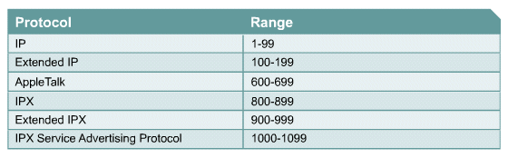

Slide 17
After the proper command mode is entered and the list type number is decided upon, the user enters the access list statements using the keyword access-list, followed by the proper parameters.
Creating the access list is the first half of using them on a router.
The second half of the process is assigning them to the proper interface.

Slide 18
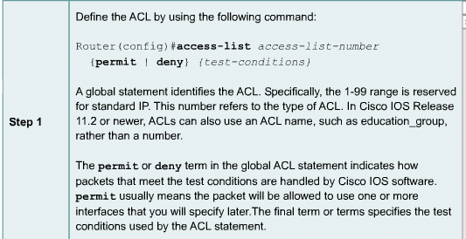

Slide 19
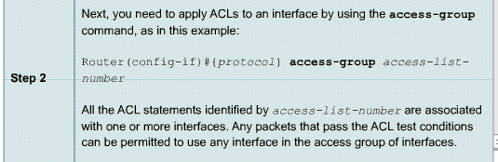

Slide 20
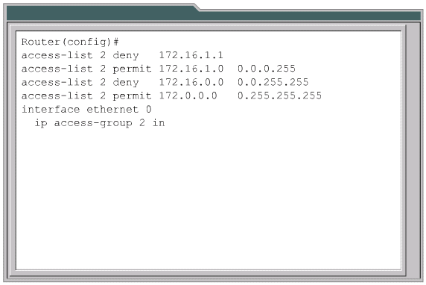

Slide 21
These basic rules should be followed when creating and applying access lists:
One access list per protocol per direction.
Standard access lists should be applied closest to the destination.
Extended access lists should be applied closest to the source.
Use the inbound or outbound interface reference as if looking at the port from inside the router.
Statements are processed sequentially from the top of list to the bottom until a match is found, if no match is found then the packet is denied.
There is an implicit deny at the end of all access lists. This will not appear in the configuration listing.
Access list entries should filter in the order from specific to general. Specific hosts should be denied first, and groups or general filters should come last.

Slide 22
The match condition is examined first. The permit or deny is examined ONLY if the match is true.
Never work with an access list that is actively applied.
Use a text editor to create comments outlining the logic, then, fill in the statements that perform the logic.
New lines are always added to the end of the access list. A no access-list x command will remove the whole list. It is not possible to selectively add and remove lines with numbered ACLs.
An IP access list will send an ICMP host unreachable message to the sender of the rejected packet and will discard the packet in the bit bucket.
Care should be used when removing an access list.
Outbound filters do not affect traffic originating from the local router.

Slide 23
The function of a wildcard mask
A wildcard mask is a 32-bit quantity that is divided into four octets.
The numbers one and zero in the mask are used to identify how to treat the corresponding IP address bits.
Wildcard masks have no functional relationship with subnet masks.
They are used for different purposes and follow different rules.
Subnet masks start from the left side of an IP address and work towards the right to extend the network field by borrowing bits from the host field.
Wildcard masks are designed to filter individual or groups of IP addresses permitting or denying access to resources based on the address.

Slide 24
Another issue is that the ones and zeros mean something different in a wildcard mask as opposed to a subnet mask.
In order to eliminate confusion, X’s will be substituted for the 1’s in the wildcard masks in the graphics.
This mask would be written as 0.0.255.255.
A zero means let the value through to be checked, the X’s (1’s) mean block the value from being compared.

Slide 25
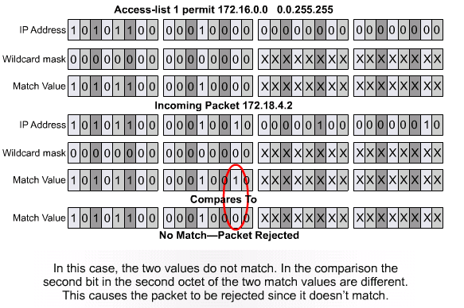

Slide 26
There are two special keywords that are used in ACLs, the any and host options.
Simply put, the any option substitutes 0.0.0.0 for the IP address and 255.255.255.255 for the wildcard mask.
This option will match any address that it is compared against.
The host option substitutes for the 0.0.0.0 mask.
This mask requires that all bits of the ACL address and the packet address match.
This option will match just one address.

Slide 27
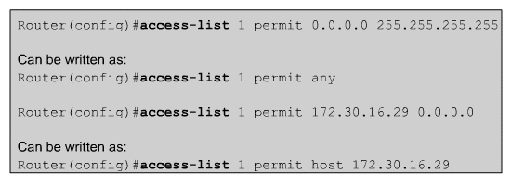

Slide 28
Verifying ACLs
The show ip interface command displays IP interface information and indicates whether any ACLs are set.
The show access-lists command displays the contents of all ACLs on the router.
The show running-config command will also reveal the access lists on a router and the interface assignment information.

Slide 29
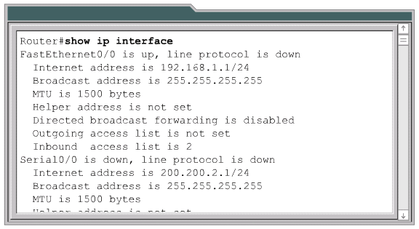

Slide 30
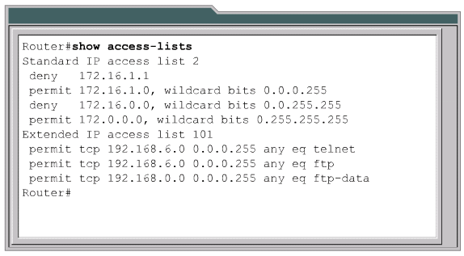

Slide 31
Outline
Access Control List Fundamentals
Access Control Lists (ACLs)

Slide 32
Standard ACLs
Standard ACLs check the source address of IP packets that are routed.
The standard version of the access-list global configuration command is used to define a standard ACL with a number in the range of 1 to 99 (also from 1300 to 1999 in recent IOS).
The full syntax of the standard ACL command is:
Router(config)#access-list access-list-number {deny | permit} source [source-wildcard ] [log]
The no form of this command is used to remove a standard ACL. This is the syntax:
Router(config)#no access-list access-list-number

Slide 33
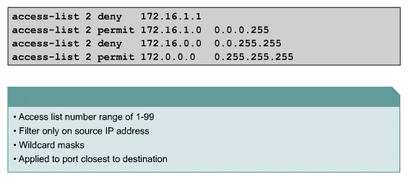

Slide 34
Extended ACLs
Extended ACLs check the source and destination packet addresses as well as being able to check for protocols and port numbers.
At the end of the extended ACL statement, additional precision is gained from a field that specifies the optional Transmission Control Protocol (TCP) or User Datagram Protocol (UDP) port number.
Logical operations may be specified such as, equal (eq), not equal (neq), greater than (gt), and less than (lt), that the extended ACL will perform on specific protocols.
Extended ACLs use an access-list-number in the range 100 to 199 (also from 2000 to 2699 in recent IOS).

Slide 35
The ip access-group command links an existing extended ACL to an interface.
Remember that only one ACL per interface, per direction, per protocol is allowed.
The format of the command is:
Router(config-if)#ip access-group access-list-number {in | out}

Slide 36
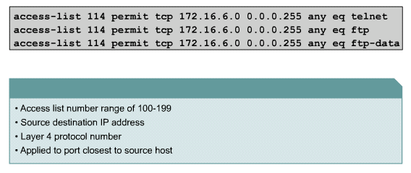

Slide 37
Named ACLs
The advantages that a named access list provides are:
Intuitively identify an ACL using an alphanumeric name.
Eliminate the limit of 798 simple and 799 extended ACLs
Named ACLs provide the ability to modify ACLs without deleting and then reconfiguring them. It is important to note that a named access list will allow the deletion of statements but will only allow for statements to be inserted at the end of a list.

Slide 38
A named ACL is created with the ip access-list command.
This places the user in the ACL configuration mode.
In ACL configuration mode, specify one or more conditions to be permitted or denied.

Slide 39
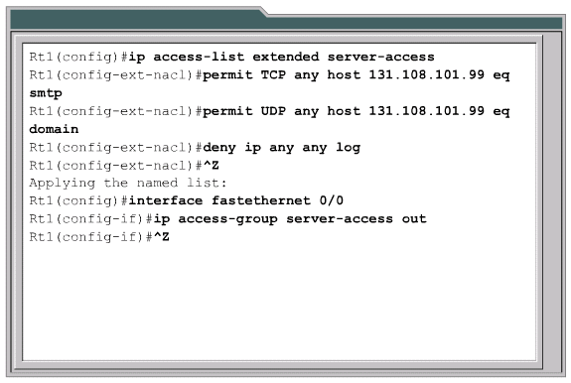

Slide 40
Placing ACLs
Another important consideration of implementing ACLs is where the access list is placed.
If the ACLs are placed in the proper location, not only can traffic be filtered, but it can make the whole network more efficient.
If traffic is going to be filtered, the ACL should be placed where it has the greatest impact on increasing efficiency.

Slide 41
The general rule is to put the extended ACLs as close as possible to the source of the traffic denied.
Standard ACLs do not specify destination addresses, so they should be placed as close to the destination as possible.

Slide 42
Firewalls
A firewall is an architectural structure that exists between the user and the outside world to protect the internal network from intruders.
In this architecture, the router that is connected to the Internet, referred to as the exterior router, forces all incoming traffic to go to the application gateway.
ACLs should be used in firewall routers, which are often positioned between the internal network and an external network, such as the Internet.

Slide 43
Restricting virtual terminal access
Just as there are physical ports or interfaces, such as Fa0/0 and S0/0 on the router, there are also virtual ports.
These virtual ports are called vty lines.
For security purposes, users can be denied or permitted virtual terminal access to the router.
As a result, there is only one type of vty access list.
Identical restrictions should be placed on all vty lines as it is not possible to control which line a user will connect on.

Slide 44
However, applying the ACL to a terminal line requires the access-class command instead of the access-group command.
The following should be considered when configuring access lists on vty lines:
When controlling access to an interface, a name or number can be used.
Only numbered access lists can be applied to virtual lines.
Set identical restrictions on all the virtual terminal lines, because a user can attempt to connect to any of them.

Slide 45
