Slide 1
CS 540 Computer Networks II
Sandy Wang
chwang_98@yahoo.com
Notes:
“Data and Computer Communications”, 10/e, by William Stallings, Chapter 11 “Local Area Network Overview”.

Slide 2
6. Routing Protocols – BGP
Notes:
In this chapter, we look at the underlying technology and protocol architecture
of LANs. Chapters 12 and 13 are devoted to a discussion of specific
LAN systems.

Slide 3
Topics
Overview
LAN Switching
IPv4
IPv6
Tunnels
Routing Protocols -- RIP, RIPng
Routing Protocols -- OSPF
IS-IS
Midterm Exam
BGP
MPLS
Transport Layer -- TCP/UDP
Congestion Control & Quality of Service (QoS)
Access Control List (ACL)
Final Exam

Slide 4
Reference Books
Cisco CCNA Routing and Switching ICND2 200-101 Official Cert Guide, Academic Edition by Wendel Odom -- July 10, 2013. ISBN-13: 978-1587144882
The TCP/IP Guide: A Comprehensive, Illustrated Internet Protocols Reference by Charles M. Kozierok – October 1, 2005. ISBN-13: 978-1593270476
Data and Computer Communications (10th Edition) (William Stallings Books on Computer and Data Communications) by Williams Stallings – September 23, 2013. ISBN-13: 978-0133506488
http://class.svuca.edu/~sandy/class/CS540/

Slide 5
Interior and Exterior Gateway Protocols
 | Interior Gateway Protocols |  |  |  | Exterior Gateway Protocols
 | Distance Vector Routing Protocols |  | Link State Routing Protocols |  | Path Vector
Classful | RIPv1 (1982/1988) | IGRP (1985) |  |  | EGP (1982)
Classless | RIPv2 (1994) | EIGRP (1992) | OSPFv2 (1991) | IS-IS (1990) | BGPv4 (1995)
IPv6 | RIPng (1997) | EIGRP for IPv6 (not yet released) | OSPFv3 (1999) | IS-IS for IPv6 (2000) | BGPv4 for IPv6 (1999)
Note: IGRP and EIGRP are Cisco proprietary protocols. They are meant as an alternative between the limited RIP routing protocol and the more complicated and resource intensive OSPF and IS-IS routing protocols. IGRP was discontinued with IOS 12.2 in 2005.
The dates shown are when the RFC or other document was finalized. The protocol may have been implemented earlier than this date.

Slide 6
BGP -- Border Gateway Protocol
An inter-Autonomous Routing Protocol
RFC 1105, 1989 -- A Border Gateway Protocol (BGP)
RFC 1163, 1990 -- A Border Gateway Protocol (BGP)
RFC 1267, 1991 -- A Border Gateway Protocol 3 (BGP-3)
RFC 1771, 1995 – A Border Gateway Protocol 4 (BGP-4)
Latest RFC 4271 -- A Border Gateway Protocol 4 (BGP-4)
Use TCP as the transport protocol (Use port 179)
Eliminates the need to implement explicit update fragmentation, retransmission, acknowledgement, and sequencing.

Slide 7
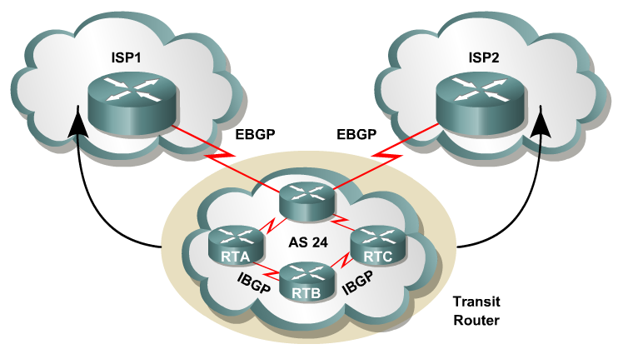
BGP Basics
BGP is a path vector routing protocol.
BGP is a distance vector routing protocol, in that it relies on downstream neighbors to pass along routes from their routing table.
BGP uses a list of AS numbers through which a packet must pass to reach a destination.

Slide 8
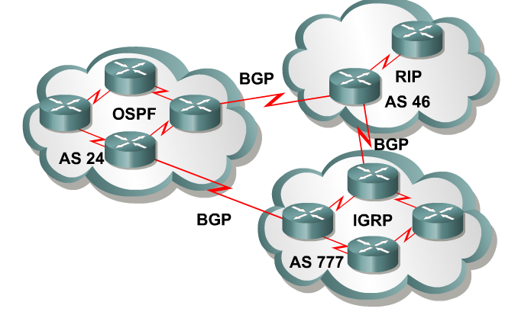
Overview of autonomous systems
An AS is a group of routers that share similar routing policies and operate within a single administrative domain.
An AS can be a collection of routers running a single IGP, or it can be a collection of routers running different protocols all belonging to one organization.
In either case, the outside world views the entire Autonomous System as a single entity.

Slide 9
Autonomous System Number
A unique ASN is allocated to each AS for use in BGP routing. AS numbers are important because the ASN uniquely identifies each network on the Internet.
Internet Assigned Numbers Authority (IANA)
IANA allocates AS numbers to Regional Internet Registries (RIRs). Each AS has an identifying number that is assigned by an Internet registry or a service provider.
This number is between 1 and 65,535.
AS numbers within the range of 64,512 through 65,535 are reserved for private use.
Because of the finite number of available AS numbers, an organization must present justification of its need before it will be assigned an AS number.
Extend to 32-bit in RFC 6793 -- BGP Support for Four-Octet Autonomous System (AS) Number Space

Slide 10
Overview of autonomous systems
Today, the Internet Assigned Numbers Authority (IANA) is enforcing a policy whereby organizations that connect to a single provider and share the provider's routing policies use an AS number from the private pool, 64,512 to 65,535.

Slide 11
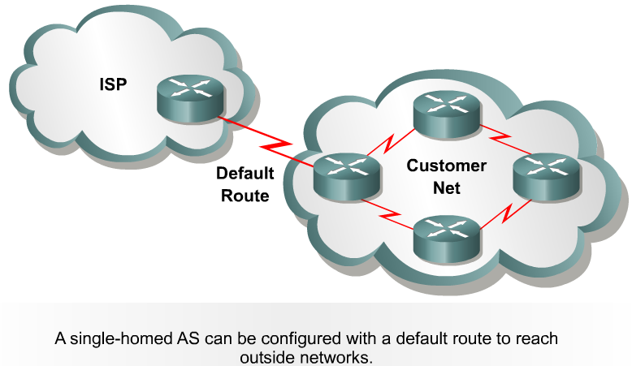
Single-homed autonomous systems
Static Route
If an AS has only one exit point to outside networks, it is considered a single-homed system.
Single-homed autonomous systems are often referred to as stub networks or stubs.
Stubs can rely on a default route to handle all traffic destined for non-local networks.
BGP is not normally needed in this situation.

Slide 12
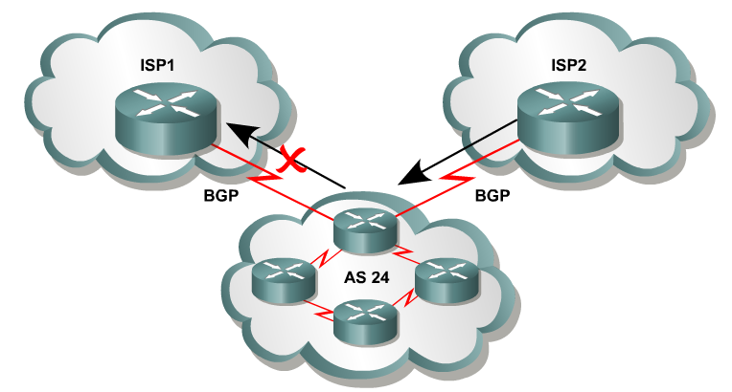

Multihomed nontransit autonomous systems
Or same ISP
Multihomed nontransit autonomous systems do not really need to run BGP4 with their providers.
It is usually recommended and often required by ISPs.
As it will be seen later in this module, BGP4 offers numerous advantages, including increased control of route propagation and filtering.

Slide 13
Multihomed nontransit autonomous systems
Incoming route advertisements influence your outgoing traffic, and outgoing advertisements influence your incoming traffic.
If the provider advertises routes into your AS via BGP, your internal routers have more accurate information about external destinations.
BGP also provides tools for setting routing policies for external destinations.
If your internal routes are advertised to the provider via BGP, you have influence over which routes are advertised at which exit point.
BGP also provides tools for your influencing (to some degree) the choices the provider makes when sending traffic into your AS.

Slide 14
Multi-homed Transit Autonomous Systems
Edge Router
When BGP is running inside an AS, it is referred to as Internal BGP (IBGP).
When BGP runs between autonomous systems, it is called External BGP (EBGP).
If the role of a BGP router is to route IBGP traffic, it is called a transit router.
Routers that sit on the boundary of an AS and that use EBGP to exchange information with the ISP are called border or edge routers.

Slide 15
IBGP vs EBGP
…
When BGP is running inside an AS, it is referred to as Internal BGP (IBGP).
If a BGP router’s role is to route IBGP traffic, it is called a transit router.
When BGP runs between autonomous systems, it is called External BGP (EBGP).
Routers that sit on the boundary of an AS and use EBGP to exchange information with the ISP are called border routers.
IBGP
EBGP

Slide 16
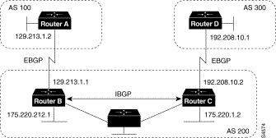
Routers A and B are running EBGP (BGP), and Routers B and C are running IBGP.
Note that the EBGP (BGP) peers are directly connected and that the IBGP peers are not. (They can be.)
As long as there is an IGP running that allows the two neighbors to reach one another, IBGP peers do not have to be directly connected.

Slide 17
All BGP speakers within an AS must establish a peer relationship with each other, that is, the BGP speakers within an AS must be fully meshed logically. (later)
BGP4 provides two techniques that alleviate the requirement for a logical full mesh: confederations and route reflectors. (later)
AS 200 is a transit AS for AS 100 and AS 300---that is, AS 200 is used to transfer packets between AS 100 and AS 300.

Slide 18
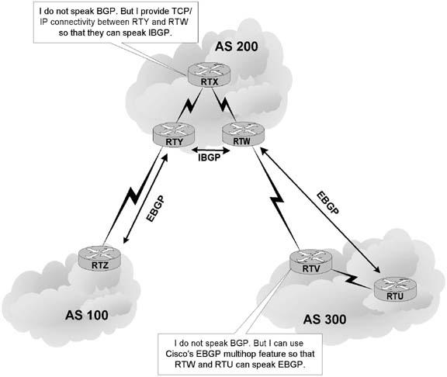
EBGP vs IBGP
EBGP peers must be directly connected, but there are certain exceptions to this requirement.
In contrast, IBGP peers merely require TCP/IP connectivity within the same AS.
As long as RTY can communicate with RTW using TCP, both routers can establish an IBGP session.
If needed, an IGP such as OSPF can provide IBGP peers with routes to each other.

Slide 19
EBGP
EBGP Multihop
EBGP Multihop
I do not speak BGP. But RTW and RTU can use EBGP multihop to speak BGP.
EBGP neighbors must be directly connected in order to establish an EBGP session.
However, EBGP multihop is a Cisco IOS option allows RTW and RTU to be logically connected in an EBGP session, despite the fact that RTV does not support BGP.
The EBGP multihop option is configured on each peer with the following command:
Router(config-router)#neighbor IP-address ebgp-multihop [hops]

Slide 20
EBGP
EBGP Multihop
EBGP Multihop

Slide 21
BGP Packet Format
MAC Hdr
IP Hdr
TCP Hdr
BGP Hdr
Data
TCP Port 179
Notes:
01:00:5E:00:00:00 - 01:00:5E:7F:FF:FF 0x0800 IPv4 Multicast (RFC 1112), insert the low 23 Bits of the multicast IPv4 Address into the Ethernet Address (RFC 7042 2.1.1.)
33:33:xx:xx:xx:xx 0x86DD IPv6 Multicast (RFC 2464), insert the low 32 Bits of the multicast IPv6 Address into the Ethernet Address (RFC 7042 2.3.1.)
224.0.0.5 The Open Shortest Path First (OSPF) All OSPF Routers address is used to send Hello packets to all OSPF routers on a network segment.
224.0.0.6 The OSPF All Designated Routers ""(DR)"" address is used to send OSPF routin`g information to designated routers on a network segment.

Slide 22
BGP Message Types
Before establishing a BGP peer connection the two neighbors must perform the standard TCP three-way handshake and open a TCP connection to port 179.
After the TCP session is established, BGP peers exchanges several messages to open and confirm connection parameters and to send BGP routing information.
All BGP messages are unicast to the one neighbor over the TCP connection.
There are four BGP message types:
Type 1: OPEN
Type 2: KEEPALIVE
Type 3: UPDATE
Type 4: NOTIFICATION

Slide 23
BGP messages
BGP header format
Marker: 16-octet that is used to detect loss of synchronization and to authenticate messages when authentication is supported.
Length: indicates the total length of the message in octets, including the BGP header.
Type: indicates the type of the message.
0
16
24
31
Marker
Length
Type
Notes:
An Interesting Idea is behind the use of the Marker field in the BGP messages header. Since BGP uses TCP to provide reliable transport for routing information, so technically BGP is an Application. When TCP deliver data to the application layer it does not know what is the format of data it is carrying in its payload (text, Image, …etc) TCP only identifies data by connection (IP Address + Port Number) for TCP data is a stream of bytes with no boundaries between them, its up to the application to distinguish between different data formats.
So to mark the beginning of each message BGP uses the Marker field, a 16 bytes long field that contains a value both side agree to use to identify the beginning of a message. A value of all ones is used in the initial message and sometime its value is also used to carry authentication data, although the BGP message contains a length field a miscount of bytes might occur which could cause a synchronization error so the marker field is also used so both sender and receiver can remain synchronized.
Upon identifying the beginning of the BGP message the Type field is used to identify the Type of the message (OPEN, UPDATE, NOTIFICATION, and KEEPALIVE).

Slide 24
OPEN message
0
8
16
24
31
Marker
Length
Type=OPEN
Version
My autonomous system
Hold time
BGP identifier
Optional parameter length
Optional parameters
Version: the protocol version number of the message.
My autonomous system: The AS number of the sending router.
Hold time: the number of seconds between the transmission of successive KEEPALIVE messages.
BPG identifier: the sending BGP router.
Optional parameter: a list of optional parameters, encoded in TLV structure.

Slide 25
KEEPALIVE message
0
8
16
24
31
Marker
Length
Type=KEEPALIVE
If the hold time is zero, then KEEPALIVE messages will not be sent.

Slide 26
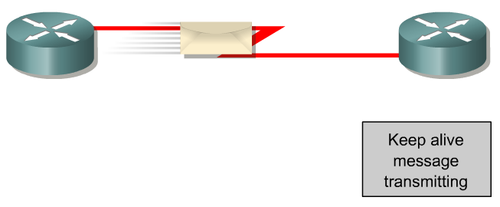
Type 2: BGP Keepalive Message
This message type is sent periodically between peers to maintain connections and verify paths held by the router sending the keepalive.
If a router accepts the parameters specified in its neighbor’s Open message, it responds with a Keepalive.
Subsequent Keepalives are sent every 60 seconds by Cisco default or equal to one-third the agreed-upon hold time (180 seconds).
If the periodic timer is set to a value of zero (0), no keepalives are sent.

Slide 27
NOTIFICATION message
0
8
16
24
31
Marker
Length
Type=NOTIFICATION
Error code
Data
Error subcode
Error code: the type of error condition.
Error subcode: specific information about the nature of the error.
Data: the reason for the notification.

Slide 28
BGP Notification Message Error Code
Type Code | Name | Sub-Code and Description
1 | Message Header Error | 1: Connection not synchronized 2: Bad message length 3: Bad message type
2 | Open Message Error | 1: Unsupported Version number 2: Bad peer AS 3: Bad BGP Identifier 4: Unsupported optional parameter 5: Authentication failure 6: Unacceptable hold time
3 | Update Message Error | 1: Malformed attribute list 2: Unrecognized well-known attribute 3: Mission well-known attribute 4: Attribute flags error 5: Attribute length error 6: Invalid ORIGIN attribute 7: AS Routing loop 8: Invalid NEXT_HOP attribute 9: Optional attribute error 10: Invalid network field 11: Malformed AS_PATH
4 | Hold Time Expired
5 | Finite State Machine Error
6 | Cease

Slide 29
UPDATE message
Length (1 octet)
Prefix (variable)
……
Length (1 octet)
Prefix (variable)
BGP header
Unfeasible routes length (2 octets)
Attribute type
Attribute length
Attribute value
Withdrawn routes (variable)
……
Total path attribute length (2 octets)
Attribute type
Attribute length
Attribute value
Path attributes (variable)
Network layer reachability information (variable)
Length (1 octet)
Prefix (variable)
……
Length (1 octet)
Prefix (variable)
Unfeasible routes length: the total length of the withdrawn routes field in octets.
Withdrawn routes: a list of IP address prefixes for the routes that need to be withdrawn from BGP routing tables.
Total path attribute length: the total length of the Path Attributes field in octets.
Path attributes: a variable length sequence of path attributes.
NLRI: a list of IP prefixes.

Slide 30
Type 3: BGP Update Message
Network-Layer Reachability Information (NLRI)
This is one or more (Length, Prefix) tuples that advertise IP address prefixes and their lengths.
192.168.160.0/19
Prefix = 192.168.160.0
Prefix Length = 19
Path Attributes
This is described later, providing the information that allows BGP to choose a shortest path, detect routing loops, and determine routing policy.
Withdrawn Routes
These are (Length, Prefix) tuples describing destination that have become unreachable and are being withdrawn from service.

Slide 31
BGP Attribute Categories
Well-Known Mandatory : Must be recognized and included in all BGP Update messages
Well-Known Discretionary: Must be recognized but may or may not be included in a specific Update message
Optional Transitive: Not required to be supported. Accept the attribute and pass on to peers
Optional Non-transitive: Not required to be supported. Quietly ignore and not advertise to other peers.

Slide 32
Update message (cont.)
Attribute type
Attribute length
Attribute value
O
T
P
E
0
Attribute type code
Attribute flag (1 octet):
O bit: attribute is optional (O=1), or required (O=0).
T bit: an optional attribute is transitive (T=1), or non-transitive (T=1). Set to 1 for Well-known attributes
P bit: the information in the optional transitive attribute is partial (P=1), or complete (P=0). Set to 0 for well-known attributes and for optional non-transitive attributes
E bit: the attribute length is two octets (E=1), or one octet (E=0).

Slide 33
BGP Attributes
Type Code | Name | Value Code | Description
1 | Origin | 0 | IGP | Well-Known Mandatory
 |  | 1 | EGP
 |  | 2 | Incomplete
2 | AS_PATH | 1 | AS_SET | Well-Known Mandatory
 |  | 2 | AS_SEQUENCE
 |  | 3 | AS_CONFED_SET
 |  | 4 | AS_CONFED_SEQUENCE
3 | NEXT_HOP | 0 | Next-Hop IP Address | Well-Known Mandatory
4 | MULTI_EXIT_DISC | 0 | 4-octet MET | Optional Non-transitive
5 | LOCAL_PREF | 0 | 4-octet LOCAL_PREF | Well-Known Discretionary
6 | ATOMIC_AGGREGATE | 0 | None | Well-Known Discretionary
7 | AGGREGATOR | 0 | AS Number and IP Address of aggregator | Well-Known Discretionary
8 | COMMUNITY | 0 | 4-octet community identifier | Optional Transitive
9 | ORIGINATOR_ID | 0 | 4-octet router ID of originator | Optional Non-transitive
10 | CLUSTER_LIST | 0 | Variable-length list of cluster IDs | Optional Non-transitive

Slide 34
Update message (cont.)
Attribute type code:
ORIGIN (type code 1): defines the origin of the NLRI.
AS_PATH (type code 2): lists the sequence of Ass that the route have traversed to reach the destination.
NEXT_HOP (type code 3): defines the IP address of the border router that should be used as the next hop to the destination listed in the NLRI.
MULTI_NEXT_DISC (type code 4): discriminates among multiple entry/exit points to a neighboring AS and gives a hint to the neighboring AS about the preferred path.
LOCAL_PREF( type code 5): informs other BGP routers within the same AS of its degree of preference for an advertised route.
ATOMIC_AGGREGATE (type code 6): informs other BGP routers that it selected a less specific route without selecting a more specific one that is included in it.
AGGREGATOR (type code 7): specifies the last AS number that formed the aggregate route followed by the IP address of the BGP router that formed the aggregate route.

Slide 35
The ORIGIN Attribute
IGP – The router was learned from a protocol internal to the originating AS.
EGP – The route was learned from the Exterior Gateway Protocol
Incomplete – The router was learned by some other means. Routes learns through redistribution has the incomplete origin attribute, because there is no way to determine the original source of the route.

Slide 36
The AS-Path Attribute
Sequence of ASs a route has traversed – Prepended only when the route is advertised between EBGP peers
Loop detection
Apply policy
AS 200
AS 100
170.10.0.0/16
180.10.0.0/16
180.10.0.0/16 300 200 100
170.10.0.0/16 300 200
AS 300
AS 400
150.10.0.0/16
AS 500
180.10.0.0/16 300 200 100
170.10.0.0/16 300 200
150.10.0.0/16 300 400

Slide 37
The AS-Path Attribute
AS 100
180.10.0.0/16
180.10.0.0/16 100 100 100
180.10.0.0/16 100
AS 200
180.10.0.0/16 100
180.10.0.0/16 200 100
AS 400
AS 300
180.10.0.0/16 400 100 100 100
180.10.0.0/16 400 100
AS 500
180.10.0.0/16 300 200 100

Slide 38
The Next Hop Attribute
150.10.1.1
150.10.1.2
AS 200
A
B
AS 300
150.10.0.0/16
150.10.0.0/16 150.10.1.1
160.10.0.0/16 150.10.1.1
AS 100
160.10.0.0/16
20

Slide 39
Next Hop (continued)
Advertising to different AS – the NEXT_HOP is the IP address of the advertising router’s interface
Advertising to the same AS and the route is in the same AS – NEXT_HOP is the IP address of the originating router
Advertising to the same AS and the route is in a different AS – NEXT_HOP is the IP address of the external peer from which the route was learned

Slide 40
The Next Hop Attribute
172.16.5.0/24
172.16.83.2
172.16.83.1
A
B
172.16.101.1
172.16.5.0/24
NEXT_HOP = 172.16.83.2
iBGP
172.16.101.2
AS 200
C
20

Slide 41
The Next Hop Attribute
192.168.5.1
D
207.135.64.0/19
NEXT_HOP = 192.168.5.1
AS 300
eBGP
172.16.83.2
172.16.83.1
A
B
172.16.101.1
207.135.64.0/19
NEXT_HOP = 192.168.5.1
iBGP
172.16.101.2
AS 200
C
20

Slide 42
The Local Preference Attribute
AS 100
160.10.0.0/16
AS 200
AS 300
D
500
800
E
A
B
AS 400
160.10.0.0/16 500
> 160.10.0.0/16 800
C

Slide 43
The Local Preference Attribute
Local to an AS – non-transitive
Only between iBGP peers
Local preference set to 100 when heard from neighbouring AS
Used to influence BGP path selection
Determines best path for outbound traffic
Path with highest local preference wins

Slide 44
The Multi-Exit Discriminator (MED) Attribute
192.68.1.0/24 0
AS 200
iBGP
C
D
eBGP
192.68.1.0/24 2000
192.68.1.0/24 1000
A
B
192.68.1.0/24
AS 201

Slide 45
The Multi-Exit Discriminator Attribute
Inter-AS Metric: Optional non-transitive
Carried in eBGP updates to inform another AS of the preferred ingress point
Lowest MED value is preferred
Used only to influence traffic between two directly connected AS
Not passed beyond the receiving AS
Metric reset to 0 on announcement to next AS
Comparable if paths are from same AS

Slide 46
The ATOMIC_AGGREGATE and AGGREGATOR Attributes
The ATOMIC_AGGREGATE is a well-know discretionary attribute. Used to alert downstream routers that a loss of path information has occurred.
Receiving router must attach the ATOMIC_AGGREGATE attribute
The AGGREGATOR attribute is optional transitive. Provide information about where the aggregation was performed by including the AS number and the Router ID that originated the aggregate route.

Slide 47
Route Aggregation
206.25.192.0/19
(3113,237,225)
206.25.160.0/19
(3113,237)
206.25.224.0/19
(3113,810)
206.25.128.0/17
(3113)
AS 3113
206.25.128.0/19
206.25.192.0/19
(237,225)
206.25.160.0/19
(237)
AS 237
206.25.160.0/19
206.25.224.0/19
(810)
206.25.192.0/19
(225)
AS 810
206.25.224.0/19
128 10000000
192 11000000
160 10100000
224 11100000
AS 225
206.25.192.0/19

Slide 48
ATOMIC_AGGREGATE and AGGREGATOR
206.25.128.0/17
(3113)
ATOMIC_AGGREGATE
AGGREGATOR = 3113, 206.25.254.252
AS 3113
206.25.128.0/19
RID= 206.25.254.252
206.25.192.0/19
(237,225)
206.25.160.0/19
(237)
206.25.224.0/19
(810)
AS 237
206.25.160.0/19
206.25.192.0/19
(225)
AS 810
206.25.224.0/19
128 10000000
192 11000000
160 10100000
224 11100000
AS 225
206.25.192.0/19

Slide 49
AS_SET and AS_SEQUENCE
AS_SEQUENCE: Ordered list of AS numbers
AS_SET: Unordered list of the AS numbers
When a BGP router aggregates routes learned from other AS, it can include all those AS numbers in the AS_PATH as an AS_SET

Slide 50
Inter-AS Routing Loops
1
206.25.192.0/19 e1
206.25.160.0/17 e1
206.25.224.0/19 e2
206.25.128.0/17
(3113)
206.25.128.0/17 e1
AS 3113
206.25.128.0/19
e3
e1
AS 6571
e1
e2
e2
206.25.192.0/19
(237,225)
206.25.160.0/19
(237)
206.25.224.0/19
(810)
2
e1
e2
206.25.128.0/17
(6571,3113)
206.25.225.0/24 e3
206.25.128.0/17 e2
AS 810
206.25.224.0/19
192 11000000
160 10100000
224 11100000
3
206.25.225.1
e3

Slide 51
AS_SET and AS_SEQUENCE
206.25.128.0/17
AS_SEQUENCE = (3113)
AS_SET = (237,810,225)
AS 3113
206.25.128.0/19
206.25.192.0/19
(237,225)
206.25.160.0/19
(237)
206.25.224.0/19
(810)
AS 237
206.25.160.0/19
206.25.192.0/19
(225)
AS 810
206.25.224.0/19
192 11000000
160 10100000
224 11100000
AS 225
206.25.192.0/19

Slide 52
The COMMUNITY Attribute
Optional transitive attribute to simplify policy enforcement
Originally Cisco-specific. Standardized in RFC 1997.
Identify a destination as a member of a community
Represented as two 16bit integers AA:NN (AA is the AS Number)
Well-known Communities:
INTERNET : no value. Can be advertised freely
NO_EXPORT (0xFFFFFF01) : cannot be advertised outside the confederation
NO_ADVERTISE (0xFFFFFF02) : cannot be advertised at all
LOCAL_AS (0xFFFFFF03) : Cannot be advertised to EBGP peers

Slide 53
Community
ISP 2
160.10.0.0/16 300:1
170.10.0.0/16 300:1
X
200.10.0.0/16
AS 400
E
200.10.0.0/16 300:9
D
ISP 1
AS 300
160.10.0.0/16 300:1
C
170.10.0.0/16 300:1
AS 100
A
B
AS 200
160.10.0.0/16
170.10.0.0/16

Slide 54
The ORIGINATOR_ID and CLUSTER_LIST Attributes
Optional non-transitive attributes used by route reflectors to prevent routing loops
ORIGINATOR_ID: Router ID of the originator of the route in the local AS
CLUSTER_LIST: A sequence of route reflector cluster IDs through which the route has traversed.

Slide 55
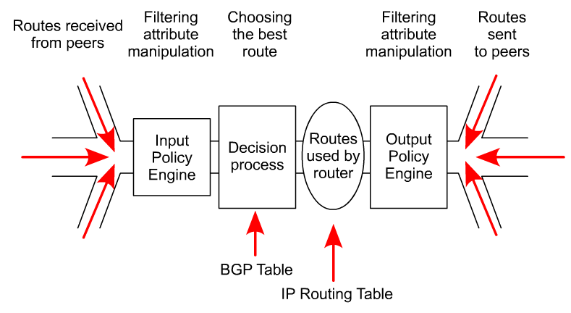
BGP Routing
BGP is so flexible because it is a fairly simple protocol.
Routes are exchanged between BGP peers via UPDATE messages.
BGP routers receive the UPDATE messages, run some policies or filters over the updates, and then pass on the routes to other BGP peers.

Slide 56
BGP Route Selection Algorithm
Summary of the BGP Path Selection Process
BGP selects only one path as the best path.
When the path is selected, BGP puts the selected path in its routing table and propagates the path to its neighbors.
BGP uses the following criteria, in the order presented, to select a path for a destination:
If the path specifies a next hop that is inaccessible, drop the update
2. Prefer the path with the largest weight.
3. If the weights are the same, prefer the path with the largest local preference.
4. If the local preferences are the same, prefer the path that was originated by BGP running on this router.
5. If no route was originated, prefer the route that has the shortest AS_path.
6. If all paths have the same AS_path length, prefer the path with the lowest origin type (where IGP is lower than EGP, and EGP is lower than Incomplete).
7. If the origin codes are the same, prefer the path with the lowest MED attribute.
8. If the paths have the same MED, prefer the external path over the internal path.
9. If the paths are still the same, prefer the path through the closest IGP neighbor.
10. Prefer the path with the lowest IP address, as specified by the BGP router ID.

Slide 57
Internal vs. External BGP
BGP can be used by R3 and R4 to learn routes
How do R1 and R2 learn routes?
R1
E-BGP
AS1
R3
R4
AS2
R2

Slide 58
Internal BGP (I-BGP)
Same messages as E-BGP
Different rules about re-advertising prefixes:
Prefix learned from E-BGP can be advertised to I-BGP neighbor and vice-versa, but
Prefix learned from one I-BGP neighbor cannot be advertised to another I-BGP neighbor
Reason: no AS PATH within the same AS and thus danger of looping.

Slide 59
Internal BGP (I-BGP)
R3 can tell R1 and R2 prefixes from R4
R3 can tell R4 prefixes from R1 and R2
R3 cannot tell R2 prefixes from R1
R2 can only find these prefixes through a direct connection to R1
Result: I-BGP routers must be fully connected (via TCP)!
contrast with E-BGP sessions that map to physical links
R1
E-BGP
AS1
R3
R4
AS2
R2
I-BGP

Slide 60
Reasons For Fully Meshed iBGP
To prevent BGP routing loops within an AS
To ensure that all routers along the path of a BGP route know how to forward packets to the destination

Slide 61
Route Flap Dampening
Route flap
Going up and down of path or change in attribute
BGP WITHDRAW followed by UPDATE = 1 flap
eBGP neighbour going down/up is NOT a flap
Ripples through the entire Internet
Wastes CPU
Route Dampening is to To limit the propagation of flapping routes. Advertise stable routes only
Described in RFC2439

Slide 62
Route Dampening
Route Dampening Parameters:
History state: After a single route flap, the route is assigned a penalty, and the dampening state of the route is set to History. Each time the route flaps, the penalty increases.
Suppress limit: If the penalty exceeds the suppress limit, the route is Dampened. When the route is in Damp state, the router is not considered for best path selection and is not advertised to BGP peers.
Half life: The penalty of a route is decreased based on the half-life period. The default half-life period is 15 minutes. The penalty on the route is reduced every 5 seconds.
Reuse limit: When the penalty falls below the reuse limit, the route is unsuppressed. When the penalty falls below half of reuse limit, the history of the route is cleared.
Maximum suppress limit: It is the maximum amount of time a route can be suppressed for.
Cisco Default: Penalty = 1000 per flap. Suppress limit = 2000, half-life period = 15 minutes, reuse-limit = 750 and maximum suppress-limit = 60 minutes.

Slide 63
Operation
Add penalty (1000) for each flap
Change in attribute gets penalty of 500
Exponentially decay penalty
half life determines decay rate
Penalty above suppress-limit
do not advertise route to BGP peers
Penalty decayed below reuse-limit
re-advertise route to BGP peers
penalty reset to zero when it is half of reuse-limit

Slide 64
Operation
4000
Suppress limit
3000
Penalty
2000
Reuse limit
1000
0
0
1
2
3
4
5
6
7
8
9
10
11
12
13
14
15
16
17
18
19
20
21
22
23
24
25
Time
Network
Announced
Network
Not Announced
Network
Re-announced

Slide 65
Route Reflector
All iBGP peers must be fully meshed which requires n(n-1)/2 iBGP connections in the AS.
A router is configured as a route reflector (RR)
Other iBGP routers (clients) peer with the RR only
Rules to Advertise
Routes learned from a non-client iBGP peer – Advertise to clients only
Routes learned from a client – Advertise to all non-clients and clients, except the originating client
Routes learned from an eBGP peer – Advertise to all clients and non-clients

Slide 66
Router Reflector
AS 9184
Router Reflector
Client
Client
Client
Client
Client
Router Reflector Cluster

Slide 67
Router Reflection Cluster Peering Relationships
AS 829
EBGP
AS 9184
Router Reflector
iBGP
Non-Client
Router Reflector Cluster
iBGP
iBGP
iBGP
Client
Client
Client
EBGP
AS 2153

Slide 68
Route Reflector
Reflector receives path from clients and non-clients
Selects best path
If best path is from client, reflect to other clients and non-clients
If best path is from non-client, reflect to clients only
If a route is received from an EBGP peer, reflect to all clients and non-clients
Described in RFC2796
Clients
Reflectors
A
B
C
AS 100

Slide 69
Route Reflectors: Loop Avoidance
Originator_ID attribute
Carries the RID of the originator of the route in the local AS (created by the RR)
An RR does not advertise a route back to the originator
If the originator receives an update with its own RID, the update is ignored
Cluster_list attribute
The local cluster-id is added when the update is sent by the RR
Cluster-id is router-id (address of loopback)
When an RR receives an update, it checks the CLUSTER_LIST. Ignores the update if it sees its own cluster ID in the list

Slide 70
Confederations
Member Autonomous Systems: An AS subdivided into a group of sub-autonomous systems. Usually use AS number in the reserved range 64512 to 65535.
iBGP to peers in the same member AS and eBGP to peers in other member AS
Confederation ID: the AS number of the entire confederation which is represented to peers outside of the confederation as the AS number of the entire confederation.
AS_CONFED_SEQUENCE: ordered list of AS numbers within the confederation
AS_CONFED_SET: Unordered list of AS numbers within the confederation
When update sent to a peer external to the confederation, the AS_CONFED_SEQUENCE and AS_CONFED_SET is stripped, and the confederation ID is prepended. External peers see the confederation as a single AS.
Choosing a route: EBGP external to the confederation > EBGP to member AS > IBGP

Slide 71
Confederation
AS 1836
eBGP
AS 9184
AS 65510
Confederation ID
iBGP
eBGP
eBGP
AS 65520
AS 65530
iBGP
iBGP
iBGP
iBGP

Slide 72
Inter-AS Routing Loops
206.25.192.0/19 e1 1
206.25.160.0/19 e1 1
206.25.224.0/19 e2 1
206.25.192.0/19 e1 2
206.25.160.0/19 e1 2
206.25.224.0/19 e2 1
206.25.192.0/19 1
206.25.160.0/19 1
206.25.224.0/19 1
206.25.224.0/19 e2 1
AS 3113
206.25.128.0/19
e3
e1
AS 6571
e1
e2
e2
206.25.192.0/19 0
206.25.160.0/19 0
206.25.192.0/19 1
206.25.160.0/19 1
206.25.224.0/19 1
206.25.224.0/19 0
e1
e2
AS 810
206.25.224.0/19
206.25.224.0/19 e3 0
206.25.225.1
e3

