Slide 1
CS 540 Computer Networks II
Sandy Wang
chwang_98@yahoo.com
Notes:
“Data and Computer Communications”, 10/e, by William Stallings, Chapter 11 “Local Area Network Overview”.

Slide 2
9. Transport Layer – TCP/UDP
Notes:
In this chapter, we look at the underlying technology and protocol architecture
of LANs. Chapters 12 and 13 are devoted to a discussion of specific
LAN systems.

Slide 3
Topics
Overview
LAN Switching
IPv4
IPv6
Routing Protocols -- RIP, RIPng, OSPF
Routing Protocols -- ISIS, BGP
MPLS
Midterm Exam
Transport Layer -- TCP/UDP
Access Control List (ACL)
Congestion Control & Quality of Service (QoS)
Application Layer Protocols
Application Layer Protocols continue
Others – Multicast, SDN
Final Exam

Slide 4
Reference Books
Cisco CCNA Routing and Switching ICND2 200-101 Official Cert Guide, Academic Edition by Wendel Odom -- July 10, 2013. ISBN-13: 978-1587144882
The TCP/IP Guide: A Comprehensive, Illustrated Internet Protocols Reference by Charles M. Kozierok – October 1, 2005. ISBN-13: 978-1593270476
Data and Computer Communications (10th Edition) (William Stallings Books on Computer and Data Communications) by Williams Stallings – September 23, 2013. ISBN-13: 978-0133506488
http://class.svuca.edu/~sandy/class/CS540/

Slide 5
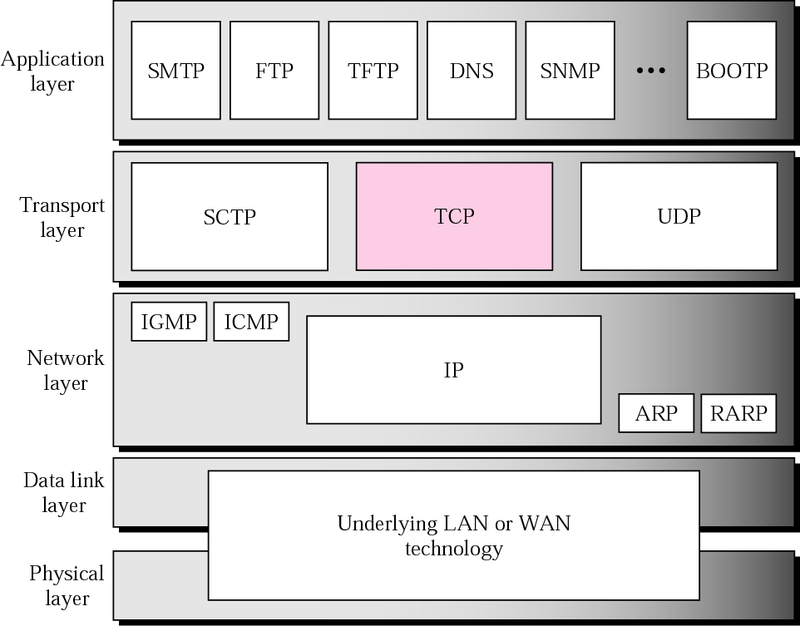
TCP/IP protocol suite

Slide 6
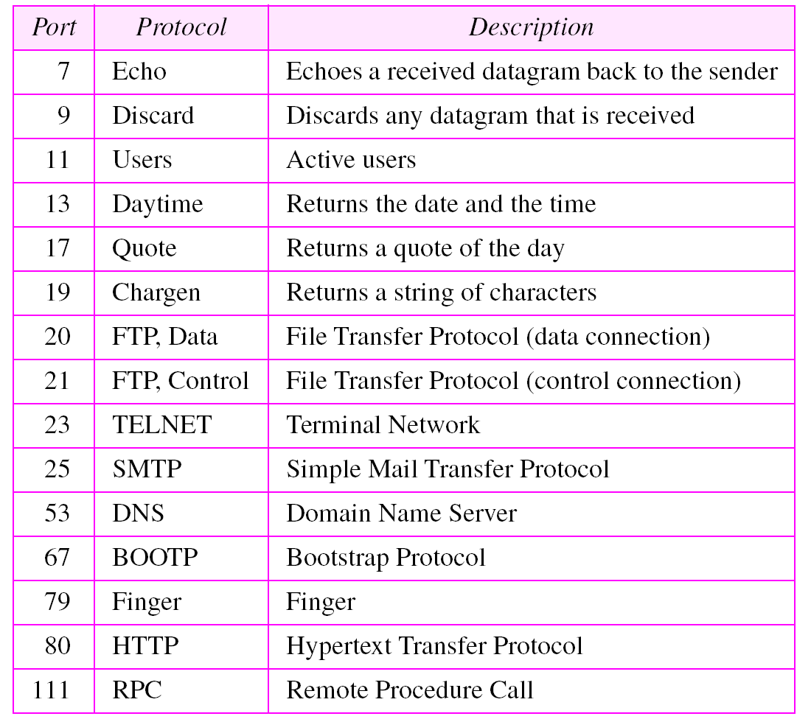
Table 12.1 Well-known ports used by TCP

Slide 7
TCP Features FEATURES
Numbering System
Flow Control
Error Control Congestion Control

Slide 8
The bytes of data being transferred in each connection are numbered by TCP. The numbering starts with a randomly generated number.

Slide 9
Example
Suppose a TCP connection is transferring a file of 5000 bytes. The first byte is numbered 10001. What are the sequence numbers for each segment if data is sent in five segments, each carrying 1000 bytes?
Solution The following shows the sequence number for each segment:
Segment 1 ➡ Sequence Number: 10,001 (range: 10,001 to 11,000)
Segment 2 ➡ Sequence Number: 11,001 (range: 11,001 to 12,000)
Segment 3 ➡ Sequence Number: 12,001 (range: 12,001 to 13,000)
Segment 4 ➡ Sequence Number: 13,001 (range: 13,001 to 14,000)
Segment 5 ➡ Sequence Number: 14,001 (range: 14,001 to 15,000)

Slide 10
The value in the sequence number field of a segment defines the number of the first data byte contained in that segment.

Slide 11
The value of the acknowledgment field in a segment defines the number of the next byte a party expects to receive.
The acknowledgment number is cumulative.

Slide 12
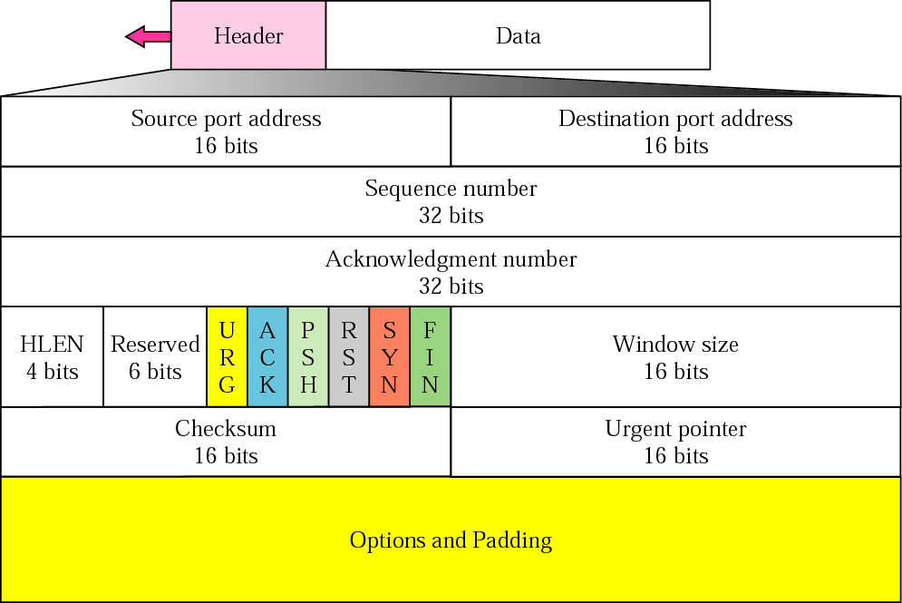
TCP segment format

Slide 13
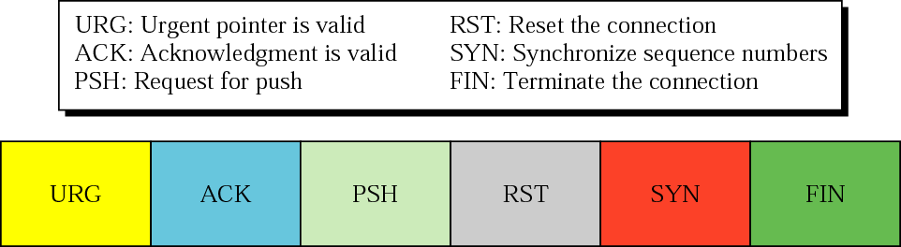
Control field

Slide 14
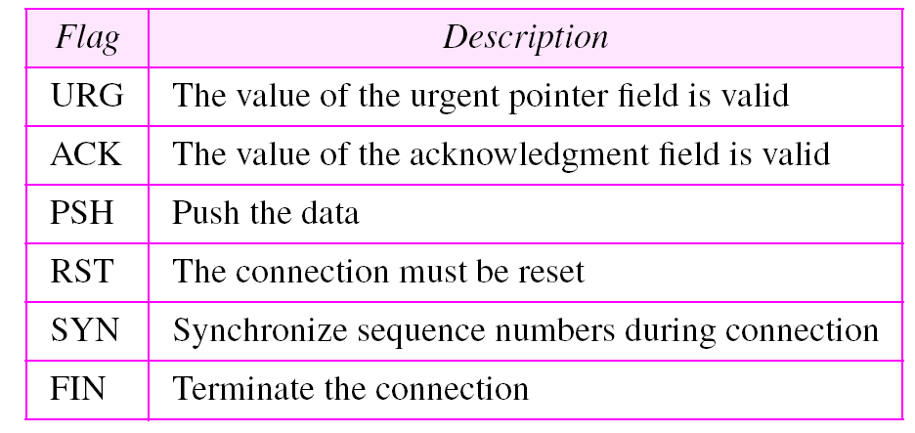
Table 12.2 Description of flags in the control field
I

Slide 15
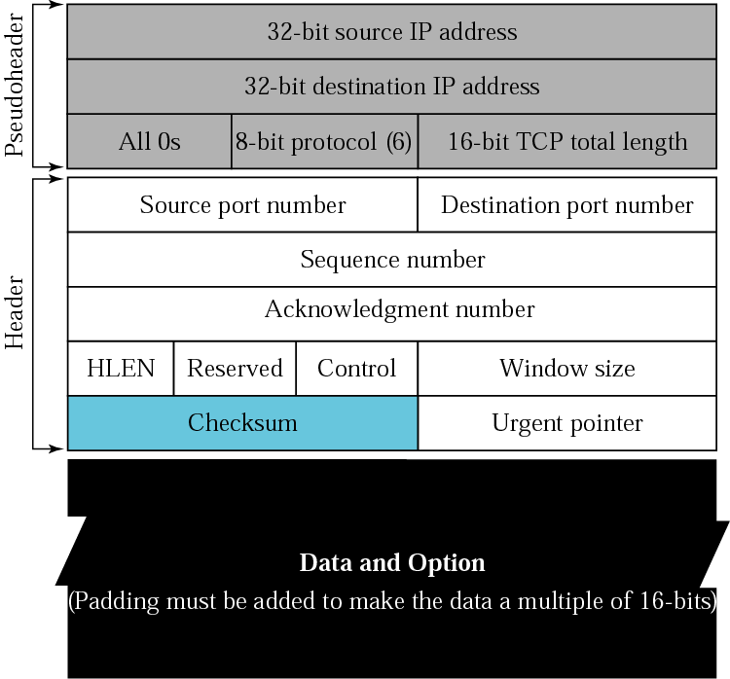
Pseudoheader added to the TCP datagram
TCP Hdr + Data

Slide 16
The inclusion of the checksum in TCP is mandatory.

Slide 17

Encapsulation and decapsulation

Slide 18
A TCP CONNECTION
TCP is connection-oriented. A connection-oriented transport protocol establishes a virtual path between the source and destination. All of the segments belonging to a message are then sent over this virtual path. A connection-oriented transmission requires three phases: connection establishment, data transfer, and connection termination.
Connection Establishment
Data Transfer
Connection Termination
Connection Reset

Slide 19
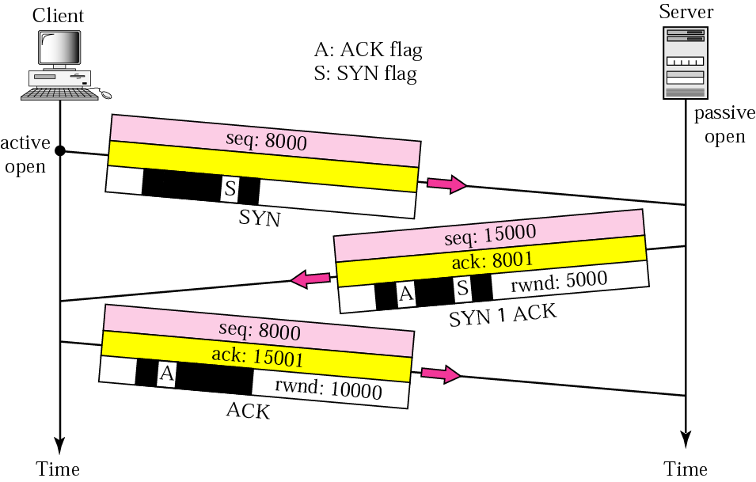
Connection establishment -- three-way handshaking

Slide 20
A SYN segment cannot carry data, but it consumes one sequence number.

Slide 21
A SYN + ACK segment cannot carry data, but does consume one sequence number.

Slide 22
An ACK segment, if carrying no data, consumes no sequence number.

Slide 23
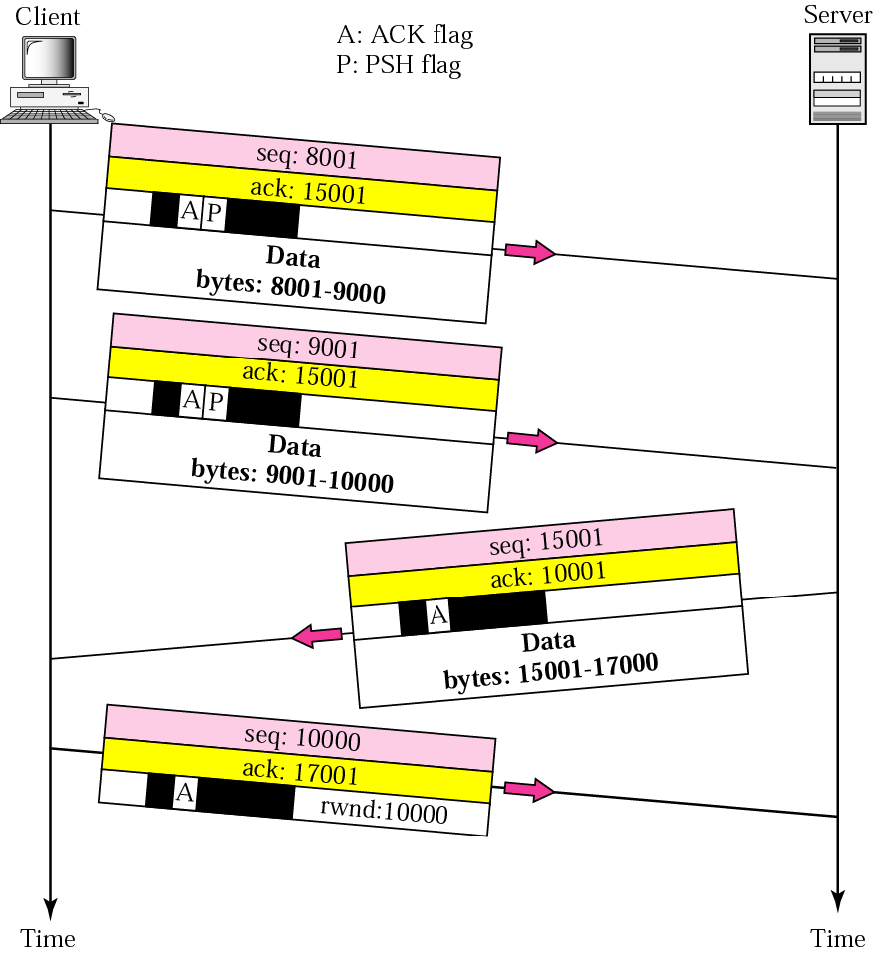
Data transfer

Slide 24
The FIN segment consumes one sequence number if it does not carry data.

Slide 25
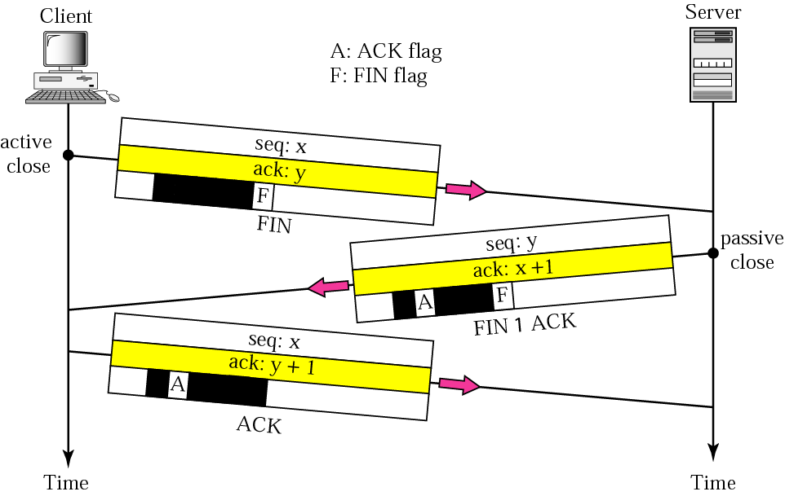
Connection termination using three-way handshaking

Slide 26
The FIN + ACK segment consumes one sequence number if it does not carry data.

Slide 27
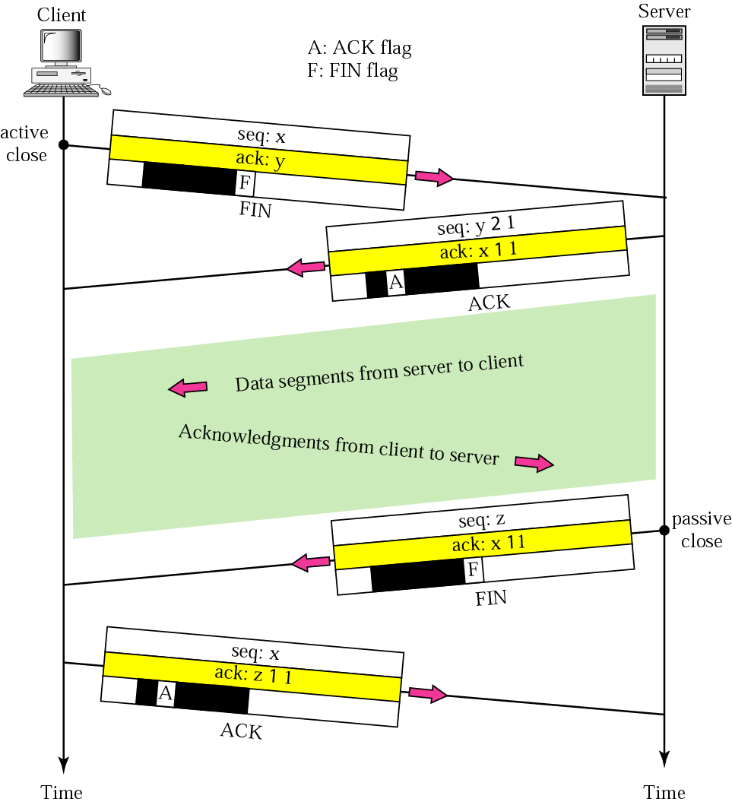
Half-close

Slide 28
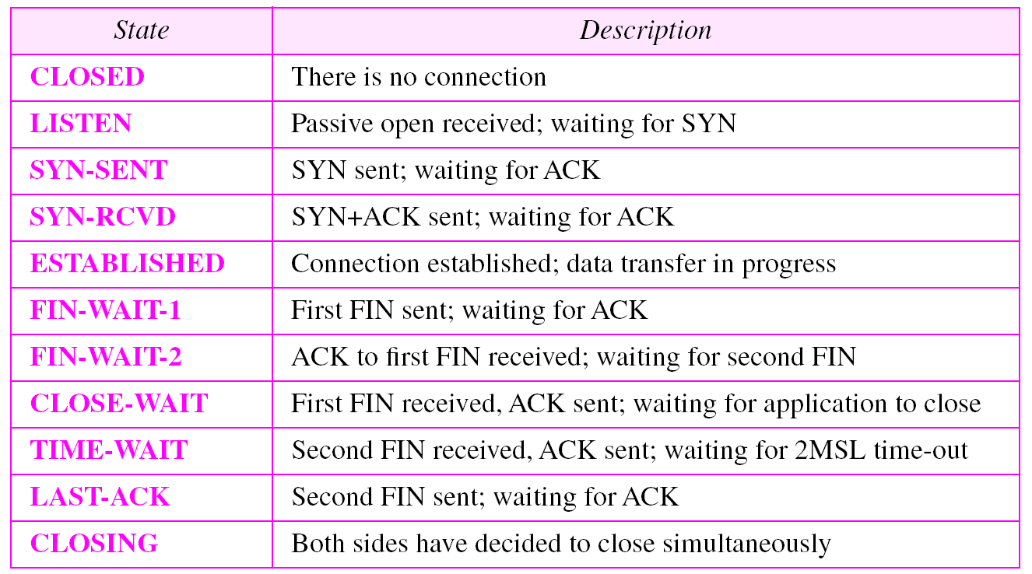
States for TCP

Slide 29
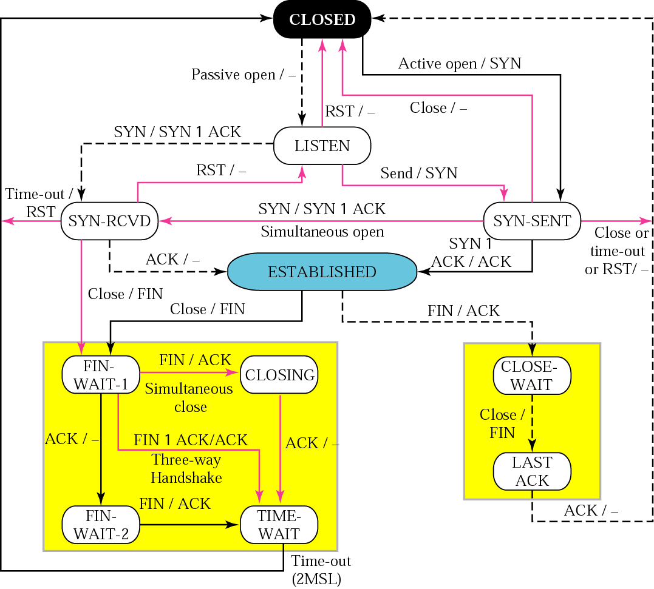
State transition diagram

Slide 30
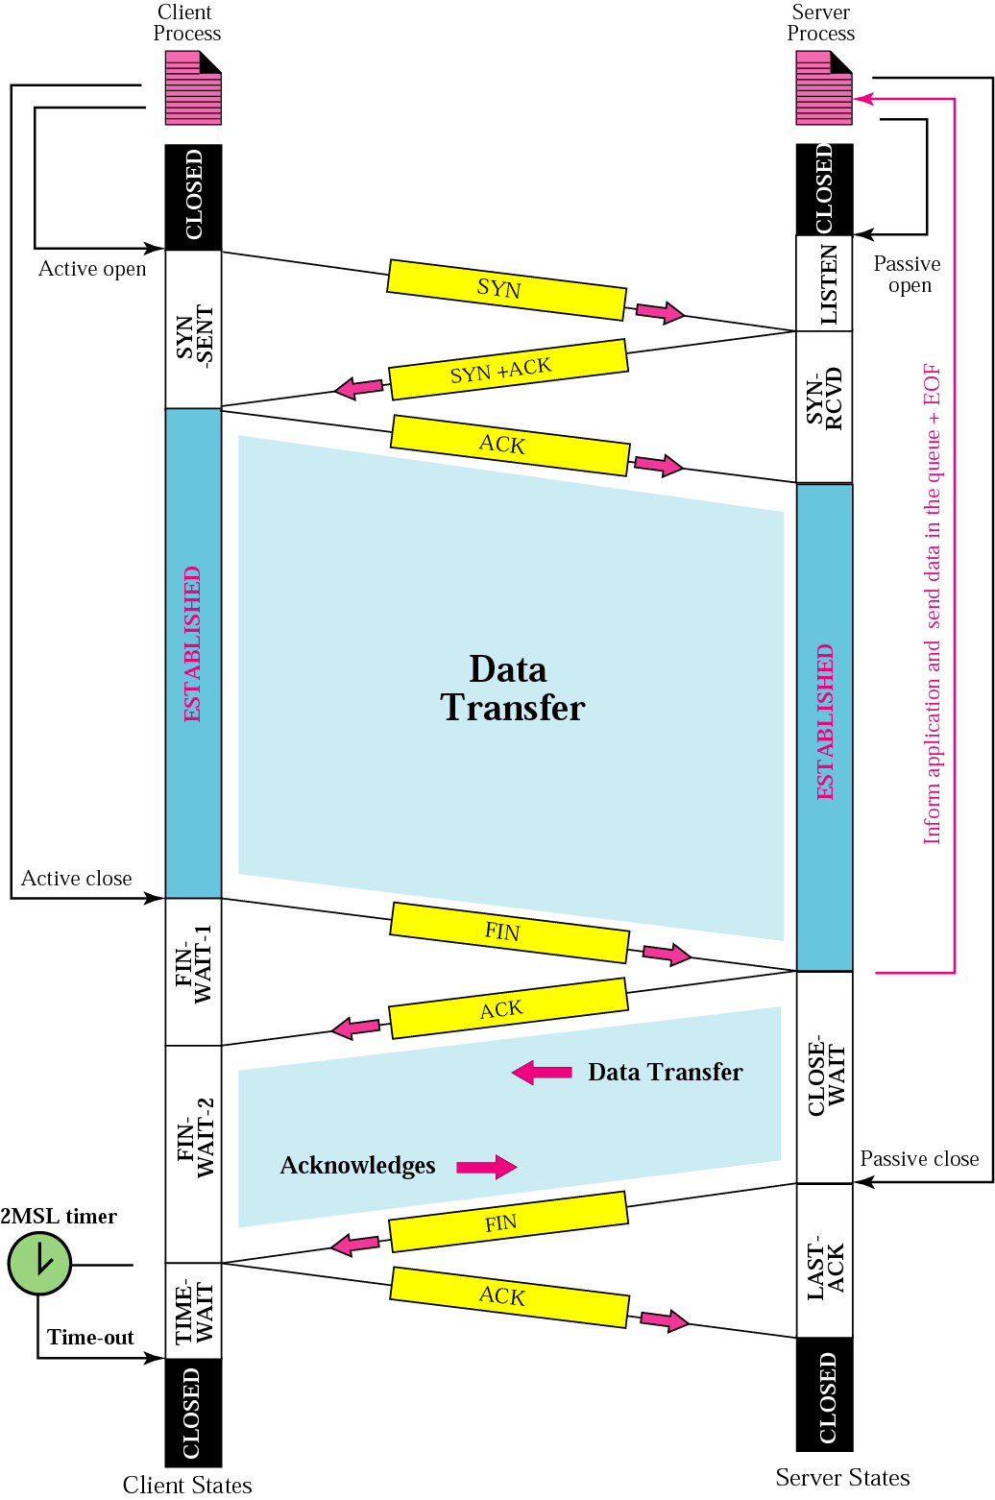
Common scenario

Slide 31
The common value for MSL is between 30 seconds and 1 minute.
MSL – Maximum Segment Lifetime

Slide 32
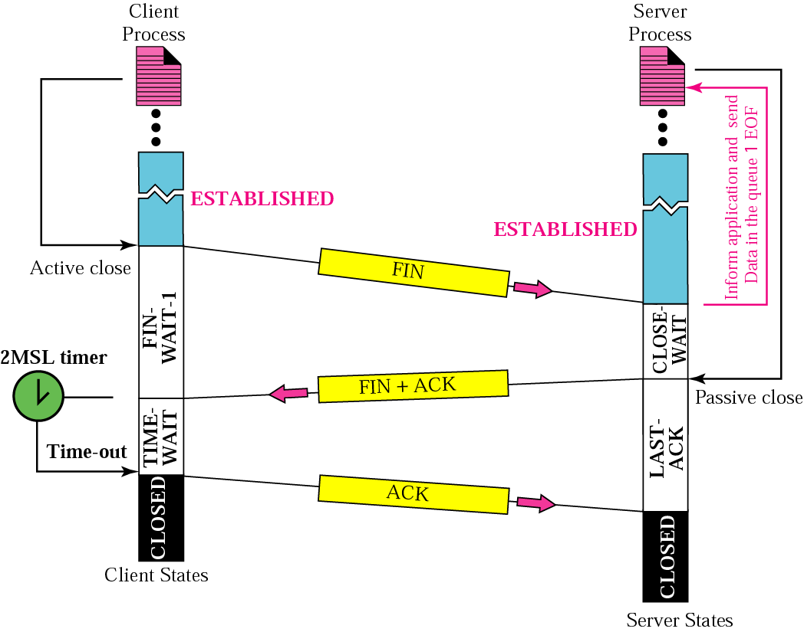
Three-way handshake

Slide 33
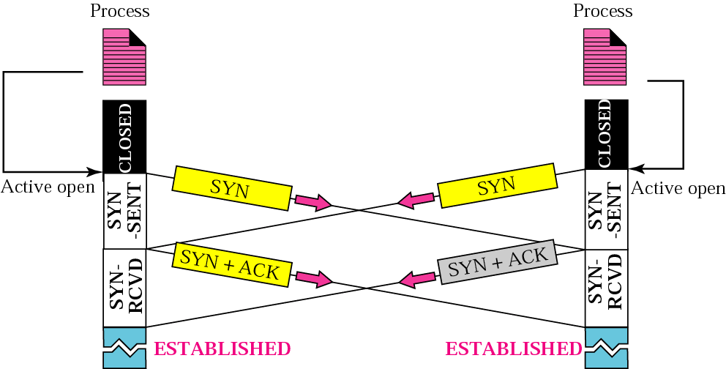
Simultaneous open

Slide 34
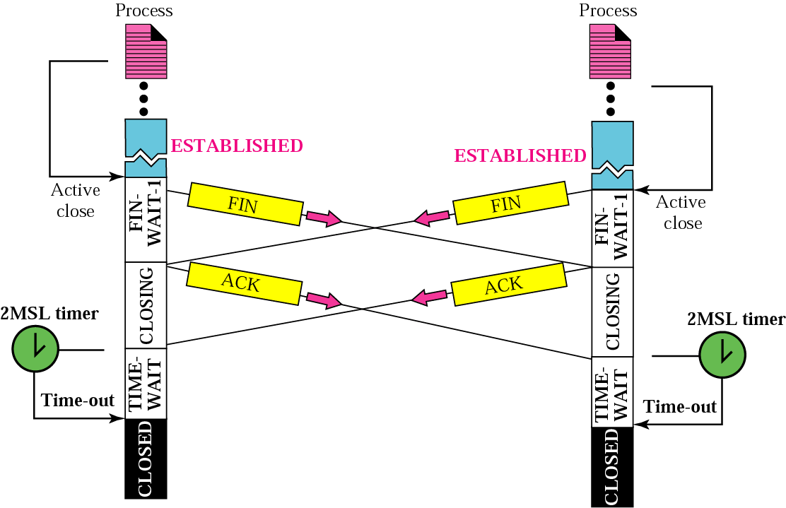
Simultaneous close

Slide 35
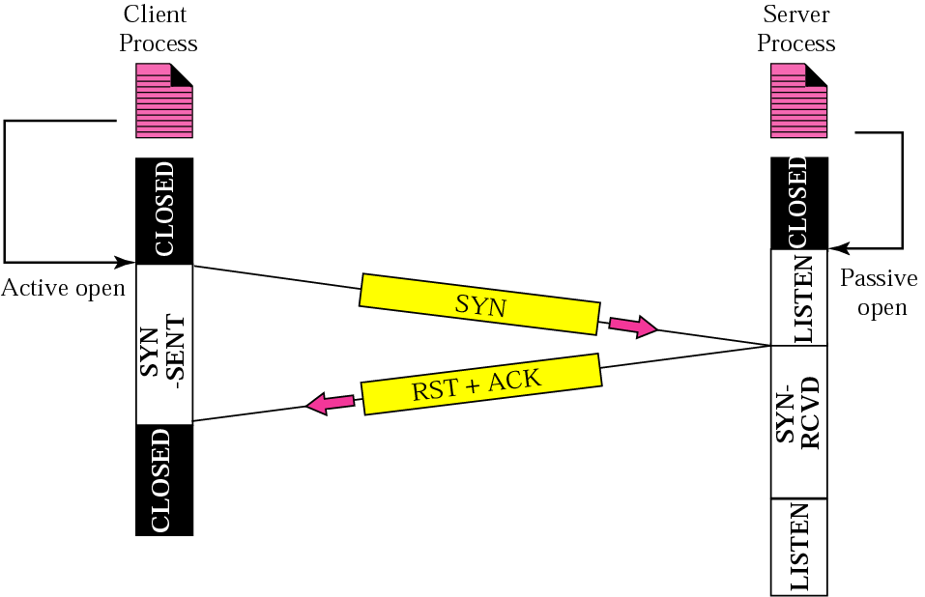
Denying a connection

Slide 36
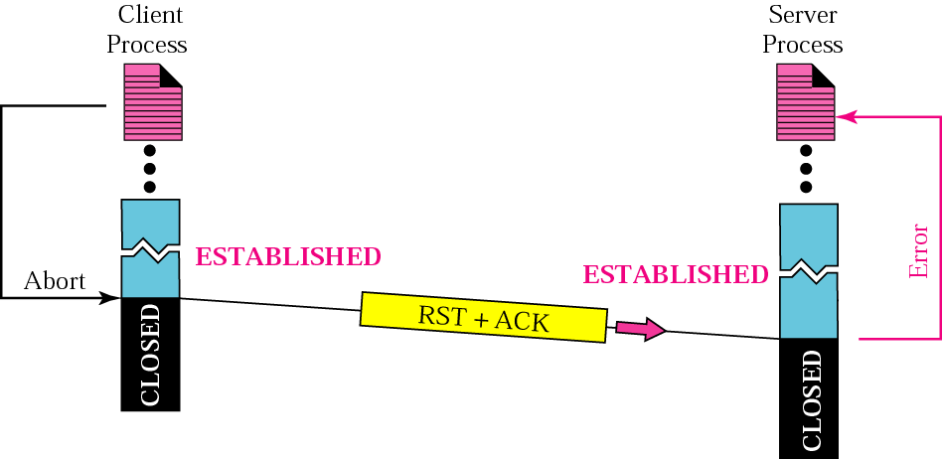
Aborting a connection

Slide 37
Flow Contrl
Flow control regulates the amount of data a source can send before receiving an acknowledgment from the destination. TCP defines a window that is imposed on the buffer of data delivered from the application program.
Sliding Window Protocol
Silly Window Syndrome

Slide 38
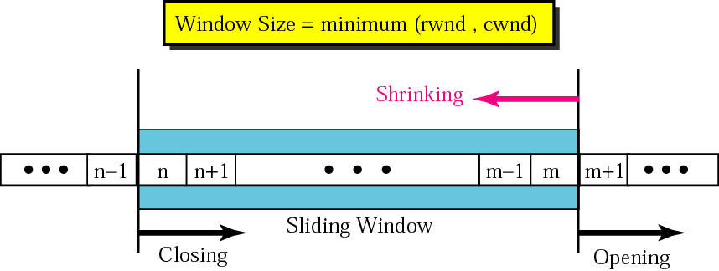
Sliding Window

Slide 39
A sliding window is used to make transmission more efficient as well as to control the flow of data so that the destination does not become overwhelmed with data.
TCP’s sliding windows are byte oriented.

Slide 40
Example
What is the value of the receiver window (rwnd) for host A if the receiver, host B, has a buffer size of 5,000 bytes and 1,000 bytes of received and unprocessed data?
Solution The value of rwnd = 5,000 − 1,000 = 4,000. Host B can receive only 4,000 bytes of data before overflowing its buffer. Host B advertises this value in its next segment to A.

Slide 41
Example 4
What is the size of the window for host A if the value of rwnd is 3,000 bytes and the value of cwnd is 3,500 bytes?
Solution The size of the window is the smaller of rwnd and cwnd, which is 3,000 bytes.

Slide 42
Example
The sender has sent bytes up to 202. We assume that cwnd is 20 (in reality this value is thousands of bytes). The receiver has sent an acknowledgment number of 200 with an rwnd of 9 bytes (in reality this value is thousands of bytes). The size of the sender window is the minimum of rwnd and cwnd or 9 bytes. Bytes 200 to 202 are sent, but not acknowledged. Bytes 203 to 208 can be sent without worrying about acknowledgment. Bytes 209 and above cannot be sent.

Slide 43
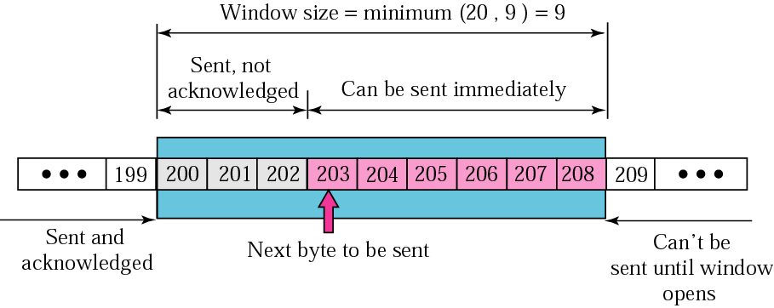
Example 5

Slide 44
Example
In Figure 12.21 the server receives a packet with an acknowledgment value of 202 and an rwnd of 9. The host has already sent bytes 203, 204, and 205. The value of cwnd is still 20. Show the new window.
Solution Figure 12.22 shows the new window. Note that this is a case in which the window closes from the left and opens from the right by an equal number of bytes; the size of the window has not been changed. The acknowledgment value, 202, declares that bytes 200 and 201 have been received and the sender needs not worry about them; the window can slide over them.

Slide 45
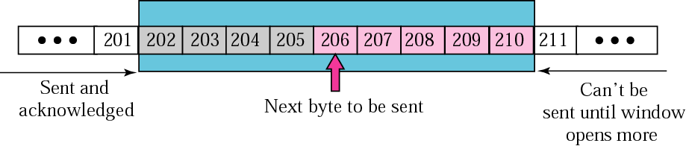
Example 6

Slide 46
Example
In Figure 12.22 the sender receives a packet with an acknowledgment value of 206 and an rwnd of 12. The host has not sent any new bytes. The value of cwnd is still 20. Show the new window.
Solution The value of rwnd is less than cwnd, so the size of the window is 12. Figure 12.23 shows the new window. Note that the window has been opened from the right by 7 and closed from the left by 4; the size of the window has increased.

Slide 47
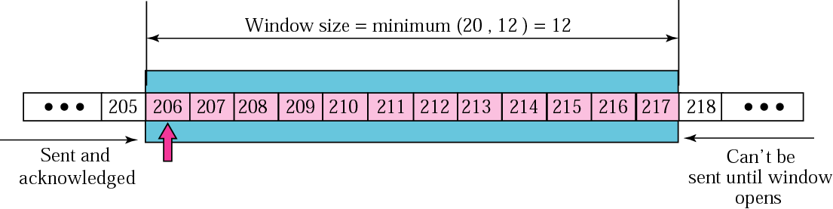

Slide 48
Example
In Figure 12.23 the host receives a packet with an acknowledgment value of 210 and an rwnd of 5. The host has sent bytes 206, 207, 208, and 209. The value of cwnd is still 20. Show the new window.
Solution The value of rwnd is less than cwnd, so the size of the window is 5. Figure 12.24 shows the situation. Note that this is a case not allowed by most implementations. Although the sender has not sent bytes 215 to 217, the receiver does not know this.

Slide 49
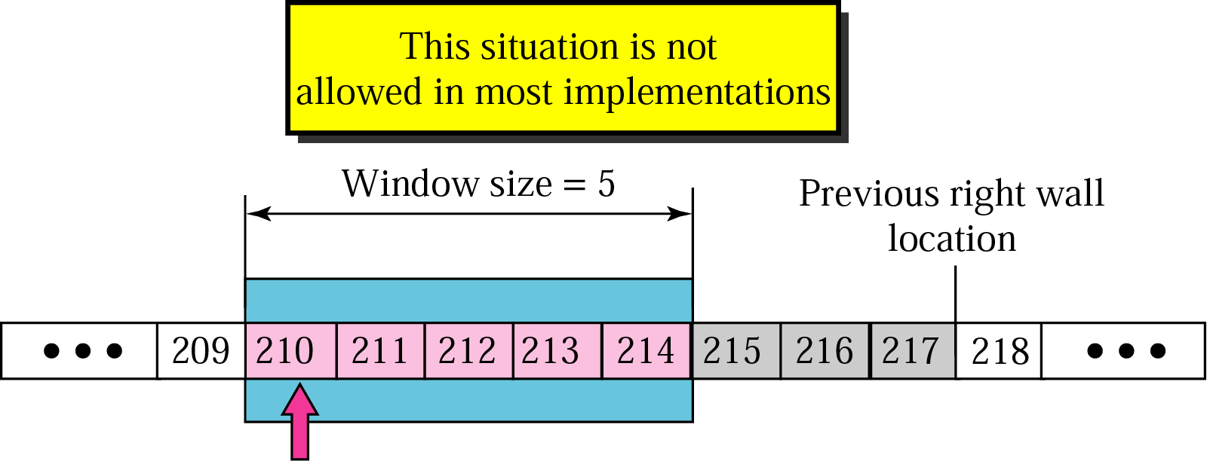

Slide 50
Example
How can the receiver avoid shrinking the window in the previous example?
Solution The receiver needs to keep track of the last acknowledgment number and the last rwnd. If we add the acknowledgment number to rwnd we get the byte number following the right wall. If we want to prevent the right wall from moving to the left (shrinking), we must always have the following relationship.
new ack + new rwnd ≥ last ack + last rwnd or new rwnd ≥ (last ack + last rwnd) − new ack

Slide 51
To avoid shrinking the sender window, the receiver must wait until more space is available in its buffer.

Slide 52
Note:
Some points about TCP’s sliding windows:
❏ The size of the window is the lesser of rwnd and cwnd. ❏ The source does not have to send a full window’s worth of data. ❏ The window can be opened or closed by the receiver, but should not be shrunk. ❏ The destination can send an acknowledgment at any time as long as it does not result in a shrinking window. ❏ The receiver can temporarily shut down the window; the sender, however, can always send a segment of one byte after the window is shut down.

Slide 53
Error Control
TCP provides reliability using error control, which detects corrupted, lost, out-of-order, and duplicated segments. Error control in TCP is achieved through the use of the checksum, acknowledgment, and time-out.
Checksum
Acknowledgment
Acknowledgment Type
Retransmission
Out-of-Order Segments
Some Scenarios

Slide 54
ACK segments do not consume sequence numbers and are not acknowledged.

Slide 55
In modern implementations, a retransmission occurs if the retransmission timer expires or three duplicate ACK segments have arrived.

Slide 56
No retransmission timer is set for an ACK segment.

Slide 57
Data may arrive out of order and be temporarily stored by the receiving TCP, but TCP guarantees that no out-of-order segment is delivered to the process.

Slide 58
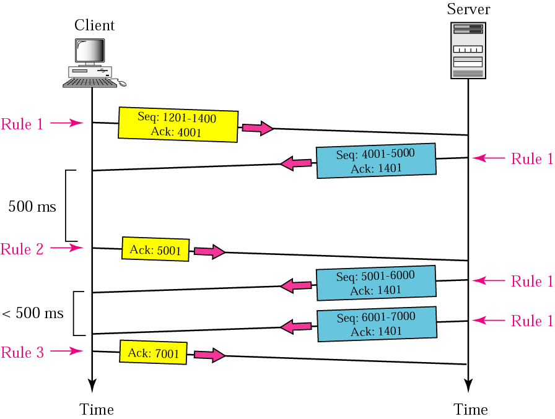
Normal Operation

Slide 59
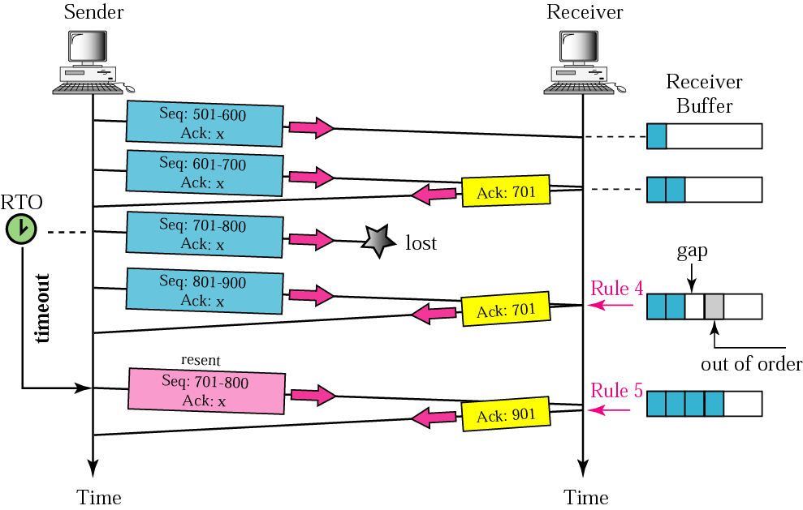
Lost Segment

Slide 60
The receiver TCP delivers only ordered data to the process.

Slide 61
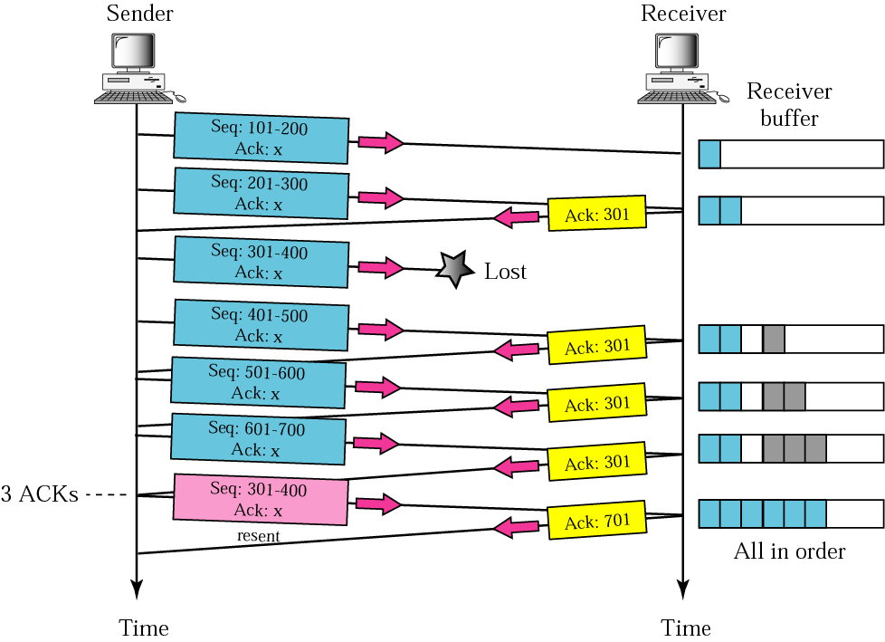
Fast Retransmission

Slide 62
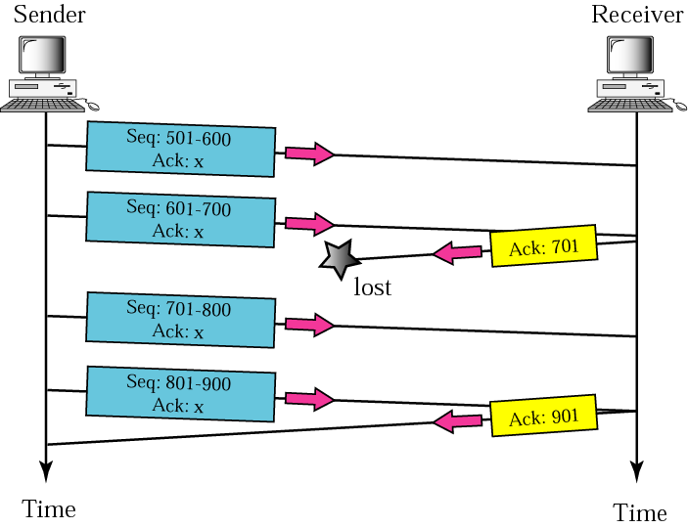
Lost Acknowledgement

Slide 63
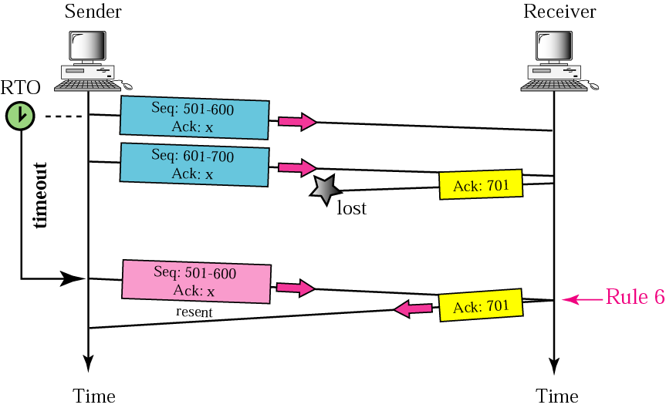
Lost acknowledgment corrected by resending a segment

Slide 64
Lost acknowledgments may create deadlock if they are not properly handled.

Slide 65
Congestion Control
Congestion control refers to the mechanisms and techniques to keep the load below the capacity.
Network Performance
Congestion Control Mechanisms
Congestion Control in TCP

Slide 66
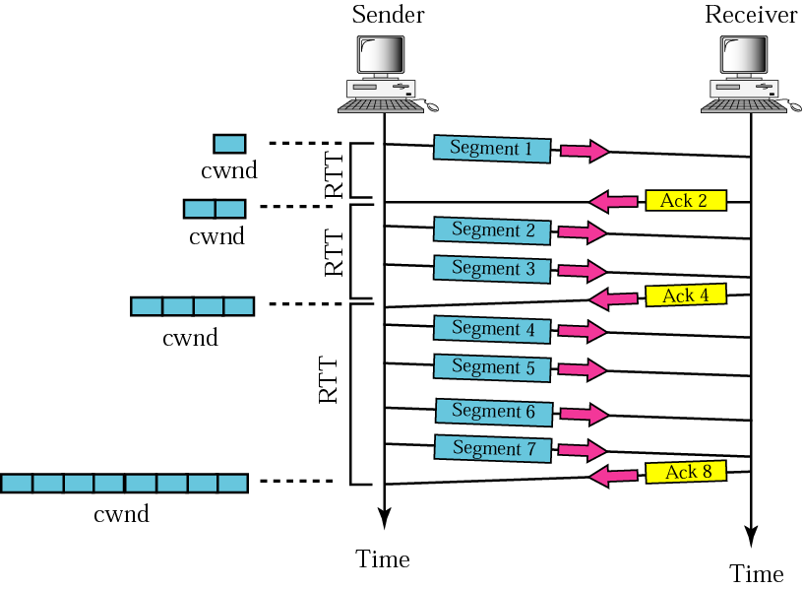
Slow start, exponential increase

Slide 67
In the slow start algorithm, the size of the congestion window increases exponentially until it reaches a threshold.

Slide 68
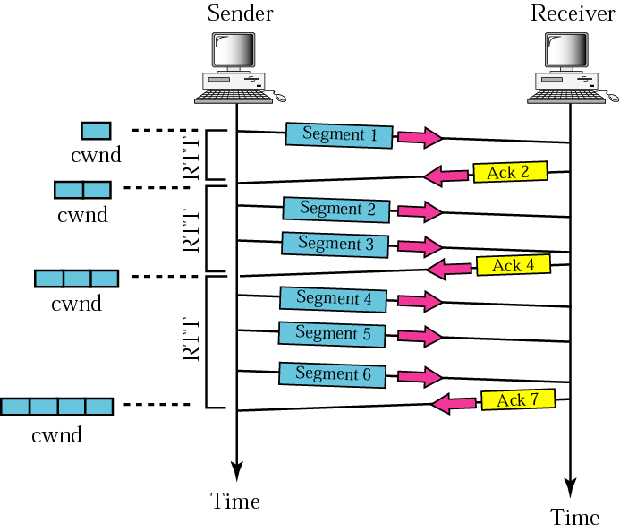
Congestion avoidance, additive increase

Slide 69
In the congestion avoidance algorithm the size of the congestion window increases additively until congestion is detected.

Slide 70
Most implementations react differently to congestion detection:
❏ If detection is by time-out, a new slow start phase starts.
❏ If detection is by three ACKs, a new congestion avoidance phase starts.

Slide 71
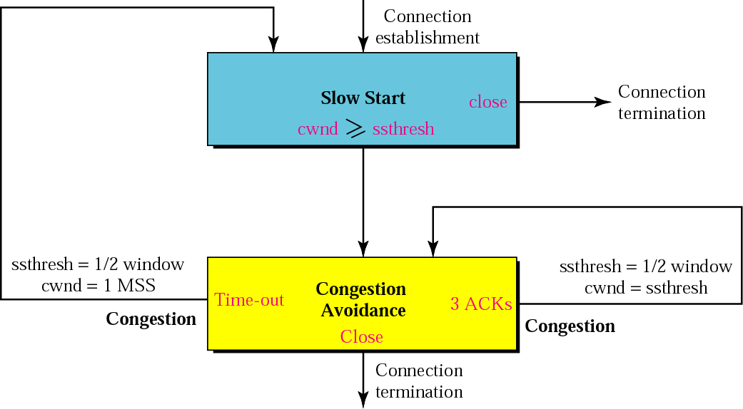
TCP congestion policy summary

Slide 72
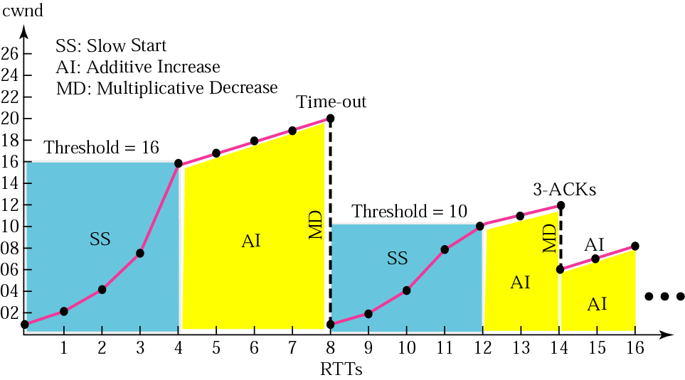
Congestion example

Slide 73
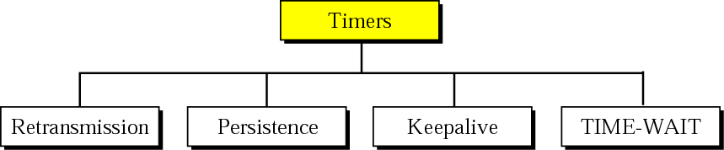
TCP Timers
To perform its operation smoothly, most TCP implementations use at least four timers.
Retransmission Timer
Persistence Timer
Keepalive Timer
TIME-WAIT Timer

Slide 74
TCP Timers
TCP maintains four (4) timers for each connection:
Retransmission Timer:
The timer is started during a transmission. A timeout causes a retransmission
Persist Timer
Ensures that window size information is transmitted even if no data is transmitted
Keepalive Timer
Detects crashes on the other end of the connection
2MSL Timer
Measures the time that a connection has been in the TIME_WAIT state
MSL – Maximum Segment Lifetime

Slide 75
Retransmission Timer (RT Timer)
Setting the RT timer
When a segment is sent and RT timer is not running, start RT timer with RTO value
Turn off RT timer, when all data is acknowledged
When an ACK is received for new data, reset the RT timer to RTO value
RT timer expires
Retransmit the earliest segment that has not been acknowledged
Double value of RTO (see Karn’s rule)
Start the RT timer with RTO value
Notes:
Retransmission too short – Unnecessary retransmission
Retransmission too long – Reduce performance
Set retransmission slightly larger than Round Trip Time (RTT)
Ping www.tcpipguide.com

Slide 76
TCP Round Trip Time Calculation
RFC 2988 “ Computing TCP’s Retransmission Timer”
RTT_{new} = ( α * RTT_{old}) + (( 1- α) * RTT_{measured} )
α | RTT
 | 0 | 1 | 2 | 3 | 4 | 5
 | 1.500 | 2.000 | 2.500 | 3.000 | 3.500 | 4.000
1 | 1.500 | 1.500 | 1.500 | 1.500 | 1.500 | 1.500
2 | 1.500 | 1.625 | 1.844 | 2.133 | 2.475 | 2.856
3 | 1.500 | 1.750 | 2.125 | 2.563 | 3.031 | 3.516
4 | 1.500 | 1.875 | 2.344 | 2.836 | 3.334 | 3.833
5 | 1.500 | 2.000 | 2.500 | 3.000 | 3.500 | 4.000

Slide 77
Acknowledgement Ambiguity
Problem: Cannot distinguish original segment from retransmitted segments when receiving an acknowledgement.
This affects the correctness of RTT calculation.
Karn’s Algorithm
Do not measure RTT for any segments that are retransmitted
Timer Backoff – Increase retransmission time for every retransmitted packet
Keep the longer retransmission time until a valid RTT can be measured on a segment that is sent and acked without retransmission

Slide 78
TCP Persist Timer
Assume the window size goes down to zero and the ACK that opens the window gets lost
If ACK (see figure) is lost, both sides are blocked.
Persist Timer:
Forces that the sender periodically queries the receiver about its window size (window probes)

Slide 79
TCP Persist Timer
The persist timer is started by the sender when the sliding window is zero
Persist timer uses exponential backoff (initial value is 1.5 seconds) rounded to the range [5 sec, 60sec]
So the time interval between timeouts are at:
5, 5, 6, 12, 24, 48, 60, 60, ...
The window probe packet contains one byte of data (TCP can do this even if the window size is zero)

Slide 80
TCP Persist Timer

Slide 81
TCP Keepalive Timer
When a TCP connection has been idle for a long time (1 min – 2 hours), a Keepalive timer reminds a station to check if the other side is still there.
A segment wihtout data is sent if the connection has been idle for 2 hours
Assume a probe has been sent from A to B:
(1) B is up and running: B responds with an ACK (2) B has crashed and is down: A will send 10 more probes, each 75 seconds apart. If A does not get a response, it will close the connection
(3) B has rebooted: B will send a RST segment (4) B is up, but unreachable: Looks to A the same as (2)

Slide 82
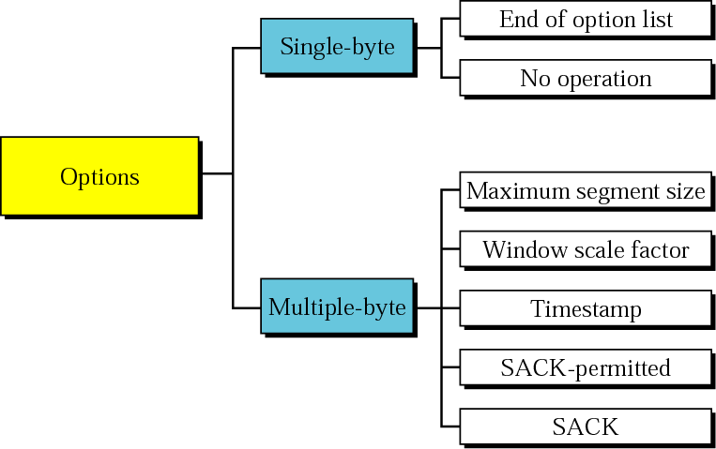
TCP Options
The TCP header can have up to 40 bytes of optional information.

Slide 83
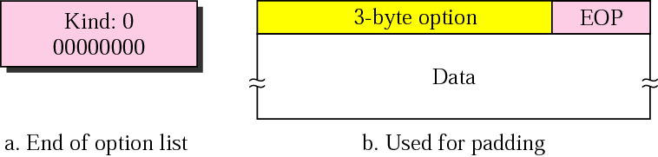
End-of-option option

Slide 84
EOP can be used only once.

Slide 85
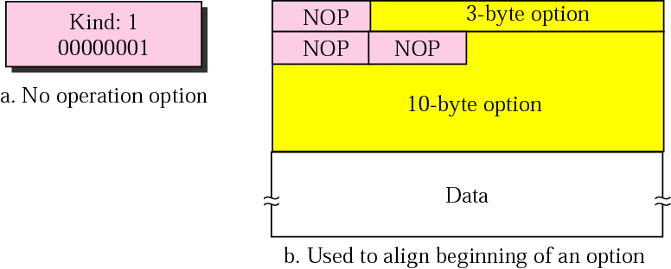
No-operation option
An option may begin on any byte boundary. The TCP header must be padded with zeros to make the header length a multiple of 32 bits.

Slide 86
NOP can be used more than once.

Slide 87
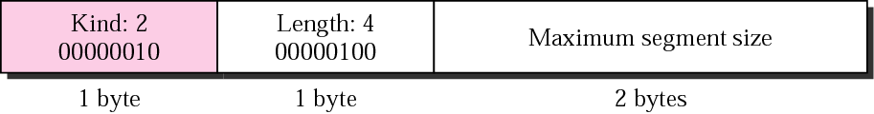
Maximum-segment-size option

Slide 88
The value of MSS is determined during connection establishment and does not change during the connection.

Slide 89
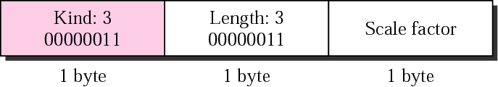
Window-scale-factor option

Slide 90
The value of the window scale factor can be determined only during connection establishment; it does not change during the connection.

Slide 91
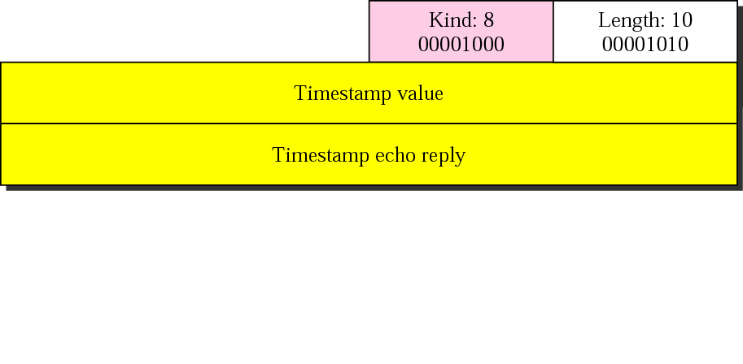
Timestamp option

Slide 92
One application of the timestamp option is the calculation of round trip time (RTT).

Slide 93
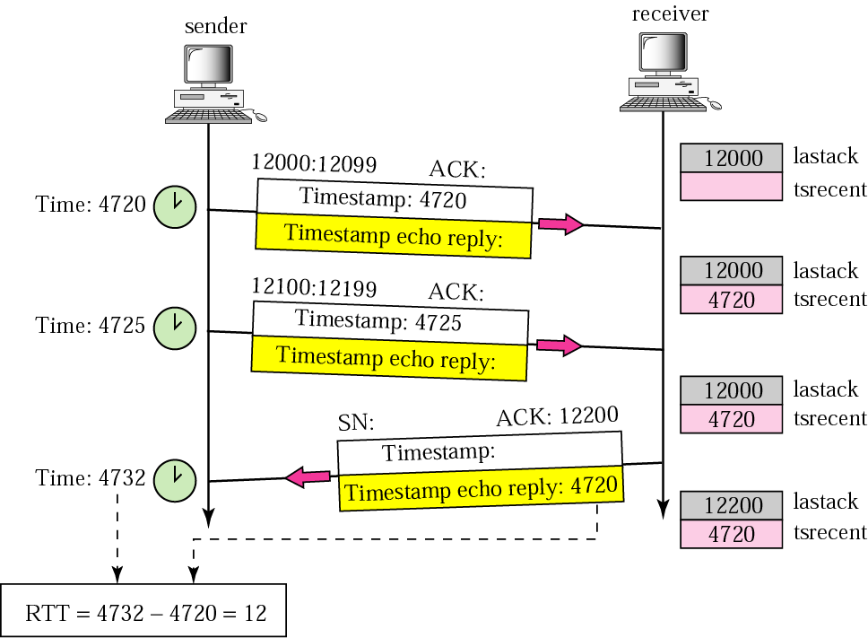
Example 12

Slide 94
The timestamp option can also be used for PAWS – Protection Against Wrapping Sequence Number

Slide 95
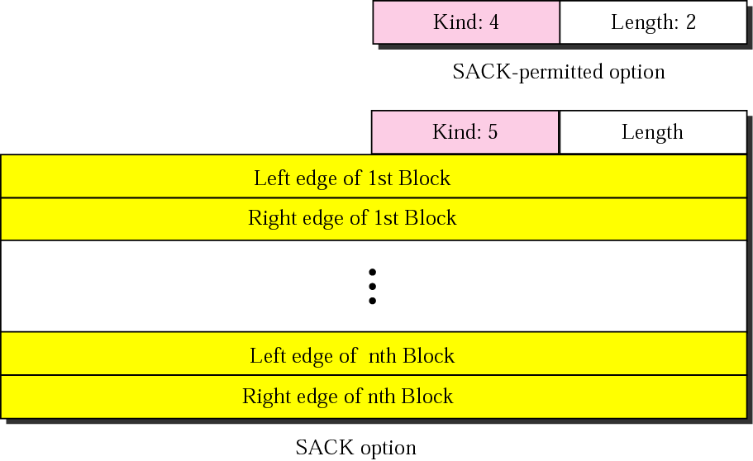
SACK

Slide 96
Example 13
Let us see how the SACK option is used to list out-of-order blocks. In Figure 12.48 an end has received five segments of data.
The first and second segments are in consecutive order. An accumulative acknowledgment can be sent to report the reception of these two segments. Segments 3, 4, and 5, however, are out of order with a gap between the second and third and a gap between the fourth and the fifth. An ACK and a SACK together can easily clear the situation for the sender. The value of ACK is2001, which means that the sender need not worry about bytes 1 to 2000. The SACK has two blocks. The first block announces that bytes 4001 to 6000 have arrived out of order. The second block shows that bytes 8001 to 9000 have also arrived out of order. This means that bytes 2001 to 4000 and bytes 6001 to 8000 are lost or discarded. The sender can resend only these bytes.

Slide 97
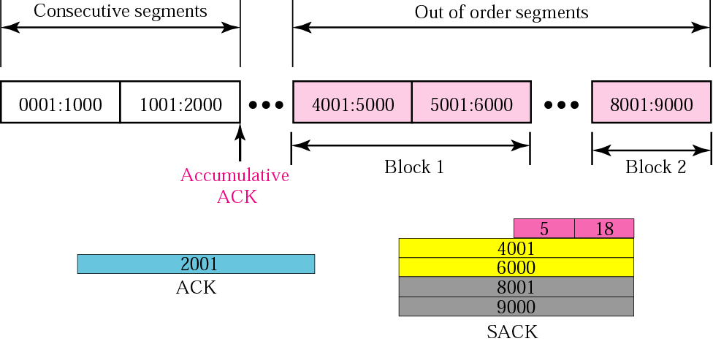
Example 13

Slide 98
Example 14
The example in Figure 12.49 shows how a duplicate segment can be detected with a combination of ACK and SACK. In this case, we have some out-of-order segments (in one block) and one duplicate segment. To show both out-of-order and duplicate data, SACK uses the first block, in this case, to show the duplicate data and other blocks to show out-of-order data. Note that only the first block can be used for duplicate data. The natural question is how the sender, when it receives these ACK and SACK values knows that the first block is for duplicate data (compare this example with the previous example). The answer is that the bytes in the first block are already acknowledged in the ACK field; therefore, this block must be a duplicate.

Slide 99
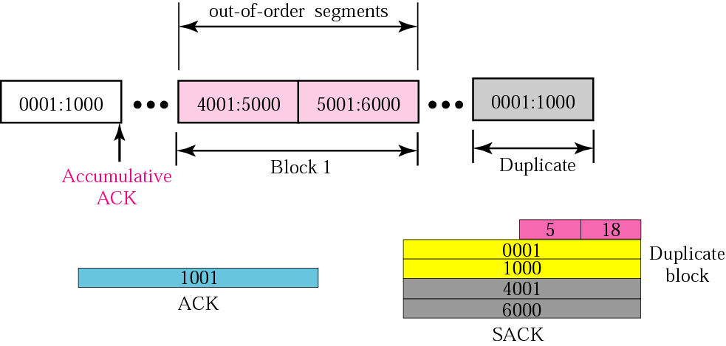
Example 14

Slide 100
Example 15
The example in Figure 12.50 shows what happens if one of the segments in the out-of-order section is also duplicated. In this example, one of the segments (4001:5000) is duplicated. The SACK option announces this duplicate data first and then the out-of-order block. This time, however, the duplicated block is not yet acknowledged by ACK, but because it is part of the out-of-order block (4001:5000 is part of 4001:6000), it is understood by the sender that it defines the duplicate data.

Slide 101
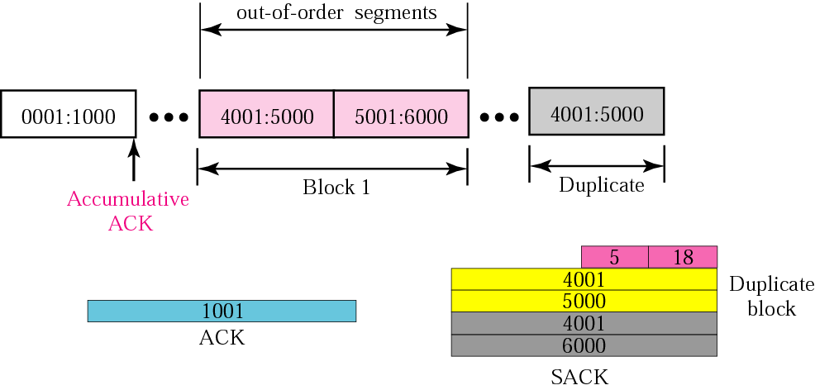
Example 15

Slide 102
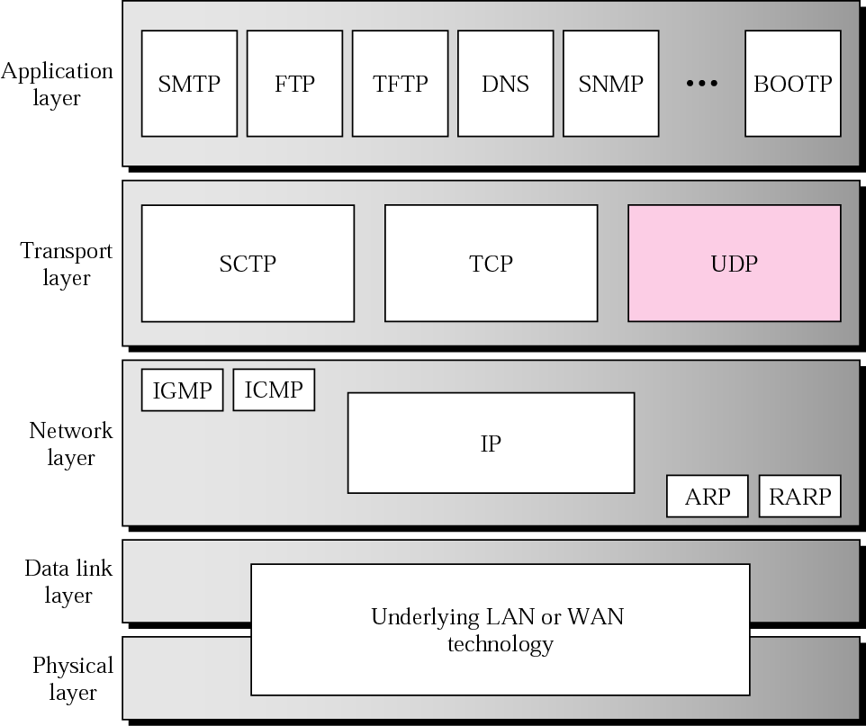
Position of UDP in the TCP/IP protocol suite

Slide 103
PROCESS-TO-PROCESS COMMUNICATIOn
Before we examine UDP, we must first understand host-to-host communication and process-to-process communication and the difference between them.
Port Numbers
Socket Addresses

Slide 104
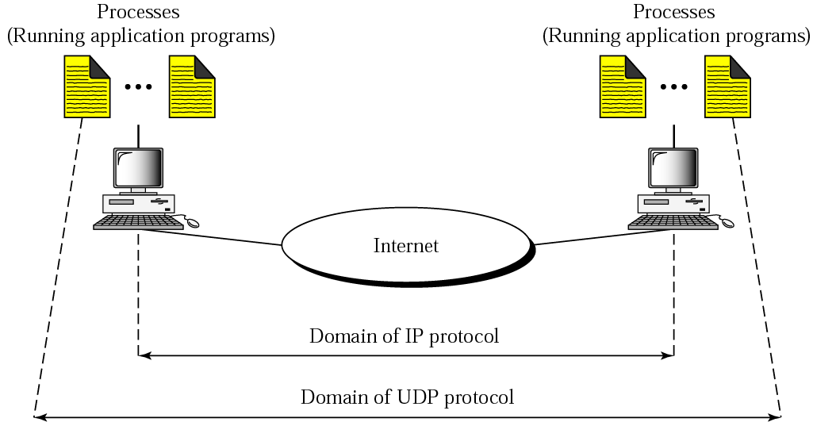
UDP versus IP

Slide 105
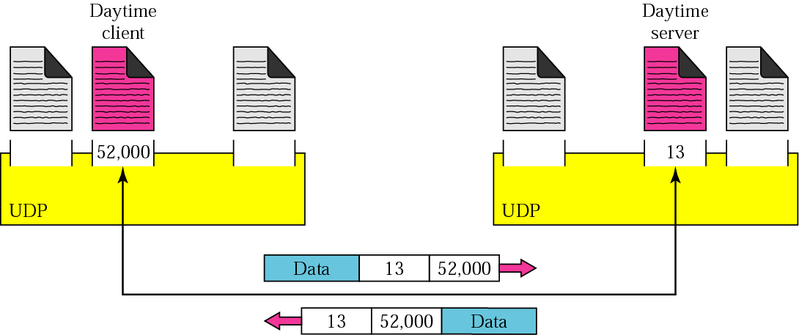
Port numbers

Slide 106
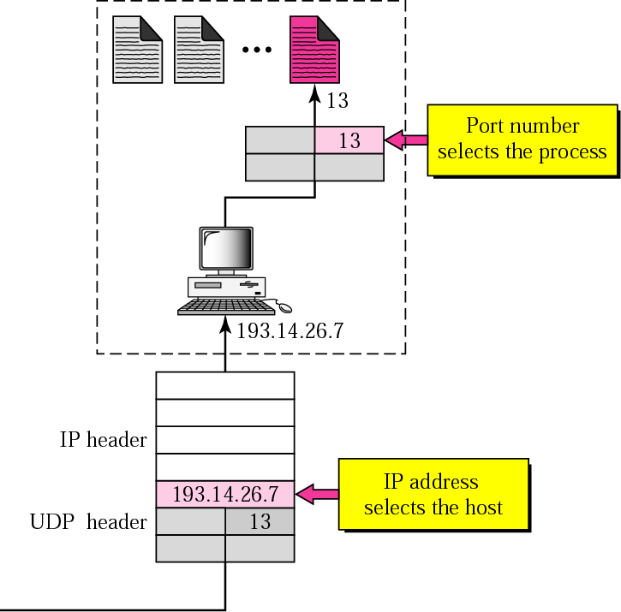
IP addresses versus port numbers

Slide 107
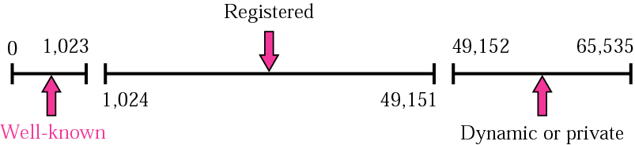
ICANN ranges

Slide 108
The well-known port numbers are less than 1024.

Slide 109
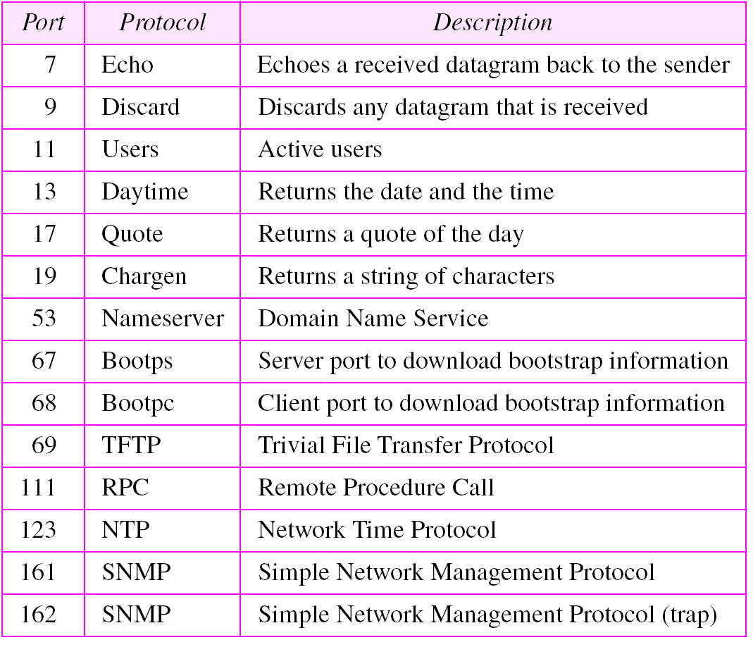
Table 11.1 Well-known ports used with UDP

Slide 110
Example 1
In UNIX, the well-known ports are stored in a file called /etc/services. Each line in this file gives the name of the server and the well-known port number. We can use the grep utility to extract the line corresponding to the desired application. The following shows the port for TFTP. Note TFTP can use port 69 on either UDP or TCP.
$ grep tftp /etc/services tftp 69/tcp tftp 69/udp
See Next Slide

Slide 111
Example 1 (Continued)
SNMP uses two port numbers (161 and 162), each for a different purpose, as we will see in Chapter 21.
$ grep snmp /etc/services snmp 161/tcp #Simple Net Mgmt Proto snmp 161/udp #Simple Net Mgmt Proto snmptrap 162/udp #Traps for SNMP

Slide 112

Socket address

Slide 113

User datagram format
UDP packets are called user datagrams and have a fixed-size header of 8 bytes.

Slide 114
UDP length = IP length − IP header’s length

Slide 115
UDP Checksum
UDP checksum calculation is different from the one for IP and ICMP. Here the checksum includes three sections: a pseudoheader, the UDP header, and the data coming from the application layer.
Checksum Calculation at Sender
Checksum Calculation at Receiver
Optional Use of the Checksum

Slide 116

Pseudoheader for checksum calculation

Slide 117

Checksum calculation of a simple UDP user datagram

Slide 118
UDP OPERATION
Connectionless Services
Flow and Error Control
Encapsulation and Decapsulation
Queuing
Multiplexing and Demultiplexing

Slide 119

Encapsulation and decapsulation

Slide 120

Queues in UDP

Slide 121

Multiplexing and demultiplexing

