Slide 1
CS 540 Computer Networks II
Sandy Wang
sandy.w@svuca.edu

Slide 2
5. Tunnels
Notes:
In this chapter, we look at the underlying technology and protocol architecture
of LANs. Chapters 12 and 13 are devoted to a discussion of specific
LAN systems.

Slide 3
Topics
Overview
LAN Switching
IPv4
IPv6
Tunnels
Routing Protocols -- RIP, RIPng
Routing Protocols -- OSPF
IS-IS
Midterm Exam
BGP
MPLS
Transport Layer -- TCP/UDP
Congestion Control & Quality of Service (QoS)
Access Control List (ACL)
Final Exam

Slide 4
Reference Books
Routing TCP/IP Volume I, 2nd Edition by Jeff Doyle and Jennifer Carroll
ISBN: 1-57870-089-2
Routing TCP/IP Volume II by Jeff Doyle and Jennifer DeHaven ISBN: 1-57870-089-2
Cisco CCNA Routing and Switching ICND2 200-101 Official Cert Guide, Academic Edition by Wendel Odom -- July 10, 2013. ISBN-13: 978-1587144882
The TCP/IP Guide: A Comprehensive, Illustrated Internet Protocols Reference by Charles M. Kozierok – October 1, 2005. ISBN-13: 978-1593270476
CCNA Routing and Switching 200-120 Network Simulator. By Wendell Odom, Sean Wilkins. Published by Pearson IT Certification.
http://class.svuca.edu/~sandy/class/CS540/

Slide 5


Overlay Networks

Slide 6
Overlay Networks
Focus at the application level

Slide 7
IP Tunneling to Build Overlay Links
IP tunnel is a virtual point-to-point link
Illusion of a direct link between two separated nodes
Encapsulation of the packet inside an IP datagram
Node B sends a packet to node E
… containing another packet as the payload
A
B
E
F
Logical view:
tunnel
A
B
E
F
Physical view:

Slide 8
Tunnels Between End Hosts
B
Src: A
Dest: B
Src: C
Dest: B
Src: A
Dest: B
A
C
Src: A
Dest: C
Src: A
Dest: B

Slide 9





From: C
To: D
From: A
From: A
To: B
To: B
C
D
A
B

Slide 10
Overlay Networks
A logical network built on top of a physical network
Overlay links are tunnels through the underlying network
Many logical networks may coexist at once
Over the same underlying network
And providing its own particular service

Slide 11
Common Uses
Carry data over incompatible delivery-networks
Provide a (encrypted) path through a public network
Allowing “some kind” of traffic may lead to “any kind”

Slide 12
Misuse of Network Tunneling
Pre-existing network-based security tools (firewalls, IDS) may not be able to apply the controls to the tunneled traffic
Evading traffic regulation
Lack of host-based security controls
Defense in depth
Inability for ingress and egress filtering
‘Open-ended’ tunnel may forward traffic to other internal hosts

Slide 13
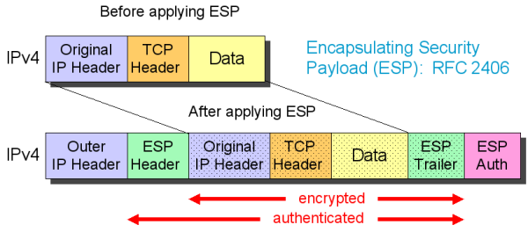
IPSec Tunnel Mode
The original IP packet is encrypted
The ESP header indicates that the entire packet is the payload (IP-in-IP)
Inserts a new IP header (next header is ESP)
Image taken from http://www.free-it.de/archiv/talks_2005/paper-11156/paper-11156.html

Slide 14
IPSec Tunnel Mode
Security services from gateway to gateway or from host to gateway over an insecure network
The entire original packet is encrypted
Internal traffic behind the gateways is not protected
Often used to implement Virtual Private Networks (IPsec VPNs)
Site-to-site
Client-to-site

Slide 15
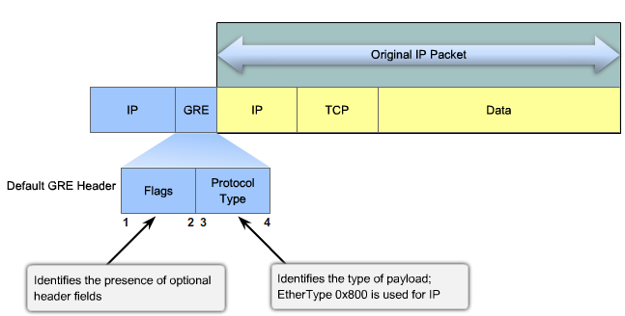
GRE – Generic Routing Encapsulation
“GRE (Generic Routing Encapsulation) specifies a protocol for encapsulation of an arbitrary protocol over another arbitrary network layer protocol” – RFC 2784 and 2890
Point-to-point links
Image taken from http://netwild.ru/pptp/

Slide 16
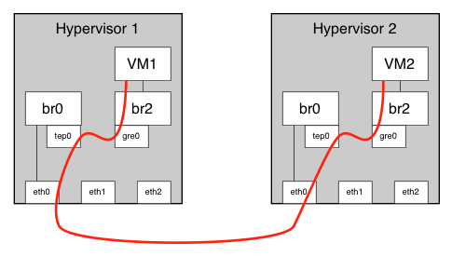
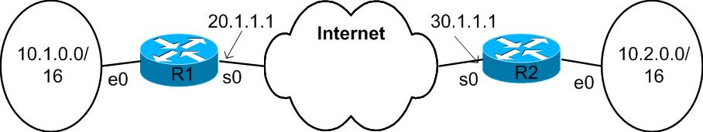
GRE and IP
Ethernet over IPv4/IPv6 (e.g. Openstack Neutron)
Support for tunneling broadcasting/multicasting
e.g. Delivering routing updates to multiple sites
IPv4/IPv6 over IPv4/IPv6
No default encryption/security services
IPSec Tunnel/Transport over GRE

Slide 17
IP Protocol Numbers
Decimal | Hex | Keyword | Protocol
4 | 0x04 | IP-in-IP | IP_in_IP (encapsulation)
41 | 0x29 | IPv6 | IPv6 Encapsulation
47 | 0x2F | GRE | Generic Routing Encapsulation
50 | 0x32 | ESP | Encapsulating Security Payload
51 | 0x33 | AH | Authentication Header

Slide 18
Tunnel Mode and Encapsulation
Tunnel Header
Original Packet
IPv4 Hdr
GRE Hdr
IPv4 Hdr
Data
gre
Proto = 47
Proto = 0x0800
IPv4 Hdr
GRE Hdr
IPv6 Hdr
Data
Proto = 47
Proto = 0x86DD
ipv6ip
IPv4 Hdr
IPv6 Hdr
Data
Proto = 41
ipip
IPv4 Hdr
IPv4 Hdr
Data
Proto = 4

Slide 19



Generic Routing Encapsulation (GRE)
Tunneling
Encapsulation with delivery header
The addresses in the delivery header are the addresses of the head-end and the tail-end of the tunnel
Delivery header
20.1.1.1/30.1.1.1
GRE
10.1.1.1/10.2.1.1
20.1.1.1
30.1.1.1
10.1.1.1/10.2.1.1
Private
network site
tunnel
Private
network site
10.1.0.0/16
Public Network
10.2.0.0/16
10.1.1.1
10.2.1.1

Slide 20
Generic Routing Encapsulation (GRE)
RFC 2784 – Generic Routing Encapsulation
0 1 2 3 4 5 6 7 8 9 0 1 2 3 4 5 6 7 8 9 0 1 2 3 4 5 6 7 8 9 0 1
+-+-+-+-+-+-+-+-+-+-+-+-+-+-+-+-+-+-+-+-+-+-+-+-+-+-+-+-+-+-+-+-+
|C| Reserved0 | Ver | Protocol Type |
+-+-+-+-+-+-+-+-+-+-+-+-+-+-+-+-+-+-+-+-+-+-+-+-+-+-+-+-+-+-+-+-+
| Checksum (optional) | Reserved1 (Optional) |
+-+-+-+-+-+-+-+-+-+-+-+-+-+-+-+-+-+-+-+-+-+-+-+-+-+-+-+-+-+-+-+-+
Protocol Type – EtherType in RFC 1700. Examples below:
EtherType | Protocol
0x0800 | Internet Protocol version 4 (IPv4)
0x0806 | Address Resolution Protocol (ARP)
0x86DD | Internet Protocol Version 6 (IPv6)

Slide 21
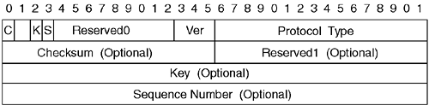
RFC 2890 – Key and Sequence Number Extensions to GRE
GRE Header Format Based on RFC 2784 and the RFC 2890 Enhancements
Key – Identify an individual traffic flow within a tunnel. Packets belonging to a traffic flow are encapsulated using the same Key value and the decapsulating tunnel endpoint identifies packets belonging to a traffic flow based on the Key Field value.
Sequence Number -- inserted by the encapsulator when Sequence Number Present Bit is set. The Sequence Number MUST be used by the receiver to establish the order
Notes:
The interesting fields in this header are as follows:
Flags- The following descriptions are taken from RFC 1701 with comments added for clarification:
- Checksum Present (bit 0)- If the Checksum Present bit is set to 1, the checksum field is present and contains valid information. If either the Checksum Present bit or the Routing Present bit is set, both the Checksum and Offset fields are present in the GRE packet.
- Routing Present (bit 1)- If the Routing Present bit is set to 1, the Offset and Routing fields are present and contain valid information. If either the Checksum Present bit or the RoutingPresent bit is set, both the Checksum and Offset fields are present in the GRE packet.
- Key Present (bit 2)- If the Key Present bit is set to 1, the Key field is present in the GRE header. Otherwise, the Key field is not present in the GRE header.
- Sequence Number Present (bit 3)- If the Sequence Number Present bit is set to 1, the Sequence Number field is present. Otherwise, the Sequence Number field is not present in the GRE header.
- Strict Source Route (bit 4)- It is recommended that this bit be set to 1 only if all the routing information consists of strict source routes.
- Recursion Control (bits 5-7)- Recursion control contains a 3-bit unsigned integer that contains the number of additional encapsulations that are permissible. This should default to 0.
- Version Number (bits 13-15)- The Version Number field must contain the value 0.
Protocol Type- The Protocol Type field contains the protocol type of the packet in the payload of the GRE packet. For example, when IP is the protocol being carried inside the GRE packet, this field is set to 0x800.
Checksum- This field is used to ensure the integrity of the GRE header and the payload packet. It contains an IP checksum of the GRE header and the payload packet.
Key- The Key field contains a number that is used to authenticate the GRE packet's encapsulator. This is a very weak form of security offered by GRE. In essence, the key prevents misconfiguration or injection of packets from a foreign source. The two tunnel endpoints accept GRE packets only with the correct key in the header. The key needs to be manually configured on both the endpoints. This is obviously not a feature to be relied on for security, because as soon as an attacker figures out the key simply by looking at a GRE packet, he or she can generate as authentic a GRE packet as the original encapsulator.
Another use of the key is to identify individual traffic flow within a tunnel. For example, packets might need to be routed based on context information not present in the encapsulated data. The Key field provides this context and defines a logical traffic flow between encapsulator and decapsulator. An example of this is the not very widely-deployed multipoint GRE tunnels. These tunnels require that a key be defined in order for the traffic to be distinguished. For the sake of this chapter, we will focus on the more common point-to-point GRE tunnels.
Sequence Number- The two endpoints can use the sequence number to track the sequence in which packets are being received and optionally drop packets that arrive out of sequence. This is useful when carrying passenger protocols that function poorly when they receive packets out of order (such as LLC2-based protocols).
Routing- The Routing field lists Source Route Entries (SREs). This field is not very commonly used. It is used when there is a need to do source routing on GRE packets.

Slide 22
Generic Routing Encapsulation (GRE)
IP access of the tunnel through the tunnel interface
20.1.1.1/30.1.1.1 GRE 10.1.1.1/10.2.1.1
Gateway
Gateway
serial 0/0
20.1.1.1
Internet
30.1.1.1
serial 0/0
tunnel 0
tunnel 0
e0
10.1.1.1/10.2.1.1
e0
10.1.1.1/10.2.1.1
10.1.1.1/10.2.1.1
10.1.0.0/16
10.2.0.0/16
Customer Sites

Slide 23
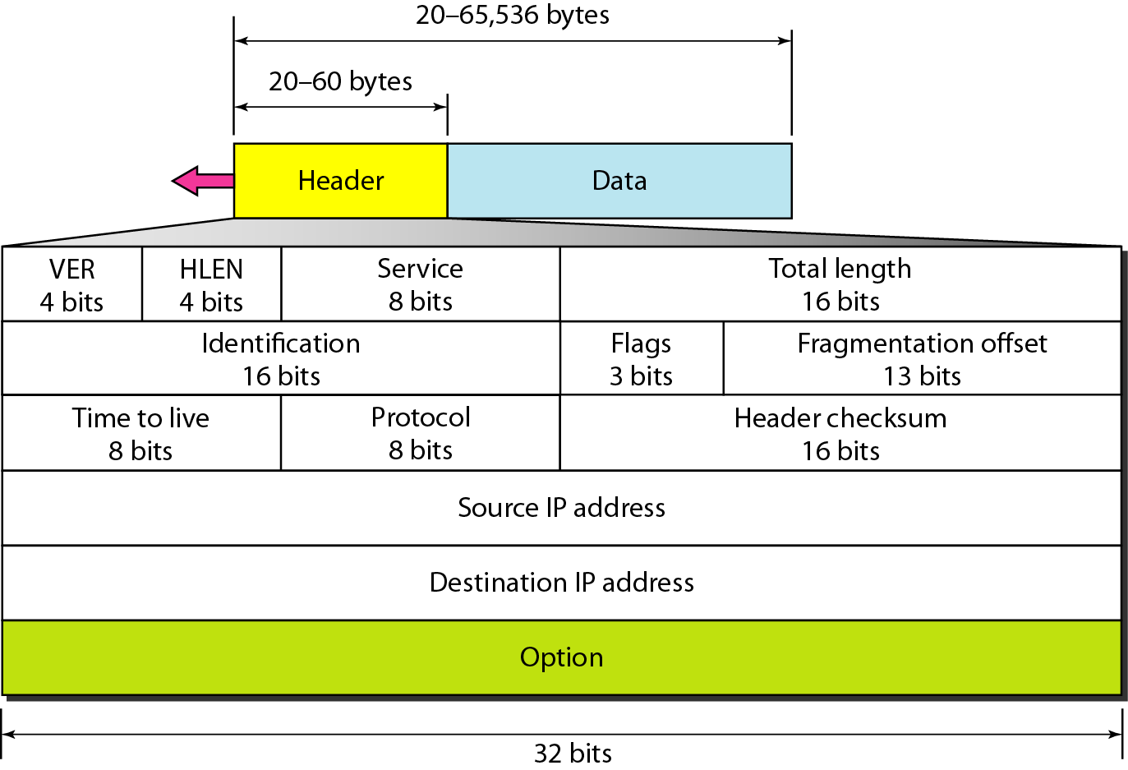
Encapsulation
4
5
8
1420
100
4
20.1.1.1
301.1.1
4
5
8
1400
100
6
10.1.1.1
10.2.1.1

Slide 24
Decapsulation
4
5
8
1420
80
4
20.1.1.1
301.1.1
4
5
8
1400
100
6
10.1.1.1
10.2.1.1

Slide 25
Generic Routing Encapsulation (GRE)
interface tunnel0
mode GRE
tunnel source 20.1.1.1
tunnel destination 30.1.1.1
!
ip route 10.2.0.0 255.255.0.0 tunnel0
interface tunnel0
mode GRE
tunnel source 30.1.1.1
tunnel destination 20.1.1.1
!
ip route 10.1.0.0 255.255.0.0 tunnel0
Routing table of R1
Routing table of R2
10.1.0.0/16 e0
20.1.1.1/30 s0
10.2.0.0/16 tunnel0
0.0.0.0/0 s0
10.2.0.0/16 e0
30.1.1.1/30 s0
10.1.0.0/16 tunnel0
0.0.0.0/0 s0

Slide 26
Generic Routing Encapsulation (GRE)
Tunneling mechanism at IP
Outbound traffic
Routing table of R1
20.1.1.1/30.1.1.1
10.1.0.0/16 e0
20.1.1.1/30 s0
10.2.0.0/16 tunnel0
0.0.0.0/0 s0
(6)
(3)
IP
GRE
(7)
(4)
(2)
(5)
(8)
s0
e0
…
Tunnel0
(9)
(1)
20.1.1.1/30.1.1.1 [10.1.1.1/10.2.1.1]
10.1.1.1/10.2.1.1

Slide 27
Generic Routing Encapsulation (GRE)
Inbound traffic
Routing table of R2
10.2.0.0/16 e0
30.1.1.1/30 s0
10.2.0.0/16 tunnel0
0.0.0.0/0 s0
(6)
(3)
IP
GRE
(2)
(7)
(5)
(4)
10.1.1.1/10.2.1.1
s0
e0
…
Tunnel
0
(1)
(8)
20.1.1.1/30.1.1.1 [10.1.1.1/10.2.1.1]
10.1.1.1/10.2.1.1

Slide 28
IP Tunnel Example -- Linux
ip [ OPTIONS ] tunnel { COMMAND | help }
ip tunnel { add | change | del | show | prl } [ NAME ]
[ mode MODE ] [ remote ADDR ] [ local ADDR ]
[ [i|o]seq ] [ [i|o]key KEY ] [ [i|o]csum ] ]
[ encaplimit ELIM ] [ ttl TTL ]
[ tos TOS ] [ flowlabel FLOWLABEL ]
[ prl-default ADDR ] [ prl-nodefault ADDR ] [ prl-delete ADDR]
[ [no]pmtudisc ] [ dev PHYS_DEV ]

Slide 29
IP Tunnel Example -- Linux
MODE := { ipip | gre | sit | isatap | ip6ip6 | ipip6 | ip6gre | any }
ADDR := { IP_ADDRESS | any }
TOS := { STRING | 00..ff | inherit | inherit/STRING | inherit/00..ff}
ELIM := { none | 0..255 }
TTL := { 1..255 | inherit }
KEY := { DOTTED_QUAD | NUMBER }
TIME := NUMBER[s|ms]

Slide 30
Transformation From IPv4 to IPv6
27.3 TRANSITION FROM IPv4 TO IPv6
Three strategies have been devised by the IETF to provide for a smooth transition from IPv4 to IPv6.
The topics discussed in this section include:
Dual Stack
Tunneling
Header Translation

Slide 31
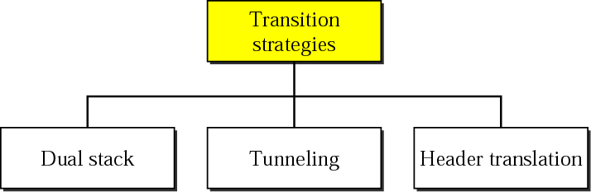
Three transition strategies

Slide 32
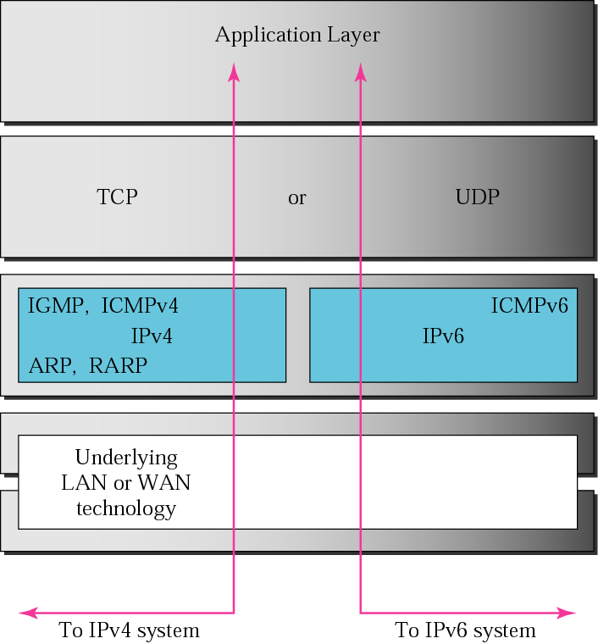
Dual stack

Slide 33
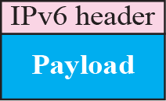
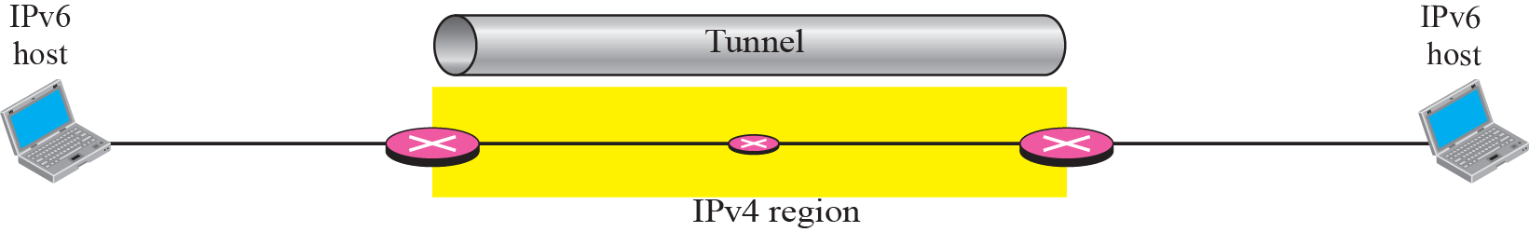
Tunneling strategy

Slide 34
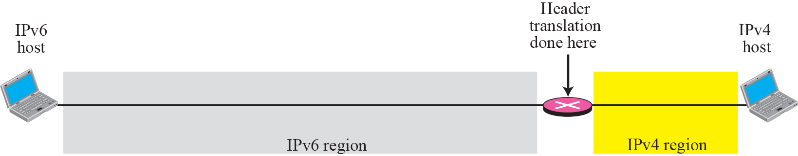
Header translation strategy

Slide 35
Naming Services
DNS must be included in transition strategy
Resolving Names:
IPv4 specifies “A” records
IPv6 specifies “AAAA” records
Applications should be aware of both records
Will require development update and thorough testing
Tools like “Scrubber” by Sun make it easy

Slide 36
Naming Services
Querying DNS server

Slide 37
IPv6 over IPv4 Transition Mechanisms
Tunnel Brokers provide a network tunneling service
6in4 – IPv6 over IPv4
Configured Tunnel
6to4 Tunnel
ISATAP
6RD Tunnel
Teredo – IPv6 over UDP over IPv4
…and others

Slide 38
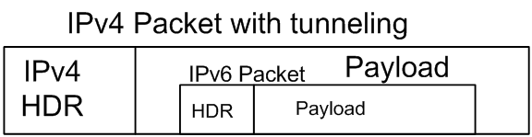
Manually Configured Tunnels
Manually configured tunnels are logical tunnels formed when one protocol version packet is encapsulated in the payload of another version packet
e.g. IPv4 encapsulated in IPv6 or IPv6 encapsulated in IPv4

Slide 39
Configured Tunnel-building
Configured tunnels require static IPv4 addresses
Configured tunnels are generally setup and maintained by a network administrator
Configured tunnels are a proven IPv6 deployment technique and provide stable links

Slide 40
Configured Tunnel -- Configuration
interface tunnel0
tunnel mode ipv6ip
tunnel source 192.1.2.1
tunnel destination 170.121.99.1
ipv6 address 2001:db80:e100:2::1/64
interface tunnel0
tunnel mode ipv6ip
tunnel source 170.121.99.1
tunnel destination 192.1.2.1
ipv6 address 2001:db80:e100:2::2/64
2001:db80:e100:2::/64 → tunnel0

Slide 41
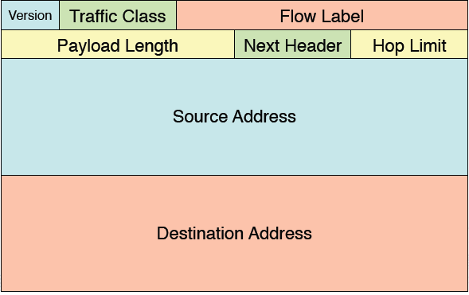
Encapsulation
4
5
1460
TTL from inner or configured
TOS from inner or configured
41
192.1.2.1
170.121.99.1
8
1400
6
100
2001:DB80:E100:2::100
2001:DB80:E100:2::200

Slide 42
Potential Tunnel Issues
MTU fragmentation
ICMPv4 error handling
Filtering protocol 41
NAT (Network Address Translation)

Slide 43

interface tunnelAB
tunnel source 100.0.0.1
tunnel destination 101.0.0.1
!
interface tunnelAC
tunnel source 100.0.0.1
tunnel destination 103.0.0.1
!
interface tunnelAD
tunnel source 100.0.0.1
tunnel destination 104.0.0.1
interface tunnelBA
tunnel source 101.0.0.1
tunnel destination 100.0.0.1
!
interface tunnelBC
tunnel source 101.0.0.1
tunnel destination 103.0.0.1
!
interface tunnelBD
tunnel source 101.0.0.1
tunnel destination 104.0.0.1
172.17.0.0/16
172.18.0.0/16
100.0.0.1
101.0.0.1
A
B
Tunnel AB
Tunnel AD
Tunnel BC
Tunnel AC
Tunnel BD
Tunnel CD
interface tunnelCA
tunnel source 103.0.0.1
tunnel destination 100.0.0.1
!
interface tunnelCB
tunnel source 103.0.0.1
tunnel destination 101.0.0.1
!
interface tunnelCD
tunnel source 103.0.0.1
tunnel destination 104.0.0.1
C
D
interface tunnelDA
tunnel source 104.0.0.1
tunnel destination 100.0.0.1
!
interface tunnelDC
tunnel source 104.0.0.1
tunnel destination 103.0.0.1
!
interface tunnelDB
tunnel source 104.0.0.1
tunnel destination 101.0.0.1
103.0.0.1
104.0.0.1
172.19.0.0/16
172.20.0.0/16

Slide 44
172.17.0.0/16
172.18.0.0/16
interface tunnelB
tunnel source 101.0.0.1
100.0.0.1
101.0.0.1
A
B
interface tunnelA
tunnel source 100.0.0.1
!
Tunnel A
Tunnel B
interface tunnelC
tunnel source 103.0.0.1
Tunnel C
Tunnel D
C
D
103.0.0.1
104.0.0.1
172.19.0.0/16
interface tunnelD
tunnel source 104.0.0.1
172.20.0.0/16

Slide 45
ISATAP
ISATAP (Intra-Site Automatic Tunneling Addressing Protocol) an automatic tunneling mechanism used inside an organization that has an IPv4-dominant backbone, but has selected users that need IPv6 capability

Slide 46
ISATAP Functions
ISATAP connects dual-stack nodes, isolated within an IPv4-only network
To exchange IPv6 traffic with each other (host ISATAP)
To exchange traffic with the global IPv6 Internet
ISATAP is a mechanism with minimal configuration required
ISATAP is ideal when there are relatively few, relatively scattered individual nodes that need service

Slide 47
Link-Local ISATAP

Slide 48
Link-local ISATAP example
Two ISATAP hosts exchanging packets using link-local addresses
Only route on ISATAP hosts is “send all IPv6 traffic via ISATAP pseudo-IF”
Hosts are many IPv4 hops away which appear link-local to IPv6
FE80::5EFE:192.0.2.100
=
FE80::5EFE:C000:0264
FE80::5EFE:192.0.2.200
=
FE80::5EFE:C000:02C8

Slide 49
FE80::5EFE:192.0.2.100
=
FE80::5EFE:C000:0264
FE80::5EFE:192.0.2.200
=
FE80::5EFE:C000:02C8
src: 192.0.1.100
dst: 192.0.2.200
src: FE80::5EFE:C000:0264
dst: FE80::5EFE:C000:02C8

Slide 50

FE80::5EFE:192.0.2.10
=
FE80::5EFE:C000:020A
FE80::5EFE:192.0.2.100
=
FE80::5EFE:C000:0264
FE80::5EFE:192.0.2.200
=
FE80::5EFE:C000:02C8
src: 192.0.1.100
dst: 192.0.2.10
src: FE80::5EFE:C000:0264
dst: FE80::5EFE:C000:020A

Slide 51
IPv4 Network
ISATAP Tunnel
B
192.0.1.100
192.0.1.1
FE80::5EFE:C200:0164
Src: FE80::5EFE:C200:0164
Dst: FE80::5EFE:C200:0101

Slide 52
Globally-routable ISATAP
ISATAP more flexible when using an ISATAP router
ISATAP hosts are configured with ISATAP router IPv4 address
Hosts sends router solicitation, inside tunnel, and ISATAP router responds
192.0.2.100/25
FE80::5EFE:192.0.2.100
2001:DB80:A:B::5EFE:C000:0264
ISATAP Router: 192.0.2.1
192.0.2.200/25
FE80::5EFE:192.0.2.200
2001:DB80:A:B::5EFE:C000:02C8
ISATAP router: 192.0.2.1
Notes:
IPv4 routing is aware of ISATAP router (address block allocation)
Tunnel uses local-link and application can use global-scope address

Slide 53
ISATAP Summary
ISATAP scales better than manually configured tunnels inside the enterprise
Decapsulate-from-anywhere issues (like 6to4) mitigated by internal deployment
No authentication provided – any dual stack node that knows ISATAP router address can obtain services
May need to look at other alternatives if security is required

Slide 54
IPv6 6to4 Transition Mechanism
6to4 is an automatic tunneling mechanism that provides v6 capability to a dual-stack node or v6-capable site that has only IPv4 connectivity to the site

Slide 55
6to4 Basics
6to4 is an automatic tunnel mechanism
Provides v6 upstream for v6-capable site over v4-only Internet connection
Uses embedded addressing (v4addr embedded in v6addr) as do other automatic mechanisms

Slide 56
6to4 Address Construction
6to4 setups a valid, unique /48 IPv6 prefix from the outside IPv4 address of the site router

Slide 57
Encapsulation
4
5
1460
TTL from inner or configured
TOS from inner or configured
41
192.0.2.75
192.0.2.150
8
1400
6
100
2002:C000:024B:20E::45
2002:C000:0296:a7::61

Slide 58
2002:6400:1::/48
interface tunnelB
tunnel mode ipv6ip 6to4
tunnel source 101.0.0.1
2002::/16 → tunnelB
2002:6500:1::/48
100.0.0.1
101.0.0.1
A
B
interface tunnelA
tunnel mode ipv6ip 6to4
tunnel source 100.0.0.1
!
2002::/16 → tunnelA
Tunnel A
Tunnel B
interface tunnelD
tunnel mode ipv6ip 6to4
tunnel source 104.0.0.1
2002::/16 → tunnelD
interface tunnelC
tunnel mode ipv6ip 6to4
tunnel source 103.0.0.1
2002::/16 → tunnelC
Tunnel C
Tunnel D
C
D
103.0.0.1
104.0.0.1
2002:6700:0001::/48
2002:6800:0001::/48

Slide 59

Site A
2002:C000:296:B1::/64 → e1
2002:C000:296:B2::/64 → e2
2002::/16 → tunnelAB
Site B
2002:c000:24B::/48
2002:c000:296::/48
Site A1
Site B1
2002:c000:024B:20E::/64
2002:c000:0296:B1::/64
IPv4 Network
e1
e1
2002:C000:024B:20E::1
A
tunnelAB
B
2002:C000:0296:B1::1
e2
e2
192.0.2.75/25
192.0.2.150/25
Site B2
2002:c000:024B:30E::/64
2002:c000:0296:B2::/64
Site A2
2002:C000:24B:20E::/64 → e1
2002:C000:24B:30E::/64 → e2
2002::/16 → tunnelAB
2002:C000:024B:30E::1
2002:C000:0296:B2::1

Slide 60
Site A
2002:C000:296:B1::/64 → e1
2002:C000:296:B2::/64 → e2
2002::/16 → tunnelAB
Site B
Site A1
Site B1
IPv4 Network
e1
e1
2002:C000:024B:20E::1
A
tunnelAB
B
2002:C000:0296:B1::1
e2
e2
192.0.2.75/25
192.0.2.150/25
Site B2
Site A2
2002:C000:24B:20E::/64 → e1
2002:C000:24B:30E::/64 → e2
2002::/16 → tunnelAB
2002:C000:024B:30E::1
2002:C000:0296:B2::1
Src: 2002:C000:024B:30E::1
Dst: 2002:C000:024B:20E::1
Src: 2002:C000:024B:30E::1
Dst: 2002:C000:0296:B2::1

Slide 61
6RD Tunnel
IPv6 Rapid Deployment on IPv4 Infrastructures (6rd) – RFC 5969
Utilize an SP's own IPv6 address prefix rather than a well-known prefix (2002::/16)

Slide 62
6RD Address Format
6rd delegated prefix
IPv4 addr bits
Subnet ID
Intf ID
N bits
M bits
Z bits
64 bits
N + M + Z = 64 bits
Common prefix
IPv4 addr bits
Common Suffix
Parameter | Value
6rd Prefix/length | 2001:DB8::/32
IPv4 Common prefix/length | 10.1.0.0/16
IPv4 Common suffix/length | 0.0.0.1/8

Slide 63
6rd Prefix 2001:DB8::/32
IPv4 common prefix: 10.1.0.0/16
IPv4 common suffix: 0.0.0.1/8
2001:DB8:0100:/40
2001:DB8:0300:/40
10.1.1.1/16
10.1.3.1/16
IPv6
CE1
BR
IPv4 Network
CE2
IPv6
IPv4
10.1.2.1/16
2001:DB8:0200:/40
IPv6: 2001:DB8:0100::C15C:0 → 2001:DB8:0200::C26B:0
IPv4: 10.1.1.1 → 10.1.2.1

Slide 64
6rd Prefix 2001:DB8::/32
IPv4 common prefix: 10.1.0.0/16
IPv4 common suffix: 0.0.0.1/8
2001:DB8:0100:/40
2001:DB8:0300:/40
10.1.1.1/16
10.1.3.1/16
IPv6
CE1
BR
IPv4 Network
CE2
10.1.2.1/16
2001:DB8:0200:/40
2001:DB8::/32 Tunnel0
::/0 2001:BABE::1
2001:DB8::/32 Tunnel0
::/0 Tunnel0 or
::/0 2001:DB8:0300::D55C:3

Slide 65
IPv6 Tunnel Address Format
64 bytes
64 bytes
ISATAP
0000: 5EFE :XXXX:XXXX
48 bytes
6to4
2002 :XXXX:XXXX
Interface ID
Proto = 41
6RD
XX
Interface ID
N bits
M bits
Z bits
N + M + Z = 64 bits

