Slide 1

Bringing Life
to the Last Mile.
Camp Life, City Standard
Food Service
One trusted partner. Multiple integrated solutions.
Facility Management
Workforce Solutions

Slide 2
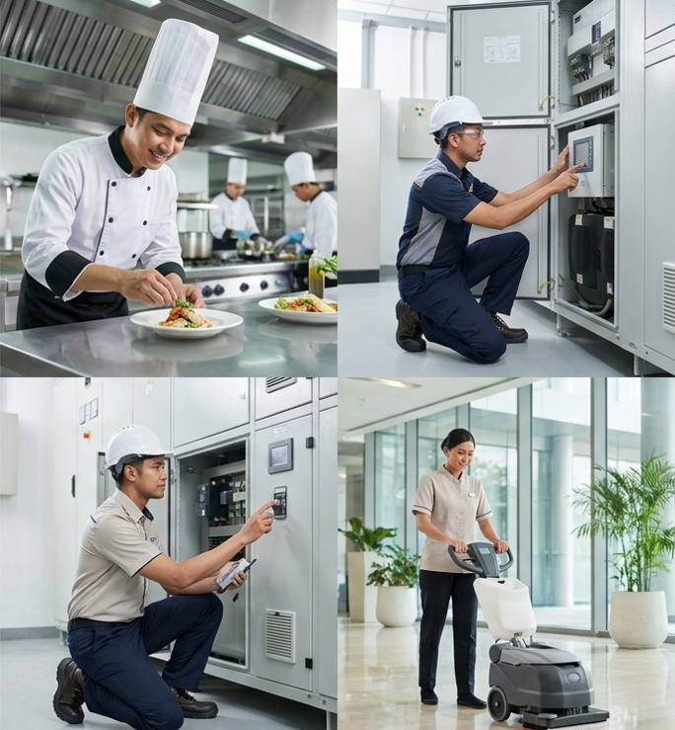

About Sunshine Facility Management
More Than a Decade of Operational Excellence.
One Integrated Solution Partner
For over 10 years, Sunshine has built a strong track record in delivering reliable operational services across Indonesia, earning the trust of leading organizations through food service excellence, operational expertise, and a commitment to quality.
Building on this foundation, we have evolved into Sunshine Facility Group—an integrated facility solutions partner delivering Food Services, Technical Services, Soft Services, and Supply Chain Solutions through one trusted platform.
Today, we support clients across healthcare, corporate, retail, industrial, hospitality, and institutional sectors, helping them simplify operations and achieve consistent, high-quality performance.
Simplifying operations | Delivering excellence | Enhancing workplaces.

Slide 3


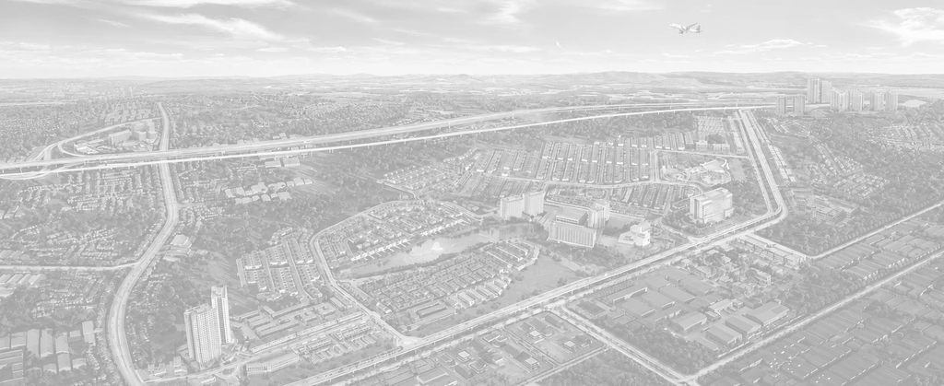
Our Journey
Today
From Food Expertise to Integrated Facility Solutions.
Sunshine Facility Group
Delivering end-to-end integrated facility solutions beyond food.
This evolution is supported by SFG's expansion from catering into broader support and facility services over the
past decade.
2015
2017-2020
2021–2024
2025
Healthcare
Catering
Corporate
Catering
Operations
& Technology
Facilities
& Partnerships
Established as Sunshine Food Group with a focus on healthcare catering.
Expanded into corporate catering and industrial catering services.
Strengthened nutrition expertise, kitchen management, coffee solutions and digital operational systems.
Expanded facility support capabilities through strategic partnerships and integrated services.

Slide 4














Supporting retail food operations from concept to execution
Supporting facility readiness through engineering collaboration
Powered by
One of Indonesia's Strongest Business Ecosystems.
Food and
Lifestyle
EPC
Large-scale retail operational support and food solutions
Clinical nutrition
and hospital food operations
Retail
Healthcare
Education
Hospitality
Our experience across multiple industries allows us to understand diverse operational needs.
Supporting the development of Indonesia’s education landscape through leading school and higher education
Supporting quality dining and operational services across hospitality environments
Financial
Services
Part of Lippo Indonesia.
Built for Integrated Operations.
Supporting integrated business ecosystems

Slide 5
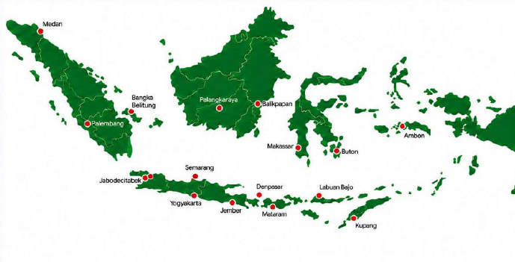
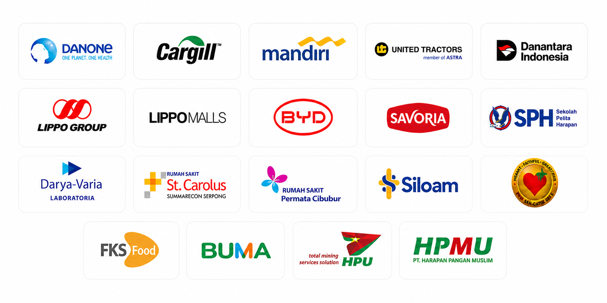
SFG IN INDONESIA
Serving Clients Across Indonesia
Trusted by Leading Organizations
18+
Cities
10+
Years Experienced
1.000+
Employees
05

Slide 6


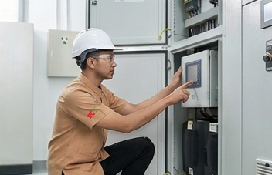
Three Integrated Services.
One Trusted Partner.
Soft
Services
Cleaning
& hygiene
Security
& safety
Workspace management
Property
management
Food
Services
Technical design
& consultancy
High-volume canteen
High-end
catering
Modular café design & operation
Technical Services and Maintenance
Predictive & preventive maintenance
Facilities & utilities maintenances
Upgrade, retrofit & technical projects
Energy
optimization

Slide 7









Food Services
30+
projects
End-to-End
Food Service Solutions.
10+ years
experienced
Delivering safe, nutritious and operationally efficient food services across industries.
5 million+
meals served annually
Kitchen Operations | Catering Services
Kitchen Management Kitchen Design & Layout Kitchen Equipment Planning Coffee & Pantry Management Restaurant & Cafeteria Management | Healthcare Corporate Industrial Events
80+
dietitian
Nutrition & Wellness | Food Technology
Clinical Nutrition Dietitian Consultancy Menu Engineering Special Diet Programs | Hospital Ordering System CRM & Ticketing Digital Kitchen Solutions
200+
cook
1 corporate RND chef
6 cluster culinary chef
Powered by Hands-On Brand Experience
10 head chef

Slide 8
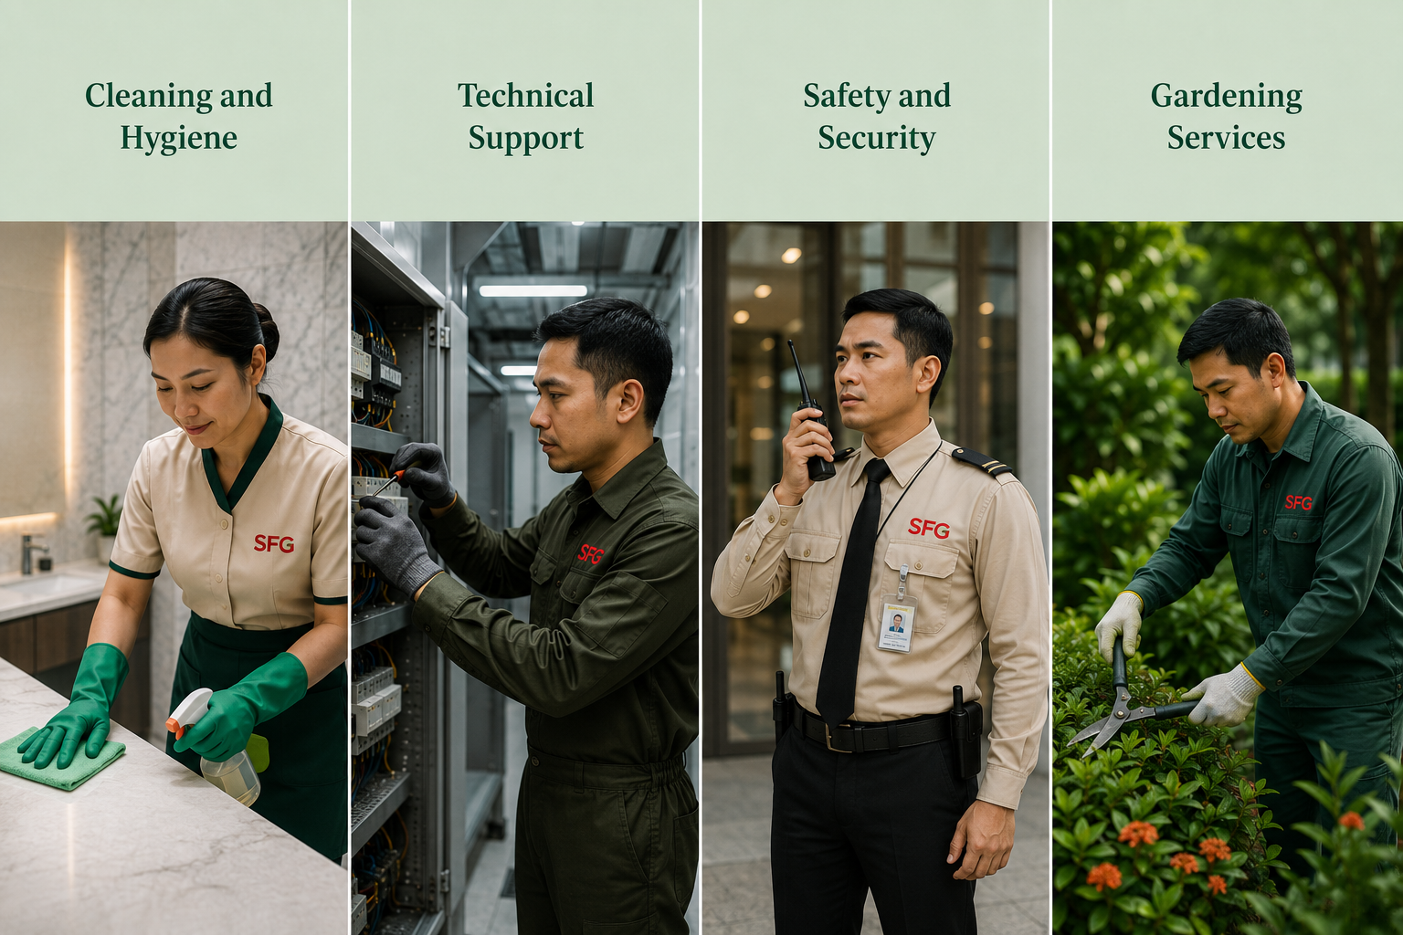
Facility Management
Keeping Facilities Running
at Their Best.
Cleaning and Hygiene
Technical Support
Safety and Security
Environmental Services
Daily Cleaning Deep Cleaning Healthcare Cleaning Waste Management
Kitchen Equipment Maintenance Preventive Maintenance Facility Maintenance
Access & Security Management Security Surveillance Fire Safety & Prevention Visitor & Front-of-House Management
Pest Control Waste & Recycling Sustainability Support Gardening
Notes:
Saftey & Security (explanationd ibawahnya)

Slide 9







Workforce Solutions
Empowering businesses
with the people, processes,
and technology to perform at scale.
Your operations. Our people. One seamless workforce solution.
01. | Recruitment and Selection
Sourcing, screening, and selecting qualified personnel based on role requirements, operational standards, and client needs.
02. | Workforce Deployment
Efficient placement and onboarding of personnel across multiple locations, functions, and operational environments.
03. | Training and Development
Role-specific training, service standards, safety protocols, and continuous capability development.
04. | Workforce Management
Managing attendance, shifts, staffing requirements, documentation, and day-to-day workforce administration.
05. | Performance Management
Monitoring workforce performance through defined KPIs, regular evaluations, and continuous improvement programs.
06. | Payroll and Administration
Streamlining payroll, employment documentation, and workforce administration for greater accuracy and operational efficiency.
07. | Digital Workforce Management
Technology-enabled visibility across attendance, scheduling, workforce performance, and operational reporting

Slide 10


Integrated Supply Chain Excellence.
Delivering operational consistency through an integrated supply chain
that connects procurement, production, logistics, and on-site execution.
Kalimantan
Pontianak
Palangkaraya
Banjarmasin
Balikpapan
Samarinda
Sulawesi
Manado
Palu
Makassar
Kendari
60
Retail Distribution
5
Distribution Hubs
Sumatra
Banda Aceh
Medan
Pekanbaru
Padang
Jambi
Palembang
Bengkulu
Bandar Lampung
Batam
Pangkal Pinang
Makassar
Cibitung
Porong
(Surabaya)
Timika
(Lowland & Highland)
Balaraja
Java
Jakarta Bekasi Bogor Depok Tangerang Cilegon Serang | Karawang Bandung Cirebon Pekalongan Semarang Yogyakarta Solo | Madiun Kediri Malang Surabaya Sidoarjo Gresik Jember
Bali & Nusa Tenggara
Denpasar
Mataram
Kupang
Maluku & Papua
Ambon
Ternate
Jayapura
Sorong

