Slide 1
Final Project:
Predicting Hospital Readmission Rates for Diabetes
CS109a: Introduction to Data Science
Team members: Karim Gowani
Ryan McGillicuddy
Yaseen Mohmand
Steven Worthington

Slide 2
Data & EDA

Slide 3
Research Question

Slide 4
Data Preprocessing Pipeline
Image Data
Partition Data (Leakage)
Downsampling
TF Dataset
Augmentation
Label Data
Partition Data (Leakage)
One-hot Encode
TF Dataset
Combined Data
Zip X-ray & Label TF Datasets
Batching

Slide 5
BREAK

Slide 6
Modeling Approach

Slide 7
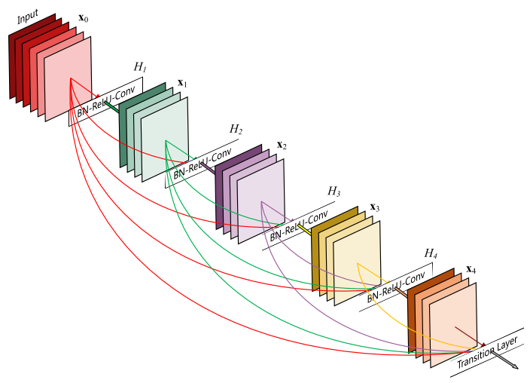
Model Architectures
Output 15 Sigmoid
Tried several different loss functions:
Binary cross-entropy for sigmoid
Weighted loss
Multi-task weighted loss
}
Dense 64
Dropout
Multiple Configs
Dense 128
Dropout
Dense 256
}
Multiple Configs
Conv2D 512
Conv2D 512
Dropout
Global Pooling
DenseNet121
Input (256, 256, 3)

Slide 8
Train & Val AUROC and Hyperparameter Tuning

Slide 9
Test Set AUROC and Model Selection
Notes:
Alex - up to you if you want to keep this and mention it. If you don’t want to or don’t have time, just ditch it!

Slide 10
BREAK

Slide 11
Model Interpretation

Slide 12
Conclusions

Slide 13
Future Work
placeholder1.
placeholder2.
placeholder3.

