Slide 1
Final Project:
Predicting Hospital Readmission Rates for Diabetes
CS109a: Introduction to Data Science
Team members: Karim Gowani
Ryan McGillicuddy
Yaseen Mohmand
Steven Worthington

Slide 2




Problem: Predicting Readmission
Inpatient Hospital Visit
Discharged Patient
Discharge
Readmission?
Based on a patient’s profile, are they at an elevated risk of readmission within 30 days?

Slide 3
Data Overview
Observation IDs
47 Features
Response
Patient # | Encounter ID | Gender | Time in Hospital | 45 other features | Re-admitted
1 | 1 | Male | 1 | … | 0
2 | 2 | Female | 4 | … | 1
3 | 3 | Female | 3 | … | 0
1 | 4 | Male | 6 | … | 0
4 | 5 | Female | 3 | … | 0
5 | 6 | Male | 4 | … | 1
… | … | … | … | … | …
101766 encounter observations from 130 hospitals over 10 years
Currently encounter based data, instead, aggregate all patient data together, deriving new features from past visits, to create patient-based observations.

Slide 4
Data After Aggregation
Observation ID
Original Features
Derived Features
Response
Patient # | Gender | 44 other features | Av. t in hospital | 37 other features | Re-admitted
1 | Male | … | 3.5 | … | 0
2 | Female | … | 4 | … | 1
3 | Female | … | 3 | … | 0
4 | Female | … | 3 | … | 0
5 | Male | … | 4 | … | 0
… | … | … | … | … | …
69990 patient observations from 130 hospitals over 10 years
~ 5% of patient observations are readmitted
All subsequent analysis and modeling is on the aggregated dataset.

Slide 5
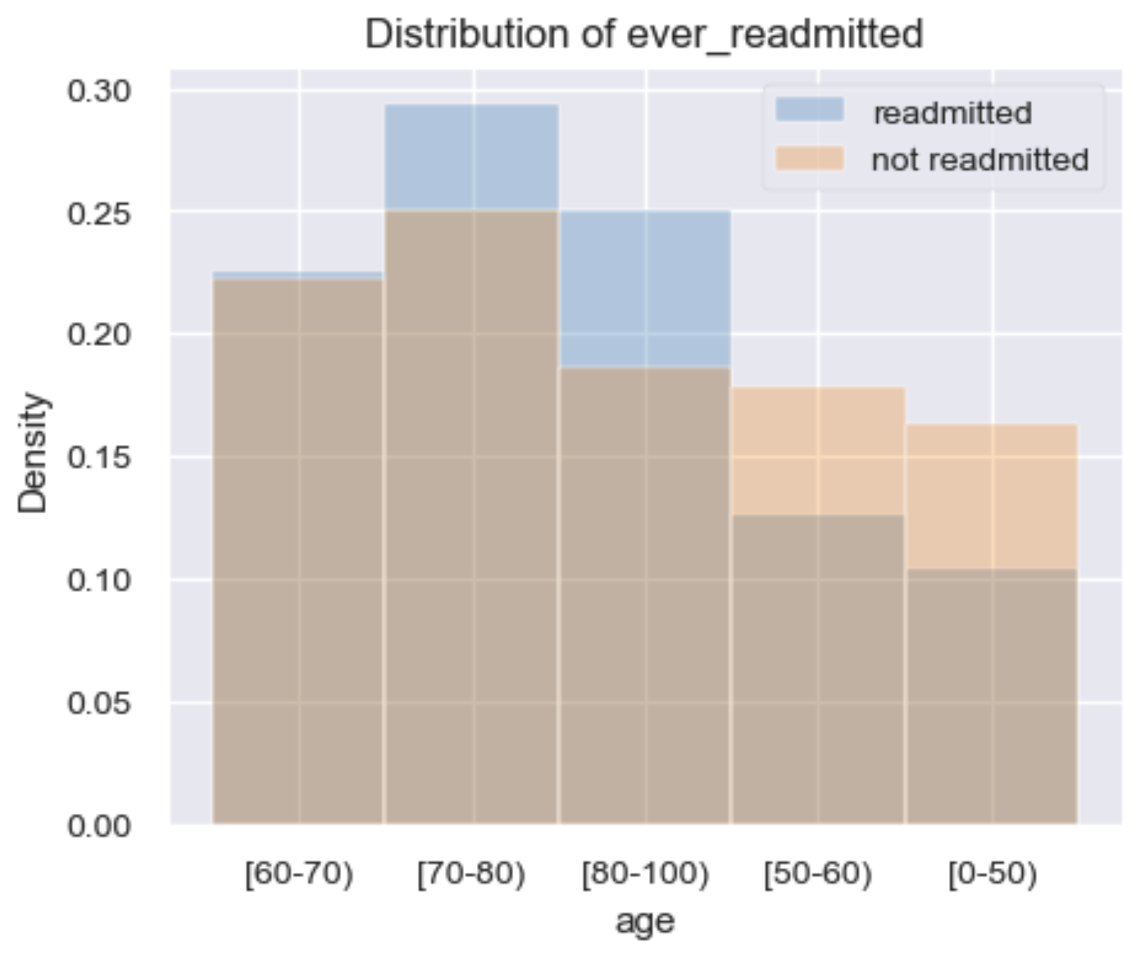
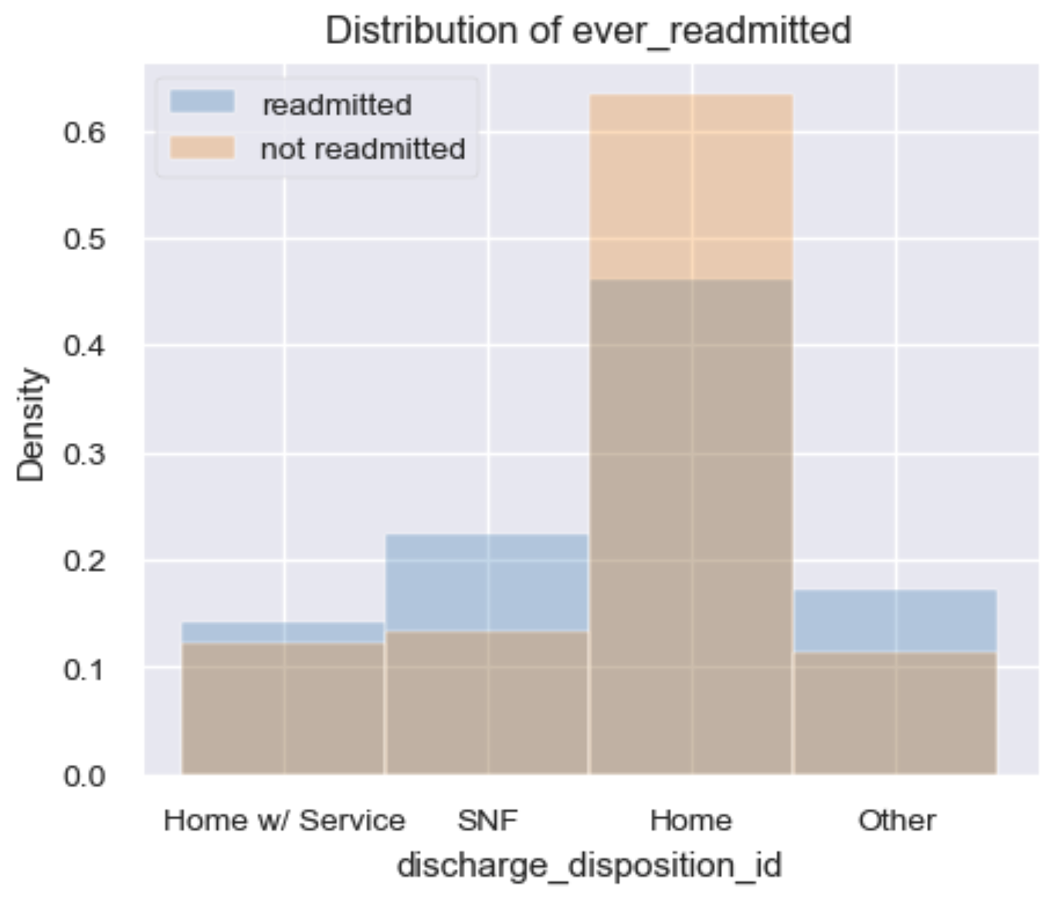
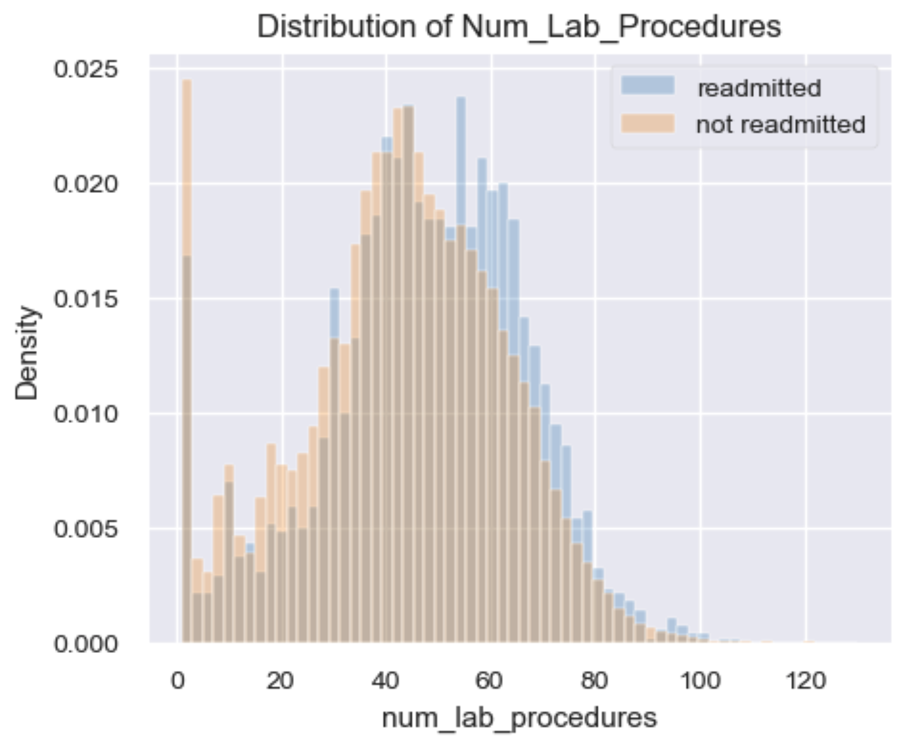
EDA: Features That Depend on The Response
This slide needs a little more work

