Slide 1
Final Project:
Predicting Hospital Readmission Rates for Diabetes
CS109a: Introduction to Data Science
Team members: Karim Gowani
Ryan McGillicuddy
Yaseen Mohmand
Steven Worthington

Slide 2
Data & EDA
~112K images
Multi-label / class problem
Huge class imbalance
Data leakage

Slide 3
Research Question

Slide 4
Data Preprocessing Pipeline
Image Data
Partition Data (Leakage)
Downsampling
TF Dataset
Augmentation
Label Data
Partition Data (Leakage)
One-hot Encode
TF Dataset
Combined Data
Zip X-ray & Label TF Datasets
Batching

Slide 5
BREAK

Slide 6
Modeling Approach

Slide 7
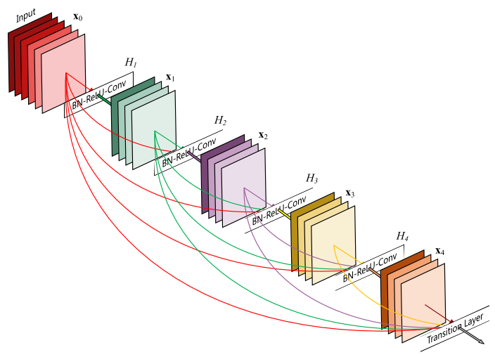
Model Architectures
Output 15 Sigmoid
Tried several different loss functions:
Binary cross-entropy for sigmoid
Weighted loss
Multi-task weighted loss
}
Dense 64
Dropout
Multiple Configs
Dense 128
Dropout
Dense 256
}
Multiple Configs
Conv2D 512
Conv2D 512
Dropout
Global Pooling
DenseNet121
Input (256, 256, 3)

Slide 8
Train & Val AUROC of Best Model

Slide 9
Train & Val AUROC of Model with Images from one folder
Notes:
Alex - up to you if you want to keep this and mention it. If you don’t want to or don’t have time, just ditch it!

Slide 10
BREAK

Slide 11
AUROC & Precision/Recall Curve on Test Set

Slide 12
Conclusions

Slide 13
Future Work
placeholder1.
placeholder2.
placeholder3.

