Slide 1
创新研究课程 科研项目短课

Slide 2
Course Syllabus 课程大纲
Content 内容 | 课时 | 课程说明 | 课后练习 | 备注
Version control – Git & Github, learn to write ReadMe | 3 |  | Write a readme file and upload to Github | README: https://classroom.udacity.com/courses/ud777 Git: https://classroom.udacity.com/courses/ud123 Github: https://classroom.udacity.com/courses/ud456 https://classroom.udacity.com/courses/ud775
Latex for scientific writing | 3 |  | Download CVPR latex template and upload to Github | The Not So Short Introduction to Latex (PDF)
Python tutorial | 3 |  | Finish a demo script and upload to Github | http://cs231n.github.io/python-numpy-tutorial/
Computer Vision and Opencv | 3 |  | Finish a demo script and upload to Github | http://cs231n.stanford.edu/2017/ https://docs.opencv.org/3.4/d9/df8/tutorial_root.html
Viola-Jones face recognition | 3 |  | Final assignment | https://docs.opencv.org/3.4/d7/d8b/tutorial_py_face_detection.html
Introduction to deep learning | 3 |  | -- | https://www.coursera.org/learn/ai-for-everyone/

Slide 3
Setup Instructions
Working locally

Slide 4
1. Installing Anaconda: https://www.anaconda.com/distribution/

Slide 5
Python tutorial

Slide 6
Today’s agenda: Python Tutorial
Python
Basic data types
Containers
Functions
Classes
Numpy
Matplotlib

Slide 7
Jupyter notebook

Slide 8
Assignment
Fill in the quiz number and the name.
Upload the solution file and name it as “your_name_No.py” (Di_WU_762.py” ) to the AI_Precourse\ Week3_Python folder
Push the new change to your “origin” repo and create a pull request so that you change will be seen by the “upstream”

Slide 9
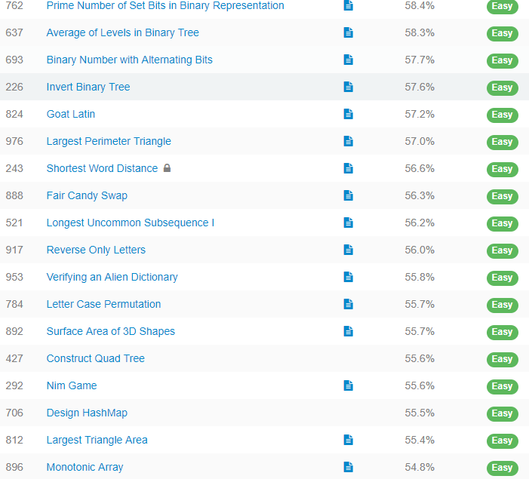
Number | Name
762 | Yangjiarui
637 | linjiajun
226 | QiuZengzhen
824 | WuHaoBang
976 | LiBaoWei
243 | chenkaipeng
888 | LiuJunLin
521 | HuangShaocong
917 | HeZhanhui
953 | ZhangZiyao
784 | ZhuRui
892 | LingJiaying
427 | huanghuazhen
292 | liufumingquan

