Slide 1
Terrorists and Refugees
Informing today's decisions with previous ones

Slide 2
Terrorist Attacks in the Past

Slide 3
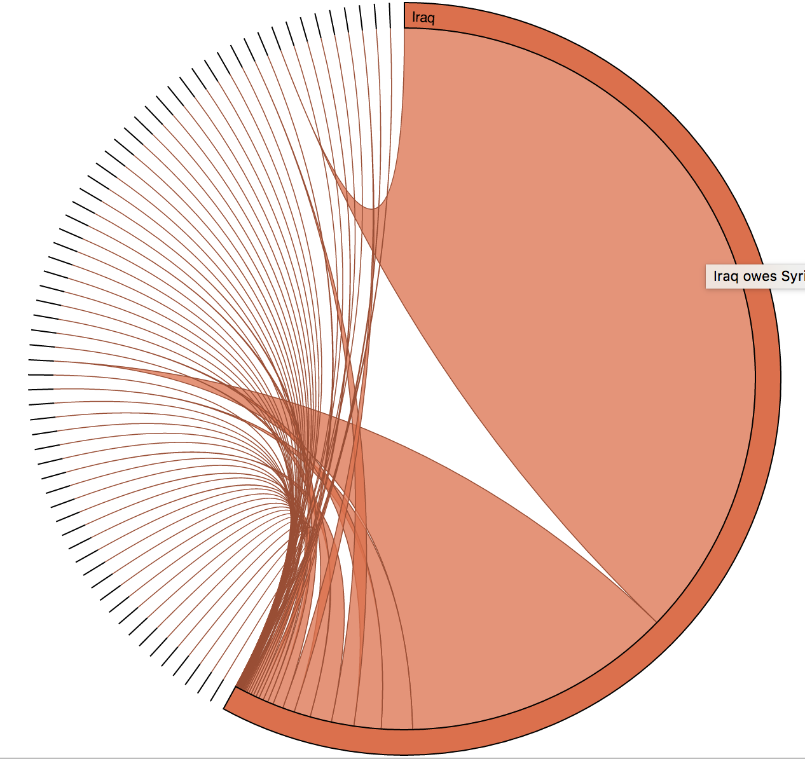
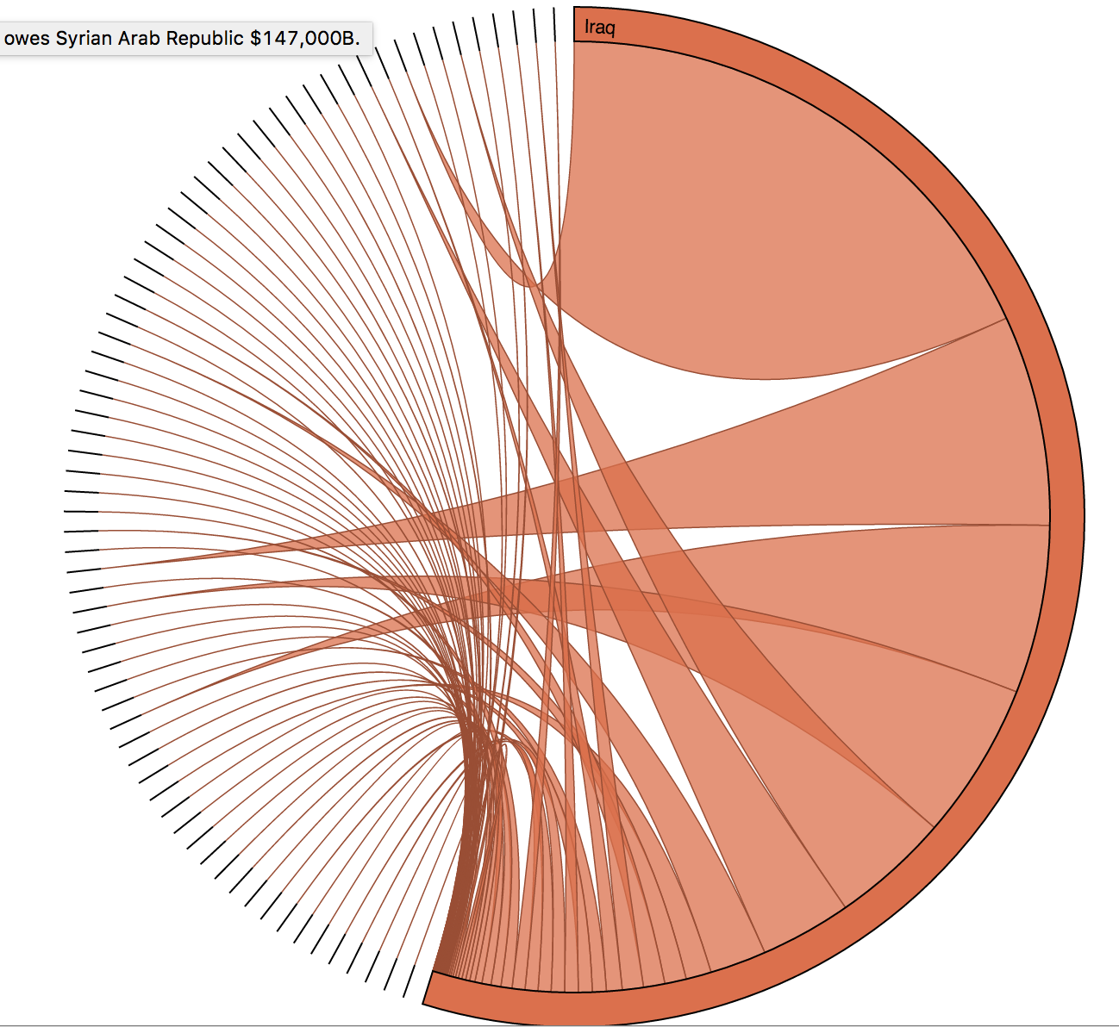
Refugees..a look at the Past

Slide 4
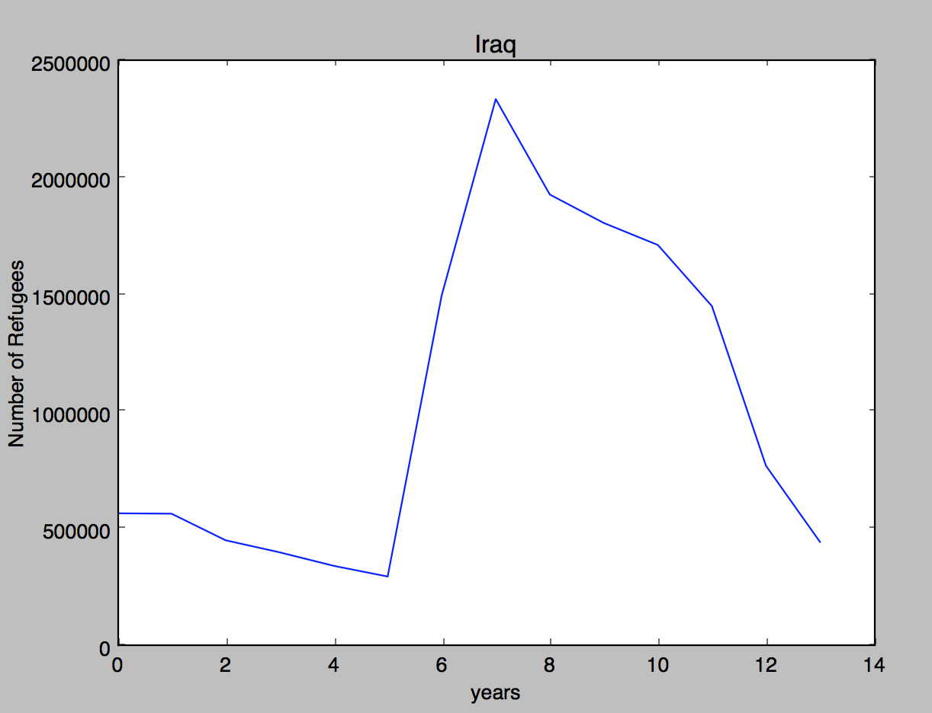

Slide 5
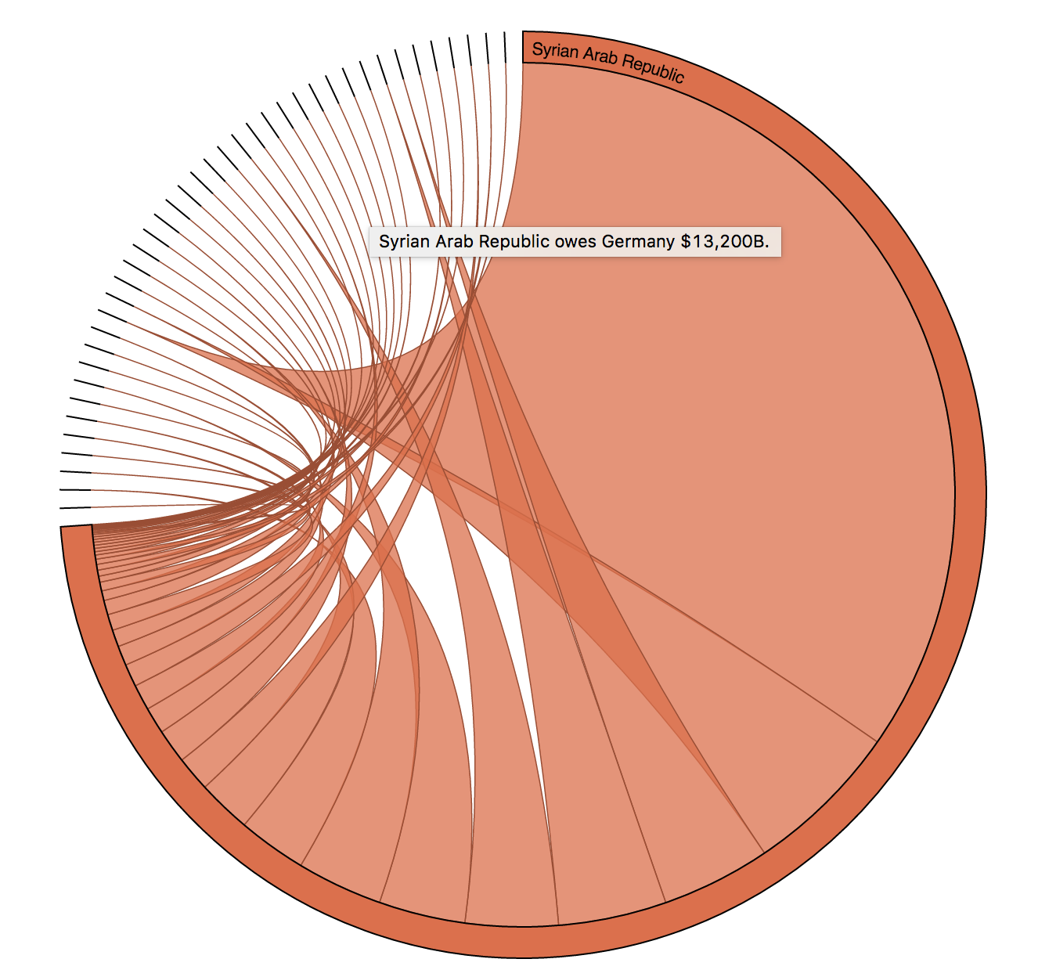

Slide 6
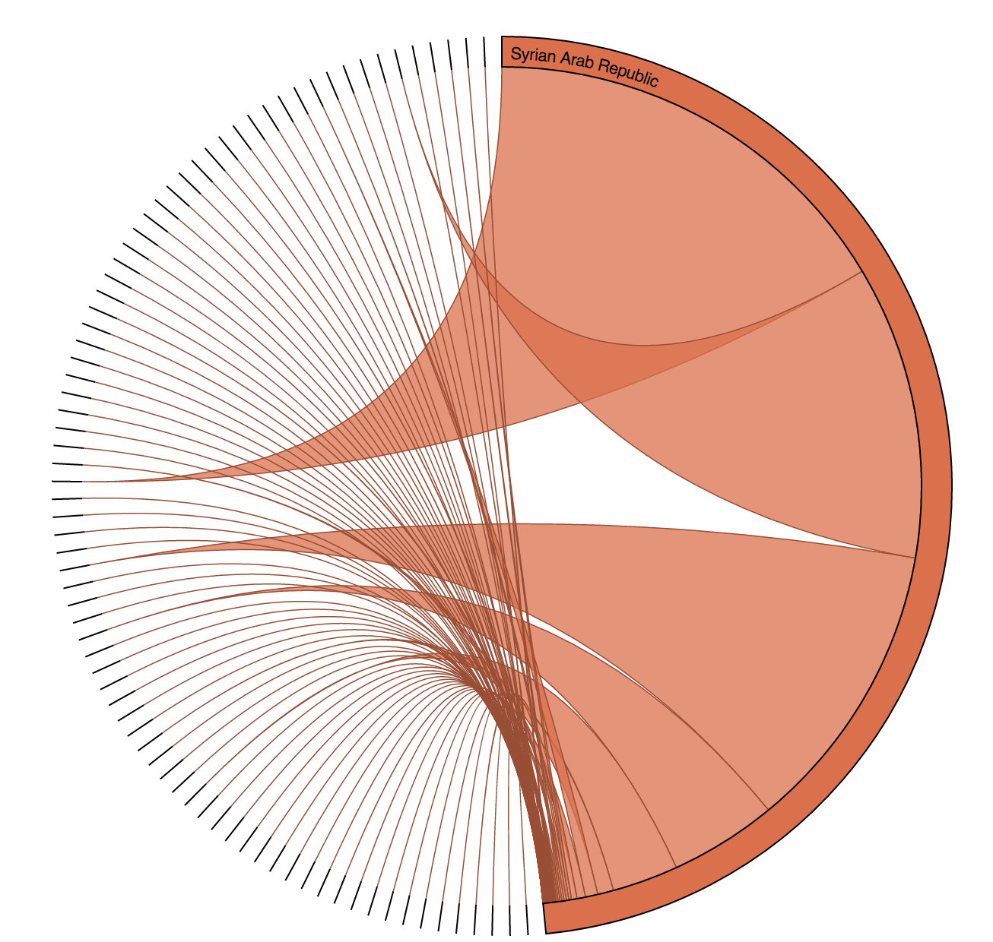

Slide 7
