Slide 1

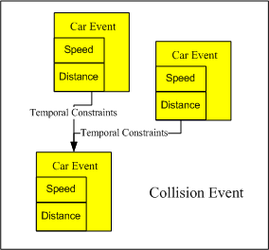


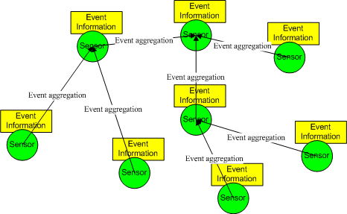
Publish / Subscribe Middleware for Wireless Sensor Network
面向無綫傳感器網絡的訂閲/發佈中間件
Publish / Subscribe (pub/sub) paradigm is easy to use and suits a wide range of Wireless Sensor Network applications. Our pub/sub middleware allows the application programmers to subscribe composite events which are a set of events with temporal relationships.
We have been investigating a lot of research issues in developing such a middleware including:
Event definition: provide an easy yet expressive event definition language to the application programmer
Event detection: design protocols to allow the network to detect the events in an energy-efficient way.
Event notification: deliver the detected events reliably and efficiently
訂閲/發佈的開發模式非常易于使用，而且適用于很多無綫傳感器網絡的應用。我們的訂閲/發佈中間件可以讓程序員定義並訂閲複雜事件，也就是一組具有時間關係的事件。
在這個中間件，我們所研究的課題包括：
如何定義事件：用一種易用但是有表達力的事件定義語言，是程序員可以方便的定義組合事件。
如何檢測事件：設計一些協議，使網絡可以有效並省電地檢測到事件。
如何發佈事件：實踐一旦被檢測到，必須有效並且可靠地被傳輸。
Define
Application Programmer
Notify
Application Requirements
Subscribe
Event Definition
Our pub/sub middleware can be used to support the development of our other WSN-based projects such as Intelligent Transportation Systems (ITS) and Structure Health Monitoring (SHM).
我們的訂閲/發佈中間件可用于支持開發我們一些其他的無綫傳感器網絡的項目，例如智能交通系統 (ITS) 以及結構健康監測系統(SHM).
Event Detection

