Slide 1
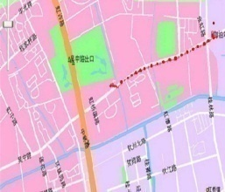





PolyU iSenNet
Intelligent Services with Wireless Sensor Networks
Wireless networked sensing and control for engineering applications
Transportation management
(iTransNet)
Structure Health Monitoring
(SHM)
Less cost, more efficient and scalable than wired sensor systems

Slide 2
Objectives
Develop a wireless sensor network (WSN) platform that provides reliable and real-time sensing and control services
  hardware and software
Develop an software infrastructure for applications to subscribe and be notified of the events.
  In-network processing of complex events
  Event subscription and delivery
Develop application solutions based on the infrastructure
  Collision avoidance
  Congestion control
  Vehicle tracking
  Car park management
  Monitoring and damage detection of bridges and buildings

Slide 3
Products: System and Software
High-performance wireless sensor network platform
  Dual-mote: sensor nodes for real-time & high throughput applications
  Platform supporting high sensing frequency & time syn. precision
Middleware
  Pub/Sub-based application development tool-kit
  Collaborative event processing infrastructure
Intelligent car park management system
  Automatic car park information management
  Mobile car park reservation
Demos
  Distributed algorithm for avoiding collisions at intersections, based on sensing and actuation using the road events.
  Traffic light control
  Vehicle tracking

