Slide 1
Pub/Sub Middleware for WSN
Steven Lai

Slide 2
Agenda
Introduction
  Background
  Motivation
Related Works
  Pub/Sub in WSN
  Middleware in WSN
  Macroprogramming in WSN
Current Works
  System Model and Architecture
  Event Description Language
  Middleware Development

Slide 3
Agenda
Introduction
  Background
  Motivation
Related Works
  Pub/Sub in WSN
  Middleware in WSN
  Macroprogramming in WSN
Current Works
  System Model and Architecture
  Event Description Language
  Middleware Development

Slide 4
Pub/Sub Paradigm
Pub/Sub essential features – decoupling in 3 dimensions:
  Space decoupling
  Time decoupling
  Flow decoupling
API’s
  Publisher: publish()
  Subscriber: subscribe(), notify()

Slide 5
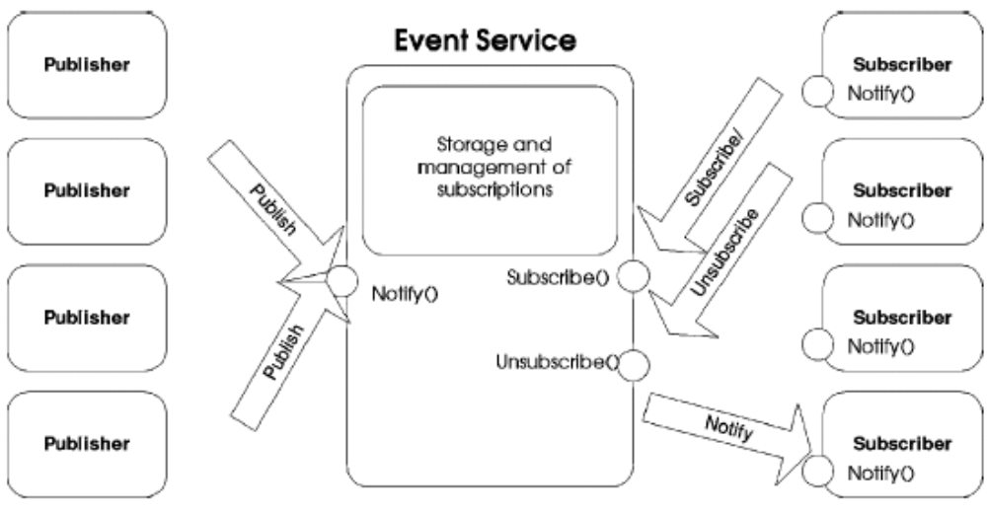
Pub/Sub Paradigm
Conceptual illustration

Slide 6
Agenda
Introduction
  Background
  Motivation
Related Works
  Pub/Sub in WSN
  Middleware in WSN
  Macroprogramming in WSN
Current Works
  System Model and Architecture
  Event Description Language
  Middleware Development

Slide 7
Motivation
Programming in WSN is not trivial. Programmers need to be aware of the underlying issues such as deadlock, race conditions.
Middleware is a natural approach to hide the low-level details from application programmers.
Pub/Sub Middleware Approach: suitable for a wide range of WSN applications.
  Complex monitoring
  Object tracking
  Contour finding

Slide 8
Motivation
Existing works on Pub/Sub for WSN are too weak.
Other approaches are not suitable for all kinds of applications and programmers
  Query-based: unsuitable to describe temporal relationships
  VM-based: make the programs hard to read and maintain
  Neighbor-based: more suitable for object tracking applications.
  Agent-based: more generic but existing work (Agilla) is based on Maté and inherits the problems come with VM-based approaches

Slide 9
Research Issues
Event description language: we need to provide an event description language which is powerful yet easy to use.
Event description language compiler: a compiler is essential to translate the programs written in our high-level language into a low-level language understandable by the sensor nodes. The compiler must be smart enough to extract the semantic meanings from the program and do some optimization.
Runtime environment support: the middleware running on each sensor node should provide a runtime environment to execute the compiled programs.
Smart Code dissemination: the compiled code should be intelligently disseminated into the network. Big programs may need to be divided into small ones and only related sensor nodes need to be updated.
Data aggregation: some kind of events such as average values may need to be aggregated before they are published to the subscriber.
Energy efficient routing: when publishing events, energy-efficient routing protocols are needed so that the data will be delivered at the minimum cost

Slide 10
Agenda
Introduction
  Background
  Motivation
Related Works
  Pub/Sub in WSN
  Middleware in WSN
  Macroprogramming in WSN
Current Works
  System Model and Architecture
  Event Description Language
  Middleware Development

Slide 11
Pub/Sub in WSN
Low-level naming: based on directed diffusion with attribute-based naming. Subscriptions are flooded to the network. Events are published with the ‘reverse path’. Matching rules are defined as ‘actual’ and ‘formal’ (originally from Linda).
Diffusion filters: extend low-level naming by using GEAR to reduce the flooding overhead.
Mires: a pub/sub middleware for WSN. Use ‘Bcast’ to flood and ‘MultihopRoute’ to publish.
Semi-probabilistic: extend the flooding / notification mechanisms by using controlled flooding (flooding stops after certain number of hops) and opportunistic forwarding (if publisher is not reached during flooding, events will be forwarded with certain probability).

Slide 12
WSN Middleware
Query-based
  Suitable for periodic monitoring applications.
  Examples: TinyDB, Cougar, SINA
VM-based
  Could be suitable for a wide range of applications but still requires some kind of low-level programming knowledge.
  Examples: Maté, MagnetOS
Mobile Agent-based
  Especially suitable for applications that need to migrate information among sensor nodes (object tracking, contour detection).
  Examples: Agilla, SensorWare
Object tracking: enviroTrack

Slide 13
Representative Works - TinyDB
The query language features: aggregation queries, sample period specification, event based query, storage creation.
Sample Query:
  ON EVENT bird-detect(loc):
  SELECT AVG(light), AVG(temp), event.loc
  FROM sensors AS s
  WHERE dist(s.loc, event.loc) < 10m
  SAMPLE PERIOD 2 s FOR 30 s
Sample Query 2:
  CREATE
  STORAGE POINT recentlight SIZE 8
  AS (SELECT nodeid, light FROM sensors
  SAMPLE PERIOD 10s)

Slide 14
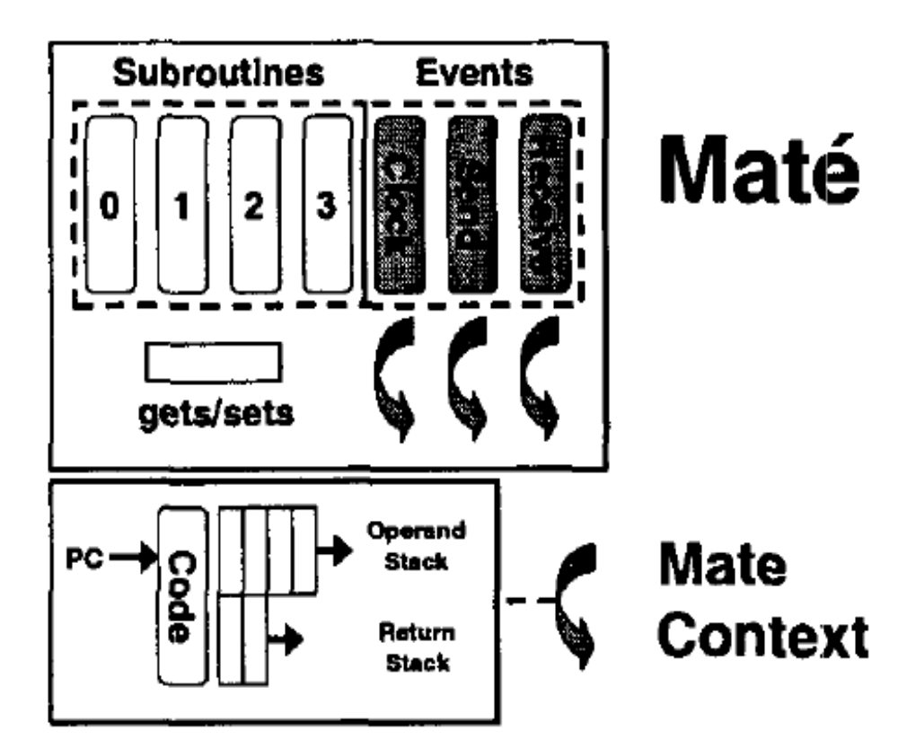
Representative Works - Maté
Codes are divided into capsules for easy distribution.
All the instructions are stack-based.

Slide 15
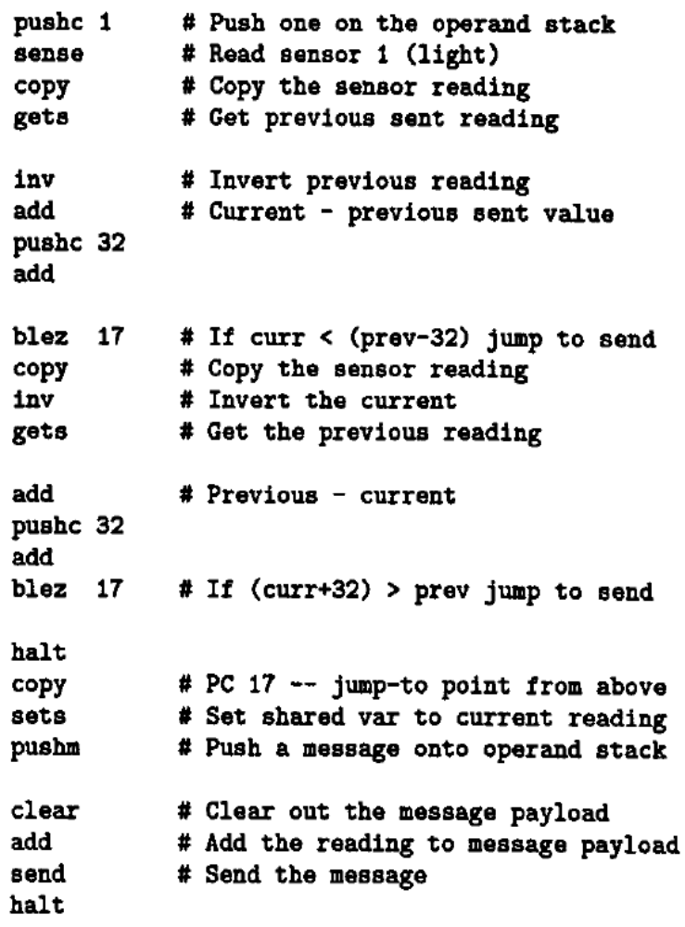
Maté – Example Program
Collect the sensor reading and report if the current reading differs from the previous one at a given threshold.

Slide 16
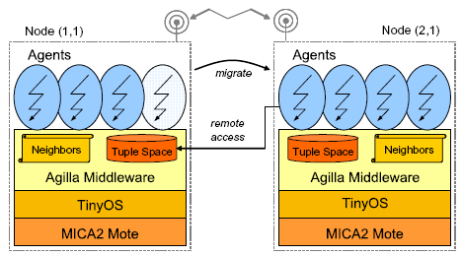
Agilla
Extension to Maté
  Provide support for tuple space operations.
  Provide mechanisms for agent migration.

Slide 17
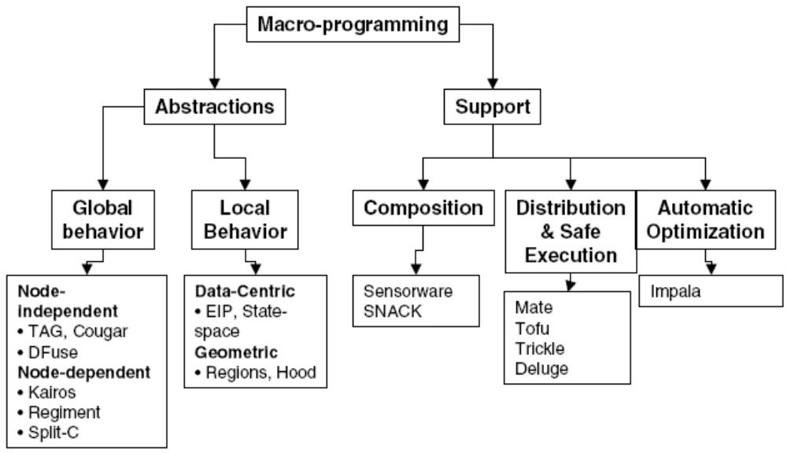
Macroprogramming in WSN

Slide 18
Macroprogramming in WSN – Implementation Issues
Macroprogramming with Utility library
  Since NesC is already a powerful component-oriented programming language, some MP just provides a library in NesC as the API to the application programmers.
  Examples: Abstract Region, TinyThread.
Macroprogramming with Native Code generation
  A higher level language is provided and it will be pre-compiled to NesC programs or directly compiled into binaries.
  Tools like Deluge, XNP, Trickle can be used to distribute the program to the network.
  Examples: Kairos, SNACK, Hood.
Macroprogramming with Middleware support
  Some of the heavily used subroutines are built into the middleware to provide a run-time environment. The program size can therefore be reduced.
  Designing a good middleware run-time environment is the key challenging part.
  Examples: Regiment, TinyDB.

Slide 19
Representative Works
Regiment: use a high-level functional language called Regiment. Some primitives such as region, events, etc. are defined. Functions are used to process such kind of primitives. Example (object tracking):
    let aboveThresh (p,x) = p > threshold
    read node =
    (read sensor PROXIMITY node,
    get location node)
    in centroid (afilter aboveThresh
    (amap read world))

Slide 20
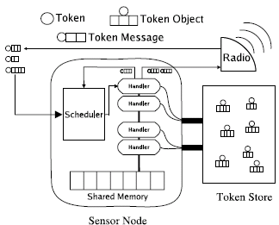
Regiment (cont’)
An intermediate language is necessary to support the execution of the language.
Token machine language (TML): TML is composed of a token store, a set of token handlers, etc. Tokens can share variables.
shared int s;
token Red (int a, int b) {
stored int x;
if ( present(Green) )
x = 39;
else {
x += a + b;
timed schedule Red(500, s, a);
}
}

Slide 21
Agenda
Introduction
  Background
  Motivation
Related Works
  Pub/Sub in WSN
  Middleware in WSN
  Macroprogramming in WSN
Current Works
  System Model and Architecture
  Event Description Language
  Middleware Development

Slide 22
System Model
N number of sensor nodes as publisher
One sink node as subscriber
An event description language is provided to the application programmers to develop applications
The program written by application programmers will be compiled into the codes in an intermediate language
The compiled codes will be disseminated to the network

Slide 23
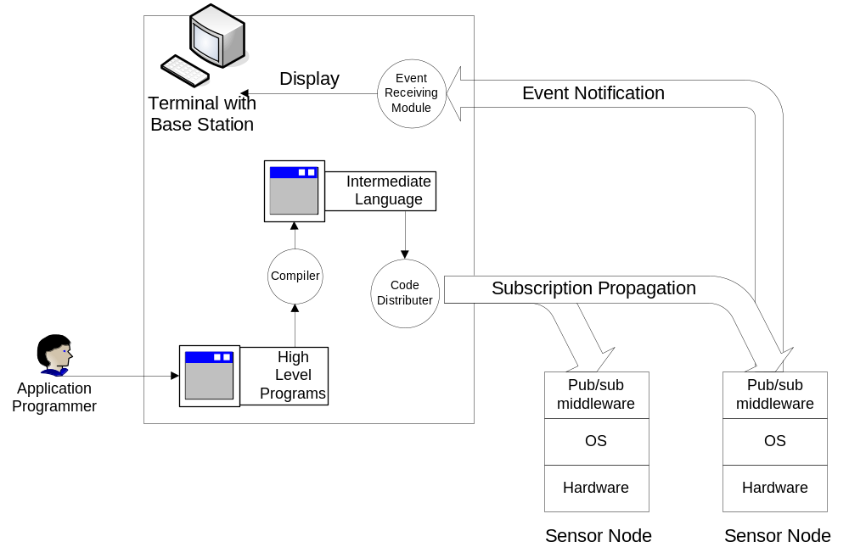
System Architecture

Slide 24
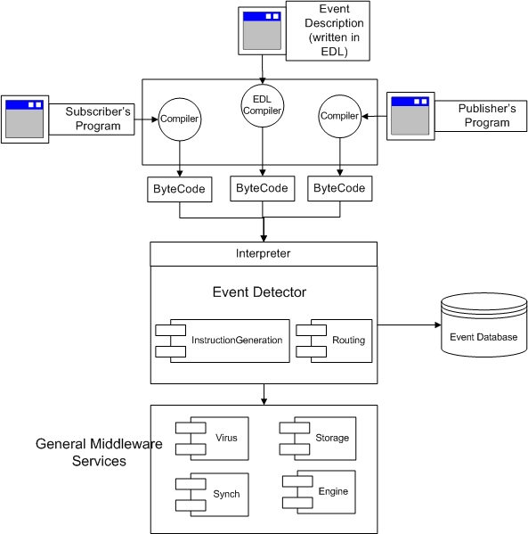
Software Architecture

Slide 25
Detailed System Architecture
On the top layer, different languages are provided for different purposes. All the programs written in different languages will be compiled into byte codes and disseminated to the network.
  Event Description Language is provided for composite event description.
  Subscribers are provided with a language to define subscriber related policies.
  Publishers are provided with a language to define publisher related policies such as when to publish and where to publish if the subscriber is mobile.
The middleware is divided into two parts. The core component, the event detector is used to detect the events. Depending on the implementation details, it may require support from a database.
Our event detector will be implemented on top of some general middleware services such as services for code storage, code dissemination and concurrency control.

Slide 26
Agenda
Introduction
  Background
  Motivation
Related Works
  Pub/Sub in WSN
  Middleware in WSN
  Macroprogramming in WSN
Current Works
  System Model and Architecture
  Event Description Language
  Middleware Development

Slide 27
Primitive Events
Events are expressed as a set of ‘attribute-value’ pairs:
  Event BasicEvent {
  Time time;
  int id;
  int duration;}
Besides the attributes related to sensors, there are some attributes provided by the system (built-in attributes):
  Time (the timestamp)
  Rate (the rate of the generation of an event)
  ID (the ID of the sensor node)
  Duration (the duration of each event)
Built-in attributes are included in the ‘BaseEvent’. User created events will automatically inherit ‘BaseEvent’ and have these attributes.

Slide 28
Event Methods
Constructors: initialization
‘occurred()’ method: indicate the occurrence of an event
Event LightEvent {
Time time;
uint16_t light;
uint16_t threshold;
int id;
int duration;
int locationX;
int locationY;
public LightEvent (uint16_t threshold) {
this.threshold=threshold;
}
public bool occurred () {
if (light> threshold)
return true;
else
return false;
}
}

Slide 29
Composite Events
Event LightSeqEvent {
uint8_t minX;
uint8_t maxX;
bool detected;
public LightSeqEvent (uint8_t x1, uint8_t x2) {
this.minX = x1;
this.maxX = x2;
detected = false;
}
bool occurred () {
LightEvent previous;
walkthrough {
LightEvent e= new LightEvent (400);
if (e.locationX==minX && e.occurred()) {
detected = true;
previous = e;
}
else if (e.locationX==0 && !e.occurred())
detected = false;
if (detected) {
if (e.time==previous.time+1 && e.locationX==previous.locationX+1
&& e.occurred()) {
previous=e;
if (e.locationX==maxX)
return true;
}
else if (e.time==previous.time+1 && e.llocationX==previous.locationX+1
&& !e.occurred()) {
detected=false;
}
}
}
}
}

Slide 30
Composite Events (cont.)
‘LightSeqEvent’ detects a sequence of light events.
We introduce a new notation ‘walkthrough’ here. The code block of ‘walkthrough’ is executed on each sensor nodes in the network for exactly once.
Events are collected from each sensor nodes by calling “LightEvent e= new LightEvent (400);”

Slide 31
Event Subscription
To subscribe events, users simply need to construct an array of interested events and call ‘sub()’ function to subscribe.
1: sub (Event eventlist []);

Slide 32
Composite Operators Implementation
1: bool Conjunction (Event e1, Event e2) {
2: return e1.occurred() && e2.occurred ();
3: }
1: bool Disjunction (Event e1, Event e2) {
2: return e1.occurred() || e2.occurred ();
3: }
1: bool Sequence (Event e1, Event e2) {
2: if (e1.occurred() && e2.occurred())
3: return e1.time < e2.time;
4: }
1: bool Concurrency (Event e1, Event e2) {
2: if (e1.occurred() && e2.occurred())
3: return e1.time == e2.time;
4: }

Slide 33
Example Applications – Average Reading
1: Event LightAvgEvent {
2: uint16_t avg;
3: uint8_t maxX;
4: uint8_t maxY;
5: public LightAvgEvent (uint8_t x, uint8_t y) {
6: this.maxX = x;
7: this.maxY = y;
8: avg = 0;
9: }
10: bool occurred () {
11: uint16_t total;
12: uint8_t count;
13: walkthrough () {
14: LightEvent e = new LightEvent (0);
15: if (e.locationX<maxX && e.locationY<maxY) {
16: total += e.light;
17: count++;
18: }
19: }
20: avg = total/count;
21: return true;
22: }
23: }

Slide 34
Example Applications – Contour Detection
1: Event LightContourEvent {
2: bool init;
3: uint8_t minX; uint8_t minY; uint8_t maxX; uint8_t maxY;
4: public LightContourEvent () {
5: init = false;
6: }
7: bool occurred () {
8: walkthrough () {
9: LightEvent e = new LightEvent (400);
10: if (e.occurred()) {
11: if (!init) {
12: minX=maxX=e.locationX;
13: minY=maxY=e.locationY;
14: } else {
15: if (e.locationX<minX) minX=e.locationX;
16: if (e.locationX>maxX) maxX=e.locationX;
17: if (e.locationY<minY) minY=e.locationY;
18: if (e.locationY>maxY) maxY=e.locationY;
19: }
20: }
21: }
22: return true;
23: }
24: }

Slide 35
Create Common Libraries
Example, library ‘Average Event’:
class AverageEvent {
public AverageEvent (AverageFunction af, uint8_t x, uint8_t y);
Event average ();
}
Users just need to provide an average function with such interface:
interface AverageFunction {
public Event generateEvent();
public Event average(Event e1, Event e2);
}

Slide 36
Use the Library
Users define the averaging function
class LightAverFunction implements AverageFunction {
public Event generateEvent() {
return new LightEvent();
}
public Event average(Event e1, Event e2) {
LightEvent e3;
e3 = new LightEvent();
e3.count = e1.count+e2.count;
e3.light = (e1.light*e1.count+e2.light*e2.count)/e3.count;
return e3;
}
}
Subscribe the composite event with the help of our library
LightAverFunction laf = new LightAverFunction();
AverageEvent ae = new AverageEvent(laf, 1, 20);
LightEvent le = ae.average();
Event subEvent [] = new Event [1];
subEvent[0] = le;
sub(subEvent);

Slide 37
Internal Implementation
class AverageEvent {
AverageFunction af;
uint8_t maxX;
uint8_t maxY;
public AverageEvent (AverageFunction af, uint8_t x, uint8_t y) {
this.af = af;
this.maxX = x;
this.maxY = y;
}
Event average () {
Event previous, current;
previous=current=null;
walkthrough () {
if (previous==null) {
previous=af.generateEvent();
if (previous.locationX>maxX && previous.locationY>maxY) {
previous=null;
}
}
else {
current=af.generateEvent();
if (current.locationX<maxX && current.locationY<maxY) {
previous = af.average(previous, current);
}
}
}
return previous;
}
}

Slide 38
Summary
Instead of inventing new syntax, our event description is similar to Java (follow the rule of least surprise).
We introduce very few new notations such as ‘walkthrough’
Our language is able to support a large set of WSN applications
A front end of the language has been developed using JFlex and CUP.

Slide 39
Agenda
Introduction
  Background
  Motivation
Related Works
  Pub/Sub in WSN
  Middleware in WSN
  Macroprogramming in WSN
Current Works
  System Model and Architecture
  Event Description Language
  Middleware Development

Slide 40
Middleware Development
Core components (inspired by Mate)
  Engine: the main program, scheduler
  ContextSyn: provide mechanisms for context switching.
  Virus: Code disseminator (among different sensor nodes)
  CapsuleStore: Code storage
A set of instructions and contexts may be defined and wired to the middleware.

Slide 41
Issues to Be Solved
Pub/Sub API and primitives: define pub/sub API at different layers.
Network code generation: allow the sensor nodes to set up a way to detect the subscribed events.

