Slide 1
Pub/Sub Middleware - VM
Steven Lai

Slide 2
Overview
Built on top of Mate
A simple activation record mechanism for function call
A heap mechanism for data allocation
Some mechanism for data aggregation

Slide 3
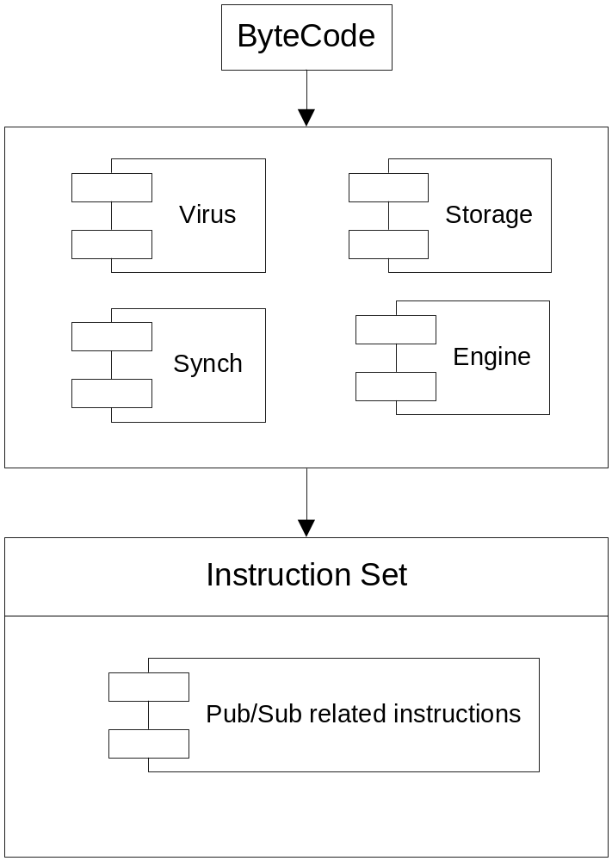
Architecture

Slide 4
Runtime Environment
VM: stack-based instructions (allow higher code density)
  Push 3
  Push 5
  Add
Multiple code capsule
  Each capsule is an executable program

Slide 5
ISA
Mate instructions
  Arithmetic: add, sub, div, mod, mul
  Relational: gt, lt, gte, lte
  Logical: and, not, or
  Others: jump, push, pop, copy
Additional instructions
  Function calls
  Heap management
  Global variable management

Slide 6
ISA for Activation Record and Heap
Local data: ‘setlocal’, ‘getlocal’
Machine status: ‘call’, ‘return’
Control link: ‘call’, ‘return’
Returned values: ‘createreturn’, ‘setreturn’, ‘getreturn’.
Parameters: ‘setparameter’, ‘getparameter’
Heap Management: setheap, getheap

Slide 7
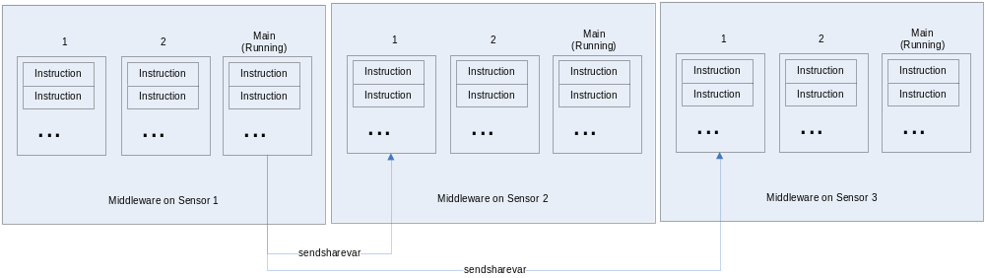
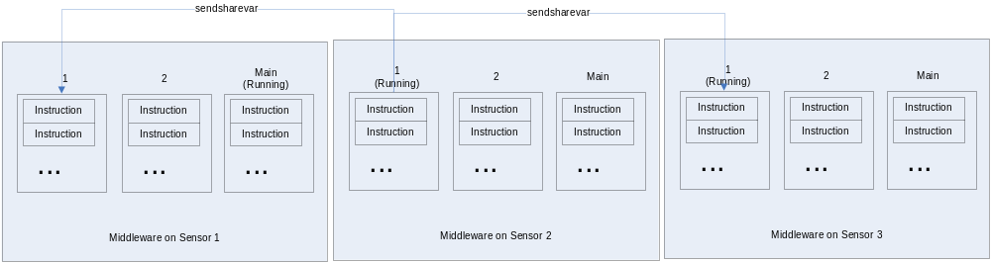
Data Aggregation Mechanism

Slide 8
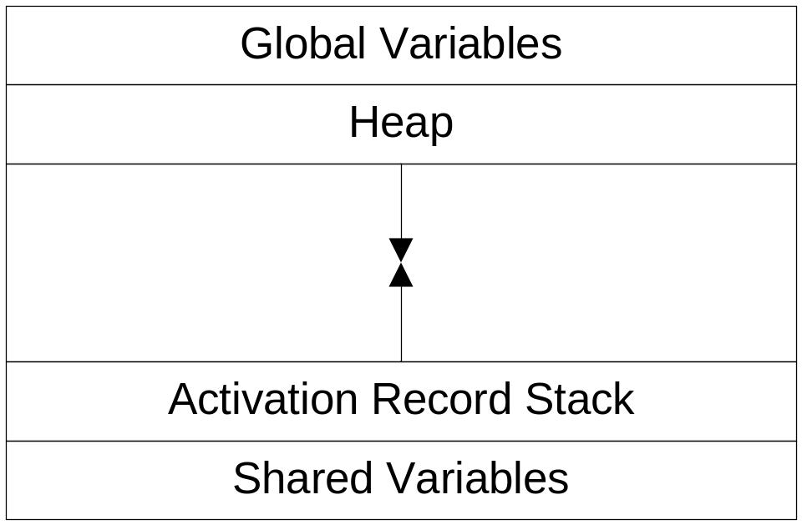
Memory Management

