Slide 1
Opportunistic Flooding in Low-Duty-Cycle Wireless Sensor Networks with Unreliable Links
Shuo Guo, Yu Gu, Bo Jiang and Tian He

Slide 2

Problem
Given a low-duty-cycle wireless sensor network, where each node sleeps most of time and wake up asynchronously. In addition, the wireless links are unreliable.
The problem is how to make decisions of when to forward based on the delay distribution of next-hop nodes

Slide 3
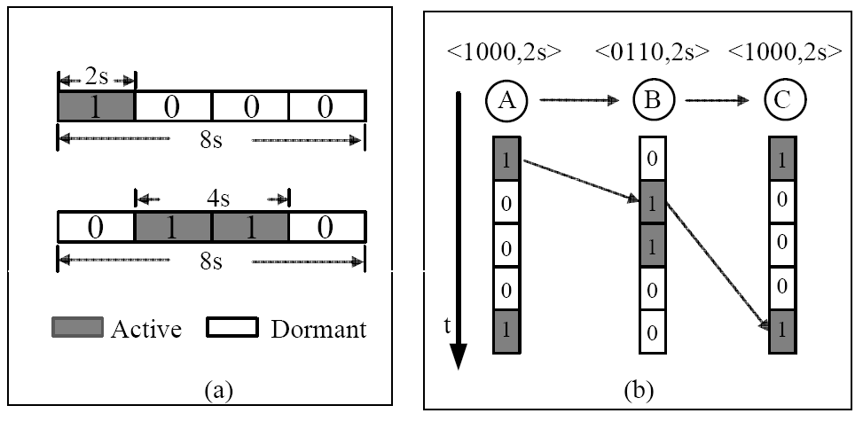
Low-Duty-Cycle Network Model

Slide 4
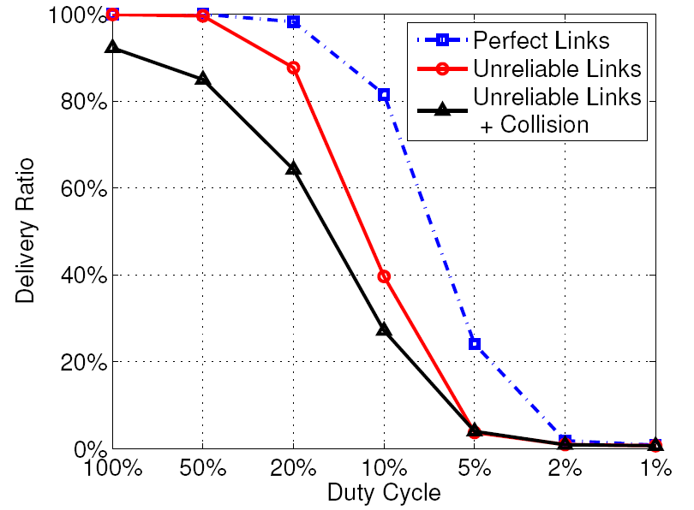
Problem with Previous Flooding in Low-Duty-Cycle Networks
Simulation

Slide 5
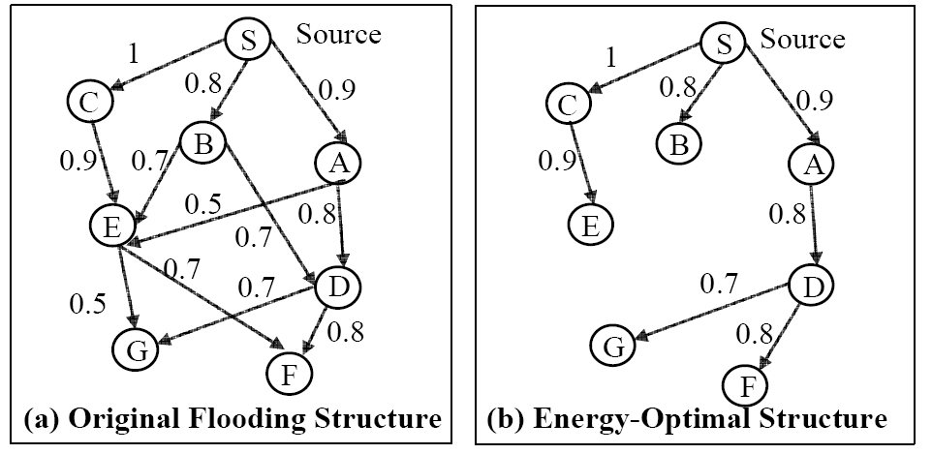
Flooding Structure
Weigthed DAG

