Slide 1
System Model and Analysis
Steven Lai

Slide 2
Objectives
Simple Objective: sensors try to wake up when there is a car.
Advanced Objective: sensors try to wake up when there is a potential collision.
Energy Consumption: consume as little energy as possible.

Slide 3
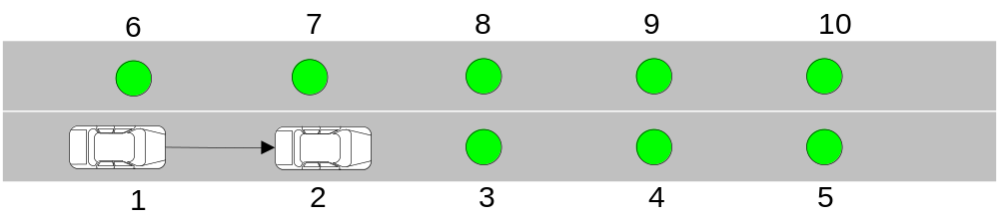
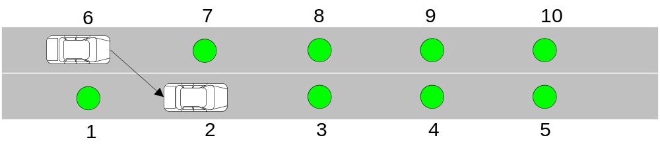
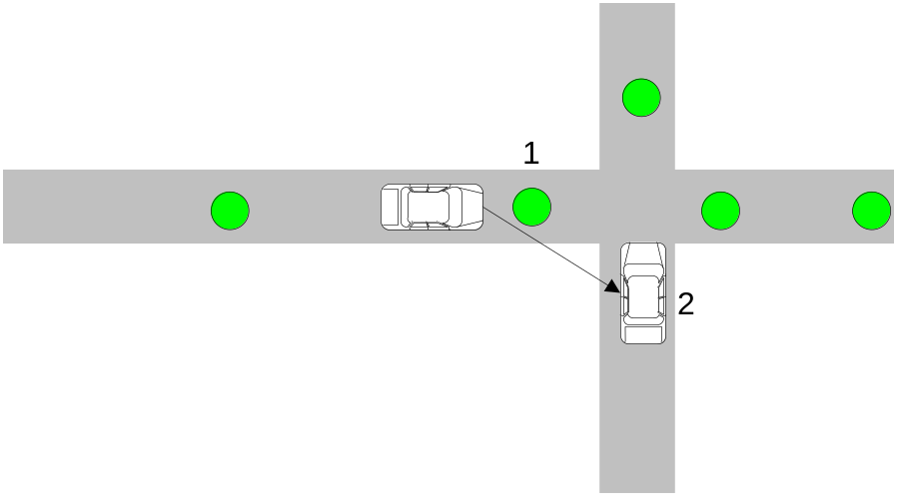
Types of Collisions
Collision on the same lane
Collision when a car is trying to switch lane
Collision in the intersection

Slide 4
Collision Detection – Single Lane
Measure the speed of the vehicles
Measure the time difference of the two vehicles reaching the sensor.
Know the distance of the two consecutive sensors so that each sensor can estimate the position of the potential collision.

Slide 5


System Model
Sensors:
Roads:
Roads are straight paths and sensors are deployed on the roadbed.
The distances between each 2 consecutive sensors are the same.
Vehicles: randomly arrive with uniform distribution (especially suitable for highway)

Slide 6



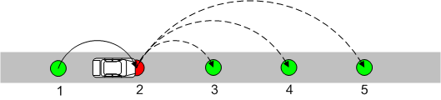
Radio Model
Error rate:
Transmission range – 1 hop:
Multi-hop can be considered in the future but it will also dramatically increase the complexity of the analysis.

Slide 7
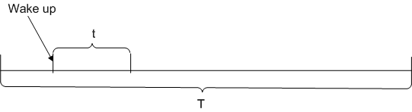
Wake-up Model
For a specific time period T, each time when a sensor is waken up, it stays active for a time period t.
If the sensor doesn’t receive any wake-up during the active period, it will go back to sleep mode.

Slide 8
Schemes
Always-on: all of the sensors are active at all the time.
Normal wake-up: When a sensor detects a car, it will wake up its next sensor.
Normal wake-up + automatically wake up: in addition to being woken up by the previous sensor, each sensor will also wake up spontaneously.
Random wake-up: all the sensors are woken up randomly.
Selective wake-up: sensors are woken up depending on the safety of the vehicles

Slide 9
Scheme – Selective Wakeup
Sensor will be woken up depending on the potential danger on the road.
Sensor will first try to calculate the speed of the vehicle. If the speed cannot be calculated, a sensor will be woken up.
Once the speed is calculated, the sensor can determine the safety of that vehicle and choose which sensor to wake up.

Slide 10
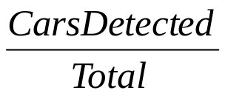
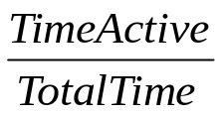
Theoretic Analysis
Accuracy
  How many cars are correctly detected?
  Defined as:
  Here, cars detected are the cars that reach the sensor when the sensor is awaken.
Energy Consumption
  How much time each sensor should be active?
  Defined as:

Slide 11
Application Scenario
Single Lane – Analyzed here.
Multiple Lane – Should have similar results in terms of accuracy as single lane.
Intersection – Should have similar results in terms of accuracy as single lane.

Slide 12

Accuracy – Always-on
Always accurate because the sensor is always active:

Slide 13


Accuracy – Random Wakeup
Since the arrival time of the vehicles are uniformly distributed, accuracy of such a scheme is directly related to the wakeup probability of each sensor.
Wakeup probability:
Average accuracy:

Slide 14
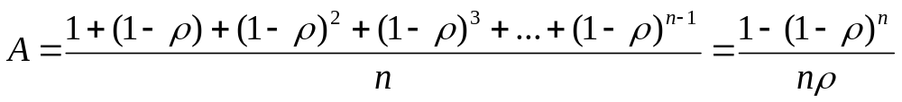
Accuracy – Normal Wakeup
May not be 100% because wakeup message can be lost due to the message loss rate in the radio model.
Accuracy for a sensor can affect the accuracy for some other sensors.
Number of sensors: n
Average accuracy:

Slide 15



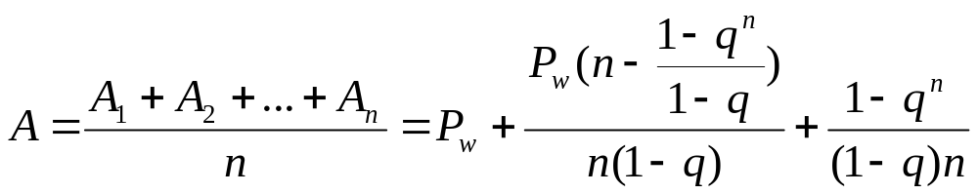
Accuracy – Normal Wakeup + Automatic Wakeup
Wakeup probability:
For convenience:
Number of sensors: n
Average accuracy:

Slide 16

Energy Consumption - Always-on
Energy consumption is the highest:

Slide 17

Energy Consumption – Random Wakeup
Energy consumption is completely dependent on the wakeup probability.
Wakeup probability:
Average energy consumption:

Slide 18
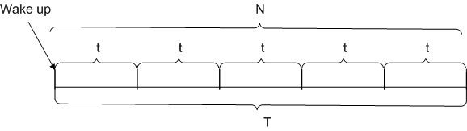
Energy Consumption– Normal Wakeup
Depending on the average number of vehicles that reach the sensor in each time period T.
Number of cars passing the sensor: m
T=Nt.

Slide 19
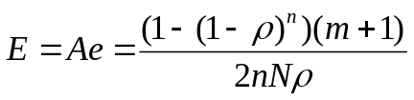
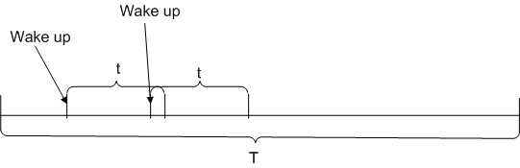
Energy Consumption– Normal Wakeup
Wake up period can overlap with each other.
If m<=N, average energy consumption for time period T is:
If m>N, I haven’t found out how to calculate e.

Slide 20

Energy Consumption– Normal Wakeup
Average energy consumption:

Slide 21
Energy Consumption – Normal Wakeup + Automatic Wakeup
This scheme should be a combination of normal wakeup and random wakeup.
The key point here is to calculate the ‘overlapping’ wakeup period between these 2 schemes.
The more ‘overlapping’ we have, the more energy is saved.
More ‘overlapping’ means accurate prediction.

Slide 22
Future Works
If my current direction is OK. I will keep on working until get a complete version of the modeling and analysis based on the current works.
Consider other application scenarios (should be similar).
Consider multi-hop.
Find out how to do traffic prediction.

