Slide 1
Implementation of Pub/Sub in DTN
Steven Lai

Slide 2
Application Scenario
There are a group of sensor nodes in certain area.
A group of ferries travel around the area and will deliver events.
Each of the sensor node can be a publisher or subscriber (depending on if it has any subscriptions).
User can attach to any of the node and enter command to subscribe information (e.g. subscribe 1 light > 500)
After user enters the command, that particular node becomes a subscriber.

Slide 3
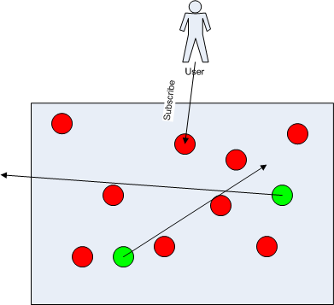
Application Scenario

Slide 4
Architecture
Middleware layer
  Pub/Sub + a simple localization module.
  Current implemented with the idea of DTN.
  Several entities: subscriber, publisher, ferry.
Application layer
  Built on the top of the pub/sub layer.
  For current implementation, I created a simple application that collects the data.

Slide 5
Middleware - Subscriber
When a user is attached to a node, he / she can enter certain subscription and that node becomes a subscriber.
In current implementation, the subscription is kept by the local node.
When the local node receives events from the ferry, it will process the events to see if they match the subscription.
The middleware layer will notify the application layer about the events if they match to the subscription.

Slide 6
Middleware - Publisher
When the application needs to publish certain events, the events are buffered at the middleware layer.
When publisher detects a ferry nearby, it will transmit the buffered events to the ferry.
Ferry will carry the events and deliver the events when a subscriber requests

Slide 7
Middleware - Ferry
Ferries travel around the network.
Ferries will carry the events delivered by the publisher.
When ferries reach certain subscribers, they will deliver all the events they have stored. All the events delivered will be processed by subscribers

Slide 8
API
Publisher:
    interface Publisher {
    command result_t publish (Event * e);
    }
Subscriber:
    interface Subscriber {
    command result_t subscribe (Subscription * s);
    command result_t unsubscribe (Subscription * s);
    event result_t notify (Event * e);
    }

Slide 9
Data Structure
Event:
    struct Event {
    uint16_t topic;
    uint8_t type;
    uint16_t value;
    }
Subscription / Filter:
    struct Subscription {
    uint16_t topic;
    uint8_t type;
    uint8_t oper;
    uint16_t value;
    }

Slide 10
Application Layer
A simple application based on my works about traffic management which is used to detect the presence of a vehicle.
Each sensor will continually sample the data and publish the data when there is a significant change.
A data filtering algorithm is used.

Slide 11
Some Issues
Who will do the event processing for the subscriber?
  Subscribers themselves (current implementation): if there are a lot of events, a large overhead can incur.
  Ferry: if the subscription is too complex, then the subscribers will have to send a lot of data to the ferries.

Slide 12
Some Issues
Publisher: choose the optimal ferry to carry the events.
Ferry: decide when to purge the old events.
How to handle subscriptions to aggregated events (e.g. average temperature for a group of nodes.)
  Clock synchronization so that the aggregated events are meaningful?
  Does the ferry need to carry all of events or just the aggregated events? (ferry may needs to know the subscriptions in order to aggregate the events)

