Slide 1
PSWare: A High Performance Publish / Subscribe Middleware for WSN
Steven Lai

Slide 2
Outline
Overview
System design
Composite event detection problem
Applications
Evaluation
Conclusion

Slide 3
Overview
Motivation
Applications
Background
Composite events
Publish / subscribe (pub/sub)
WSN-based middleware

Slide 4
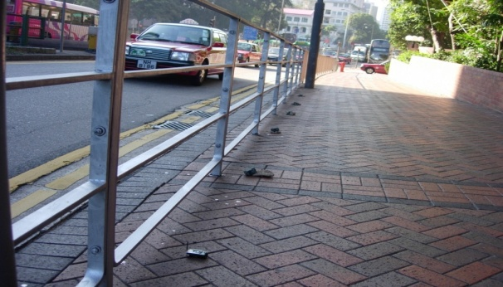
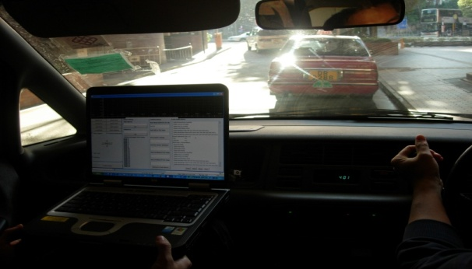
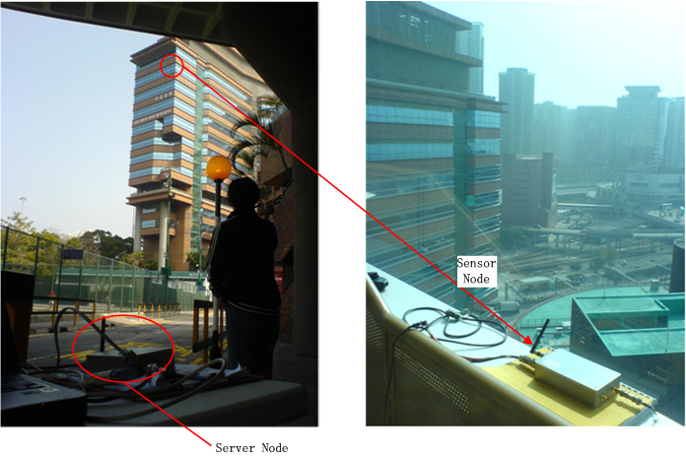
Motivating Applications
Intelligent Transportation System (ITS)
Structural Health Monitoring (SHM)

Slide 5
Motivation
Many WSN applications are event-based:
Applications: ITS, SHM, etc.
Composite events are needed
Some event-related operations (event subscription, event detection) are common
Middleware approach
Provide high level abstractions to the application developers
Implement high performance event processing mechanisms

Slide 6
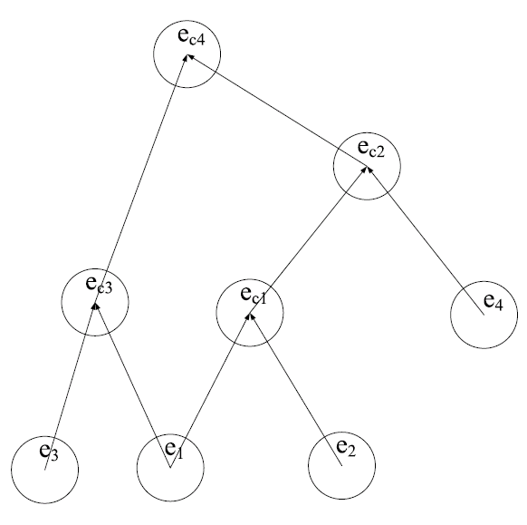
Background – Composite Events
Events may be composed of sub-events
Sub-events may be distributed in the network
Challenge in WSN
Resources constraints
Network dynamics

Slide 7
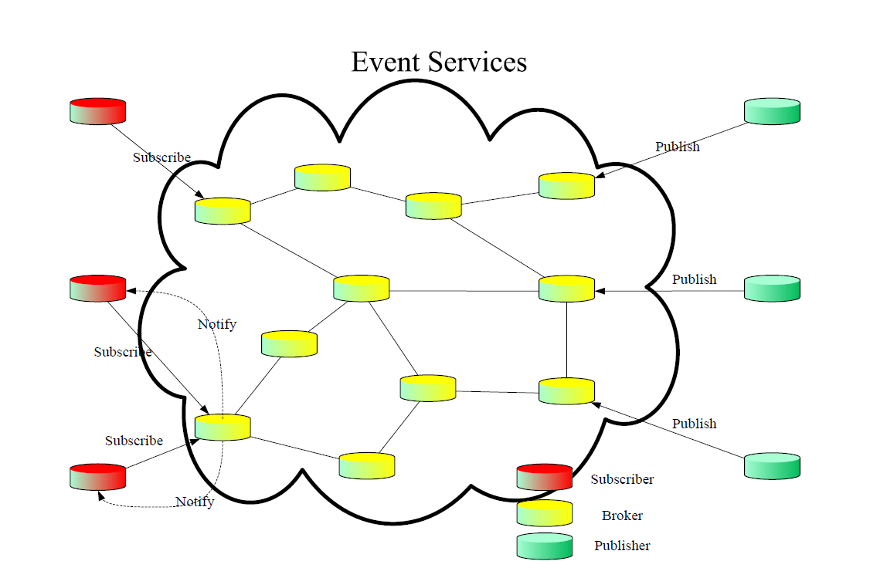
Pub / Sub
The pub / sub paradigm
Suitable for event processing
Decoupling
Event-related operations: event definition, detection and delivery

Slide 8
Literature Review
Programming abstraction
WSN middleware
Data aggregation

Slide 9
Literature – Programming Abstraction
Why pub / sub is more suitable

Slide 10
Middleware for WSN
VM-based: each device as a virtual machine
Mate
Query-based: the entire network as a database
TinyDB, Cougar
Neighborhood-based: each sensor can contact its neighbors with simple APIs
Hood
PSWare takes a hybrid approach:
High level: pub / sub with composite event
Low level: VM-based approach that allows domain specific customization

Slide 11
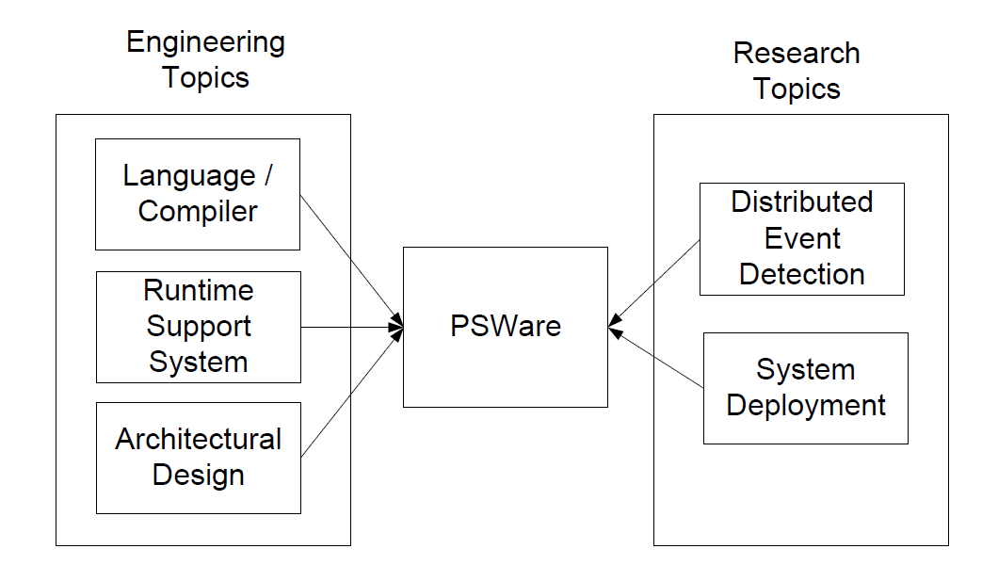
System Design Overview

Slide 12
System Architecture

Slide 13
Event Definition
Existing pub/sub systems:
Topic-based
Content-based
Type-based
Why type-based?
Composite events are easily defined by types
Types allow distributed event detection

Slide 14
Event Definition Language (EDL)
Inspired by works from active database
An EDL example:
Event Comp {
int avg = (e1.x + e2.x) / 2;
} on {
SimpleEvent e1, e2;
} where {
e1.time<e2.time and
e1.x-e2.x==1
}
Events may be represented by directed acyclic graph (DAG)
DAG can be constructed by examining the syntax tree.

Slide 15
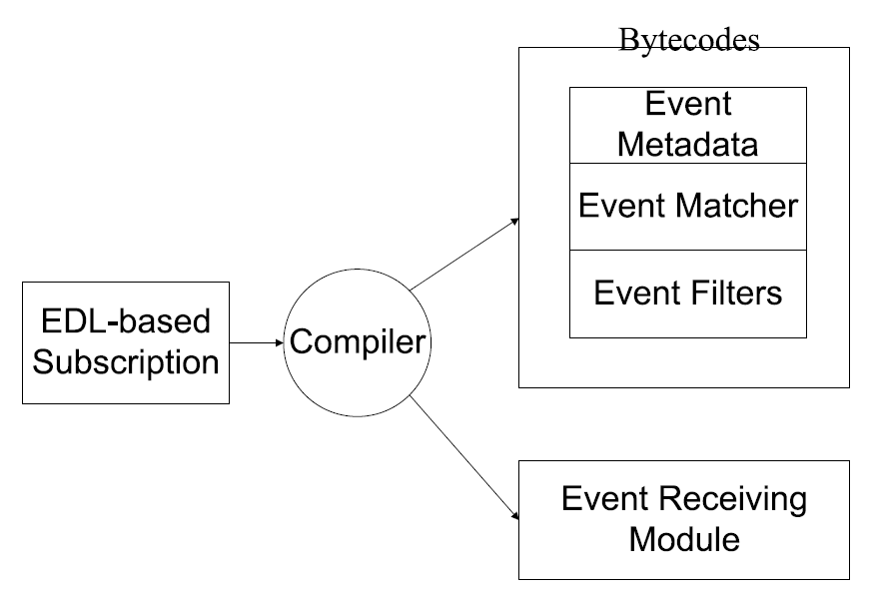
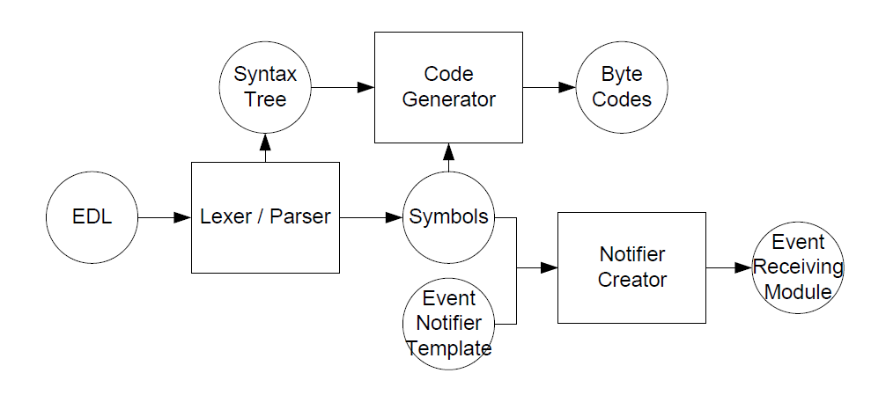
EDL Compiler
Compiler structure:
Compiler logical flow:

Slide 16
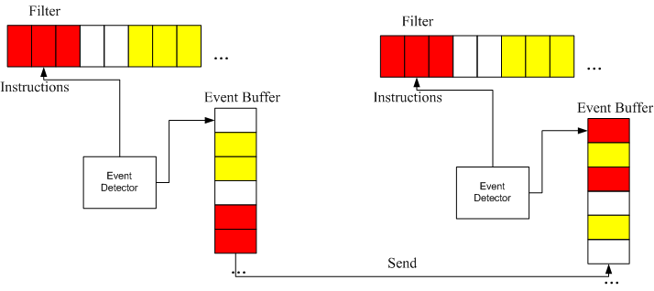
Event Detection Framework

Slide 17
Instructions and Modules
Instruction: the basic atomic operation
Filter: the codes for evaluating each event type
Why instruction-based: customization can be easily achieved by implementing the corresponding instructions

Slide 18
Composite Event Detection Problem
System model
Problem formulation
Basic idea of TED

Slide 19
Event Detection - System Model
A network
Subscriptions
Event types
Event relations
Primitive / composite event
Cost function
Message cost is used
For each event type, cost is denoted as:

Slide 20
Event Detection - Problem Formulation
Given:
A network
Subscriptions consisting of event types and event relations
Cost function
Find
For each event type, when an event of this type happens, find a subset of nodes which will be involved in detecting the event
Objective:
Minimize total energy consumption
The problem can be reduced to Steiner Tree problem

Slide 21
Centralized Solution

Slide 22
Basic Ideas of TED
Select some nodes in the network as event fusion points (FP).
When events are detected, sensors will first randomly forward them to certain FP.
Upon detection of composite events, the FP will send ‘feedback’ to event sources.
By comparison, the sensor nodes can know which FP to forward the event, when the events happen again.
Problems:
How often should the nodes re-select FP for a certain event type.
How many FPs should be selected?

Slide 23
Fusion Point Reselection Probability
Use distance as approximation to measure hope count and message cost.
For a composite event, its sub-events’ locations satisfy an exponential distribution.
Two costs:
cost1: cost if the nodes stick with the old FP
cost2: cost if the nodes choose a new FP.
Objective: minimize reselection probability while keeping cost1 > cost2

Slide 24
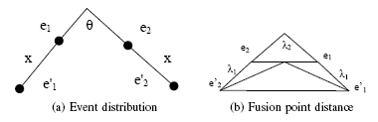
Fusion Point Reselection Probability (cont.)

Slide 25
Fusion Point Selection Problem
Essential idea: trade-off between event detection cost and overhead
Overhead:
Cost of forwarding
Cost of feedback
Cost of keeping track of the fusion points
Other constraints
Memory constraints

Slide 26
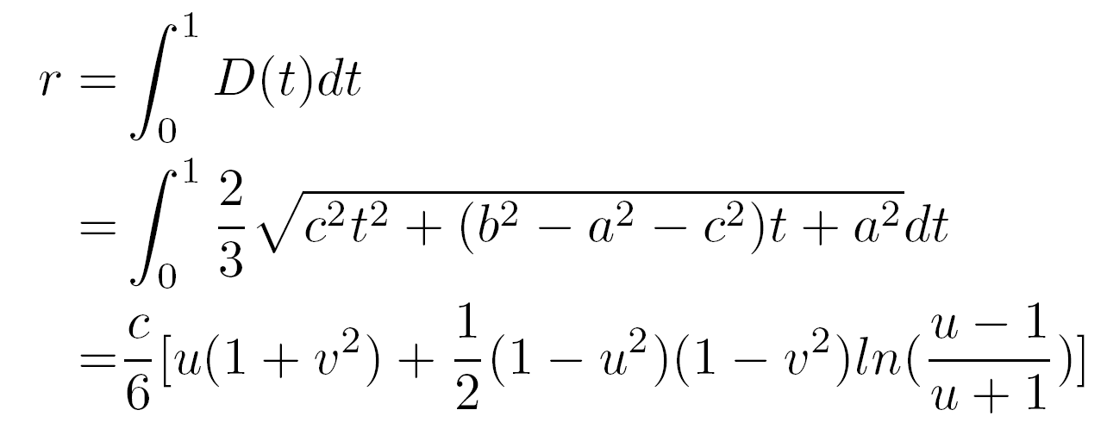
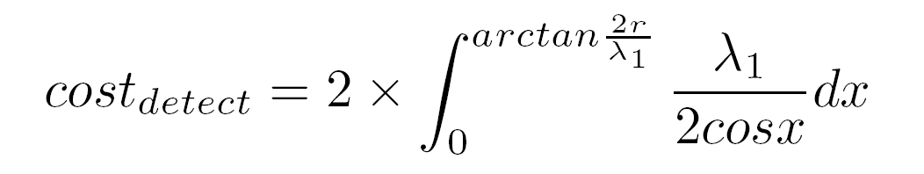
Fusion Point Selection Problem (cont.)

Slide 27
Applications
Used PSWare for WSN applications deployed in the real world
Intelligent transportation system (ITS)
Indoor environment monitoring and alarm
Structural health monitoring (SHM)
Advantage of using PSWare:
Fewer lines of code
Fast deployment (through pub / sub paradigm)
Extra research issues:
Clustering in SHM

Slide 28
SHM - Background

Slide 29
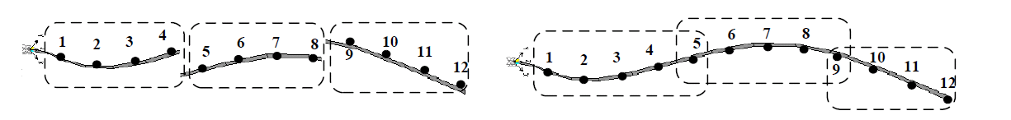
SHM
Domain specific event detection (mode shape):
The network can be divided into clusters to collect data in a distributed fashion
Clusters have requirements on size
Data from the neighboring clusters should be assembled first

Slide 30

Clustering Problem
Given:
A sensor network: G = (V, E)
Find:
Clusters that include all nodes in the network
Objective:
Minimize energy consumption
Constraints:
Clusters must be connected
There must be at least p nodes in each cluster
NP-complete: can be reduced to set cover problem

Slide 31
Distributed Heuristics
Start from the sink
Each node keeps track of its clustered & unclustered neighbors
Those nodes with fewer number of unclustered neighbors will first be given a chance to form clusters

Slide 32
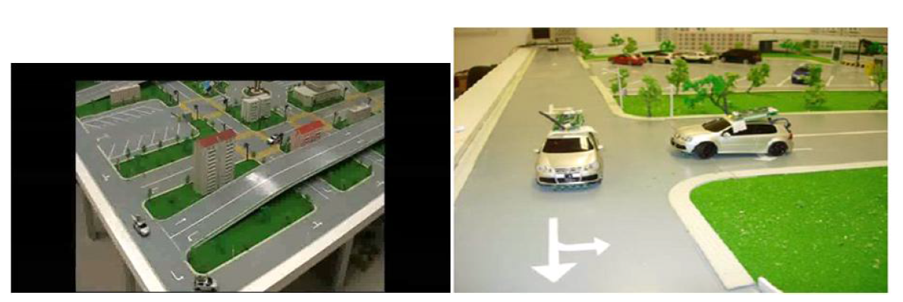
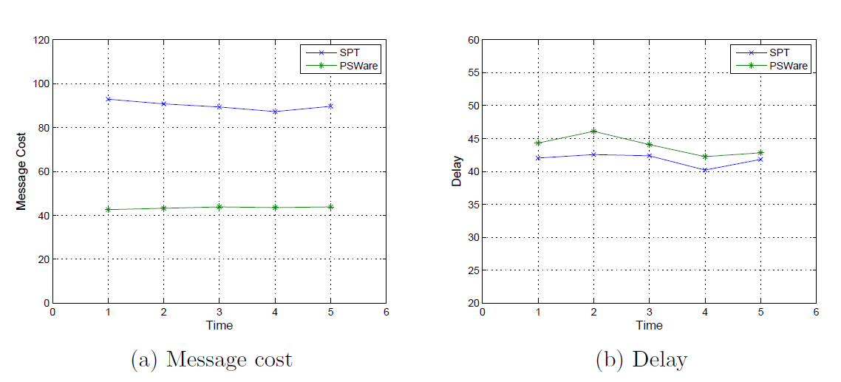
Evaluation
Indoor testbed setup
Results

Slide 33
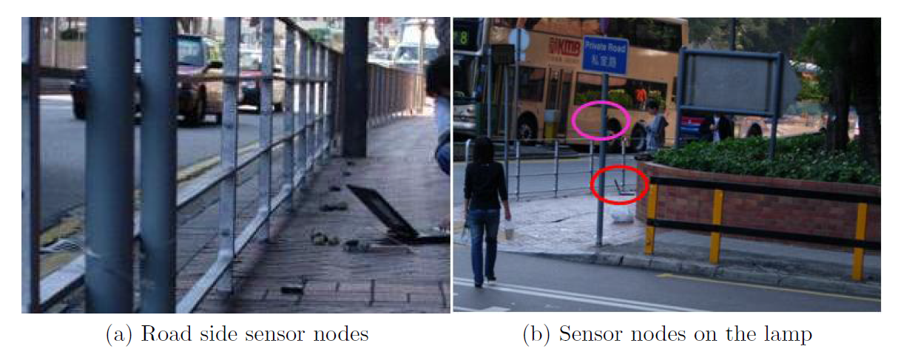
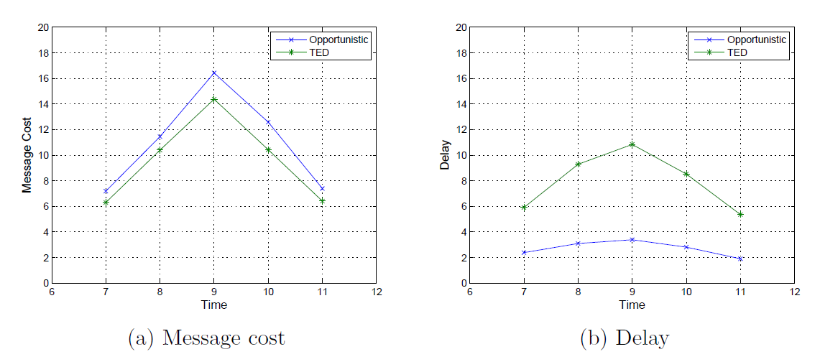
Evaluation (cont.)
Outdoor deployment
Results

Slide 34
Conclusion
PSWare can serve as a tool for developing WSN applications
Provide high level event abstraction
Allow low level customization for domain specific event processing
Future directions
Event delivery and cross layer optimization
Event actions

