Slide 1
TED: Efficient Type-based Composite Event Detection for Wireless Sensor Network
Steven Lai, Jiannong Cao and XP Fan
IMCL
The Hong Kong Polytechnic University

Slide 2

Outline
Motivating applications
Middleware approach
Approach to event detection
Composite event detection problem
Our solution to the problem
Evaluation
Conclusion

Slide 3
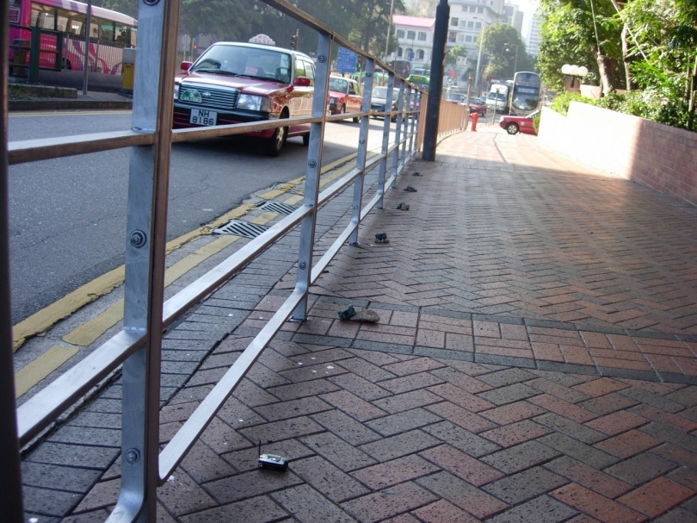
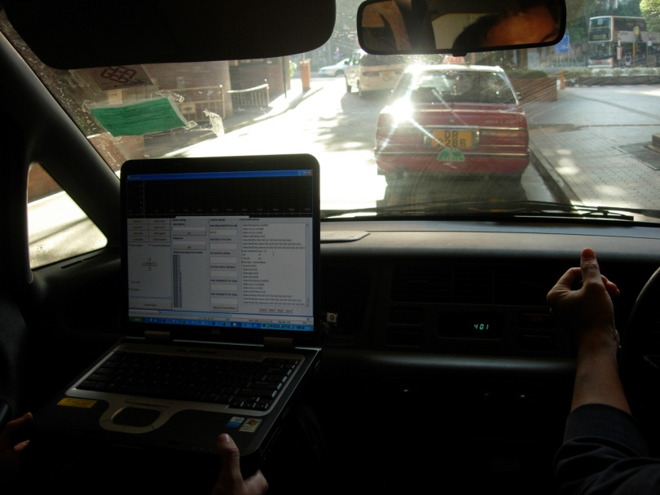
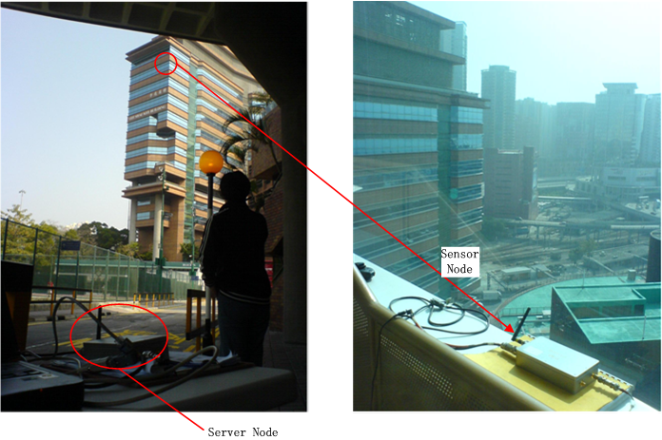
Motivating Applications
Intelligent Transportation System (ITS)
Structural Health Monitoring (SHM)

Slide 4
Motivating Applications (cont.)
These applications are event-based:
  Common requirements for event detection
  Composite event detection
Middleware approach: avoid reinventing the wheel
Existing works:
  Have not sufficiently address composite event detection
  Have not formally study energy efficient composite event detection

Slide 5

The Middleware Approach - Background
Use pub/sub as a paradigm for providing event services
  Subscription management
  Event detection
  Event delivery
Events and subscriptions
  Event: a list of attributes
  Subscription: constraints on certain attributes of an event

Slide 6
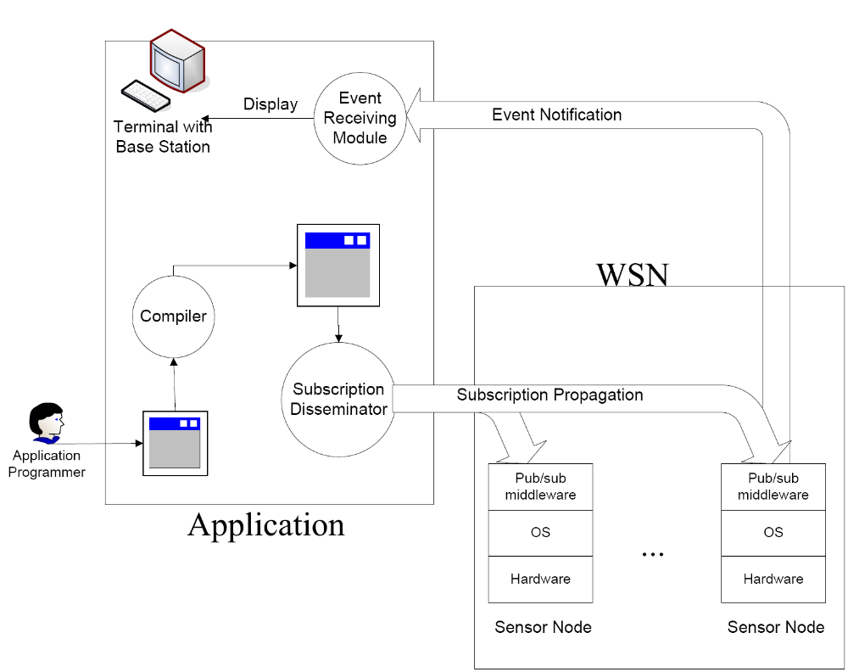
The Middleware Approach – System Architecture

Slide 7
Composite Event Detection in WSN
Concerns for WSN
  Energy constraints
  Utilize the computational capability of individual sensor nodes
Composite events in most WSN-based applications:
  Short life span
  Locality

Slide 8
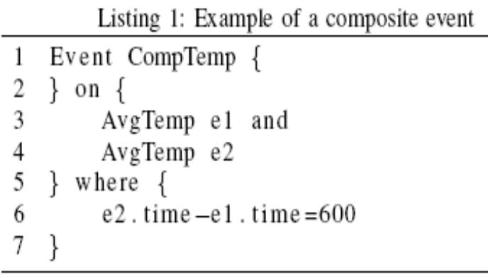
Approach to Composite Event Detection
Existing pub/sub systems:
  Topic-based
  Content-based
  Type-based
Why type-based?
  Composite events are easily defined by types
  Types allow distributed event detection

Slide 9
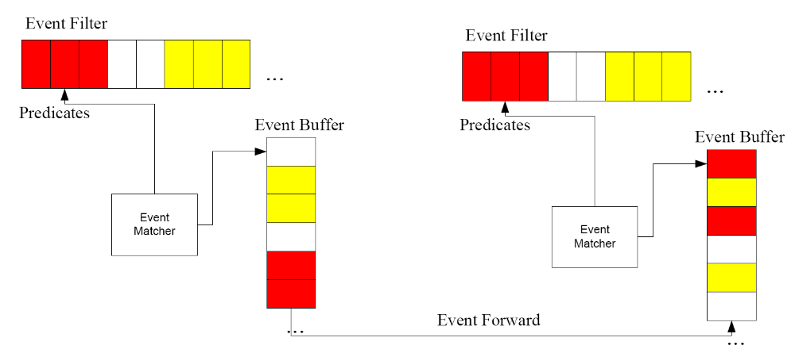
Approach to Type-based Event Detection
Type-based event detection framework
Problem: when an event is detected, how should it be forwarded?

Slide 10





Problem Formulation - System Model
A network
Subscriptions
  Event types
  Event relations
  Primitive / composite event
Cost function
  Message cost is used
  For each event type, cost is denoted as:

Slide 11
Problem Formulation
Given:
  A network
  Subscriptions consisting of event types and event relations
  Cost function
Find
  For each event type, when an event of this type happens, find a subset of nodes which will be involved in detecting the event
Objective:
  Minimize total energy consumption
The problem is similar to Steiner Tree problem

Slide 12
Basic Ideas of TED (Type-based Event Detection)
Select some nodes in the network as event fusion points (FP).
When events are detected, sensors will first randomly forward them to certain FP.
Upon detection of composite events, the FP will send ‘feedback’ to event sources.
By comparison, the sensor nodes can know which FP to forward the event, when the events happen again.
Problems:
  How often should the nodes re-select FP for a certain event type.
  How many FPs should be selected?

Slide 13
Fusion Point Reselection Probability
Use distance as approximation to measure hope count and message cost.
For a composite event, its sub-events’ locations satisify an exponential distribution.
Two costs:
  cost1: cost if the nodes stick with the old FP
  cost2: cost if the nodes choose a new FP.
Objective: minimize reselection probability while keeping cost1 > cost2

Slide 14
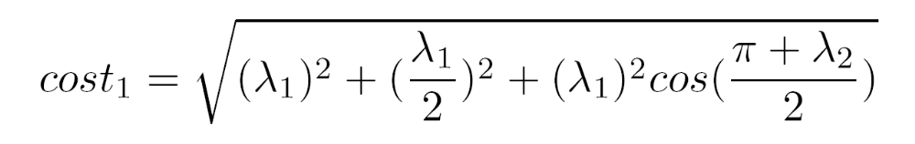
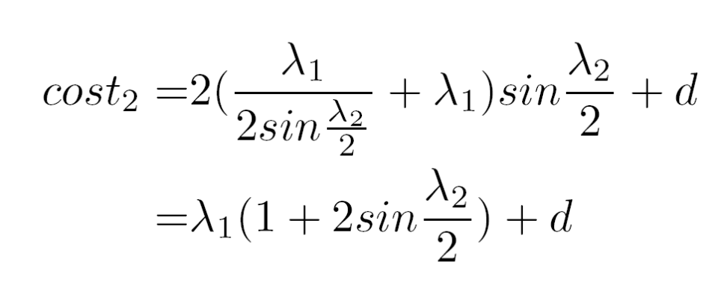
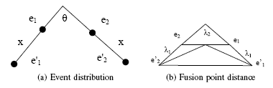
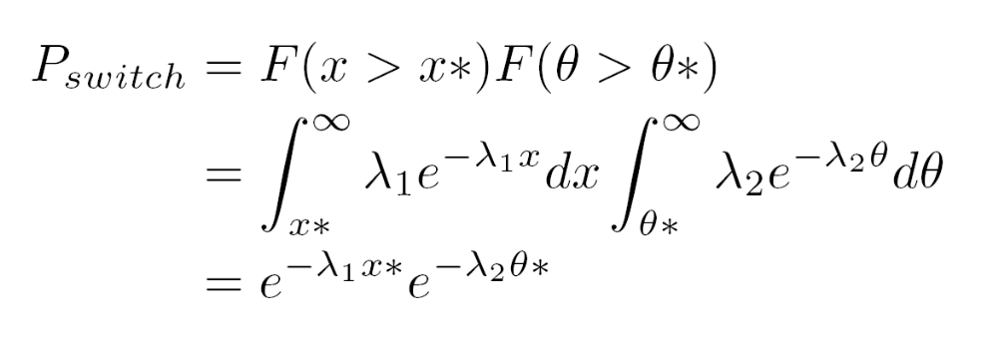
Fusion Point Reselection Probability (cont.)

Slide 15
Fusion Point Selection Problem
Essential idea: trade-off between event detection cost and overhead
Overhead:
  Cost of forwarding
  Cost of feedback
  Cost of keeping track of the fusion points
Other constraints
  Memory constraints

Slide 16
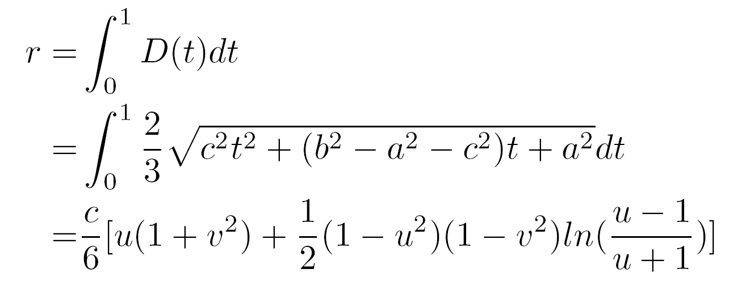
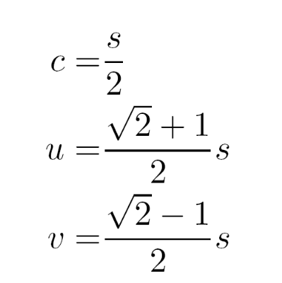

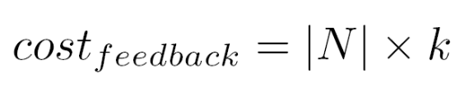
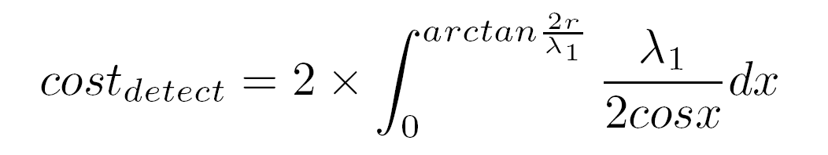
Fusion Point Selection Problem (cont.)

Slide 17
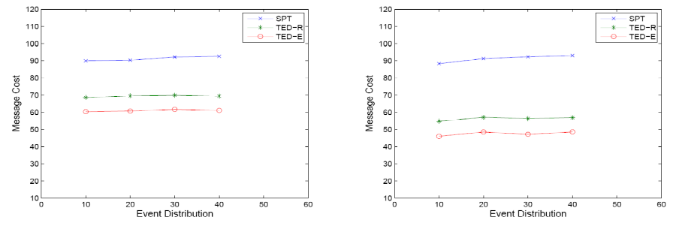
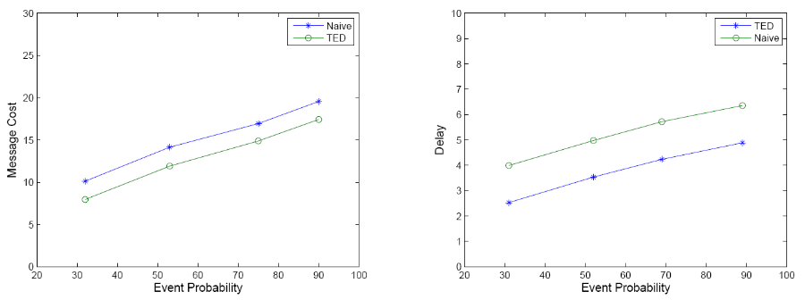
Evaluation
Compared with opportunistic event detection where the type information is not considered.
Simulations
Experiments

Slide 18
Conclusion
Significance of this work
  Achieve energy-efficient event detection in WSN by making use of event type information.
  Formulate the problem and propose the corresponding solutions
On-going / future work
  Study new event models
  Other issues in our middleware such as subscription management and event delivery

Slide 19
Q & A
Thank you all for listening!

