Slide 1
PSWare: A High Performance Pub/Sub Middleware for WSN
Steven Lai

Slide 2
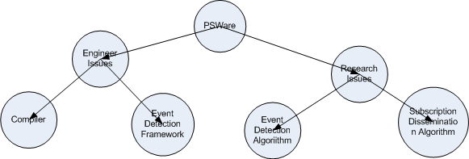
PSWare Design Overview

Slide 3
EDL and Events
An EDL example:
Event Comp {
} on {
SimpleEvent e1, e2;
} where {
e1.time<e2.time and
e1.x-e2.x==1
}
Events may be represented by directed acyclic graph (DAG)
DAG can be constructed by examining the syntax tree.

Slide 4
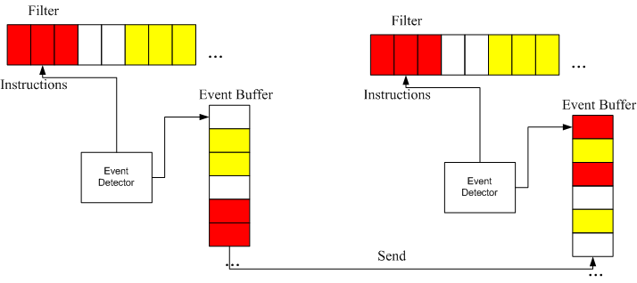
Event Detection Framework

Slide 5
Instructions and Modules
Instruction: the most basic atomic operation
Filter: the codes for evaluating each event type
Examples of how an event is detected:
Create E3
Push E1, x
Push E2, x
Minus
Push 3
Equal
Eval E3

Slide 6
Event Detector
Main loop: execute all the instructions in rounds.
Upon the execution of eval
Upon the reception of event type E, the detector will execute the corresponding module for E.
Problem: when an event is evaluated to be true, what to do next?

Slide 7
The Composite Event Detection Problem
Given:
A sensor network G=(N, A)
A set of events E={E₁, E₂, … E_{n}}
A set of relations R={R₁, R₂, … R_{n}} where R_{i}= E_{j}R E_{k}
Cost function cost(|E_{i}|) where |E_{i}| represents the number of nodes involved in detecting E_{i}
Objective:
Find the optimal set of nodes to detect all events E

Slide 8
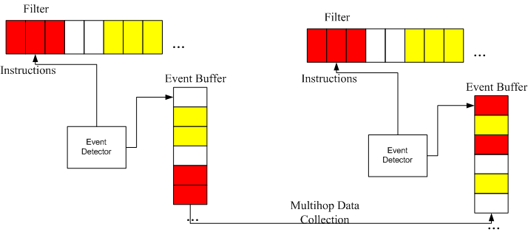
A Straightforward Centralized Approach
Let all the sensor nodes detect events and then send the detected events to sink
Implementation: upon the execution of the eval, if the filter is evaluated to be true, then just send the event to sink with any existing multi-hop data collection protocols

Slide 9
A Second Centralized Approach
The first approach implicitly assumes that the composite events can only be detected at sink.
If there are more than one event detectors in the network, we may have more choices to forward the events.
Basic idea of the second approach:
Calculate the cost for each event based on filters.
Based on the cost information, set up the "event forwarding table"
Events will be detected based on these forwarding tables.
Input: events and relation, network topology
Output: event forwarding table for each node for each event.

Slide 10
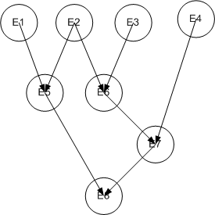
A Second Centralized Approach
Event DAG:

Slide 11
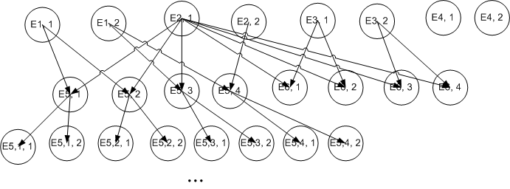
A Second Centralized Approach
If there are two event detectors

Slide 12
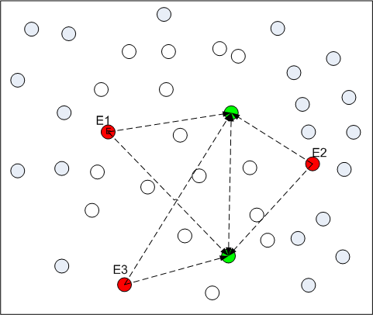
A Second Centralized Approach

Slide 13
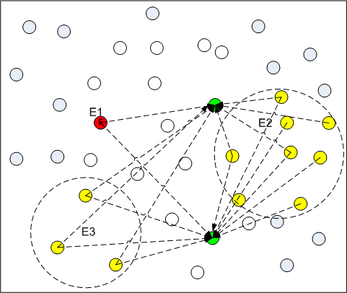
A Second Centralized Approach

Slide 14
A Second Centralized Approach - Summary
For each sensor node:
For each primitive event:
Calculate |E_{i}| for each event
Choose the |E_{i}| that will minimize the total cost
Construct the event forwarding table based on the selected set of |E_{i}|

