Slide 1
PSWare: A High Performance Publish / Subscribe Middleware for WSN
PhD Candidate: Yi Lai (Steven)
Supervisor: Prof. Jiannong Cao
Department of Computing
The Hong Kong Polytechnic University
26 April, 2013

Slide 2
Outline
Overview
Scope of research
Background
System design
Composite event detection problem
Applications
Evaluation
Conclusion

Slide 3


Pub / Sub Middleware for WSN
WSN
  Enabling technology for a wide range of applications
  Features: allowing large scale deployment, autonomous
Pub/sub middleware:
  Provide abstractions for easier programming
  Help to manage resources

Slide 4
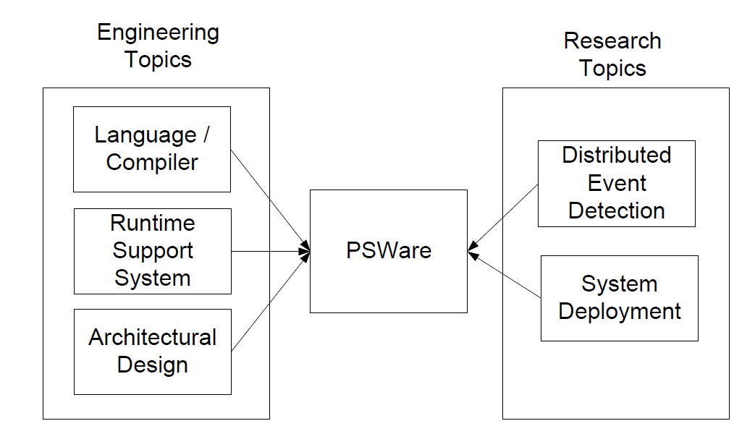

Topics and Issues

Slide 5
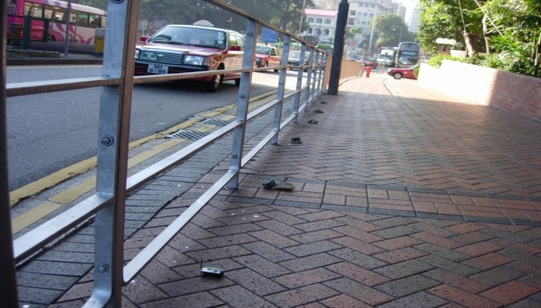
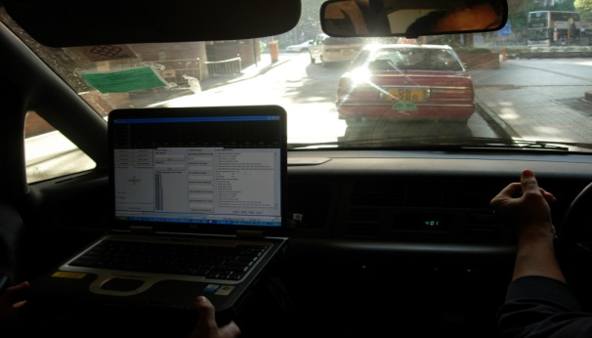
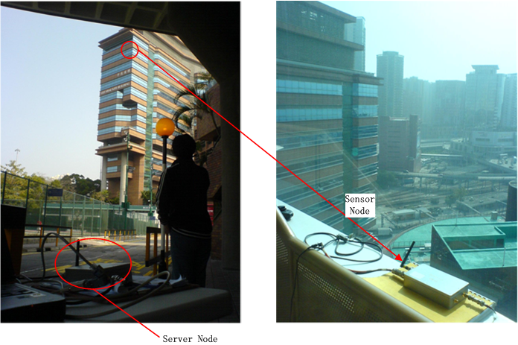
Motivating Applications
Intelligent Transportation System (ITS)
Structural Health Monitoring (SHM)

Slide 6
Motivation
Many WSN applications are event-based:
  Applications: ITS, SHM, etc.
  Need composite events process
  Some event-related operations (event subscription, event detection) are common
Middleware approach – avoid reinventing the wheel
  Provide high level abstractions to different applications
  Implement high performance event processing mechanisms

Slide 7
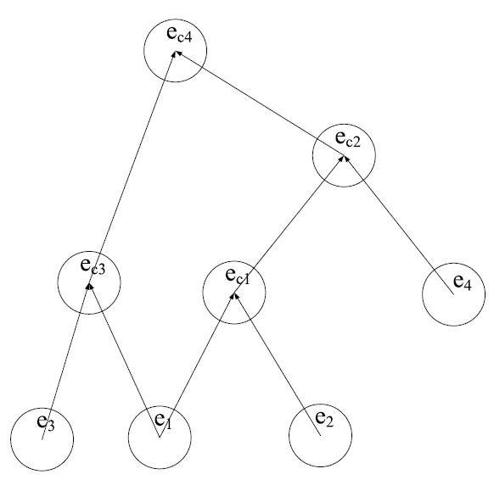
What is Composite Event?
Events may be composed of sub-events
Sub-events may be distributed in the network
Challenge in WSN
  Resources constraints
  Network dynamics

Slide 8
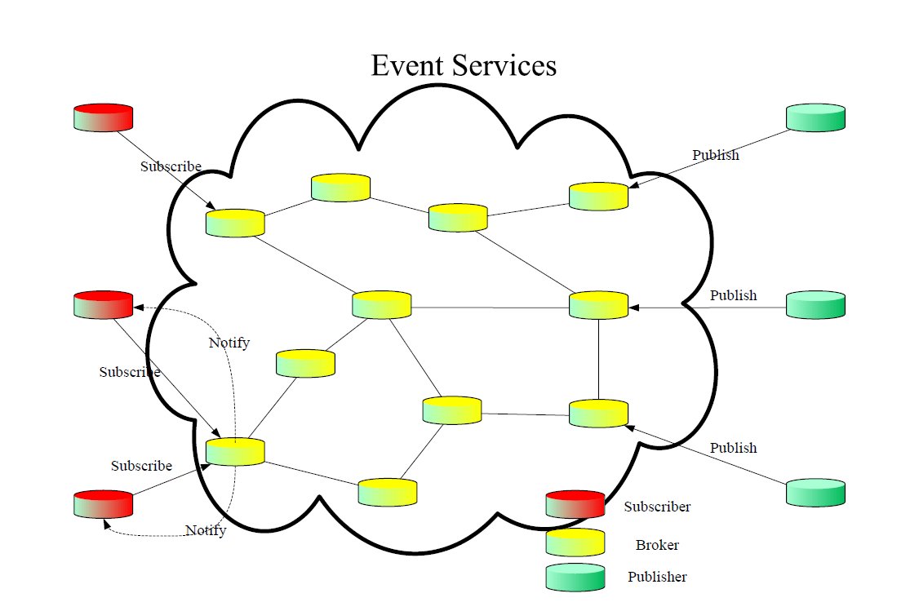
Pub / Sub
The pub / sub paradigm
  Suitable for event processing
  Decoupling
  Event-related operations: event definition, detection and delivery

Slide 9
Existing Works
WSN middleware
Programming abstraction

Slide 10
Middleware for WSN
Query-based: the entire network as a database
  TinyDB, Cougar
  Query is reactive, not really suitable for event-based applications
Neighborhood-based: each sensor can contact its neighbors with simple APIs
  Hood
  Events may not have a strong correlation with neighborhoods
VM-based: each device as a virtual machine
  Mate
  Suitable for creating an intermediate layer of abstractions but still not a high level abstraction

Slide 11
Event-based Systems
Sensor networks:
  Primitive events: directed diffusion
  Address a specific issue: CEA (for reliability)
Active database (ADB):
  ECA rules: event-condition-action
  Event operators: conjunction, disjunction, sequence, etc.

Slide 12
PSWare’s Approach
A hybrid approach:
  High level pub / sub abstraction
  Composite event definition similar to ADB
  Low level VM-like run time for event detection
Why pub/sub?
  Allows decoupling between the application developer and the underlying event detection mechanisms
Why VM-like run time?
  Allow customization for domain-specific applications

Slide 13
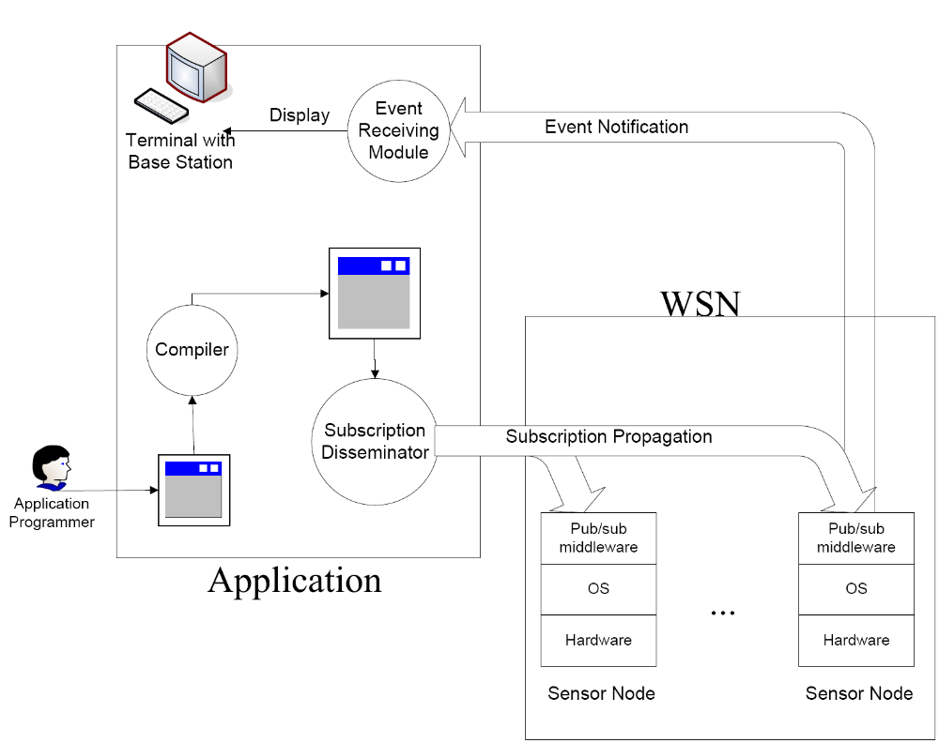
System Architecture

Slide 14
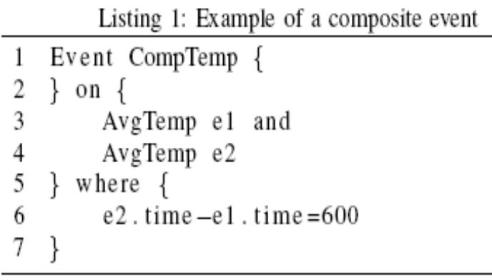
Event Definition
Existing pub/sub systems:
  Topic-based
  Content-based
  Type-based
Why type-based?
  Composite events are easily defined by types
  Types allow distributed event detection

Slide 15
Event Definition Language (EDL)
Inspired by works from ADB
An EDL example:
  Event Comp {
  int avg = (e1.x + e2.x) / 2;
  } on {
  SimpleEvent e1, e2;
  } where {
  e1.time<e2.time and
  e1.x-e2.x==1
  }
Events may be represented by directed acyclic graph (DAG)
DAG can be constructed by examining the syntax tree.

Slide 16
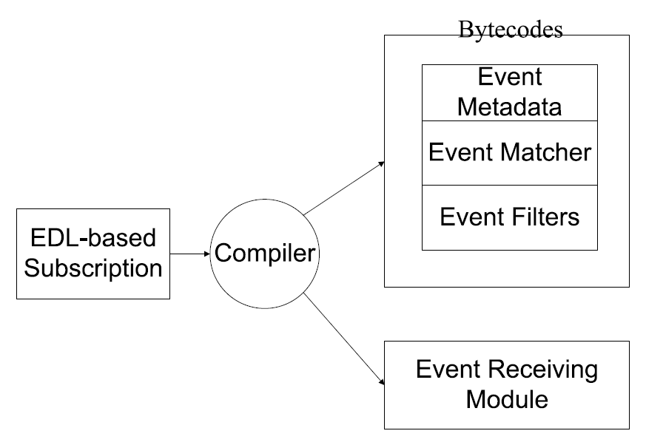
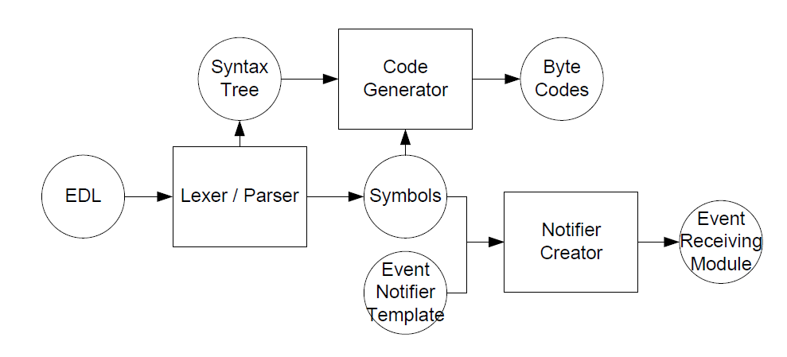
EDL Compiler
Compiler structure:
Compiler logical flow:

Slide 17
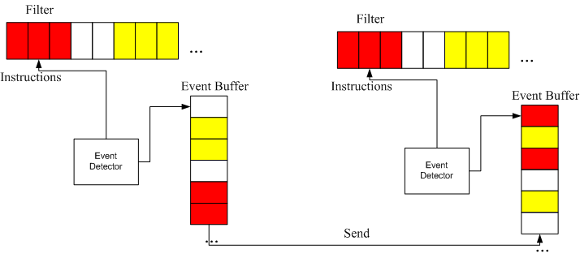
Event Detection Framework

Slide 18
Instructions and Modules
Instruction: the basic atomic operation
Filter: the codes for evaluating each event type
Why instruction-based: customization can be easily achieved by implementing the corresponding instructions

Slide 19
Composite Event Detection Problem
System model
  Consideration: message cost since wireless is unreliable
Problem formulation
  NP-complete
Type-based event detection (TED)
  Centralized
  Distributed

Slide 20





System Model
A network
Subscriptions
  Event types
  Event relations
  Primitive / composite event
Cost function
  Message cost: average number of retransmissions to deliver a message on a particular link
  For each event type, cost is denoted as:

Slide 21
Problem Formulation
Given:
  A network
  Subscriptions consisting of event types and event relations
  Cost function
Find
  For each event type, when an event of this type happens, find a subset of nodes which will be involved in detecting the event
Objective:
  Minimize total energy consumption

Slide 22
Proof of NP-completeness
When the events are detected, we need to select some nodes in the network to detect composite events
Events can be treated as tree nodes
Selected event detectors are used to create a Steiner tree
Thus the problem can be reduced to Steiner tree problem

Slide 23
Additional Consideration
Event locality:
  Events that are detected by a group of sensor nodes may be detected by same group of sensor again
  Event detectors may be reused / improved over the time
  Comes from real applications: detecting cars on a road

Slide 24
Centralized Solution
Basic idea:
  Sink collects the events and link status.
  Sink selects detectors in a centralized fashion
  Use SPT to construct the tree
Locality consideration:
  Use exponential distribution to quantify event locality
  Use distance to approximate the cost

Slide 25

Fusion Point Reselection Probability
To cope with event dynamics
Based on the exponential distribution of locality
Considering two costs:
  cost1: cost if the nodes stick with the old FP
  cost2: cost if the nodes choose a new FP.
Objective: minimize reselection probability while keeping cost1 > cost2

Slide 26
Distributed TED
Pre-select some nodes in the network as event fusion points (FP).
When events are detected, sensors will first randomly forward them to certain FP.
  Message cost will be recorded during forward
Upon detection of composite events, the FP will send ‘feedback’ to event sources
Event fusion point reinforcement:
  By comparison, the sensor nodes can know which FP to forward the event, when the events happen again.
Problems:
  After using an FP for a while, when shall a node consider other FP candidates?
  Given an application deployment, can we find optimized parameters for event detection in TED?

Slide 27
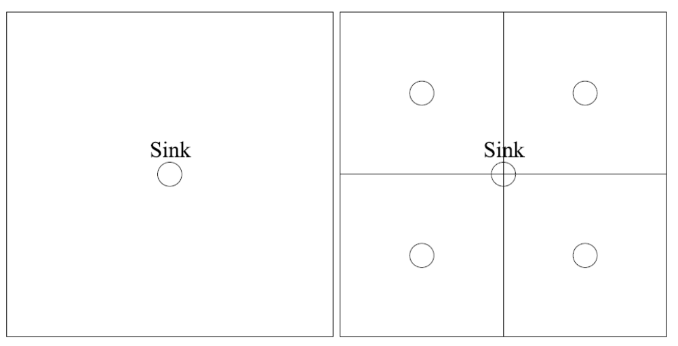
Fusion Points Deployment Strategies
Random deployment
Hierarchical deployment

Slide 28
Fusion Point Selection Strategy
Essential idea: trade-off between event detection cost and overhead
Overhead:
  Cost of forwarding
  Cost of feedback
  Cost of keeping track of the fusion points
Other constraints
  Memory constraints

Slide 29
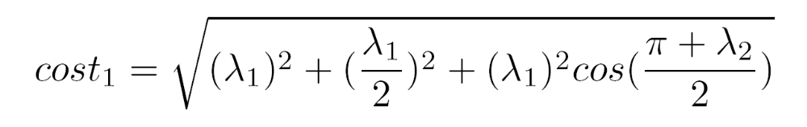
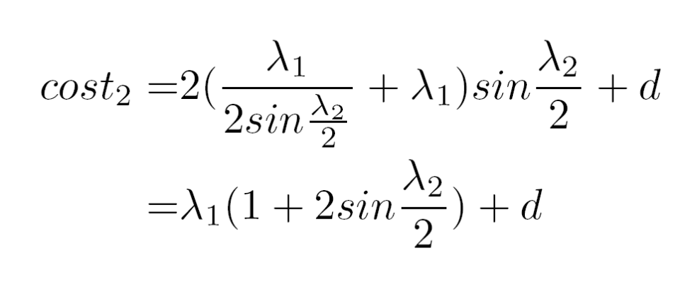
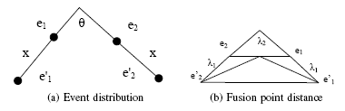
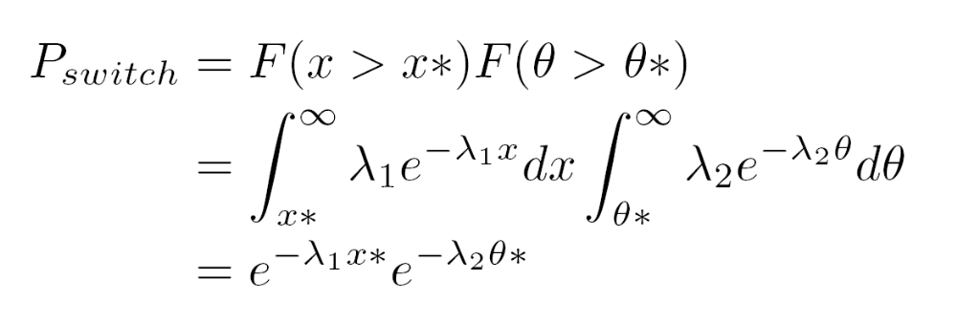
Fusion Point Reselection Probability (cont.)

Slide 30
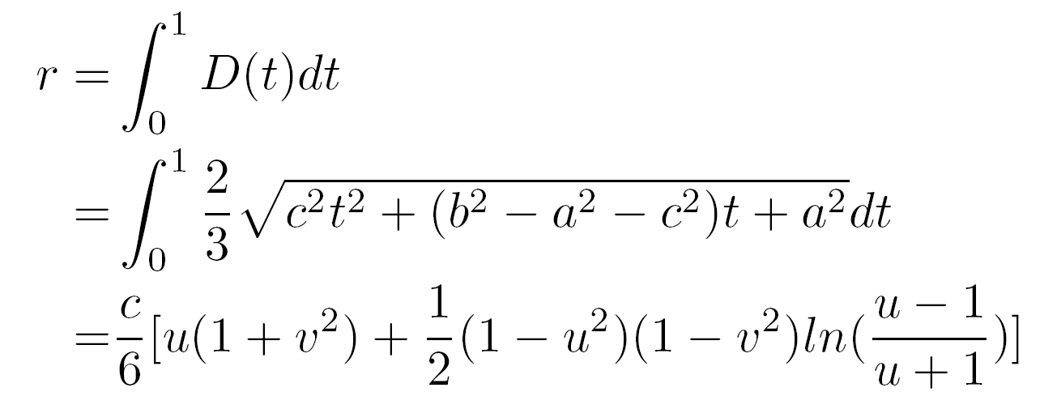
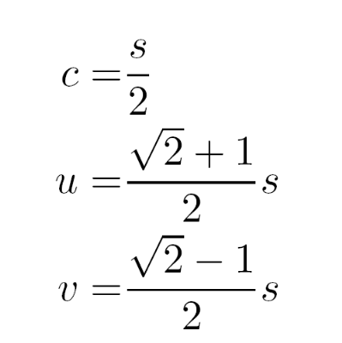

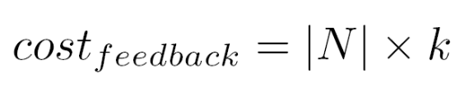
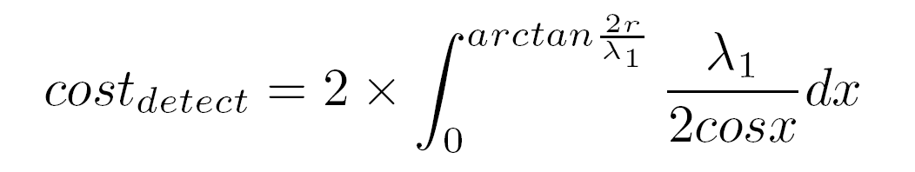
Fusion Point Selection Problem (cont.)

Slide 31
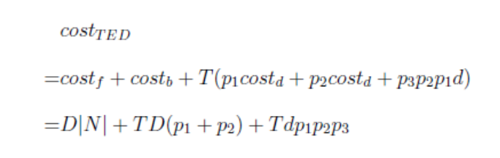

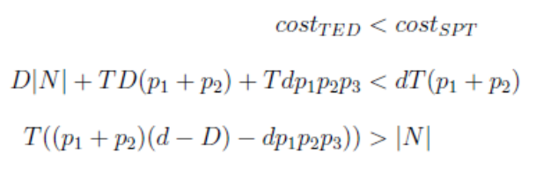
Analytical Results
Compared with SPT:
Conclusion: TED saves more energy when:
  Fusion points are close to the event sources
  Probability of primitive event is high while the probability of composite events are low

Slide 32
Applications
Used PSWare for WSN applications deployed in the real world
  Intelligent transportation system (ITS)
  Indoor environment monitoring and alarm
  Structural health monitoring (SHM)
Advantage of using PSWare:
  Fewer lines of code
  Fast deployment (through pub / sub paradigm)
Extra research issues:
  Clustering in SHM

Slide 33
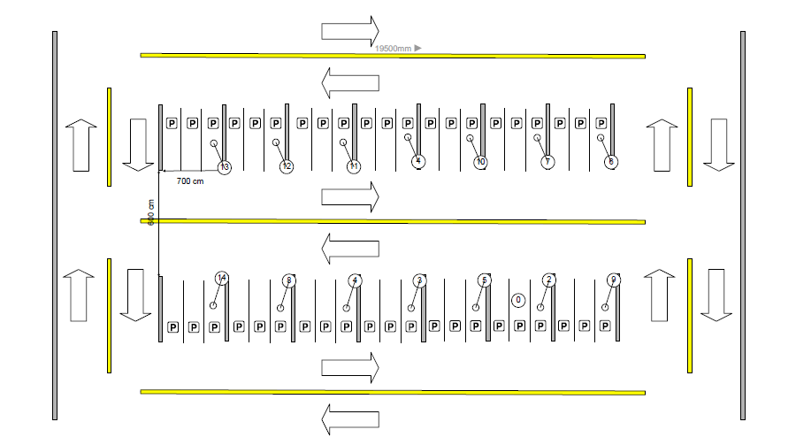
Car Park
Deployment:

Slide 34
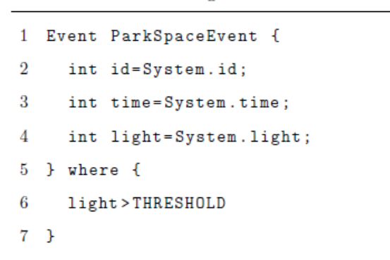
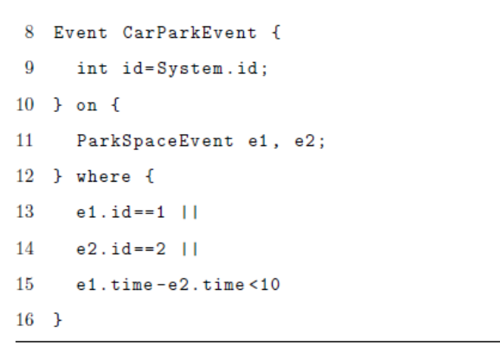
Car Park
Event definition

Slide 35
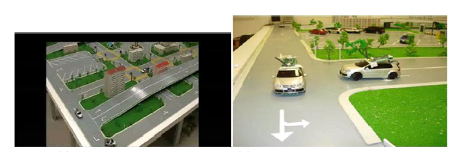
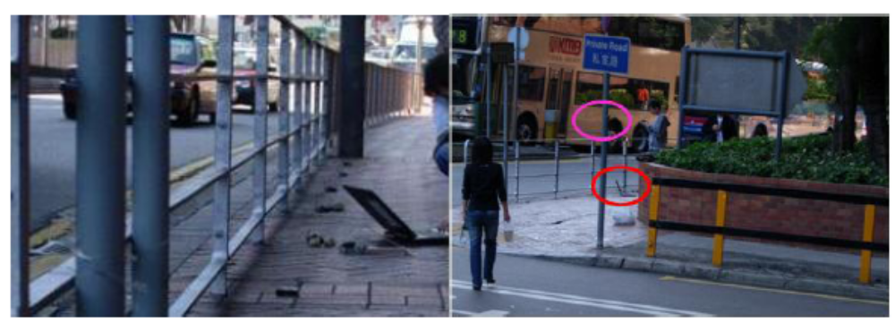
ITS
Testbed
Road

Slide 36
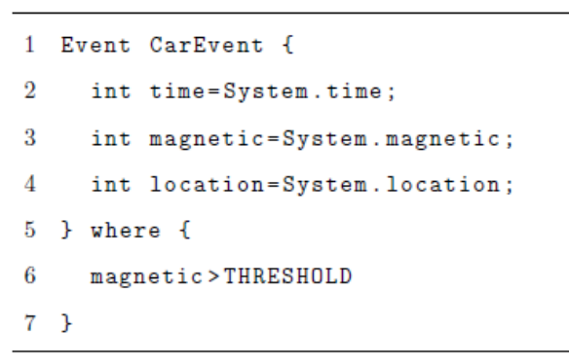
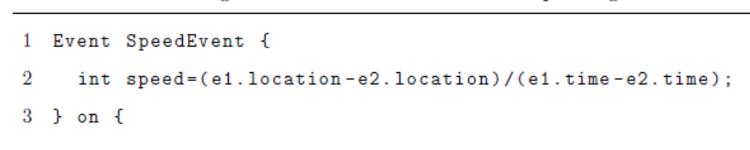
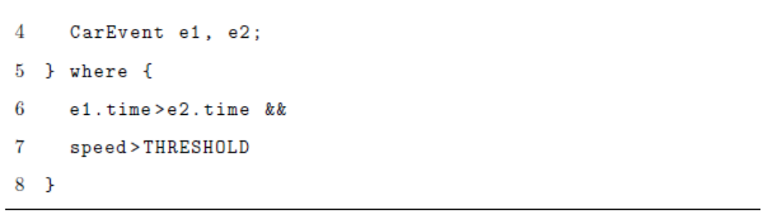
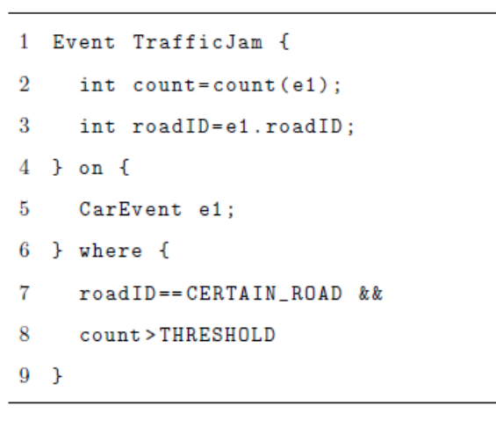
ITS
Event definitions

Slide 37
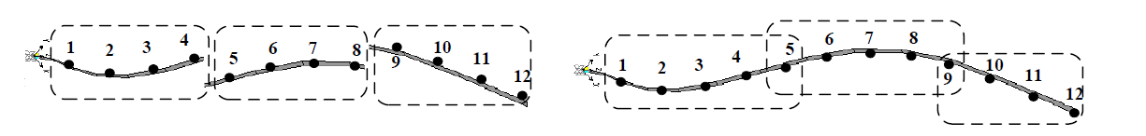
SHM
Domain specific event detection (mode shape):
  The network can be divided into clusters to collect data in a distributed fashion
  Clusters have requirements on size
  Data from the neighboring clusters should be assembled first

Slide 38

Clustering Problem
Given:
  A sensor network: G = (V, E)
Find:
  Clusters that include all nodes in the network
Objective:
  Minimize energy consumption
Constraints:
  Clusters must be connected
  There must be at least p nodes in each cluster
NP-complete: can be reduced to set cover problem

Slide 39
Centralized Solutions
Similar to the greedy algorithm for set cover problem
Difference lies in how to connect the clusters:
  Algorithm 1: connect during selection
  Algorithm 2: connect after selection

Slide 40
Distributed Heuristics
Start from the sink
Each node keeps track of its clustered & unclustered neighbors
Those nodes with fewer number of unclustered neighbors will first be given a chance to form clusters

Slide 41
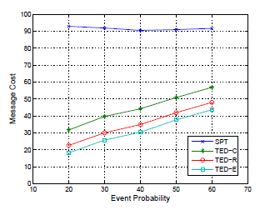
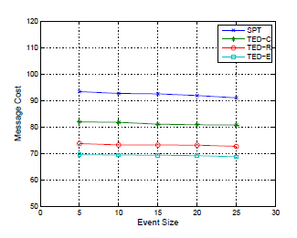
Evaluation
Simulations on TED

Slide 42
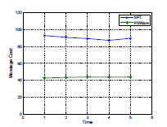
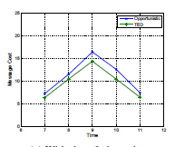
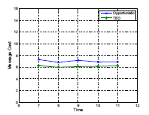
Evaluation
Experiments
  ITS
  Car park
  SHM

Slide 43
Conclusion
PSWare can serve as a tool for developing WSN applications
  Provide high level event abstraction
  Allow low level customization for domain specific event processing
TED can achieve energy efficiency:
  By taking advantage of part of application level knowledge
Deployed on real applications

Slide 44
Future Directions
Event operations in PSWare:
  Event detection
  Event subscriptions
  Event delivery
  Cross layer optimization
From pub/sub to ECA system (sensor-actor system)
  Pub/sub can be treated as a special case of ECA
  How to generalize PSWare to be an ECA system

Slide 45
Publications
Published:
  Steven Lai, Jiannong Cao, and Xiaopeng Fan. “Ted: Efficient type-based composite event detection for wireless sensor network”. DCOSS11
  Xuefeng Liu, Jiannong Cao, Steven Lai, Chao Yang, Hejun Wu, and Youlin Xu. “Energy efficient clustering for wsn-based structural health monitoring”. INFOCOM11
  Steven Lai, Jiannong Cao, and Yuan Zheng. “Psware: A publish / subscribe middleware supporting composite event in wireless sensor network”. PerSeNS09
  Yi Lai, Yuan Zheng, and Jiannong Cao. “Protocols for traffic safety using wireless sensor network”. ICA3PP07
  Jiannong Cao, Hejun Wu, Xuefeng Liu, and Yi Lai. “ISensNet: an infrastructure for research and development in wireless sensor networks”. Frontiers of Computer Science in China
Under submission:
  Steven Lai, Jiannong Cao and Xuefeng Liu “PSWare: A Flexible Middleware Framework for Composite Event Processing in Wireless Sensor Networks”. Submitted to TSE

